Slide 1
How to Teach Students to Understand Word Problems
MCLS
June 18, 2019

Slide 2
srpowell@austin.utexas.edu
@sarahpowellphd
119

Slide 3
Let’s think about word problems

Slide 4
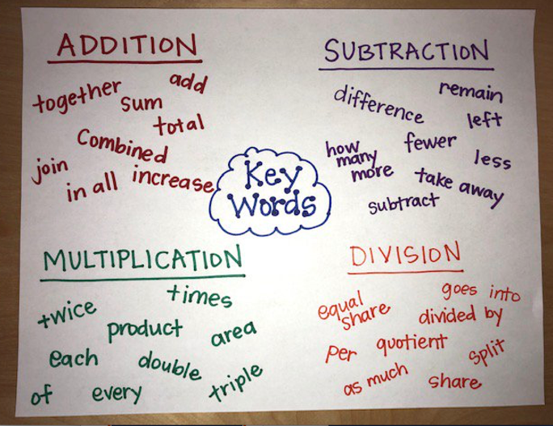

Slide 5
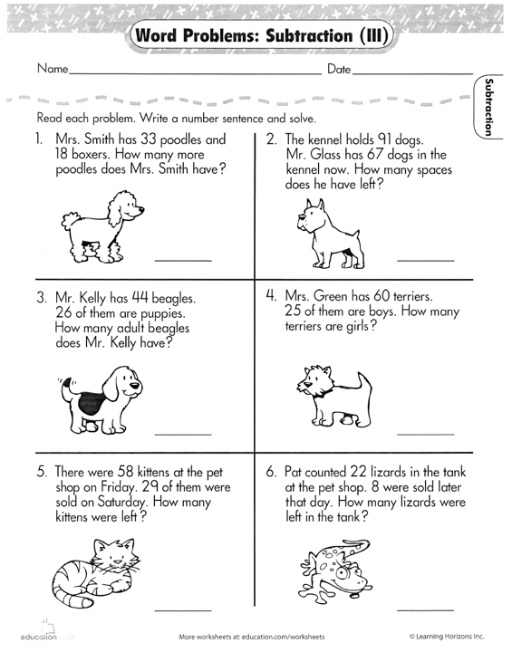

Slide 6
Don’t tie key words to operations

Slide 7
Do have an attack strategy
Do teach word-problem schemas

Slide 8
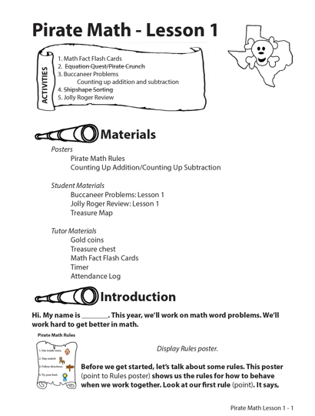
Pirate Math Equation Quest
17 weeks
3 times a week
25-30 min/session
Individual instruction provided by tutors

Slide 9
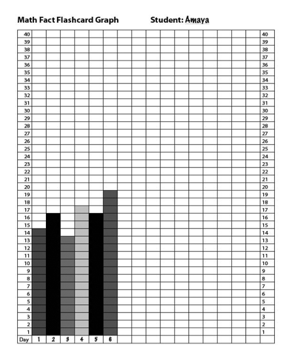
Math Fact Flashcards
1 min addition and subtraction flashcards
Student counts score
Another 1 min
Student counts score
Student graphs highest score of day
Notes:
Talk about counting up strategy
2 trials of 1 min each
Student graphs highest score

Slide 10
Equation Quest
2 min about the equal sign and solving equations
Equal sign defined as “same as”
Practice with manipulatives and pictures
Practice isolating a variable
Notes:
Talk about counting up strategy
2 trials of 1 min each
Student graphs highest score

Slide 11
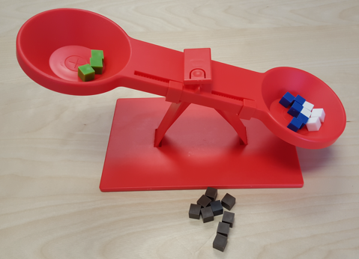
Equation Quest
2 min about the equal sign and solving equations
Equal sign defined as “same as”
Practice with manipulatives and pictures
Practice isolating a variable
3 + __ = 5 + 4
Notes:
Talk about counting up strategy
2 trials of 1 min each
Student graphs highest score

Slide 12
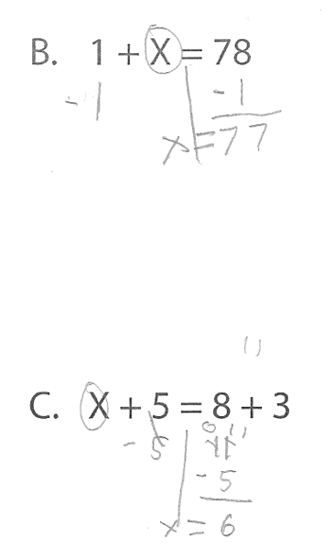
Equation Quest
2 min about the equal sign and solving equations
Equal sign defined as “same as”
Practice with manipulatives and pictures
Practice isolating a variable
Notes:
Talk about counting up strategy
2 trials of 1 min each
Student graphs highest score

Slide 13
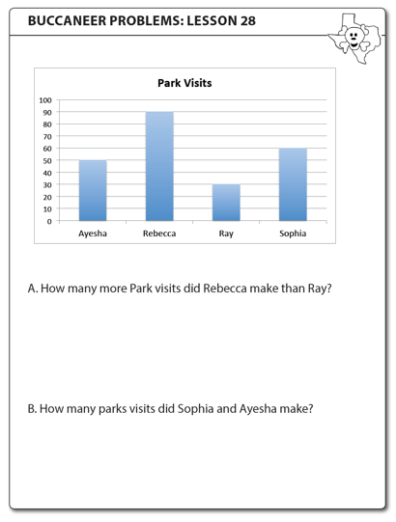
Buccaneer Problems
12-15 min of instruction related to word-problem schemas
Total
Difference
Change
2-3 word problems per session
Notes:
Talk about counting up strategy
2 trials of 1 min each
Student graphs highest score

Slide 14
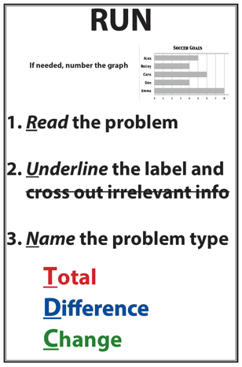
Buccaneer Problems
Notes:
Talk about counting up strategy
2 trials of 1 min each
Student graphs highest score

Slide 15
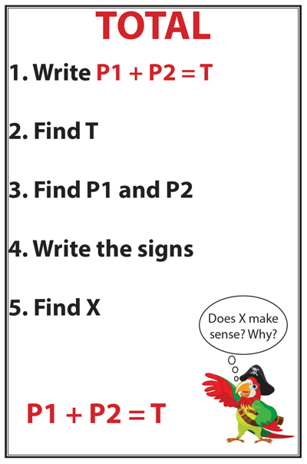
Buccaneer Problems
Notes:
Talk about counting up strategy
2 trials of 1 min each
Student graphs highest score

Slide 16
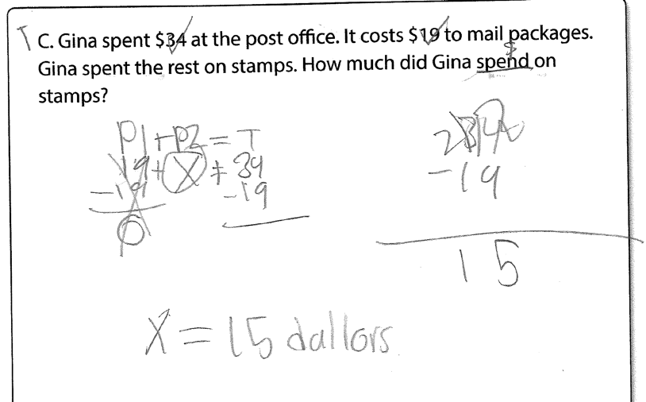
Notes:
Educator-Led Lesson: Buccaneer Problems
Talk about word problems; solve using an equation; solve for X like pirates, 3 BPs per lesson
This slide shows Total Problem example

Slide 17
Buccaneer Problems
Notes:
Talk about counting up strategy
2 trials of 1 min each
Student graphs highest score

Slide 18
Notice the use of a word-problem label to accompany the numerical answer
Notes:
Educator-Led Lesson: Buccaneer Problems
Talk about word problems; solve using an equation; solve for X like pirates, 3 BPs per lesson
This slide shows Difference Problem example

Slide 19
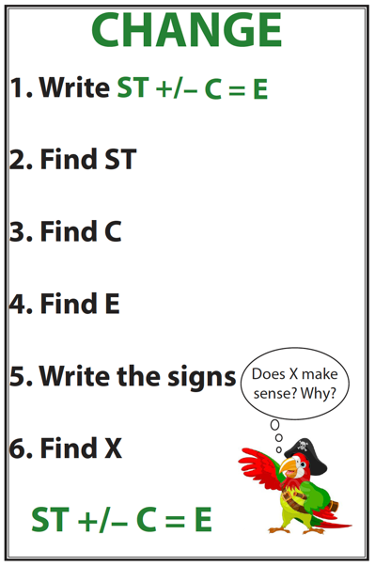
Buccaneer Problems
Notes:
Talk about counting up strategy
2 trials of 1 min each
Student graphs highest score

Slide 20
Notes:
Educator-Led Lesson: Buccaneer Problems
Talk about word problems; solve using an equation; solve for X like pirates, 3 BPs per lesson
This slide shows Change Problem example

Slide 21
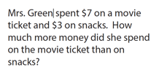
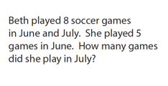
Shipshape Sorting
1 min to sort word problems by schema
Review at end of 1 min
Notes:
Talk about counting up strategy
2 trials of 1 min each
Student graphs highest score

Slide 22
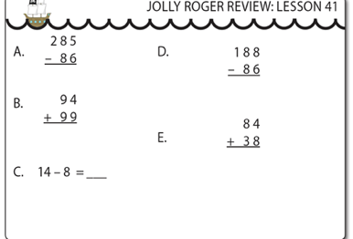
Jolly Roger Review
1 min to solve addition and subtraction problems
2 min to solve a word problem
Notes:
Talk about counting up strategy
2 trials of 1 min each
Student graphs highest score

Slide 23
Non-Standard Equation Solving

Slide 24
Equal Sign Tasks

Slide 25
Double-Digit Word Problems

Slide 26
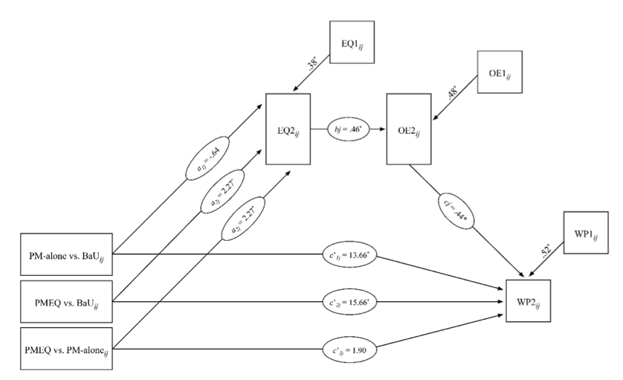
Mediation Analysis

Slide 27
Don’t tie key words to operations
Do have an attack strategy
Do teach word-problem schemas

Slide 28
Thank You
Teachers and students in Austin, TX
Research team at the University of Texas at Austin

Slide 29
https://intensiveintervention.org/intensive-intervention-math-course
srpowell@austin.utexas.edu
@sarahpowellphd
119

