Slide 1
Yuma Agriculture Water – Rights and Supply
Yuma’s Agriculture Water: What You Need To Know
Yuma Agriculture Water Conference
January 13, 2016
Thomas Buschatzke, Director
Arizona Department of Water Resources

Slide 2
Arizona’s Water Supply Annual Water Budget 2014
Water Source | Million Acre-Feet (MAF) |  | % of Total
SURFACE WATER
Colorado River |  | 2.8 | 40 %
CAP | 1.6 |  | 23%
On-River | 1.2 |  | 17%
In-State Rivers |  | 1.2 | 17%
Salt-Verde | .7
GROUNDWATER |  | 2.8 | 40%
RECLAIMED WATER |  | 0.2 | 3%
Total |  | 7 MAF
Source: ADWR, 2015

Slide 3
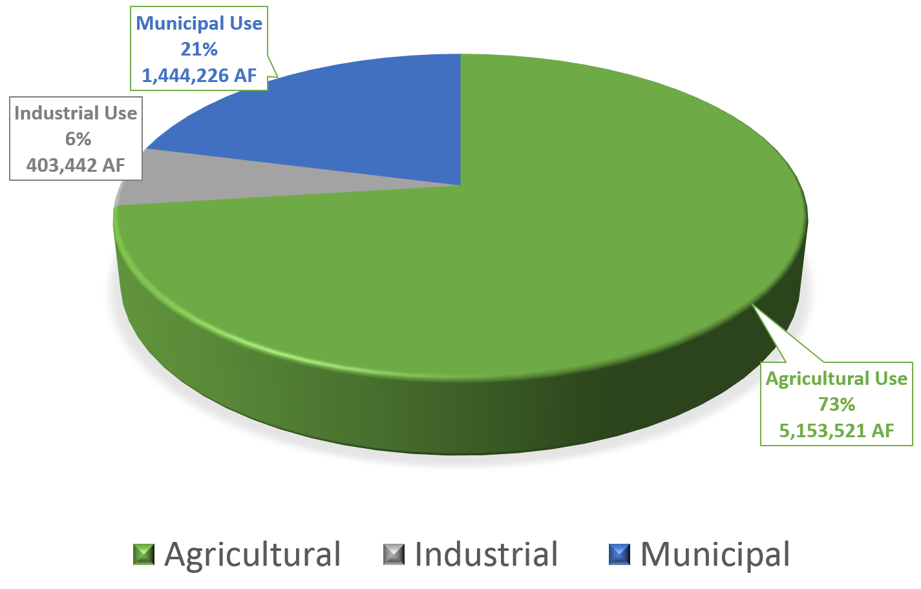
Arizona’s Water Use by Sector (2014)

Slide 4
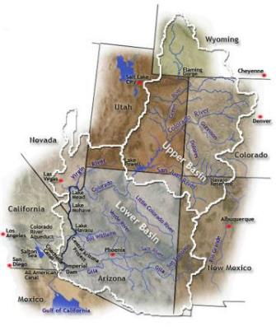
Colorado River Basin Allocations
Upper Basin (7.5 maf)
Lower Basin (7.5 maf)
CA – 4.4 maf
AZ – 2.8 maf
NV – 0.3 maf
Arizona Upper Basin (50 kaf)
Mexico 1.5 maf

Slide 5
Arizona’s Colorado River Water Allocation
85 On-River contracts (including CAP)
Priority based system
Largest number of contracts among all the Lower Basin States
Uses include agriculture, municipal & industrial, wildlife refuges, military reservations and Indian Tribes/Communities
Mainstem Consumptive use – 1.2 maf
CAP average annual delivery – 1.6 maf

Slide 6
Arizona Department of Water Resources’ Authority
ADWR is the state entity charged with promoting, protecting, and comprehensively managing Arizona's annual apportionment of 2.8 million acre-feet of Colorado River water.
A.R.S Section 45-105: “…the Director is responsible for the water management of the state.”
A.R.S. 45-107: Cooperation with the Secretary of the Interior of the United States
A.R.S. 45-107(A). “The director is authorized, for and on behalf of the state of Arizona, to consult, advise and cooperate with the secretary of the interior of the United States…” regarding Colorado River issues and contracts
A.R.S. 45-106: “An agreement entered into between the director and the United States or a state or government involving a sovereign right or claim of this state is not effective unless approved by the legislature by concurrent resolution.”

Slide 7
Mainstem Colorado River Water Priority System
1st Priority (P1) are present perfected rights as described by decree (AZ v. CA, 2006 consolidated)
2nd Priority (P2) are federal reservations and perfected rights established before 9/30/1968
3rd Priority (P3) are for water users that executed contracts with BOR before 9/30/1968
4th Priority (P4) are for water users with contracts, reservations or other rights after 9/30/1968
5th and 6th Priority are for unused Arizona entitlements and surplus water

Slide 8
Who holds Contracts? What are their Priorities?
Large P1 Contract Holders include the Cocopah Indian Reservation, Fort Yuma Indian Reservation, Unit B Irrigation and Drainage District, Yuma County Water Users, City of Yuma
Large P2 Contract Holders include Marine Corps Air Station and Yuma Proving Ground

Slide 9
Who holds Contracts? What are their Priorities?
Large P3 Contract Holders include Gila Monster Farms, North Gila Valley Irrigation District, Unit B Irrigation and Drainage District, Wellton-Mohawk IDD, Yuma Irrigation District, Yuma Mesa IDD, City of Yuma
P4 Contract Holders include Arizona State Land Department, Gila Monster Farms, Cocopah Indian Reservation and several other private agricultural operations

Slide 10
Contracts
Contracts between the Secretary of the Interior and water users are administered by the US Bureau of Reclamation
State of Arizona holder of Master Contract (1944 Contract)
Director consults with Arizona water users and makes recommendations to the US Secretary of the Interior
New entitlements
Contract actions: transfers, assignments, leases and conveyances
Department’s Role
A.R.S. 45-107(D) – entities are required to consult with and obtain the advice of the Director
Recommendation process
Series of consultations with Reclamation Contract Officer, Solicitor and water user

Slide 11
Colorado River Transfers
Transfers pursuant to ADWR’s Policy and Procedure for Transferring an Entitlement of Colorado River Water
Director will review transfers for the purpose of determining the potential impacts caused by redistribution of water
Two-party agreements between a willing buyer and a willing seller
Priority given to keeping an entitlement available for the benefit of the area it was intended to serve
Ensures reasonable use and review of impacts
Provides recommendation to Reclamation
Some mainstem users have expressed concerns regarding transfers off-river

Slide 12
Water Right Priority System Mainstem
Priority | Water Right Holder
Priority 1 | In general are held by Indian Reservations, Irrigation Water Projects (Yuma County Water Users Association etc.), and small present perfected rights
Priority 2 &3 | In general are held by Federal Wildlife refuges, Military installations and Irrigation Water Projects (Wellton-Mohawk Irrigation and Drainage District)
Priority 4 | Generally held by Municipal & Industrial (Including CAP) and small irrigation uses.
Priorities 5 & 6 | Generally held by Arizona Game and Fish Commission, APS, ASLD, some ag uses, the Hopi Tribe and Parker

Slide 13
2007 Guidelines
Shortage Sharing
Lake Mead Elevation | Arizona Reduction | Nevada Reduction | Mexico Reduction | California Reduction
1075’ | 320,000 AF | 13,000 AF | 50,000 AF | 0
1050’ | 400,000 AF | 17,000 AF | 70,000 AF | 0
1025’ | 480,000 AF | 20,000 AF | 125,000 AF | 0

Slide 14
Probabilities of Lower Colorado River Basin Shortage
 | 2016 | 2017 | 2018 | 2019 | 2020
Probability of any level of shortage (Mead ≤ 1,075 ft.) | 0 | 18 | 52 | 65 | 59
1st level shortage (Mead ≤ 1,075 and ≥1,050 ft) | 0 | 18 | 42 | 47 | 35
2nd level shortage (Mead <1,050 and ≥1,025 ft) | 0 | 0 | 10 | 14 | 18
3rd level shortage (Mead <1,025) | 0 | 0 | 0 | 4 | 7
Source: U.S. Bureau of Reclamation CRSS Model Run – August 2015

Slide 15
SCHEMATIC OF DELIVERY
ARIZONA’S COLORADO RIVER ALLOCATION OF 2.8 MILLION ACRE-FEET (MAF)
Priority 1 Contractors
Ak-Chin and Salt River Pima-Maricopa Indian Water Rights Settlements
Indian Demand
LAKE MEAD
Priority 2 Contractors
M & I Leases
Indian Demand
Priority 3 Contractors
Indian Priority Subcontractors
Priority 3 Central Arizona Project
M & I Leases
Priority 4 Central Arizona Project
Municipal and Industrial Priority Subcontractors
Priority 4 Contractors
Priority 4 Mainstem Contractors
Indian Demand
X
Non-Indian Agriculture Relinquished Pool
Priority 5 Contractors
M & I Demand
Agricultural Settlement Pool (ends in 2030)
X
Priority 6 Contractors
Excess Pool
AWBA and CAGRD Pool
Unused Entitlement and/or Return Flow
Miscellaneous Excess Users
Notes:
15
Focus: Unused Entitlement – CR water that is unused in any year, is diverted by the CAP for use in central AZ. As these other water users demand increases over time, water available for diversion by CAP decreases.

Slide 16
Arizona Shortage in the Near-Term
Arizona’s Allocation – 2.8 MAF
Tier 1 Shortage = 320,000 AF
Tribes, Industry, Ag
Other Excess
Ag
Excess
River Cities
Cities & Tribes
City of Yuma, Yuma Ag, Tribes and Military Bases
Long Term Entitlements
Cities Industry & Tribes
On-River 1.2 MAF
CAP 1.6 MAF
Cities & Tribes

Slide 17
Efforts to address challenges on the Colorado River Drought Contingency Planning
ADWR Director serves as Arizona’s Principal on matters relating to the Colorado River (A.R.S. 45-107(D))
Discussions between:
Basin States
Department of the Interior
Other contract holders
Goal of discussions:
Restore risks to levels achieved in the 2007 Guidelines
Conserve 1.5 – 3.0 MAF in Lake Mead over the next 5 years
Reduce the risks of Lake Mead falling below 1,000 ft. elevation as we saw in the 2013 model projections
Memorandum of Understanding
Central Arizona Project = 345,000 AF
Metropolitan Water District = 300,000 AF
Southern Nevada Water Authority = 45,000 AF
Bureau of Reclamation = 50,000 AF

Slide 18
Bypass Flows Work Group
Stakeholder process to identify and analyze options to address the Bypass Flow issue
Workgroup objective is to aid in identifying, analyzing and recommending a set of options that collectively conserve at least 100,000 AF annually in Lake Mead
Bypass Flows are primarily agricultural return flow water from Wellton-Mohawk Irrigation and Drainage District
Due to salinity issues, flows bypass the Colorado River and are conveyed by the bypass drain to Mexico but are not counted towards the Mexican Treaty obligation
Co-chaired by ADWR and BOR
Participants in the workgroup include: BOR, ADWR, CAWCD, Yuma area agricultural water users, the Environmental Defense Fund, the Nature Conservancy, California and Nevada

Slide 19
Minute 32X
Minute Negotiating Group (MNG), which includes reps of both countries, as well as the Upper and Lower Basin States, continues to meet monthly to negotiate terms of “Minute 32X,” a successor to Minute 319.
MNG has delegated certain tasks to binational workgroups (Salinity, Projects, Environmental, and Basin Conditions and Hydrology), with interim reports due in January and final reports due in March.
The two countries intend to agree on general terms for the next minute by June of 2016.

Slide 20
Questions?
Thomas Buschatzke
Director
Phone: 602.771.8426
Email: tbuschatzke@azwater.gov
Website: www.azwater.gov
Twitter: @azwater

