Slide 1
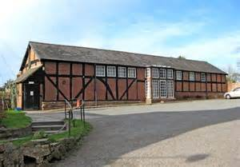
A Warm Welcome to the Belbroughton and Fairfield Annual Parish Meeting

Slide 2
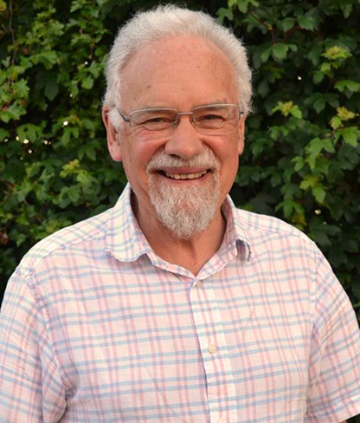
Agenda
1. Apologies
2. Minutes of the 2017 Annual Meeting
3. Annual Reports.
Parish Council Chairman
The Draft Parish Action Plan
Parish Council Committees
County and District Councillors
4. Fairfield W.I.
5. Neighbourhood Planning – Cllr. Dr Bob Morgan
6. ‘We Don’t buy Crime’ - Mick Simpson Project Manager
7. Footpath Wardens - Paul & Lynne Hardcastle
8. First World War Commemorations – Cllr. James Bradley
9. Open forum

Slide 3
Review 2017/18 P.C. Chairman Cllr. James Bradley
Overall: Lots of Effort, Some Achievement
Survey of Parish Opinion
Belbroughton Recreation Centre
Fairfield Recreation Ground
The Green Belbroughton

Slide 4
Review 2017/18 Chairman Cllr. James Bradley
Overall: Lots of Effort, Some Achievement
Little Bell Hall Pool
Glebe Fields Development
Budget Outturn
People

Slide 5
Parish Draft Action Plan Cllr. James Bradley
1. Purpose of The Plan
2. Role of the Parish Council
3. Priorities:
i. Traffic
ii. Green Spaces
iii. The Green Belbroughton
iv. Neighbourhood Planning

Slide 6
Parish Action Plan Cllr. James Bradley
4. Other Activities:
a. Communication
b. Agricultural Holdings
c. Budget and Management
d. Grants to Village Bodies
e. Parish Projects

Slide 7
Parish Action Plan Cllr. James Bradley
5. Effects of cuts elsewhere
6. People

Slide 8
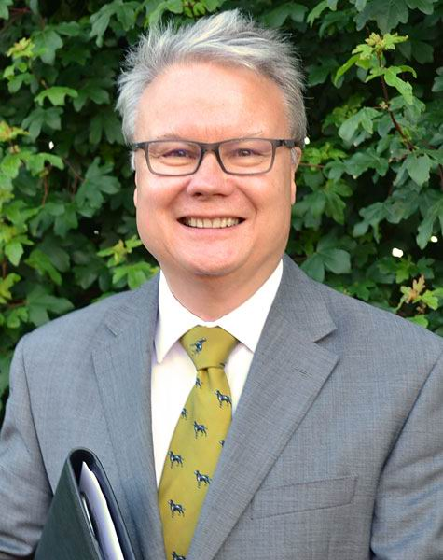
Finance Committee Report Cllr. Simon Nock Key Message 2017/18
Subject to both the internal and external audits which take place during May, the Council expects to report an overall surplus of around £650.
In early June the detailed accounts will be published on our website belbroughtonandfairfield-pc.info
with paper copies available upon request.

Slide 9
‘Ordinary’ and ‘Other ‘ Income
Income
Precept - £65,000
Lengthsman Scheme - £3,148
Meeting Room Rent £1,200
Other Income £20,256
Total - £89,604

Slide 10
‘Other’ Income from the P.C. Assets
Agricultural Holdings rents £7,767
Parish Room Belbroughton rent £4,800
Investment inc. from Cash deposits £4,543
Fairfield Villa F.C. rent £2,626
Wayleaves £520
Total from Assets £20,256
Plus Grants from W.C.C. Cllrs. £2,350

Slide 11
Major Expenditure items
Clerk salary (inc. on costs) £24,237
Grass Cutting & Green Spaces £10,414
Footway Lighting £5,223
Lengthsman £3,870
Dog bins £3,474
Tree work £3,040

Slide 12
Maintenance Grants Paid
Belbroughton Parochial Church Council £2,200
Belbroughton Recreation Centre £1,155
Fairfield Village Hall £730
Belbroughton Church Hall £730

Slide 13
2017/18 Items Approved or Paid Out
Capital Grants:
* Belbroughton Rec. Centre – Play Area upgrade £20,000
* Fairfield Village Hall – projection equipment £500
Parish Projects:
* New noticeboard located outside Fairfield V.Hall £1,740
* First World War Commemorations in 2018 £1,000
* Footpath diversion – Nr. Beckett’s Farm £706
* Stourbridge Rd. Fairfield – B.T. box removal
to enable W.C.C. to install a dropped kerb £576
Minor Grants:
* Fairfield Community Association £350
* Belbroughton Life Savers £250

Slide 14
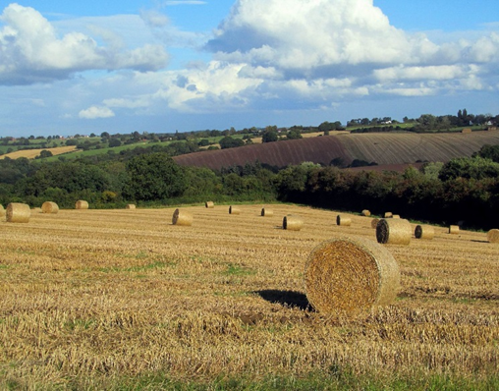
Agricultural Holdings Committee
The Council owns 85 acres of arable
farmland in Wildmoor & Stoneybridge.
Let under 13 tenancies at £90 /acre and is
used for various arable cropping types.
The income is used to fund the Capital & Minor Grants and Parish Projects.
Council inspects the holdings during the year to ensure they are well maintained which has again proved to be the case.
As well as providing a regular income the land is a significant area of ‘Green Belt’ in the Council’s ownership and control.

Slide 15
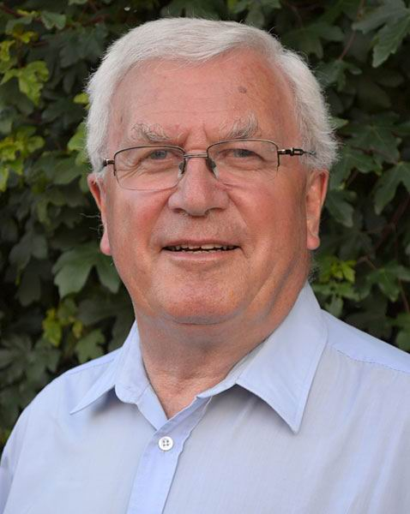
Planning Committee Chairman Cllr. Chris Scurrell
46 planning applications were considered
Recommendations made to District Council :
23 No Objection
14 No Objection but with conditions
9 Objected to

Slide 16
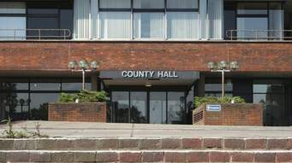
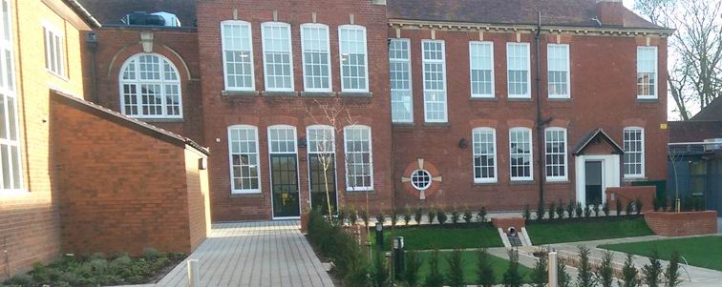
County and District Councillors
County Councillor Karen May
District Councillor Margaret Sherrey

Slide 17
The Fairfield W.I.

Slide 18
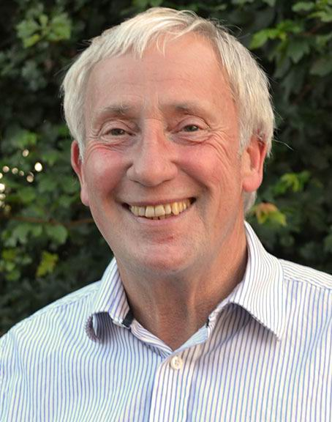
Neighbourhood Planning
Cllr. Dr Robert
Morgan
Notes:
What is it all about
Where has it come from
what are the other terms associated with the idea.

Slide 19
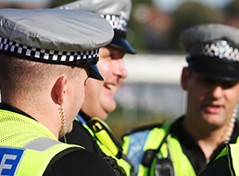
West Mercia Police ‘ We Don’t Buy Crime Initiative’
Mick Simpson - Project Manager
The Parish Council has approved the principle of sponsoring a ‘Smartwater’ initiative in the parish area. This would cost approximately £10,000.

Slide 20
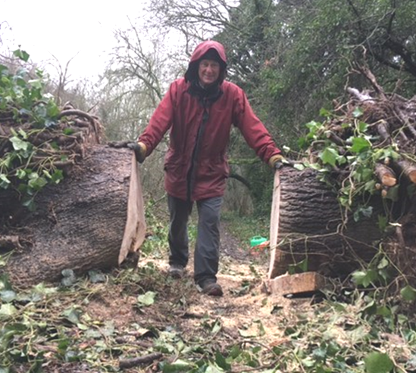
Parish Footpath Warden Report
Paul Hardcastle

Slide 21
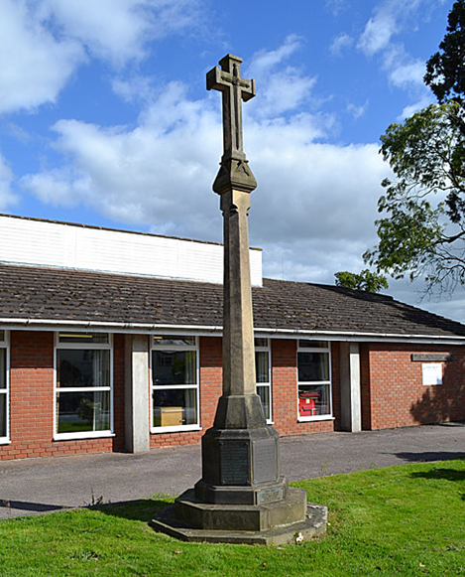
First World War Commemorations
Cllr. James Bradley - To advise of Parish Council support and proposals for
commemorations in 2018

Slide 22
Open Forum
Question time on any matters of interest to residents and an opportunity for other organisations promote themselves to the parish community.
Please tell us your name and which village you are resident in.

Slide 23
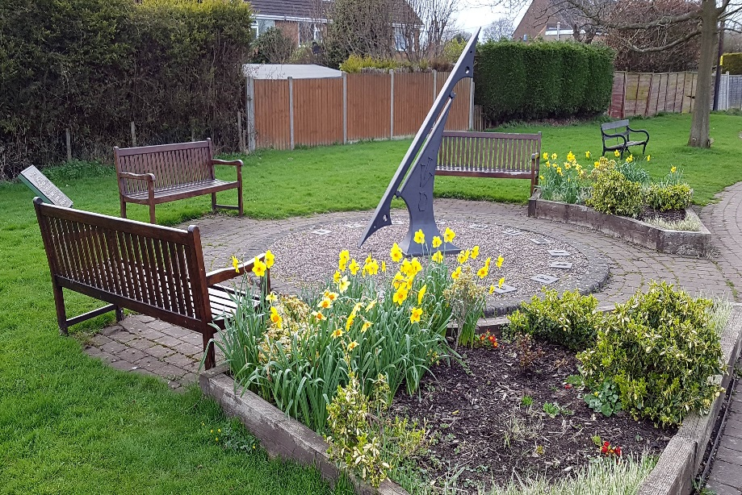
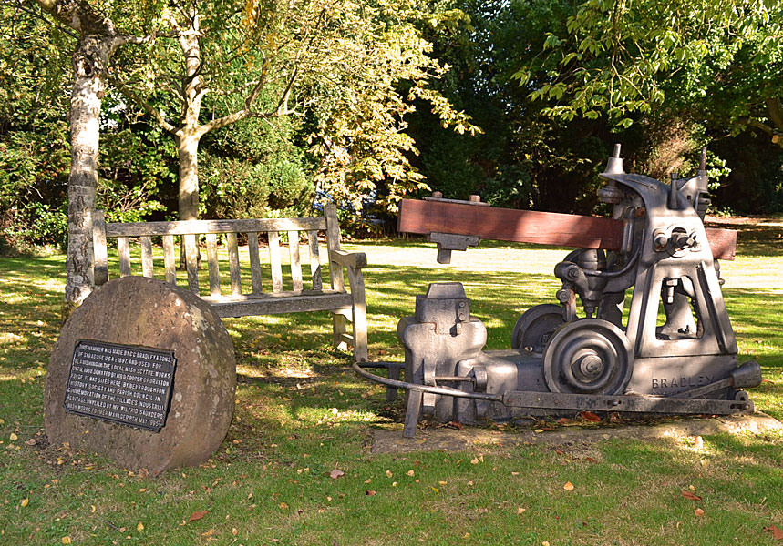
Thanks
Thank you for coming to the
Annual Parish Meeting

