Slide 1
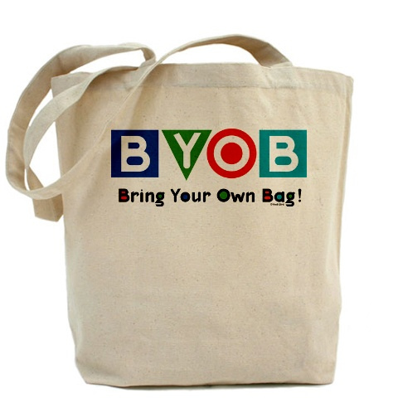
ARTICLE 42
PLASTIC BAG REDUCTION BYLAW
Notes:
2 - Opening Slide
Hi. My name is Mike Croci and I was born and raised in Framingham.
My parents were both raised in Framingham.
All 4 of my grandparents lived most of their lives in Framingham.
I grew up on the North Side and currently reside on a south side property that has been owned by my family for over 90 years.
I am a townie and I truly love this town.
Today I will be speaking about Article 42 regarding a Bring Your Own Bag initiative.
Myself and two partners have been working with over a dozen volunteers to share the benefits of Bringing Your Own Bags.

Slide 2
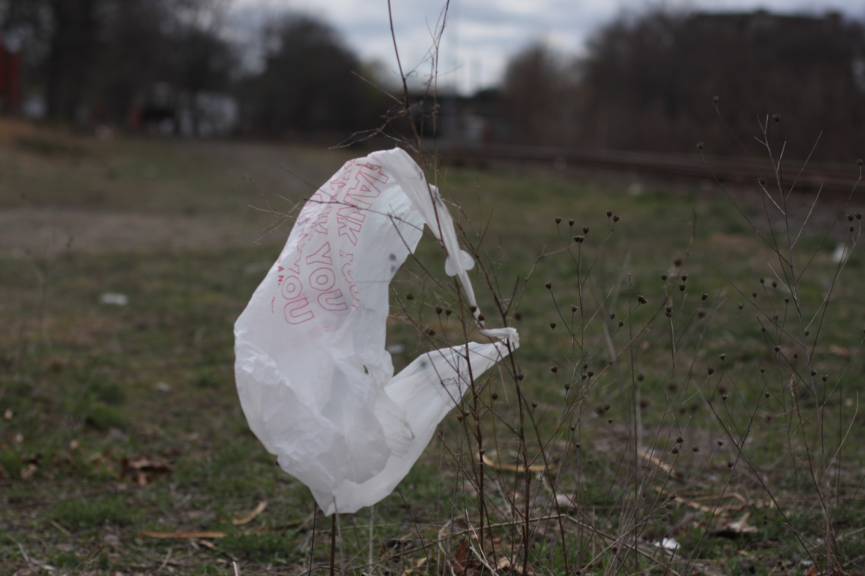
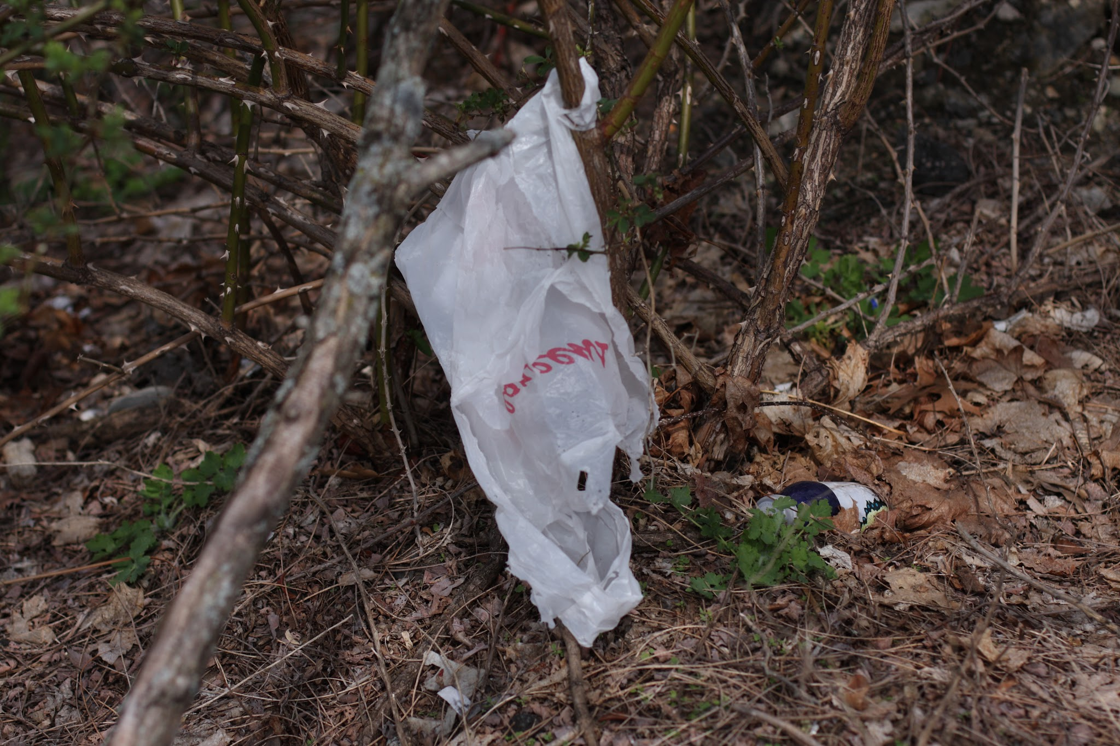
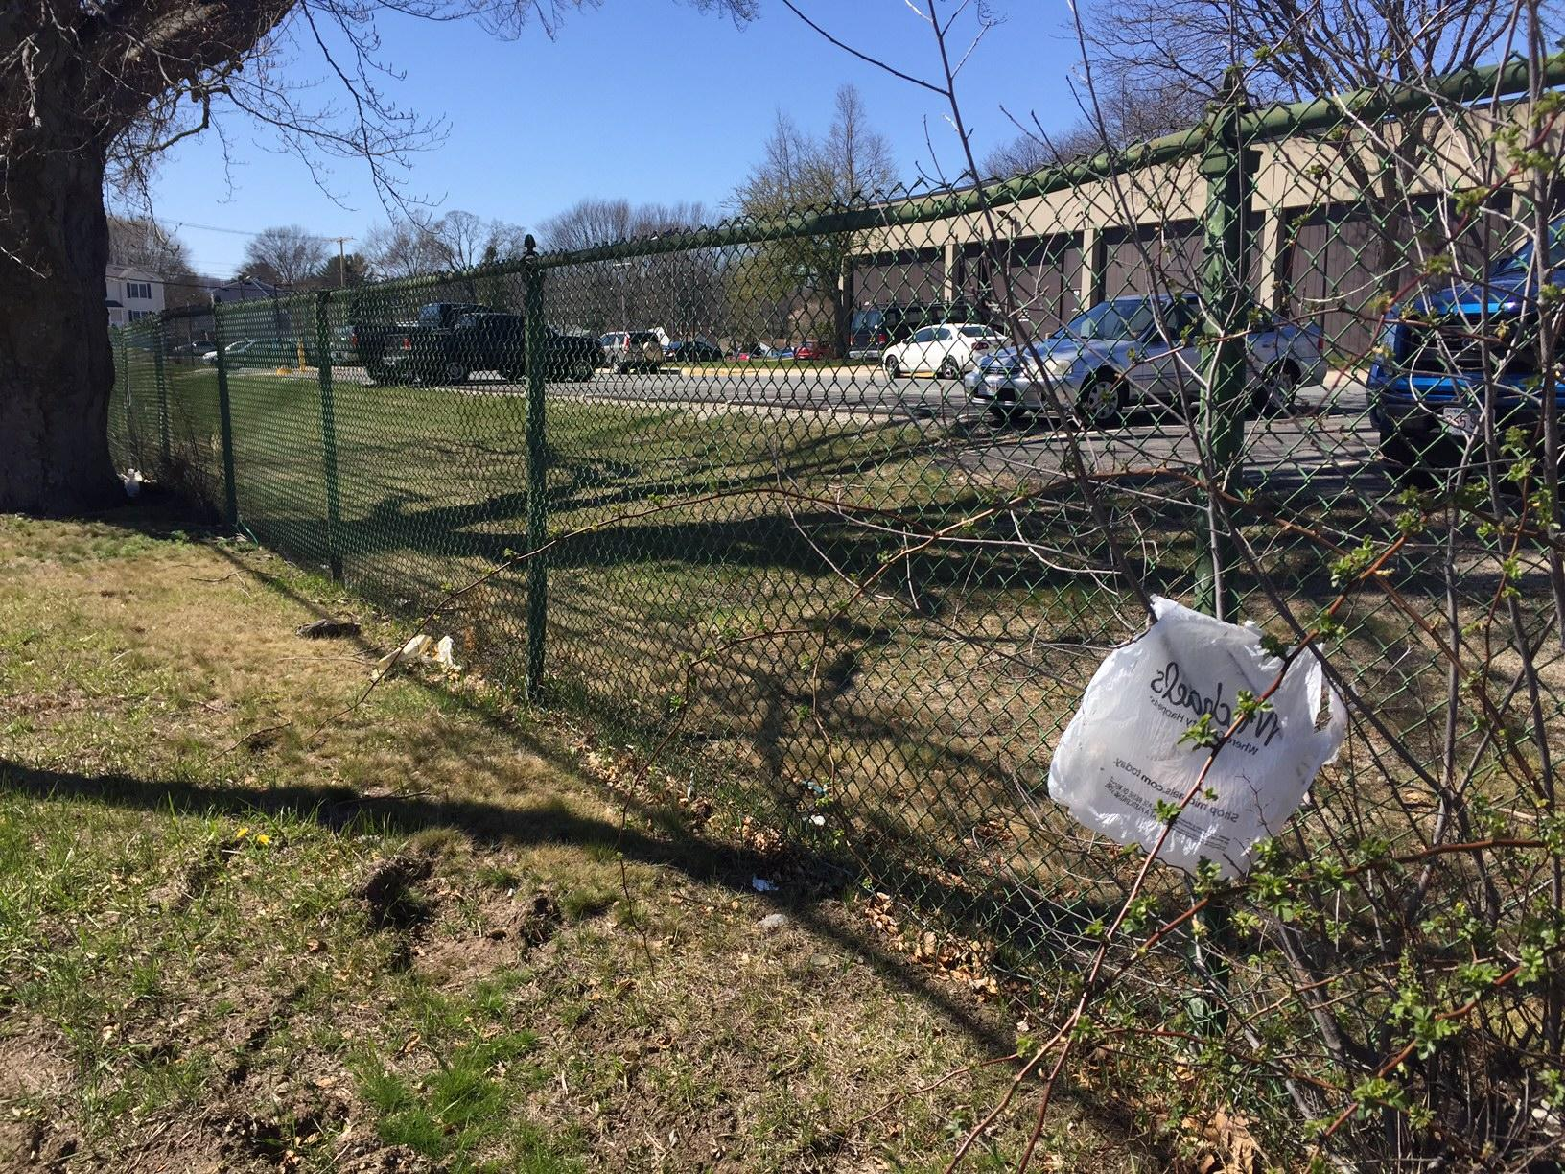
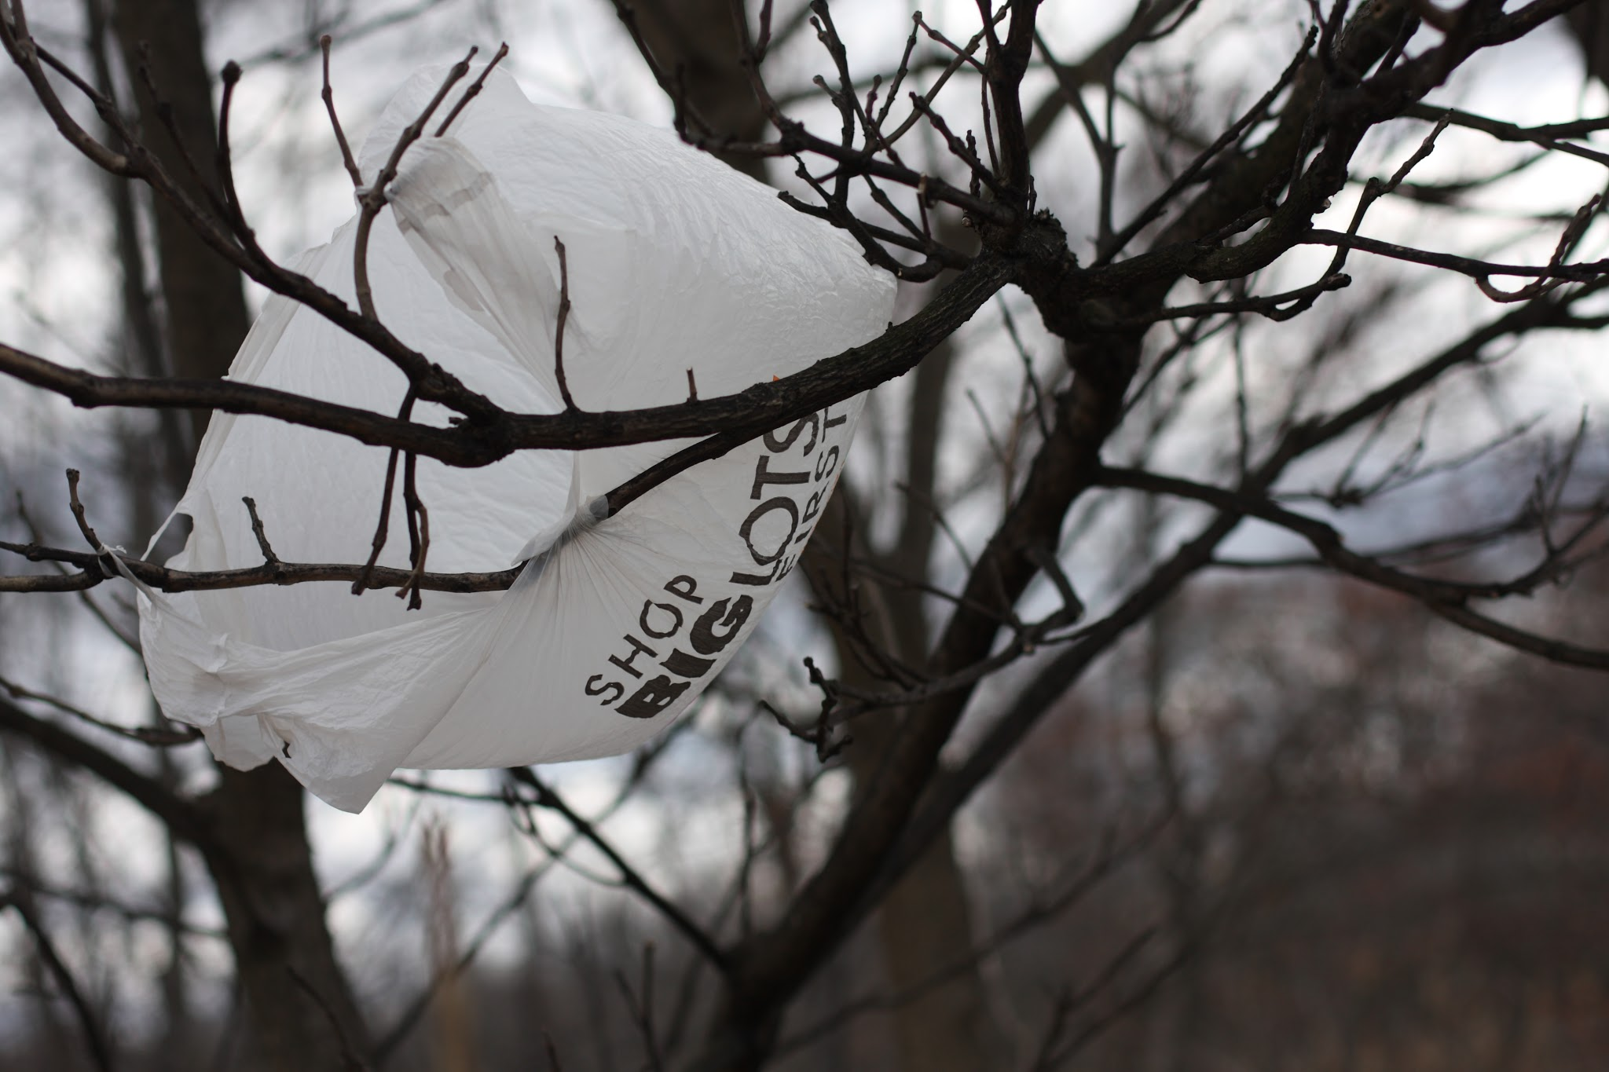
Train Station
Downtown
Keefe Tech
Edgell Road
Shoppers World
Route 135
Notes:
3 - Bags around town
When you walk or drive around town it’s hard not to see plastic bags in a number of places they should not be.
Here is a small sampling of the dozens of pictures that we have taken around town recently.
These bags get into the wild and because they are so aerodynamic they go wherever the wind will take them.
They then become a permanent part of our landscape.
Is this the type of community that you want to live in?

Slide 3
How Many Plastic Bags?!?
34 million every year in Framingham
Average grocery store 20,000 per week
Rerence - New York Times
Notes:
4 - How Many Bags?
We use way too many plastic bags:
34 million are distributed in Framingham each year
The average grocery store will give out 20,000 per week

Slide 4
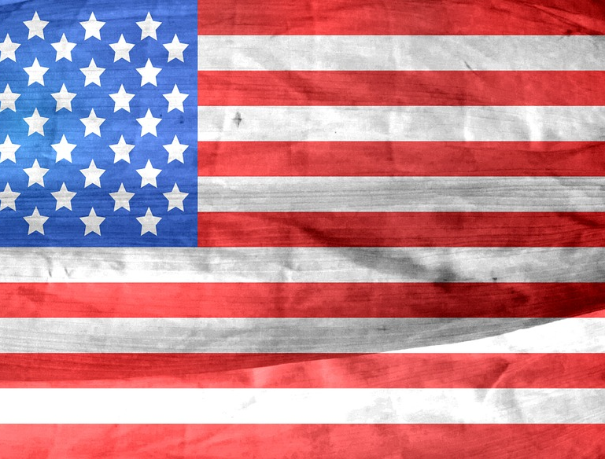
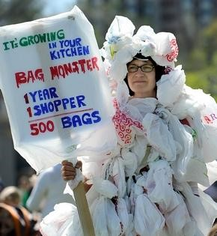
500
The number of bags an average American will use each year.
Notes:
5 - Average American
The average American uses 500 bags each year… And we have almost 70,000 people in this town.
The average use time of a plastic bag is only 12 minutes.
That a lot of waste for a momentary convenience.

Slide 5
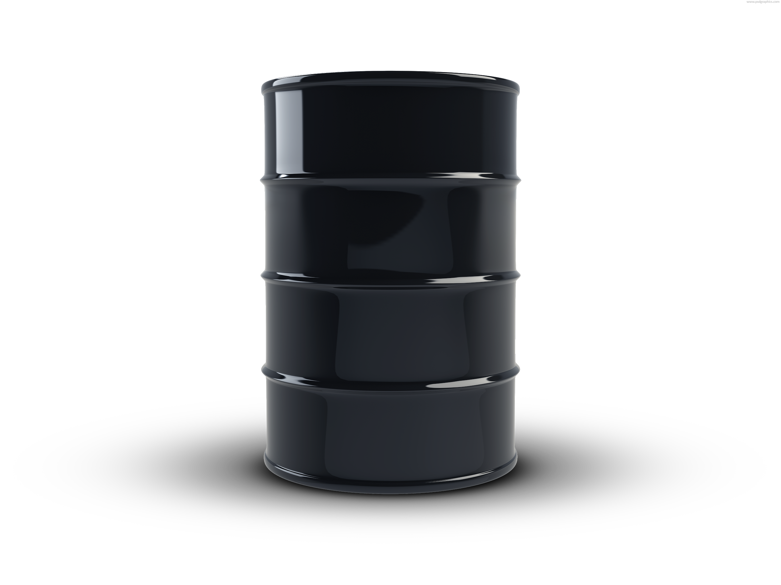
Environment Impact
Plastic bags require non-renewable fossil fuels to create
Notes:
6 - Non renewable
There are a number of environmental issues with these bags.
Plastic bags require non renewable fossil fuels to create.

Slide 6
Environmental Impact
Plastic bags need 500 to 1000 years to break down and they never fully biodegrade
Notes:
7 - Break Down
They require hundreds of years to break down and they never fully biodegrade.

Slide 7
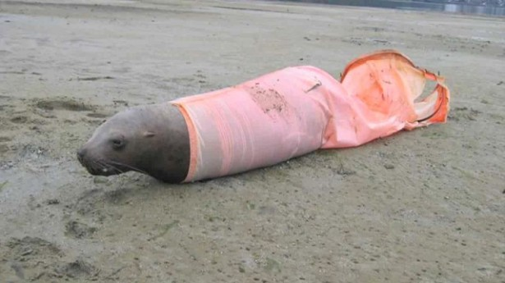
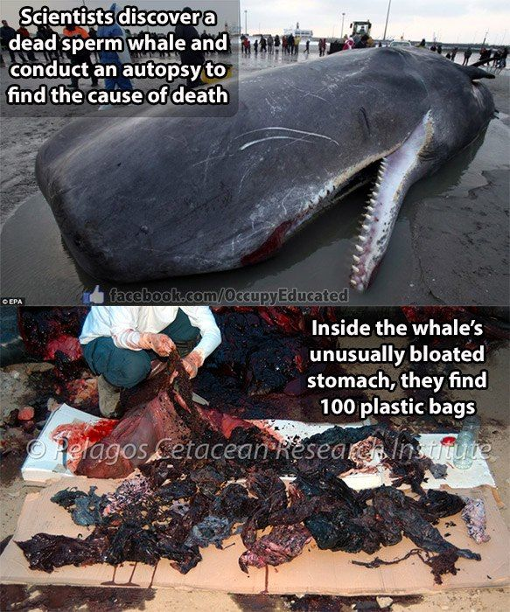
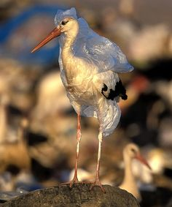
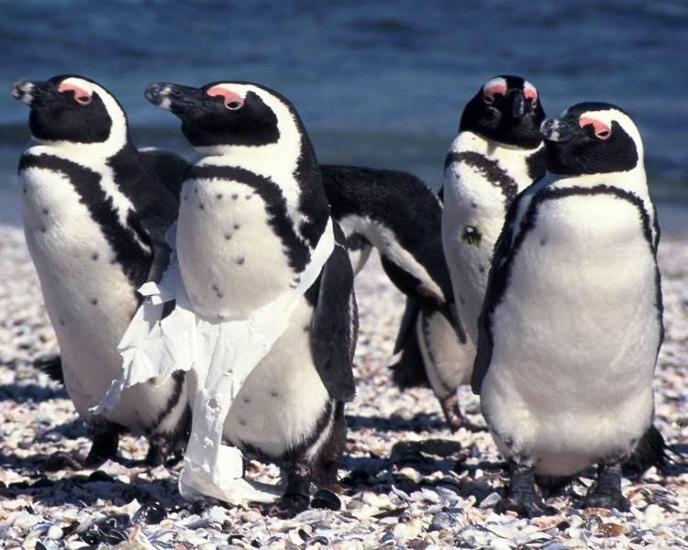
Environmental Impact
Notes:
8 - Animals
Untold numbers of animals die due to eating these bags or becoming entangled in them.
The whale on the right died and the autopsy showed over 100 plastic bags in it’s stomach.

Slide 8
Environmental Impact
Only 5-10% of plastic bags are properly recycled
Notes:
9 - % of recycling
Only a small percentage of these bags are properly recycled.

Slide 9
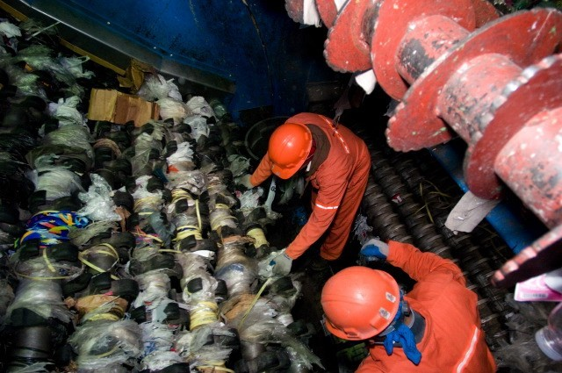
“This is the #1 contaminate in our recycling stream.” EL Harvey and Framingham DPW
Workers removing plastic bags from recycling machinery.
Photo courtesy of Klicker and Waste Connections
Notes:
10 - Recycling Problems
Plastic Bags require special recycling
When put into the standard stream they have become the #1 contaminate according to the Framingham DPW and EL Harvey.
They get caught in the sorting machines and it requires manual effort to get them out as you see here.
Even when properly recycled in most cases it costs more to deliver the plastic to a recycling facility than the plastic is worth.
Recycling is not the answer.

Slide 10
Why can’t we just educate?
We have to legislate.
You can never reach the whole population
Some people simply don’t care about litter
We do not have a budget for education
This bylaw will NOT affect town budget
Notes:
11 - Education
Unfortunately education alone is not enough.
Education costs money and it’s impossible to reach the whole population
Some people won’t care about the education because they simply do not care about litter.
The best way to solve this problem is to legislate in combination with education.
This bylaw will NOT affect the town budget.

Slide 11
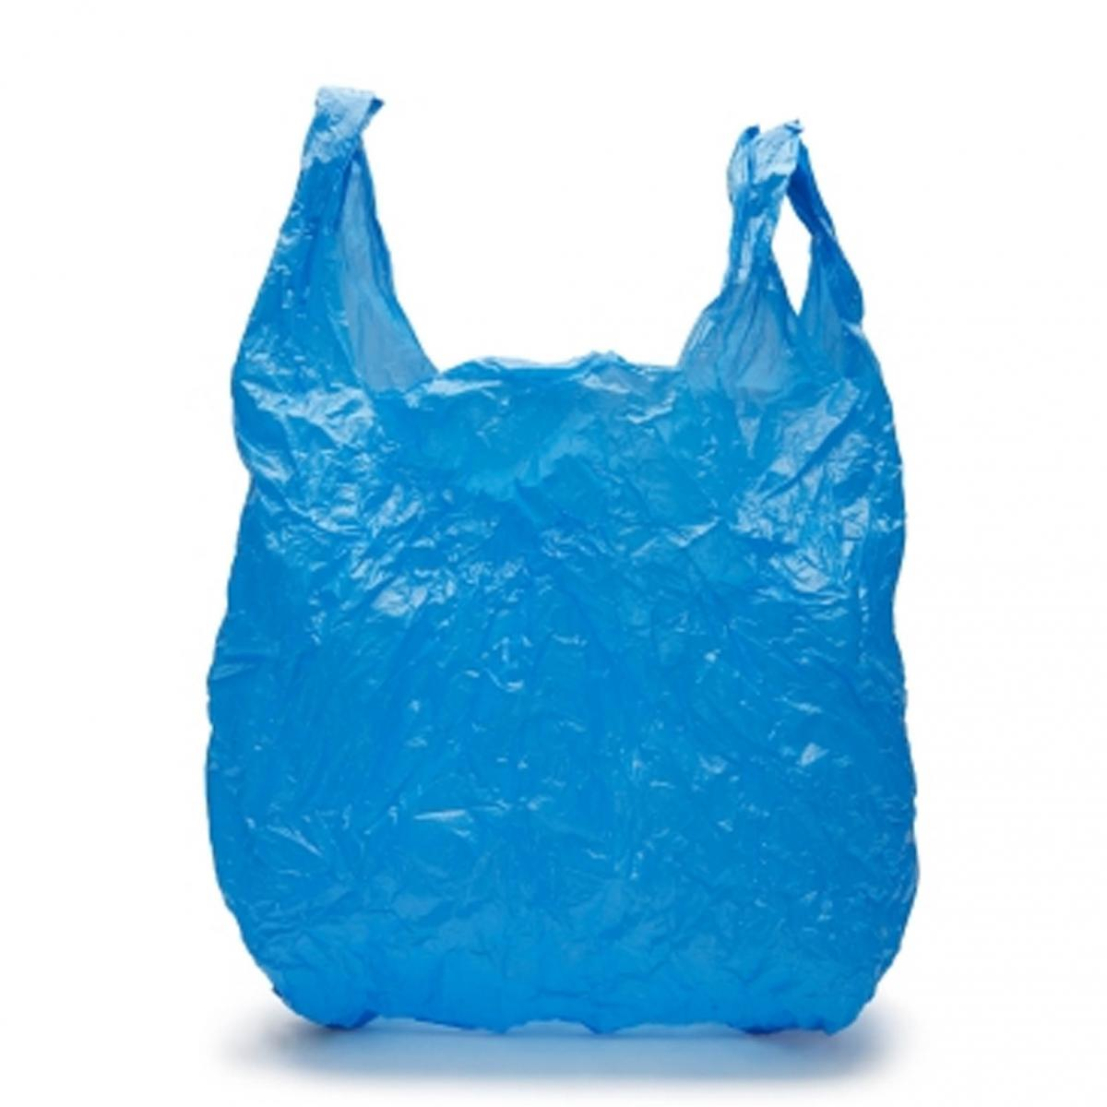
Article 42 Bylaw
Reduction of thin-film plastic checkout bags at all retail and grocery stores in Framingham starting on January 1st 2018
Notes:
12 - Proposal
So, what exactly are we proposing?
A reduction of thin-film plastic checkout bags at all retail and grocery stores in Framingham starting on January 1st 2018.
We know this transition will take time for citizens and stores.
Thus we decided to push this to 2018 to give plenty of time to make this transition as smooth as possible.

Slide 12
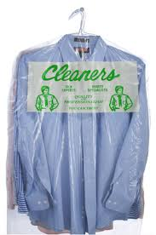
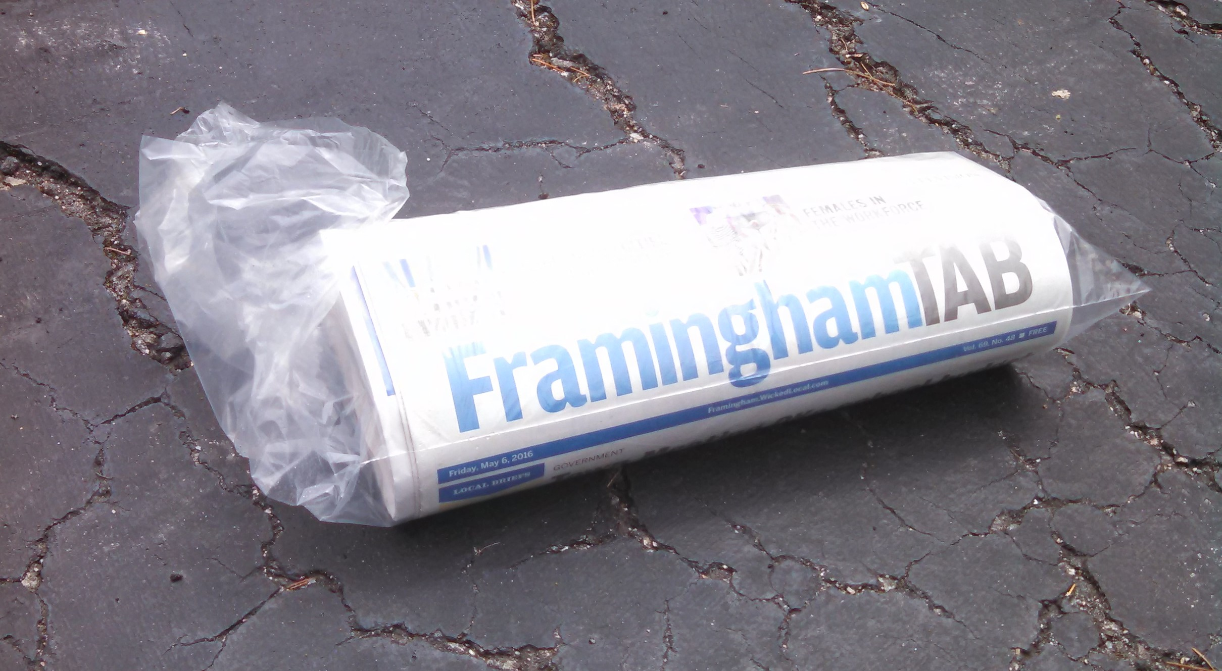
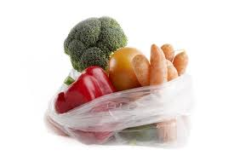
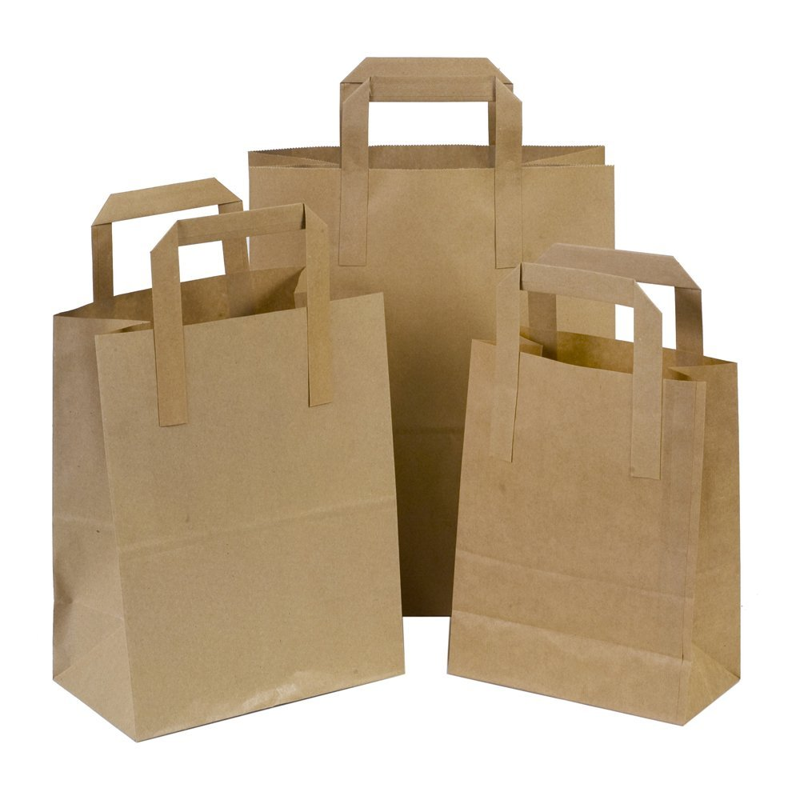
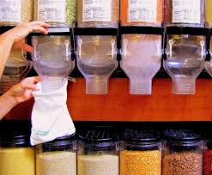
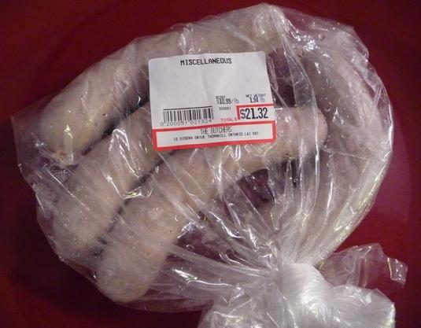
Bags that will still be available
Notes:
13 - Still Available
You will still be able to get Dry cleaning, Newspaper, Produce, Bulk foods and paper bags.
It’s only the plastic bags with handles that you get at checkout that are part of this bylaw (show bag here)
You will still be able to get paper bags at checkout; but this isn’t the long term solution either
Even paper bags made from recycled materials have an Economic and Environmental Impact in order to produce, ship and recycle

Slide 13
(Bring Your Own Bag)
BYOB
Notes:
14 - BYOB
The most sustainable practice is to Bring Your Own Bag!
There are many different sizes and shapes of bags to suit any shopping need
Reusable bags are much stronger and are easier to carry
They are easier to pack and sit much better in your car than plastic bags
Over time they are cheaper than both paper or plastic bags
There is a transition period when beginning to use your own bags; so here are some helpful tips to get started

Slide 14
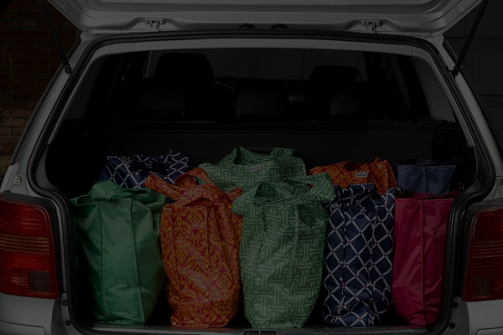
Tips for an easy transition
Store bags in your car
Put them back in car after unloading
Notes:
15 - Tips
First of all; keep these bags in your car so you always have them
If your family has multiple cars it’s best to keep some bags in each car
Be sure to have enough bags to allow for shopping at multiple stores in the same trip
After you unload your groceries and other items at home put the bags right back in your car
It’s probably best to have different bags for different types of items; especially having one designated for meat that you can clean easily
We have fielded a number of concerns about reducing plastic bags
I would like to share solutions for some of these

Slide 15
Concerned?

Slide 16
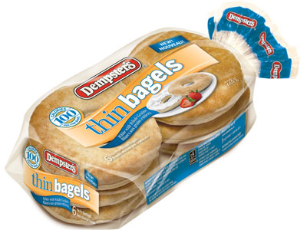
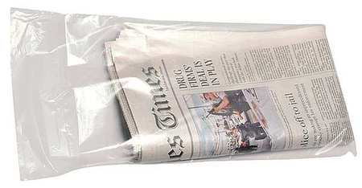
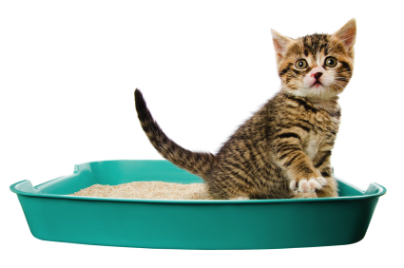
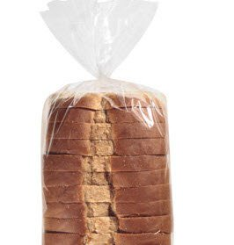
Pet waste bags
Notes:
17 - Pet Waste
A number of people use these bags for pet waste.
You could use other bags that you acquire for free like Newspaper and Produce bags or Bread and Bagel Bags

Slide 17
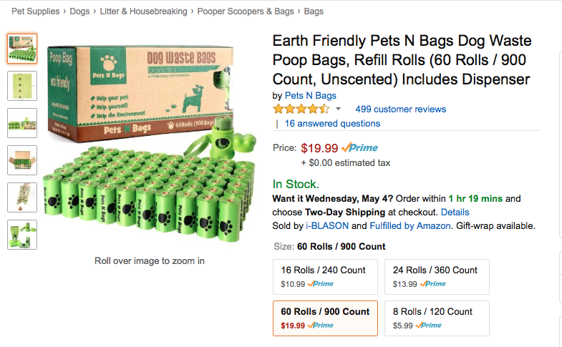
Biodegradable eco friendly bags are cheap!
Notes:
18 - Eco Friendly Pet
If you don’t mind spending a penny or two a piece you could buy eco-friendly pet waste bags that will break down over time.

Slide 18
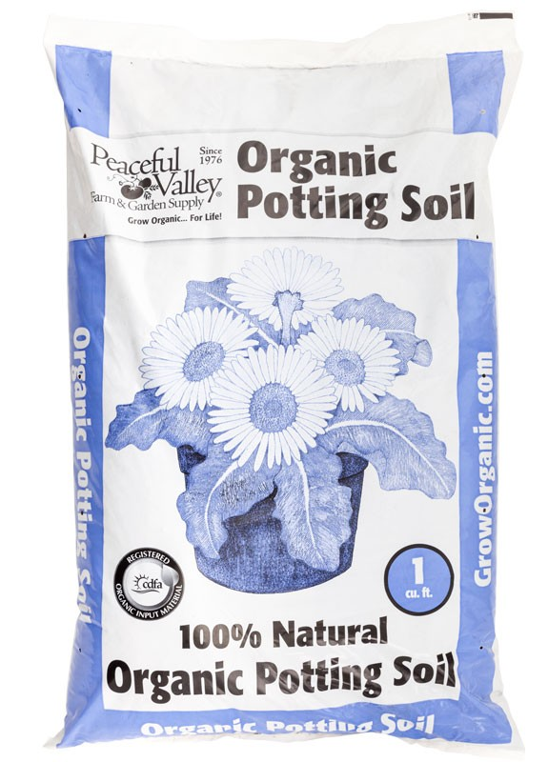
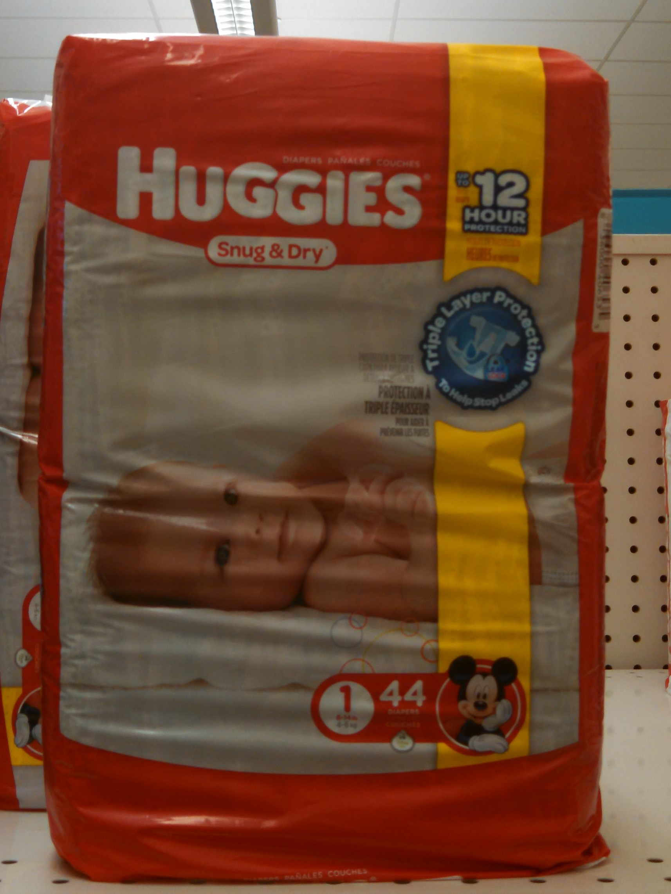
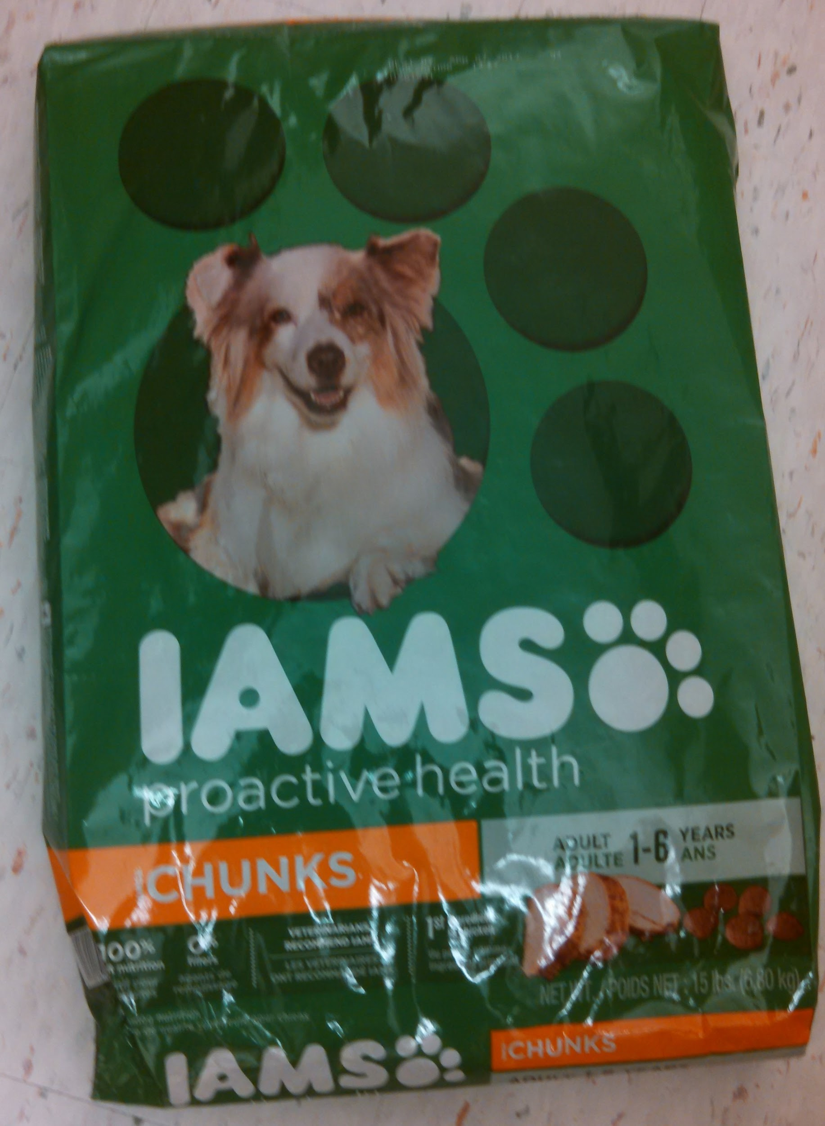
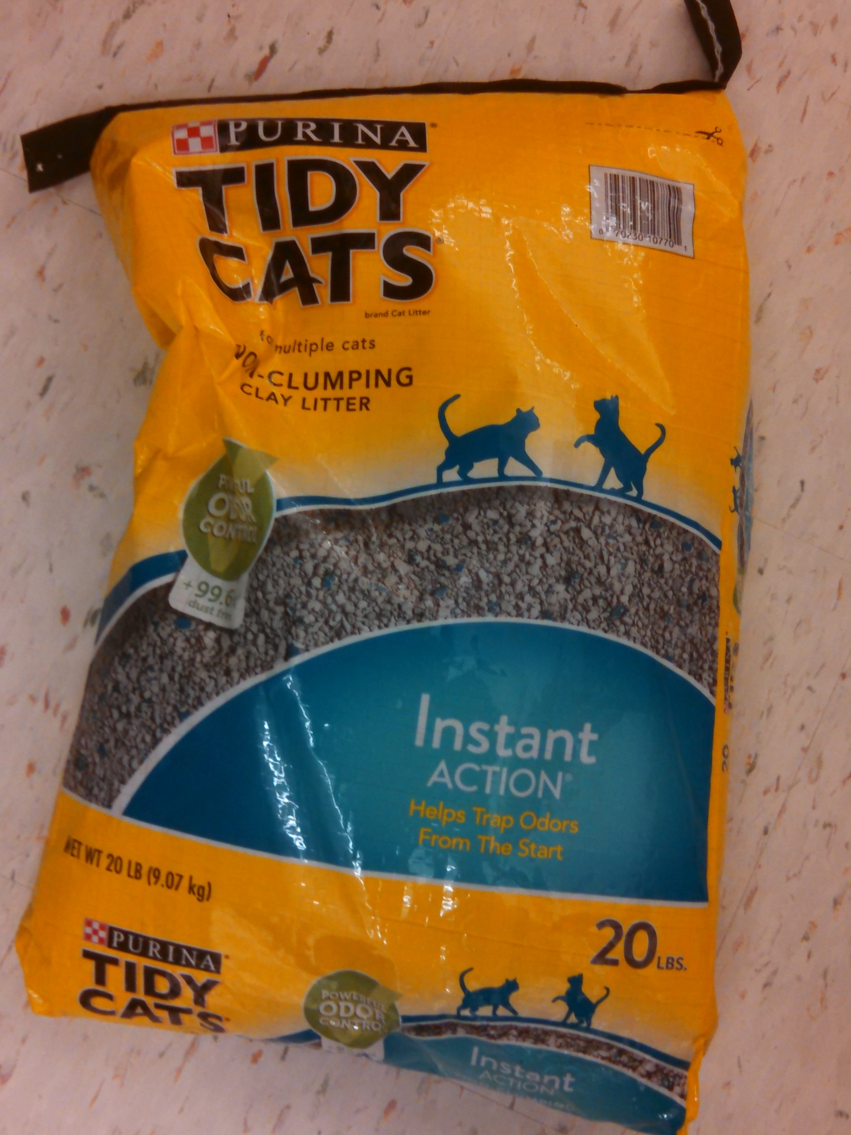
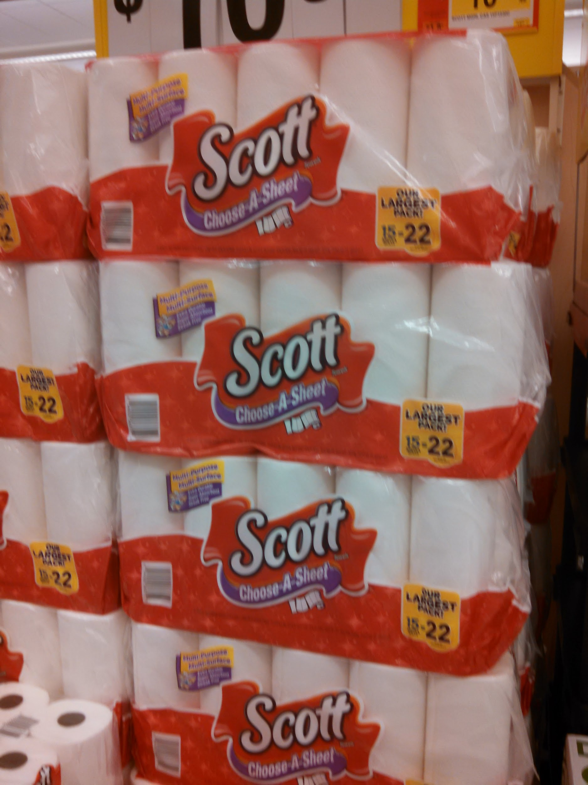
Garbage can liner ideas...
Notes:
19 - Trash can liners
Many people use these bags to line small trash bins in their houses.
Produce bags work well for this
Paper bags work well in rooms where your trash is not wet
You can get creative and reuse or repurpose any number of other bags you have around you house
There are eco-friendly options for trash cans similar to the pet waste bags

Slide 19
Aren't plastic bags
FREE?
Plastic checkout bags cost between 2 and 5 cents
Average Supermarket pays around $1000 every week for plastic bags
Notes:
16 - Free??
Many people like these bags because they are free; but they are not...
These bags cost retailers between 2 and 5 cents apiece
They pass this cost onto the consumers by including it into the prices of items you purchase
The cost of these bags is very real and you as the consumer are surely paying for them one way or another.

Slide 20
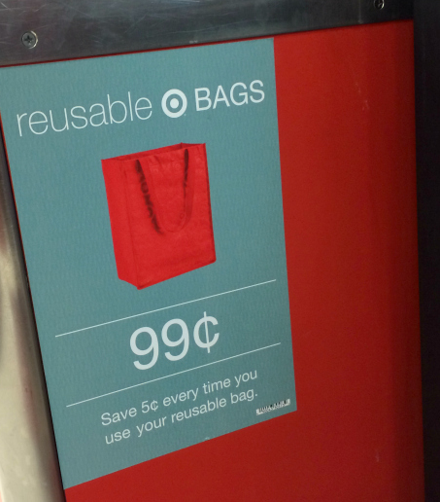
Will this hurt businesses?
Buying less bags saves businesses money
Revenue from reusable bag sales
Reusable bags as advertising
BJs, Trader Joe’s and Whole foods haven’t had plastic bags for years
Notes:
20 - Businesses
This will not hurt businesses.
By purchasing less bags stores will save money.
By selling more reusable bags stores will make a bit of money and get free advertising.
Many stores have not had plastic bags for years and they are all doing just fine.

Slide 21
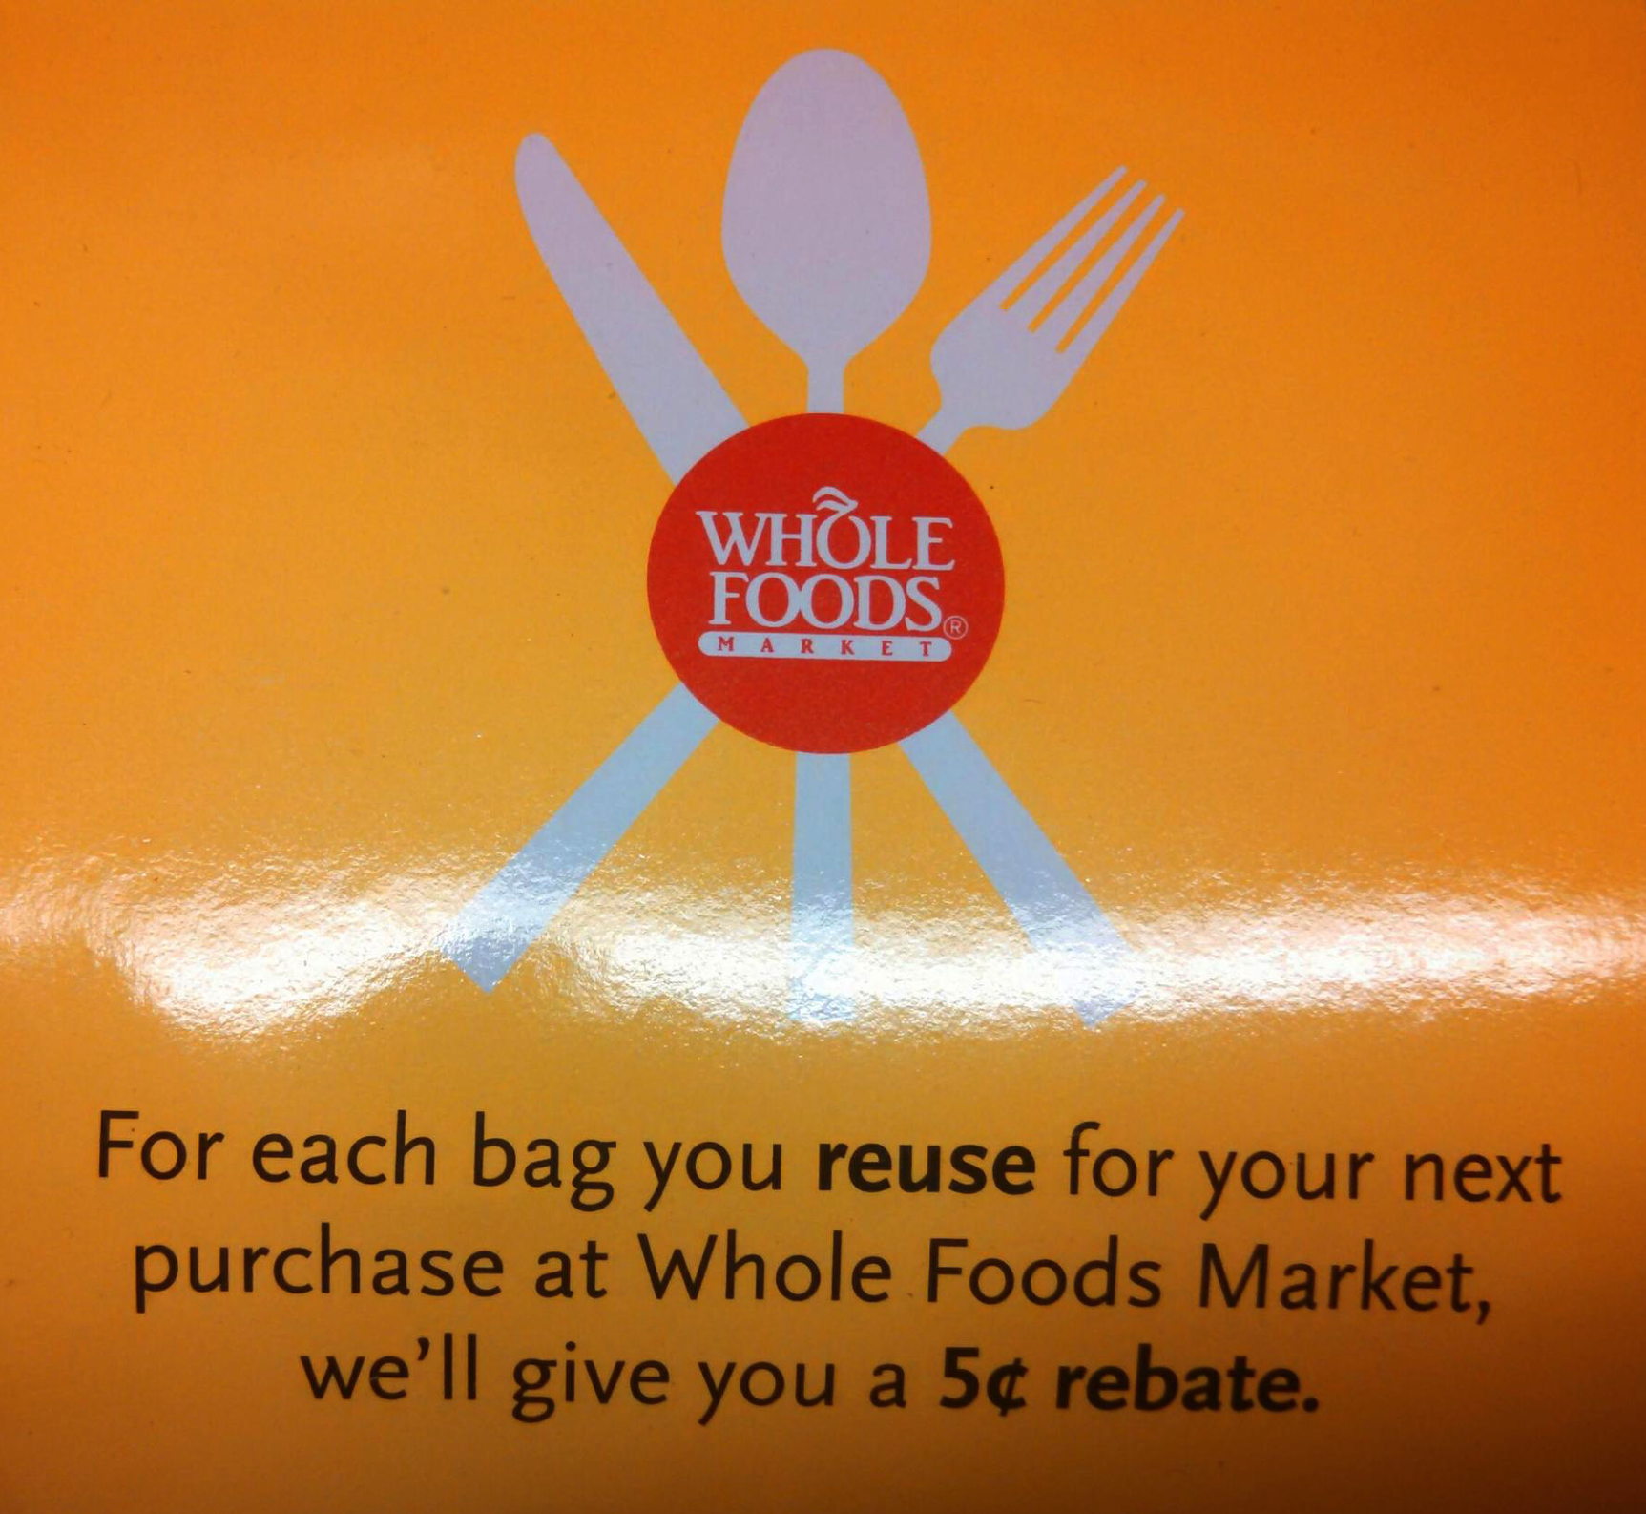
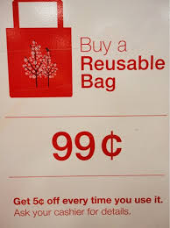
How will this help me?
Some retailers offer discounts for using your own bags
Target 5 cents
Trader Joes Raffle
Whole Foods 5 cents
Notes:
20 - Low Income
Right now some retailers offer discounts for using reusable bags.
We will be working with other stores to encourage them to offer similar discounts to their patrons

Slide 22
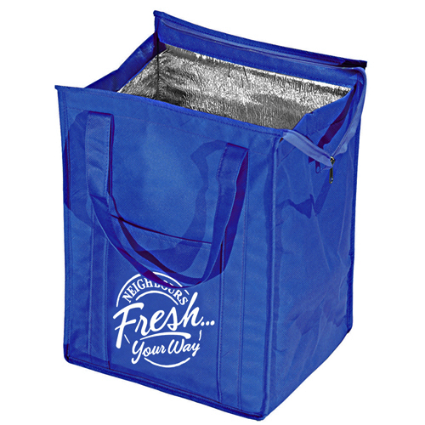
Is it sanitary to carry meat in reusable bags?
Yes, it’s safe.
In 30+ years since the advent of reusable shopping bags there is no credible research or evidence linking reusable bags to outbreaks of e-coli or any other harmful bacteria
Notes:
19 - Safe for meat?
It is quite safe to carry meat in these bags.
There is no credible research or evidence linking reusable bags to outbreaks of e-coli or any harmful bacteria
We recommend wrapping any meat you have in a produce bag if you are concerned
You can designate one of the padded / insulated reusable bags as your “meat bag”
This will keep your meat insulated and these bags are generally lined with a material that can be easily cleaned

Slide 23
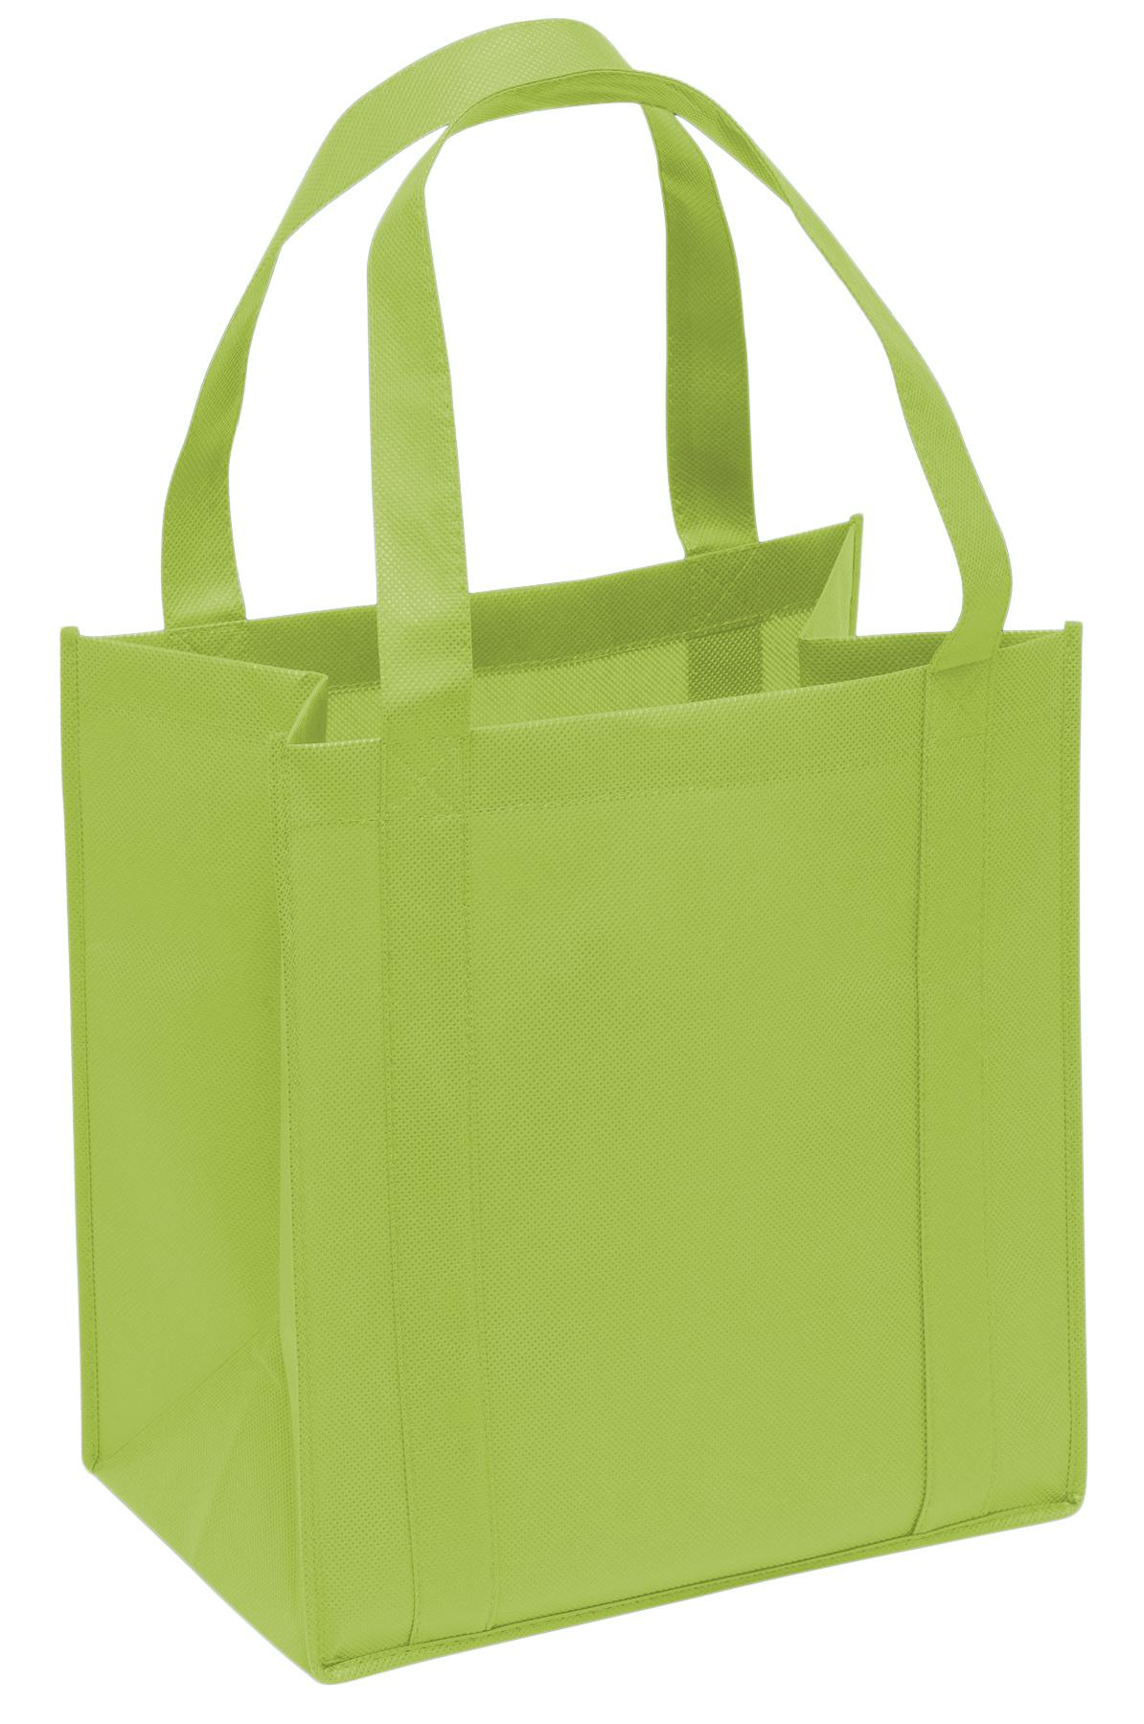
Will this hurt low income families?
Many bags as cheap as $1
Whole Foods - 3 for $2
Sometime even free!
They last for years
$1
Notes:
20 - Low Income
This will not hurt low income families
Many reusable bags are quite cheap or even free at certain times
We will work with businesses to donate bags to low income families
We will have a reusable bag drive where those who have extra can share with those who are in need

Slide 24
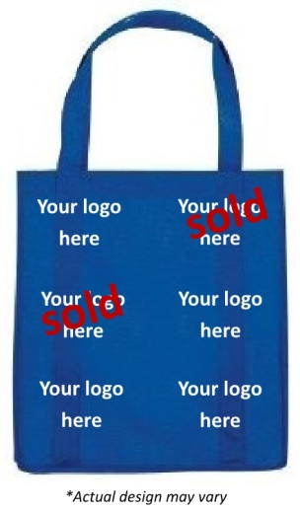
Will this hurt low income families?
We will work with businesses and the Chamber of Commerce to create bags with ads, that can be given out for FREE to low income families.
Notes:
20 - Low Income
This will not hurt low income families
Many reusable bags are quite cheap or even free at certain times
We will work with businesses to donate bags to low income families
We will have a reusable bag drive where those who have extra can share with those who are in need

Slide 25
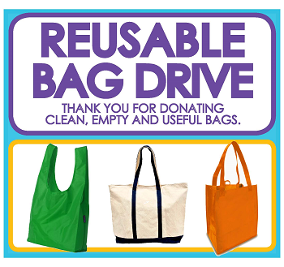
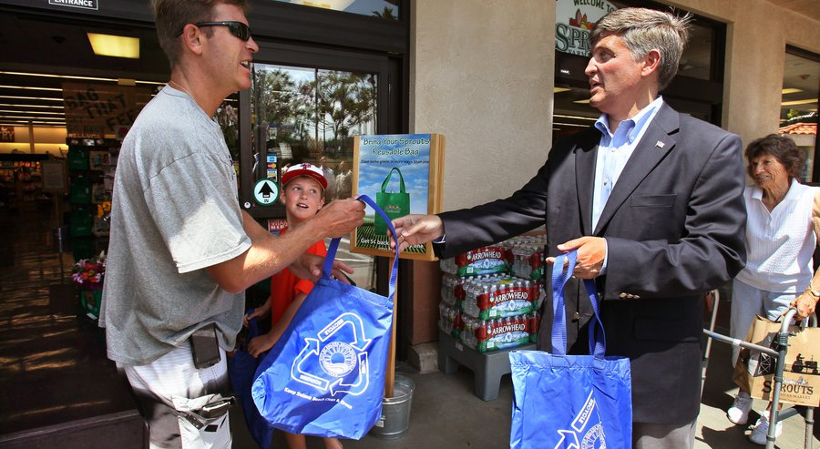
Will this hurt low income families?
Reusable Bag Drive - gather bags from those who have extra to share with those who do not have enough
Notes:
20 - Low Income
This will not hurt low income families
Many reusable bags are quite cheap or even free at certain times
We will work with businesses to donate bags to low income families
We will have a reusable bag drive where those who have extra can share with those who are in need

Slide 26
28 Other Massachusetts towns + cities
Aquinnah, Barnstable, Bridgewater, Brookline, Cambridge, Chilmark, Concord, Edgartown, Falmouth, Great Barrington, Greenfield (proposed), Hamilton, Harwich, Manchester, Marblehead, Nantucket, Newburyport, Newton, Northampton, Pittsfield (proposed), Provincetown, Somerville, Tisbury, Truro, Wellesley, Wellfleet, West Tisbury, Williamstown
cFRAMINGHAM (proposed)
Notes:
21 - Other Towns + Cities
Over 20 towns and cities in the Massachusetts have already passed similar legislation.
We would love to see Framingham join this group in terms of setting the trend for the rest of the State.

Slide 27
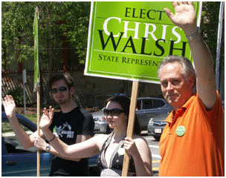
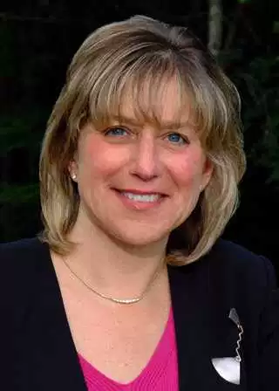
Our Local Supporters
Senator
Karen Spilka
Notes:
22 - Local Support
We have had an immense amount of local support for this initiative.
Almost everyone we have reached out to sees the benefits for our community.

Slide 28
600+ Bags Used in Framingham during this presentation
Notes:
23 - 10 minutes...
Since I started this presentation over 600 plastic bags have been distributed in Framingham.
Given that these bags are made from fossil fuels and never biodegrade we must do something to change this trend.

Slide 29
We want to make Framingham more beautiful.
We want to avoid littering and polluting our Town.
VOTE YES FOR ARTICLE 42
Notes:
24 - Vote Yes for Article 42
By reducing the number of plastic bags that get into our community we are taking a big step towards making Framingham a more beautiful place to live, work and play.
Help us make this happen and Vote YES for Article 42.

