Slide 1

Lab Safety & Orientation
Ecology: Lab #1
Rules & Procedures

Slide 2
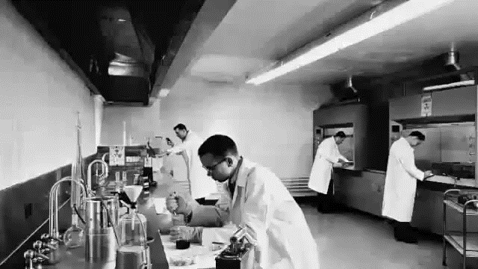

Slide 3
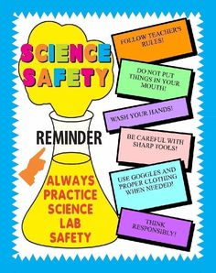
A Safe Lab Environment
Safe lab environments are dependent upon both you and your classmates.
Everyone must work together to ensure the safety of yourself and those working around you. You always need to work cautiously in the lab.

Slide 4
Lab Safety Overview
Emergency Plan
Handling Glassware
Fire Prevention
Protective Equipment
Chemical Safety
General Safety Rules

Slide 5
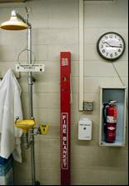
In an Emergency!
In the lab, it is important
to know the location of:
  Fire blanket
  Fire extinguisher
  Emergency Exits
  Gas Emergency cutoff switch
  Safety Shower and Eye Wash

Slide 6
Accidents can happen!!
Getting something in your eye
  Lead partner to eye wash station
  Contact teacher
  Wash for 10-15 minutes, see a doctor
Large Spills
  Take partner to safety shower
  Contact teacher
  See a doctor

Slide 7
Glassware
Glassware is the #1 cause of accidents in the lab!
To reduce the chance of injury use common sense when handling glassware!

Slide 8
Glassware
Never use glassware to hold food or drinks!
Always inspect your glassware before lab starts
Place broken glass into broken glass box – using protection on your hands

Slide 9
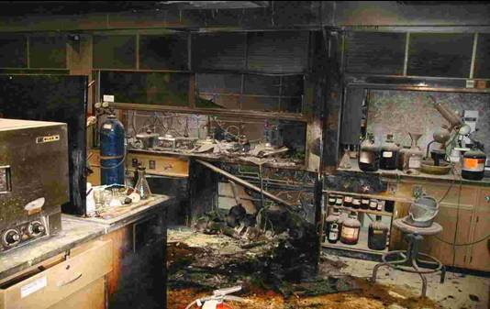
FIRE!!!
If there is a fire, alert the class to evacuate – the teacher will handle the rest!

Slide 10

Protective Equipment
Goggles – ALWAYS!
  To protect your eyes
Apron – worn often
  To protect your body
Gloves – when using dangerous chemicals
  To protect your hands

Slide 11

Chemical Safety
Chemicals always need to be properly labeled and stored in designated areas!
  Flammables need to be kept in flammable cabinet, acids in acidic cabinet, etc.

Slide 12

Safety Rules
Ecology: Lab #1

Slide 13
Safety Rules
Be alert and responsible at all times in the laboratory.
Follow all written and verbal instructions carefully. If you do not understand a direction or part of a procedure,
ASK BEFORE PROCEEDING WITH THE ACTIVITY
Never work alone in the laboratory. No student may work in the Lab without the presence of the teacher.

Slide 14
Safety Rules
When first entering the lab, do not touch any equipment, chemicals, or other materials in the laboratory area until you are instructed to do so.
Perform only those experiments authorized by your teacher. Carefully follow all instructions, both written and oral.
Do not eat food, drink beverages, or chew gum in the laboratory. Do not use laboratory glassware as containers for food or beverages.

Slide 15
Safety Rules
Always work in a well-ventilated area.
Work areas should be kept clean and tidy at all times.
Notify the teacher immediately of any unsafe conditions you observe.

Slide 16
Safety Rules
Dispose of all chemical waste properly. Never mix chemicals in sink drains. Sinks are to be used only for water.
Labels and equipment instructions must be read carefully before use.
Keep hands away from face, eyes, mouth, and body while using chemicals or lab equipment. Wash your hands with soap and water after performing all experiments.

Slide 17
Safety Rules
Know the locations and operating procedures of all safety equipment including: first aid kit(s), and fire extinguisher. Know where the fire alarm and the exits are located.
Any time chemicals, heat, or glassware are used, students will wear safety goggles.
Dress properly during a laboratory activity. Long hair, dangling jewelry, and loose or baggy clothing are a hazard in the laboratory. Long hair must be tied back, and dangling jewelry and baggy clothing must be secured. Shoes must completely cover the foot. No sandals allowed on lab days.

Slide 18
Safety Rules
Report any accident (spill, breakage, etc.) or injury (cut, burn, etc.) to the teacher immediately, no matter how trivial it seems. Do not panic.
If you or your lab partner is hurt, immediately (and loudly) yell out the teacher's name to get the teacher's attention. Do not panic.
If a chemical should splash in your eye(s) or on your skin, immediately flush with running water for at least 20 minutes. Immediately (and loudly) yell out the teacher's name to get the teacher's attention.

Slide 19
Safety Rules
Never return unused chemicals to their original container.
Never remove chemicals or other materials from the laboratory area.
Never handle broken glass with your bare hands. Use a brush and dustpan to clean up broken glass. Place broken glass in the designated glass disposal container.

Slide 20
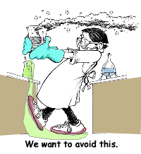
Safety Rules
If you do not understand how to use a piece of equipment, ASK THE TEACHER FOR HELP!
Do not immerse hot glassware
in cold water. The glassware
may shatter.

