Slide 1
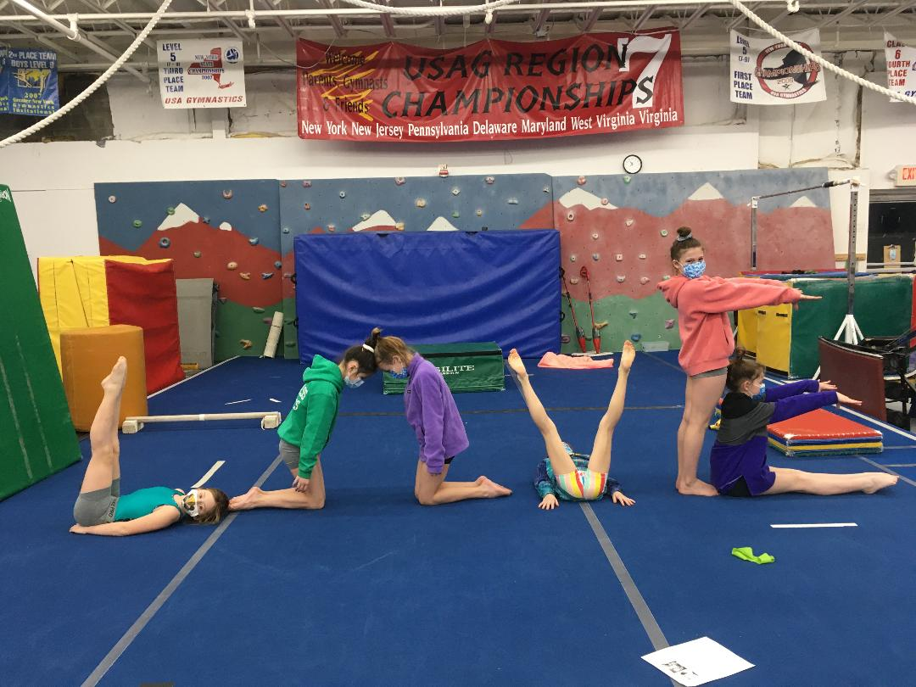
Countdown to Wellness
5 Steps to Making Today Great

Slide 2
5 Affirmations or Positive Thoughts
Examples of Affirmations
Examples of Positive Thoughts
There is no one better to be than myself
I am enough
I get better every single day
I am an amazing person
I am perfect just the way I am
I accept who I am
I am brave
All of my problems have solutions
My mistakes help me learn and grow
I have the power to make my dreams and goals come true
I can control my happiness
Good things are going to come to me
Today is going to be an awesome day

Slide 3
4 Mindfulness Moments:
Mindfulness is having awareness of the present moment. Noticing thoughts, feelings, and sensations as they rise and fall.
Mindfulness is:
Mindfulness is not:
Awareness of the present moment
Noticing thoughts, feelings, and sensations
Can be formal (meditation) or informal (packing your bag, standing in line)
Religion or doctrine
Thinking hard about one particular thing
Absence of thought
Just for monks, priests, and spiritual leaders
Perfect

Slide 4
Why be Mindful?
Helps create distance from your thoughts/opinions so you don’t get caught up in your head.
Helps you to pause and take a break
Helps build healthier relationships
Helps you shift your focus to your surroundings in the present moment and away from what is causing you to feel anxious or uncomfortable
It can help you interrupt unhealthy thought patterns
Helps you focus on things you can control

Slide 5
What can I do to be mindful?
Here is one Activity to practice:
Sit Quietly
Look around and notice:
5 things you can see: Your hands, the sky, a plant in the room, etc.
4 things you can physically feel: Your feet on the ground, a ball, your friend’s hand
3 things you can hear: The wind blowing, laughter, your breath
2 things you can smell: Soap, coffee, fresh-cut grass
1 thing you can taste: A mint, gum, fresh air

Slide 6
Other ways to find Mindful Moments:
Go for a walk and use your “spidey senses – smell, sight, hearing, taste, and touch” to notice as many things as you can along the way.
Play your favorite music. How many sounds and different instruments you can you hear?
Get lost in artwork. Notice depths of color, the texture of the artwork, and what if feels like to hold the artwork or tools you are using in your hands.
Use an app for a guided meditation.
Use any of the breathing exercises we learned to focus on your breath. Notice your breath as you do the exercise.
Lie on your back outside and look for shapes and animals in the clouds.
Blow bubbles. Notice the taste and feel of the gum as you make and blow the bubbles.

Slide 7
3 Expressions of Gratitude:
Why practice gratitude?
Practicing gratitude has far reaching effects from improving attitude to boosting relationships
Helps you notice the little wins
Strengthens your ability to notice the good in your life
Noticing small moments string together to create a sense of overall well-being

Slide 8
How do I practice gratitude:
Keep a gratitude journal
Share your gratitude to others
Use visual reminders – a gratitude jar, pictures of things that make you feel grateful and thankful
Make a vow to practice gratitude
Watch your language – use language that expresses your gratitude and appreciation for yourself and others
Acts of gratitude toward others – smiling, writing letters of gratitude, doing good deeds, “paying it forward”
Think outside the box – look for creative ways to help you practice gratitude

Slide 9
2 Self Care Choices: Self care is not self indulgence. Self care is self respect.
Take a Nap
Get a massage
Take a warm bath
Do your nails
Play
Get outside
Read just for fun
Treat yourself to a yummy snack

Slide 10
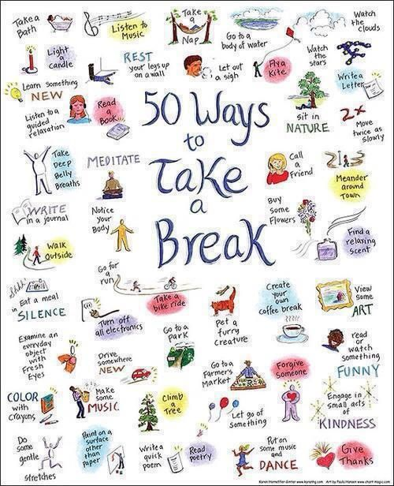

Slide 11
1 Goal for the day
Make it specific:
See it clearly in your mind. Picture it as if it is already happening.
Put a timeline on it. “I see myself achieving this goal by ______.”
Why is it important to you?
This will be in my best interest because_______.
What do you need to do to achieve your goal?
What 3 things can you do to help you reach your goal?
What tools do you need or assistance do you require to reach your goal?
What 2 things can you do to help you stay focused on your goal?
How will you know when you reach your goal?
What markers can you use to know you have met your goal?

Slide 12
How To Work on My Goals:
My Goal:
Why is it Important to me?
Target Goal Date: See it in your mind
Three Things I can do to reach my goal:
I will know I reach my goal when:
2 Things I can do to help me stay focused on my goal:

