Slide 1
BUSI 406-3 Didow
Reset for the Remainder of Spring Semester 2020
March 23, 2020
Professor Nicholas Didow
nick_didow@unc.edu www.didow.info
Kenan-Flagler Business School

Slide 2
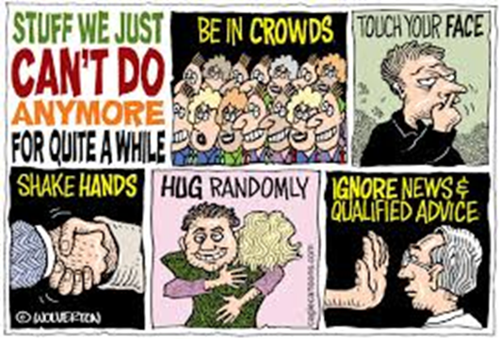
The top priority is your safety and your well being
Are you okay?
What do you need from me, the UBP, KFBS, or UNC?
Are you following the Federal and State guidelines to lessen the spread of coronavirus?
Stay at home if you can -- “Shelter in Place”
Practice social distancing
Wash your hands frequently
Cover your sneeze of cough
Avoid touching your eyes, nose, and mouth
How can you do some good in the world in this challenging and difficult circumstance?
Family
Friends
Neighbors

Slide 3
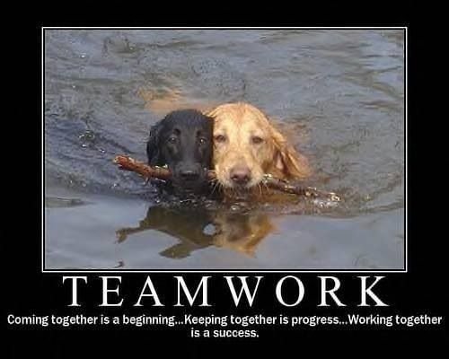
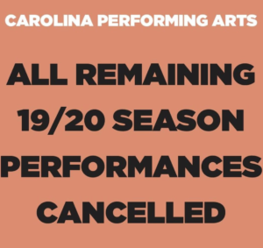
BUSI 406-3 will be taught and experienced online (and recorded) using Zoom for the rest of Spring Semester 2020 – Mondays and Wednesdays from 12:30-1:45
Together we can get through this!
You can choose to take BUSI 406 Pass/Fail or for a letter grade
Revised schedule has been posted on Canvas and on www.didow.info
Marketing Research Participation Session #3 has been cancelled and everyone gets 1.7 points credit for it
Running On team case assignment now due April 1 and Wise Water team case assignment now due April 15
Submit when due as email attachment to nick_didow@unc.edu
The major team Marketing Strategy Planning Project and Presentation has been cancelled – please advise your client contacts about this
This 15% of your grade has been reassigned to the Final Exam

Slide 4
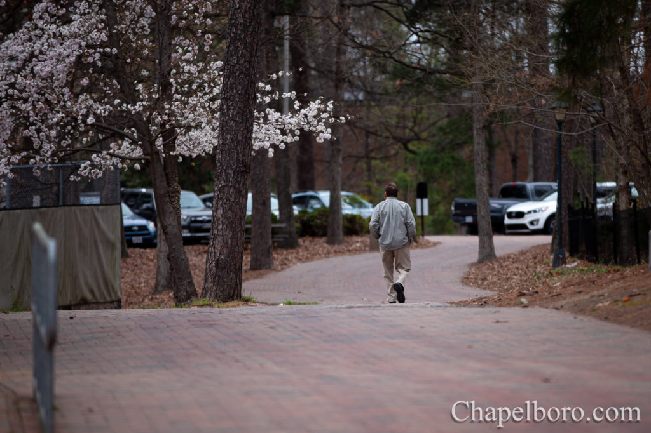
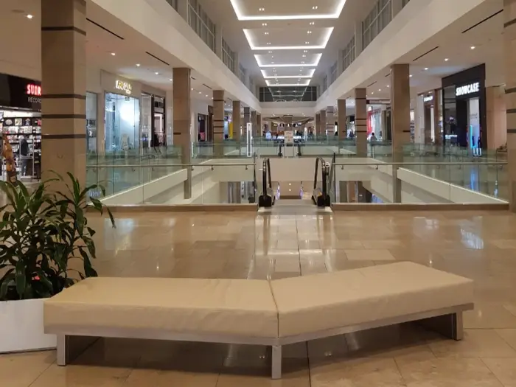
We have moved everything online for the remainder of Spring Semester
The BUSI 406 Final Exam will now be worth 45% (not 30%) and will be taken online Tuesday, April 28, 12-3 pm as scheduled
Details TBD
McGraw Hill has provided free online access to an electronic version of our Essentials of Marketing textbook
Access directions posted on Canvas and at www.didow.info
Prepare for online Zoom class Wednesday, March 25, 12:30-1:45 by reading Chapter 12 – Retailers, Wholesalers, and Their Strategy Planning
What is the impact of this coronavirus situation on retailers?
What advice would you give to a retailer as to how to recover from this challenging situation?
What about shopping malls?

