Slide 1
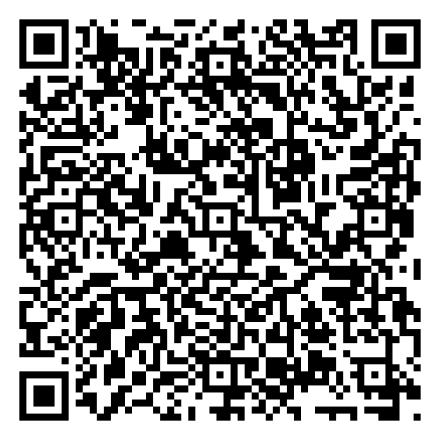
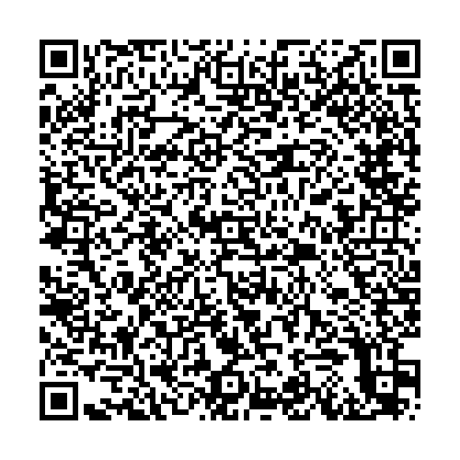
PSJMC-DFCC Team Project
Take a Break Intervention
Authors: Martha Inofuentes-Likins MSN-RN, OCN, CMSRN
Susan Scott BSN-RN, OCN, ONN-CG
Background The COVID pandemic placed unmeasurable stress in our health care teams. Causing work fatigue, burn out syndrome, and preventing teams to work cohesively together. A call to action was needed to improve teamwork and reconnect teams who had once worked as one unit.
Methods With the permission from our leadership, the break for this event was increased to 30 minutes. The nursing team created simple crafts with donated materials. Outdoor games were provided. A small stipend was provided for snacks.
Results Surveys pre and post were provided to each “Take a Break” participant. This survey measured their mood pre and post event. A 9-point Likert scale was used to yield results. 100% of participants rated their mood was improved from pre –event survey.
Discussion Comments shared by participants showed how much better they felt after 30 minutes. The combination of laughter and comradery proved to be effective. Their enthusiasm was noted by them looking forward to the next event.
Implications for Practice Participation of the nursing staff in this event was found to be uplifting. This intervention can easily be adapted by other teams to increase team building
Purpose
The purpose of this project was to use breaks in a meaningful way. Breaks that would encourage team forming, and socialization by using crafts and games that encourage socializations and team building.
 | #1 Event 6/30/2021 4th of July | #2 Event 3/23/2022 Carnival Day | #3 Event 4/27/2022 Day at the Beach | #4 Event 10/27/2022 Halloween
 | Attendee: 38 Survey 33: = 87% return Pre- event: Range: 3-9. Mode: 5. Median: 6. Mean: 5.5 Post-event: Range: 7-9. Mode: 9. Median: 8. Mean: 8.6 100% mood was lifted | Attendee: 39 Survey: 22 = 56% return Pre-event: Range: 1-9. Mode: 4. Median: 5. Mean: 5.39 Post event: Range: 7-9. Mode: 9. Median: 9. Mean: 8.5 100% mood was lifted | Attendees: 57 Survey: 47 = 84% return Pre-event: Range: 2-9. Mode: 7. Median: 6.45. Mean 6.19 Post—event: Range:5-9. Mode: 9. Median: 9. Mean: 9 100% indicated mood was lifted. | Attendees: 48 Survey: 30 = 62% return Pre-event: Range: 2-9. Mode: 5. Median: 6. Mean: 6.1 Post-event: Range 7-9. Mode: 9. Median: 9. Mean: 8.5 100% indicated mood was lifted.
Acknowledgments
Thanks to the PSJMC-DFCC Nursing team and leadership
For references and additional information, please use the QR code above to view the electronic poster online.

Slide 2
PSJMC-DFCC Team Project
Take a Break Intervention
Authors: Martha Inofuentes-Likins MSN-RN, OCN, CMSRN
Susan Scott BSN-RN, OCN, ONN-CG
Background The COVID pandemic placed unmeasurable stress in our health care teams. Causing work fatigue, burn out syndrome, and preventing teams to work cohesively together. A call to action was needed to improve teamwork and reconnect teams who had once worked as one unit.
Methods With the permission from our leadership, the break for this event was increased to 30 minutes. The nursing team created simple crafts with donated materials. Outdoor games were provided. A small stipend was provided for snacks.
Results Surveys pre and post were provided to each “Take a Break” participant. This survey measured their mood pre and post event. A 9-point Likert scale was used to yield results. 100% of participants rated their mood was improved from pre –event survey.
Discussion Comments shared by participants showed how much better they felt after 30 minutes. The combination of laughter and comradery proved to be effective. Their enthusiasm was noted by them looking forward to the next event.
Implications for Practice Participation of the nursing staff in this event was found to be uplifting. This intervention can easily be adapted by other teams to increase team building
Purpose
The purpose of this project was to use breaks in a meaningful way. Breaks that would encourage team forming, and socialization by using crafts and games that encourage socializations and team building.
 | #1 Event 6/30/2021 4th of July | #2 Event 3/23/2022 Carnival Day | #3 Event 4/27/2022 Day at the Beach | #4 Event 10/27/2022 Halloween
 | Attendee: 38 Survey 33: = 87% return Pre- event: Range: 3-9. Mode: 5. Median: 6. Mean: 5.5 Post-event: Range: 7-9. Mode: 9. Median: 8. Mean: 8.6 100% mood was lifted | Attendee: 39 Survey: 22 = 56% return Pre-event: Range: 1-9. Mode: 4. Median: 5. Mean: 5.39 Post event: Range: 7-9. Mode: 9. Median: 9. Mean: 8.5 100% mood was lifted | Attendees: 57 Survey: 47 = 84% return Pre-event: Range: 2-9. Mode: 7. Median: 6.45. Mean 6.19 Post—event: Range:5-9. Mode: 9. Median: 9. Mean: 9 100% indicated mood was lifted. | Attendees: 48 Survey: 30 = 62% return Pre-event: Range: 2-9. Mode: 5. Median: 6. Mean: 6.1 Post-event: Range 7-9. Mode: 9. Median: 9. Mean: 8.5 100% indicated mood was lifted.
Acknowledgments
Thanks to the PSJMC-DFCC Nursing team and leadership
For references and additional information, please use the QR code above to view the electronic poster online.

