Slide 1
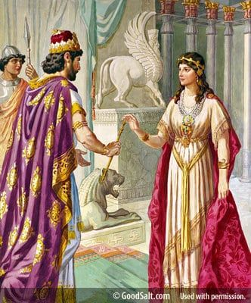
Esther
God’s Providence
God’s Care
for a
Careless People

Slide 2
Esther and Today’s World
Who would have ever thought that right after going through a pandemic we would be faced with the potential of World War III? No one could have imagined that the world could get more chaotic. No matter what TV station you turn on we see bombed out buildings, death and destruction and millions of people being displaced by violence and war. The Ukrainians never thought that this could happen to their country. I read an article that over 77% of Ukrainians claim to be believers. I am sure that they are asking; “where is God in all of this?”

Slide 3
Esther and Today’s World
I am sure the Israelites asked the same question when they were taken into captivity and forced to leave their land and take up residence in a foreign land. The reaction of each individual was different. Some resisted and couldn’t wait to get back to the Land of Israel. When Zerubbabel, Ezra and Nehemiah came along, they jumped at the chance to go back to Jerusalem. Others slowly assimilated into the Babylonian and Persian culture and became comfortable and had no desire to go back home. How have we as Christians assimilated into our culture over a long period of time? Do we as Christians take a stand against our culture or do we passively watch our culture change and adjust accordingly?

Slide 4
The Author of Esther
The unknown author of the book of Esther was most likely a Jew very familiar with the royal Persian court. The detailed descriptions of court life and traditions, as well as the events that occurred in the book, point to an eyewitness author.
Because his perspective was pro-Jewish, scholars believe he was a Jew writing for the remnant that had returned to Judah under Zerubbabel. Some have suggested Mordecai himself was the author, though the accolades for him found in the text suggest that another person, perhaps one of his younger contemporaries, was the author.

Slide 5
The Historical Setting of Esther
Esther was written in the same time period of Ezra, Nehemiah and records the story of those who became assimilated in the Persian culture and did not want to leave.
Historically it falls within the reign of King Ahasuerus/Xerxes I of the Persian empire from 485 to 465 B.C.
Xerxes I, commonly known as Xerxes the Great, was the fourth King of the Achaemenid Empire, ruling from 486 to 465 BC. He was the son and successor of Darius the Great and his mother was Atossa, a daughter of Cyrus the Great, the founder of the Achaemenid empire. [Wikipedia]

Slide 6
The Historical Setting of Esther

Slide 7
Historical Setting of Esther
“No sooner had Xerxes ascended the throne than first Egypt and then Babylon rebelled against him. He quelled both revolts. With this background, he was well equipped after the death of his father to take over Darius’ two unfinished tasks: the conquest of Greece and the completion of the royal palace at Persepolis. As everyone knows, Xerxes failed completely in the first. . . . But as only too few general readers know, Xerxes was highly successful in his second task: the building of the Persepolis.” John C. Whitcomb, Esther: Triumph of God’s Sovereignty, p. 31, citing Carey A. Moore, Esther, The Anchor Bible (Garden City, N.Y.: Doubleday, 1971), p. xxxviii.

Slide 8
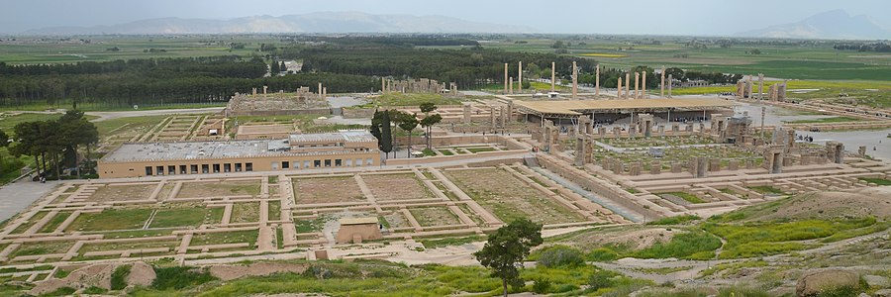
Xerxes’ Persepolis

Slide 9
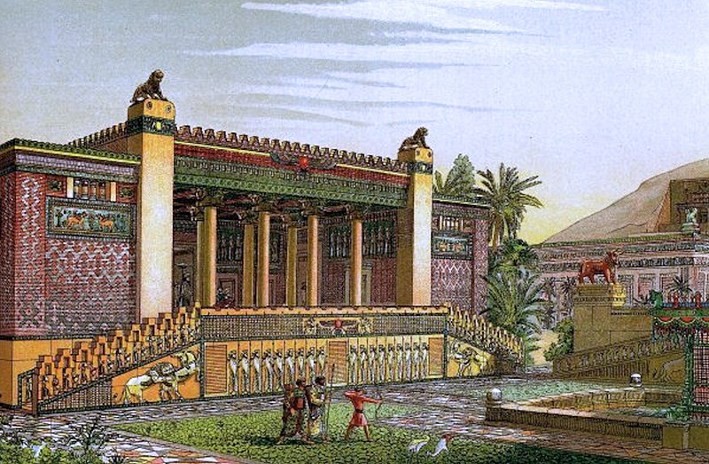
Xerxes’ Persepolis

Slide 10
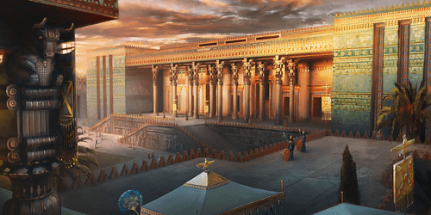
Xerxes’ Persepolis

Slide 11
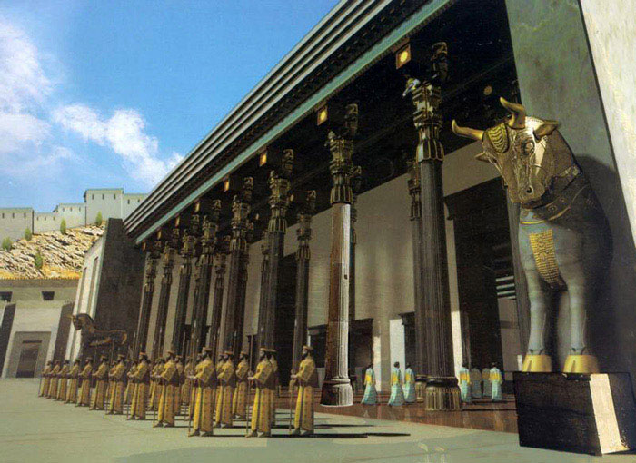
Xerxes’ Persepolis

Slide 12
Xerxes’ Persepolis

Slide 13
Xerxes’ Persepolis

Slide 14
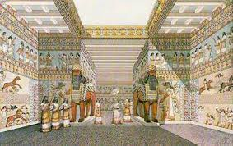
Xerxes’ Persepolis

Slide 15
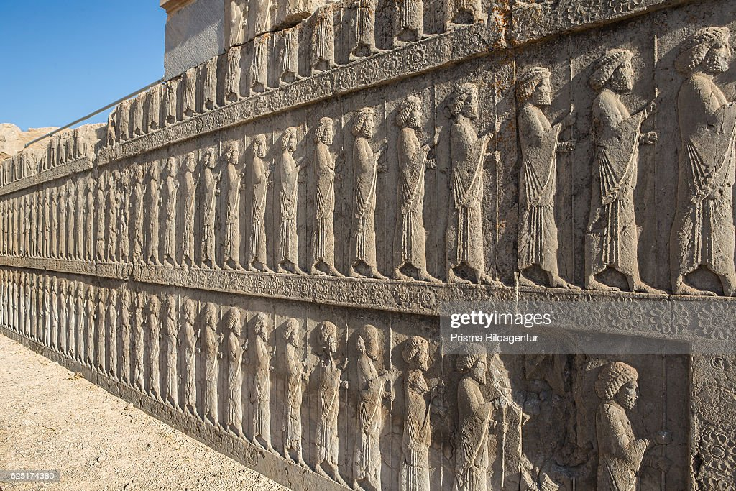
Xerxes’ Persepolis

Slide 16
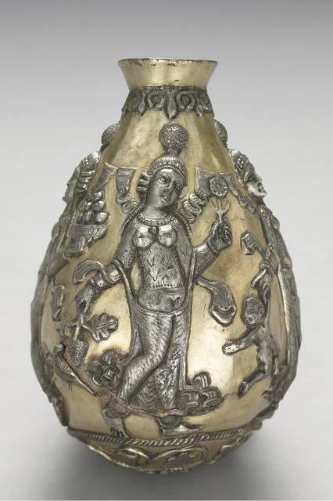
Persian Gods/Goddesses
Anahita (The Goddess of the Waters on the Earth)
Ahura Mazda - King of the Gods

Slide 17
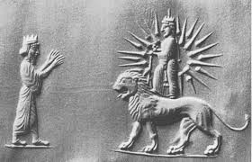
Persian Gods/Goddesses
Ishtar
Goddess of Fertility
Mithra (The God of the Sun)

Slide 18
Persian Women
Women in Persia were very honored and revered; they often had important positions in the Courthouse, Ministries, Military, State and Treasury Department, and other official administrations. Women were treated like Goddesses esteemed as mothers of creation before the barbaric invasion upon Persia.
The fortification tablets at the Ruins of Persepolis also reveals that men and women were represented in identical professions and that they received equal payments as skilled laborers and that gender was not a criterion at all (unlike our modern world).

Slide 19
Persian Women
One of the reasons that Ancient Persians held women in high regard might have been their religion. Zoroastrianism was the dominant religion, and its ideology that stressed men and women were equals.
Naturally, this would shape the worldview of Ancient Persians, and we can say that overall women were seen as important figures in society.
New mothers and pregnant women even received wages far above those of their male co-workers as gratitude.

Slide 20
Persian Women
The Star of Ishtar or Star of Inanna is a symbol of the ancient Persian and Sumerian goddess Inanna and her East Semitic counterpart Ishtar. Ishtar is mostly associated with the planet Venus, which is also known as the morning star.
It is interesting that Esther’s name in Hebrew is Hadassah which also mean star or morning star. Once again God is working behind the scenes Esther becoming the Queen of the Persian Empire. Esther is going to bring life out of death for the Jews living in Persia.

Slide 21
Xerxes conquest of Athens
Xerxes I was committed to follow through with the second task his father wanted accomplished.
“Xerxes, being about to take in hand the expedition against Athens, called together an assembly of the noblest Persians, to learn their opinions, and to lay before them his battle strategies.”
This is the probable reason for the seven days of banquets to woo his allies to join him. In the midst of the celebrations, he went too far and wanted to display the beauty of his wife Vashti.

Slide 22
Esther
God’s Care for a Careless People
Rise
Of
Esther
Rise
Of
Haman
Courage
Of
Esther
Plan
Of
Esther
Feast
Of
Purim
1:1 2:23 3:1 3:15 4:1 7:10 8:1 9:19 9:20 10:3
Party Power Purpose Protection Provision
King’s Favor
Haman’s Position
Mordecai’s Refusal
Mordecai’s Identity
Haman’s Disdain
Haman’s Complaint
Haman’s Plot
King’s Decree
Haman’s Bounty
City in Confusion
Mordecai’s Wailing
Jews Mourning
Jews fasting
Esther’s Anguish
Esther’s Inquiry
Esther’s Crisis
Esther’s Request
Haman’s Gallows
King’s Dream
Mordecai Honored
Haman Humiliated
Haman Caught
Haman hanged
King’s Gift to Esther
Mordecai Revealed
Esther’s Request
Decree Unchanged
King’s Response
Jews Armed
Mordecai’s News
Jews Rejoice
Jews Defense
Haman’s Sons Hanged
Jews Victory
Mordecai’s Report
Casting of the Pur
Feast of Purim
Esther’s Letter
Purim Established
Mordecai Elevated
Mordecai’s Legacy
King’s Request
Queen’s Refusal
King’s Counsel
Queen’s Demise
Beauty Pageant
Esther Taken
Hegai’s Kindness
Esther Chosen
Esther’s Secret
Mordecai’s Word
Esther’s Report
Assassins Killed
Issues
God not mentioned
Not Quoted in NT
No Law/Sacrifices
Fasting Mentioned
Prayer not mentioned
No Supernatural

Slide 23
God’s Promises to Israel
Abrahamic Covenant – Gen. 12:1-3
12:1 The Lord had said to Abram, “Go from your country, your people and your father’s household to the land I will show you. 2 “I will make you into a great nation, and I will bless you; I will make your name great, and you will be a blessing. 3 I will bless those who bless you, and whoever curses you I will curse; and all peoples on earth will be blessed through you.”
God promises – Land, Seed (nation) and Blessing

Slide 24
God’s Promises to Israel
Davidic Covenant – 2 Samuel 7:12-16
12 “When your days are fulfilled and you rest with your fathers, I will set up your seed after you, who will come from your body, and I will establish his kingdom. 13 He shall build a house for My name, and I will establish the throne of his kingdom forever. 14 I will be his Father, and he shall be My son. If he commits iniquity, I will chasten him with the rod of men and with the blows of the sons of men. 15 But My mercy shall not depart from him, as I took it from Saul, whom I removed from before you. 16 And your house and your kingdom shall be established forever before you. Your throne shall be established forever.”

Slide 25
God’s Promises to Israel
The New Covenant – Jeremiah 31:31-
31 “Behold, the days are coming, declares the Lord, when I will make a new covenant with the house of Israel and the house of Judah, 32 not like the covenant that I made with their fathers on the day when I took them by the hand to bring them out of the land of Egypt, my covenant that they broke, though I was their husband, declares the Lord. 33 For this is the covenant that I will make with the house of Israel after those days, declares the Lord: I will put my law within them, and I will write it on their hearts. And I will be their God, and they shall be my people. 34 And no longer shall each one teach his neighbor and each his brother, saying, ‘Know the Lord,’ for they shall all know me, from the least of them to the greatest, declares the Lord. For I will forgive their iniquity, and I will remember their sin no more.”

Slide 26
Take Aways
God is actively engaged in history and is working all things toward His purpose and design.
God is faithful to his promises and keeps his covenants.
God is always working behind the scenes especially in times of chaos and confusion.
God uses imperfect and weak people to carry out his plans.
Christians have to constantly evaluate how much we have assimilated into our societal norms and weigh that against what scripture requires.

