Slide 1
Intensive Intervention
June 20, 2018

Slide 2
Contact
Sarah R. Powell, Ph.D.
srpowell@austin.utexas.edu
@sarahpowellphd

Slide 3
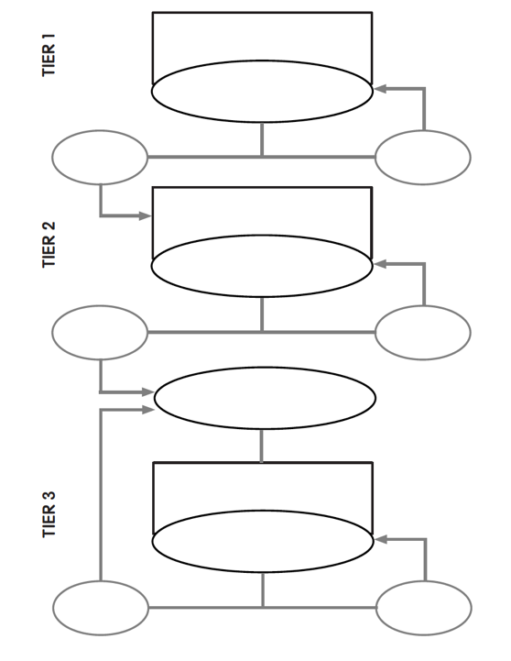
Tier 1

Slide 4
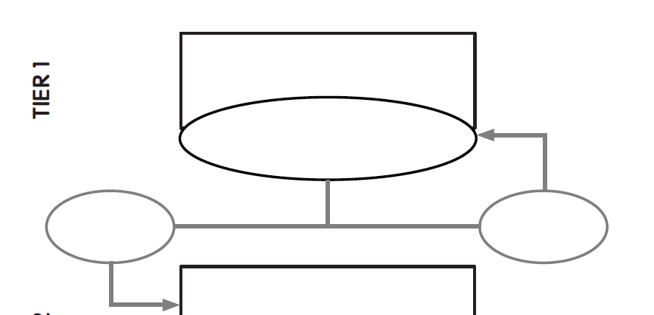
Evidence-based instruction
All students screened
At-risk students progress
monitored for 6-10 weeks
inadequate
response
adequate
response

Slide 5
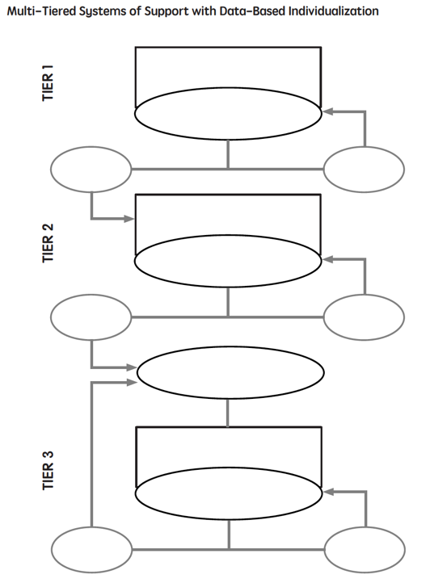
Intensive Intervention

Slide 6
Tier 2
Students are tutored in small groups using evidence-based practices
Tutoring takes place three or four times a week
Each tutoring session lasts 30 to 60 minutes
Tutoring lasts 10 to 20 weeks
Progress monitoring continues weekly

Slide 7
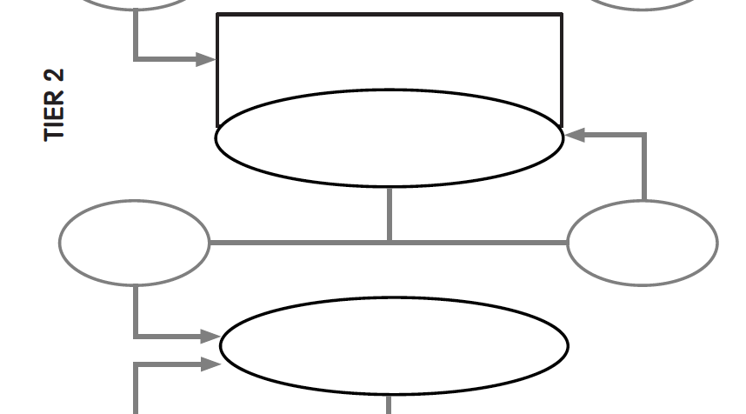
Evidence-based instruction provided in small groups
Progress monitoring for 10-20 weeks
inadequate
response
adequate
response
Diagnostic assessment

Slide 8
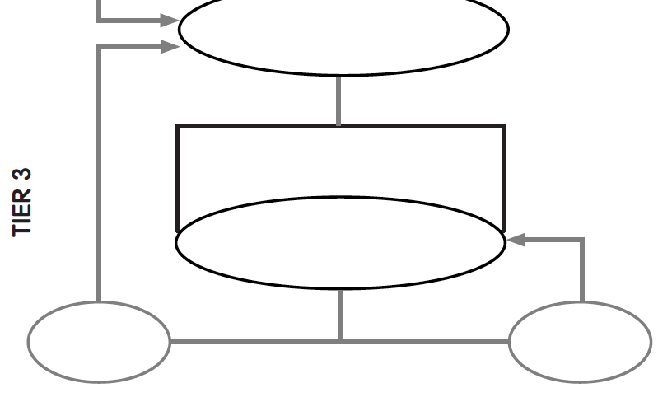
Diagnostic assessment
Evidence-based instruction provided individually or in small groups
Progress monitoring for 10-20 weeks
inadequate
response
adequate
response

Slide 9
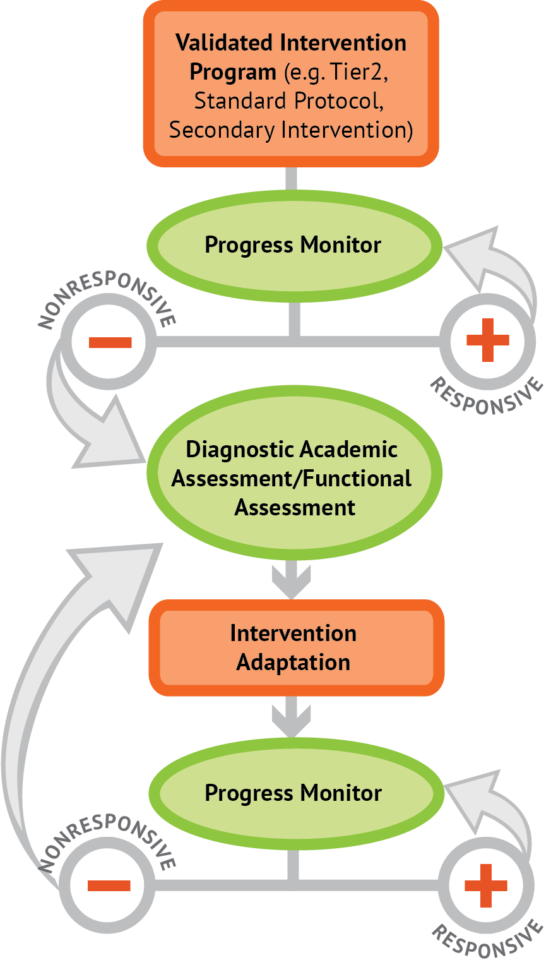
Intervention: Occurs frequently and with intensity
Assessment: Formative
Assessment: Diagnostic
Intervention adaptation: Content, dosage, explicit instruction, attention to transfer
Assessment: Formative

Slide 10
Instructional Platform
INSTRUCTIONAL DELIVERY
Explicit instruction
Multiple representations
Concise language
INSTRUCTIONAL STRATEGIES
Fluency building
Problem solving instruction
Motivation component

Slide 11
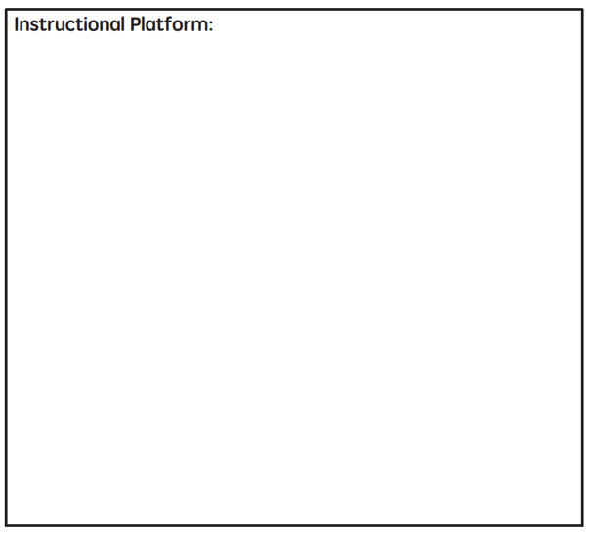

Slide 12
Explicit Instruction
Modeling
Practice
Clear Explanation
Guided
Practice
Planned
Examples
Independent Practice
Supporting Practices
Asking the right questions
Eliciting frequent responses
Providing immediate specific feedback
Maintaining a brisk pace

Slide 13
Goal and importance
“Today, we are learning about division. This is important because sometimes you have to share objects or things with your friends.”
Modeling
Practice
Clear Explanation
Guided
Practice
We Do
Planned
Examples
Independent Practice
“Let’s continue working with our three-dimensional shapes and volume. Understanding volume and calculating volume helps with measuring capacity.”
You Do
Supporting Practices
Asking the right questions
Eliciting frequent responses
Providing immediate specific feedback
Maintaining a brisk pace
Copyright 2018 Sarah R. Powell, Ph.D.

Slide 14
Goal and importance
Model steps
Modeling
Practice
Clear Explanation
Guided
Practice
“To solve 26 plus 79, I first decide about the operation. Do I add, subtract, multiply or divide?”
We Do
Planned
Examples
Independent Practice
“The plus sign tells me to add. So, I’ll add 26 plus 79. I’ll use the partial sums strategy. First, I add 20 plus 70. What’s 20 plus 70?”
You Do
Supporting Practices
“20 plus 70 is 90. I write 90 right here.”
Asking the right questions
Eliciting frequent responses
Providing immediate specific feedback
Maintaining a brisk pace
“Then I add 6 plus 7. What’s 6 plus 7?”
“6 plus 7 is 13. So, I write 13 here.”
“Finally, we add the partial sums: 90 and 13. 90 plus 13 is 103. So, 26 plus 79 equals 103.”
Copyright 2018 Sarah R. Powell, Ph.D.

Slide 15
Goal and importance
Model steps
Modeling
Practice
Clear Explanation
Concise language
Guided
Practice
We Do
Planned
Examples
Independent Practice
“To solve 26 plus 79, I first decide about the operation. Do I add, subtract, multiply, or divide?”
You Do
“The plus sign tells me to add. So, I’ll add 26 plus 79. I’ll use the partial sums strategy. First, I add 20 plus 70. What’s 20 plus 70?”
Supporting Practices
Asking the right questions
Eliciting frequent responses
Providing immediate specific feedback
Maintaining a brisk pace
“20 plus 70 is 90. I write 90 right here under the equal line.”
“Then I add 6 plus 7. What’s 6 plus 7?”
“6 plus 7 is 13. So, I write 13 here.”
“Finally, we add the partial sums: 90 and 13. 90 plus 13 is 103. So, 26 plus 79 equals 103.”
Copyright 2018 Sarah R. Powell, Ph.D.

Slide 16
Examples
“Today, we are learning about division. This is important because sometimes you have to share objects or things with your friends.”
Modeling
Practice
Clear Explanation
Guided
Practice
24 / 6
We Do
35 $)$ 5
28 $÷$ 7
Planned
Examples
Independent Practice
You Do
Supporting Practices
Asking the right questions
Eliciting frequent responses
Providing immediate specific feedback
Maintaining a brisk pace
Copyright 2018 Sarah R. Powell, Ph.D.

Slide 17
Examples
“Today, we are learning about division. This is important because sometimes you have to share objects or things with your friends.”
Modeling
Practice
Clear Explanation
Guided
Practice
24 / 6
We Do
35 $)$ 5
28 $÷$ 7
Planned
Examples
Independent Practice
You Do
With non-examples
Supporting Practices
Asking the right questions
Eliciting frequent responses
Providing immediate specific feedback
Maintaining a brisk pace
32 $÷$ 8
42 $÷$ 7
25 $−$ 5
Copyright 2018 Sarah R. Powell, Ph.D.

Slide 18
Modeling
Practice
Clear Explanation
Guided
Practice
Planned
Examples
Independent Practice
Supporting Practices
Asking the right questions
Eliciting frequent responses
Providing immediate specific feedback
Maintaining a brisk pace
Copyright 2018 Sarah R. Powell, Ph.D.

Slide 19
I Do
Modeling
Practice
Clear Explanation
Guided
Practice
Planned
Examples
Independent Practice
Supporting Practices
Asking the right questions
Eliciting frequent responses
Providing immediate specific feedback
Maintaining a brisk pace
Copyright 2018 Sarah R. Powell, Ph.D.

Slide 20
Teacher and student practice together
I Do
Modeling
Practice
Clear Explanation
Guided
Practice
Planned
Examples
Independent Practice
Supporting Practices
Asking the right questions
Eliciting frequent responses
Providing immediate specific feedback
Maintaining a brisk pace
Copyright 2018 Sarah R. Powell, Ph.D.

Slide 21
Teacher and student practice together
I Do
Student practices with teacher support
Modeling
Practice
Clear Explanation
Guided
Practice
Planned
Examples
Independent Practice
Supporting Practices
Asking the right questions
Eliciting frequent responses
Providing immediate specific feedback
Maintaining a brisk pace
Copyright 2018 Sarah R. Powell, Ph.D.

Slide 22
Modeling
Practice
Clear Explanation
Guided
Practice
Planned
Examples
Independent Practice
Supporting Practices
Asking the right questions
Eliciting frequent responses
Providing immediate specific feedback
Maintaining a brisk pace
Copyright 2018 Sarah R. Powell, Ph.D.

Slide 23
I Do
Modeling
Practice
Clear Explanation
Guided
Practice
We Do
Planned
Examples
Independent Practice
You Do
Supporting Practices
Asking the right questions
Eliciting frequent responses
Providing immediate specific feedback
Maintaining a brisk pace
Copyright 2018 Sarah R. Powell, Ph.D.

Slide 24
I Do
Modeling
Practice
Clear Explanation
Guided
Practice
Low-level and high-level
We Do
Planned
Examples
Independent Practice
You Do
“What is 7 times 9?”
“Which shape has 6 sides?”
Supporting Practices
“What do you do when you see a word problem?”
Asking the right questions
Eliciting frequent responses
Providing immediate specific feedback
Maintaining a brisk pace
“Why do you have to regroup?”
“How would you solve this problem?”
“Why do you have to use zero pairs?”
Copyright 2018 Sarah R. Powell, Ph.D.

Slide 25
I Do
Modeling
Practice
Clear Explanation
Guided
Practice
Low-level and high-level
We Do
Planned
Examples
Independent Practice
You Do
Classwide, individual, partner, write on paper, write on whiteboard, thumbs up, etc.
Supporting Practices
Asking the right questions
Eliciting frequent responses
Providing immediate specific feedback
Maintaining a brisk pace
“Turn and discuss the formula for perimeter with your partner.”
“Write the multiplication problem on your whiteboard.”
“In your math journal, draw a picture to help you remember to term parallelogram.”
Copyright 2018 Sarah R. Powell, Ph.D.

Slide 26
I Do
Modeling
Practice
Clear Explanation
Guided
Practice
Low-level and high-level
We Do
Planned
Examples
Independent Practice
You Do
Classwide, individual, partner, write on paper, write on whiteboard, thumbs up, etc.
Supporting Practices
Asking the right questions
Eliciting frequent responses
Providing immediate specific feedback
Maintaining a brisk pace
Affirmative and corrective
“Good work using your word-problem attack strategy.”
“Let’s look at that again. Tell me how you added in the hundreds column.”
Copyright 2018 Sarah R. Powell, Ph.D.

Slide 27
I Do
Modeling
Practice
Clear Explanation
Guided
Practice
Low-level and high-level
We Do
Planned
Examples
Independent Practice
You Do
Classwide, individual, partner, write on paper, write on whiteboard, thumbs up, etc.
Supporting Practices
Asking the right questions
Eliciting frequent responses
Providing immediate specific feedback
Maintaining a brisk pace
Affirmative and corrective
Planned and organized
Copyright 2018 Sarah R. Powell, Ph.D.

Slide 28
Modeling
Practice
Supporting Practices
Introduction of material
Review of material
Modeling
Practice
Modeling
Practice
Supporting Practices
Supporting Practices

Slide 29
How do you use explicit instruction within intensive intervention?
Model steps using concise language
Provide guided practice opportunities
Provide independent practice opportunities
Use supporting practices during modeling and practice
Ask the right questions
Elicit frequent responses
Provide feedback
Be planned and organized

Slide 30
Multiple Representations
Abstract
Representational
Concrete

Slide 31
Abstract
Representational
Concrete
Three-dimensional objects

Slide 32
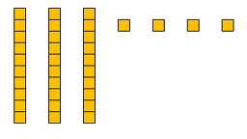
Abstract
Representational
Concrete
Two-dimensional images

Slide 33
Abstract
Representational
Concrete
Numerals and symbols
2 + 8 = 10
34 = 3 tens and 4 ones
x – 6 = 8
4,179
+ 569

Slide 34
How should multiple representations be used within intensive intervention?
Use three-dimensional concrete materials to teach concepts and procedures
Use two-dimensional representations to teach concepts and procedures
Ensure students understand mathematics with numbers and symbols (i.e., the abstract)

Slide 35
Focus on Language
precise
concise

Slide 36
Instead of…
Say…
“And the last one is 10.”
“8, 9, 10. We’ll stop counting there but we could count more.”
“What number is in the tens place?”
“What digit is in the tens place?”
“Six hundred and forty-eight”
“Six hundred forty-eight”
“Bigger number and smaller number”
“Number that is greater and the number that is less”
Hughes et al. (2016)

Slide 37
Instead of…
Say…
“Numbers in the fraction”
“This fraction is one number.”
“Top number and bottom number”
“Numerator and denominator”
“Reduce”
“Find an equivalent fraction”
“One point two nine”
“One and twenty-nine hundredths”
Hughes et al. (2016)

Slide 38
Instead of…
Say…
“Corner”
“Angle”
“Flips, slides, and turns”
“Reflections, translations, and rotations”
“Box or ball
“Cube or sphere”
“Long hand and short hand”
“Minute hand and hour hand”
Hughes et al. (2016)

Slide 39
How do you attend to language within intensive intervention?
Understand why formal mathematical language is important
Plan for mathematical language to be precise
Plan for mathematical language to be concise

Slide 40
Fluency
Addition
Subtraction
Multiplication
Division
Students must understand the concepts
Students should learn and use strategies to solve the facts
Students should develop fluency with facts

Slide 41
How to build fact fluency within intensive intervention?
Teach the concepts of the operations
Teach strategies to understand how facts fit together
Practice building fluency with a variety of activities and games

Slide 42
Problem Solving
SIGNS
Survey questions
Identify key words
Graphically draw problem
Note operations
Solve and check
SOLVE
Study the problem.
Organize the facts.
Line up the plan.
Verify the plan with computation.
Examine the answer.

Slide 43
Problem Solving
When teaching about word problems, students should learn the schema of the word problem.
Jitendra & Star (2011); Riley & Greeno (1988); Van de Walle, Karp, & Bay-Williams (2010)
Additive
Multiplicative
Total
Equal Groups
Difference
Comparison
Change
Ratios/
Proportions

Slide 44
How do you incorporate effective problem-solving strategies within intensive intervention?
Don’t use key words tied to operations
Do teach students an attack strategy
Do teach students schemas
Do explicitly teach problem solving
Do provide problem-solving instruction regularly (i.e., several times a week)
Do practice schemas that students will encounter regularly

Slide 45
Motivation Component
on task
keep attention
regulate behavior

Slide 46
How do you incorporate a motivational component within intensive intervention?
Utilize a motivational component, when necessary

Slide 47
Instructional Platform
INSTRUCTIONAL DELIVERY
Explicit instruction
Multiple representations
Concise language
INSTRUCTIONAL STRATEGIES
Fluency building
Problem solving instruction
Motivation component

Slide 48
Instructional Platform

Slide 49
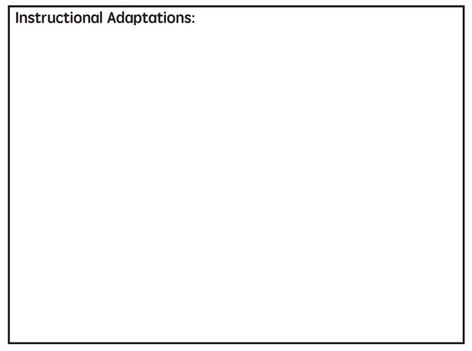

Slide 50
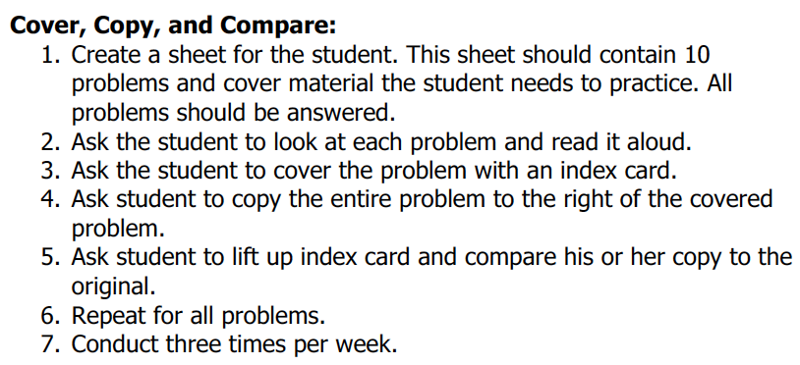
Implement with greater fidelity
Adaptation
Ensure that you are implementing the intervention or strategy with fidelity

Slide 51
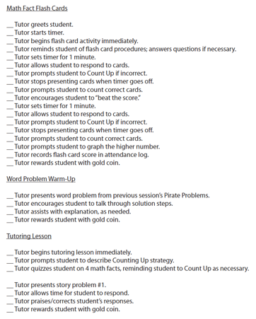
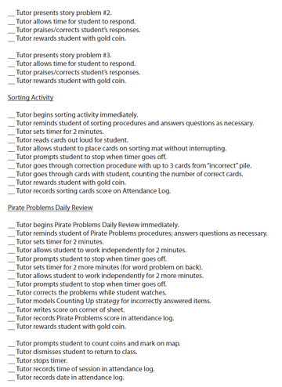
Implement with greater fidelity
Adaptation
Ensure that you are implementing the intervention or strategy with fidelity
Fuchs et al. (2008)

Slide 52
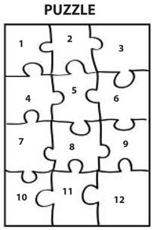
Implement with greater fidelity
Adaptation
Embed behavioral supports
May want to incorporate strategies to improve self-regulation and minimize nonproductive behavior
Powell, Driver, & Julian (2015)

Slide 53
Implement with greater fidelity
Adaptation
Embed behavioral supports
May want to incorporate strategies to improve self-regulation and minimize nonproductive behavior
UPSCheck
Understand
Plan
Solve
Check

Slide 54
Implement with greater fidelity
Adaptation
Embed behavioral supports
Increase dosage
Conduct longer sessions, more sessions per week, or more weeks within DBI

Slide 55
Implement with greater fidelity
Adaptation
Embed behavioral supports
Increase dosage
Conduct longer sessions, more sessions per week, or more weeks within DBI

Slide 56
Implement with greater fidelity
Adaptation
Embed behavioral supports
Increase dosage
Conduct longer sessions, more sessions per week, or more weeks within DBI
Number of weeks left in intervention

Slide 57
Implement with greater fidelity
Adaptation
Embed behavioral supports
Increase dosage
Adapt mathematics content

Slide 58
Implement with greater fidelity
Adaptation
Embed behavioral supports
Increase dosage
Adapt mathematics content
Where student IS
Where student NEEDS TO BE
Alter the scope and sequence
Explain why addition and subtraction strategies work, using place value and the properties of operations.
Use addition and subtraction within 100 to solve one- and two-step word problems…
Fluently add and subtract within 100 using strategies based on place value, properties of operations, and/or relationships.
Apply properties of operations as strategies to multiply and divide….
Fluently multiply and divide within 100, using strategies such as the relationship between multiplication and division…
Understand that the three digits of a three-digit number represent amounts of hundreds, tens, and ones.
Find whole number quotients and remainders with up to four-digit dividends and one-digit divisors, using strategies based on place value, …
Solve multi-step word problems posed with whole numbers and having whole-number answers using the four operations…
Understand that the two digits of a two-digit number represent amounts of tens and ones.
Use multiplication and division within 100 to solve word problems…
Fluently add and subtract multi-digit whole numbers using the standard algorithm.
Fluently multiply multi-digit whole numbers using the standard algorithm.
continuum of mathematics learning

Slide 59
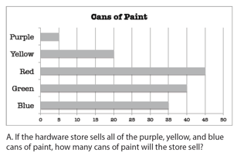
Implement with greater fidelity
Adaptation
Embed behavioral supports
Increase dosage
Solve
Adapt mathematics content
Write equation
Break down problems into smaller steps
Draw picture
Identify schema
Label graph
Underline labels
Read the problem

Slide 60
Implement with greater fidelity
Adaptation
Embed behavioral supports
Increase dosage
Adapt mathematics content
precise
Focus on the language of mathematics
concise

Slide 61
Implement with greater fidelity
Adaptation
Embed behavioral supports
Increase dosage
Adapt mathematics content
Define: | Characteristics:
Example: | Non-example:
Focus on the language of mathematics
MATH JOURNAL

Slide 62
Implement with greater fidelity
Adaptation
Embed behavioral supports
Increase dosage
“Tell me how you solved this problem.”
Adapt mathematics content
“What were you thinking about when you regrouped?”
Engage student in more discourse
“How would you teach this problem to another student?”
“Describe the word problem in 10 words or less.”

Slide 63
Implement with greater fidelity
Adaptation
Embed behavioral supports
Increase dosage
“Talk through this problem with me.”
Adapt mathematics content
Provide worked examples
405
+ 16
405
+ 16
411
421

Slide 64
Implement with greater fidelity
Adaptation
Embed behavioral supports
Increase dosage
Adapt mathematics content
Utilize more three-dimensional representations
Abstract
Representational
Concrete

Slide 65
Implement with greater fidelity
Adaptation
Embed behavioral supports
Increase dosage
Adapt mathematics content
Utilize more two-dimensional representations
Abstract
Representational
Concrete

Slide 66
Implement with greater fidelity
Adaptation
Embed behavioral supports
Increase dosage
Adapt mathematics content
Ensure student understand the abstract
Abstract
Representational
Concrete

Slide 67
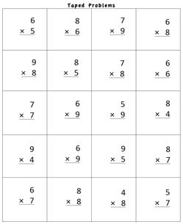
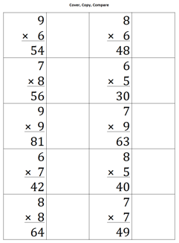
Implement with greater fidelity
Adaptation
Embed behavioral supports
Increase dosage
Adapt mathematics content
Focus on fact fluency

Slide 68
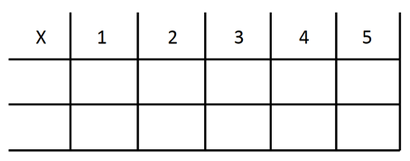
Implement with greater fidelity
Adaptation
Embed behavioral supports
Increase dosage
Adapt mathematics content
Focus on other types of fluency
-3 + (-4) = ___ 5 – (-6) = ___

Slide 69
Implement with greater fidelity
Adaptation
Embed behavioral supports
Increase dosage
Adapt mathematics content
Teach alternate algorithms

Slide 70
Implement with greater fidelity
Adaptation
Embed behavioral supports
Increase dosage
Adapt mathematics content
Explicitly teach problem solving
Additive
Multiplicative
Total
Equal Groups
Difference
Comparison
Change
Ratios/
Proportions

Slide 71
Implement with greater fidelity
Adaptation
Embed behavioral supports
Increase dosage
Adapt mathematics content
Encourage alternate methods and solutions
405
+ 16
405
+ 16
400
10
11
421
421
+

Slide 72
Implement with greater fidelity
Adaptation
Embed behavioral supports
Increase dosage
Adapt mathematics content
Modeling
Practice
Utilize explicit instruction
Clear Explanation
Guided
Practice
Make sure you’re doing it! And do it well!
Planned
Examples
Independent Practice
Supporting Practices
Asking the right questions
Eliciting frequent responses
Providing immediate specific feedback
Maintaining a brisk pace

Slide 73
Implement with greater fidelity
Adaptation
Embed behavioral supports
Increase dosage
405
+ 16
4305
+ 216
Adapt mathematics content
Utilize explicit instruction
Explicitly teach transfer
Marney baked 89 cookies and sold 40 cookies at the bake sale. How many cookies does Marney have left?
Explicitly teach how current learning relates to other learning
Marney had $89 and spent $40 on shoes. How many much does Marney have left?
Marney had $89 and spent $40 on shoes. How much money will Marney have after buying the shoes?

Slide 74
Implement with greater fidelity
Adaptation
Embed behavioral supports
Increase dosage
Adapt mathematics content
Utilize explicit instruction
Explicitly teach transfer

Slide 75
Instructional Platform
INSTRUCTIONAL DELIVERY
Explicit instruction
Multiple representations
Concise language
INSTRUCTIONAL STRATEGIES
Fluency building
Problem solving instruction
Motivation component

Slide 76
Contact
Sarah R. Powell, Ph.D.
srpowell@austin.utexas.edu
@sarahpowellphd

