Slide 1
Rethinking Patient Care in Endometrial and Cervical Cancer How Nurses Can Lead the Targeted and Immunotherapeutic Revolution
Kimberly Halla, MSN, FNP-C Family Nurse Practitioner
Arizona Oncology Associates PC
Scottsdale, Arizona

Slide 2
Faculty Disclosures
Kimberly Halla, MSN, FNP-C, has a financial interest/relationship or affiliation in the form of:
Speakers Bureau participant with GlaxoSmithKline and Merck & Co., Inc.

Slide 3
Planning Committee Disclosures
The planners from Medical Learning Institute, Inc., the accredited provider, and PVI, PeerView Institute for Medical Education, the joint provider, do not have any financial relationships with an ACCME-defined commercial interest related to the content of this accredited activity during the past 12 months unless listed below.

Slide 4
Disclosure of Unlabeled Use
This educational activity may contain discussions of published and/or investigational uses of agents that are not indicated by the FDA. The planners of this activity do not recommend the use of any agent outside of the labeled indications. The opinions expressed in the educational activity are those of the faculty and do not necessarily represent the views of the planners. Please refer to the official prescribing information for each product for discussion of approved indications, contraindications, and warnings.
Disclaimer
Participants have an implied responsibility to use the newly acquired information to enhance patient outcomes and their own professional development. The information presented in this activity is not meant to serve as a guideline for patient management. Any procedures, medications, or other courses of diagnosis or treatment discussed or suggested in this activity should not be used by clinicians without evaluation of their patient's conditions and possible contraindications and/or dangers in use, review of any applicable manufacturer's product information, and comparison with recommendations of other authorities.

Slide 5
Housekeeping Notes
Thank you for taking time out of your busy schedules to attend this virtual CNE activity, jointly provided by Medical Learning Institute, Inc. and PVI, PeerView Institute for Medical Education.
We would like to thank GlaxoSmithKline, Merck & Co., Inc., and Seattle Genetics for making this event possible through the provision of educational grants supporting this activity.
You should have received a link to an online post-test and program evaluation. In order to receive CNE credit you must complete the online post-test and evaluation at the conclusion of the meeting.
Post-test and Evaluation: PeerView.com/GynOnc-Survey-FDM
Your evaluation of the program is very important in helping us to better meet your current and future medical education needs. We welcome your opinions and comments.
Please feel free to submit questions by entering them in the chat box.
Notes:
CME: General notes for the speaker

Slide 6
Pre-Test Polling Questions

Slide 7
Polling Question 1
Please rate your knowledge of new evidence and ongoing studies testing checkpoint inhibitors and tyrosine kinase inhibitors in patients with advanced endometrial cancer.
I’m not familiar with current evidence/ongoing trials in this area
Limited
Average
Good
I’m confident in my knowledge of the current evidence in ongoing studies testing these agents in endometrial cancer
Notes:
CME New

Slide 8
Polling Question 2
Please rate your knowledge of new evidence and ongoing studies testing checkpoint inhibitors and emerging agents (eg, ADCs) in patients with advanced cervical cancer.
I’m not familiar with current evidence/ongoing trials in this area
Limited
Average
Good
I’m confident in my knowledge of the current evidence in ongoing studies testing these agents in advanced cervical cancer
Notes:
CME New

Slide 9
Polling Question 3
How often do you discuss clinical trial enrollment with eligible patients who have advanced endometrial or cervical cancer?
Never
Infrequently
Sometimes
Always
N/A for me
Notes:
CME New

Slide 10
Polling Question 4
How often do you counsel patients receiving IO, TKI, or ADC therapies on appropriate strategies to prevent and/or manage class effect toxicities (such as fatigue and GI symptoms, among others)?
Never
Infrequently
Sometimes
Always
N/A for me
Notes:
CME New

Slide 11
Polling Question 5
How often do you discuss with patients the importance of reporting adverse events immediately, rather than waiting for their next scheduled visit, especially if on a combination regimen?
Never
Infrequently
Sometimes
Always
N/A for me
Notes:
CME New

Slide 12
Recent Updates in Endometrial Cancer

Slide 13
Endometrial Cancer Snapshot: SEER Data¹
How Common Is This Cancer?
Percent of New Cases by Age Group: Uterine Cancer
3.6%
Median Age at Diagnosis
Uterine cancer represents 3.6% of all new cancer cases in the U.S.
63
Percent of Cases by Stage
5-Year Relative Survival
5-Year Relative Survival
Localized (67%)
Confined to primary site
Regional (21%)
Spread to regional lymph nodes
Distant (9%)
Cancer has metastasized
Unknown (3%)
Unstaged
95%
69%
81.2%
52.9%
16.8%

Slide 14
Uterine Cancer: Age-Adjusted New Cases and Deaths—SEER, 1975-2017 (All Races)¹
1975 | 1980 | 1985 | 1990 | 1995 | 2000 | 2005 | 2010 | 2017
Rate of New Cases
Death Rate

Slide 15
Endometrial Cancer Stage and Survival¹
Trends in Age-Adjusted Uterine Cancer Incidence Rates, by Racial/Ethnic Group—United States, 1999-2015
Trends in Age-Adjusted Uterine Cancer Death Rates, by Racial/Ethnic Group—United States, 1999-2016
Black (AAPC = 1.5)
White (AAPC = 1.0)
AI/AN (AAPC = 1.4 [NS])
Overall (AAPC = 1.1)
Hispanic (AAPC = 1.7)
API (AAPC = 2.5)
Rate of Uterine Cancer per 100,000 Women
Rate of Uterine Cancer Deaths per 100,000 Women
Black (AAPC = 2.4)
White (AAPC = 0.5)
AI/AN (AAPC = 2.7)
Overall (AAPC = 0.7)
Hispanic (AAPC = 1.8)
API (AAPC = 2.0)
Time of Diagnosis, y
Time of Death, y
Incidence increased 12%
Death rates increased 21%

Slide 16
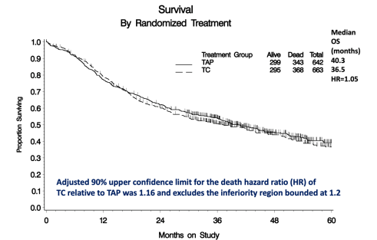
NCCN Guidelines: Recurrent, Metastatic or High-Risk Disease¹
NCCN Guidelines Version 1.2020
Endometrial Carcinoma
NCCN Evidence BlocksTM
Systemic Therapy for Recurrent, Metastatic, or High-Risk Disease
Chemotherapy Regimens
Preferred Regimens
Carboplatin/paclitaxel (category 1 for carcinosarcoma)
Carboplatin paclitaxel/trastuzumab (for stage III/IV or recurrent HER2+ uterine serous carcinoma)
Other Recommended Regimens
Carboplatin/docetaxel
Cisplatin/doxorubicin
Cisplatin/doxorubicin/paclitaxel
Cisplatin/paclitaxel/bevacizumab
Cisplatin
Carboplatin
Doxorubicin
Liposomal doxorubicin
Paclitaxel
Albumin-bound paclitaxel
Topotecan
Useful in Certain Circumstances
Pembrolizumab (for MSI-H/dMMR tumors)
Larotrectinib or entrectinib for NTRK gene fusion-positive tumors (category 2B)
Adjuvant Treatment When Used for Uterine-Confined-Disease Preferred Regimens
Carboplatin/paclitaxel
GOG 209 established
paclitaxel carboplatin as SOC²
Hormone Therapy Preferred Regimens
Medroxyprogesterone acetate/tamoxifen (alternating)
Megestrol acetate/tamoxifen (alternating)
Progestational agents
Medroxyprogesterone acetate
Megestrol acetate
Levonorgestrel IUD (for select fertility-sparing cases)
Aromatase inhibitors
Tamoxifen
Fulvestrant
Other Recommended Regimens
Everolimus letrozole (for endometrioid histology)
Bevacizumab
Temsirolimus
Docetaxel (category 2B)
Lenvatinib/pembrolizumab
Ifosfamide (for carcinosarcoma)
Ifosfamide/paclitaxel (for carcinosarcoma)
Cisplatin/ifosfamide (for carcinosarcoma)
OS vs Trastuzumab, All Evaluable Subjects
With Number of Subjects at Risk
HR: 0.581; 90% CI: 0.339-0.994;
P = .0462
No | 28 | 23 | 15 | 6 | 5 | 5 | 4 | 1
Yes | 30 | 28 | 21 | 10 | 7 | 4 | 0
Trastuzumab
No
Yes
Addition of trastuzumab based
on OS data for UPSC³

Slide 17
Treatment Options
Immune checkpoint inhibitors
Combinations (chemotherapy, VEGF inhibition)

Slide 18
Shifting the Paradigm: Changing the Focus to Molecular Classification
Low responses with chemotherapy (GOG 129 series)
ORR <15% with most chemotherapy agents¹
Low responses with targeted agents (GOG 229 series)
Only bevacizumab, aflibercept, brivanib, and cediranib met the bar for further study²
Improved responses with checkpoint inhibitors (anti–PD-1)
KEYNOTE-028: ORR 13%; 24 PD-L1–positive tumors³
KEYNOTE-158: ORR 57%; 49 MSI-H tumors⁴

Slide 19
A Quick Guide to How Immunotherapy Works…
Normally, cancer cells can avoid detection by the body’s immune system (T cells)
T Cell
Cancer Cell

Slide 20
…As an Anti-Cancer Strategy
A new class of drugs, immune checkpoint inhibitors, “takes the brakes off” the body’s immune system, and allows T cells to attack and destroy cancer cells
Immunotherapy enhances the ability of T cells to attack cancer cells

Slide 21
PD-1 and PD-L1 Inhibition
Tumor cell
T cell
TCR
+
Activated
+
Inactivated
-
PD-L1
PD-1

Slide 22
PD-1 and PD-L1 Inhibition
Tumor cell
T cell
TCR
+
Activated
+
Activated
PD-L1
PD-1

Slide 23
Anti–PD-1 Agents in the Second-Line Setting
Single agent
Pembrolizumab¹
Keynote-028 trial was performed in multiple tumor types
Dostarlimab²
GARNET trial
Dual agent
Pembrolizumab + lenvatinib³
FDA-approved combination

Slide 24
KEYNOTE-028: Endometrial Cancer Highlights¹
Study design
N = 24 locally advanced/metastatic EC (all subtypes) that progressed after standard treatment
Treatment: Pembrolizumab 10 mg/kg every 2 weeks for up to 24 months or until progression/unacceptable toxicity
Primary endpoint: ORR by RECIST
Secondary endpoints: safety/ tolerability; DOR, PFS, OS
Results:
Primary endpoint (ORR):13.0%
Secondary endpoints (PFS and OS)
Take Home
PFS, %
Time, mo
No. at Risk
 | 23 | 5 | 4 | 3 | 3 | 0
Pembrolizumab is effective in patients with advanced EC
OS, %
FDA approved
FDA indication
Time, mo
No. at Risk
 | 23 | 15 | 13 | 9 | 5 | 2 | 0

Slide 25
Phase 1/2 GARNET Trial: Dostarlimab in Recurrent or Advanced MSI-H/MSS EC¹
Part 1 Dose finding
Part 2A
Fixed-dose safety run-in
Part 2B
Expansion cohorts
A1ª: MSI-H/MSS
Best Overall Response | MSI-H (n = 41) | MSS (n = 79) | MSI Status unknown (n = 5) | Total (N = 125)
Overall response rate, n (%) [95% CI] | 20 (48.8) [32.9-64.9] | 16 (20.3) [12.0-30.8] | 1 (20.0) [0.5-71.6] | 37 (29.6) [21.8-38.4]
Complete response, n (%) | 2 (4.9) | 4 (5.1) | 0 (0) | 6 (4.8)
Partial response, n (%) | 18 (43.9) | 12 (15.2) | 1 (20.0) | 31 (24.8)
Disease control rate, % [95% CI] | 63.4 [46.9-77.9] | 46.8 [35.5-58.4] | 60.0 [14.7-94.7] | 52.8 [43.7-61.8]
Response ongoing, % | 85.0 | 81.3 | 100 | 83.8
The treatment was tolerable and the infusion schedule was favorable

Slide 26
GARNET: Updated Efficacy Results¹
Patients with progression after prior platinum doublet regimen
Interim analysis, N = 70
ORR at 11.2 months: n = 30 (42%; 95% CI, 31-55)
Take Home
Best overall response
by RECIST v1.1
CR
PR
SD
PD
NE
Ongoing
Dostarlimab is effective in recurrent or advanced MSI-H, MSS, and dMMR EC progression after platinum doublet regimen
Best Change From Baseline in
Target Lesion Size, %
Investigational
Patients
The ongoing phase 3 RUBY trial is directly comparing carboplatin + paclitaxel with placebo or dostarlimab in patients with recurrent or primary advanced EC (NCT03981796)²

Slide 27
Rationale for Combinations^{1,2}
Promoting the presentation of tumor antigens
Advantages of combination immunotherapy
Increasing the infiltration of T cells and the activity of CTLs
Enhancing the immunogenicity of tumor cells
Limitations of PD-1/L1 blockade
Eliminating or reducing the efficacy of immunosuppressive molecules
Relapse and recurrence of tumor
Lack of accurate prediction indicators
irAEs
Combination approaches
Combination with chemotherapy
Different response rates in patients with homologous tumors
Combination with radiotherapy
Combination with targeted therapy
Hyperprogression following checkpoint blockade treatment
Combination with other immunotherapy

Slide 28
KEYNOTE-146: Phase 2 Trial of Lenvatinib Plus Pembrolizumab in Patients With EC¹⁻³
Eligibility Criteria
Age ≥18 years
Metastatic EC (unselected for MSI or PD-L1)
ECOG PS 0-1
≤2 previous systemic therapies
Measurable disease according to irRECIST
Life expectancy of ≥12 weeks
N = 357
Lenvatinib 20 mg/day orally + pembrolizumab 200 mg IV every 3 weeks
Until disease progression, development of unacceptable toxic effects, or withdrawal of consent
Primary endpoint: ORR at week 24
Secondary endpoints: Overall ORR, DOR, PFS, OS, DCR, CBR, DSDR, no. of patients with TEAEs and treatment-emergent SAEs, AUC of lenvatinib, and apparent clearance of lenvatinib

Slide 29
KEYNOTE-146: Final Efficacy Results¹
Patients with progression after previous systemic treatment (N = 108)
ORR at week 24 = 41 (38.0%; 95% CI 28.8-47.8)ª
Take Home
Histology Subtypes
Endometrioid adenocarcinoma Clear cell adenocarcinoma
Serous adenocarcinoma Other
PD-1/PD-L1 Status:
+
o
Maximum tumor shrinkage
>0% = 72/84 (85.7%)
≥50% = 26/84 (31.0%)
≥75% = 13/84 (15.5%)
Positive Not Available
+
+
+
+
+
+
Pembrolizumab + lenvatinib is effective in patients with advanced EC
Change in Sum of Diameters of Target Lesions From Baseline, %^{b}
+
+
+
+
+
+
+
+
+
+
+
+
+
+
o
o
+
+
+
+
+
+
+
+
+
+
+
o
o
o
+
+
+
+
+
+
+
+
+
+
o
+
30%
50%
75%
FDA approved
In September 2019, the FDA approved lenvatinib + pembrolizumab for the treatment of patients with advanced EC that is not MSI-H or dMMR who have disease progression following prior systemic therapy²
A randomized phase 3 trial of lenvatinib + pembrolizumab (study 309/KEYNOTE-775 [NCT03517449]) for patients who have received ≤1 prior therapies is currently enrolling³
FDA indication

Slide 30
Summary of New Developments for Endometrial Cancer Care
Traditionally, these patients have limited treatment options, representing a high unmet need
Checkpoint inhibitor monotherapy is promising
Pembrolizumab is approved for second-line therapy in MSI-H/dMMR tumors
Dostarlimab treatment resulted in a robust ORR in patients with recurrent or advanced EC (MSI-H, MSS, dMMR) that had progressed on prior therapy, with durable responses
Pembrolizumab + lenvatinib combination has accelerated FDA approval for second-line therapy in MSS tumors

Slide 31
Polling Question 1
Please re-assess your knowledge of new evidence and ongoing studies testing checkpoint inhibitors and tyrosine kinase inhibitors in patients with advanced endometrial cancer.
I’m not familiar with current evidence/ongoing trials in this area
Limited
Average
Good
I’m confident in my knowledge of the current evidence in ongoing studies testing these agents in endometrial cancer

Slide 32
Recent Updates in Cervical Cancer

Slide 33
Cervical Cancer Snapshot: SEER Data^{1,2}
How Common Is This Cancer?
Percent of New Cases by Age Group: Cervical Cancer
Cervical cancer is most frequently
diagnosed among women aged 35-44
Cervical cancer represents 0.8% of
all new cancer cases in the U.S.
Median Age at Diagnosis
50
22.8%
22.5%
19.7%
Percent of New Cases
13.8%
12.0%
6.4%
2.7%
0.8%
0.1%
Percent of Cases by Stage
Age
5-Year Relative Survival
4%
Localized (44%)
Confined to primary site
91.8%
5-Year Relative Survival
66.1%
2010-2016
16%
Regional (36%)
Spread to regional lymph nodes
44%
57.6%
Distant (16%)
Cancer has metastasized
Percent surviving
49.7%
Unknown (4%)
Unstaged
16.8%
36%
Stage

Slide 34
Chemoradiation for Early Stage/Locally Advanced Disease¹
Chemoradiation
Preferred Regimens Cisplatin Carboplatin if patient is cisplatin intolerant Other Recommended Regimens Cisplatin + fluorouracil

Slide 35
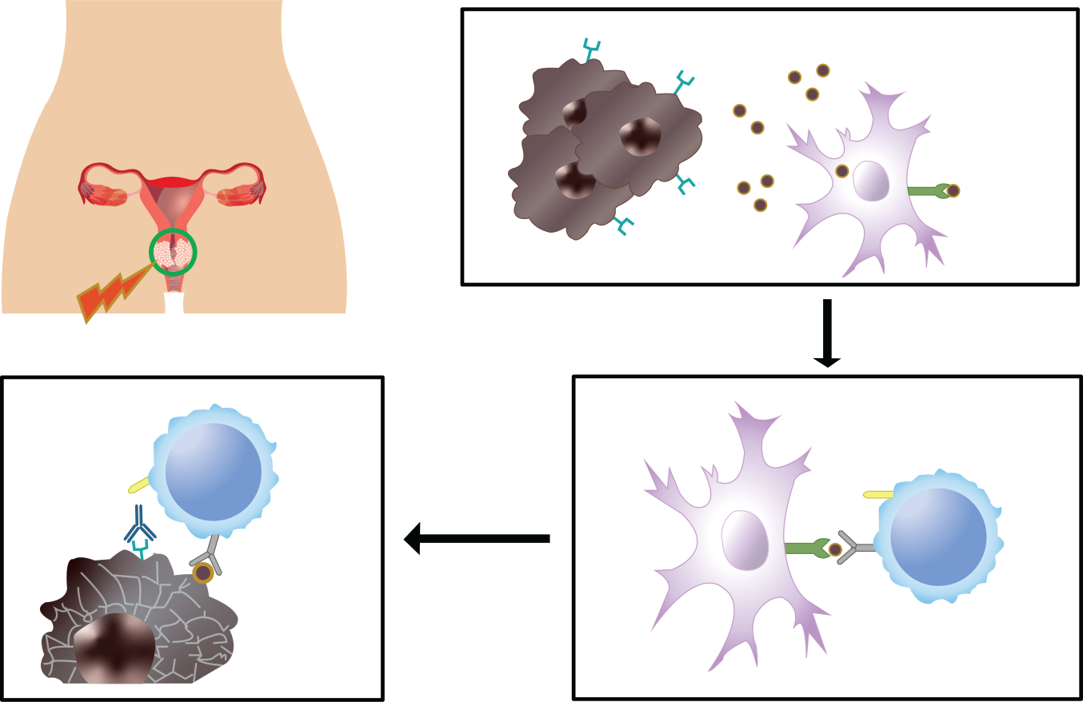
Chemoradiation + PD-L1 Blockade
Chemoradiation induces tumor cell death,
activates IC, and promotes tumor cell phagocytosis
Phase 1 NCT01711515¹: SOC CRT followed by ipilimumab
Tolerable safety
12-month OS: 90%
PFS: 81%
PD-L1
HPV triggers ↑ PD-L1
Tumor cell antigen
↑ IFN
↑ HMGB1
↑ ATP
↑ CRT
Fallopian
tube
SOC
Uterus
IC
Ovary
MHC I or II
Cervical tumor
Endometrium
Tumor cells
Vagina
Chemoradiation
Ongoing
PD-1
CD8⁺
T cell
PD-1
Phase 3 CALLA²: SOC CCRT vs durvalumab + SOC CCRT followed by durvalumab monotherapy
Durvalumab
T-cell
receptor
IC
CD8⁺
T cell
PD-L1
T-cell receptor
Tumor cell antigen
MHC I or II
Tumor cell death
PD-L1 blockade disinhibits
chemoradiation immunogenicity
IC activates CD8⁺ T cell

Slide 36
A Randomized Phase 2 Study of Chemoradiation and Pembrolizumab for Locally Advanced Cervical Cancer: Design^{1,2}
ARM 1: Pembrolizumab After CRT
Cisplatin 40 mg/m² weekly for 5-6 weeks
CCRT: EBRT plus brachytherapy
3 cycles of consolidative pembrolizumab: 200 mg every 21 days beginning week 9 for 3 cycles
Eligibility criteria
Squamous, adenosquamous, adenocarcinoma of the cervix
Stages IB2-IVA or IB1 with positive nodes (FIGO 2009)
ECOG PS of 0-2
1:1
R
ARM 2: Pembrolizumab During CRT
Cisplatin 40 mg/m² weekly for 5-6 weeks
3 cycles of concurrent pembrolizumab: 200 mg every 21 days beginning day 1 for 3 cycles
CCRT: EBRT plus brachytherapy
Primary endpoint: Safety
Secondary endpoint: CR, PFS, OS

Slide 37
A Randomized Phase 2 Study of Chemoradiation and Pembrolizumab for Locally Advanced Cervical Cancer: Safety^{1,2}
AE to any treatment:
≥1 grade 4 AE
(n = 11)
≥1 grade 3 AE
(n = 12)
Diarrhea (n = 35)
Grade 1 (n = 27)
Grade 2 (n = 6)
Grade 3 (n = 2)
No pulmonary AEs
Rash
(n = 3, all grade 1)
3 dose-limiting toxicity events in 2 patients:
Grade 3 diarrhea
Grade 3 nausea
Grade 3 vomiting

Slide 38
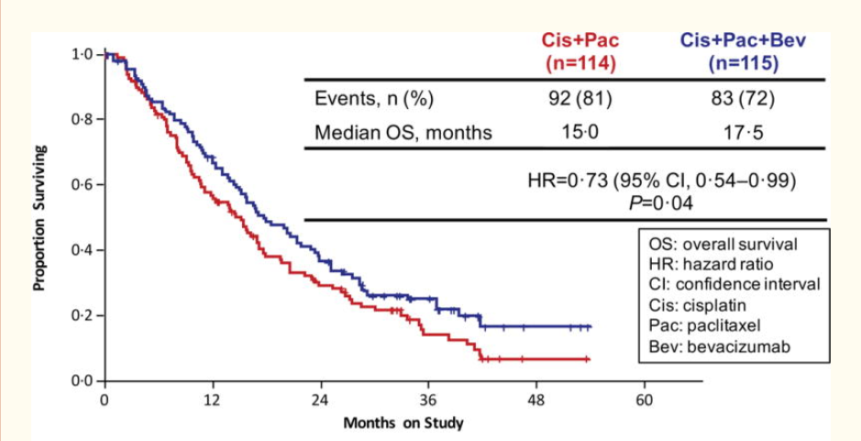
NCCN Guidelines: Recurrent or Metastatic Cervical Cancer^{1,2}
Systemic Therapy Regimens for Recurrent or Metastatic Cervical Cancer
First-line Combination Therapy: Preferred Regimens
Cisplatin + paclitaxel + bevacizumab (category 1)
Carboplatin + paclitaxel + bevacizumab
Possible First-Line Single-Agent Therapy: Preferred Regimens
Cisplatin
Second-Line Therapy: Preferred Regimens
Pembrolizumab for PD-L1+ or MSI-H/dMMR tumors
1
Proportion Surviving
0.8
0.6
P = .04
0.4
0.2
0
0
12
24
36
48
60
Months on Study
Consider MMR/MSI, or PD-L1, and/or NRTK gene fusion testing for patients with recurrent, progressive, or metastatic disease

Slide 39
Checkpoint Inhibitors in Cervical Cancer
Pembrolizumab¹
Keynote-028 trial was performed in multiple tumor types
FDA approved in recurrent or metastatic disease
Investigational in locally advanced disease
Nivolumab + ipilimumab²
CheckMate -358 trial
Ongoing investigations³

Slide 40
KEYNOTE-158: Phase 2 Trial of Pembrolizumab in Previously Treated Advanced Cervical Cancer^{1,2}
Eligibility Criteria
Histologically/cytologically documented advanced cervical SCC
ECOG PS 0-1
Progression on/ intolerance to prior therapies
Radiologically measurable disease
Life expectancy of ≥3 months
N = 98
Pembrolizumab 200 mg every 3 weeks
For 2 years or until disease progression, intolerable toxicity, or physician or patient decision
Tumor imaging was performed every 9 weeks for the first 12 months and every 12 weeks thereafter
Primary endpoint: ORR assessed by RECIST v1.1
Secondary endpoint: Safety
2018: FDA granted accelerated approval of pembrolizumab for patients with advanced PD-L1+ª cervical cancer who experienced progression during or after chemotherapy

Slide 41
KEYNOTE-158: Efficacy Results^{1,a}
Patients with previously treated advanced cervical cancer
N = 98, single-arm study
ORR at 10.2 months: n = 12 (12.2%; 95% CI, 6.5%-20.4%)^{b}
Take Home
PD-L1 positive
PD-L1 negative
PD-L1 unknown
Best Change From Baseline in Target Lesion Size, %
Pembrolizumab is effective in patients with PD-L1–positive advanced cervical cancer
Best Change From Baseline in Target Lesion Size, %
+20%
30%
FDA approved
FDA indication

Slide 42
Phase 1/2 CheckMate -358: Nivolumab + Ipilimumab in Metastatic Cervical Cancer¹⁻³
Eligibility criteria
Age ≥18 years
Histopathologic confirmation of cervical SCC
≤2 prior systemic treatments for advanced disease
ECOG PS 0-1
Measurable disease by CT or MRI
N = 91
Nivolumab 3 mg/kg every 2 weeks + ipilimumab 1 mg/kg every 6 weeks
1:1
R
Nivolumab 1 mg/kg + ipilimumab 3 mg/kg every 3 weeks for 4 doses followed by nivolumab 240 mg every 2 weeks
Primary endpoints: incidence of TRAEs and treatment-related SAEs, ORR, rate of surgery delay
Secondary endpoints: PFS, OS, DOR
Notes:
See also: https://www.targetedonc.com/view/nivolumab-plus-ipilimumab-shows-durable-clinical-activity-in-cervical-cancer
URL OK

Slide 43
CheckMate -358: Combination Therapy Efficacy Results¹
Patients with recurrent/metastatic cervical cancer
N = 91; randomized 1:1
Take Home
 | Nivolumab (3 mg/kg) + Ipilimumab (1 mg/kg) |  | Nivolumab (1 mg/kg) + Ipilimumab (3 mg/kg)
 | No Prior Treatment | Prior Treatment | No Prior Treatment | Prior Treatment
ORR at 12 mo, % | 31.6 | 23.1 | 45.8 | 36.4
Median PFS, mo | 13.8 | 3.6 | 8.5 | 5.8
Combination therapy with nivolumab and ipilimumab was effective in patients with advanced cervical cancer
Investigational

Slide 44
Emerging Therapies: Antibody-Drug Conjugates¹
ADCs are a rapidly growing class of oncologic agents that can confer tumor-specific delivery of a cytotoxic agent
ADCs have been FDA approved in a variety of malignancies and are a growing area of study in gynecologic cancers with targets including mesothelin, MUC16, NaPi2B, TROP2, and tissue factor
Notes:
CME: The text in the box is updated.

Slide 45
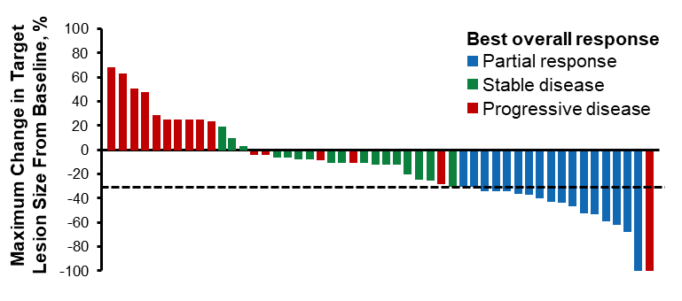
Emerging Therapies: Antibody-Drug Conjugates
Tisotumab vedotin is an ADC that targets tissue factor, a protein often highly expressed in cervical cancer and associated with poor prognosis
Phase 1/2 innovaTV 201 (NCT02001623)¹
ORR: 22%
Median DOR: 6.0 months
6-month PFS: 40%
Phase 2 innovaTV 204 (NCT03438396)²
ORR: 24%
Median DOR: 8.3 months
Phase 1/2 innovaTV 205 (NCT03786081)³
In combination with pembrolizumab
Notes:
CME New

Slide 46
Emerging Therapies: Adoptive Cell Therapy^{1,2}
Phase 2: innovaTIL-04
Adoptive cell transfer with autologous infiltrating lymphocytes (LN-145)
 | LN-145
N | 27
ORR, n (%) | 12 (44.4)
CR, n (%) | 3 (11.1)
PR, n (%) | 9 (33.3)
SD, n (%) | 11 (40.7)
DCR, % | 85.2
Median DOR,ª mo | NR
Median PFS, mo | NR
Surgical resection of tumor
Fragment tumor and isolate TILs
Expand TILs ex vivo
Lymphodepletion and infusion of TILS and IL-2
Primary endpoint: ORR assessed by RECIST v1.1
Secondary endpoints: DOR, DCR, and safety

Slide 47
Summary of New Developments for Cervical Cancer Care
Single-agent immunotherapy is approved for advanced cervical cancer care in the second-line setting
Immunotherapy combination approaches are showing promise
Additional emerging therapies are on the horizon
Antibody-drug conjugates
Adoptive cell transfer
Vaccines

Slide 48
Polling Question 2
Please re-assess your knowledge of new evidence and ongoing studies testing checkpoint inhibitors and emerging agents (eg, ADCs) in patients with advanced cervical cancer.
I’m not familiar with current evidence/ongoing trials in this area
Limited
Average
Good
I’m confident in my knowledge of the current evidence in ongoing studies testing these agents in advanced cervical cancer

Slide 49
Are Clinical Trials Right for Your Patients?
Patients with many types of gynecological cancers, including those with newly diagnosed, advanced, or resectable disease, can benefit from clinical trial enrollment^{1,2}
Cultivate an institutional culture to offer clinical trials to all patients¹
Share resources that can help with patient education²
Many patient organizations provide resources for fielding questions on clinical trial enrollment, from the basics to more complex issues^{3,4}
Sample Q&A
Q. Is a clinical trial right for me?
A. A clinical trial can be a very good option for treatment if you have cancer.
The most obvious reason for considering a clinical trial is to find a treatment that will be best for you.
Many patients join a trial hoping that the treatment they can get on a trial is better than the current standard of care.
https://www.foundationforwomenscancer.org/
https://www.sgo.org/patient-resources/cervical-cancer/
https://www.sgo.org/patient-resources/uterine-cancer/
http://cervivor.org/

Slide 50
Select Ongoing Trials in Advanced Endometrial Cancer¹
Trial | Class | Setting | Treatment Arms | NCT Number
Phase 3 RUBY | IO + chemo | 1L | Dostarlimab + carboplatin-paclitaxel vs placebo + carboplatin-paclitaxel | NCT03981796
Phase 3 AtTEnd | IO + chemo | 1L | Atezolizumab + carboplatin-paclitaxel vs placebo + carboplatin-paclitaxel | NCT03603184
Phase 3 DUO-E | IO + chemo (± PARPi) | 1L | Durvalumab + carboplatin-paclitaxel, followed by durvalumab maintenance (± olaparib) | NCT04269200
Phase 3 LEAP-001 | TKI + IO | 1L | Lenvatinib + pembrolizumab vs carboplatin-paclitaxel | NCT03884101
Phase 3 KEYNOTE-775 | TKI + IO | 2L | Lenvatinib + pembrolizumab vs physician's choice chemo | NCT03517449
Phase 2 | ADC | 2L | SYD985 single-arm study (in HER2+ EC) | NCT04205630
Notes:
CME: Updated slide. Removed primary endpoint column; added phases to trials names; added a class column; added ADC trial (last row)

Slide 51
Select Ongoing Trials in Advanced Cervical Cancer¹
Trial Name | Class | Setting | Treatment Arms | NCT Number
Phase 3 KEYNOTE-826 | IO + chemo | 1L | Pembrolizumab + chemo vs placebo + chemo | NCT03635567
Phase 3 EMPOWER-Cervical 1 | IO | 2L | Cemiplimab vs investigator’s choice chemo | NCT03257267
Phase 3 CALLA | IO + RT | Locally advanced | Durvalumab + SOC CCRT vs placebo + SOC CCRT | NCT03830866
Phase 3 KEYNOTE-A18 | IO + RT | Locally advanced | Pembrolizumab + CRT vs placebo + CRT | NCT04221945
Phase 3 BEAT | Chemo + TKI ± IO | 1L | Cisplatin-paclitaxel + bevacizumab ± atezolizumab | NCT03556839
Phase 2 STAR | PARPi + IO | 2L | Niraparib + dostarlimab | NCT04068753
Phase 2 innovaTV 204 | ADC | 2L | Tisotumab vedotin | NCT03438396
Phase 1/2 innovaTV 205 | ADC + TKI/IO/chemo | 1L/2L | Tisotumab vedotin ± bevacizumab/pembrolizumab/chemo | NCT03786081
Notes:
CME: Updated slide. Removed primary endpoint column; added a phases to trials names; added a class column; added ADC trials (last rows)

Slide 52
The Nurse’s Role in Gynecological Cancer Care

Slide 53
The Oncology Nurse’s Role in Gynecological Cancer Care
What nurses can bring to the table
Understanding of the MOA of newer agents
Support for patients receiving TKIs or immunotherapy
Vigilance and education on TKI- and immune-related AEs

Slide 54
Patient and Professional Communication¹
Educate patients and family caregivers
Share timely and up-to-date information about immunotherapies, their MOA, and possible irAEs prior to initiating therapy and throughout treatment and survivorship
Emphasize
Immunotherapy works differently than traditional chemotherapy
Immunotherapy is associated with unique responses and irAEs
Consistently assess and document each encounter with your patient
ONS Immunotherapy Wallet Card Example

Slide 55
The Spectrum of AEs With TKI Therapy
GI events (diarrhea)
Watch for “classic” events associated with TKI therapy … and remind your patients what to expect
Fatigue
HFSR
Hypertension

Slide 56
Differences to Note Between Checkpoint Inhibitors and TKIs
Unlike TKIs, checkpoint inhibitors are intravenously administered using an every 2- to 4-week schedule
Use of calendars can be helpful to convey a complex schedule
Checkpoint inhibitors are associated with a unique spectrum of AEs that are likely related to immune stimulation

Slide 57
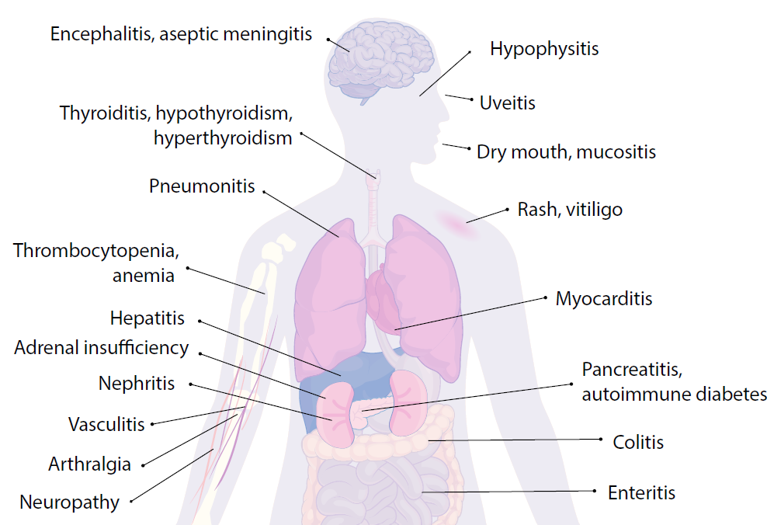
The Spectrum of Immune-Related AEs^{1,2}
“Taking the brakes off” of the immune system can help the body fight cancer, but it can also lead to toxicity from a supercharged immune system
Any organ system can be affected
Encephalitis, aseptic meningitis
Hypophysitis
More commonly occurring irAEs are
Dermatologic (rash, pruritus, blisters, ulcers, and vitiligo)
GI (diarrhea, enterocolitis, transaminitis, hepatitis, and pancreatitis)
Endocrine (thyroiditis, hypophysitis, diabetes, and adrenal insufficiency)
Pulmonary (pneumonitis)
Thyroiditis, hypothyroidism, hyperthyroidism
Uveitis
Dry mouth, mucositis
Pneumonitis
Rash, vitiligo
Thrombocytopenia, anemia
Hepatitis
Myocarditis
Adrenal insufficiency
Pancreatitis, autoimmune diabetes
Nephritis
Vasculitis
Colitis
Arthralgia,
myositis
Enteritis
Neuropathy

Slide 58
Immunotherapy + TKI Combination Toxicities
!
Be aware of overlapping toxicities that can occur with immunotherapy + TKI combination therapy
Immunotherapy
Pruritus
Pneumonitis
Myocarditis
Adrenal crisis
VEGF TKI
Hypertension
Taste changes
Stomatitis
Dyspepsia
Cytopenias
HFSR
Rash
Diarrhea
Hepatitis
Hypothyroid
AMS
Encephalitis
PRES
Stop the VEGF TKI

Slide 59
Immunotherapy Side Effect Management Toolbox
Anti-diarrhea medications and probiotics
Anti-nausea medications
Grading of side effects sheet
Permission to call
Immunotherapy Toolbox

Slide 60
Managing Diarrhea Related to TKIs¹⁻⁴
Monitor bowel habits and report any increase in activity above normal
Avoid spicy or fatty foods; plain, simple foods are best; avoid fruit and caffeine
Maintain adequate fluid intake to avoid dehydration
Monitor/manage electrolytes
Medical management: Loperamide is usually effective; if ineffective, consider diphenoxylate/atropine
Remind your patients to notify the medical team of diarrhea or abdominal distress

Slide 61
Managing Fatigue Related to TKIs¹⁻⁴
Recommend that patients:
Stay as active as possible, which can help regulate sleep
Maintain a normal work and social schedule
Take breaks as needed
Tell the medical team if activity is intolerable or fatigue worsens
Medical management: Consider methylphenidate
Counsel your patients on these key principles for combating fatigue

Slide 62
Managing Hypertension¹⁻²
Recommendations
Obtain a BP cuff and track BP at the same time every day or have BP monitored in clinic or local pharmacy
Call if BP is >150/90 mmHg
May require changes to current anti-hypertension regimen
May require delayed initiation of TKI therapy (until hypertension is well controlled)
Keep a log of morning and evening BP
Educate patients on hypertension warning signs and monitoring

Slide 63
Managing Hand–Foot Skin Reactions¹
Common symptoms
Erythema with or without blisters
Hyperkeratotic lesions on palms and soles
Commonly accompanied by dysesthesia (burning, pain, and tingling)
RAAR
Hot water, direct sunlight, constrictive footwear, excessive friction, vigorous activity, and contact with cleaning products with strong chemicals
Remove
Avoid
Calluses and hyperkeratotic regions
Apply
Report
Moisturizer (daily), cold packs (indirectly) for 20 min/d; wear thick cotton gloves and socks, gently pat hands/feet dry after washing
Signs and symptoms immediately
Various preventive (eg, urea cream) and treatment strategies (such as clobetasol 0.05% ointment or dose interruption) can be used depending on severity

Slide 64
Nursing Considerations for ADC Therapies^{1,2}
Monitor patients for infusion reactions
Premedication with a corticosteroid, antihistamine, and acetaminophen is recommended 1 hour prior to ADC infusion
AEs often depend on the specific components of each ADC (antibody, linker, payload), but can include:
GI toxicity (nausea, diarrhea, and constipation)
Ocular events (conjunctivitis, dry eye, and blurred vision)
Peripheral neuropathy
Neutropenia
Let your patients know that AEs can often be addressed by simple mitigation strategies or dose reductions
Notes:
CME New

Slide 65
irAE Management: Grade 1
In general, checkpoint inhibitor therapy should be continued with close monitoring, with the exception of some neurologic, hematologic, and cardiac toxicities^{1,2}
(
Common Terminology Criteria for AEs
Grade 1: Mild; asymptomatic or mild symptoms
Grade 2: Moderate; minimal, local, or noninvasive intervention indicated
Grade 3: Severe or medically significant, but not immediately life-threatening
Grade 4: Life-threatening consequences; urgent intervention indicated
Grade 5: Death related to an AE

Slide 66
irAE Management: Grade 2
Hold checkpoint inhibitor therapy for most grade 2 toxicities^{1,2}
Consider resuming immunotherapy when symptoms and/or laboratory values revert to grade ≤1
Corticosteroids (initial dose of 0.5-1 mg/kg/d of prednisone or equivalent) may be administered

Slide 67
irAE Management: Grade 3/4
Grade 3 toxicities^{1,2}
Hold checkpoint inhibitor therapy
Initiate high-dose corticosteroids (prednisone 1-2 mg/kg/d or methylprednisolone IV 1-2 mg/kg/d)
If no improvement with in 48-72 hours of high-dose corticosteroid, infliximab may be offered for some toxicities
Taper corticosteroids over at least 4-6 weeks
When symptoms and/or laboratory values revert to grade ≤1, rechallenging with immunotherapy may be offered; however, caution is advised, especially in those with early onset irAEs; dose adjustments are not recommended
Grade 4 toxicities^{1,2}
In general, permanent discontinuation of checkpoint inhibitor therapy is warrantedª

Slide 68
irAEs: Useful Tools for Patients¹
ONS Immunotherapy Wallet Card Example
wallet card²
IMMUNOTHERAPY
Wallet cards detailing symptoms to watch for and how to notify their healthcare provider are effective tools in empowering patients and their caregivers to recognize and manage irAEs
May be useful to other healthcare providers (eg, emergency department staff) caring for patients with a history of immunotherapy
NAME: _________________________________________________________________
CANCER DX: ____________________________________________________________
IO AGENTS RECEIVED: ◻ Single-Agent Checkpoint Inhibitor ◻ Multiple Checkpoint Inhibitors ◻ Tyrosine Kinase Inhibitors
DRUG NAME(S): _________________________________________________________
IMMUNOTHERAPY TX START DATE: ________________________________________
OTHER CANCER MEDICATIONS: ___________________________________________
Note: Immunotherapy agents are not chemotherapy, and adverse events must be managed differently
ONS Immunotherapy Wallet Card Example
IMMUNE-MEDIATED SIDE EFFECTS*, COMMON WITH CHECKPOINT INHIBITORS VARY IN SEVERITY AND MAY REQUIRE REFERRAL AND STEROIDS. PATIENTS HAVE A LIFETIME RISK OF IMMUNE-RELATED SIDE EFFECTS.
*May present as rash, diarrhea, abdominal pain, cough, fatigue, headaches, vision changes, etc. Confer with your oncology team before changing an IO regimen or starting treatment for an adverse event.
ONCOLOGY PROVIDER: _________________________________________________
ONCOLOGY PROVIDER #: ________________________________________________
EMERGENCY CONTACT: _________________________________________________
CONTACT PHONE #: _____________________________________________________
IMMUNOTHERAPY WALLET CARD

Slide 69
Nursing Take-Homes Caring for Patients With Advanced Endometrial or Cervical Cancer
Pay attention to oral administration issues
Be prepared to address the classic spectrum of AEs (eg, fatigue, hypertension, diarrhea, and HFSR)
TKIs
IV administration
A unique spectrum of irAEs requiring vigilance and education of patients
Dual checkpoint inhibitor and immunotherapy-TKI regimens are available
Immunotherapy
Emerging option in clinical trials
AEs can include GI toxicity, ocular events, peripheral neuropathy, and neutropenia
ADCs
Always an option for patients with cancer
Cancer patient support groups can be an excellent resource for patients who may be clinical trial candidates
Clinical Trials
Notes:
CME: Updated slide. Added ADCs.

Slide 70
Polling Question 3
How often will you now discuss clinical trial enrollment with eligible patients who have advanced endometrial or cervical cancer?
Never
Infrequently
Sometimes
Always
N/A for me
Notes:
CME New

Slide 71
Polling Question 4
How often will you now counsel patients receiving IO, TKI, or ADC therapies on appropriate strategies to prevent and/or manage class effect toxicities (such as fatigue and GI symptoms, among others)?
Never
Infrequently
Sometimes
Always
N/A for me

Slide 72
Polling Question 5
How often will you now discuss with patients the importance of reporting adverse events immediately, rather than waiting for their next scheduled visit, especially if on a combination regimen?
Never
Infrequently
Sometimes
Always
N/A for me

Slide 73
Audience Q&A
Notes:
CME: slide added

Slide 74
Please remember to complete and submit your Post-Test and Evaluation for CNE credit.
PeerView.com/GynOnc-Survey-FDM
Thank you and have a good day.
Notes:
CME: slide added

