Slide 1
Assessment Update
Mark Jackson | TCAP Customer Service Coordinator | Office of Strategy and Data | Sept. 27, 2019

Slide 2
Spring 2019 Debrief
Notes:
HP

Slide 3
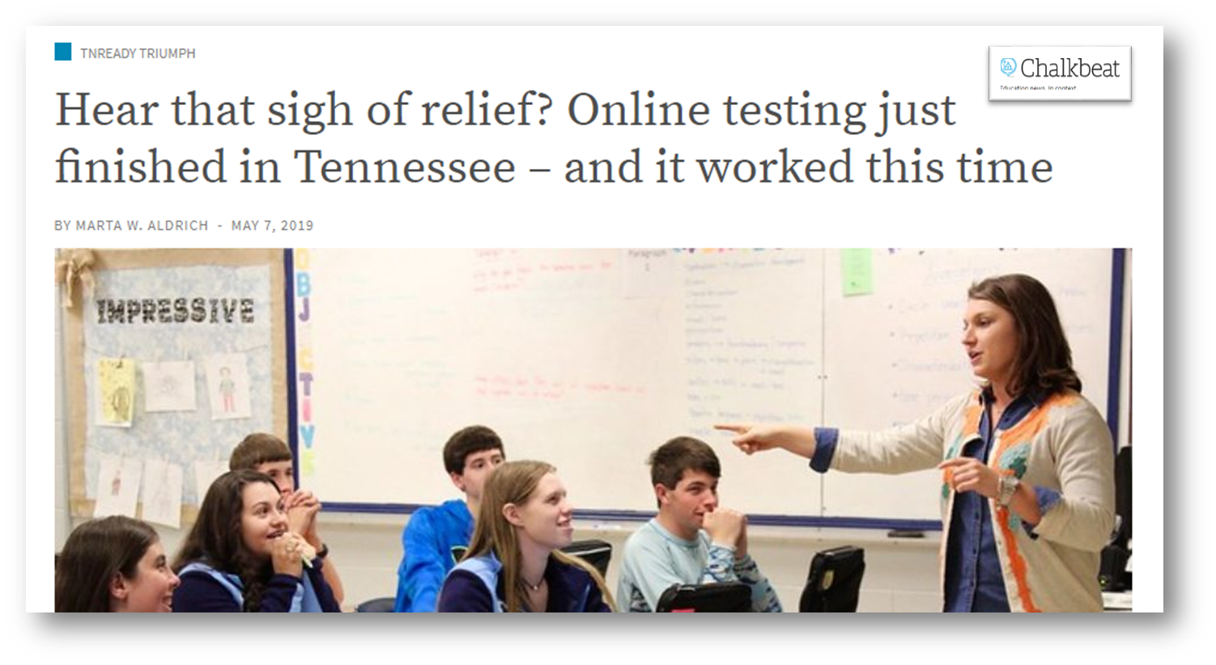
Spring 2019 Debrief
Testing
Approx. 715,000 students completed 2 million tests
Approx. 700,000 of those tests were online
Reporting
EOC raw scores released on schedule
3-8 raw scores released on schedule to those districts who wanted to use them
EOC reports released (early July)
3-8 reports released (early August)
Notes:
HP

Slide 4
Changes for 2019-20
New administration vendor: Pearson
All paper/pencil (PBT)
No U.S. history/social studies writing
Raw scores will be delivered with other content areas
Standards setting
Late score reports for science
Operational testing of science
Raw scores will be delivered with other content areas
Standards setting
Late score reports for science
Notes:
Pearson
Paper/pencil is state law for 2019-20
Timing will be revised for US History EOC and Grade 6-8 Social Studies… Grade 3-5 Social Studies is still paused
Science will be operational in 2019-20… however, scores will be delayed due to standard setting in the summer of 2020
There will also be standard setting for USH/Social Studies due to the change in the tests

Slide 5
Visibility Tool

Slide 6
Information Flow
District SIS
EIS
Visibility Tool
PearsonAccess^{next}

Slide 7
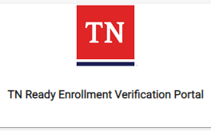
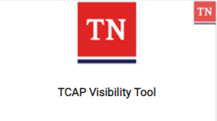
Visibility Tool
Note the new name, but the same location in Orion.

Slide 8
Visibility Tool
Opened on Sept. 3!
Start checking your information now.
First pull of information from Visibility Tool into PearsonAccess^{next} occurs on October 11
Daily data refreshes will show up in PearsonAccess^{next} in 24-48 hours.

Slide 9
PearsonAccess^{next} Accounts
All accounts will be created by Pearson/TDOE.
Public districts and non-public districts will access the site directly.
Login is different from ACT.
PANext logins will be available Oct. 14.

Slide 10
Business Rules for the EIS Enrollment
For a student record to result in a test registration, the student must have:
Enrollment in a school
Instructional Grade record for that enrollment
Student Class Assignment (course code) for that enrollment
Class Section (local class number) for the student class assignment
Teacher identified as the teacher of record for the class section (master teacher record)
Valid Teacher License number for the teacher of record

Slide 11
Importance of Data Quality
Accurate, quality data will help ensure a student does not experience issues being loaded into PearsonAccess^{next} due to human data entry error.
Visibility Tool will catch errors such as: | Visibility Tool will not catch:
Classes missing teachers of record Students enrolled in duplicate course codes Teachers with no TLN | Typos in information Students marked in SIS with incorrect gender, DOB, etc.
Notes:
Amanda & Melissa

Slide 12
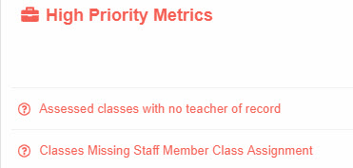
High Priority Metrics
Class issues
Assessed classes with no teacher of record*
Classes with multiple teachers of record
Course codes in the wrong test window
Classes with deleted teacher
Classes missing staff member class assignment*
Notes:
*Assessed classes with no teacher of record: We have received a staff member class assignment but there is no teacher of record; Classes missing staff member class assignment: We have not receive a staff member class assignment.

Slide 13
High Priority Metrics
Teacher issues
Teachers without an email address
Teachers without a license number
Teacher assignments with no end date

Slide 14
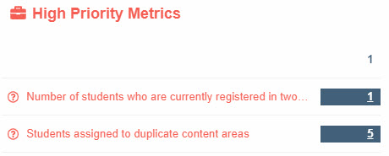
High-Priority Metrics
Student issues
Students assigned to duplicate
content areas
Students who are currently
registered in two different
districts and/or schools
Students not enrolled in at least one assessed course code
Students enrolled in retired assessment course codes
Students with incomplete enrollments
Students enrolled in non-assessed retired course codes
Students with an assigned grade of P3 or P4
Students listed in two different grades
Students without a last name
Students enrolled in assessed classes with no teacher of record

Slide 15
Visibility Tool and PearsonAccess^{next}
Your district will need to be checking both platforms. Make sure that all students are properly withdrawn to ensure accurate entry into the new district.
Remember – any corrections found in Visibility Tool need to be made in your SIS.
Changes will show up in Visibility Tool and PearsonAccess^{next} in 24-48 hours.
If student information is correct in the Visibility Tool but not PearsonAccess^{next} , the district testing coordinator will need to contact Pearson for assistance.

Slide 16
Course Code Guidance

Slide 17
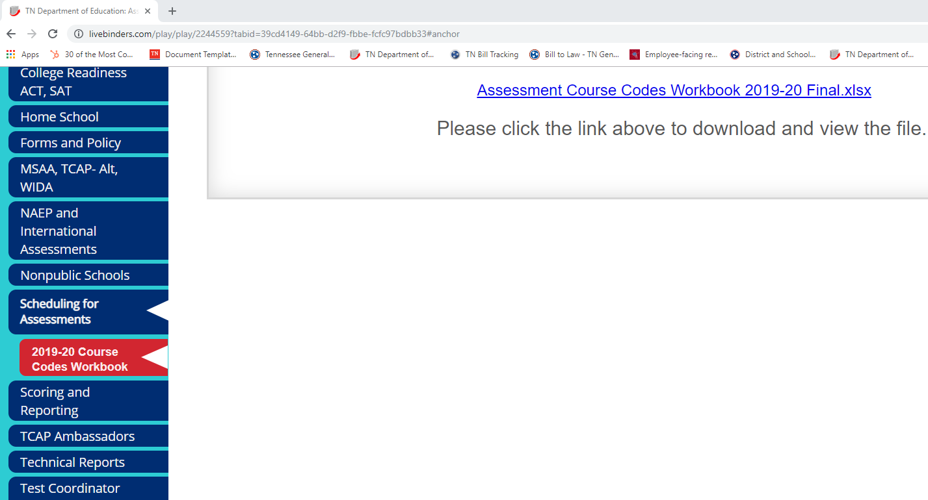
Assessment Course Codes Document
The 2019-20 Assessment Course Codes document is posted on Livebinders.

Slide 18
Important Safety Tips
Districts cannot use the same assessment course code twice for different classes.
Service enrollments do not pull for assessment.
If you need a student to test a particular content area, they need to be given a primary enrollment with an assessed course code.
You - the district EIS person – are a vital part of your district assessment team!

Slide 19
Online Verification Test

Slide 20
Online Verification Test
T.C.A. 49-6-6013
Tennessee comprehensive assessment program (TCAP) tests administered in the 2019-2020 school year must be administered in paper format. Before TCAP tests are administered in the 2020-2021 school year, each LEA shall participate in an online verification test conducted by the department of education. The commissioner of education shall determine, based on the results of the online verification test, the format for TCAP tests administered in the 2020-2021 school year.

Slide 21
Online Verification Test
Verification test tentatively scheduled for spring 2020.
Further details will be shared throughout the year.

Slide 22
Alternative Schools Guidance
Notes:
MJ

Slide 23
Alternative Schools
Students enrolled in alternative schools during 2019-20 TCAP can be assessed at their alternative school or their school of remand.
For the 2019-20 school year, a student who has been remanded from their primary school to an alternative school with a school number does not need their enrollment to be moved back to their school of remand for assessment or accountability purposes.
Notes:
MJ

Slide 24
Thank you!

