Slide 1
Humboldt Watershed Cooperative Weed Management Area
JANUARY 2015

Slide 2
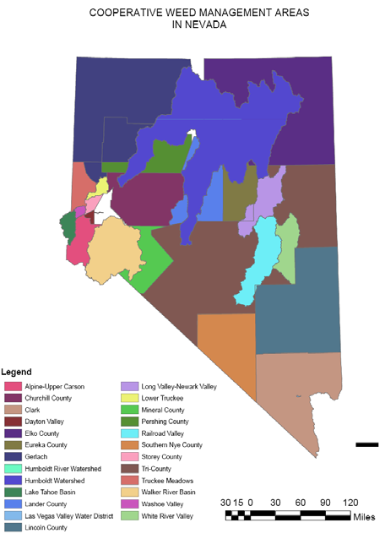
Nevada CWMA Program
Cooperative Weed Management Area
Nevada’s program first began in 2002. The Nevada Department of Agriculture (NDA) received a State and Private Forestry (S&P) grant from the United States Forest Service (USDA).
The S&P grant funds were provided to assist states to establish CWMA’s. To date Nevada has 30 weed management areas and nine weed districts though not all are active.
HWCWMA
Notes:
CWMA is short for…. The Humboldt Watershed CWMA is one of the largest in the state, and overlaps with several others, such as Elko County and Spring Creek Regional CWMA’s.

Slide 3
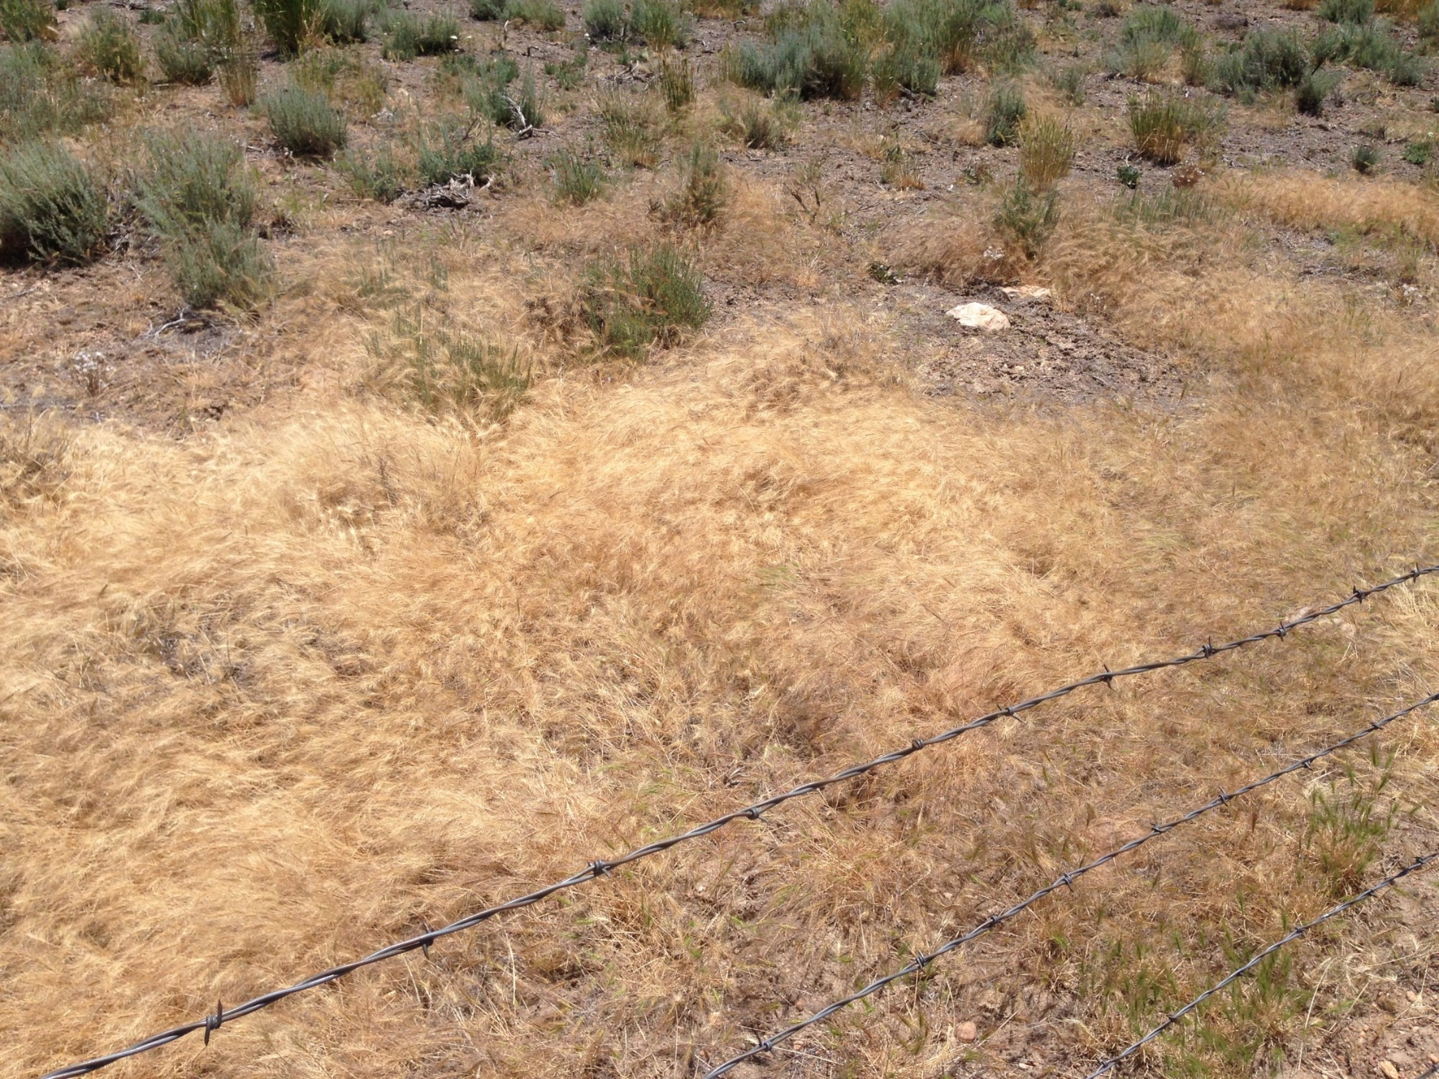
Basic Characteristics of CWMAs
Operate within a defined, local geographic area
Facilitate cooperation across jurisdictional boundaries
Involve a broad cross-section of landowners & natural resource managers
Have a comprehensive plan for invasive plant management
Are usually led by a steering committee, or board
Have a long-term commitment to cooperation (e.g. MOU’s)
Notes:
In short, CWMA’s attempt to work across ownership boundaries to coordinate the best possible noxious weed management results in the area they serve.

Slide 4
Humboldt Watershed CWMA
Many Stakeholders
A very diverse array of landowners, management agencies, municipalities and other entities are involved.
Multiple Governing Bodies
The watershed is substantial, reaching through the Counties of Elko, Eureka, Lander, Pershing and Humboldt.
East & west from Wells to the Humboldt Sink – and north & south from Orovada to Ione, the watershed is 16,843 square miles.
Millions of Acres
Vast Travel Corridors
Interstate 80 and Union Pacific Railroad meander through the center of the watershed.
Notes:
HWCWMA is more specifically characterized by it’s size.
To coordinate all these factors, HWCWMA definitely has it’s work cut out for it!

Slide 5
HWCWMA Mission Statement
The Humboldt Watershed CWMA is dedicated to the management and control of noxious and invasive weeds within the Humboldt River Watershed area.
The primary function of Humboldt Watershed CWMA is to provide land managers, owners and local weed control groups with assistance in the areas of funding, agency and weed group coordination and general communication and cooperation.
Notes:
However, our mission is simple.

Slide 6
Noxious Weeds Damage Us All
Watershed
Degrade water quality by damaging watersheds and systems
Displace native grasses, willows, and other stabilizing plant species
Increase soil erosion by wind and water
Increase the costs, water and nutrients required for crop production
Increase equipment wear and tear, and fuel costs for crop production
Reduce crop and rangeland quality and quantity
Decrease wildlife habitat, displacing native and endangered species
Act as alternate hosts for insects and diseases
Affect human and animal health, through allergies and poisonings
Increase public and private transportation and infrastructure costs
Decrease human habitat and recreational opportunities
Increase fire danger and severity
Decrease land values, appearance and uses
Increase taxes due to rising maintenance costs of public properties
Environment
Wildlife
Agriculture
Business
Public
Notes:
When left to multiply weed infestations damage all of us.
What can we do to protect and defend our ecosystem?

Slide 7
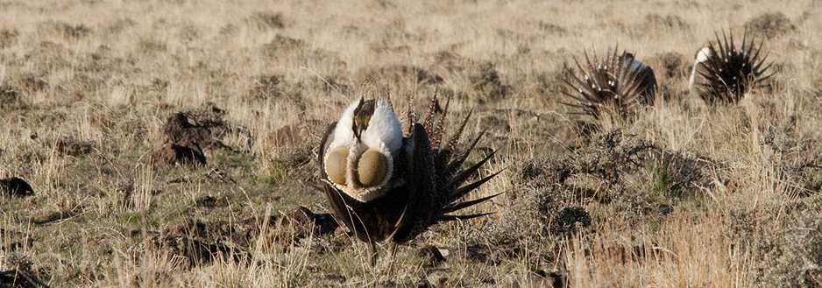
Impacts On Sage Grouse
Invasive and noxious weeds degrade rangelands and habitat for sage grouse. The weeds compete with native and desirable plant species.
They increase soil erosion, reduce water quality, and often increase fire frequency.
Invasive and noxious weeds that are causing problems for Elko County sage grouse habitat include cheatgrass, medusahead, perennial pepperweed, hoary cress, leafy spurge, various thistles, and knapweeds.
Once rangelands are over taken by weeds like cheatgrass and medusahead, they are extremely hard to rehabilitate. Our best hope for sage grouse is to prevent the spread of these weeds – early detection and removal, combined with grazing practices that keep the desirable native plants healthy.
Notes:
Invasive weeds are one of the greatest threats to the sage grouse. We are losing valuable habitat every year.

Slide 8
Weed Management Obstacles
HWCWMA’s highest priority is to promote ecosystem health through management of noxious weeds
Controlling
With their rapid rate of expansion within the watershed, these invasive plants can quickly dominate and often cause permanent damage to natural plant communities.
Many of these foreign species lack natural enemies in their new environment, without the insects and fungi to keep them in check, they expand fast and crowd out our natives.
Oppressive
Invasives are highly adept at promoting their own species, like releasing chemicals in the soil that other plants can’t tolerate, or coming earlier than natives and monopolizing water and nutrients, or using exploding seed heads.
Adaptable
Seeds can remain viable in the soil for many years. Some species send roots as deep as 30 feet and have taproots that can expand by 15 feet a year. Others produce sap that make them unpalatable to livestock and wildlife.
Persistent
Notes:
Noxious weeds present us with many management obstacles. They are…

Slide 9
Overcoming Human Management Obstacles
HWCWMA’s highest priority is to promote ecosystem health through management of noxious weeds
We must educate ourselves and the public about the invasives present in our area, how they proliferate, and how everyone can help reduce the further spread of these infestations. We can stop being unknowing vectors.
Awareness
In order to compete with the invasive assault we must commit to a management plan that addresses the current infestations, and employs methods to reduce instances of noxious weeds invading new sites.
Accountability
If these resource thieves were human we would be all in for fighting to keep our ecosystem intact, how do we justify allowing the continued spread of noxious weeds to keep robbing our land of it’s value and it’s ability to produce.
Disregard
Expense
We are all stakeholders in this war that noxious weeds has waged on us, not one of us wanted the battle – but we can’t wish it away. Because there are funding assistance programs available we shouldn’t use lack of money as an excuse.
Notes:
But it may be the human obstacles that are more difficult to overcome.

Slide 10
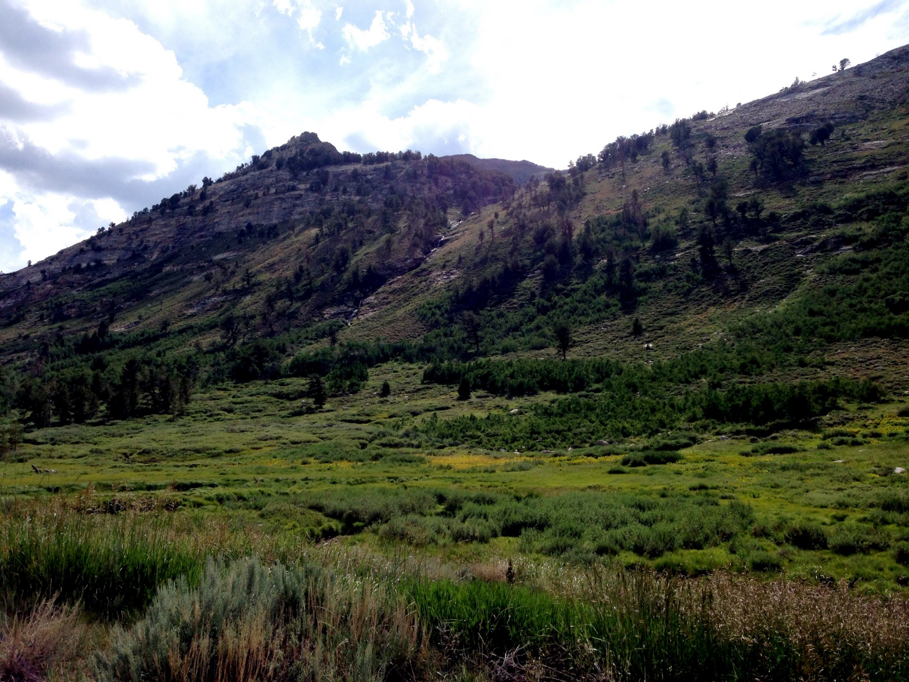
Benefits of restoring the landscape
A healthier landscape is created by restoring the natural ecosystem with native plants.
Healthy landscapes benefit landowners – whether a secure supply of fresh water, recreational use, or income from agricultural products.
The longer you wait, the more it costs to treat noxious weeds infestations.
Protects our water sources by filtering storm and waste water runoff and slowly absorbing it into the soil restoring ground water.
Property values increase when noxious weeds are removed from a landscape.
Soils benefit when surface plants and their root systems effectively prevent erosion, reducing loss of top soil and fertility.
Wildlife habitat quality and abundance is increased, supporting larger populations of multiple species.

Slide 11
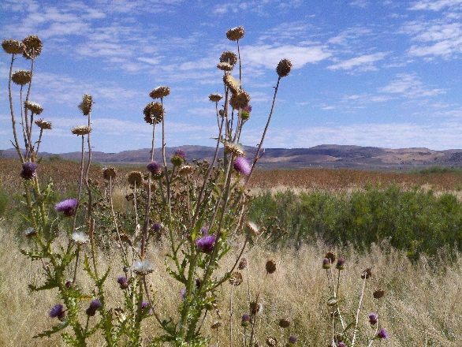
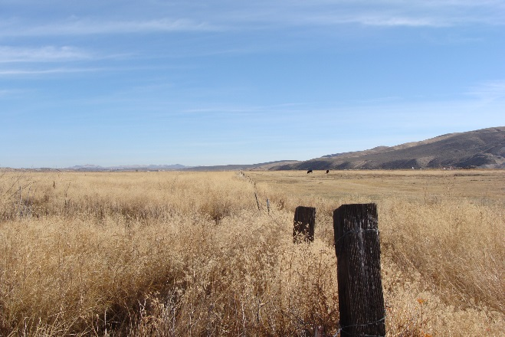
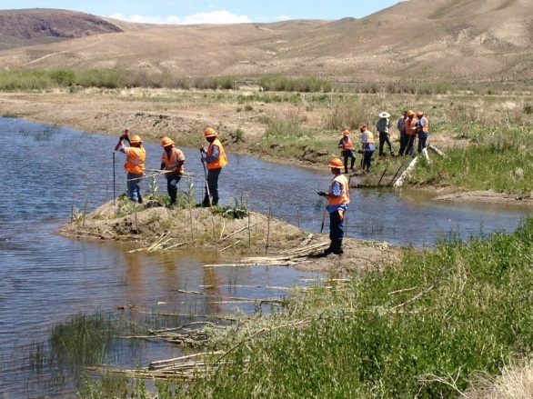
What Has HWCWMA Been Doing?
Our primary focus has been on noxious weed reduction and restoring lost vegetation in riparian areas.
We provide funding assistance to numerous private stakeholders who are actively managing invasives on their properties.
Seeding and planting willows along the main river banks to help control erosion have been incorporated into several recent projects.
In a collaborative effort with UNCE, a controlled study to determine the best management methods for Russian Knapweed is nearly complete.
We are working with Union Pacific Railroad to create a noxious weeds inventory along their corridors, from this a management plan can be developed.
Notes:
Current supporters include NDEP, NDOA, NDOW, Newmont, Barrick, and UPRR; and Project Partners BLM, USFS, NDF, UNCE, and the City of Elko, and we’d like to add Elko County to our list.

Slide 12
What Has HWCWMA Been Doing?
Over the last two years we have worked to develop a Humboldt Watershed Weed Management Plan (WMP).
We would like to have our effort on this plan serve as the foundation for a multi- County, City, Conservation District, and Weed District adopted WMP.
Our WMP focuses on approaching weed management with Education – Coordination – Containment - Restoration – Prevention.
Through a consistent watershed-wide approach to weed management we can rescue and rehabilitate our Humboldt Watershed.
As home to the headwaters and largest land area of the Humboldt River Watershed, we would respectfully ask Elko County to take the lead in being the first County to adopt our WMP.
Notes:
Copies of the WMP being given out here today, we ask that the Commissioners and staff review the plan, and meet with us to discuss any issues in the near future. We hope to have the WMP in place by March of 2015.

Slide 13
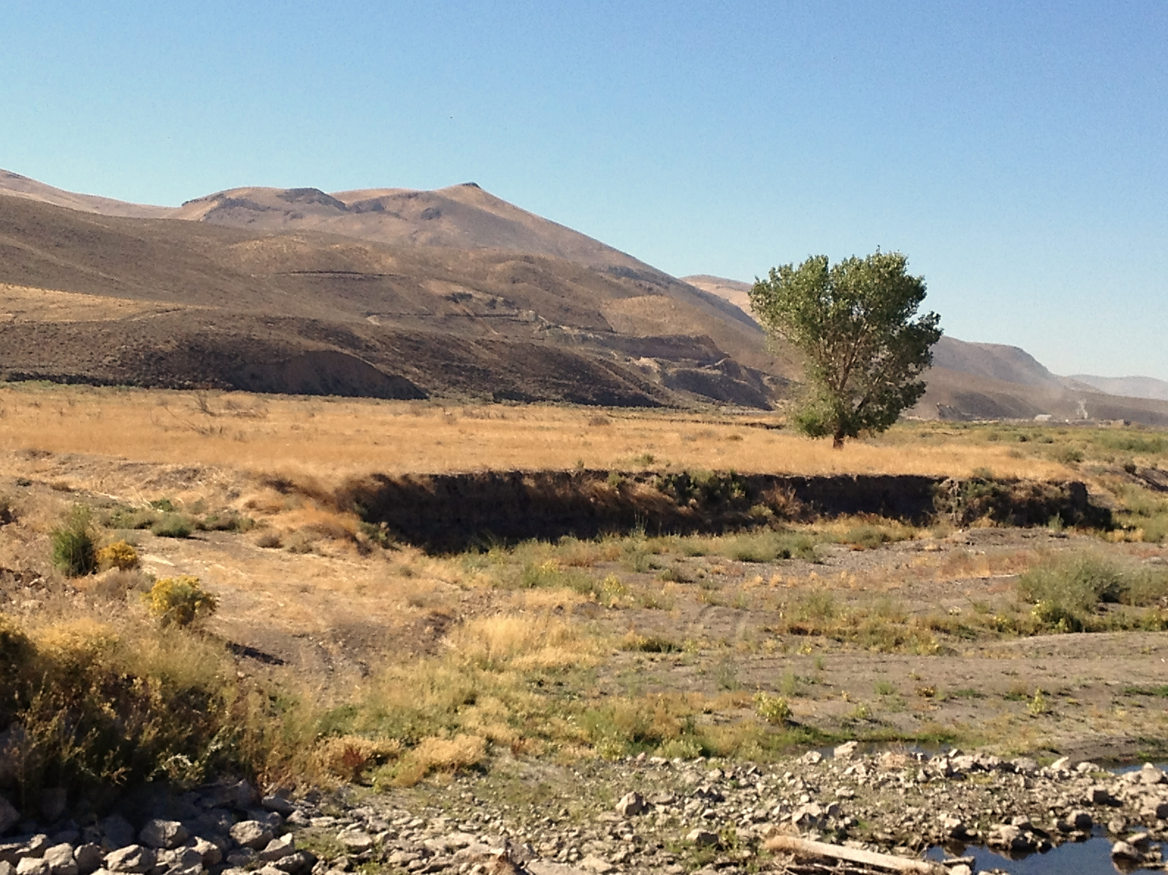
What Can Elko County Do?
Elko County encompasses a huge portion of the Humboldt Watershed as well as owning property on the Humboldt River itself.
Noxious weeds seeds and fragments flow down river and form new infestations, so it is important that we begin our combined efforts near the headwaters of the Humboldt River.
The HWCWMA wants to partner with Elko County to manage, treat and monitor the noxious weeds infestations on Elko County public properties. This will help reduce the number of weed seeds that get transported by the river flow to downstream properties.

Slide 14
Where Do We Start?
Railport
The Elko County owned Railport encompasses approximately 60 acres and is heavily dominated by noxious weeds including perennial pepperweed, hoary cress, Russian knapweed, poison hemlock, musk, Scotch and Canada thistles and tamarisk.
Because the Humboldt River and the railroad are huge vectors for the spread of noxious weeds, the HWCWMA would like to partner with Elko County to first create a noxious weed inventory of the Railport by GPS mapping the area, then developing and implementing a viable management plan that will lessen the continued downstream flow of weed seeds.
Notes:
You probably wonder…Where do we start? We have some thoughts on that. How about the Railport?

Slide 15
Our Long-Term Goals
Maintain communication between Elko County, Conservation Districts, land managers and local agencies to maximize noxious weeds management within the Humboldt Watershed.
Continue partnering
with Elko County on County-owned properties to reduce noxious weeds numbers and protect sage grouse habitat.
HWCWMA will offer funding, technical expertise and weed mapping services to monitor future infestation sizes.

Slide 16
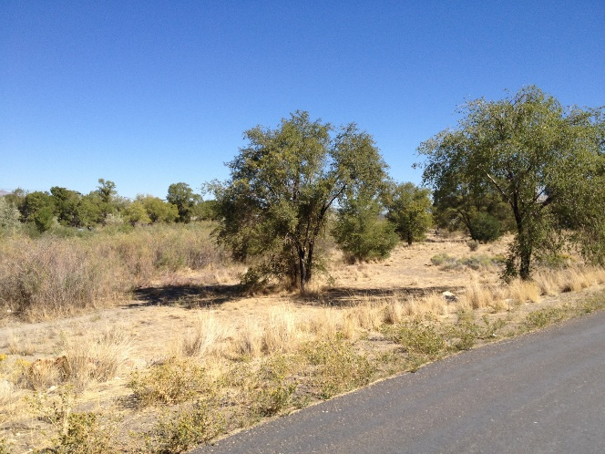
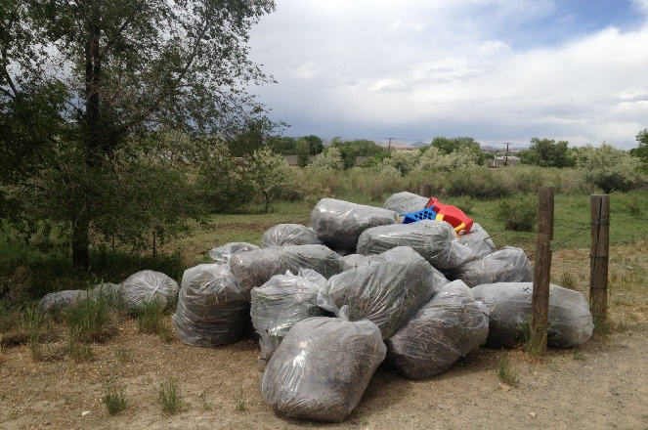
Project Spotlight
Elko Frisbee Golf Course:
Elko’s Frisbee golf course at Humboldt Area River Park (HARP) is a popular public recreation spot, adjacent to the HARP Trail that is used by walkers, bikers and runners.
Perennial pepperweed, Russian knapweed, hoary cress, tamarisk, Scotch, Canada and musk thistles were overtaking the course. So people using the course were unknowingly acting as a huge vector in the spread of noxious weeds to other areas.
HWCWMA partnered with the City of Elko and the Nevada Division of Forestry to remove the existing noxious weeds from the site, herbicide treatments were then applied, and desirable grass species that are competitive with the noxious weeds were planted.
Notes:
To promote public awareness about how weed seeds are spread we attempt to “Spread the Word…Not the Weed”. Has anyone here played disc golf? – How about at the local HARP course? TOSS A FEW DISCS OUT… GO HAVE FUN – BUT DON’T LET ANY WEED SEEDS HITCH A RIDE ON YOU WHEN YOU LEAVE THE AREA!

Slide 17
Project Spotlight
Elko Frisbee Golf Course:
This was our first project with the City, we hope to be able to partner on many more.
Over time, we would like to see the whole river corridor rehabilitated, transformed from a massive noxious weed seed bank and eyesore, to a valuable public recreational resource, an area that we can all be proud of.
One way we have been promoting public awareness about how weed seeds are spread is with our “Spread the Word…Not the Weed” golf discs.
Notes:
Disc for each commissioner? GO HAVE FUN – BUT DON’T LET ANY WEED SEEDS HITCH A RIDE ON YOU WHEN YOU LEAVE THE AREA!

Slide 18
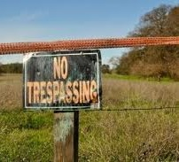
Current supporters include NDEP, NDOA, NDOW, Newmont, Barrick and UPRR.
In addition to our numerous private stakeholders, project partners include BLM, USFS, NDF, UNCE and the City of Elko.
We would like to add Elko County to our list, both as a supporter of our efforts, and as a project partner.
Notes:
We ask Elko County to take the lead in supporting the work being done to stop the alarming spread of noxious weeds.

Slide 19
Questions?
Please contact:
Andi Porreca, HWCWMA Coordinator
(775) 762-2636
aporreca@humboldtweedfree.org
Rhonda Heguy, HWCWMA Administrator
(775) 738-3085
hwcwma@gmail.com
www.humboldtweedfree.org

Slide 20
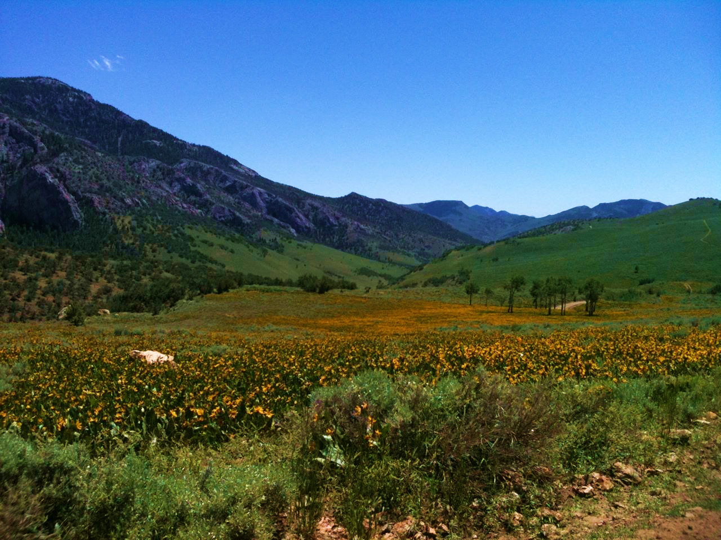
Thank you!

