Slide 1
Multi-Tier Support for Students with Mathematics Difficulty

Slide 2
Contact Information
Sarah Powell, Ph.D
The University of Texas at Austin
srpowell@austin.utexas.edu
@sarahpowellphd
119

Slide 3
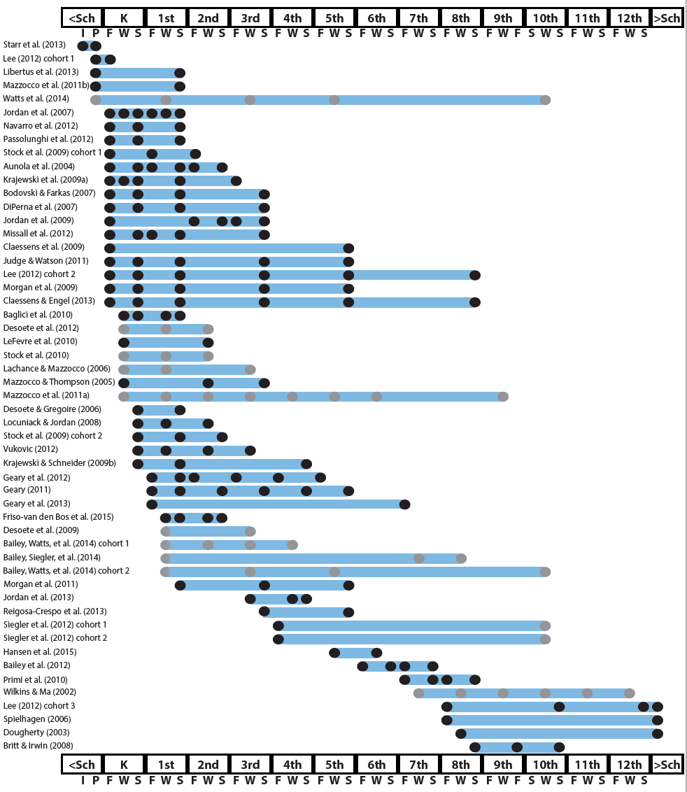
http://www.greatertexasfoundation.org/trajectories-of-mathematics-performance/

Slide 4
Broad math in preK predicted K broad math
Mathematics in preschool predicts later mathematics
http://www.greatertexasfoundation.org/trajectories-of-mathematics-performance/
Broad math in preK predicted grade 10 broad math

Slide 5
Counting in K predicted grade 1 broad math
Mathematics in kindergarten predicts later mathematics
http://www.greatertexasfoundation.org/trajectories-of-mathematics-performance/
Broad math in K predicted grade 8 broad math
K math accurately predicted math performance below 10th percentile in grades 2 and 3 with 84% correct classification

Slide 6
Mathematics in elementary school
predicts later mathematics
Addition influenced arithmetic with increasing importance from grades 1 to 5
http://www.greatertexasfoundation.org/trajectories-of-mathematics-performance/
Grade 1 arithmetic predicted arithmetic at grades 2, 3, and 4
Grade 1 broad math predicted broad math at grades 3, 5, and 10

Slide 7
Mathematics in middle school
predicts later mathematics
Counting and comparison in grades 2 or 4 predicted broad math 1 year later
http://www.greatertexasfoundation.org/trajectories-of-mathematics-performance/
Fractions at 10-12 years old predicted broad math 5 years later
Broad math in grade 7 predicted broad math in grade 8

Slide 8
Broad math in grade 8 predicted completion of 4-year college degree
Mathematics in
high school
predicts later outcomes
http://www.greatertexasfoundation.org/trajectories-of-mathematics-performance/
Students who took algebra in grades 8 took more advanced math courses and enrolled in 4-year colleges more often than students who took algebra in grade 9
Numeracy measured in adolescence impacted hourly earnings 7 to 15 years later

Slide 9
Mathematics in preschool predicts later mathematics
Mathematics in kindergarten predicts later mathematics
http://www.greatertexasfoundation.org/trajectories-of-mathematics-performance/
Mathematics in elementary school
predicts later mathematics
Mathematics in middle school
predicts later mathematics
Mathematics in
high school
predicts later outcomes

Slide 10
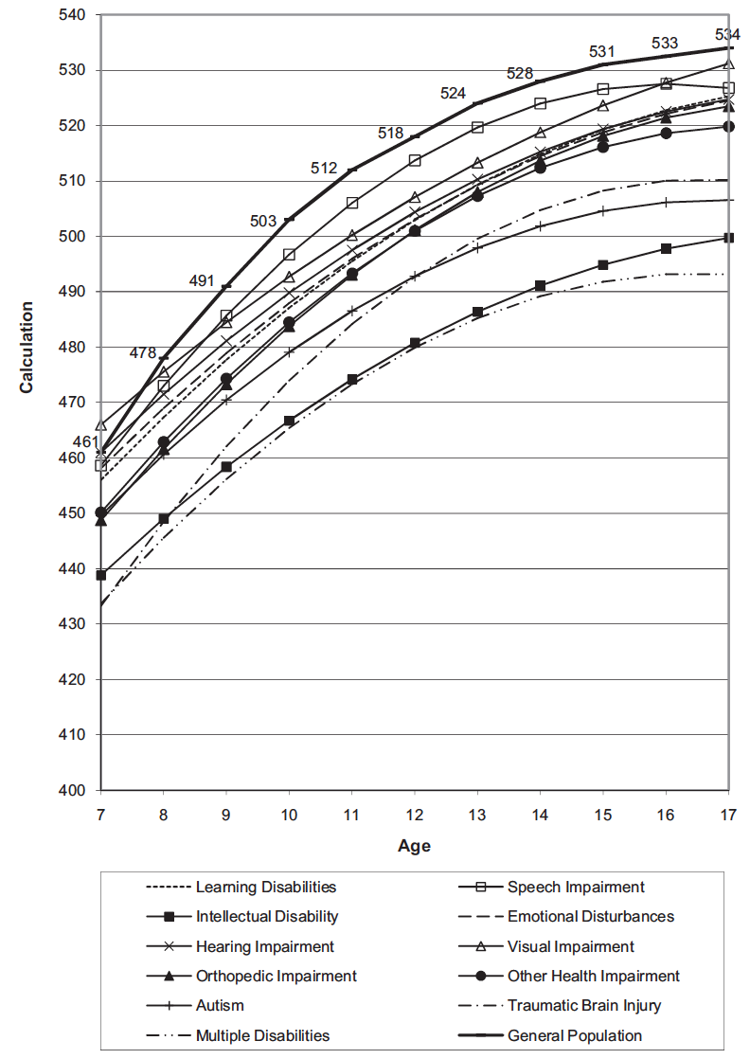
Wei, Lenz, & Blackorby (2013)

Slide 11
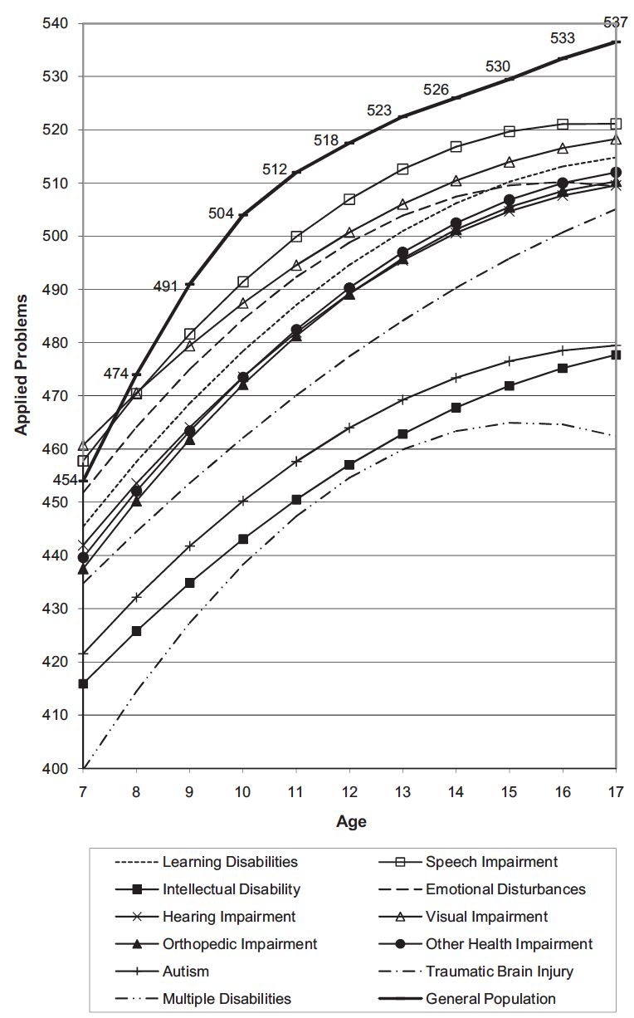
Wei, Lenz, & Blackorby (2013)

Slide 12
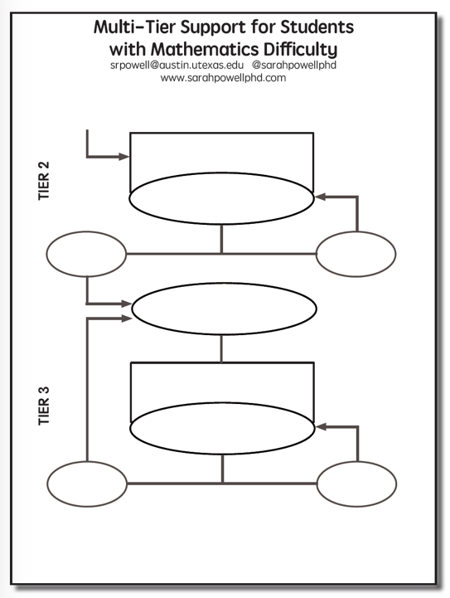

Slide 13
Tier 1
Core instruction utilizes evidence-based practices
All students screened (universal screener)
Students scoring below a cut-score are suspected at risk for math difficulties
Suspected at-risk students monitored for 6 to 10 weeks during primary prevention using progress monitoring

Slide 14
Progress Monitoring
Efficient, easy to administer measures given on a weekly basis to students who are first identified through screening
SOME, not all measures are typically Curriculum-Based Measures (CBMs)
Measures take between 1 and 8 minutes

Slide 15
Tier 1
After 6–10 weeks, student risk status is confirmed or disconfirmed

Slide 16
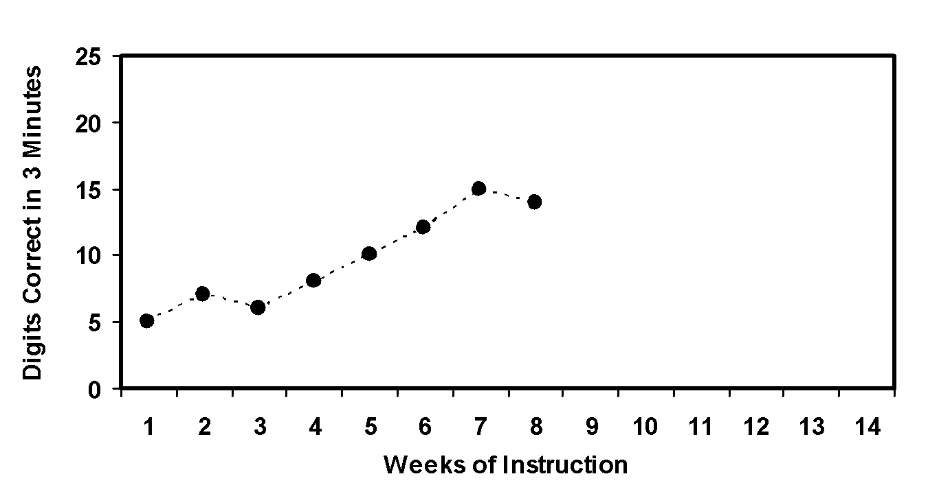
Tier 1
Slope = 1.0
13 – 6
7
X
X
Student NOT at risk.

Slide 17
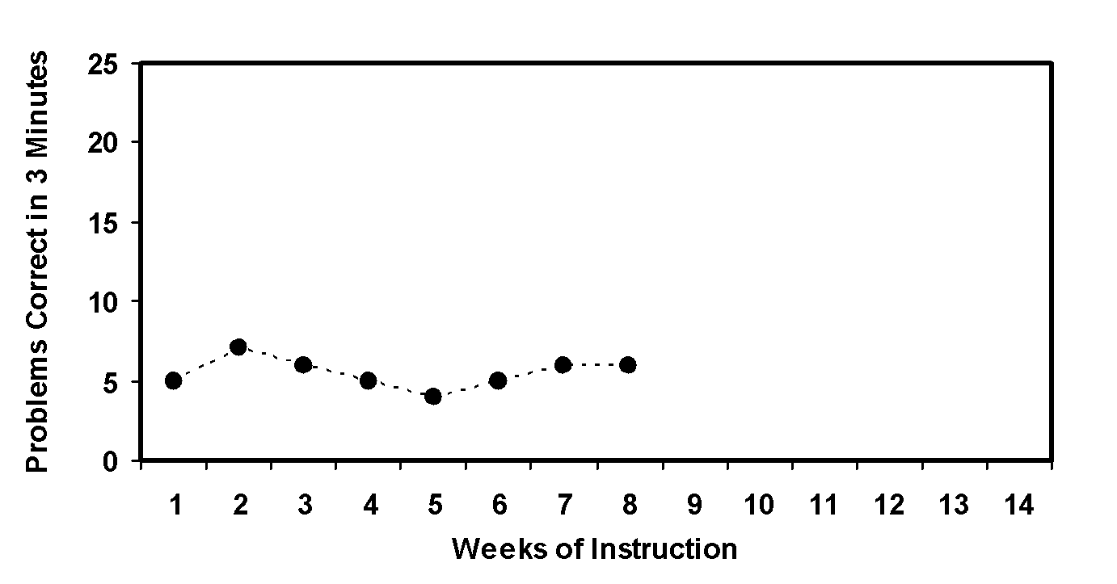
Tier 1
Slope = 0.0
6 – 6
7
X
X
Student AT RISK.
Requires additional support!

Slide 18
Tier 1
TO REVIEW…
Evidence-based instruction
All classroom students screened to identify suspected at-risk students
Suspected at-risk students remain in primary prevention and are monitored using progress monitoring for 6 to 10 weeks:
Students with adequate slopes remain in primary prevention
Students with inadequate slopes move to Tier 2 (secondary prevention)

Slide 19
Tier 2
This is the start of DBI
Students are tutored in small groups using evidence-based practices
Tutoring takes place three or four times a week
Each tutoring session lasts 30 to 60 minutes
Tutoring lasts 10 to 20 weeks
Progress monitoring continues weekly

Slide 20
Tier 2
If student response to secondary prevention is inadequate:
In some MTSS versions:
Student participates in more small-group tutoring with weekly progress monitoring
In other RTI versions:
Student moves to Tier 3
Comprehensive evaluation answers questions, determines disability, and suggests if special education services are appropriate

Slide 21
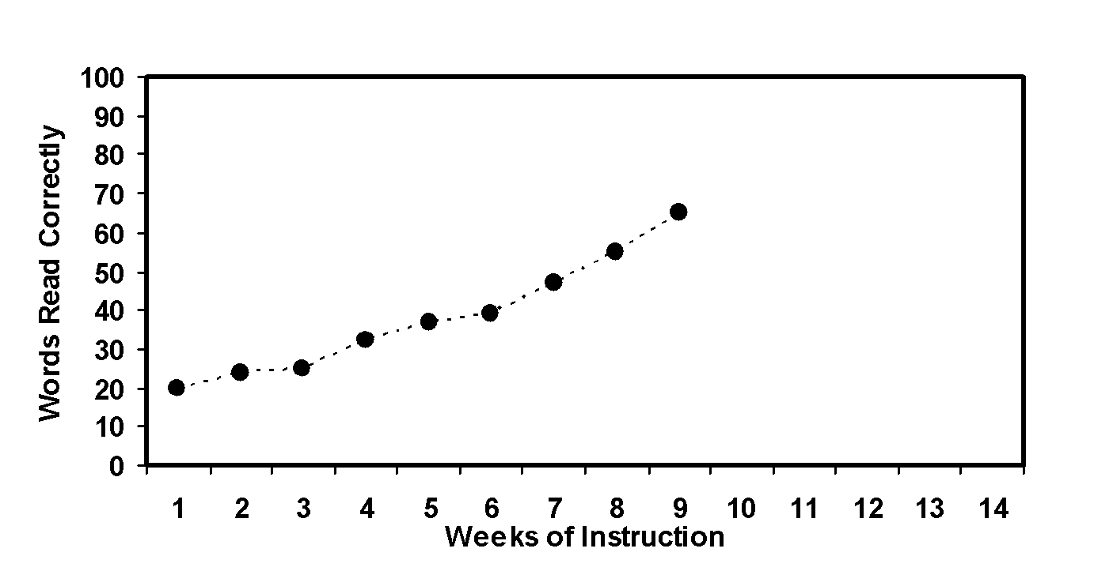
Tier 2
David’s slope:
(54 – 24) ÷ 8 = 3.75
X
David doesn’t require Tier 2/Tier3
X

Slide 22
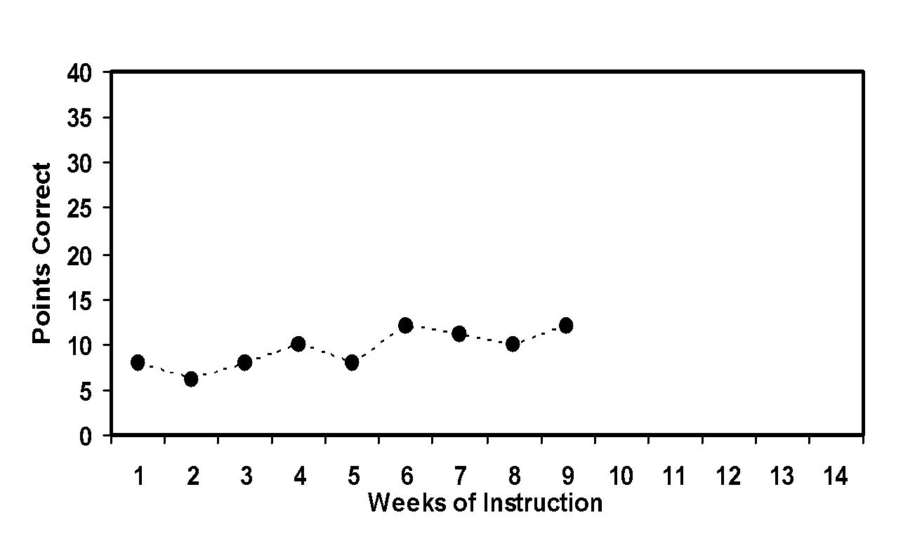
Tier 2
Martha’s slope:
(10 – 6) ÷ 8 = 0.5
X
X
Martha requires Tier 3

Slide 23
Tier 2
TO REVIEW…
Suspected at-risk students with inadequate performance in Tier 1 are tutored in small groups
Tutoring uses research-based interventions
Student progress is monitored weekly:
Students with adequate slopes return to primary prevention, with continued progress monitoring
Students with inadequate slopes move to Tier 3

Slide 24
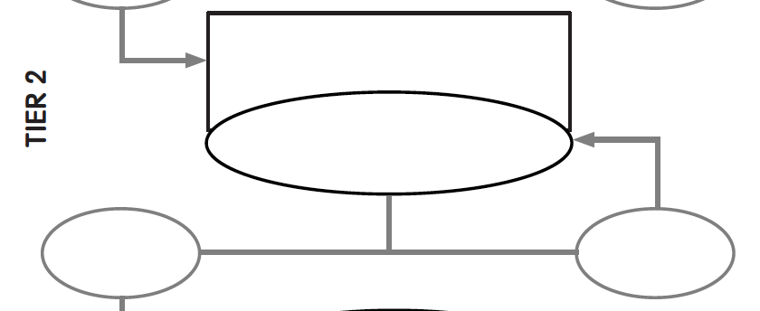
Evidence-based instruction
provided in small groups
Progress monitoring
for 10-20 weeks
Inadequate
response
Adequate
response

Slide 25
Think-Pair-Share
What is the current landscape for Tier 2 in your school?
What evidence-based mathematics interventions?
Who implements?
How is fidelity monitored?
What is the progress monitoring?
Who makes decisions?

Slide 26
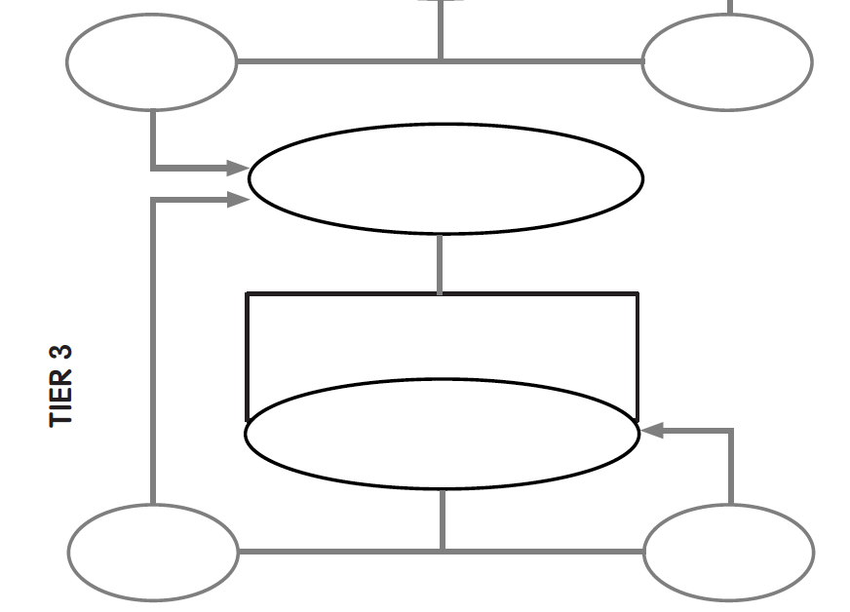
Inadequate response
Adequate
response
Diagnostic
Assessment

Slide 27
Tier 3
Diagnostics are conducted
Adaptations are made to the student’s intervention
Student progress is monitored weekly
With adequate slopes or end levels, students return to secondary or primary prevention

Slide 28
Think-Pair-Share
What is the current landscape for diagnostic assessments in your school?
What data do you use to help you understand why students are under-performing?
How do you find out students’ strengths and areas of improvement?
What information helps you identify students’ misconceptions and errors?

Slide 29
Tier 3
TO REVIEW…
Students receive individualized intervention
Goals are set
Student progress is monitored:
Students with adequate slopes and projected end levels return to Tier 2 or Tier 1, with ongoing progress monitoring
Students with inadequate slopes and projected end levels remain in Tier 3, with ongoing progress monitoring

Slide 30
Inadequate
response
Adequate
response
Diagnostic
Assessment
Evidence-based instruction provided
(small groups or individually)
Progress monitoring
for 10-20 weeks
Inadequate
response
Adequate
response

Slide 31
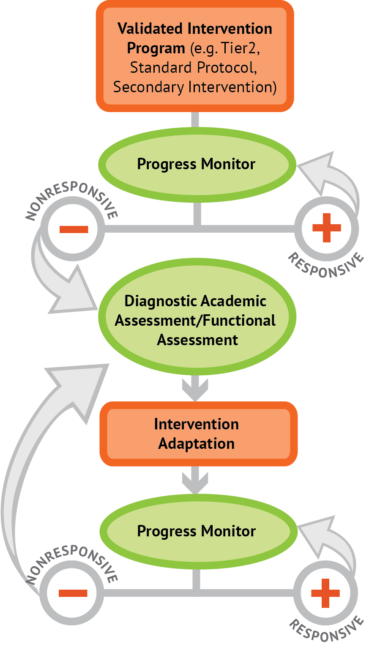
Intervention: Occurs frequently and with intensity
Assessment: Formative
Assessment: Diagnostic
Intervention adaptation: Content, dosage, explicit instruction, attention to transfer
Assessment: Formative

Slide 32
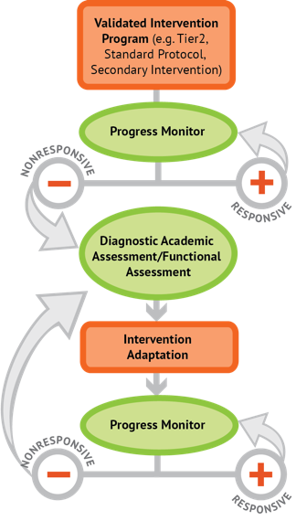
Instructional Platform
INSTRUCTIONAL DELIVERY
Explicit instruction
Precise language
Multiple representations
INSTRUCTIONAL STRATEGIES
Fluency building
Problem solving instruction
Motivation component

Slide 33
Explicit Instruction
Modeling
Practice
Clear Explanation
Guided
Practice
Planned
Examples
Independent Practice
Supporting Practices
Asking the right questions
Eliciting frequent responses
Providing immediate specific feedback
Maintaining a brisk pace

Slide 35
Goal and importance
“Today, we are learning about division. This is important because sometimes you have to share objects or things with your friends.”
Modeling
Practice
Clear Explanation
Guided
Practice
We Do
Planned
Examples
Independent Practice
“Let’s continue working with our three-dimensional shapes and volume. Understanding volume and calculating volume helps with measuring capacity.”
You Do
Supporting Practices
Asking the right questions
Eliciting frequent responses
Providing immediate specific feedback
Maintaining a brisk pace
Copyright 2018 Sarah R. Powell, Ph.D.

Slide 36
Goal and importance
Model steps
Modeling
Practice
Clear Explanation
Guided
Practice
“To solve 26 plus 79, I first decide about the operation. Do I add, subtract, multiply or divide?”
We Do
“The plus sign tells me to add. So, I’ll add 26 plus 79. I’ll use the partial sums strategy. First, I add 20 plus 70. What’s 20 plus 70?”
Planned
Examples
Independent Practice
You Do
Supporting Practices
“20 plus 70 is 90. I write 90 right here.”
Asking the right questions
Eliciting frequent responses
Providing immediate specific feedback
Maintaining a brisk pace
“Then I add 6 plus 9. What’s 6 plus 9?”
“6 plus 9 is 15. So, I write 15 here.”
“Finally, we add the partial sums: 90 and 15. Why do we add 90 and 15?”
“90 plus 15 is 105. So, 26 plus 79 equals 105.”
Copyright 2018 Sarah R. Powell, Ph.D.

Slide 37
Goal and importance
Model steps
Modeling
Practice
Clear Explanation
Concise language
Guided
Practice
We Do
Planned
Examples
Independent Practice
“To solve 26 plus 79, I first decide about the operation. Do I add, subtract, multiply, or divide?”
You Do
“The plus sign tells me to add. So, I’ll add 26 plus 79. I’ll use the partial sums strategy. First, I add 20 plus 70. What’s 20 plus 70?”
Supporting Practices
Asking the right questions
Eliciting frequent responses
Providing immediate specific feedback
Maintaining a brisk pace
“20 plus 70 is 90. I write 90 right here under the equal line.”
“Then I add 6 plus 7. What’s 6 plus 7?”
“6 plus 7 is 13. So, I write 13 here.”
“Finally, we add the partial sums: 90 and 13. 90 plus 13 is 103. So, 26 plus 79 equals 103.”
Copyright 2018 Sarah R. Powell, Ph.D.

Slide 38
Examples
“Today, we are learning about division. This is important because sometimes you have to share objects or things with your friends.”
Modeling
Practice
Clear Explanation
Guided
Practice
24 / 6
We Do
35 $)$ 5
28 $÷$ 7
Planned
Examples
Independent Practice
You Do
Supporting Practices
Asking the right questions
Eliciting frequent responses
Providing immediate specific feedback
Maintaining a brisk pace
Copyright 2018 Sarah R. Powell, Ph.D.

Slide 39
Examples
“Today, we are learning about division. This is important because sometimes you have to share objects or things with your friends.”
Modeling
Practice
Clear Explanation
Guided
Practice
24 / 6
We Do
35 $)$ 5
28 $÷$ 7
Planned
Examples
Independent Practice
You Do
With non-examples
Supporting Practices
Asking the right questions
Eliciting frequent responses
Providing immediate specific feedback
Maintaining a brisk pace
32 $÷$ 8
42 $÷$ 7
25 $−$ 5
Copyright 2018 Sarah R. Powell, Ph.D.

Slide 40
Modeling
Practice
Clear Explanation
Guided
Practice
Planned
Examples
Independent Practice
Supporting Practices
Asking the right questions
Eliciting frequent responses
Providing immediate specific feedback
Maintaining a brisk pace
Copyright 2018 Sarah R. Powell, Ph.D.

Slide 41
I Do
Modeling
Practice
Clear Explanation
Guided
Practice
Planned
Examples
Independent Practice
Supporting Practices
Asking the right questions
Eliciting frequent responses
Providing immediate specific feedback
Maintaining a brisk pace
Copyright 2018 Sarah R. Powell, Ph.D.

Slide 42
I Do
Modeling
Practice
Teacher and student practice together
Clear Explanation
Guided
Practice
Planned
Examples
Independent Practice
Supporting Practices
Asking the right questions
Eliciting frequent responses
Providing immediate specific feedback
Maintaining a brisk pace
Copyright 2018 Sarah R. Powell, Ph.D.

Slide 43
I Do
Modeling
Practice
Clear Explanation
Guided
Practice
Planned
Examples
Independent Practice
Student practices with teacher support
Supporting Practices
Asking the right questions
Eliciting frequent responses
Providing immediate specific feedback
Maintaining a brisk pace
Copyright 2018 Sarah R. Powell, Ph.D.

Slide 44
Modeling
Practice
Clear Explanation
Guided
Practice
Planned
Examples
Independent Practice
Supporting Practices
Asking the right questions
Eliciting frequent responses
Providing immediate specific feedback
Maintaining a brisk pace
Copyright 2018 Sarah R. Powell, Ph.D.

Slide 45
I Do
Modeling
Practice
Clear Explanation
Guided
Practice
We Do
Planned
Examples
Independent Practice
You Do
Supporting Practices
Asking the right questions
Eliciting frequent responses
Providing immediate specific feedback
Maintaining a brisk pace
Copyright 2018 Sarah R. Powell, Ph.D.

Slide 46
I Do
Modeling
Practice
Clear Explanation
Guided
Practice
Low-level and high-level
We Do
Planned
Examples
Independent Practice
You Do
“What is 7 times 9?”
“Which shape has 6 sides?”
“What do you do when you see a word problem?”
“Why do you have to regroup?”
“How would you solve this problem?”
“Why do you have to use zero pairs?”
Supporting Practices
Asking the right questions
Eliciting frequent responses
Providing immediate specific feedback
Maintaining a brisk pace
Copyright 2018 Sarah R. Powell, Ph.D.

Slide 47
I Do
Modeling
Practice
Clear Explanation
Guided
Practice
Low-level and high-level
We Do
Planned
Examples
Independent Practice
You Do
Classwide, individual, partner, write on paper, write on whiteboard, thumbs up, etc.
“Turn and discuss the formula for perimeter with your partner.”
“Write the multiplication problem on your whiteboard.”
Supporting Practices
Asking the right questions
Eliciting frequent responses
Providing immediate specific feedback
Maintaining a brisk pace
“In your math journal, draw a picture to help you remember to term parallelogram.”
Copyright 2018 Sarah R. Powell, Ph.D.

Slide 48
I Do
Modeling
Practice
Clear Explanation
Guided
Practice
Low-level and high-level
We Do
Planned
Examples
Independent Practice
You Do
Classwide, individual, partner, write on paper, write on whiteboard, thumbs up, etc.
Affirmative and corrective
Supporting Practices
“Good work using your word-problem attack strategy.”
Asking the right questions
Eliciting frequent responses
Providing immediate specific feedback
Maintaining a brisk pace
“Let’s look at that again. Tell me how you added in the hundreds column.”
Copyright 2018 Sarah R. Powell, Ph.D.

Slide 49
I Do
Modeling
Practice
Clear Explanation
Guided
Practice
Low-level and high-level
We Do
Planned
Examples
Independent Practice
You Do
Classwide, individual, partner, write on paper, write on whiteboard, thumbs up, etc.
Affirmative and corrective
Planned and organized
Supporting Practices
Asking the right questions
Eliciting frequent responses
Providing immediate specific feedback
Maintaining a brisk pace
Copyright 2018 Sarah R. Powell, Ph.D.

Slide 50
Modeling
Practice
Clear Explanation
Guided
Practice
Planned
Examples
Independent Practice
Supporting Practices
Asking the right questions
Eliciting frequent responses
Providing immediate specific feedback
Maintaining a brisk pace
Copyright 2018 Sarah R. Powell, Ph.D.

Slide 51
Modeling
Practice
Supporting Practices
Introduction of material
Review of material
Modeling
Practice
Modeling
Practice
Supporting Practices
Supporting Practices

Slide 52
How do you use explicit instruction within intensive intervention?
Model steps using concise language
Provide guided practice opportunities
Provide independent practice opportunities
Use supporting practices during modeling and practice
Ask the right questions
Elicit frequent responses
Provide feedback
Be planned and organized

Slide 53
Instructional Platform
INSTRUCTIONAL DELIVERY
Explicit instruction
Precise language
Multiple representations
INSTRUCTIONAL STRATEGIES
Fluency building
Problem solving instruction
Motivation component

Slide 54
Vocabulary Across Grades

Slide 55
Language of Mathematics
Technical terms
Subtechnical terms
Symbolic terms
General terms
trapezoid
rhombus
numerator
addend
subtract
base
degrees
cube
plane
arc
plus
zero
twelve
dollars
and
above
measure
answer
longest
outside

Slide 56
Instead of…
Say…
“And the last one is 10.”
“8, 9, 10. We’ll stop counting there but we could count more.”
“What number is in the tens place?”
“What digit is in the tens place?”
“Six hundred and forty-eight”
“Six hundred forty-eight”
“Bigger number and smaller number”
“Number that is greater and the number that is less”
Hughes et al. (2016)

Slide 57
Instead of…
Say…
“Numbers in the fraction”
“This fraction is one number.”
“Top number and bottom number”
“Numerator and denominator”
“Reduce”
“Find an equivalent fraction”
“One point two nine”
“One and twenty-nine hundredths”
Hughes et al. (2016)

Slide 58
Instead of…
Say…
“Corner”
“Angle”
“Flips, slides, and turns”
“Reflections, translations, and rotations”
“Box or ball
“Cube or sphere”
“Long hand and short hand”
“Minute hand and hour hand”
Hughes et al. (2016)

Slide 59
precise
“The denominator is the number of equal parts that make the whole.”
“A difference problem is two amounts compared for the difference.”
“To show the fraction, look at the denominator. A denominator of 5 means I need to break the whole into 5 equal parts.”
concise
“To use partial sums, add the hundreds, then add the tens, then add the ones. Finally, add all the partial sums.”

Slide 61
How do you attend to language within intensive intervention?
Understand why formal mathematical language is important
Plan for mathematical language to be precise
Plan for mathematical language to be concise

Slide 62
Instructional Platform
INSTRUCTIONAL DELIVERY
Explicit instruction
Precise language
Multiple representations
INSTRUCTIONAL STRATEGIES
Fluency building
Problem solving instruction
Motivation component

Slide 63
Multiple Representations
Abstract
Pictorial
Concrete

Slide 64
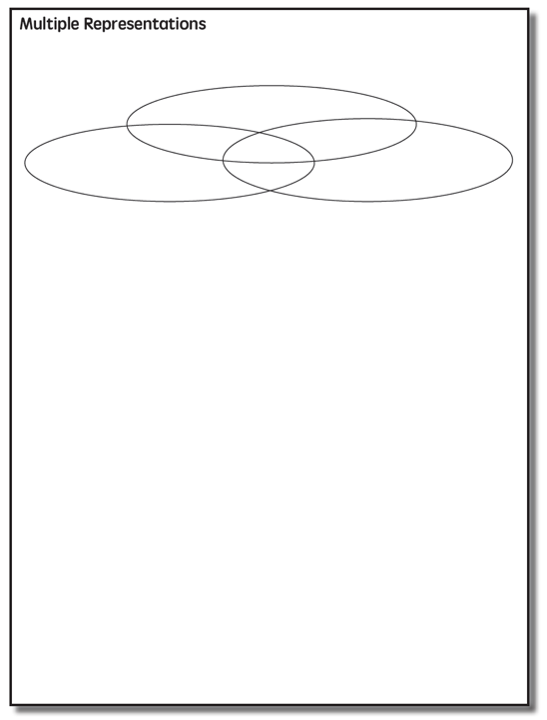

Slide 65
Abstract
Pictorial
Concrete
Three-dimensional objects

Slide 66
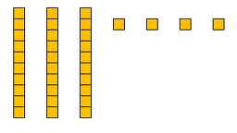
Abstract
Pictorial
Concrete
Two-dimensional images

Slide 67
Abstract
Pictorial
Concrete
Numerals and symbols
2 + 8 = 10
34 = 3 tens and 4 ones
x – 6 = 8
4,179
+ 569

Slide 68
How should multiple representations be used within intensive intervention?
Use three-dimensional concrete materials to teach concepts and procedures
Use two-dimensional representations to teach concepts and procedures
Ensure students understand mathematics with numbers and symbols (i.e., the abstract)

Slide 69
Some examples of Multiple Representations

Slide 70
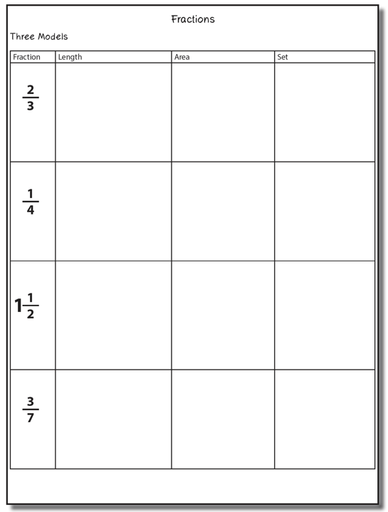

Slide 71
Fraction Models
Length
Area
Set

Slide 72
Length/Measurement
Fractions are appropriated by length
Fraction tiles/bars

Slide 73
Length/Measurement
Fractions are appropriated by length
Cuisenaire rods

Slide 74
Length/Measurement
Fractions are appropriated by length
Number line

Slide 75
Select a fraction and teach using the length model.
Explicit instruction
Multiple representations
Concise language

Slide 76
Area/Region
Shapes divided into equal sections
Fraction circles

Slide 77
Area/Region
Shapes divided into equal sections
Geoboards

Slide 78
Area/Region
Shapes divided into equal sections
Pattern blocks

Slide 79
Area/Region
Shapes divided into equal sections
Legos

Slide 80
Select a fraction and teach using the area model.
Explicit instruction
Multiple representations
Concise language

Slide 81
Set/Discrete
Individual shapes match the fraction
Two-color counters

Slide 82
Set/Discrete
Individual shapes match the fraction

Slide 83
Select a fraction and teach using the set model.
Explicit instruction
Multiple representations
Concise language

Slide 84
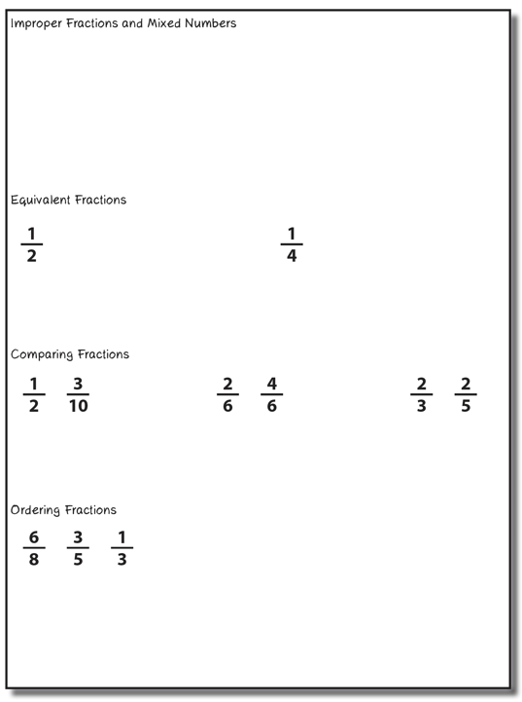

Slide 85
Improper Fractions
Fractions equal to or greater than 1
Numerator is equal to or greater than denominator
Select a fraction and teach using two models of fractions.
Explicit instruction
Mixed Numbers
Multiple representations
A mix of a whole number and a fraction
Concise language

Slide 86
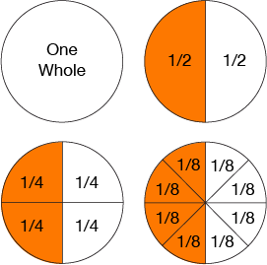
Equivalent Fractions
Determine equivalent fractions.
Explicit instruction
Multiple representations
Concise language

Slide 87
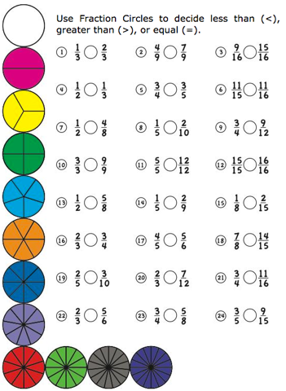
Comparing Fractions
Compare two fractions.
Explicit instruction
Multiple representations
Concise language

Slide 88
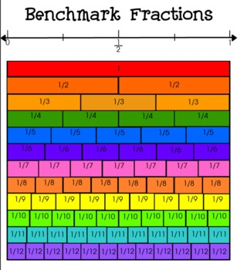
Ordering Fractions
Compare to benchmark fractions
Order three fractions.
Explicit instruction
Multiple representations
Concise language

Slide 90
Instructional Platform
INSTRUCTIONAL DELIVERY
Explicit instruction
Precise language
Multiple representations
INSTRUCTIONAL STRATEGIES
Fluency building
Problem solving instruction
Motivation component

Slide 91
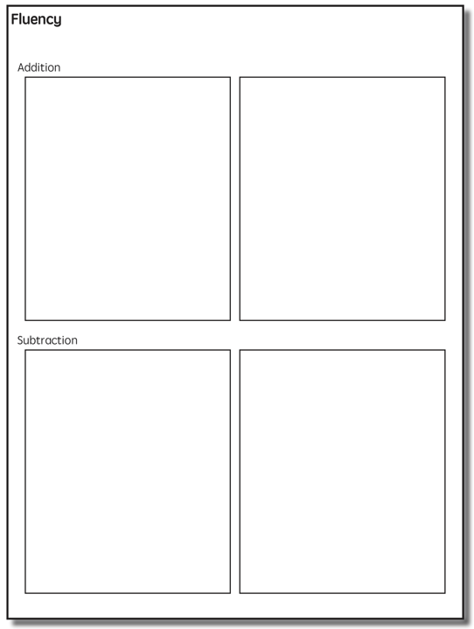

Slide 93
Addition Facts
100 addition basic facts
Single-digit addends sum to a single- or double-digit number
5 (addend)
+ 4 (addend)
9 (sum)

Slide 94
Addition: Part-Part-Whole (Total)
Count one set, count another set, put sets together, count sum
2 + 3 = 5

Slide 95
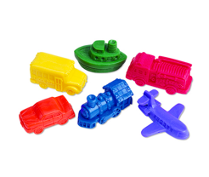
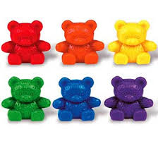
Addition: Part-Part-Whole (Total)
4 + 5 = __
3 + 7 = __
Teach this problem to a student.
Explicit instruction
Multiple representations
Concise language

Slide 96
Addition: Join (Change Increase)
Start with a set, add the other set, count sum
2 + 3 = 5

Slide 97
Addition: Join (Change Increase)
8 + 3 = __
5 + 6 = __
Teach this problem to a student.
Explicit instruction
Multiple representations
Concise language

Slide 98
Why is it important to understand addition in two separate ways?

Slide 99
Total
Parts put together into a total
Freddy saw 4 cardinals and 5 blue jays. How many birds did Freddy see?
4 + 5 = ?

Slide 100
Change
An amount that increases or decreases
Lara had $4. Then she earned $3 for cleaning her room. How much money does Lara have now?
4 + 3 = ?

Slide 101
Part-Part-Whole Versus Join
3 + 9 = __
7 + 4 = __
Determine a word problem for each schema.
Explicit instruction
Multiple representations
Concise language

Slide 103
Subtraction Facts
100 subtraction basic facts
Subtrahend and difference are single-digit numbers and minuend is single- or double-digit number
16 (minuend)
– 8 (subtrahend)
8 (difference)

Slide 104
Subtraction: Separate (Change Decrease)
Start with a set, take away from that set, count difference
5 – 3 = 2

Slide 105
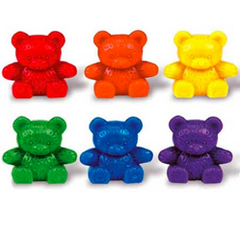
Subtraction: Separate (Change Decrease)
11 – 6 = __
13 – 7 = __
Teach this problem to a student.
Explicit instruction
Multiple representations
Concise language

Slide 106
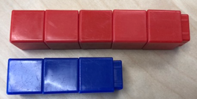
Subtraction: Compare (Difference)
Compare two sets, count difference
5 – 3 = 2

Slide 107
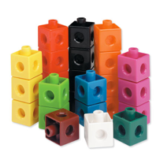
Subtraction: Compare (Difference)
10 – 7 = __
11 – 3 = __
Teach this problem to a student.
Explicit instruction
Multiple representations
Concise language

Slide 108
Why is it important to understand subtraction in two separate ways?

Slide 109
Difference
Greater and less amounts compared for a difference
Pedro has 9 apples. Silvia has 4 apples. How many more apples does Pedro have? (How many fewer does Silvia have?)
9 – 4 = ?

Slide 110
Change
An amount that increases or decreases
Melissa had 9 cookies. Then she ate 2 of the cookies. How many cookies does Melissa have now?
9 – 2 = ?

Slide 111
Separate Versus Compare
9 – 5 = __
8 – 3 = __
Determine a word problem for each schema.
Explicit instruction
Multiple representations
Concise language

Slide 113
Multiplication Facts
100 multiplication basic facts
Multiplication of single-digit factors results in a single- or double-digit product
2 (factor)
× 3 (factor)
6 (product)

Slide 114
Multiplication: Equal Groups
Show the groups, show the amount for each group, count product
3 × 2 = 6

Slide 115
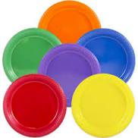
Multiplication: Equal Groups
5 × 3 = __
2 × 5 = __
Teach this problem to a student.
Explicit instruction
Multiple representations
Concise language

Slide 116
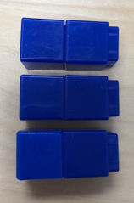
Multiplication: Array/Area
Make the array, count product
3 × 2 = 6

Slide 117
Multiplication: Array/Area
3 × 4 = __
2 × 5 = __
Teach this problem to a student.
Explicit instruction
Multiple representations
Concise language

Slide 118
Multiplication: Comparison
Show a set, then multiply the set
3 × 2 = 6

Slide 119
Multiplication: Comparison
6 × 3 = __
4 × 5 = __
Teach this problem to a student.
Explicit instruction
Multiple representations
Concise language

Slide 120
Why is it important to understand multiplication in different ways?

Slide 121
Equal Groups
Groups multiplied by number in each group for a product
Haley has 2 bags of apples. There are 6 apples in each bag. How many apples does Haley have altogether?
2 × 6 = ?

Slide 122
Comparison
Set multiplied by a number of times for a product
Beth picked 6 apples. Marcie picked 2 times as many apples as Beth. How many apples did Marcie pick?
6 × 2 = ?

Slide 124
Division Facts
90 division basic facts
Divisor and quotient are single-digit numbers and dividend is single- or double-digit number
8 ÷ 4 = 2
(dividend) (divisor) (quotient)

Slide 125
Division: Equal Groups (Partitive Division)
Show the dividend, divide equally among divisor, count quotient
6 ÷ 3 = 2

Slide 126
Division: Partitive Division
12 ÷ 4 = __
15 ÷ 3 = __
Teach this problem to a student.
Explicit instruction
Multiple representations
Concise language

Slide 127
Division: Equal Groups (Measurement Division)
Show the dividend, make groups of the divisor, count groups
6 ÷ 3 = 2

Slide 128
Division: Measurement Division
10 ÷ 5 = __
9 ÷ 3 = __
Teach this problem to a student.
Explicit instruction
Multiple representations
Concise language

Slide 129
Why is it important to understand division in different ways?

Slide 130
Equal Groups
Groups multiplied by number in each group for a product
Haley has 12 apples. He wants to share them equally among his 2 friends. How many apples will each friend receive?
2 × ? = 12
Haley has 12 apples. He put them into bags containing 6 apples each. How many bags did Mark use?
? × 6 = 12

Slide 131
Computation

Slide 133
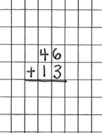
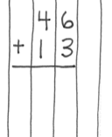
Notation Matters
Work on vertical presentation

Slide 134
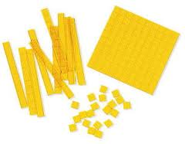
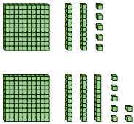
Addition and Subtraction
Focus on place value

Slide 135
Addition and Subtraction
Introduce regrouping/trading/exchanging after mastery of problems without regrouping
10 ones for 1 ten
10 tens for 1 hundred
1 ten for 10 ones
1 hundred for 10 tens
Regroup
Trade
Exchange
Carry
Addition
Regroup
Trade
Exchange
Borrow
Subtraction

Slide 136
Linda
Traditional
Work right to left (start in ones column)

Slide 137
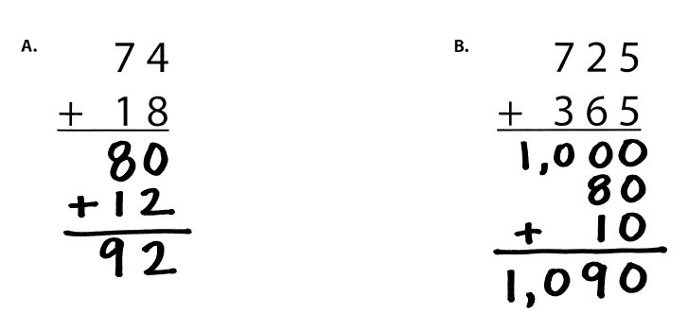
Lluvia
Partial Sums
Work left to right

Slide 138
Jennifer
Opposite Change
Round one number to nearest ten
Amount added is subtracted from other number

Slide 139
Alina
Column Addition
Work left to right

Slide 140
Teach a grade-level addition problem.
Explicit instruction
Multiple representations
Concise language

Slide 141
Kimberly
Traditional Method
Work right to left (start in ones column)

Slide 142
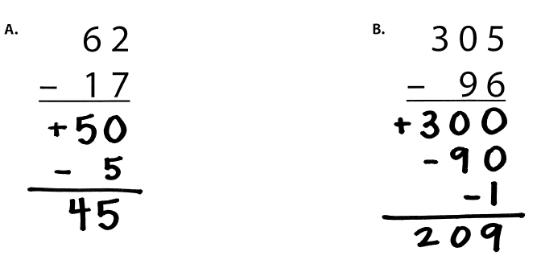
Ricardo
Partial Differences
Work left to right

Slide 143
Tiffiny
Same Change
Change subtrahend to end in 0

Slide 144
Phedra
Add-Up

Slide 145
Teach a grade-level subtraction problem.
Explicit instruction
Multiple representations
Concise language

Slide 147
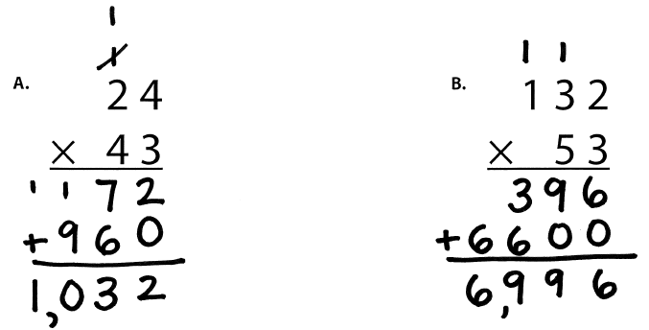
Susan
Traditional

Slide 148
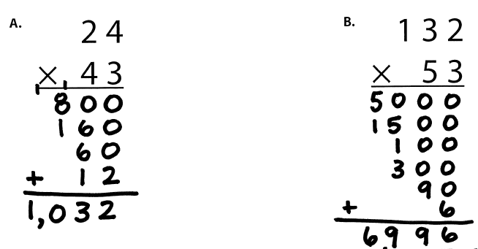
Mary
Partial Products

Slide 149
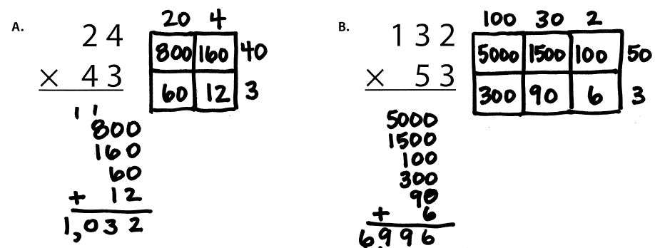
Kathryn
Area

Slide 150
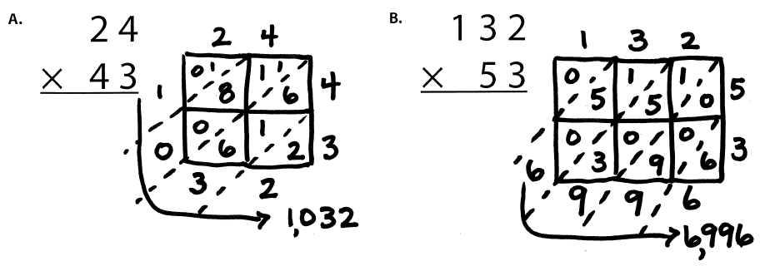
Cynthia
Lattice Method (383 × 27)

Slide 151
Teach a grade-level multiplication problem.
Explicit instruction
Multiple representations
Concise language

Slide 152
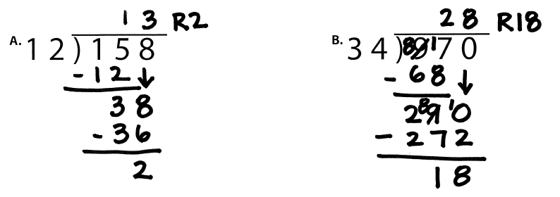
April
Traditional Method
Notes:
1. Yellow handouts: Multiplication and division

Slide 153
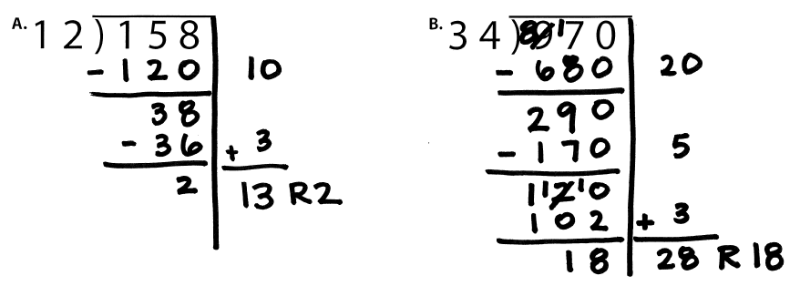
Brian
Partial Quotients

Slide 154
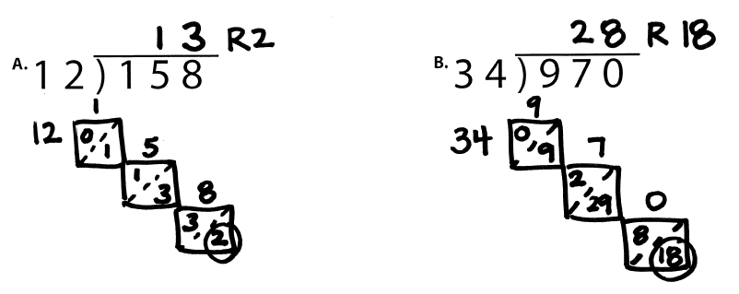
Cheryl
Lattice Division

Slide 155
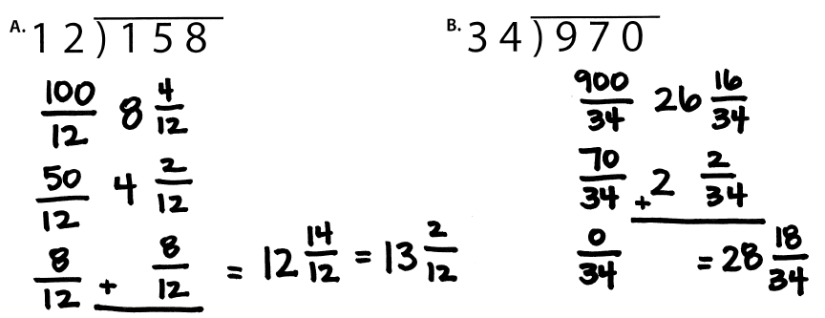
Juanita
Division as Fractions

Slide 156
Teach a grade-level division problem.
Explicit instruction
Multiple representations
Concise language

Slide 157
Fraction Computation

Slide 158
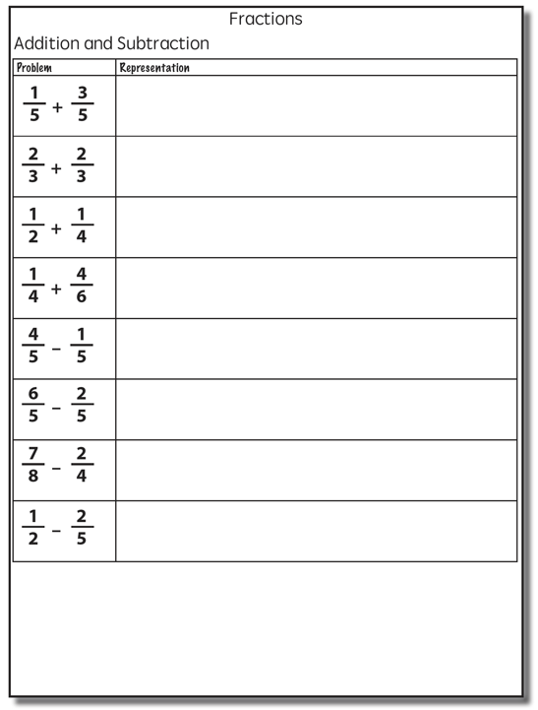
Addition

Slide 159
Addition

Slide 160
Addition

Slide 161
Explicit instruction
Multiple representations
Concise language

Slide 162
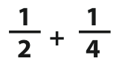
Addition

Slide 163
Addition
2: 2, 4, 6, 8, 10
4: 4, 8, 12, 16, 20

Slide 164
Addition

Slide 165
Explicit instruction
Multiple representations
Concise language

Slide 166
Subtraction

Slide 167
Subtraction

Slide 168
Explicit instruction
Multiple representations
Concise language

Slide 169
Subtraction
Take away from this set
This is for reference

Slide 170
Explicit instruction
Multiple representations
Concise language

Slide 171
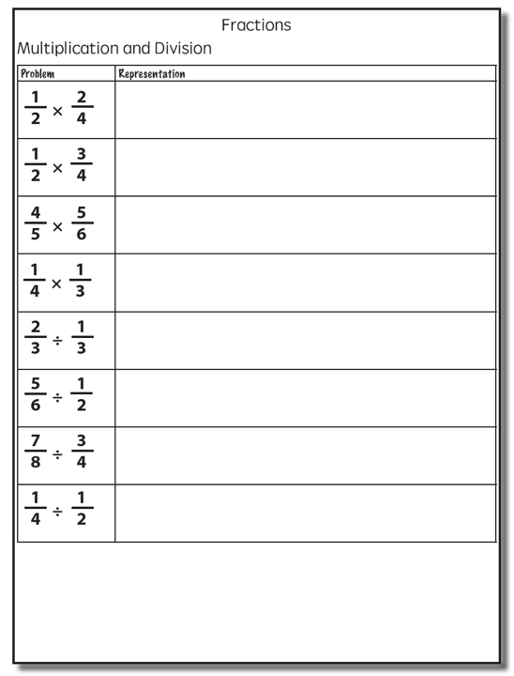
Multiplication
Multiplication
Interpret multiplication sign as “of”
2/3 of 3/4

Slide 172
Multiplication
Show
One-half of four-fourths

Slide 173
Multiplication
Show
One-half of two-fourths

Slide 174
Multiplication
Show
One-half of one-fourth
One-half of one-fourth

Slide 175
Multiplication
Show
One-half of three-fourths

Slide 176
Multiplication
Show
One-half of one-fourth
One-half of one-fourth
One-half of one-fourth

Slide 177
Multiplication
Show

Slide 178
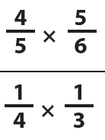
Multiplication
Choose one of the multiplication problems and design intensive instruction related to the topic.
Explicit instruction
Multiple representations
Concise language

Slide 179
Division
Division
“How many sets of the second fraction fit into the first fraction?”

Slide 180
Multiplication
Show
1 set of one-third
2 sets of one-third
3 sets of one-third

Slide 181
Multiplication
Show
1 set of one-third
2 sets of one-third

Slide 182
Multiplication
Show
1 set of one-half
Two-thirds set of one-half

Slide 183
Division
Show

Slide 184
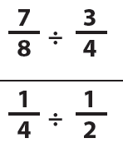
Division
Choose one of the division problems and design intensive instruction related to the topic.
Explicit instruction
Multiple representations
Concise language

Slide 185
BRIEF
(1-2 min)
DAILY
(everyday)

Slide 186
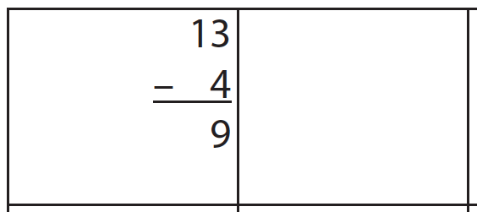
Fluency: Cover, Copy, Compare
13
- 4
9

Slide 187
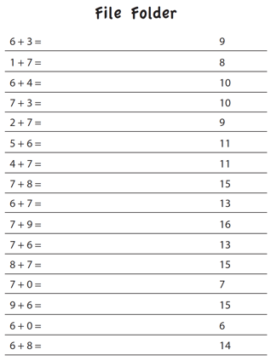
Fluency: File Folders
9
8
10
10
9
11

Slide 188
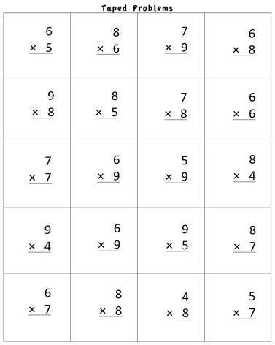
Fluency: Taped Problems

Slide 189
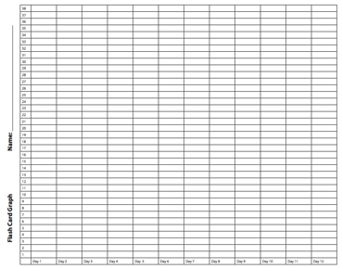
Fluency: Flash Cards
Start with a small set of flash cards. As students demonstrate mastery, add in a few more cards at a time.

Slide 190
Fluency: Magic Squares
4
5
12
8
6
1
3
3
6

Slide 191
Fluency: Wrap-Ups

Slide 192
Fluency: Cards, Dice, Dominoes
Roll dice
Select dominoes
Deal cards

Slide 193
Fluency: Games
Mobi
Smath

Slide 194
Fluency: Technology

Slide 195
BRIEF
(1-2 min)
DAILY
(everyday)

Slide 196
Instructional Platform
INSTRUCTIONAL DELIVERY
Explicit instruction
Precise language
Multiple representations
INSTRUCTIONAL STRATEGIES
Fluency building
Problem solving instruction
Motivation component

Slide 197
How would you teach this problem?
What do students need to know to solve this problem?
What might cause difficulty for students?

Slide 198
Problem Solving Difficulties
Reading problems
Understanding vocabulary
Identifying relevant information
Ignoring irrelevant information
Interpreting charts and graphs
Identifying appropriate operation(s)
Performing the computation(s)

Slide 199
Reading problems
Understanding vocabulary
Identifying relevant information
Ignoring irrelevant information
Interpreting charts and graphs
PARCC third-grade release item (2015)
Identifying appropriate operation(s)
Performing the computation(s)

Slide 201
Don’t tie key words to operations
Teach word-problem schemas
Have an attack strategy

Slide 203
Kasey made $42, and Mandy made $37. How much money did they make in all?
Kasey and Mandy made $79 in all. If Kasey made $42, how much money did Mandy make?
Becky has $70 more than Perla. If Becky has $120, how much money does Perla have?
Becky has $70 more than Perla. If Perla has $50, how much money does Becky have?

Slide 204
Matt baked 18 cookies. His brother baked twice as many. How many cookies did his brother bake?
Matt’s brother baked twice as many cookies as Matt. If Matt’s brother baked 36 cookies, how many did Matt bake?
Rachel wants to share 36 brownies with 6 friends. How many cookies will each friend receive?
Rachel shared brownies with 6 friends. Each friend ate 6 brownies. How many brownies did Rachel have to start with?

Slide 205
Michelle made 17 paper airplanes. Dante made 24 paper airplanes. How many airplanes did they make altogether?
Michelle and Dante made 41 paper airplanes altogether. If Dante made 24 paper airplanes, how many did Michelle make?
Michelle made 4 paper airplanes using 2 pieces of paper for each airplane. How much paper did Michelle use altogether?
Dante and Michelle made 40 paper airplanes altogether. Dante made 24 of the paper airplanes. If Michelle gave 7 of her paper airplanes to her friend Nicole, how many planes does Michelle have now?

Slide 206
Students need to understand key words. But, key words should not be directly tied to operations.

Slide 208
Identify a key word. Write a problem where the key word “works.” Write a problem where the key word doesn’t ”work.”

Slide 209
Don’t tie key words to operations
Teach word-problem schemas
Have an attack strategy

Slide 210
For every word problem
Regardless of problem type, students need an attack strategy for working through the problem
This strategy should work for any problem type
Routine Word Problems
Instructional Word Problems

Slide 211
RIDGES
Read the problem.
I know statement.
Draw a picture.
Goal statement.
Equation development.
Solve the equation.
RIDE
Read the problem.
Identify the relevant information.
Determine the operation and unit for the answer.
Enter the correct numbers and calculate, then check the answer.

Slide 214
SIGNS
Survey questions
Identify key words
Graphically draw problem
Note operations
Solve and check
SOLVE
Study the problem.
Organize the facts.
Line up the plan.
Verify the plan with computation.
Examine the answer.

Slide 215
R-CUBES
Read the problem.
Circle key numbers.
Underline the question.
Box action words.
Evaluate steps.
Solve and check.

Slide 217
Don’t tie key words to operations
Teach word-problem schemas
Have an attack strategy

Slide 218
Additive Schemas

Slide 219
Instruction Using Schemas
A schema refers to the structure of the word problem
Total
Difference
Change

Slide 221
Total
Parts put together into a total
Jennifer saw 4 cardinals and 5 blue jays. How many birds did Jennifer see?
4 + 5 = ?
Jennifer saw 9 birds. If 4 of the birds were cardinals, how many were blue jays?
4 + ? = 9
Jennifer saw 9 birds. 5 of the birds were blue jays, how many were cardinals?
5 + ? = 9

Slide 222
Total
P1 + P2 = T
Fuchs et al. (2008); Griffin & Jitendra (2009)

Slide 223
Total

Slide 224
Total
✔
✔
✔
P1 + P2 = T
U
P
S
✔
✔
28
+
24
=
?
✔
✔
28 + 24 = 52
X = 52 cookies
Grade 3 Smarter Balanced

Slide 225
Total
“Are parts put together for a total?”

Slide 226
Total
✔
✔
12
11
+ 1
12
12
- 11
1
✔
U
P
S
✔
✔
11
?
✔
✔
? = 1 millimeter
Grade 2 IXL

Slide 228
Difference
Greater and less amounts compared for a difference
Courtney has 9 apples. Silva has 4 apples. How many more apples does Courtney have? (How many fewer?)
9 – 4 = ?
Courtney has 5 more apples than Silva. If Silva has 4 apples, how many does Courtney have?
? – 4 = 5
Silva has 5 fewer apples than Courtney. Courtney has 9 apples. How many apples does Silva have?
9 – ? = 5

Slide 229
Difference
G – L = D
Fuchs et al. (2008); Griffin & Jitendra (2009)

Slide 230
Difference

Slide 231
Difference
✔
✔
G – L = D
✔
U
P
S
✔
✔
107
-
68
=
B
107
68
68
+ ?
107
✔
✔
107 – 68 = 39
B = 39 more beads
Grade 3 Smarter Balanced

Slide 232
Total
“Are parts put together for a total?”
Difference
“Are amounts compared for a difference?”

Slide 233
Difference

Slide 235
Change
An amount that increases or decreases
Sandra had $4. Then she earned $3 for cleaning her room. How much money does Sandra have now?
4 + 3 = ?
Sandra has $4. Then she earned money for cleaning her room. Now Sandra has $7. How much money did she earn?
4 + ? = 7
Sandra had some money. Then she made $3 for cleaning her room. Now she has $7. How much money did Sandra start with?
? + 3 = 7

Slide 236
Change
ST +/– C = E
Fuchs et al. (2008); Griffin & Jitendra (2009)

Slide 237
Change

Slide 238
Change
✔
A bus had 13 passengers. At the next stop, more passengers got on the bus. Now, there are 28 passengers. How many passengers got on the bus?
✔
✔
U
P
S
✔
ST + C = E
✔
13
+
?
=
28
✔
28
- 13
✔
13
+ ?
28
13 + 15 = 28
? = 15 passengers

Slide 239
Total
“Are parts put together for a total?”
Difference
“Are amounts compared for a difference?”
Change
“Does an amount increase or decrease?”

Slide 240
Change
An amount that increases or decreases
Yolanda baked 9 cookies. Then, she ate 2 of the cookies. How many cookies does Yolanda have now?
9 – 2 = ?
Yolanda baked 9 cookies. Then, she ate some of the cookies. Now, she has 7 cookies. How many cookies did Yolanda eat?
9 – ? = 7
Yolanda baked some cookies. She ate 2 of the cookies and has 7 cookies left. How many cookies did Yolanda bake?
? – 2 = 7

Slide 241
Change
ST +/– C = E
Fuchs et al. (2008); Griffin & Jitendra (2009)

Slide 242
Change

Slide 244
Total

Slide 245
Change

Slide 246
Difference

Slide 247
Total
P1 + P2 + P3 = T

Slide 248
Change
ST – C + C = E

Slide 249
Let’s Review
What’s a Total problem?
What’s a Difference problem?
What’s a Change problem?

Slide 250
Schema Quiz Time!

Slide 251
Difference
Grade 3 STAAR

Slide 252
Total
Grade 5 Smarter Balanced

Slide 253
Change
Grade 4 Smarted Balanced

Slide 254
Don’t describe using key words or operations
Teach word-problem schemas
Have an attack strategy

Slide 255
Multiplicative Schemas

Slide 257
Equal Groups
Groups multiplied by number in each group for a product
Kristina has 2 bags of apples. There are 6 apples in each bag. How many apples does Kristina have altogether?
2 × 6 = ?
Kristina has 12 apples. She wants to share them equally among her 2 friends. How many apples will each friend receive?
2 × ? = 12
Kristina has 12 apples. She put them into bags containing 6 apples each. How many bags did Kristina use?
? × 6 = 12

Slide 258
Equal Groups
G × N = P

Slide 260
✔
✔
✔
G x N = P
U
P
S
✔
✔
x
=
6
25
?
✔
✔
6 x 25 = 150
? = 150 cherries

Slide 261
Equal Groups
“Are there groups with an equal number in each group?”

Slide 262
Equal Groups
✔
✔
✔
U
P
S
✔
✔
?
4
24
✔
✔
? x 4 = 24
4
4
Grade 3 STAAR
? = 6 packs

Slide 263
Comparison
Set multiplied by a number of times for a product
Marcie picked 6 apples. Lisa picked 2 times as many apples as Marcie. How many apples did Lisa pick?
6 × 2 = ?
Lisa picked 12 apples. She picked 2 times as many apples as Marcie. How many apples did Marcie pick?
? × 2 = 12
Lisa picked 12 apples, and Marcie picked 6 apples. How many times as many apples did Lisa pick as Marcie did?
6 × ? = 12

Slide 264
Comparison
S × T = P

Slide 266
Comparison
✔
U
P
S
✔
6
2
?
✔
✔
✔
Grade 4 Smarter Balanced
? = 12 DVDs

Slide 267
Equal Groups
“Are there groups with an equal number in each group?”
Comparison
“Is a set compared a number of times?”

Slide 268
Ratios/Proportions
Description of relationships among quantities
Xin et al. (2005)

Slide 270
Ratios/Proportions
✔
✔
✔
✔
U
P
S
✔
✔
176
?
? = 110 slices
✔
✔
8
5

Slide 272
Ratios/Proportions

Slide 273
Equal Groups
“Are there groups with an equal number in each group?”
Comparison
“Is a set compared a number of times?”
Ratios/Proportions
“Are there relationships among quantities - if this, then this?”

Slide 275
Equal Groups

Slide 276
Ratios/Proportions

Slide 277
Comparison
Grade 4 Smarter Balanced

Slide 278
Let’s Review
What’s an Equal Groups problem?
What’s a Comparison problem?
What’s a Ratios/Proportions problem?

Slide 283
Schema Quiz Time!

Slide 284
Ratios/Proportions
Grade 6 Smarter Balanced

Slide 285
Equal Groups
Grade 4 PARCC

Slide 286
Comparison
Grade 4 Smarter Balanced

Slide 291
Schemas
Total
Difference
Change
Equal Groups
Comparison
Ratios/Proportions

Slide 292
Don’t describe using key words or operations
Teach word-problem schemas
Have an attack strategy

Slide 293
How do you incorporate effective problem-solving strategies within intensive intervention?
Don’t use key words tied to operations
Do teach students an attack strategy
Do teach students schemas
Do explicitly teach problem solving
Do provide problem-solving instruction regularly (i.e., several times a week)
Do practice schemas that students will encounter regularly

Slide 294
Instructional Platform
INSTRUCTIONAL DELIVERY
Explicit instruction
Concise language
Multiple representations
INSTRUCTIONAL STRATEGIES
Fluency building
Problem solving instruction
Motivation component

Slide 295
Motivation Component
on task
keep attention
regulate behavior

Slide 296
How do you incorporate a motivational component within intensive intervention?
Utilize a motivational component, when necessary

Slide 297
Instructional Platform
INSTRUCTIONAL DELIVERY
Explicit instruction
Concise language
Multiple representations
INSTRUCTIONAL STRATEGIES
Fluency building
Problem solving instruction
Motivation component

Slide 298
Contact Information
Sarah Powell, Ph.D.
The University of Texas at Austin
srpowell@austin.utexas.edu
@sarahpowellphd
119

