Slide 1
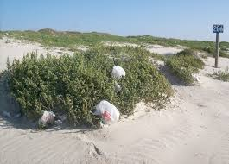
PROTECT PLYMOUTH BAN PLASTIC BAGS

Slide 2
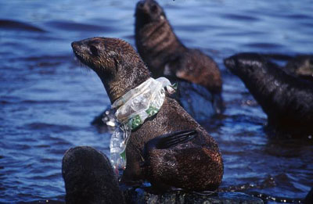
What’s The Problem ?
TOO MANY
NOT RECYCLED
MADE FROM FOSSIL FUELS
POLLUTES OUR WORLD
LASTS FOREVER
KILLS OVER 300 SPECIES ON LAND AND SEA
Notes:
DO NOT BIODEGRADE – DO NOT COMPOST

Slide 3
CONSUMPTION IS OUT OF CONTROL
IN PLYMOUTH, THE SUPERMARKETS ALONE DISPENSE
18,000,000
BAGS YEARLY
Notes:
According to a Mass Food Association survey, in 2012 the average supermarket in Massachusetts dispensed over two and one half million disposable bags – 2,682,643
The plastic shopping bag is in use for an average of 12 minutes
Americans discard 100 billion a year

Slide 4
Become Litter Are Rarely Recycle
Over 85% of plastic bags are not recycled
Not accepted for recycling at transfer stations or by curbside waste management companies in Plymouth
Notes:
So because there are limited number of places you can recycle these bags, most people just throw them out.
Why don’t they take these bags

Slide 5
Sorting Machinery Must Be Shutdown & Cleaned Every Shift
Notes:
. They have to be sorted and washed before they can be recycled. Labor intensive and hard to do.
Entangle mechanisms of recycling machinery resulting in increased labor & repair costs
With decreased cost of gas and oil - Costs more to recycle a plastic bag than to make a new one
Plastic Bags are the 3rd largest source of litter on U.S. Coasts, surpassed only by cigarette butts & bottle caps
Clogs storm drains, litter roadsides and our woods
Years of efforts to educate the public & encourage recycling have clearly failed

Slide 6
Disposal Fees Are Climbing
A plastic bag ban would eliminate 350,000 pounds or more of solid waste
Curbside and transfer station fees in Plymouth are increasing
Recycling revenue in Plymouth has declined steadily for the past 5 years

Slide 7
Made From Fossil Fuels
Annually in the United States:
191 Million barrels of Liquid Gas
412 Billion cubic feet of Natural Gas
65 Billion kilowatt hours of electricity
Notes:
Production = release of millions of tons of green house gases into the atmosphere annually . 2009- EPA study found almost 6 million tons of C02 released annually from the production of Low Density Polyethylene resin alone – just one type of plastic resin used in bags

Slide 8
Plastic Bags Are Polluting Our Oceans
Notes:
Plastic bags are not biodegradable
Break down into tiny particles called “microplastics”. Every piece of plastic that has ever entered the oceans are still there.

Slide 9
Plastic Bags Are Polluting Our Oceans

Slide 10
PLASTIC KILLS
Animals on land as well as sea by suffocation, choking, intestinal blockages and entanglement
313 species at sea worldwide
2 Million birds on land and sea annually

Slide 11
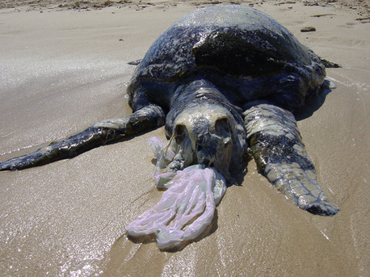
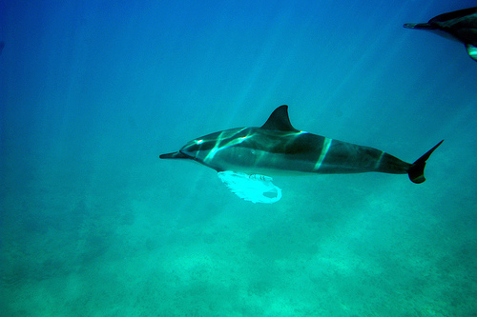
Plastic Bags Kill
Notes:
In addiition to the turtles everyone has heard about – bags kill 100,000 sea mammals annually in the North Sea alone –dolphins, porpoises, seals and whales
Plastic bags are the second leading cause of death to animals sea animals surpassed only by drifting fishing gear

Slide 12
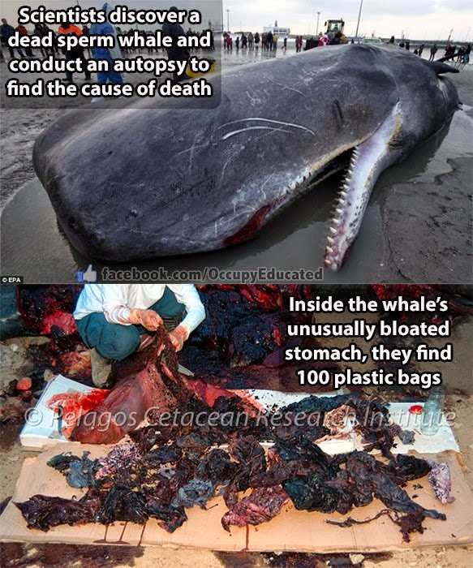
Notes:
July 29th 2013 on a northern island in the Netherlands – beached – tried to rescue – died (44 ft) – stomach bloated –stomach & intestinal blockages
March 2013 sperm whale washed up on Spain’s South coast – had swallowed over 37 lbs of plastic bags. 4/2010 Grey whale stranded on Seattle beach had over 20 plastic bags plus surgical gloves, plastic pieces, duct tape and more in its system

Slide 13
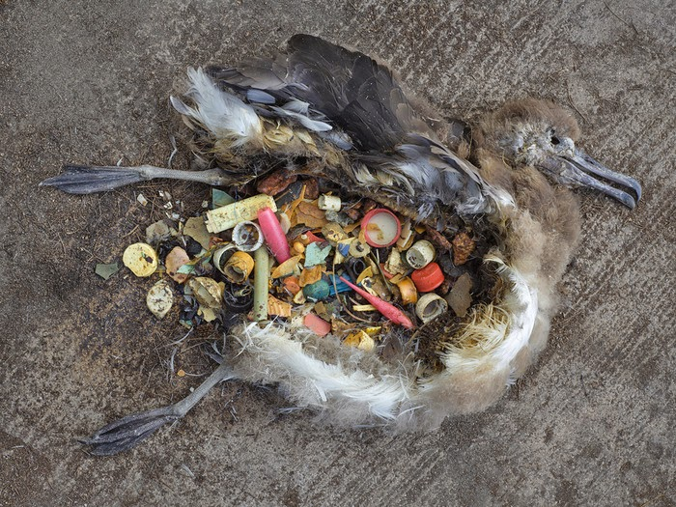
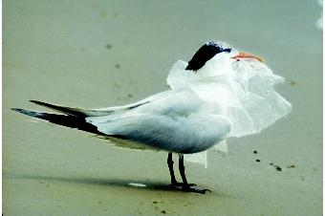
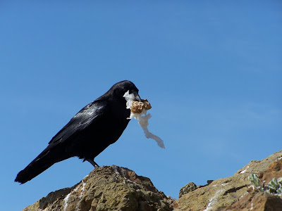
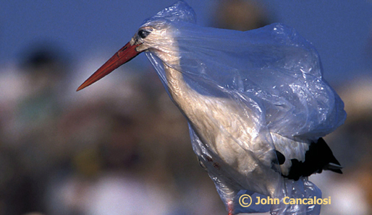
Notes:
Australian researchers estimate that all of the worlds sea birds have plastic in their systems
But not limited to sea birds - again – 2 Million annually on LAND as well as on sea

Slide 14
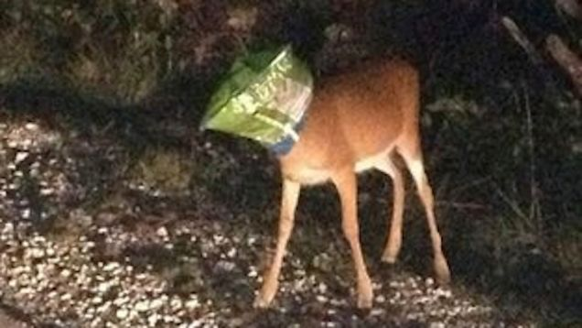
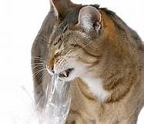
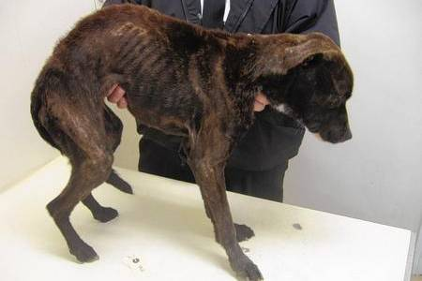
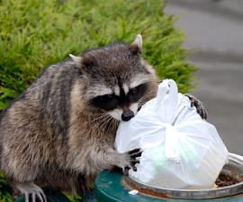
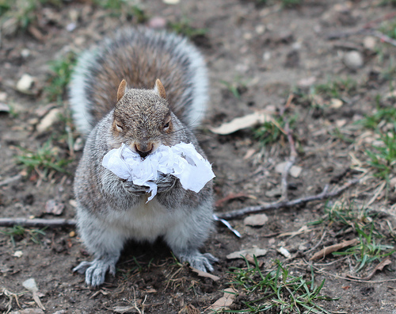
Notes:
Even Household pets. Many people have returned home, or walked into another room, to find a bag covering their beloved dog's head. Woman Charlotte NC – cremated – 5 dogs that month
March 5th 2013 – bodiy of pregnant pit bull in trash bag – beverage warehouse in Brookllyn – ASPCA necropsy – Mother had eaten plastic causing 2 acute intestinal obstructions – she had been cut open -someone tried to save the puppies – but they had died same time as mother,

Slide 15
Massachusetts Towns With Bans
Adams Framingham Newton
Amherst Great Barrington Northampton
Aquinnah Hamilton Provincetown
Barnstable Harwich Shrewsbury
Bridgewater Ipswich Somerville
Brookline Lee Tisbury
Cambridge Lenox Truro
Chatham Manchester Watertown
Chilmark Marblehead Wellesley
Concord Nantucket Wellfleet
Edgartown Natick West Tisbury
Falmouth Newburyport Williamstown

Slide 16
Plastic Bag Bans Worldwide

Slide 17
So What’s The Solution ?
Notes:
So What’s the Best solution --- Bring Your Own Bag - Reduce / Reuse / recycle - Ban about the 1st two because the third, recycling, despite valiant efforts over many years, has failed miserably.

Slide 18
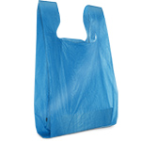
What’s In The Bylaw ?
Thin Lightweight Plastic Shopping Bags With Handles

Slide 19
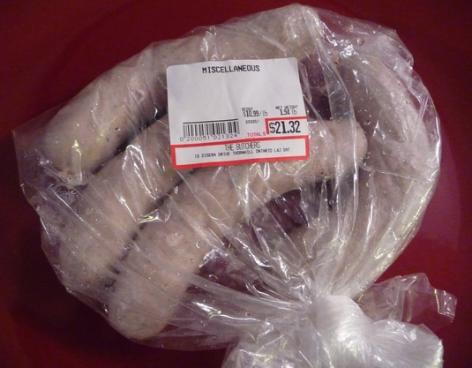
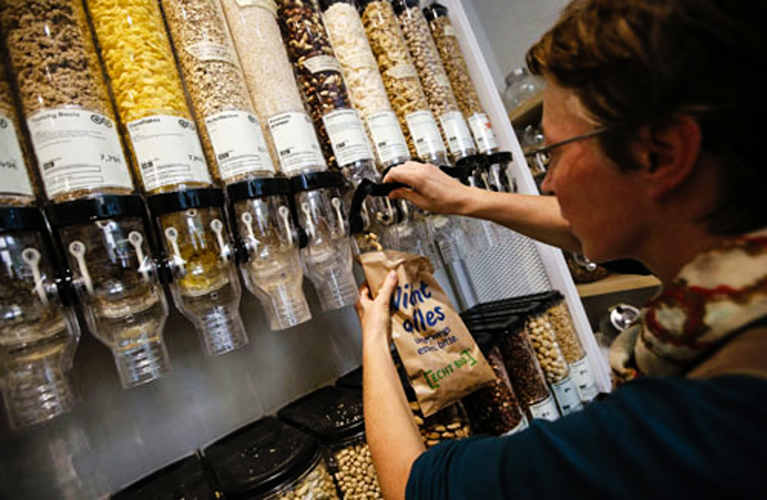
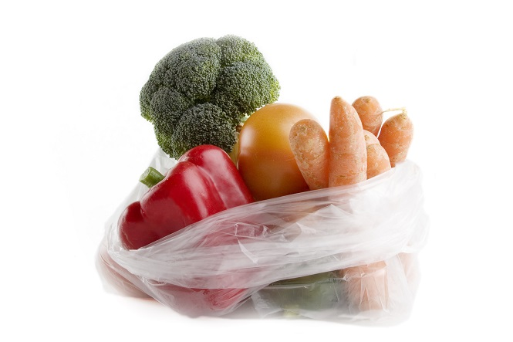
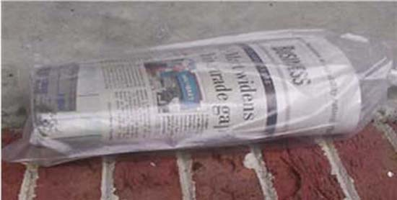
Bags That Will Still Be Available
Notes:
Barrier bags for produce and for food hygiene
Plastic carryout bags that are = to or > 3ms

Slide 20
EXEMPTS SMALL BUSINESSESS
The bylaw will affect only businesses whose space exceeds 3000 square feet or who have more than one location in Plymouth
As a result, most small, independent retailers in Plymouth will be exempt from the Plastic Bag Ban

Slide 21
Large Stores Ready To Be Onboard
Notes:
So won’t hurt the small guys. Only larger business will be required to make the transition and this is something they have already done many times throughout the state as well as nationally. Up to over a year to transition. Markets want bans –, but no one wants to be first. Reusable bags as advertising. BJs, Trader Joes, Whole Foods, Aldi, Save-A-Lot – haven’t had plastic bags for years, Never go to next town

Slide 22
Bylaw Supporters
Greater Plymouth Area League of Women Voters
Plymouth Area Interfaith Clergy Association
Open Space Committee
Network of Open Space Friends

Slide 23
Bylaw Supporters
Wildlands Trust
Southeastern Massachusetts Pine Barrens Alliance
Whale and Dolphin Conservation
Six Ponds Improvement Association

Slide 24
Bylaw Supporters
Massachusetts Audubon
Massachusetts Sierra Club
The Humane Society of the United States
Cape Wildlife Center
New England Coastal Wildlife Alliance
Cape Environmental Action

Slide 25
Help Keep Plymouth Beautiful Cut Down On Pollution And Litter Improve Plymouth’s Bottom Line Ban The Bag
Notes:
Bag Ban is good for the environment, good for businesses and good for the taxpayer -

Slide 26
Incineration Is Not The Answer
Waste to Energy incinerators release more CO2 per megawatt hour than coal, oil or natural gas fired plants
Incinerators release ultra-fine particulates of mercury & dioxins
Massachusetts – 23 year moratorium on building waste to energy incinerators
No new waste to energy incinerators built in the United States since 1992
Notes:
2009 Scott Keyes –MPH Public Policy Manager Massachusetts division of the American Lung Association in letter to Senator Kerry “facts demonstrate that our state can no longer afford to compromise our health in favor of energy production”
Stack test only reliable monitoring method available ( Ma office energy environmental affairs) – tests 1/4ly mercury; every 9 months everything else – because not continuous fluctuations >.< tests not recorded - allowed to exceed standards up to 3hrs daily startup/shutdown / during “malfunctions”

Slide 27
Incineration Is Not The Answer
Notes:
Reduction is the Real Answer

Slide 28
Plastic Bags Are Not Free
Manufactures make over $4 billion in profit selling plastic bags
The cost is passed onto you the consumer
The real cost to you is 5 to 11 cents per bag even before the cost of disposal is added in
Notes:
Markets in the area that do not dispense “free” plastic bags charge 5 to 11 cents per bag – this is the real cost to you even before the additional cost to taxpayers for disposal is considered
Stores pay an average of $1000 a week for the bags

Slide 29
Biodegradable eco friendly bags are cheap !
Notes:
2 to 3 bags a day for a year at = 2 cents a bag – as cheap or cheaper than the plastic checkout bags. 2000 waste paper lining bags can be purchased online for less than 1 and ½ cents a bag (Interplast)

Slide 30
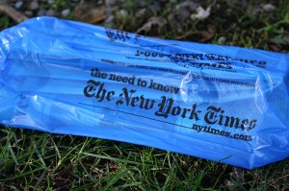
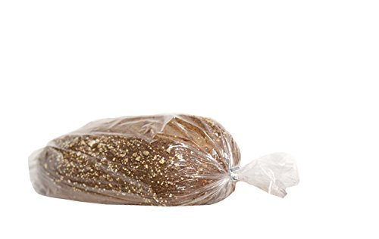
CONCERNED ? Alternatives For Pet Waste

Slide 31
Are reusable shopping bags sanitary? Yes, They Are Safe !
Since reusable shopping bags were introduced over 30 years ago, there is no credible research or evidence linking reusable bags to outbreaks of e-coli or any other harmful bacteria

Slide 32
Will This Be A Burden To Low Income Families ?
Bags designed to be reusable for up to 125 times can be purchased for as little as 10 cents
Even more durable bags, ones that can last many years, are available for as cheaply a $1 - Whole Foods sells them 3 for $2
Some establishments give them away for free

Slide 33
Reusable Bag Drive - We will gather bags from those who have extras to share with those who don’t have enough

Slide 34
Plastic Bag Bans In the U.S.A.

Slide 35
Plastic Bag Bans Are Effective
Notes:
80 – 90 % reduction when a restriction is placed on these bags – either banned or a fee. And a lot of people seem to have gotten the idea this is a good thing

Slide 36
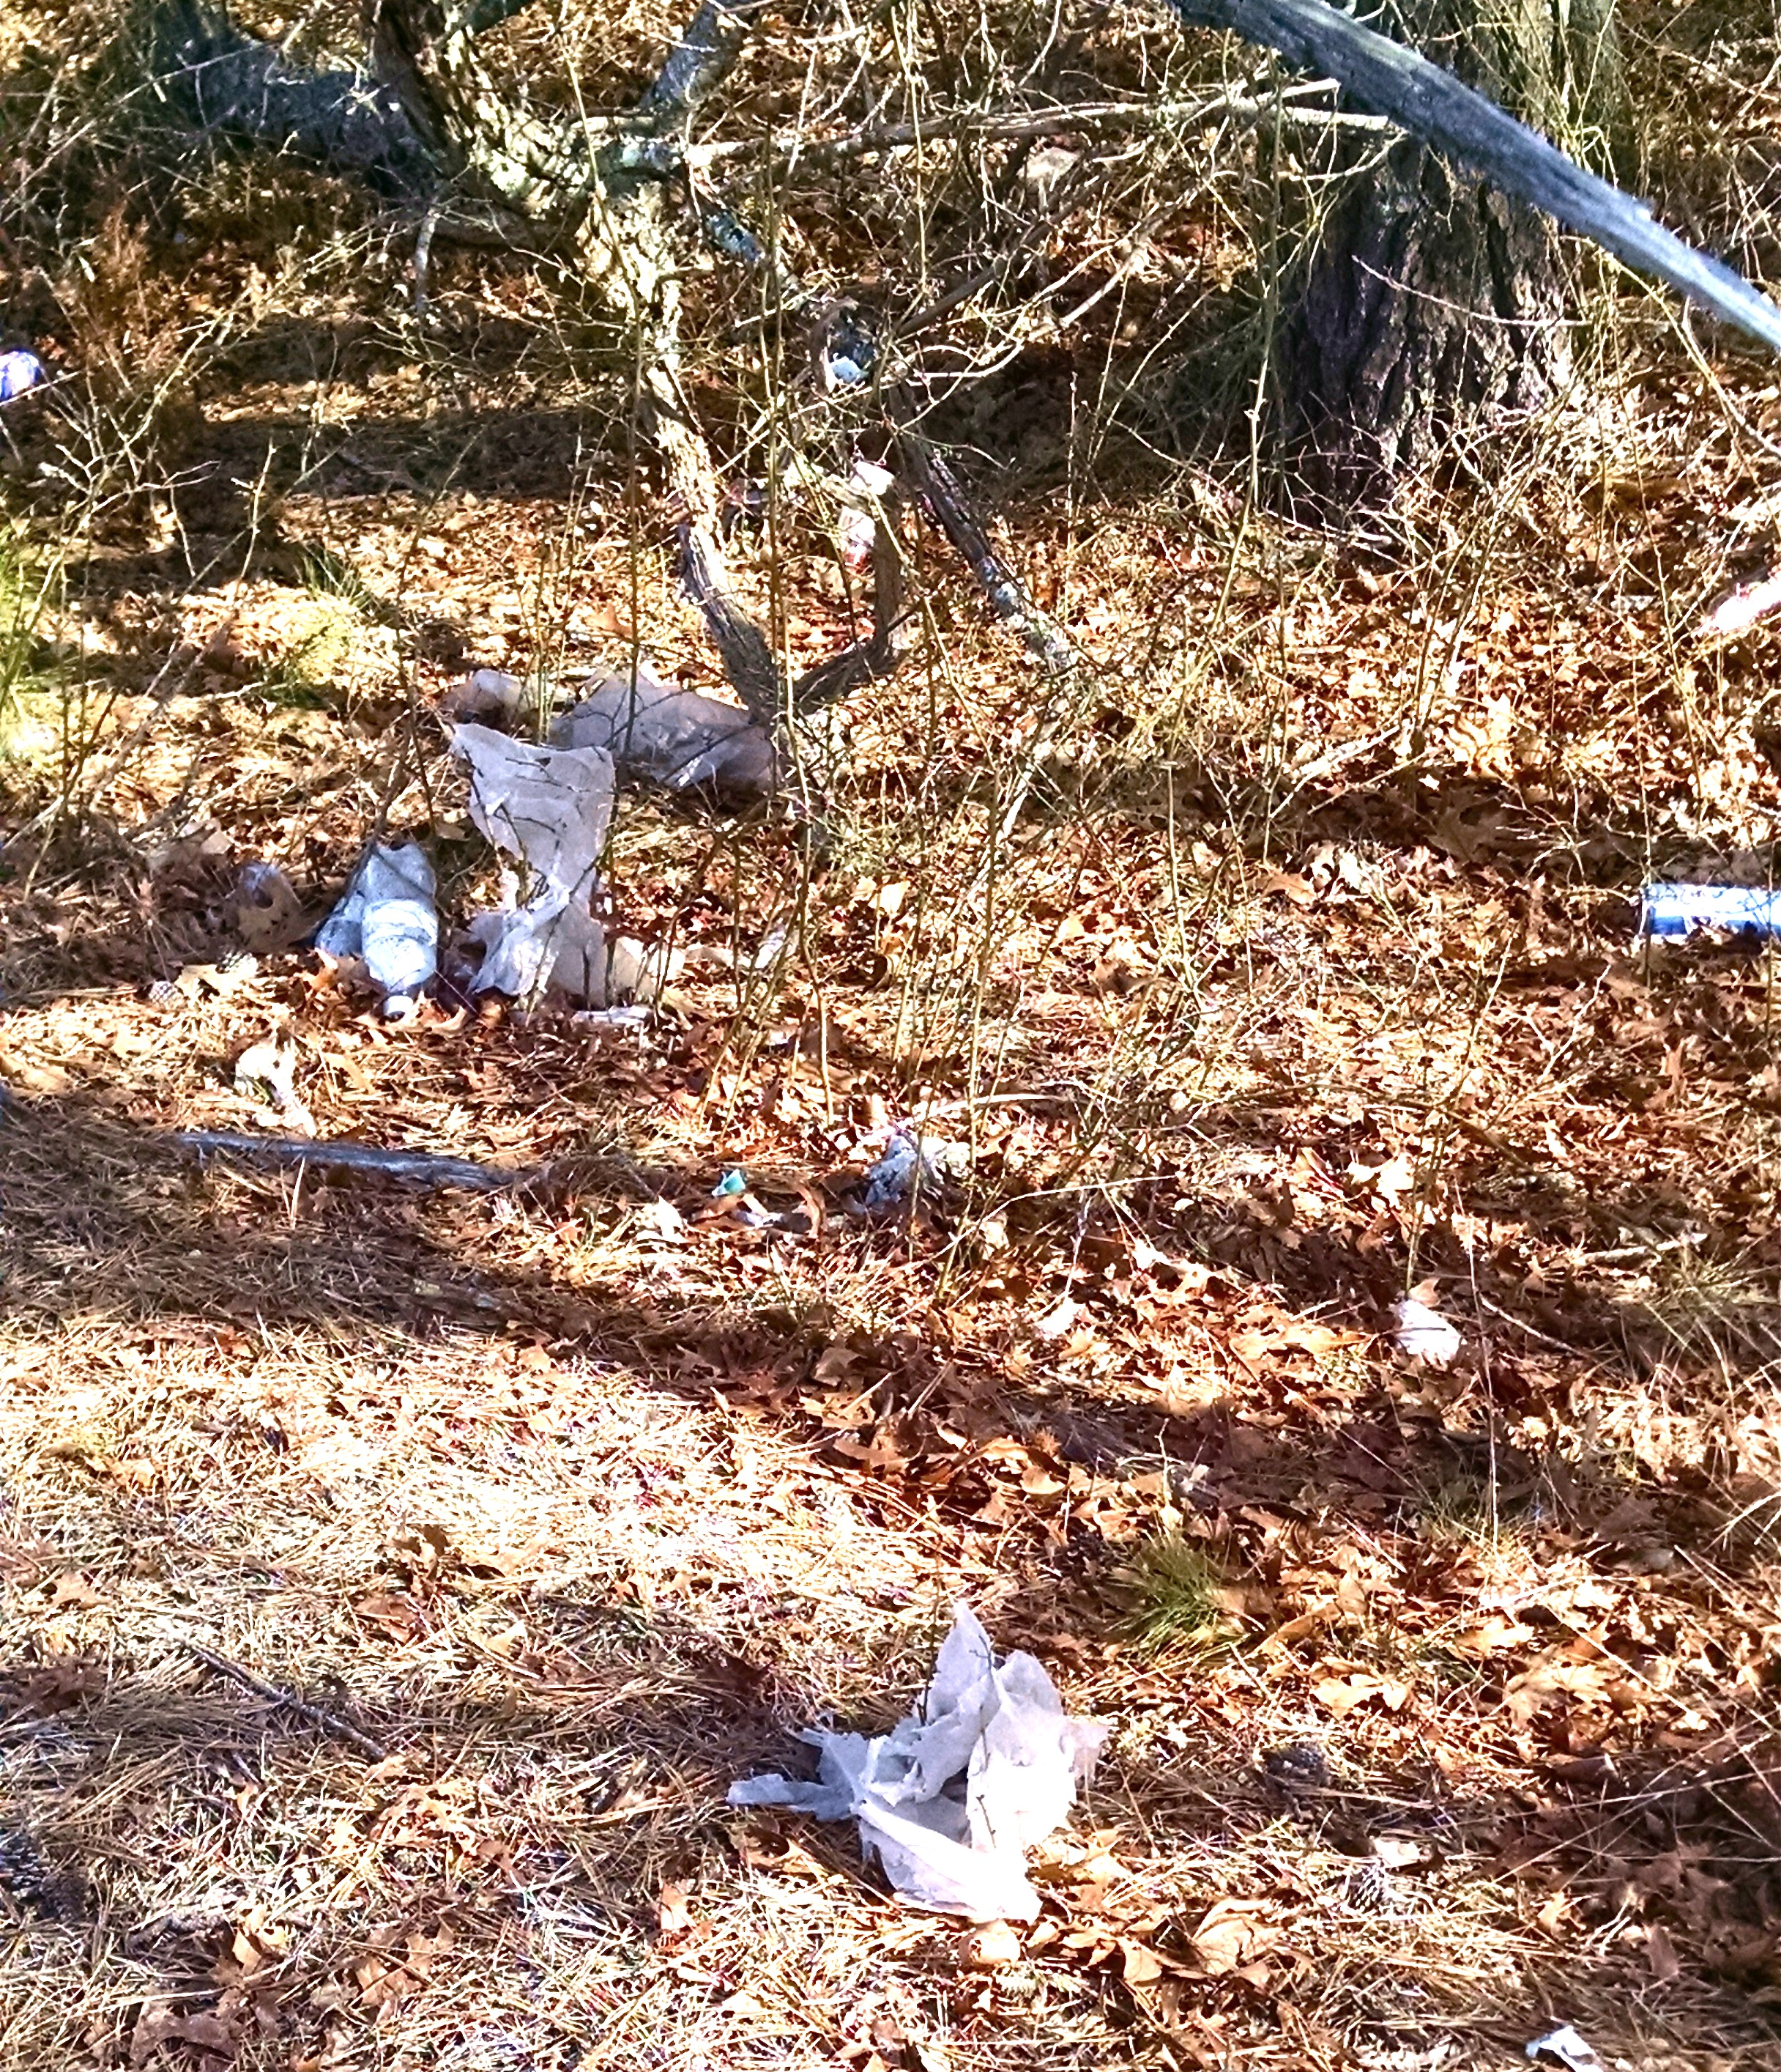
Plastic Bags Are Polluting Our World
Notes:
Obery Street

Slide 37
Plastic Bags Are Polluting Our World
On land, bags take 500 to 1000 years to decompose
Compostable bags don’t decompose in landfills
In landfills – release CO2 which promotes the leaking of other gases including Methane
Notes:
Tree in Town Square

Slide 38
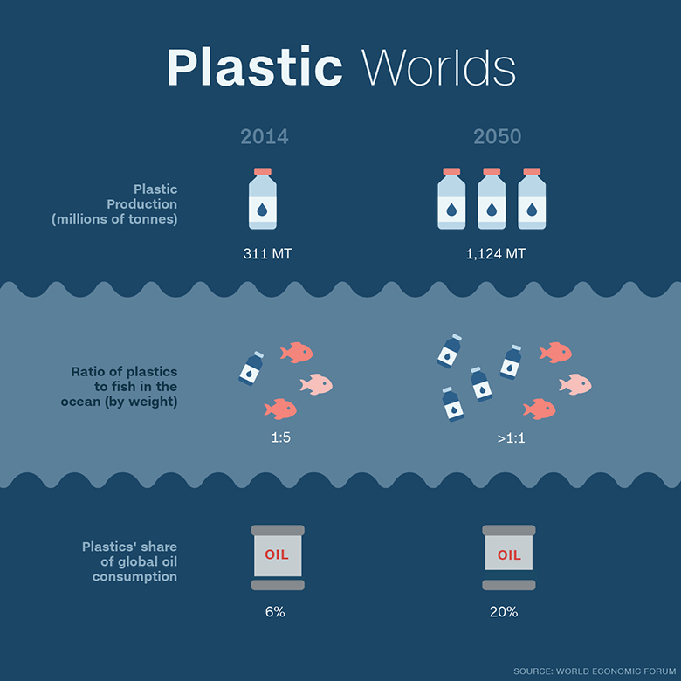
Notes:
Microplastic particles bond with other pollutants in the ocean making for highly toxic mix that moves up the food chain and onto our dinner tables
By 2050 pound for pound, there will be more plastic in the ocean then fish. the weight of plastic in the ocean will outweigh the fish (World Economic Forum)
Researchers have said that in some parts of the ocean there are 6 pounds of plastic for every one pound of plankton

Slide 39
Acknowledgements
Lee Burns, Ph.D
Plymouth Bans The Bag Volunteers
Marion Galvin, Dell & John Hammond, Mary Ann Hergenrother, Val Peck, Jon & Andrea Plate, Diane Zolla
Madhavi Venkatesan, Ph.D
Cape Environmental Action
Mass Green Network
Aldermen Alison M. Leary & Emily Norton
Dorie Stolley
Kenneth Stone, Ed.D. – Plymouth, MA

Slide 40
Become Litter And Are Rarely Recycle
Plastic Bags are the 3rd largest source of litter on U.S. Coasts, surpassed only by cigarette butts & bottle caps
Clogs storm drains, litter roadsides and our woods
Years of efforts to educate the public & encourage recycling have clearly failed
Notes:
People say recycling is the answer

