Slide 1
2020-2021 nfhs football game officials manual

Slide 2
2020-2021 Nfhs football NYSACFO MECHANICS
Game Officials Manual
Coin Toss
Historically, the NYSACFO mechanic has been “stay with the winner” of the toss.
Clapping
As a signal, clapping is allowed. The referee needs to observe the signal caller for any movement that in his judgment is illegal, i.e., moving forward or attempting to draw B into the neutral zone.
Notes:
Comment on Slide:
Reminders for 2020 from the NFHS Football Game Officials Manual Committee on the 2020-2021 NFHS Football Game Officials Manual and other items.
See comments on the slide.

Slide 3
2020-2021 Nfhs football MECHANICS SOFTWARE
Game Officials Manual
Notes:
Comment on Slide:
Reminders for 2020 from the NFHS Football Game Officials Manual Committee on the 2020-2021 NFHS Football Game Officials Manual and other items.
See comments on the slide.

Slide 4
2020-2021 CD CONSIDERATIONS FOOTBALL RULES

Slide 5
2020-21 CD CONSIDERATIONS Football RULES
Officials are not responsible for monitoring activities on the sidelines, such as social distancing, hand washing, symptoms of illnesses and other such issues. This monitoring remains with the coaching staff and school personnel.
STATE ASSOCIATION ADOPTIONS (Rule 1-7)
Each state association may adopt other playing/administrative rules for football for the 2020 season that would decrease exposure to respiratory droplets and COVID-19.
Notes:
Comment on Slide:
2020-21 NFHS information with regards to football.

Slide 6
2020-21 CD CONSIDERATIONS Football RULES
TEAM BOX (Rule 1-2-3g)
The team box may be extended on both sides of the field to the 10-yard lines (for players only) in order for more social-distancing space for the teams.
Maintain social distancing of 6 feet at all times while in the team box.
Do not share uniforms, towels and other apparel and equipment.
BALL (Rule 1-3-2)
The ball should be cleaned and sanitized throughout the contest as recommended by the ball manufacturer.
The ball holders should maintain social distancing of 6 feet at all times during the contest.
Notes:
Comment on Slide:
2020-21 NFHS information with regards to football.

Slide 7
2020-21 CD CONSIDERATIONS Football RULES
CHARGED TIME-OUTS AND AUTHORIZED CONFERENCES (Rules 2-6-2, 3-5-3, 3-5-8)
A single charged time-out may be extended to a maximum of two minutes in length.
The authorized conference for the charged time-out should take place between the 9-yard marks and not at the sideline for social-distancing purposes. (It would be permissible for more than one coach to be involved in this conference and for technology to be used.)
Each game official and player should have their own beverage container brought out to them on the field.
INTERMISSION BETWEEN PERIODS AND AFTER SCORING (Rule 3-5-7l)
The intermission may be extended to a maximum of two minutes between the first and second and the third and fourth periods and following a try, successful field goal or safety, and prior to the succeeding free kick.
Notes:
Comment on Slide:
2020-21 NFHS information with regards to football.

Slide 8
2020-21 CD CONSIDERATIONS Football RULES
TOOTH AND MOUTH PROTECTORS [Rule 1-5-1d(5)]
**Still being determined at this time on how to best handle the tooth and mouth protector during the contest. The NFHS SMAC will update the membership as soon as guidance is developed for all sports that require a tooth and mouth protector.
GLOVES (Rule 1-5-2b)
Gloves are permissible but still must comply with Rule 1-5-2b by meeting either the NOCSAE Standard or the SFIA Specification.
FACE MASKS [Rules 1-5-1a, 1-5-3c(4)]
Cloth face coverings are permissible.
Plastic shields covering the entire face (unless integrated into the face mask and attached to the helmet and clear without the presence of any tint) shall not be allowed during the contest.
Notes:
Comment on Slide:
2020-21 NFHS information with regards to football.

Slide 9
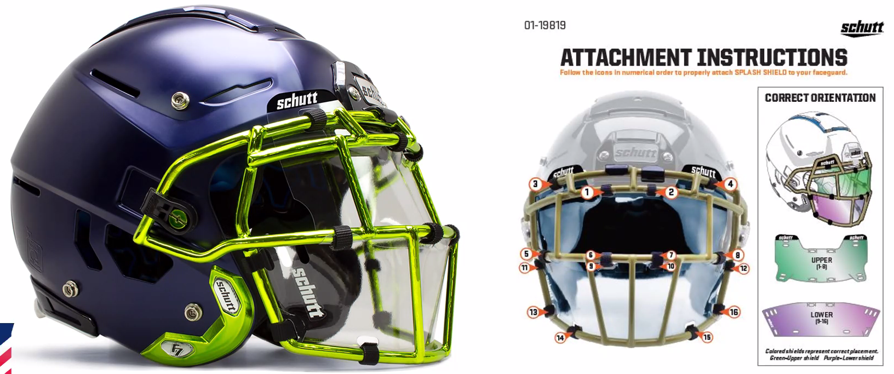
2020-21 CD CONSIDERATIONS Football RULES
Notes:
Comment on Slide:
2020-21 NFHS information with regards to football.

