Slide 1
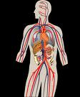
Hypertension
High Blood Pressure

Slide 2
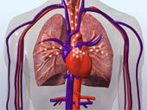
What is Hypertension
Hyper = means high or elevated
Tension = means tight or tense
When you have hypertension, you have high tension or tightness in your heart otherwise known as high blood pressure.

Slide 3
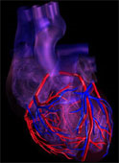
Causes of Hypertension
Family history – genetics – can skip generation
Overweight – difficult for heart to pump blood
Poor nutrition – fatty foods, salt, sugar
Sedentary lifestyle – no exercise
Age – getting older – arteriosclerosis
Stress – ongoing, constant

Slide 4
Complications of Hypertension
Pressure on heart causes heart attacks!
Pressure on kidney causes kidney failure!
Pressure on eyes causes eye damage!
Pressure on brain causes strokes!
Pressure on veins causes blood clots!

Slide 5
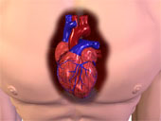
Symptoms of Hypertension
Difficult to detect – known as silent killer
Light headed – dizziness
Tiredness – heart is working overtime!
Tightness in chest – due to pressure

Slide 6
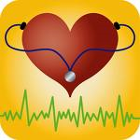
Making a Diagnosis
Family history
Blood pressure readings above normal
Should be below 140/90
BP should be taken at different times of day
Should be sitting or relaxed when taken
Watch for white coat hypertension (MD office)

Slide 7
Making a Diagnosis

Slide 8
What the numbers mean
Systolic – upper number – when blood is putting pressure on the walls of arteries
Diastolic – bottom number – when blood walls are relaxed – no pressure on the walls
Upper number should not be higher that 140
Bottom number not higher than 90
The reading should be 140/90

Slide 9
Prevention
Keep weight within “normal” limits
Table from Met Life Insurance Co used for wt.
Nutrition – low salt, low sodium meal plan
Exercise – 30 minutes daily/aerobic
Smoking cessation if smoker
Keep stress under control

Slide 10
Foods to Avoid with High BP
Limit sodium to 2400 milligrams per day (mg)
Canned goods have high sodium i.e. soup
Frozen prepared dinners (TV dinners)
Pizza – make your own
Fatty foods – i.e. gristle from pork chops, skin
Alcohol – use in moderation; don’t smoke
Sweets add calories, calories add weight

Slide 11
Choose
Fresh vegetables and fresh fruit
Read food labels for low sodium foods
Choose cholesterol free foods (read label)
Diet drink OKs; low sodium sports drinks
Cooking oils should be vegetable based
Low calorie beer!

Slide 12
Medications – How they work
Diuretic – known as water pill
Getting rid of water helps relieve pressure
Medication – most work by relaxing blood vessels in and around the heart
When blood vessels are relaxed, there is less pressure on walls of the veins, arteries
Some are call enzyme inhibitors

Slide 13
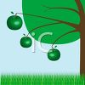
Summary - Make Lifestyle Change
Cut back on salt – read labels
Keep weight under control – check ideal wt
Check your BP – buy machine at Wal-Mart
Cardiovascular Exercise – aerobic/walking
Learn about the disease/risks/complications
Learn about medications – how they work
Choose foods wisely

