Slide 1
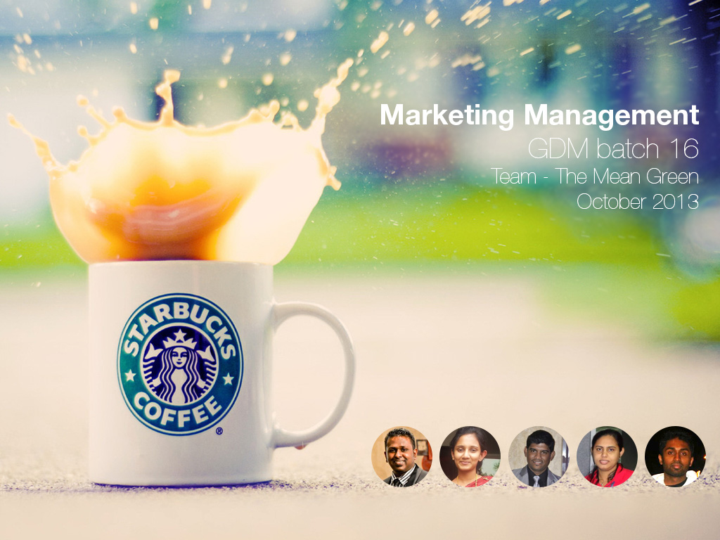

Slide 2

OBJECTIVE
  Starbucks in Global
  Starbucks Market Analysis in Sri Lanka
  Starbucks Objective
  Starbucks Market Strategy in Sri Lanka
  Starbucks Action Plan and Conclusion

Slide 3
STARBUCKS IN GLOBAL
  Starbucks is the largest coffee house company in the world
  We started in 1971 in Seattle in Washington US
  We are leading retailer, roaster and brand of specialty coffee in the world
  Our 20,891 stores in 62 countries,
  We serve brewed coffee, expresso-based hot drinks, snacks, mugs and coffee beans

Slide 4

STARBUCKS MARKET ANALYSIS IN SRI LANKA
PESTEL analysis
POLITICAL
ECONOMICAL
SOCIAL/CULTURE
Political stability (After the end of war in 2009)
Too much power is centered among few individuals in the present governing party
Government encouragement for foreign investments
Tax policy for investors
Development of Tourism industry in Sri Lanka
High inflation 6.9% (2012 est.) and change in rupee value
GDP growth of 7.2% (2012 est.)
Positive economic reforms since 2010
Tea centered culture
Coffee culture only popular in main cities
Young people quickly absorbing modern trends western standards

Slide 5
STARBUCKS MARKET ANALYSIS IN SRI LANKA
PESTEL analysis
TECHNOLOGY
ENVIRONMENT
LEGAL
Use of Internet and Mobile (Around 2 million - 2011)
Increasing use if Social media networks
Tropical rainy climate with varying temperatures
Moving towards eco friendly environment
Strong labor policies
Food safety regulations
Environmental Laws and Advertising regulations
Bribery and Corruption

Slide 6
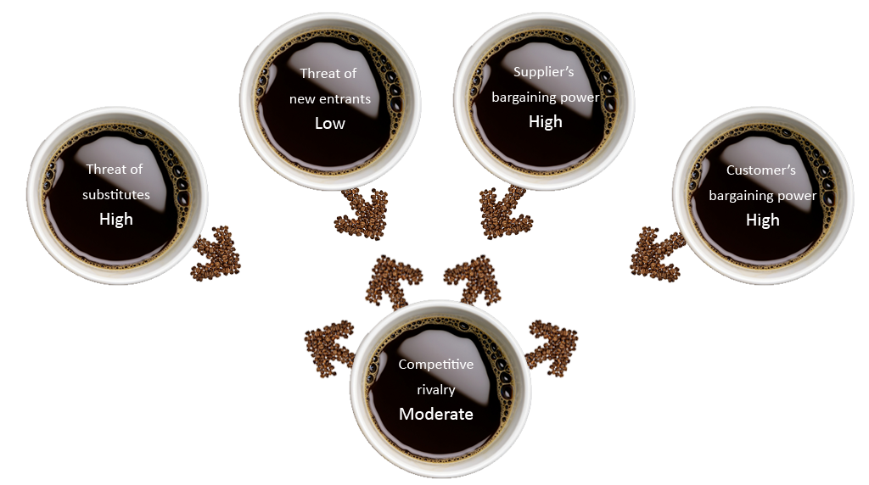
STARBUCKS MARKET ANALYSIS IN SRI LANKA
Five force analysis

Slide 7
STARBUCKS MARKET ANALYSIS IN SRI LANKA
Competitor analysis
Competitor | Quality | Price | Service | Awareness
Starbucks | Excellent | High | Very good | Poor
Barista | Good | High | Very good | Very good
Coco Veranda | Good | High | Average | Average
Coffee bean & Tea Leaf | Good | High | Average | Very good
McDonald's | Average | Low | Average | Average
Choco luv | Average | Average | Poor | Average
The Commons Coffee House | Average | High | Average | Poor
Bread Talk | Good | High | Very good | Average

Slide 8
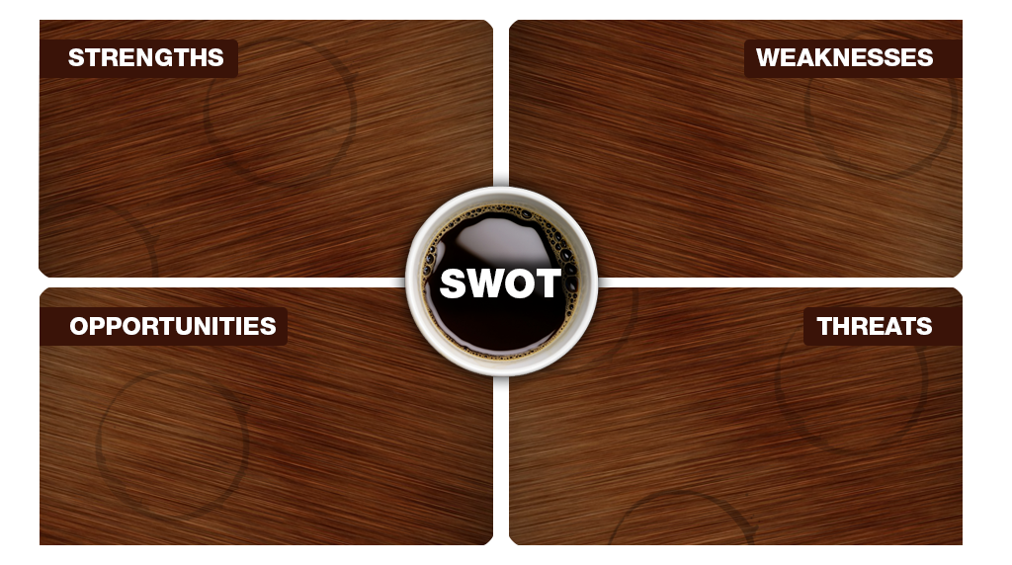
STARBUCKS MARKET ANALYSIS IN SRI LANKA
SWOT analysis
Global recognition
Quality products
Profitable organisation
Strong financial foundation
Visionary leader
High price
Importing roasted coffee
Known only for coffee
Launching new products
Skilled Labour market
More tourist attraction
Use of social media network
Cultural & Political issues
Real State cost and laws in Sri Lanka
Economic down turns
Health cautious customers

Slide 9
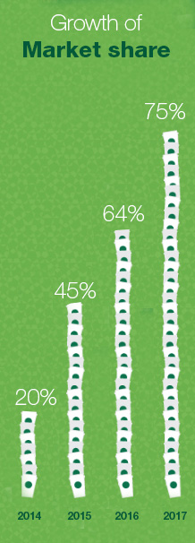
STARBUCKS OBJECTIVES & GOALS
  Open 50 outlets in 4 years
  Gain 75% of market share in 4 years
  Increase market revenue by 5% each year
  Increase brand awareness
    1000 - 3000 number of new customers within first month
    Capturing 5,000 + Facebook likes within first two months
  Number of returning customers 30% in 1 year
  Become a super brand in Sri Lanka in 5 – 7 years

Slide 10
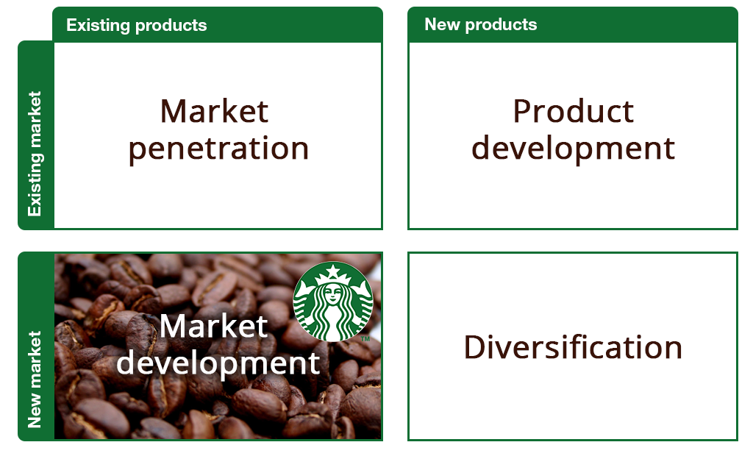
STARBUCKS MARKETING STRATEGY
Ansoff matrix
Global recognition
Global recognition
Global recognition
Global recognition

Slide 11

STARBUCKS MARKETING STRATEGY
Market segmentation
Geographics
Main Cities
Demographics
Age Children (13-17)
Young Adults (18-24)
Adults (25-40)
Matured (Above 40)
Gender Male
Female
Income Low Income (Below Rs.25,000)
Middle Income (Rs.25,000 – Rs.40,000)
Higher Income (Above Rs.40,000)
Source: ColomboPage News Desk, Sri Lanka.

Slide 12
STARBUCKS MARKETING STRATEGY
Targeting
Starbucks target market
Age group: 18 – 40
Lifecycle: Young and adults
Gender: Male and female
Occupation: College students, persons in managerial, executive, and professional positions
Income: Middle and higher income earners
Location Main cities (Colombo, Kandy, Hikkaduwa, Galle) commercial areas

Slide 13


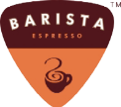



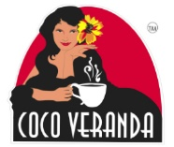


STARBUCKS MARKETING STRATEGY
Positioning
Price high
Low perceived quality
High perceived quality
Price low

Slide 14
STARBUCKS MARKETING STRATEGY
Marketing mix – 7P’s
PRODUCT
Customized coffee (However you want)
PHYSICAL
Modern furniture, uniform, sign boards, none smoking, kids play area, music
PRICE
Higher than others (Rs.390 for tall, Rs.540 for grande and Rs.740 for venti)
PROCESS
Quick service, customized cups with name, collect suggestions and feedback from customers
PLACE
Accessibility, availability
PEOPLE
Social, positive attitude, active, skilled staff, training, customer service
PROMOTION
Social media, Free samples, Credit card discounts

Slide 15
ACTION PLAN
 |  |  | 2013 |  | 2014 |  |  |  |  |  |  |  |  |  |  |  | 2015
Action Plan |  |  | Nov | Dec | Jan | Feb | Mar | Apr | May | Jun | Jul | Aug | Sep | Oct | Nov | Dec | Jan | Feb | Mar
Choosing a suitable business partner in the domestic market
Legal documentation work
Acquisition of outlets and warehouse space
Setting up supply channels
Recruit employees and training
Creating Brand Awareness through advertising via Social Media and Billboards
Press conference / Website launch
Official launch
Offering Starbucks products through Hotels & Restaurants
Customizing Products to cater to local customer tastes
Opening 15 outlets in the Colombo Area and expanding to other major Cities

Slide 16
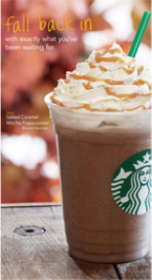
ADVERTISING
Promotional email newsletter
Hoarding
Poster and leaflet

Slide 17
CONCLUTION
  This business plan introduced Starbucks to Sri Lankan market. We presented information about the market analysis, market strategy, objective and presented the action plan for the next 17 months.
“Let’s inspire and nurture the human spirit in Sri Lanka – one person, one cup and one neighborhood at a time.”

Slide 18
