Slide 1
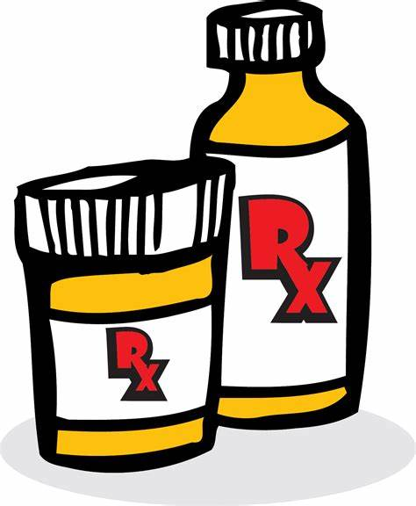
A Word About Medications
Medication Management

Slide 2
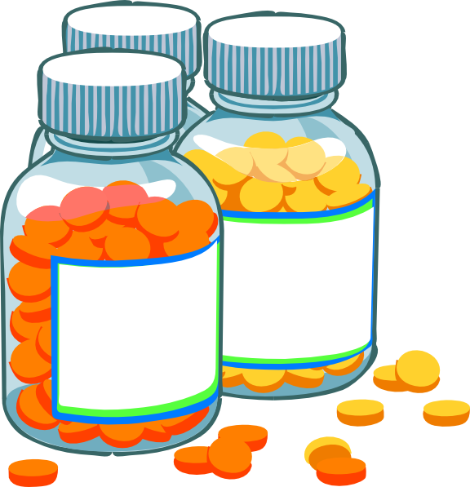
There are Brand Name and Generic Name
Brand names are just that – a familiar named pharmaceutical Co
Pfizer, Abbot, Eli Lilly, Johnson and Johnson, Amgen, Gilead, Moderna
For the most part Brand made in the USA, some in England
On the bottle you can trace the lot number where the medication originated or came from (country, state, city).

Slide 3
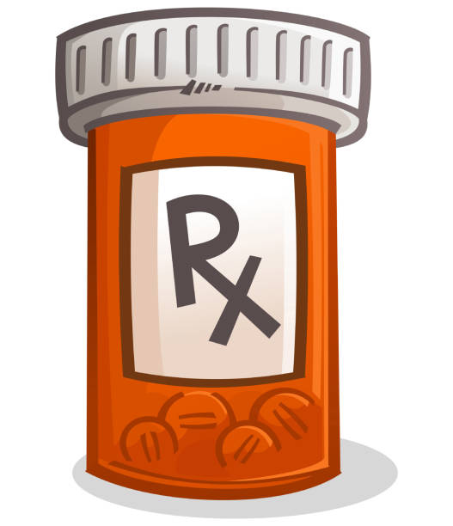
Brand name cost more, Generics, much cheaper
Which is better? Most doctors would say they are the same.
Good idea to look at the side affects.
Good examples: Brand name Synthroid used for maintain a healthy thyroid which helps regulated your metabolism (body temperature, heart rate etc. )
Generic name: Levothyroxine which is much cheaper

Slide 4
Another Example
Brand name: Lipitor for cholesterol management
Generic name: Atorvastatin (statin drugs).
Brand name: Norvasc (blood pressure medicine).
Generic name: Amlodipine

Slide 5
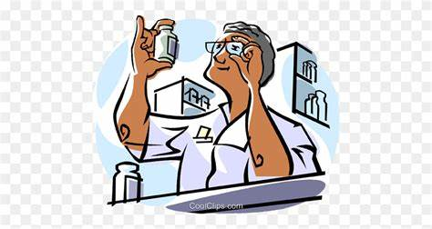
What to look for----
Is the medication working – Brand or generic
Check with or MD of healthcare provider re: lab results, vital signs etc.
Check for side effects which can be many
Which one can you afford and does your insurance pay for it?

Slide 6
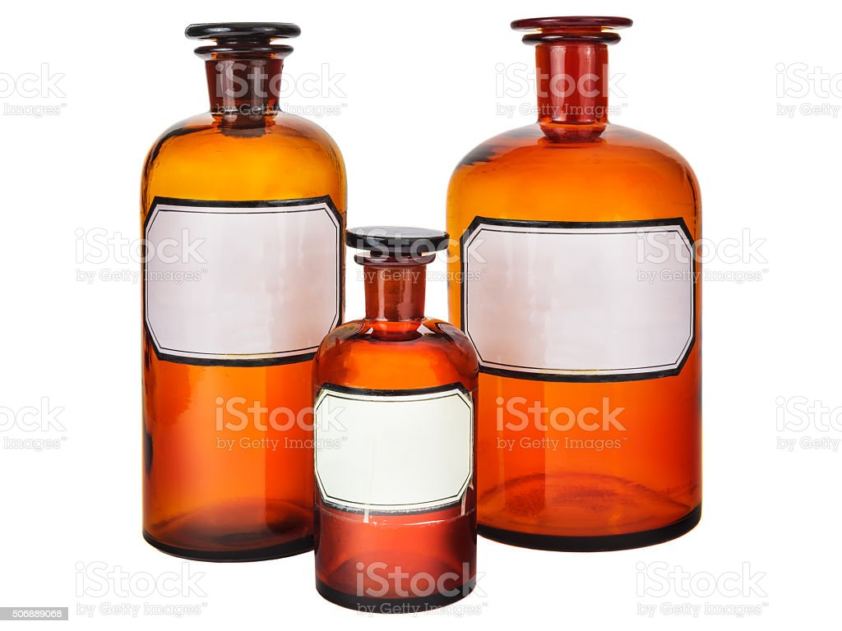
Brand vs. Generic
Generic meds may be OK, if they are working with no side
Effects – trial and error
Again, look for the lot number and expiration date. Some med might be made in India or China

Slide 7
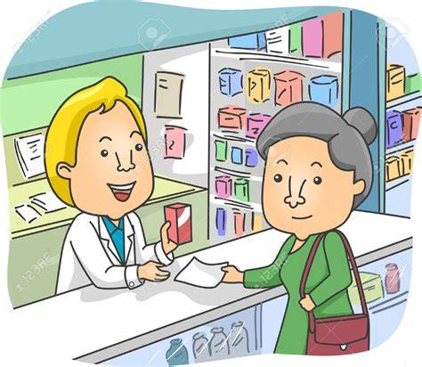
A Word About Prescriptions
Most doctor’s offices are going electronic – E-prescription.
Mail delivery is becoming popular, even Amazon is doing it
The challenge will be to track the prescription coming and going.

Slide 8
Medication Management – at home
The old fashion way still works – get a pill box with two sides, one for morning pill and one for evening pill.
Keep the pill box in a safe place, away from children
Learn how to take medications: on an empty stomach, with food; either way; there is a difference how they work in you body
Don’t forget to take your meds, you may need reminders!

Slide 9
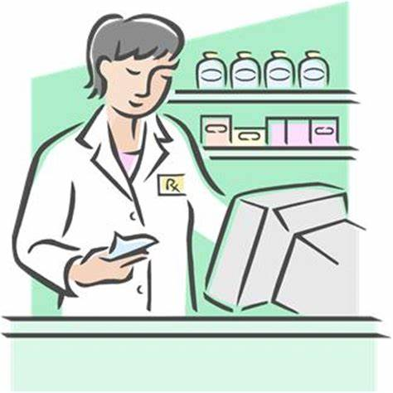
Medication Management – at home
Don’t run out of medications and then renew at the last minute!
Some pharmacies have early refill; will track medications for you
Electronic reminders are becoming popular i.e. text messages

Slide 10
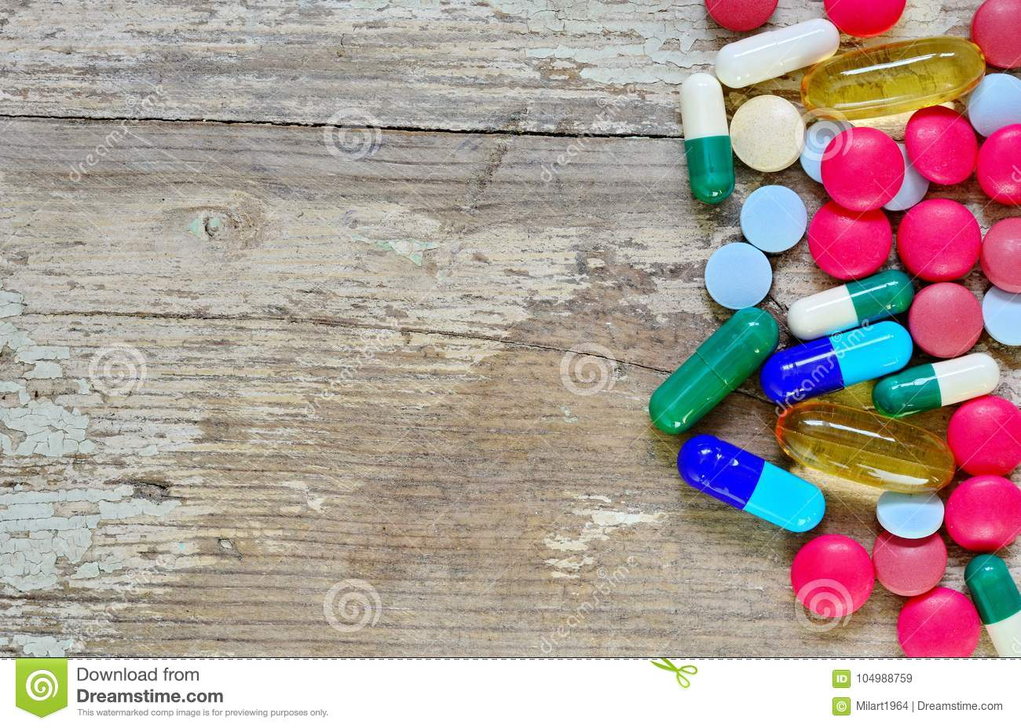
Taking Medications
Try not to take too many! Some pills are combination pills (two different kinds of pills combined into one pill.
Try to “get off” medications, if possible, through nutrition and exercise. However, some medications are essential.
Learn side effects and report to your doctor

Slide 11
Final thoughts on Medications
Don’t take too many, only essential medications
Distinguish between Brand name and Generic
Trace lot numbers if you are interested
Be aware of side effects, they may be alternatives
Find a method for taking medications which works for you.
Find a pharmacy you are comfortable with and is reliable
Keep up with changes, especially electronic (e-prescriptions).

