Slide 1
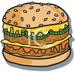
High Cholesterol
Better Known at Grease!

Slide 2
Origins of Cholesterol
Animal meats – steaks, hamburgers, pork
Dairy products – eggs, cheese, milk, cream
Seafood – shrimp, lobster, crabs
Saturated fats – butter, lard, grease, fat back
Sugar – when baking cookies, cakes, pies etc.

Slide 3
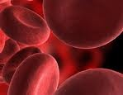
Functions of Cholesterol
Manufactured by the human body
Needed for fluids in cells and membranes
Cell physiology – biochemical transport
Nerve conduction, cell signaling
It is necessary to survive (but not too much)
So –your body makes cholesterol and cholesterol is taken in with certain foods

Slide 4
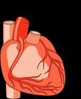
Health Hazards of Cholesterol
The cholesterol is like layers of grease
Builds up over time in the heart and blood
Eventually it clogs the arteries and veins
Like grease going down the kitchen sink
The grease can go to the brain as well

Slide 5
Chemistry of Cholesterol
Total cholesterol is composed of---
LDL – low density lipoprotein (bad)
HDL – high density lipoprotein (good)
Triglycerides – should be within norm
Good reading for cholesterol is 200 or below
Borderline is 200 – 220
Total cholesterol = LDL, HDL and Triglycerides

Slide 6
Complications
Atherosclerosis – hardening of arteries
High blood pressure – difficult to control
Diabetes – difficult to manage sugar
Obesity – weight management more difficult
Stroke – when combined with the above

Slide 7
Prevention
Read food labels for cholesterol
Aim for zero grams but 2 or 3 is OK
Learn which foods have high cholesterol
Eat more fish and chicken (without skin).
Prepare foods with vegetable oil
Bake, broil, Bar-b-que
Get cholesterol checked regularly

Slide 8
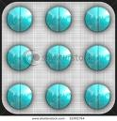
A Word about Medications
Should be last resort after diet and exercise
Most are called Statin drugs
Most work pretty well
Be aware of side affects (read info)
Some are on the $4 menu at WalMart
Once starting, usually remain on regimen
Continue diet and exercise

