Slide 1
District Technology Service Desk
Melissa Teat, Customer Product Manager, April 19, 2018

Slide 2
Our Vision

Slide 3
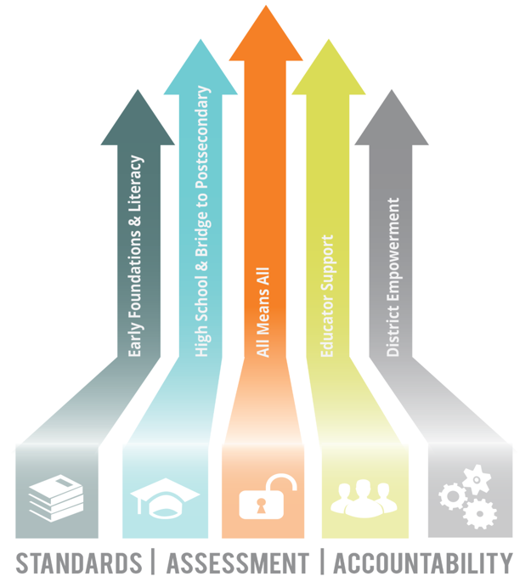
Our Priorities

Slide 4
District Technology Service Desk Information
In an effort to provide additional services and products to districts, the department is
expanding the EIS Help Desk to the District Technology Service Desk.
To more accurately represent the broadened scope of the Help Desk, we are changing
the email address from EIS.Help@tn.gov to DT.Support@tn.gov. Beginning July 1, 2018,
EIS.Help@tn.gov will no longer be active.
The phone number remains unchanged (800-495-4154), and the hours are Monday-
Friday, 6:30 a.m.-4:00 p.m. CT.

Slide 5
District Technology Service Desk Information
The Service Desk conducts multiple proactive district outreach projects throughout the school year.
1. District calendars
2. Assessment analysis
3. Ticket portal registration
4. Student final grade data
5. Promotion & retention data

Slide 6
District Technology Service Desk Information
District Technology Service Desk Staff introductions.
District Technology Request Portal is our new ticketing system. Register today!
Since implementation in July 2017, over 8,700 tickets have been resolved.

Slide 7
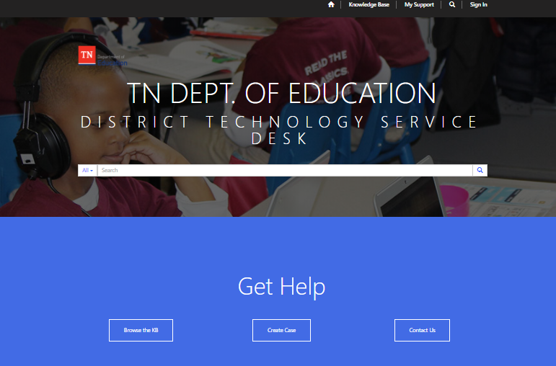
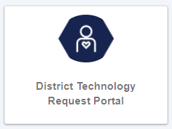
District Technology Request Portal
The Portal can be accessed using TDOE Single Sign-On, Orion.

Slide 8
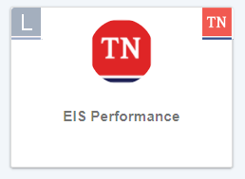
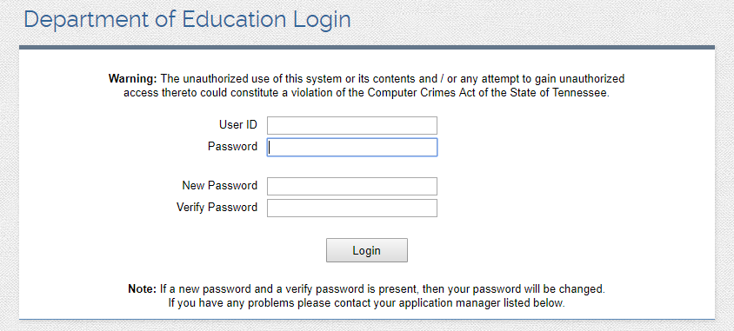
EIS Performance (Beta)
EIS Performance can be accessed using TDOE Single Sign-On, Orion, or the ‘old’ log-in site.

Slide 9
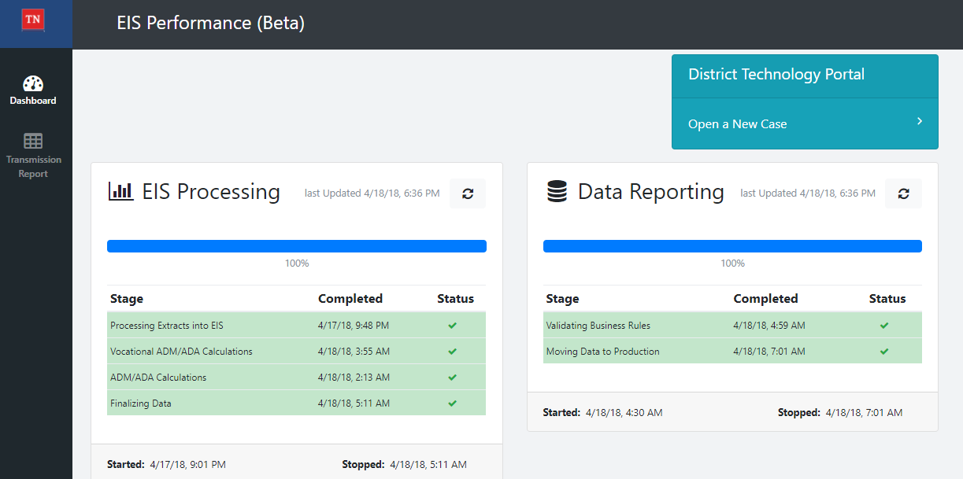
Updates & Reminders

Slide 10
Updates & Reminders
Review and update EIS contact information when a staff change is made by sending the request to dt.support@tn.gov . Don’t forget to include requests for removal and addition of department list servs.
Please make sure school staff members that work with EIS data are properly trained.

Slide 11
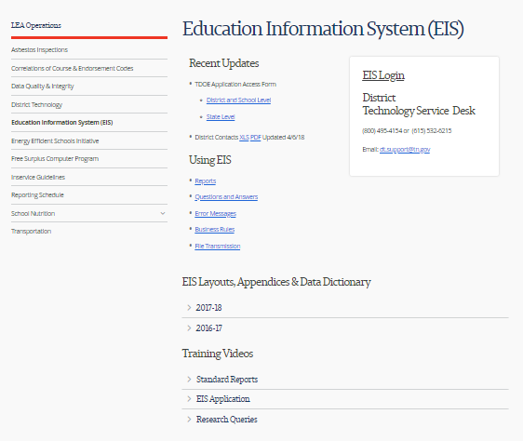
Updates & Reminders
The EIS website contains important information.

Slide 12
Updates & Reminders
The TDOE Application Access Form can be found on the EIS Website.

Slide 13
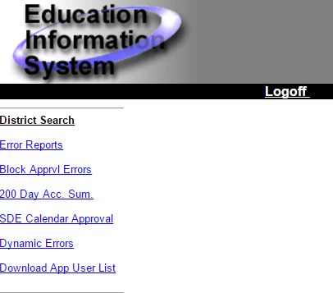
Updates & Reminders
District supervisors with DST_AA user role should periodically review the App User List in EIS Production, and make changes as needed.

Slide 14
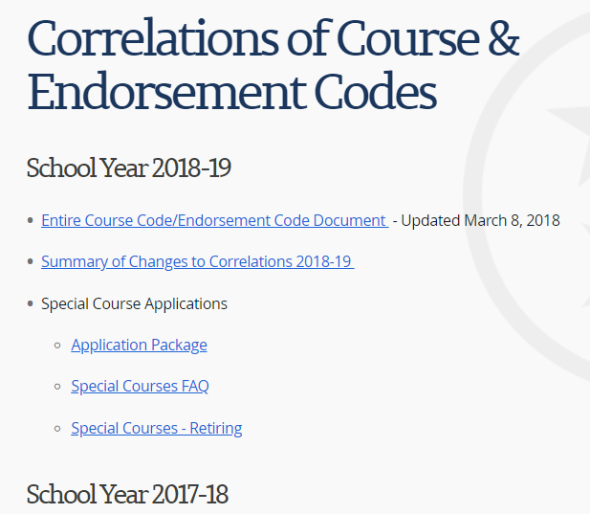
Updates & Reminders

Slide 15
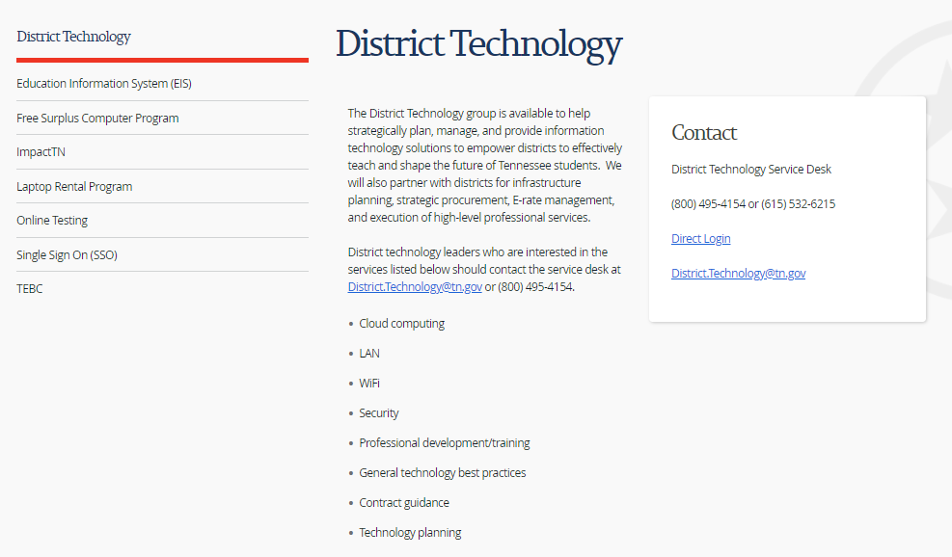
Updates & Reminders

Slide 16
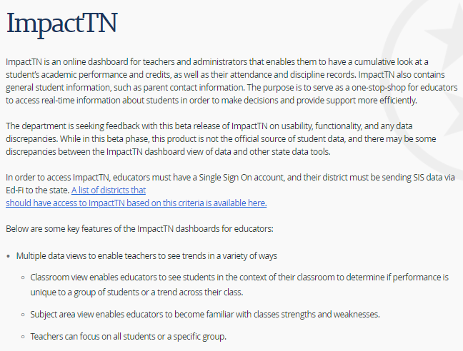
Updates & Reminders

Slide 17
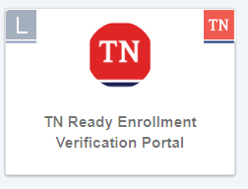
Updates & Reminders
The TN Ready Enrollment Verification Portal (Visibility Tool) can be accessed using the TDOE Single Sign-On, Orion, or the ‘old’ log-in site.

Slide 18
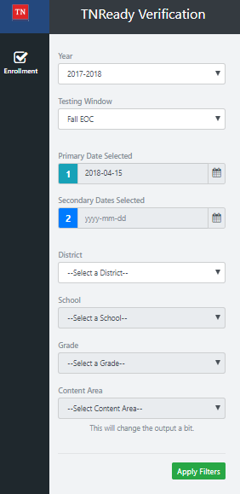
Updates & Reminders

Slide 19
EIS Changes 2018-2019
Extract 20, School Calendar:
EIS will reject school calendar number 00. Valid school calendar numbers are 01-99.
Extract 40, Student:
If a student’s new district/school alters previously submitted values for year entered 9th grade, immigrant, date first enrolled in U.S. school, country of birth, and/or native language, EIS will generate an informational message that provides the previous value. The new district/school should review the data to ensure that the correct value is reported.

Slide 20
EIS Changes 2018-2019
Extract 41, Student Enrollment & Extract 44, Student Classification:
Block loading of extract 44, student classification, ‘H’, homeless, and generate fatal error if the associated enrollment has a primary nighttime residence code of NULL or 00.
Block & generate fatal error for extract 41, if there is a NULL or 00 for primary residence and a student classification of H already exists for that enrollment.

Slide 21
EIS Changes 2018-2019
Extract 44, Student Classification:
Add student classification for students with 504 plans.
Extract 44, Student Classification:
Add student classification for students placed in each of the state’s 17 juvenile detention centers. Districts will use the ‘Student Classifications’ Research Query in Data Reports to review data submitted to EIS.

Slide 22
EIS Changes 2018-2019
Classification Code AND Classification Description:
JDC01 JDC Bedford County JDC10 JDC Richard L. Bean Service Center/Knox Co.
JDC02 JDC Blount County JDC11 JDC Rutherford County
JDC03 JDC Bradley County JDC12 JDC Scott County
JDC04 JDC Davidson County JDC13 JDC Sevier County
JDC05 JDC Hamilton County JDC14 JDC Shelby County
JDC06 JDC Madison County JDC15 JDC UHS/McDowell
JDC07 JDC Middle Tennessee JDC16 JDC Upper East Tennessee Regional
JDC08 JDC Putnam County JDC17 JDC Williamson County
JDC09 JDC Rhea County

Slide 23
EIS Changes 2018-2019
Extract 62, Staff Current Assignments:
EIS staff assignments will be aligned with the codes in PIRS/TNCompass.
Extract 80, Student Final Grades:
Validation will be added to ensure that final grades submitted by districts complies with the State Board of Education’s Uniform Grading Policy. The numeric grade cannot be NULL. Valid values are 0-100.

Slide 24
EIS Changes 2018-2019
Data Reports, Research Query Report, Staff Current Assignment:
Add staff ethnicity and race fields.

Slide 25
Melissa Teat Customer Product Manager Melissa.Teat@tn.gov (800) 495-4154

