Slide 1
PlayWell

Slide 2
The PlayWell Group, Inc. –
Established - 1988 in Albuquerque, NM, Operating in north Texas since 1999 Family Owned
D/MWB / HUB Certified BuyBoard Vendor HGAC Vendor
Offices-
Dallas, Texas -Corporate Office / Warehouse
Albuquerque, New Mexico - Customer Service Office
Local reps near you!

Slide 3
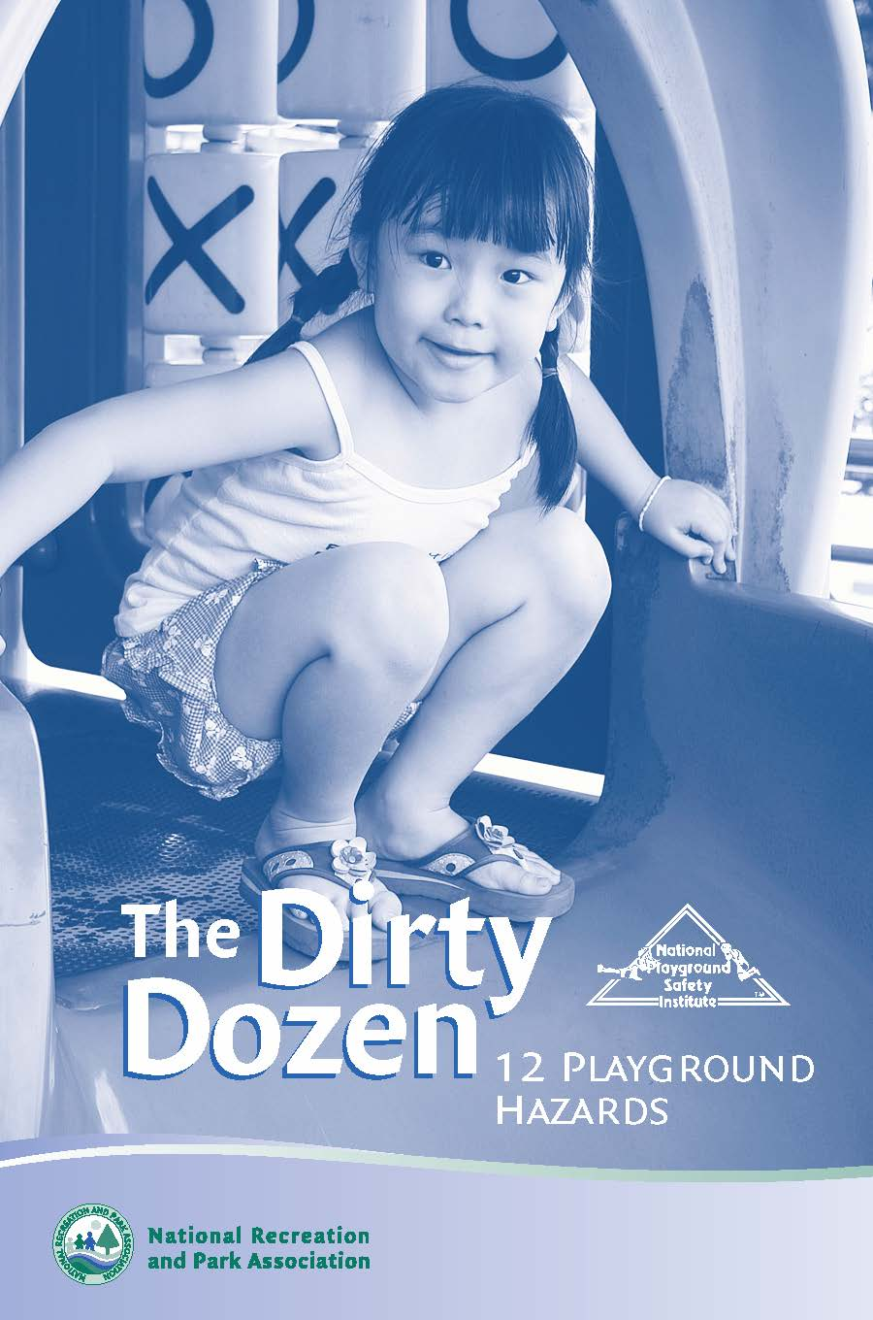
Playground Hazard
Checklist

Slide 4
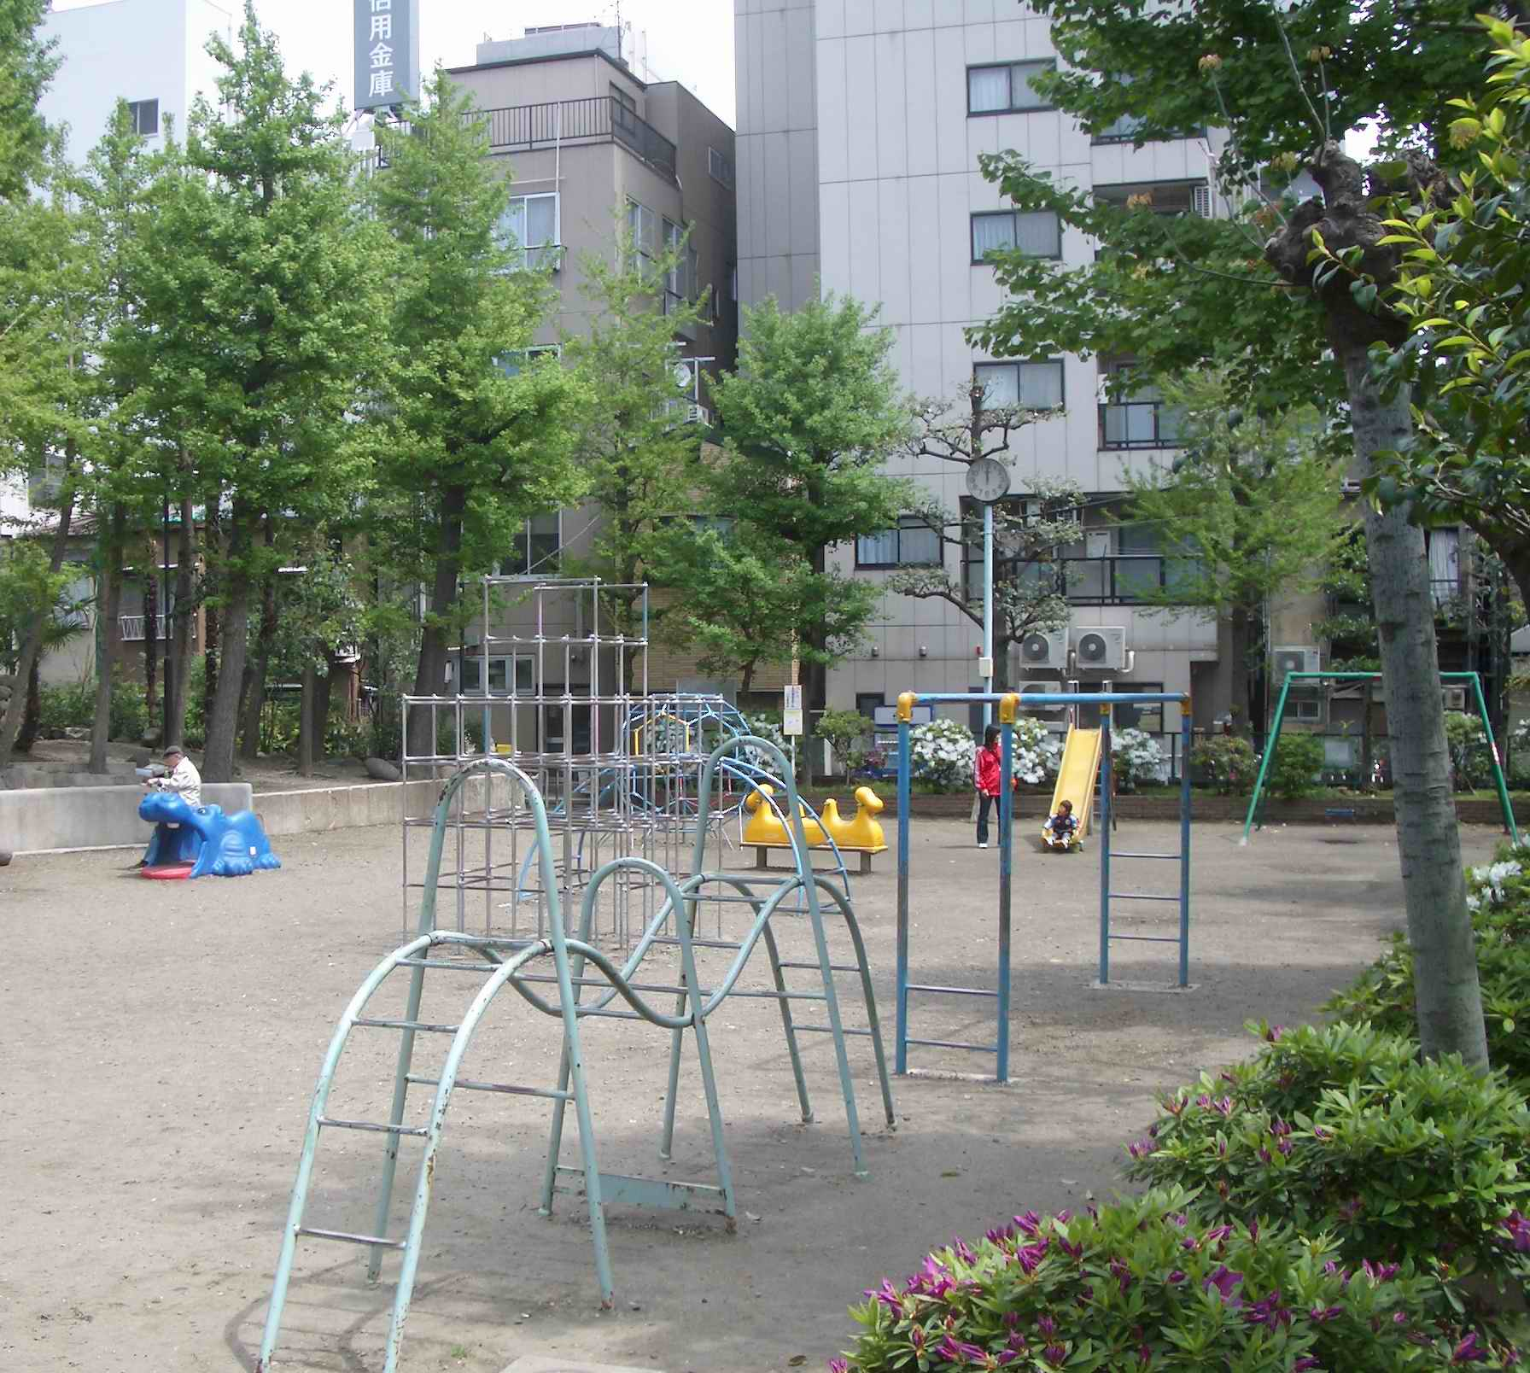
1) Improper Protective
Surfacing

Slide 5
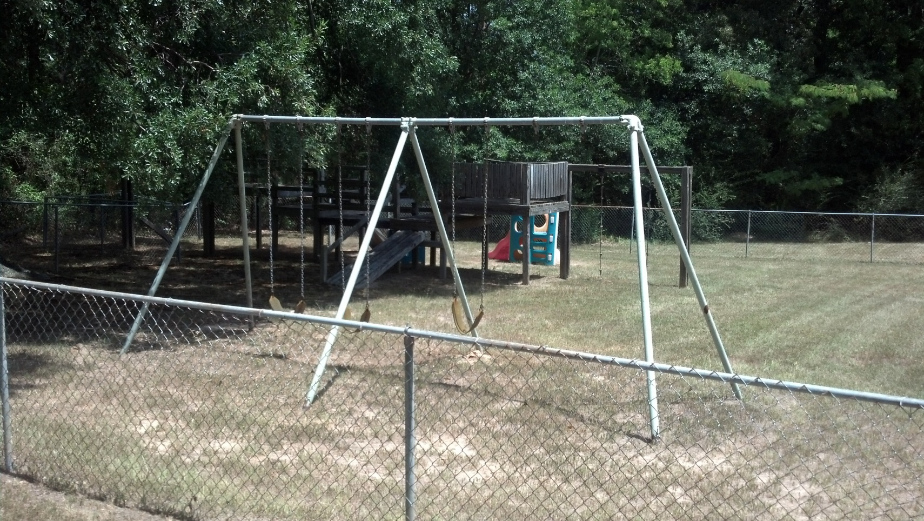
2) Inadequate Use Zone

Slide 6
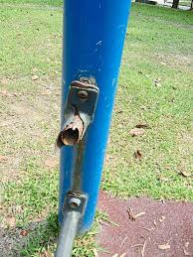
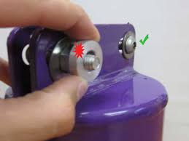
3) Protrusion & Entanglement
Hazards

Slide 7
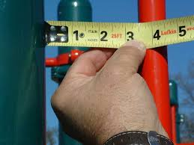
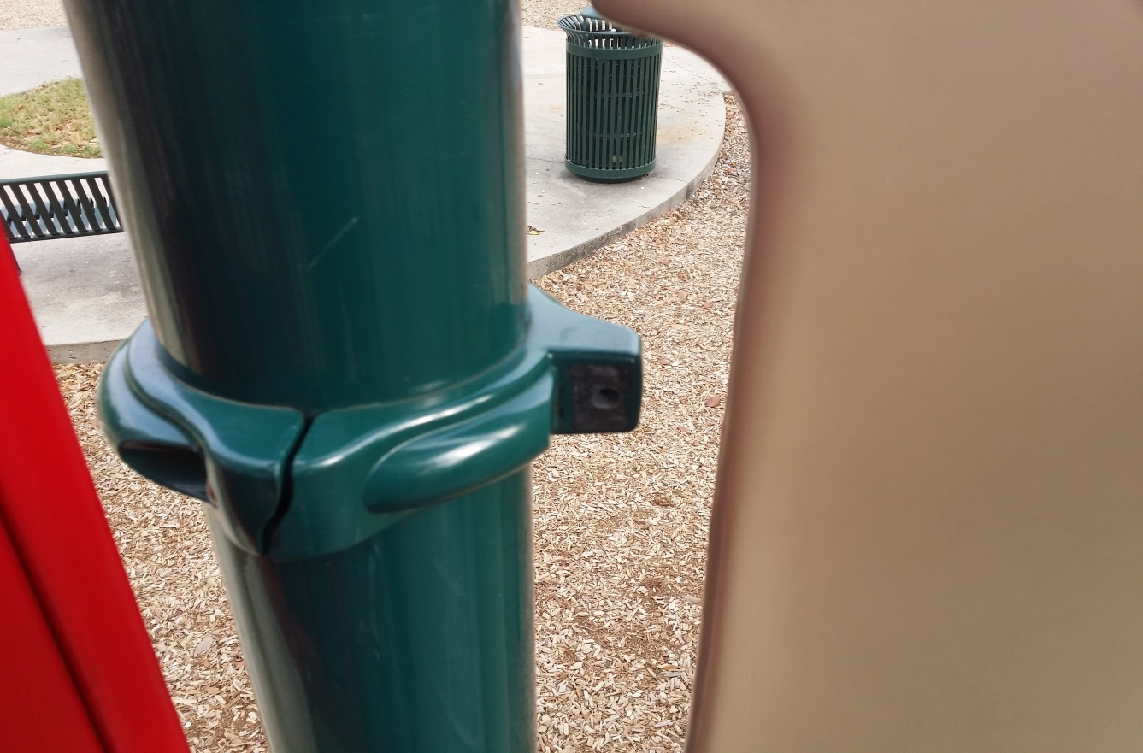
4) Entrapment in Openings

Slide 8
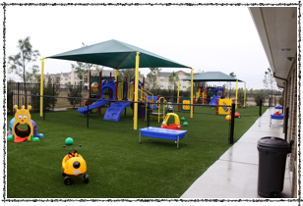
5) Insufficient Equipment
Spacing

Slide 9
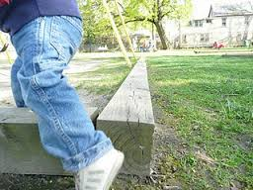
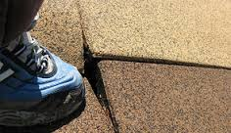
5) Trip Hazards

Slide 10
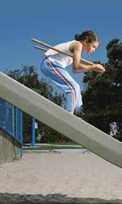
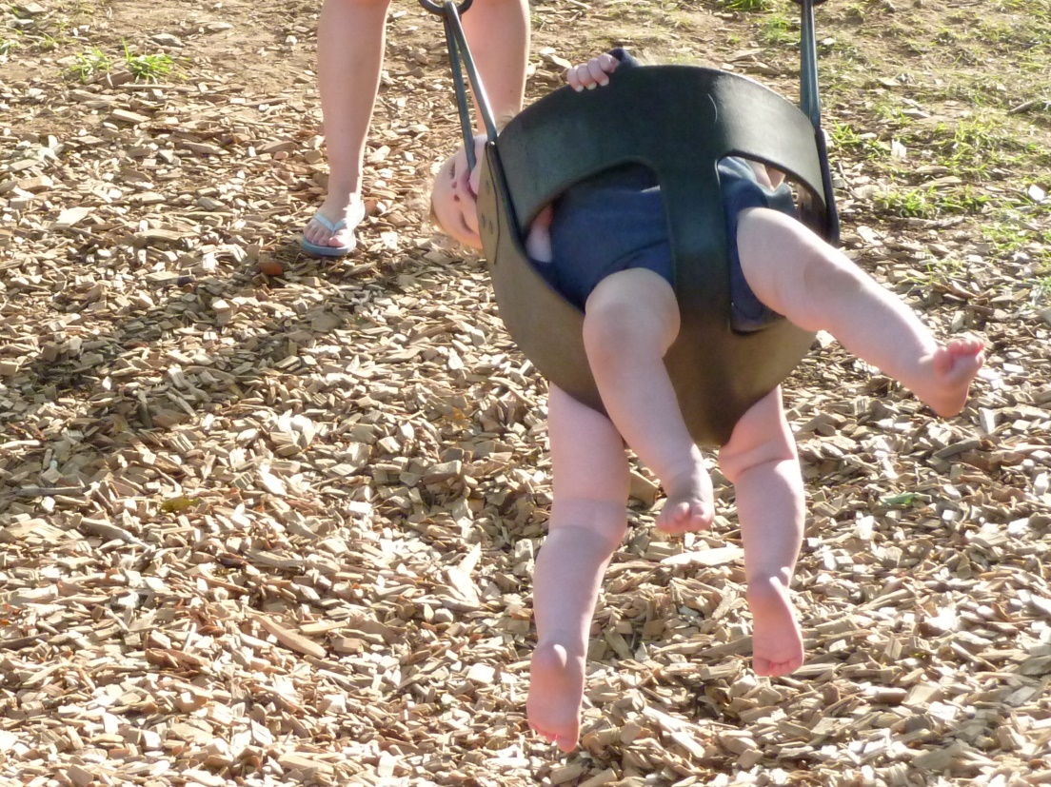
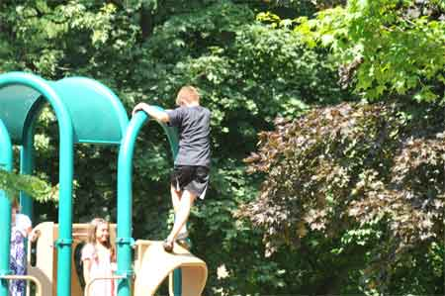
7) Lack of Supervision

Slide 11
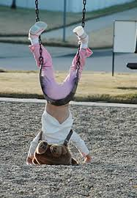
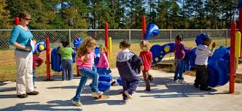
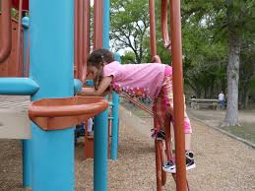
8) Age-Inappropriate
Activities

Slide 12
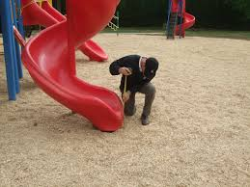
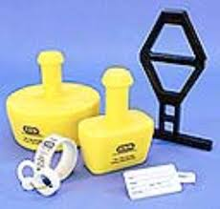
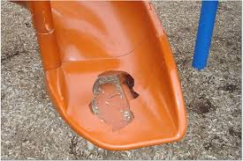
9) Lack of Maintenance

Slide 13
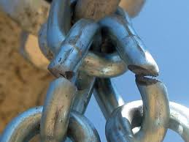
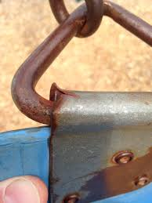
10) Crush, Shearing,
And Sharp Hazards

Slide 14
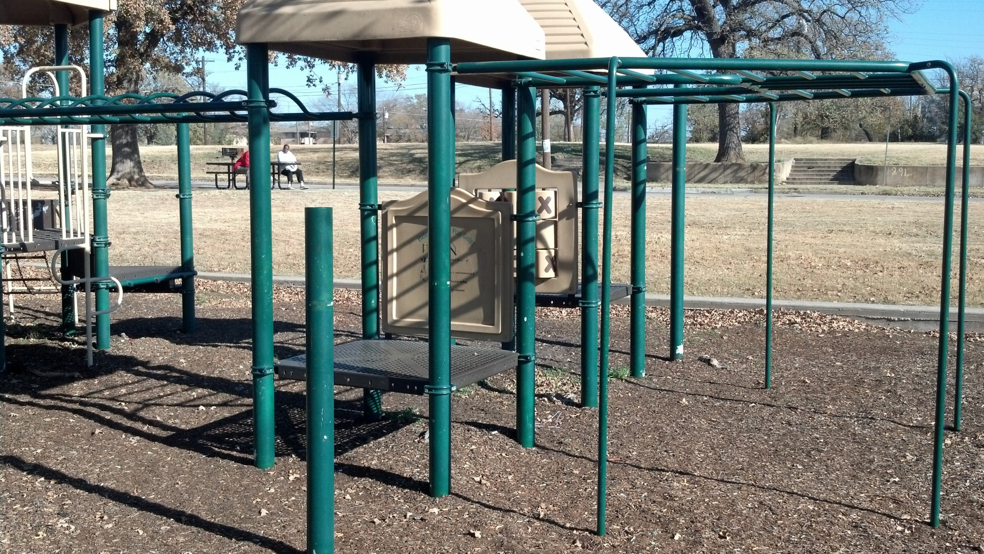
11) Platforms With
No Guardrails

Slide 15
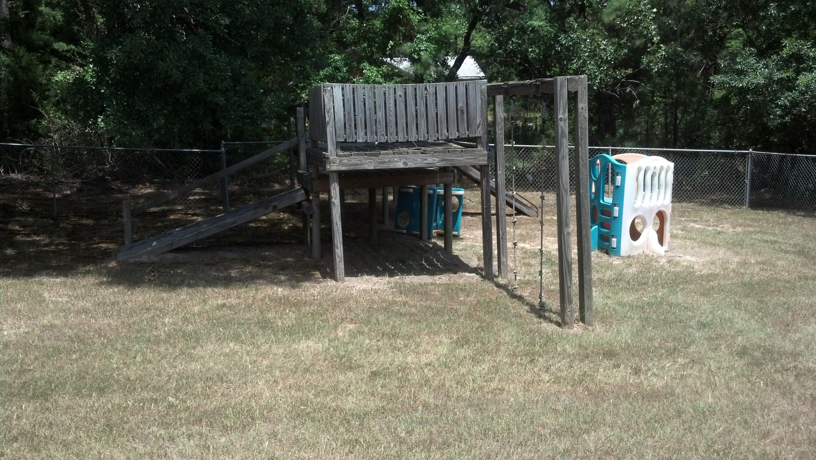
12) Equipment Not
Recommended For Public
Playgrounds

