Slide 1
Using Arthur Aron’s “Fast Friends” Paradigm as an Icebreaker
Created by Lauren Howe
Stanford University and the University of San Francisco

Slide 2
Getting to Know Each Other
We’ll be answering a series of three “get to know you” questions, in small groups of three
Each person will have 2 minutes to talk (6 minutes per question total)
Take turns with who answers the questions first: start with Person #1, then have Person #2 respond first for the next question, then Person #3 for the final question (don’t worry, it’s marked on each slide!)
Groups are on the next slide
Notes:
Lauren’s notes for instructors: This activity is based on Arthur Aronson’s “Fast Friends” paradigm. I time students so each person in the group has 2 minutes to respond to each question prompt (can set a loud phone alarm or ring a bell to signal to move to the next question)
You might change the number of students in the group to match your class size. This version was used in a General Psychology class of 30 students

Slide 3
Group 1
#1: Student Name
#2: Student Name
#3: Student Name
Group 2
#1: Student Name
#2: Student Name
#3: Student Name
Group 3
#1: Student Name
#2: Student Name
#3: Student Name
Group 4
#1: Student Name
#2: Student Name
#3: Student Name
Group 5
#1: Student Name
#2: Student Name
#3: Student Name
Group 6
#1: Student Name
#2: Student Name
#3: Student Name
Group 7
#1: Student Name
#2: Student Name
#3: Student Name
Group 8
#1: Student Name
#2: Student Name
#3: Student Name
Group 9
#1: Student Name
#2: Student Name
#3: Student Name
Group 10
#1: Student Name
#2: Student Name
#3: Student Name
Notes:
Lauren’s notes for instructors: To help students find each other, they can hold up the number of fingers that corresponds to their group

Slide 4
Question #1 – Person 1
Given the choice of anyone in the world, whom would you want as a dinner guest and why?

Slide 5
Switch – Person 2!
Given the choice of anyone in the world, whom would you want as a dinner guest and why?

Slide 6
Switch – Person 3!
Given the choice of anyone in the world, whom would you want as a dinner guest and why?

Slide 7
Question #2 – Person 2
What would constitute a “perfect” day for you?

Slide 8
Switch – Person 3!
What would constitute a “perfect” day for you?

Slide 9
Switch – Person 1!
What would constitute a “perfect” day for you?

Slide 10
Question #3 – Person 3
What is your most treasured memory?

Slide 11
Switch – Person 1!
What is your most treasured memory?

Slide 12
Switch – Person 2!
What is your most treasured memory?

Slide 13
Question #4 – Person 1
Your house, containing everything you own, catches fire. After saving your loved ones and pets, you have time to safely make a final dash to save any one item. What would it be? Why?

Slide 14
Switch – Person 2!
Your house, containing everything you own, catches fire. After saving your loved ones and pets, you have time to safely make a final dash to save any one item. What would it be? Why?
Notes:
Pause. Who enjoyed this? Did anyone recognize the questions?

Slide 15
Switch – Person 3!
Your house, containing everything you own, catches fire. After saving your loved ones and pets, you have time to safely make a final dash to save any one item. What would it be? Why?
Notes:
Lauren’s notes for instructors: Pause at this point before advancing to the next slide. Who enjoyed this? Did anyone recognize the questions?

Slide 16
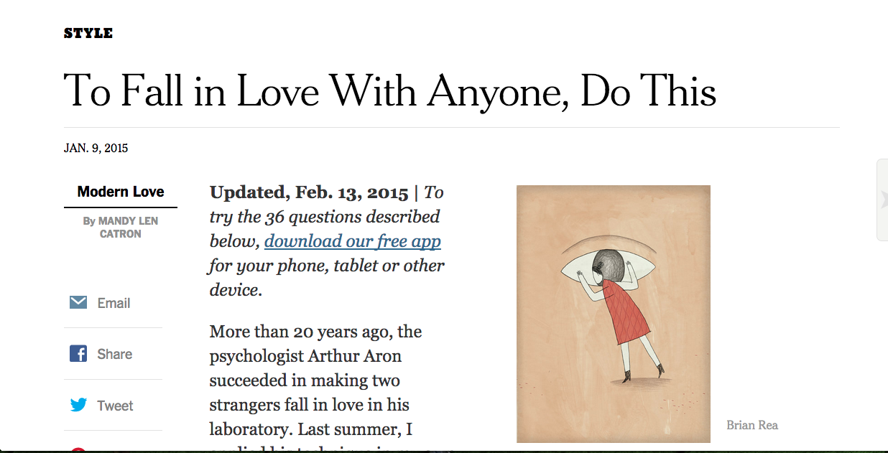
Notes:
Did anyone recognize these questions, or have a guess where they are from? (click for headline) About a year and a half ago, these questions became very popularized through a New York Times article written by an English professor. She wrote about how she had found out about questions that had been used in an activity designed by a psychological researcher. This activity was designed by the researchers to help people build a sense of intimacy and friendship at a rapid pace in the laboratory – and legend has it that two participants who completed this activity later fell in love. So, this professor answered the questions from this activity on a date, and wrote an article about her experience.

Slide 17
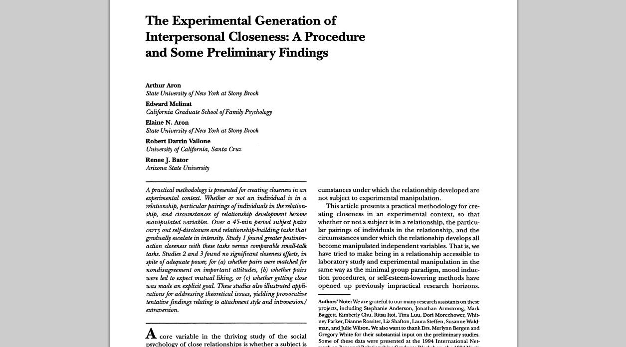
Notes:
In fact, the activity designed by these researchers had been published in an older paper back in 1997. The researchers designed this activity to experimentally generate a sense of closeness between participants who were meeting for the first time, through a process of escalating, reciprocal, personalistic self-disclosure. This activity took 45 minutes in a lab, and was 36 questions long.

Slide 18
Notes:
The article in the New York times written about this activity became extremely popular and generated TONS of headlines. Some were quite close to the original activity’s purpose: to help create a sense of closeness in the lab. But others went even further… (click to add more headlines) Some of these might teach us to be a critical consumer of reporting about research… 36 questions *guaranteed* to make you fall in love?!

Slide 19
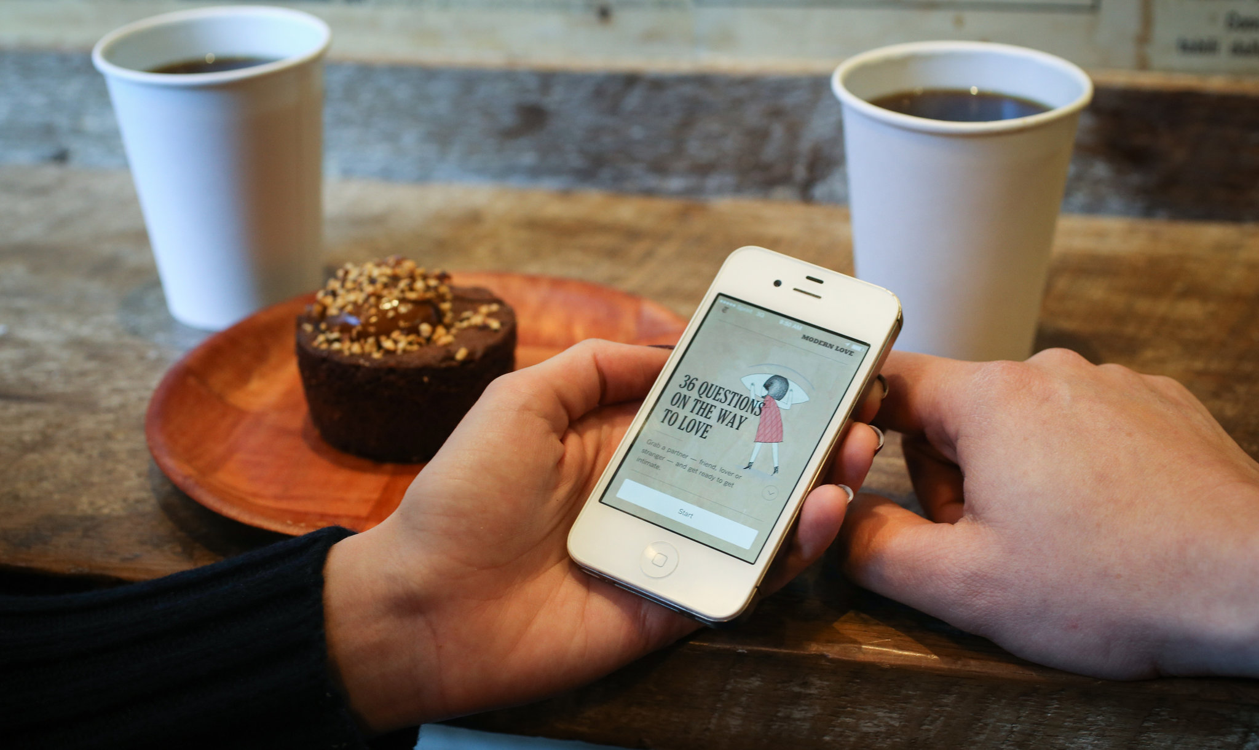
Notes:
In fact, there’s now even an app you can download to use these “36 questions” in your own life!

Slide 20
Why do this activity?
Thinking like a researcher!
Notes:
Psychology is a fascinating science because you often are asking questions about concepts that are highly abstract - including things like feelings of intimacy, and what happens when people build a sense of closeness with others. This example shows how you can change things like “intimacy” and a “sense of closeness” in order to study them.
The activity that we just went through has been used in other studies precisely for this reason. For instance, some researchers wondered whether building intimacy with people from different racial and ethnic backgrounds might improve attitudes towards racial groups and decrease prejudice. So they used this task to do that. The researchers had individuals and romantic couples participate in the activity with other people or couples who had a different racial and ethnic background, and found that engaging in this task – particularly as couples – improved people’s attitudes toward the group from which their partners came. Another group of researchers were interested in whether making “couple friendships” increases relationship quality for people in romantic relationships. These researchers used this task to create new “couple friendships” and found that creating these new friendships through the self-disclosure activity increased passionate love towards one’s own partner.
Thinking about how we can take these big, real-world ideas and study them in a systematic way is a theme that will resurface throughout the course. In the research methods lectures, we’ll talk about how we manipulate and measure other intangible things, like “aggression” or “prosocial behavior”. In the developmental lectures, we’ll talk about other interesting methodological challenges psychological researchers face, including how to figure out what an infant is thinking about the world [personalize for your courses].

Slide 21
Happy Teaching!
E-mail me with questions about this activity: Lchowe@stanford.edu

