Slide 1
The Future of Finance
Sundeep Kapur
Educator, Digital Credence

Slide 2
5. Future Roadmap
1. Define Key Trends
What I will cover
4. Applied Inferences
2. Discuss Innovation
3. Top 7 Challenges

Slide 3
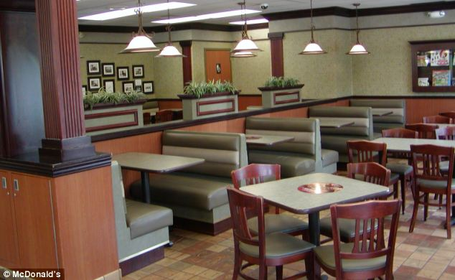
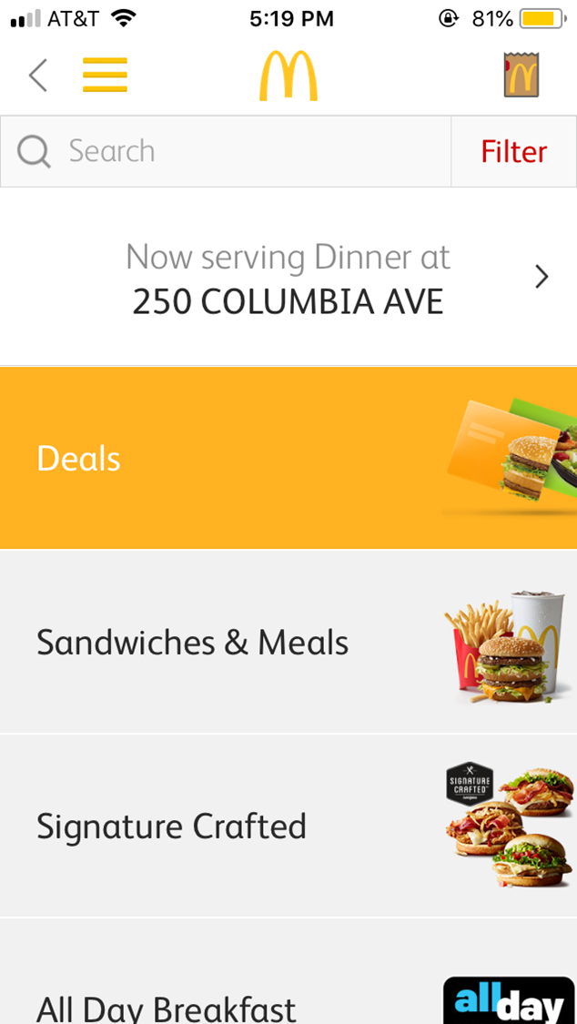
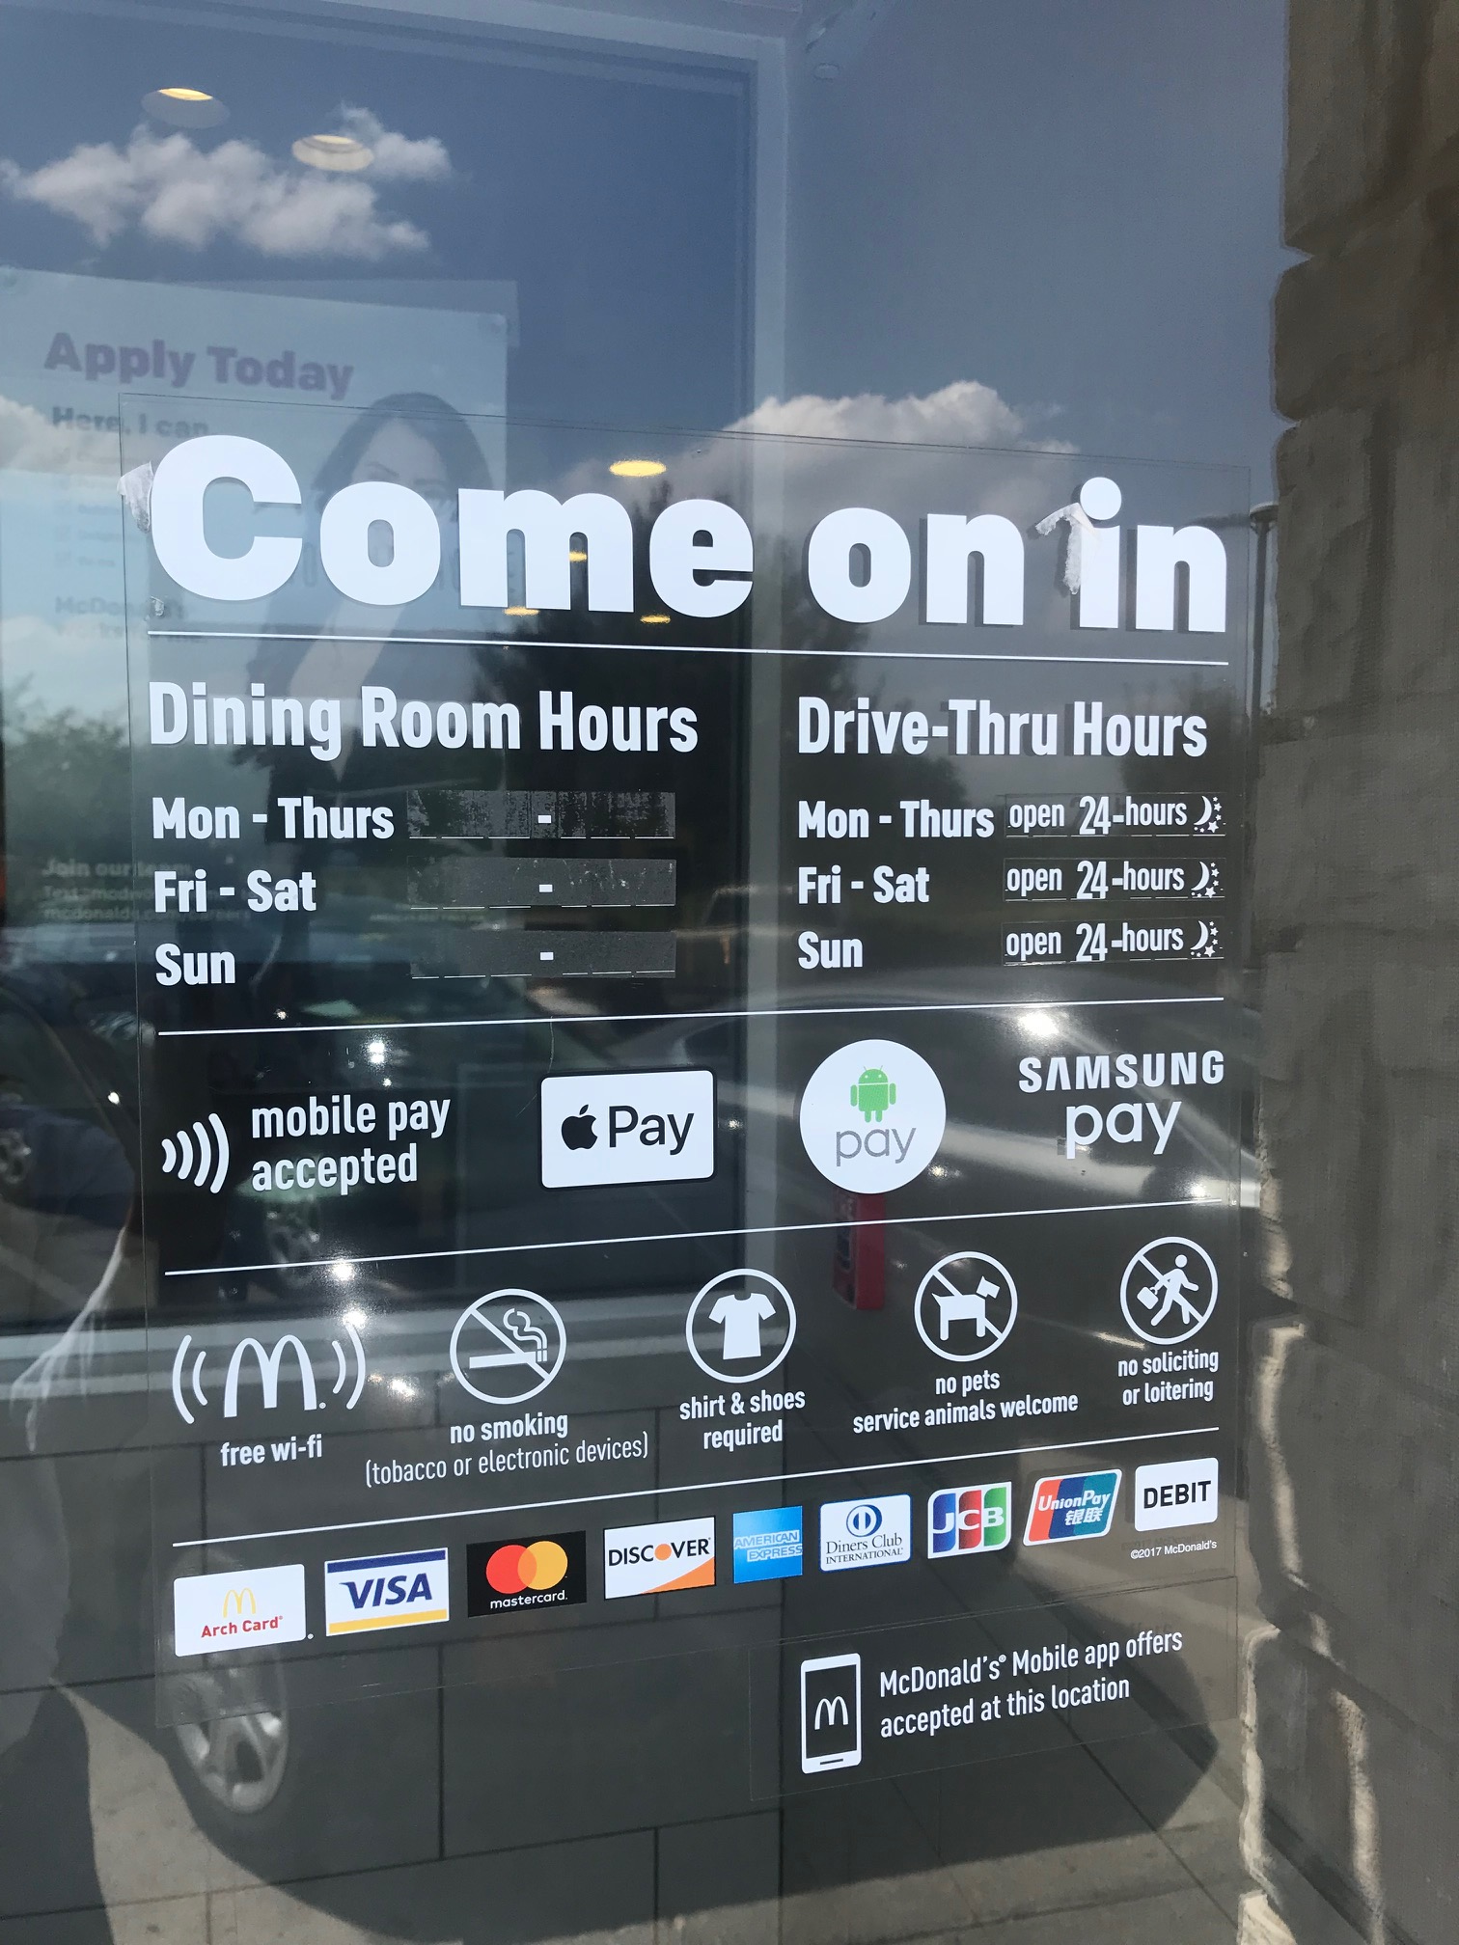
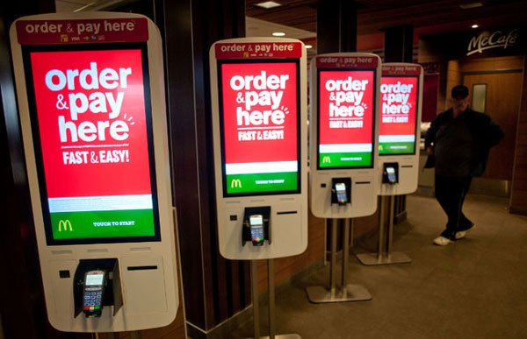

Slide 4
Paradigm Shift Continues
Frequency of Use
Less
More

Slide 5
Traditionalists
Before 1946
Millennials (Y)
1977-1995
Gen Z
After 1995
Baby Boomers
Gen X
1946-1964
1965-1976
70% Dig-Acc
Thrifty
Diligent
90% Dig-Acc
+ Work Ethic
Achievers
95% Dig-Acc
Value Work
Life Balance
97% Dig-Acc
Job Hopping
Family Imp.
Digital
Prefer Cool
Biz: Focused

Slide 6
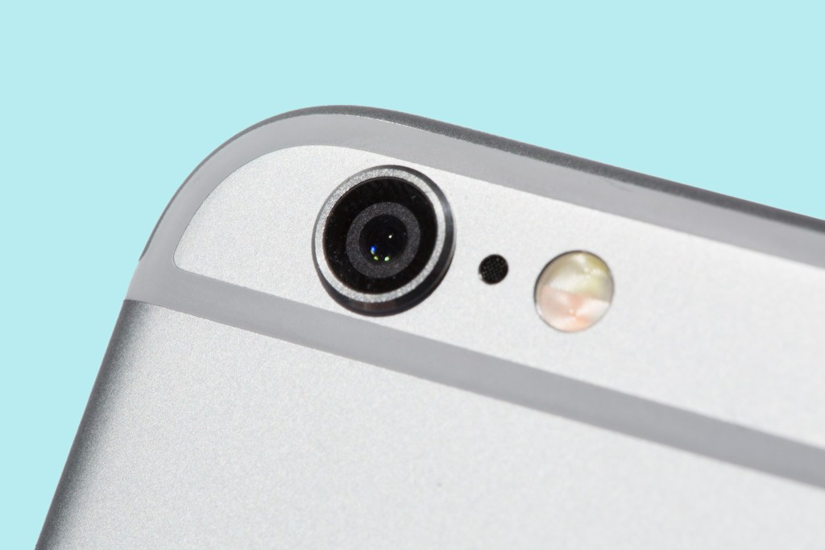
Intrusive, Creepy, Helpful?
Privacy/Monitoring
Personalization/Authentication
Machine Intelligence
Ownership/Control
Efficiency/Convenience

Slide 7
Three Major Trends
Artificial Intelligence
(AI)
Robotic Process Automation
(RPA)
Digitization of
Payments

Slide 8
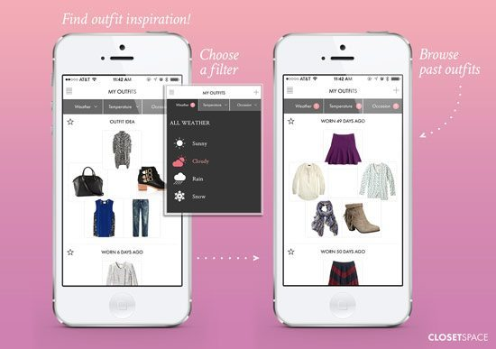
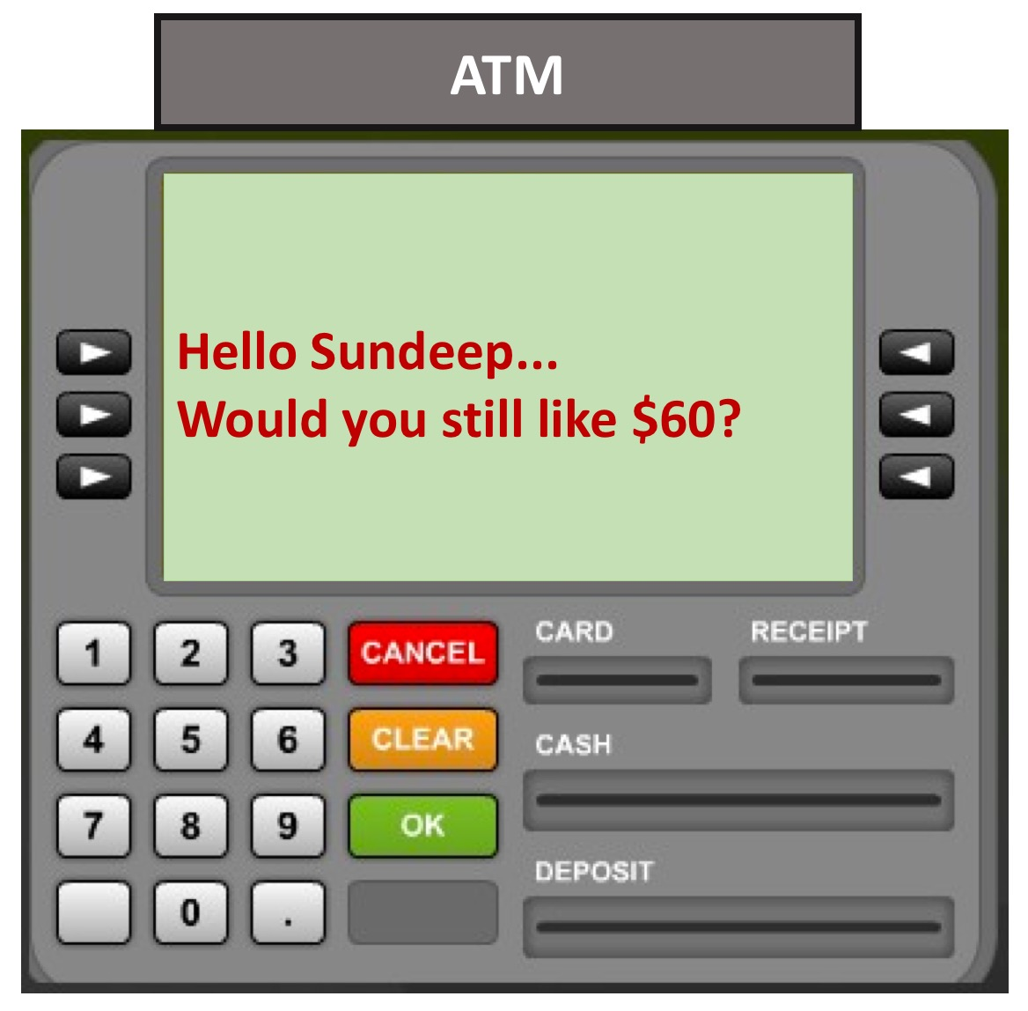
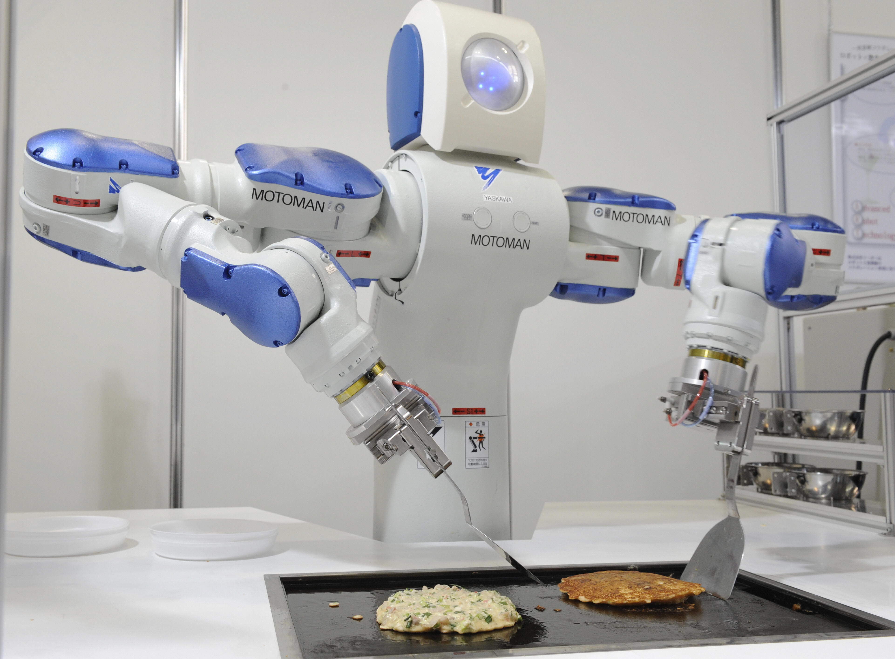
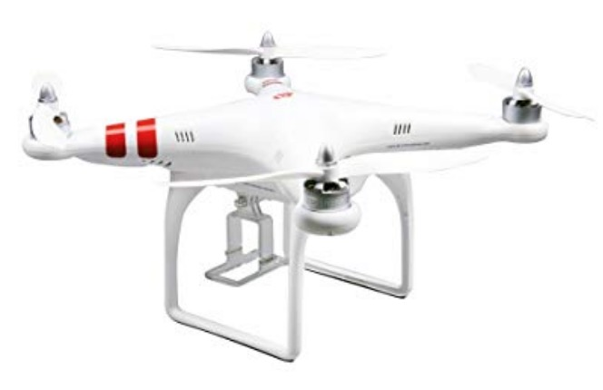
What is Defining the Future
ANTICIPATE

Slide 9
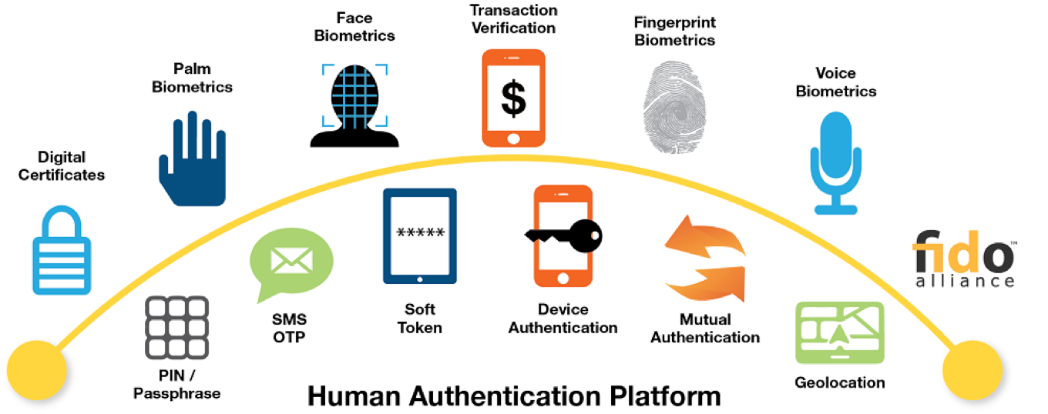
Intelligent Biometric Applications
Identify to Ensure
Recognize to Personalize
Anticipate to Serve

Slide 10
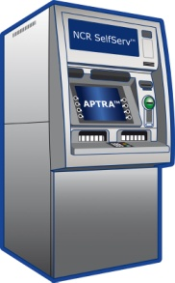
Intelligent User Experiences Across Channel
One/two touch transactions
Across Channel

Slide 11
Intelligent Money Management
Cash Management
Deposits
Loans

Slide 12
Intelligent Payment Automation
Convenience
Incentives
Protection

Slide 13
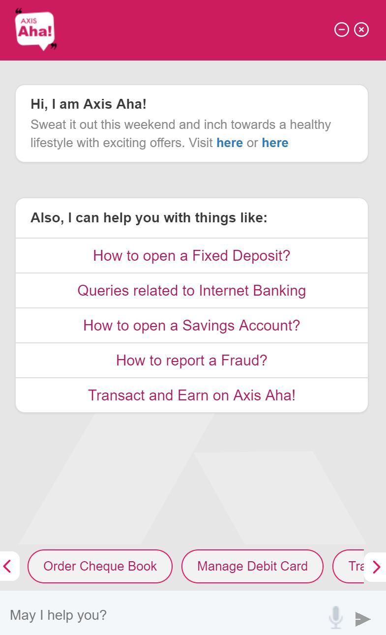
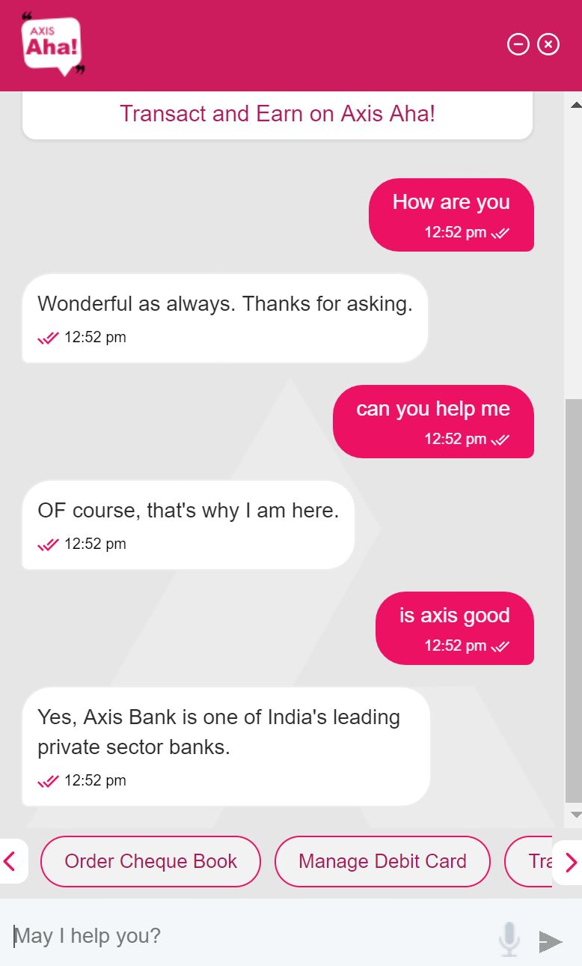
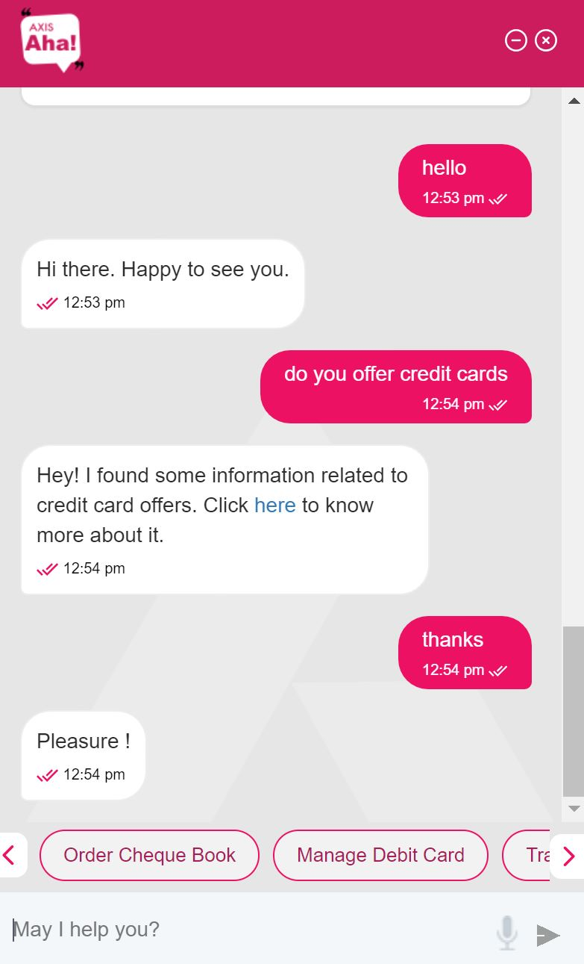
Intelligent Personalized Assistants

Slide 14
Addressing Important Challenges

Slide 15
1. The Branch Experience Has to Change
Do Not: Rebuild, Decorate, Technology
Key Journeys: Transactional, Service, Advisory
Leverage Information: Data, Journeys, Zones
Transform consumer experiences
across channel

Slide 16
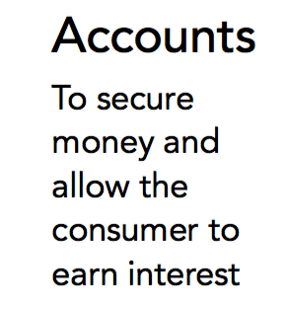
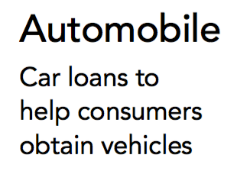
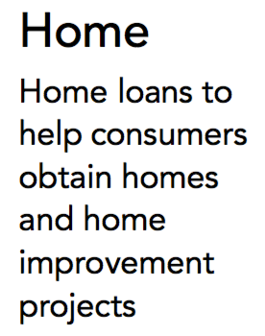
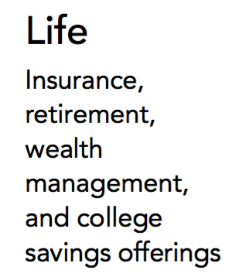
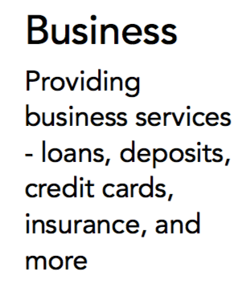
2. Develop a Foundational Digital Strategy

Slide 17
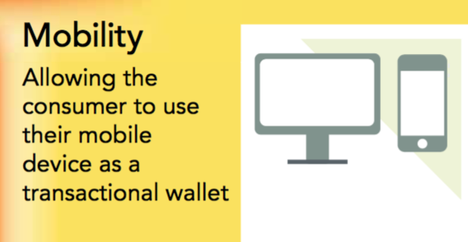
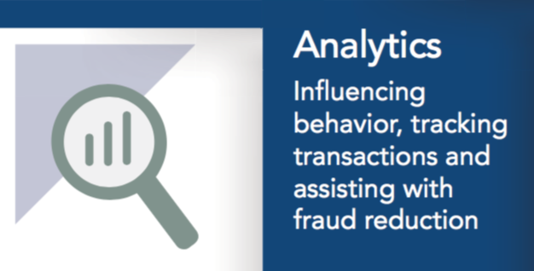
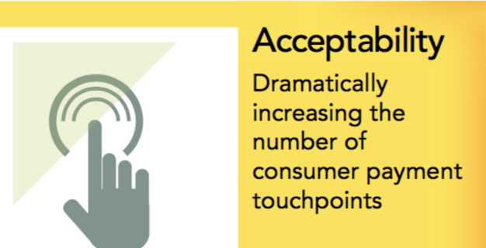
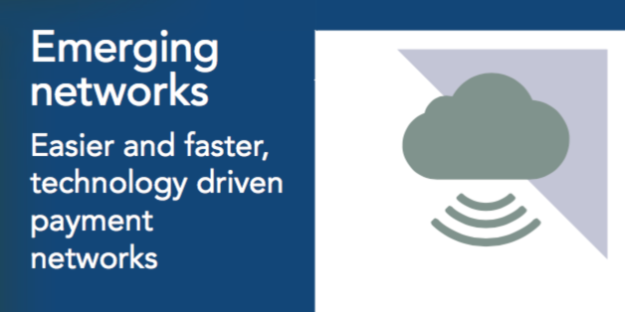
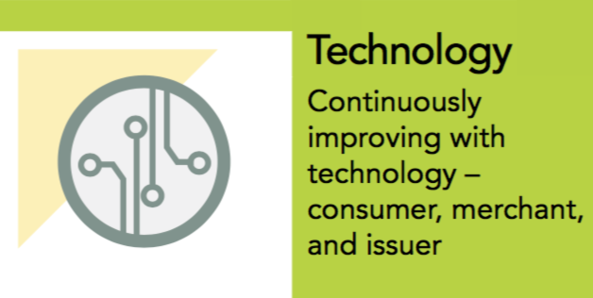
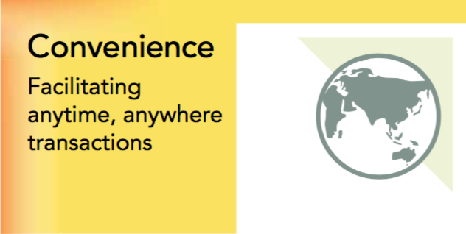
3. Lead with Payments

Slide 18
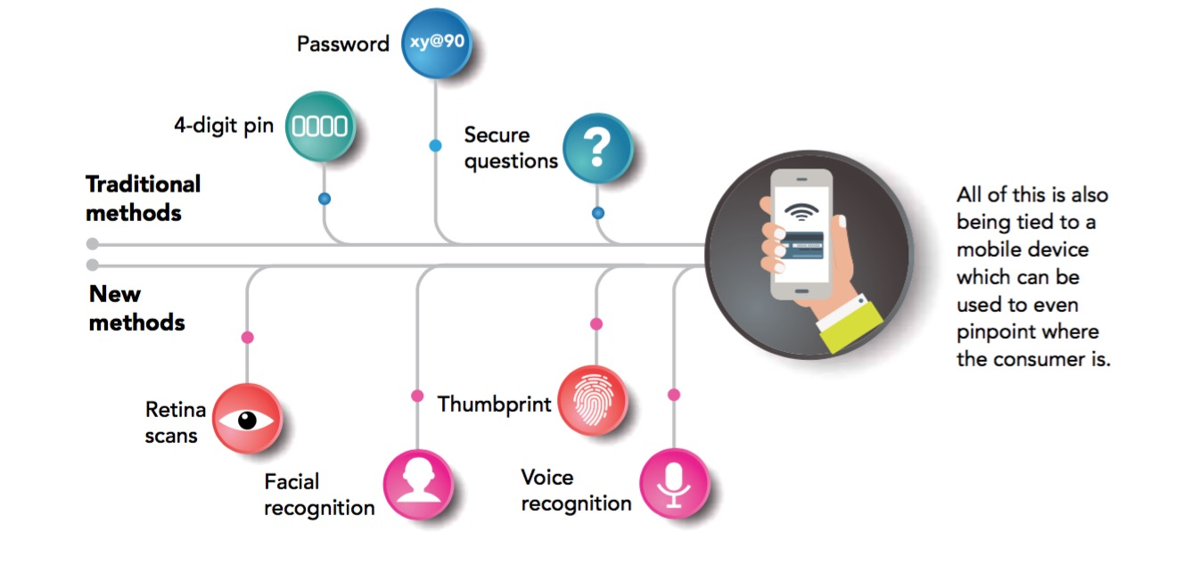
4. Secure Biometric Authentication

Slide 19
5. Build Smarter & Consistent Channels

Slide 20
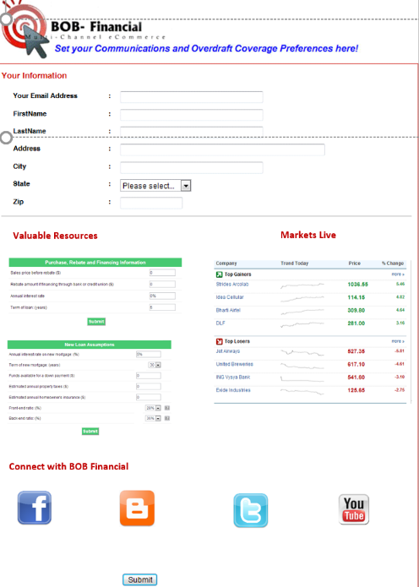
6. Develop a Perpetual Data Strategy
Branch/Kiosk
ATM/Kiosk
Contact Center
Online
Collect & Normalize Data
Score Segments
Create Rules
Execute Triggers
Analyze Results
Mobile
Direct Mail

Slide 21
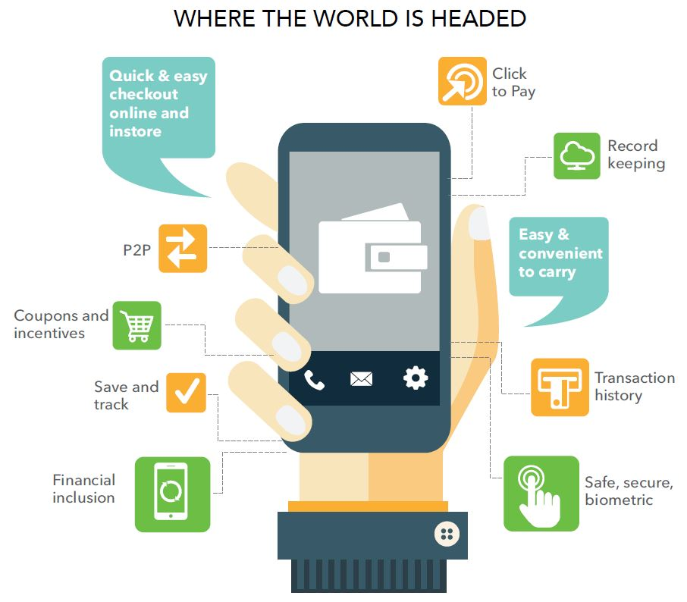
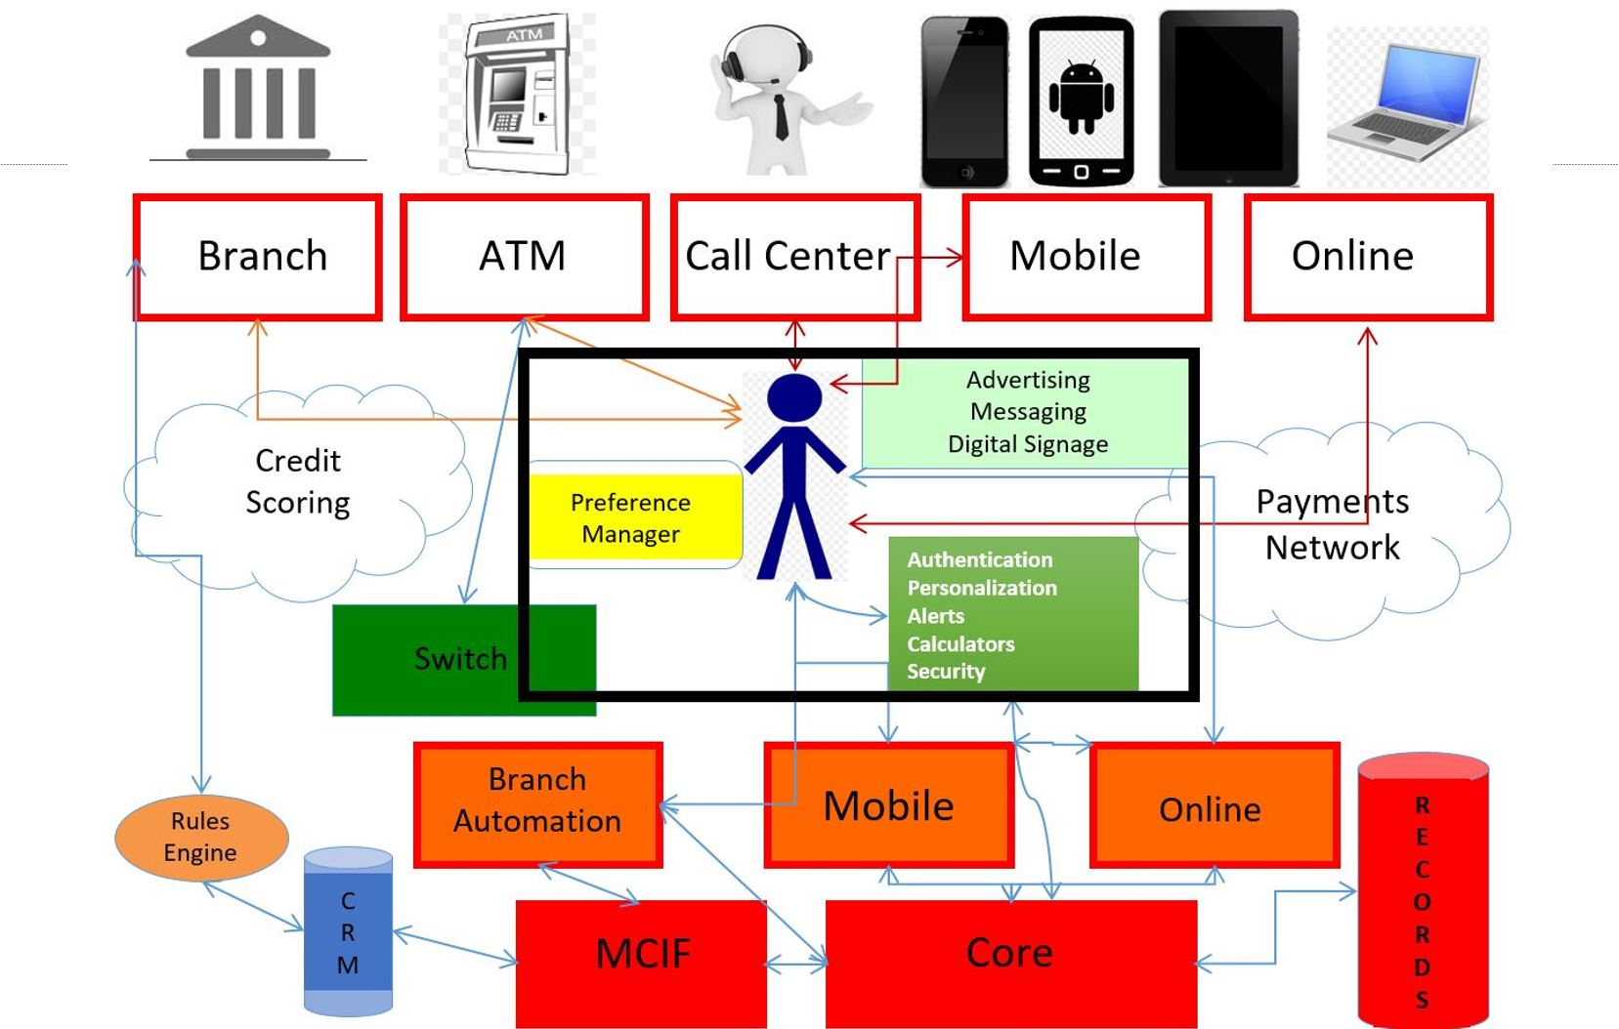
7. Build a Mobile First Strategy

Slide 22
What Consumers Want
Personalized, relevant, automated experiences
The ability to self-serve; convenience – easy & intuitive
Transaction security, protection of personal information
Incentives to transact, a loyalty program
A relationship based on trust & sincere advice

Slide 23
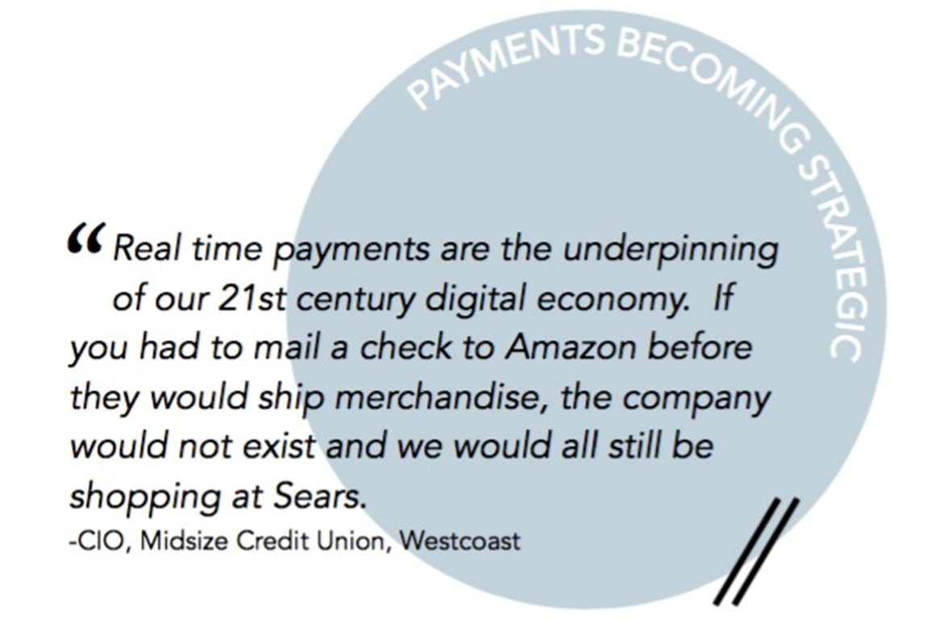
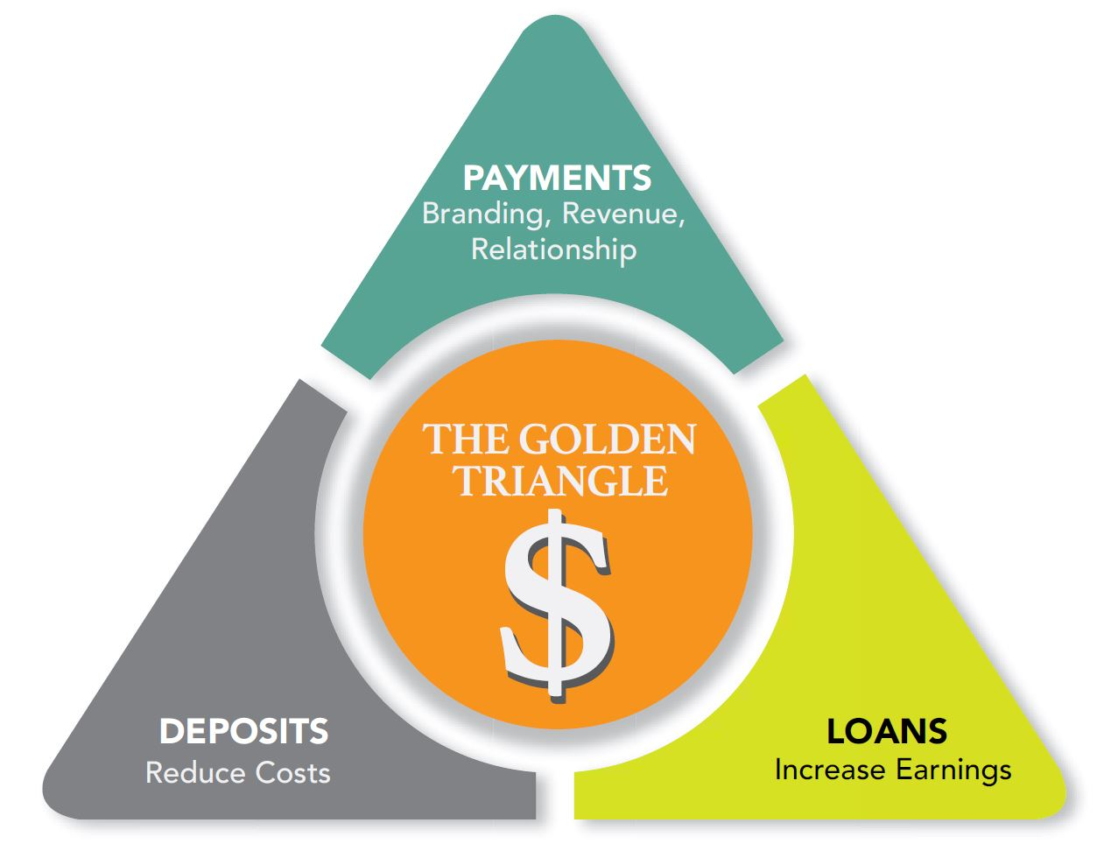
Battle FinTech, Win?

Slide 24
Battling Fintech: Five Year Roadmap
The Branch Experience Has to Change
Twice a year, prescriptive, consumer focused – financial checkup
Develop a Foundational Digital Strategy
Continuous improvement: responsive, integrated, personalized - CDO perhaps
Lead with Payments
Secure, convenient, incentive driven transactions – lead in to more
Secure Biometric Transactions
Offer biometric convenience, protect data – front end & back end
Build Smarter & Consistent Channels
Mentoring people, cognitive collaboration, delivering on consistency
Develop a Perpetual Data Strategy
Moving from reactionary to predictive to prescriptive
Build a Mobile First Plan
Catchup, getting ahead, & continuous innovation

Slide 25
Your Financial Institution Beyond 2020
Think about the Top Seven Challenges you face (whitepaper)
Establish a foundational Digital Strategy
Lead with Payments – Top of wallet, to top of mind
Leverage Perpetual-Big-Data effectively
Chart a Dynamic Five-Year Roadmap
Sundeep@DigitalCredence.com

