Slide 1
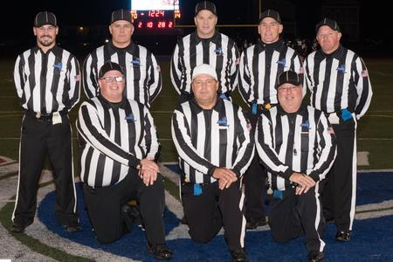
Mohawk Valley Chapter of Certified Football Officials
40 Second Play Clock

Slide 2
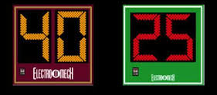
40 Second Play Clock
The 40 second play clock will provide more consistency to the game.
The ball must be snapped within 40 seconds after the end of the previous play.
This will eliminate the dependency on the referee’s signal.
YOU DO NOT NEED A VISIBLE PLAY CLOCK ON YOUR FIELD.
The back judge will be responsible of the 40 second clock.
This only applies to the play clock not the game clock.
This will be used on all Varsity games.

Slide 3
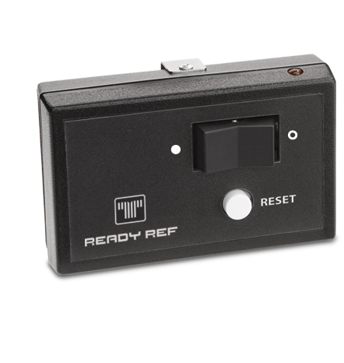
More on 40 second play clock
Every Back Judge will be equipped with a timing device that will accurately keep the 40 and 25 second play clocks.
The Back Judge will signal (by raising his hand) at 10 seconds left and will visibly count the last 5 seconds by using a chopping motion.

Slide 4
40 second clock basic premise
The play clock will start at 40 seconds within 2 seconds of the end of the previous play.
If there is an administrative stoppage of play, the play clock will be set to 25 and start on the referee’s signal.
If the 40 - second play clock has started and runs down below 25 seconds and the ball has not yet been placed on the ground and ready for play through no fault of the players (long run, long pass and ball is being relayed back, etc.), the referee may sound the whistle, reset the play clock to 25 seconds, and start the play clock (and possibly the game clock) on his whistle/signal.

Slide 5
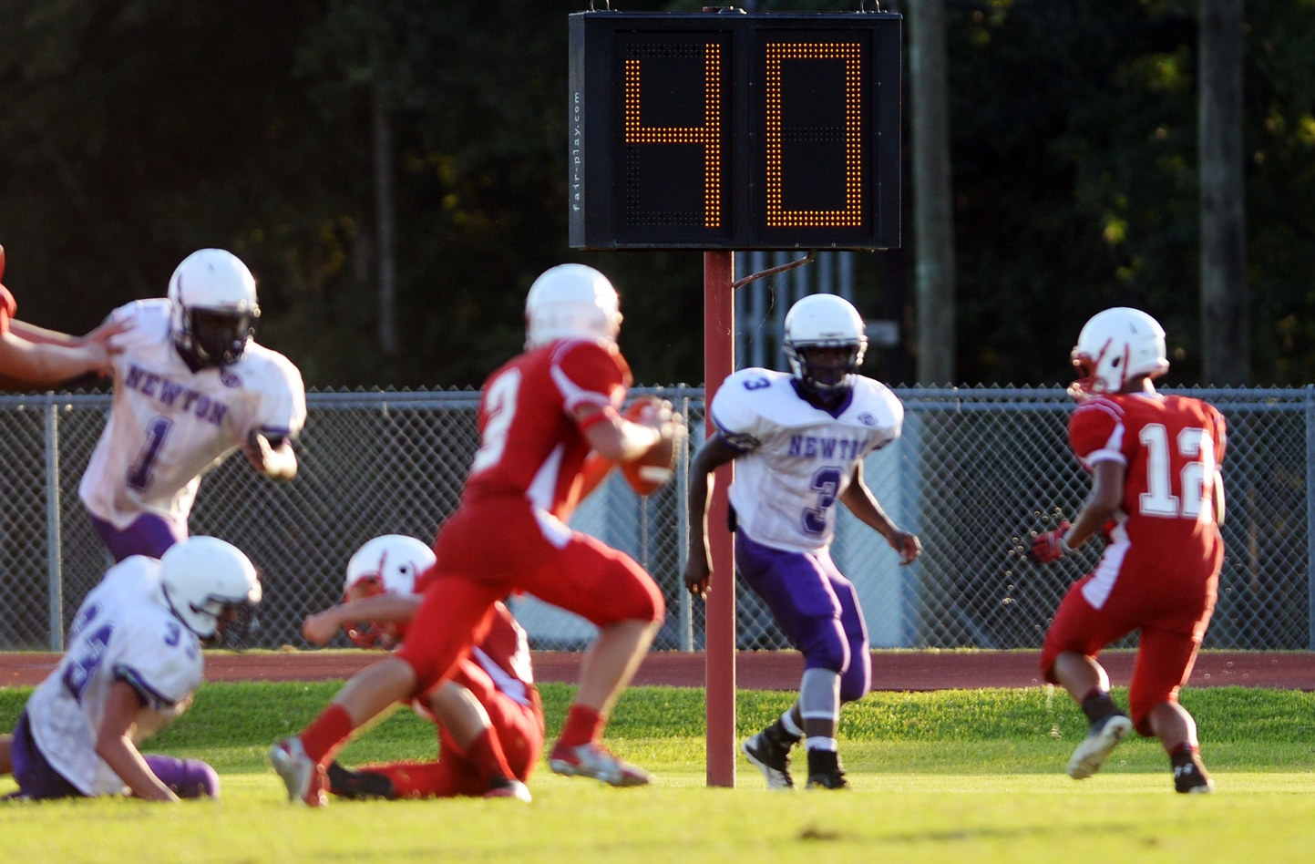
The new 40 second play clock will be used:
At the end of a running play that ends inbounds or out of bounds.
At the end of a pass play, whether the pass is complete or incomplete.
Following an official's timeout for an injury to a player or “helmet off”. **
** Referee’s Discretion, 40 or 25

Slide 6
When does the 40 second play clock start:
As soon as the play ends and the ball is dead. The covering official raises his arm straight up indicating that the ball is dead.
If the play ends out of bounds, when the official signals to stop the game clock.
On an incomplete pass, when the covering official gives the incomplete pass signal.
The clock operator (or Back Judge) will immediately start the 40 second clock, unless something else occurs that requires the 25-second play clock to be used. The 40-second play clock will be used most of the time following a play.
If during the play a change of possession occurs, the covering official will not signal to start the 40-second play clock. The timeout signal will stop the game clock and the 25-second play clock will start on the Referee’s ready-for-play signal.
If the 40-second play clock is used at the sub-varsity level, a 5-man crew must be used. The mechanics are inoperable with less than 5 crew members.

Slide 7
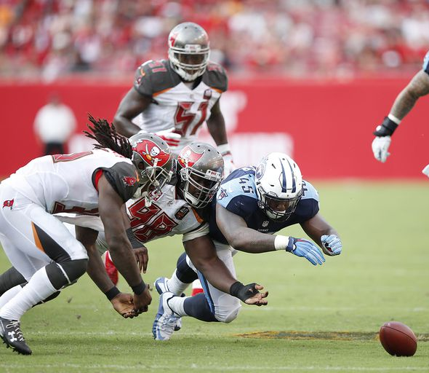
Special Circumstance Change of Possession Plays
K-R-K Change of Possession – 25 Second Play Clock to Follow.
A-B-A Change of Possession – 40 Second Play Clock to Follow.

Slide 8
25 second clock situations – the play clock will be set at 25 seconds and the game clock will be started on the snap in these situations:
After a charged team time out
Change of possession
Start of a period
After a legal kick
After a touchdown, try, field goal or safety
Start of team A’s possession in overtime
Extension of a period

Slide 9
More 25 second clock situations – the play clock will be set at 25 seconds and the game clock will be started on the snap or the ready (dependent on the clock’s status) in these situations:
Administration of a penalty
Helmet off **
Injury**
Measurement
Official's time out
** Referee’s Discretion, 40 or 25

Slide 10
Referee’s Signal
If the referee is re-setting the 25 second play clock, he will signal with one palm open in an over-the-head pumping motion to the back judge to reset the 25 second play clock.
If the referee is re-setting the 40 second play clock, he will signal with both palms open in an over-the-head pumping motion to the back judge to reset the 40 second play clock.

Slide 11
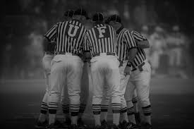
Referee’s
Pre-game discussion is a must. Discuss procedures and 40-second clock start signals with head coaches. Identify that the play clock will start within 2 seconds after the previous play ends.
All members of the crew will react to ball movement and ball placement as efficiently and as accurately as possible. (There are no warnings for waiting on the ready for play)
The umpire will stand over the ball until the box is set following Team A reaching the line to gain. Once the box is set, the umpire will step away from the ball and the ball may be snapped.

Slide 12
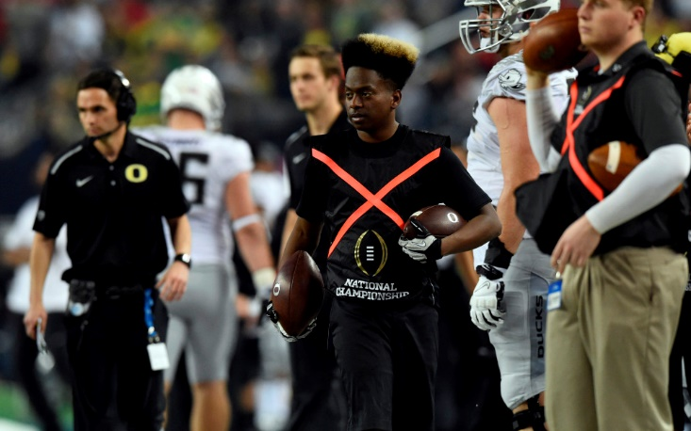
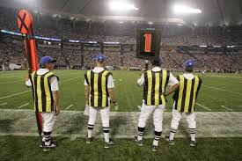
Home AND Away Teams
It is going to be necessary to have well trained ball personnel. It is recommended that 2 ball boys be on each sideline. Teams need to supply the referees with three game balls. There is no such thing as the “kicking ball.”
Once the linesman signals for the “box” person to move they must hustle (RUN) to the next spot as once the ball is placed, the ball can be snapped due to the 40 second clock running. The chain crew is an extension of the officiating crew. Sideline rules will apply to the chain crew as well. Team personnel must avoid interfering with the chain crew and its operations.

Slide 13
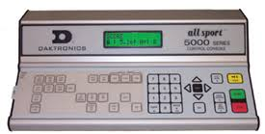
Clock Operators
A well-trained game clock operator. The game clock operator must be available to meet with the officiating crew at least 30 minutes prior to game time. Failure to do so may cause the referee to declare the on-field game clock to be turned off and the time will be kept on the field.
If the site has on-field play clocks, the home team must provide a well-trained play clock operator. It is HIGHLY recommended that a separate person be used to operate the play clock from the game clock. The play clock operator must be available to meet with the officiating crew at least 30 minutes prior to game time. Failure to do so may cause the referee to declare the on-field play clock to be turned off and the play clock will be kept on the field by the back judge.

Slide 14
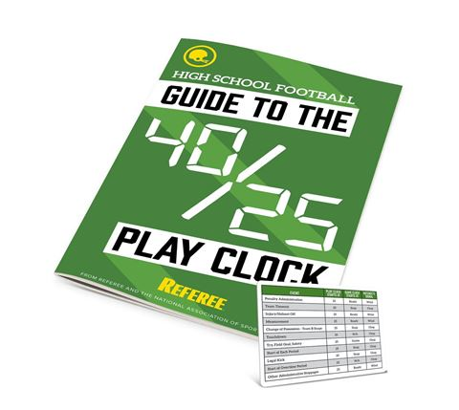
40/25 Second Play Clock
The End

