Slide 1
SERVICE ABOVE SELF

Slide 2
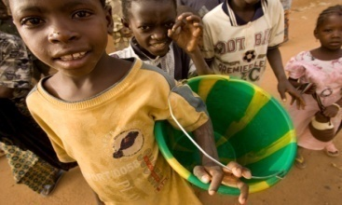
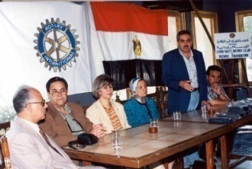
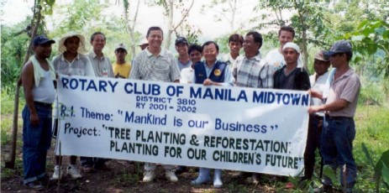
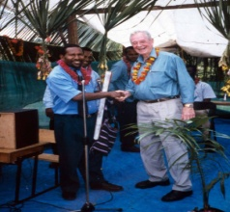
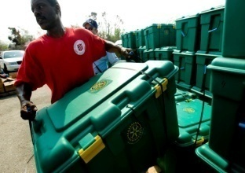
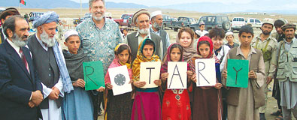
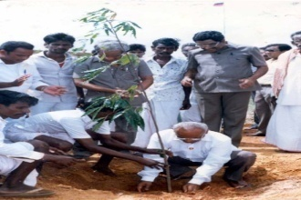
Is It The Truth Is it Fair to All Concerned Will it Build Goodwill & Better Friendships Will it be Beneficial to All Concerned
THE FOUR WAY Rotarian TEST
Of
The Things We Think, Say, and Do
Notes:
Take our club to the next level…Implement The Club Membership Plan

Slide 3
Arlington West Rotary Club
Club Board
Administration
Service
Projects
Club
President
Rotary
Foundation
Student
Projects
& RYLA
Four Avenues of Service
Club, Vocational, Community, and International Service
Notes:
Each club committee plays a part in advancing and strengthening club work around the Four Avenues of Service.

Slide 4
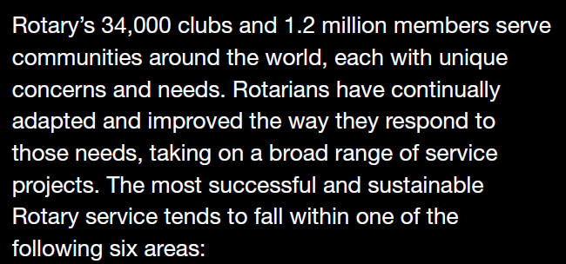

Slide 5
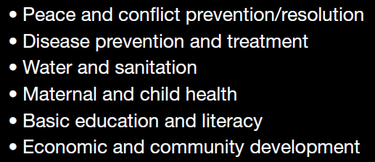
The 6 Areas of Rotary Focus

Slide 10
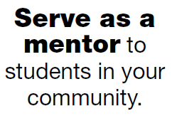
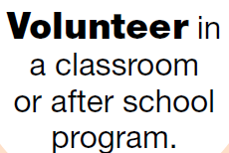
Work with an
adult literacy
program.

Slide 15
Educational & New Generations Programs
Thousands of young men and women participate in Rotary’s educational and New Generations programs.
This enables them to develop new skills, serve their communities, and foster international understanding.
But the experience doesn’t have to end when the program is over…..

Slide 16
New Generations Programs
Group Study Exchanges
Interact
Rotaract
Rotary Foundation Global Grant Recipients
Rotary Grants for University Teachers
Rotary Youth Leadership Awards (RYLA)
Certain Rotary Volunteer Grants
Rotary Youth Exchange
Rotary Peach Fellowships
Ambassadorial Scholarships

Slide 18
Rotary Polio Plus Program
We look forward to the success of your Martin High School Interact Club. We know you will represent your school and Rotary well.
In closing, we hope this case history will serve as a connection with Rotary and will instill in you the desire to serve others, and perhaps some day belong to a Rotary Club.

Slide 19
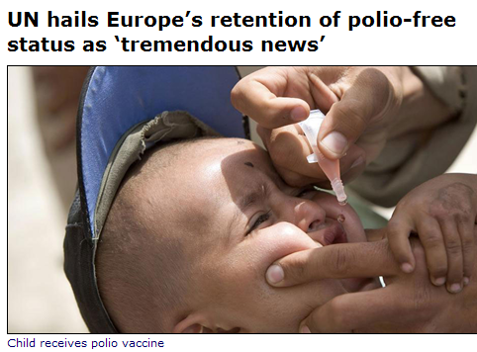
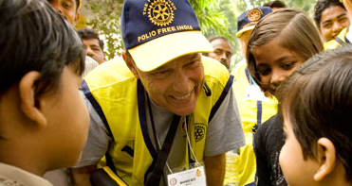

Slide 20
POLIO FACTS
1985: Rotary International PolioPlus Vision launched
More than 125 Countries were still Polio Endemic
A Thousand Children were Paralyzed Every Day
Millions of Rotarian Volunteer Hours Since 1985
Almost a Billion Dollars donated by Rotarians
2011: $250 Million partner grant from Bill Gates
More than Two BILLION children immunized
Now only Four Countries Reporting <1,000 cases
More than 5 MILLION children who would have been paralyzed are now walking
Source: UN Secretary-General

Slide 22
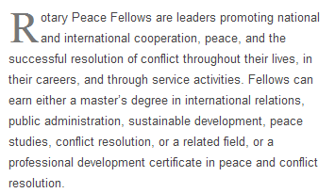
Rotary Peace Fellows

Slide 25
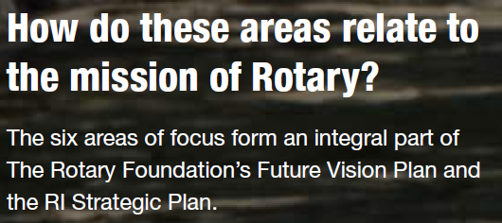

Slide 26
