Slide 1
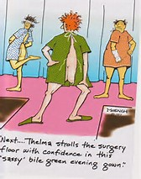
The Terror of Cancer The View from the Other Side of the Hospital Gown
Patricia Jakel, RN, MN, AOCN
Advance Practice Nurse
UCLA Santa Monica Medical Center
Associate Professor of Nursing
UCLA School of Nursing

Slide 2
Objectives for the Session
At the conclusion of the session the learner will be able to:
1. Review the “terror of cancer”
2. Describe the Praxis Theory of Suffering
3. Explain Unsupportive Social Interactions
4. Analyze the research behind the avoidance of double mastectomies.
5. Discuss Survivorship in cancer
6. List interventions for fatigue in patients with targeted therapy.

Slide 3
Terror
Webster defines Terror as:
a: State of Intense Fear
2a : one that inspires fear : scourge
b : a frightening aspect
c : a cause of anxiety : worry
d : an appalling person or thing; especially : brat
3 : reign of terror
4 : violent or destructive acts (such as bombing) committed by groups in order to intimidate a population or government into granting their demands
fear, dread, fright, alarm, panic, terror, trepidation mean painful agitation in the presence or anticipation of danger. fear is the most general term and implies anxiety and usually loss of courage <fear of the unknown>
https://www.merriam-webster.com/dictionary/terror
Notes:
Fear is not strong enough word.
Terror word from Nichole

Slide 4
The Start of the Journey
Super Bowl Sunday 2016
Radiology and MRI
Study by Flory and Lang- 3 groups
Breast Biopsy
Invasive treatment of malignant liver cancer
Benign uterine fibroids
Abnormally High Mean levels of perceived stress, impact of events and depressed moods in all 3 groups
Breast Biopsy experienced highly abnormal anxiety levels.
Finding suggest that patient’s distress not influenced by the type of procedure but the uncertainly of the outcome
Finding out the results
Flory & Lang (2010). Radiology: 260(1), 166-172.
Notes:
Inpatient CNS- breast cancer patients are ones with bad disease
Denial- don’t judge
Tell story of the GI MD telling me
Crying in the car
Ultrasound- Douglas don’t come
Ultrasound - “ Your MRI looked so bad”
Crying- trying to use humor

Slide 5
The Wait
The Praxis Theory of Suffering
Suffering-response to a threat one’s psychosocial health by potential loss
Two Major States
1. Enduring for Preserving Self
Contextual, normal, robot –like, natural and even healthy response to a potential treat of an unavoidable loss.
Care for self and others
Preserving Self as women, mother, wife, friend and employee
Caregivers maintain a respectful distance from those who are enduring, using silent compassion, refrain from touching and empathic and sympathetic statements.
Empathy is not helpful at this time
Enduring interrupted- sorrow, deep depression and anxiety
Morse JM. (2001). Advances in Nursing Science, 24, 47-59.
Morse JM, et al. (2014) Onc Nursing Forum. 41(4),350-359.
Notes:
Don’t touch me
The words I hate- can I hug you
Mammogram tech- 2 young women waiting for ultrasound and biopsy
Mammogram is not the answer- tech hugs me

Slide 6
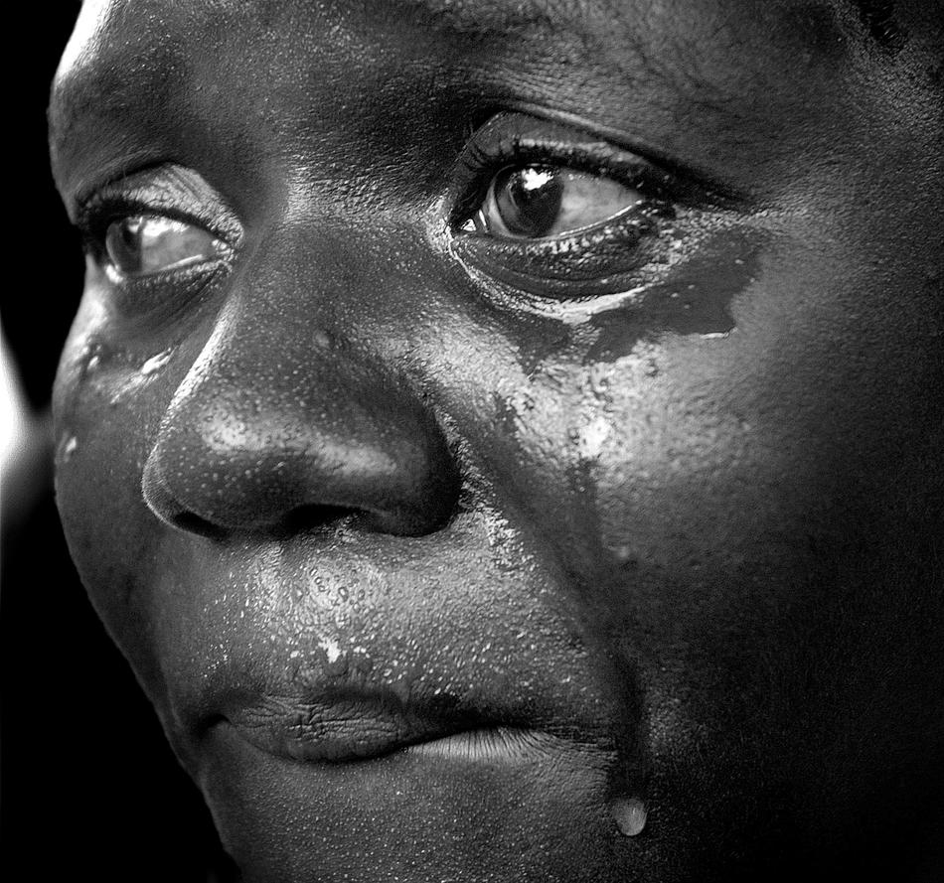
The Praxis Theory of Suffering
2. Emotional Suffering
Patients need to build their strength to feel strong enough to to take on the emotional suffering
Send “comfort Me” signals
Appropriate to hold, listen, and comfort patients in this state. When patient accepts the changed reality, the suffering can be left behind and can move on to the new reality.
Individuals move back and forth between the 2 states.
Notes:
This theory was written about me.

Slide 7
Preserving Self
Hearing Positive Results
Confronting your
worst fears
Continuing enduring
Waiting to Hear
Enduring
Wrapping your mind around it
Controlling distress
Keeping going
Abnormality on a mammogram
Facing Cancer
Feeling Stunned
Grappling with the idea
Bracing for the biopsy
Finding a lump
Hearing Negative Results
Releasing from
enduring
Sharing the good news
Entry
Breast Clinic
Post-Biopsy
Hearing the Results
Figure 1. Stages of the Mid-Range Theory of Awaiting Diagnosis: Enduring for Preserving Self
Morse JM, et al. (2014) Onc Nursing Forum. 41(4),350-359.

Slide 8
Strategies for Enduring
Family
Religious Beliefs
Exercise- running, yoga, walking
Acting “normal”- work, care of children, housework
Seeking information
Dore C et al. (2012) Health Care, 34, 39-43.
Blow, AJ et al. (2011) Qualitative Health Research, 21, 1723-1729.
Notes:
Add Nicole Video here

Slide 10
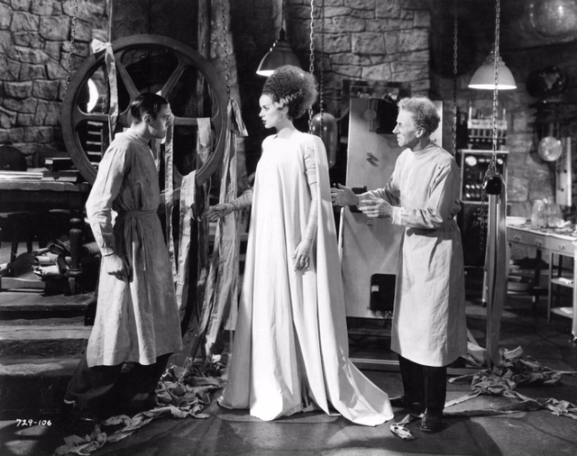
Adjustment to Cancer
The SCANS
Because your tumor is large………………….
PET/CT Scan
Notes:
PET Scan- thunder, lightening, hail- the end of the world in LA.
Cold and radiation warning signs everywhere
Freaking out on the table
Talking to myself

Slide 11
Fear of Clinical Trial
Chemotherapy will not work for you but
My clinical trial
neoMONARCH Phase II
Abemaciclib- CDK4 & CDK6 Inhibitor
Combination with anastrozole
Report from the San Antonio Breast Symposium 2016
Abemaciclib reduced levels of Ki67 in HR+, HER2- breast cancer cells – statistaically significant
Abemaciclib- 90% drop in Ki76
Anastrozole Arm- 60% had a drop in Ki67
Reduced Ki67 correlates to improved outcomes
Not changing the standard as it was concept study
Hurvitz, S (2016) Abstract S4-06
Notes:
GI Toxicity

Slide 12
Differences Among CDK 4/6 Inhibitors
 | Palbociclib |  | Abemaciclib |  | Ribociclib
Common AEs% | All Grades | Grade 3/4 | All Grades | Grade 3/4 | All Grades | Grade 3/4
Neutropenia | 95 | 54 | 88 | 27 | 46 | 29
Thrombocytopenia | 76 | 19 | 42 | 2 | 37 | 10
Fatigue | 68 | 0 | 65 | 13 | 29 | 3
Diarrhea | 16 | 0 | 90 | 20 | 22 | 3
Nausea | 23 | 0 | 65 | 5 | 46 | 2
Vomiting | 5 | 0 | 35 | 2 | 25 | 0
QTc prolongation | NR | NR | NR | NR | 8
Barroso-Sousa R, et al. Breast Care (Basel). 2016;11:167-73.
Ibrance package insert 2017; Kisqali package insert 2017; Verzenio package insert, 2017. Accessed July 9, 2018.

Slide 13
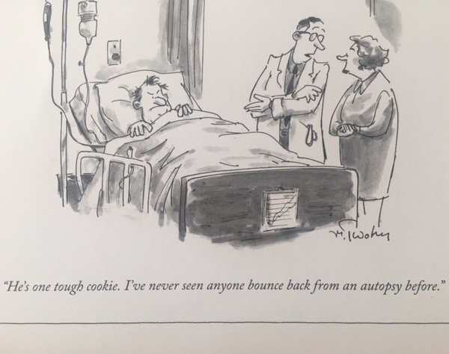

Slide 14
Telling Others
Decide on whom you want to tell yourself, and plan out the conversation in advance.
Be prepared to accept and ask for help.
Tell loved ones what the plan will be for sharing updates about your condition.
Set limits on communication if you need to.
Understand that family and friends may not respond the way you want them to.
Be prepared for the fact that some people might say or do the wrong thing, not because they are unkind, but simply because they do not know how to respond. They might look for reasons why you got breast cancer, such as diet, exercise, or lifestyle factors.
They might offer up clichés such as “Be strong,” “Stay positive,” or “If anyone can handle this, it’s you.”
Remember that you have control over how far you want to spread the word.
While it is important to tell your closest relatives, friends, and people who will be affected directly, you can decide whether or not you wish to inform anyone else.
www.breastcancer.org
Notes:
Texting
E mails
Telling the kids

Slide 15
Unsupportive Social Interactions (USI)
Stressor-Specific unsupportive responses people with cancer receive from others
Spouses, family, friends and healthcare workers can be unhelpful, avoidant, minimizing and constraining
Feeling unsupportive can lead to:
Avoiding the topic
Increase stress
Alienated from one’s social network
Depression
Poorer psychological well-being
Unsupportive environment can cause more harm then the benefit of a supportive one
The period following diagnosis is the most stressful for all cancer patients
Early Adjustment is associated with overall well being
Figueiredo ML, et al. (2004).Psych-Onc.13: 96-105

Slide 16
Unsupportive Social Interactions (USI)
Lally and et al noted after analysis of 70 incidents the following groupings.
Bumbling- awkward, uncomfortable, intrusive, fixing the person- offering advice, sad tone
Smothering- female friends, mothers, adult daughters
Over sharing
Reacting with Intense Emotion
Distancing
Minimizing- too upbeat
Blaming
Premature Grieving
Unauthorized Disclosure
Lally RM, et al. (2013) J of PsychSoc Onc. 13:468-488.

Slide 17
Nurses Supportive Social Interactions
“The nurses understand-even if I haven’t said anything- you know if something isn’t right”
“ Nurses always sit and talk a little….and just reach over and touch you and talk to you- that’s really nice.”
“You’re given so much information…the nurses repeat anything no matter how many times you ask.
“Nurse X came to see me even though she wasn’t looking after me that shift….she wanted to know what my week had been….it was so good to see her.”
Krishnasamy, M., 1996, Eur Journal of Cancer Care

Slide 18
USI By Nurses
“that nurse hadn’t bother to get to know me, to understand me-she didn’t realize how depressed I was.”
“Saying the same thing over and over….you feel like no one’s listened. It make me feel stupid.”
“Having someone half you age have control, not listen or they think they have control over you is infuriating- you just want respect- really listen to me.”
“some nurses are talking out of their hats and you know it….you ask a question because you need an answer….it doesn’t help….”
Krishnasamy, M., 1996, Eur Journal of Cancer Care

Slide 19
Unhelpful Nursing Behaviors
Category | Definition | Example
Suggests negative attribution | Conveys feeling of guilt, incompetence, blame or burden | “ I feel stupid”
Conveys lack of intimacy | Fails to provide or convey intimacy | “I feel completely alone”
Conveys lack of respect | Fails to allow control and not respectful | “you really don’t matter as an individual’
Uncertainties as regards motives of nurse | Fails to provide a clarity of intention or behavior | “it felt like the pain self-medication was to save the nurses time”
Inadequate/conflicting information | Fails to provide information, decreases confidence | “some days no one knows what is going on”
Krishnasamy, M., 1996, Eur Journal of Cancer Care

Slide 20
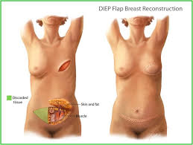
Round #2
Re-do of reconstruction
Oops – there is a node!!

Slide 21
My USIs
My USIs
Your MRI looked so bad, we wanted to rush the biospy
Because it’s large x 100
_--- is so worried about you
Screaming to God
I really thought you were someone that would not do well.
You are lucky- lymphoma patients have these every 3 months
Why didn’t your husband find it
You are so lucky that you don’t need chemotherapy
Why didn’t you tell me- scene at clinic
We have to look at this node as serendipitous
I have been up all night thinking about how to treat you
Bonus node

Slide 22
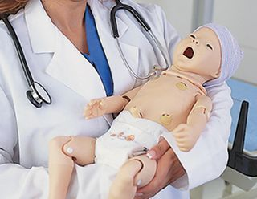
Terror and Mastectomy
Double or Nothing
WSJ Article
JAMA estimate
Stage I/II- 1.2 million women
1998- 1.9% Double
2011- 11.2%
Study 2014 double mastectomy did not improve survival vs lumpectomy and radiation
Morning of Surgery
Recovery Room
JAMA Surg; doi:10.10.1001/jamasurg.2014.2895
JAMA 2014;312:902-14.
Notes:
Plastic surgeon asked if it was bilateral
Spoke to Sara- got upset

Slide 24
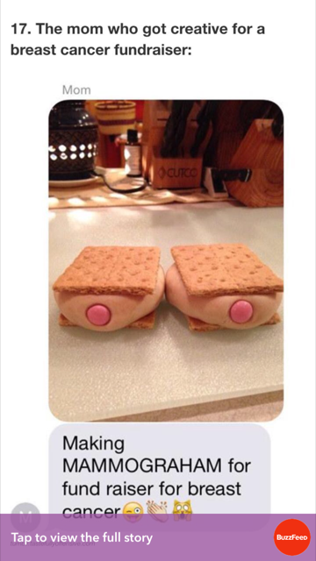

Slide 25
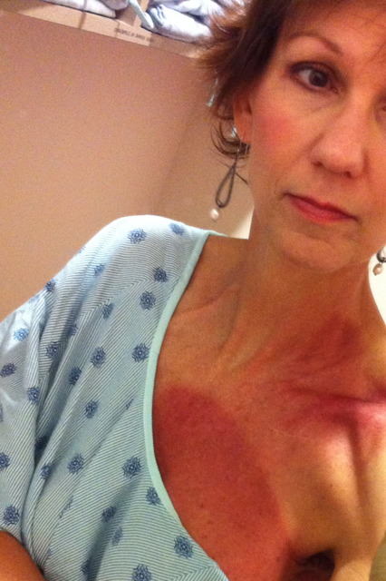
Terror and Radiation
Radiation Anxiety
Lonely
Stress
Fear
Depression
Pre-Radiotherapy Music Intervention
Decreased State Anxiety and BP
Frustration
Sharma and Purkayastha noted that women with post mastectomy undergoing radiation had impacts in the following areas:
Psychological
Financial
Sexual Aspects
Other Side Effects
Fatigue
Skin
Nausea
Chen, LC et al. (2013) Eur J Onc Nurs. 17(4). 436-41
Sharma, N, & Purkayastha, A. (2017) Asia Pac J Oncol Nurs. 4(1). 69-76/

Slide 26
Fatigue and Radiation
NCCN defines cancer fatigue as:
“ a persistent subjective sense of tiredness related to cancer or cancer treatment that interferes with usual functioning”
A state of overwhelming exhaustion which is severe and longer lasting.
75%-77% of breast cancer patients undergoing radiation experience fatigue
Pathophysiological mechanism- ? Activation of pro-inflammatory cytokines.
Treatment
Meta-analysis of nine studies concluded that that a significate reduction in fatigue noted with exercise and exercise plus psychological interventions.
NCCN.org

Slide 27
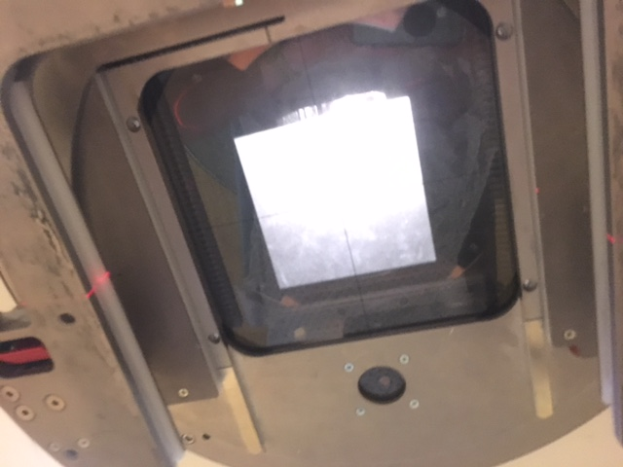
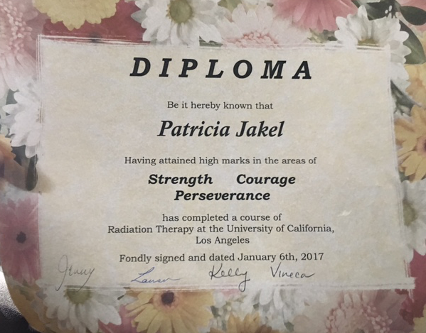
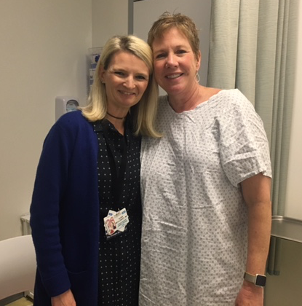
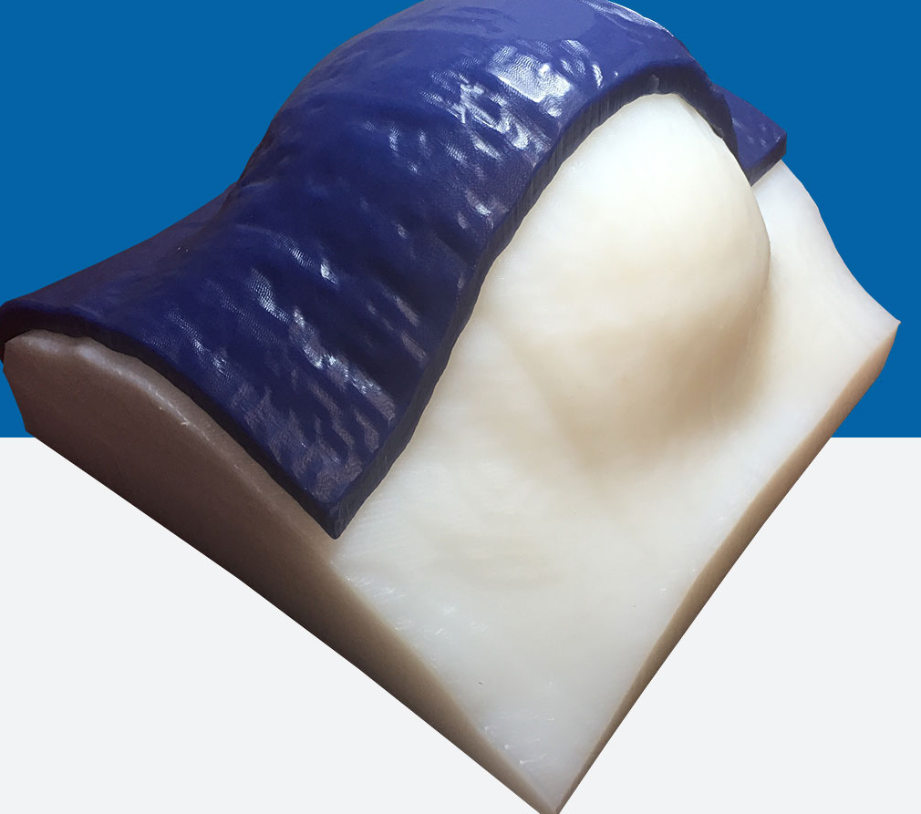
Notes:
Bolus
Cold
competition

Slide 28
Exercise and Cancer
PEP for Fatigue
Effectiveness Established
• Exercise
Likely to Be Effective
Psychoeducational interventions
Progressive muscle relaxation and/or relaxation breathing with or without imagery or distraction
Cognitive-behavioral therapy for sleep
Yoga
Structured multidimensional rehabilitation
Wisconsin ginseng
Meditation, mindfulness-based stress reduction, and cognitive- behavioral stress management
Management of concurrent symptoms
Cognitive-behavioral therapy for fatigue, depression, and pain with or without hypnosis
Support after diagnosis
Mitchell, S et al. (2014) CJO, 18(6), 38-58

Slide 29
Exercise and Lymphedema
Weightlifting for lymphedema
Zhang (2017) – significant improvement of lean mass with reduction in lymphedema symptoms
Slow Progressive weight
Panton (2017) – resistance training
Gain in muscle mass
Decrease in fat mass
Zhang, X. et al. (2017) Breast Cancer Res Treatment.
Panton, L et.al. (2017) Supp Care in Cancer.

Slide 30
Fear of Recurrence FCR
Harder to adjust then the initial diagnosis
Insecure, isolated, afraid, abandoned,
Everyone experiences transient FCR
40%-70% the fear can be chronic and disabling
High FCR
Affect mood, relationships, work, goal-setting, QOL
Inability to discuss
Healthcare Workers
Family/friends/supporters
Sebastien, S (2010) J Cancer Surviv, 4: 361-371.

Slide 31
Fear of Recurrence
Limitations to FCR research
No validated tool to measure FCR
Majority studies focus on breast cancer
Need rates of FCR between different cancer groups
Sebastien et al. concluded
Cancer survivors consider FCR to be one of their greatest concerns
Many survivors’ psychosocial needs are not met when it comes to FCR
An important area for future research
Sebastien, S (2010) J Cancer Surviv, 4: 361-371.

Slide 32
Back in the Saddle
Now what?
Anxiety
Newly Diagnosis- 50%
Chronic Anxiety- 30%
GAD- uncontrolled fear, worry and apprehension
4 million adults in the US- more women
PTSD related to cancer
Complex and chronic disorder
Trigger by traumatic events
Childhood trauma an identified risk factor
Nurses are the first line of assessment- anger, irritability, depression, chronic pain, avoidant and QOL issues
Bush, Nancy Jo (2010) ONF, 37 (5). E331-343) and Marrs, Joyce (2006) CJO, 10(3), 319-322

Slide 33
Back in the Saddle
Survivorship care :
Surveillance and screening, management of long-term effects, health promotion, and care coordination.
Management of the long-term effects of cancer and its treatment addresses common issues of pain, fatigue, lymphedema, distress, and medication side effects.
Longer -term concerns for cardiac and bone health.
Health promotion emphasizes the benefits of active lifestyle change in cancer survivors, with an emphasis on physical activity.
Sisler, J et al. (2016) Canadian Fam Phy, 62 (10), 805-811

Slide 34
Cognitive Impairment Chemo Brain
LiveStrong Survey
Perceived cognitive dysfunction was reported in a wide range of cancer survivors
70% of patients suffer “chemobrain” after treatment
Cognitive Rehabilitation is vital to survivorship
www.brainhq.com
The potential interactive effect of symptoms of depression suggests the need to develop interventions targeting both cognitive dysfunction and depression to achieve improvements in cognitive functioning
Aromatase Inhibitors
Non adherence 60%
Joint and Bone pain
Hot flashes
Sexual dysfunction
Cognitive Impairment
Schmidt, J. (2016) J Cancer Surviv, 10(2): 302-11.
Simon, R et al. (2014) J Cancer Care, 57: 26-34
Notes:
9 more years on a AI
Joint pain and stiffness
Hot flashes

Slide 35
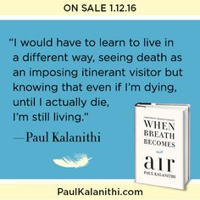

Slide 36
Huffington Post The Power of Humidity To Every Cancer Patient I Ever Took Care Of: I’m Sorry. I Didn’t Get It. I didn’t get how much you hung on to every word I said to you
Lindsey Norris
Oncology Nurse

Slide 37
120 Triumphs of Cancer Survivors
KC- GBM a 26 years old

Slide 39
References
Blow, A.J., Swieciki, P., Hann, P., Osuch, S., Symonds, L., Smith, S.S.…Boivin, M.J. (2011). The emotional journey of women experiencing a breast abnormality. Qualitative Heath Research, 21, 1316-1334.
Bush, Nancy Jo. (2010) Post-Traumatic Stress Disorder Related to Cancer: Hope, Healing, and Recovery. ONF, 37 (5), E331-343.
Dore, C., Gallagher, F., Saintonge, L., & Herbert,M. (2012) Breast cancer screening program. Health Care for Women International, 34, 34-49.
Flory, N., & Lang, E.V. (2011). Distress in the radiology waiting room. Radiology, 260, 166-173.
Figueriredo, M.I., Fries, E., & Ingram, K.M. (2004). The role of disclosure patterns and unsupportive interactions in the well being of breast cancer patients. Psycho-Oncology, 13, 96-105.
https://www.merriam-webster.com/dictionary/terror
Lipsett, A., Barett, S., Haruna, F., Mustian, K., & O’Donovan, A. (2017) The impact of exercise during adjuvant radiotherapy for breast cancer on fatigue and quality of life: A systematic review and meta-analysis. The Breast, 32, 144-155.
Manir, KS., Bhadra, K., Manna, A., Patra, S., & Sarkar, SK. (2011) Fatigue in Breast Cancer patients on adjuvant treatment: course and prevalence. Indian J Palliative Care, 18(2). 109-116.

Slide 40
References
Marrs, J. (2013) Stress, Fears, and Phobias: The Impact of Anxiety. CJON, 10(3), 319-322.
Morse, J.M. (2001). Toward a praxis theory of suffering. Advances in Nursing Science, 24, 47-59.
Morse, J.M., Pooler, C., Vann-Ward, T., Maddox, LJ., Olausson, J., Roche-Dean, M., Colorafi, K., Madden, C., Rogers, B., & Martz, K. (2014). Awaiting Diagnosis of Breast Cancer: strategies of Enduring for Preserving Self. ONF, 41 (4), 350-359.
Pure, G., Rankin, J., Allen, J., Cramp, F., Cancer Related Fatigue: a critical appraisal. Eur J Cancer, 42 (7), 846-863.
Schmidt, JE., Beckjord,DH., Low, CA., Posluszny, DM., Lowery, AR., Dew, MA……Rechis, R. (2016). Prevalence of perceived cognitive dysfunction in survivors of a wide range of cancers: results from the 2010 LIVESTRONG survey. J Cancer Survive, 10 (2), 302-311.
Sebastien, S., Savard, J., Ivers, H. (2010) Fear of Cancer Recurrence: specific profiles and nature of intrusive thoughts. Journal of Cancer Survival, 4, 361-371.
Sharma, N., & Purkayastha, A. (2017). Impact of Radiotherapy on Psychological, Financial and Sexual Aspects in Post mastectomy Carcinoma Breast Patient: A Prospective Study and Management. Asia Pacific Journal of Oncology Nursing, 4 (1), 69-76.
Sisler, J., Chaput, G., Sussman, J., & Ozokwelu, E. (2016). Follow-up after treatment for breast cancer: Practical guide to survivorship care for family physicians. Canadian Family Physician, 62(10), 805–811.
Zhang, X., Brown, J., Paskett, E., Zemel, B., Cheville, A., & Schmitz, K. (2017) Breast Cancer Research and Treatment, online.

