Slide 1
ECH CARTRIDGE FILTER HOUSINGS
ENCELADUS WATER GROUP, LLC

Slide 2
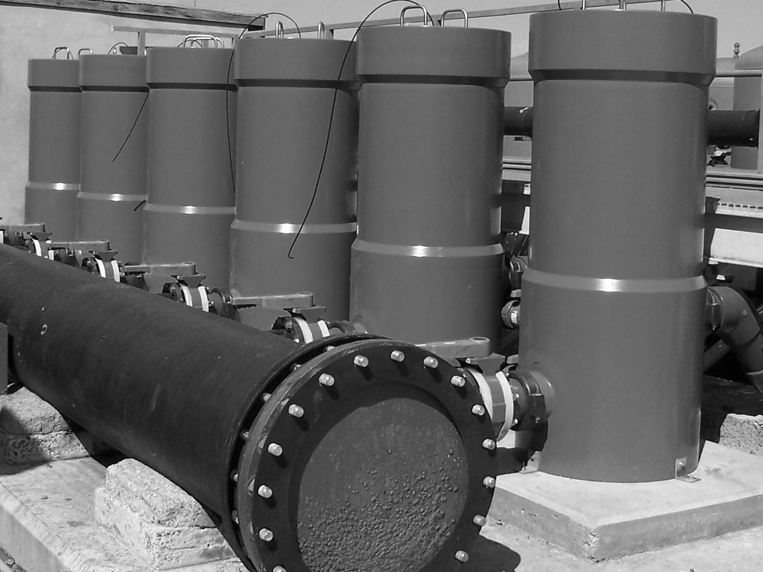
The Role of Cartridge Filtration in RO
Standard design practice for RO systems incorporates cartridge filtration immediately up-stream of the membrane elements to:
Serve as final guard filters to protect the RO membrane elements from pretreatment upsets or break-through
Insure that the membrane elements are not fouled or damaged from particulate break-through
Keep membrane performance warranties valid and in force

Slide 3
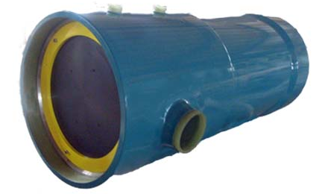
Enceladus Introduces FRP Cartridge Filter Housings
Flow rates from 12m3/h to 334m3/h
Models available in 5, 12, 22 and 60 round configurations
Housings accommodate standard 2.5” diameter cartridge elements

Slide 4
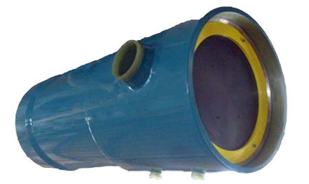
Quality Standards & Certificates
Manufactured in accordance with ASME, Section 10
Code stamp is available
ISO 9001 Certified
NSF 61 Certified

Slide 5
Why FRP and not Stainless Steel?
SWRO feedwater is highly corrosive
Stainless steel housings and internal wetted parts will corrode with time resulting in increased maintenance and ultimately failure
Fiberglass Reinforced Plastic (FRP) will not rust or corrode and gives exceptionally long service life

Slide 6
Why FRP?
Old timers in RO will remember that stainless steel pressure vessels were at one time used … no longer
Today RO pressure vessels are all constructed of FRP
316L stainless steel is no longer used for stainless piping on SWRO systems – replaced by high chromium alloy stainless, e.g. super-duplex
… Very Expensive

Slide 7
Why FRP?
Impervious to corrosion and loss of structural strength in highly corrosive environments, e.g. seawater
Less costly than high chromium stainless steel alloys
Lighter than stainless steel
Extremely long service life

Slide 8
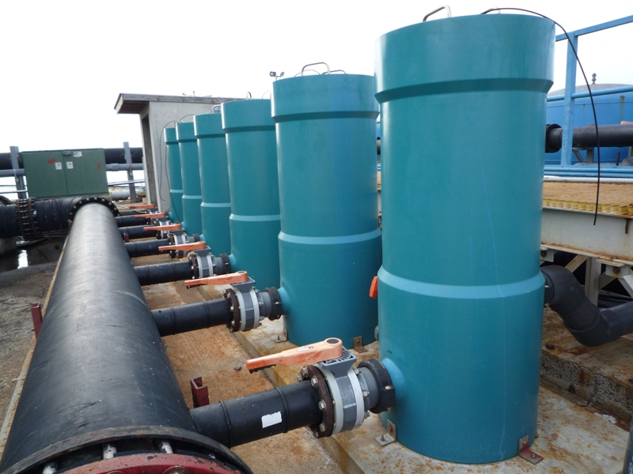
ECH Cartridge Filter Product Line
ECH-60-40 Installation

Slide 9
ECH Overview
Side-ported cartridge filter housing
High gloss polyurethane paint finish
Vent ports are standard per drawing
Drain ports are standard per drawing – IPS grooved
End plate secured using a retaining ring system
Head removal tool (handles) provided with each unit

Slide 10
ECH Overview
Suitable for use with all 2.5” diameter DOE cartridges
Design Pressure: 150 PSI / 10.3 bar
Design Temperature: 150°F /66°C
Minimum allowable temperature: 14°F / -10°C
Burst Pressure: 6X Design Pressure

Slide 11
ECH Housing Features & Competitive Differences
FRP Construction, manufactured in accordance with ASME Section 10 – no wetted steel parts
Higher tensile strength and greater chemical resistance than SS
Greater safety and reliability
Longer vessel life
Easier handling, lower installation, operation & maintenance cost
Lighter than SS, no special tools required
Separate top/bottom closure system for faster cartridge access and change-outs
Standard design features include
Separate dirty/clean water drain ports, top vent connection, side-in/side-out connections

Slide 12
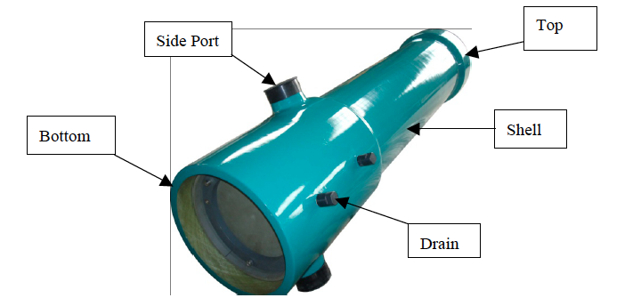

Slide 13
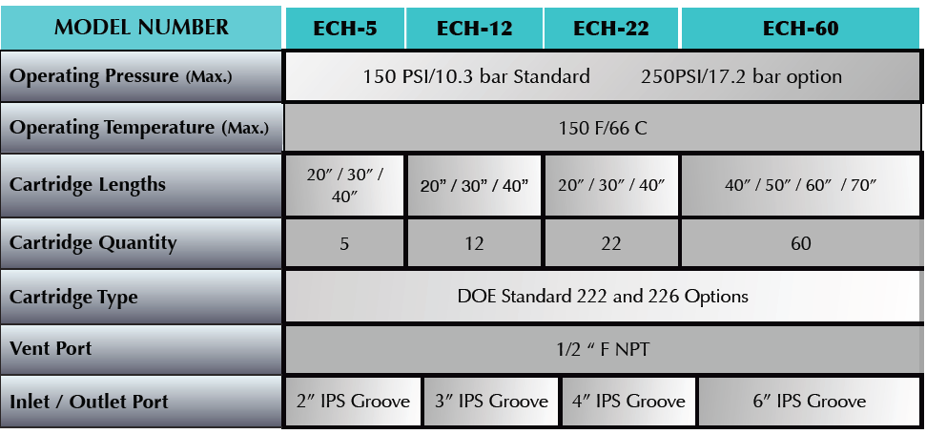
Specifications

Slide 14
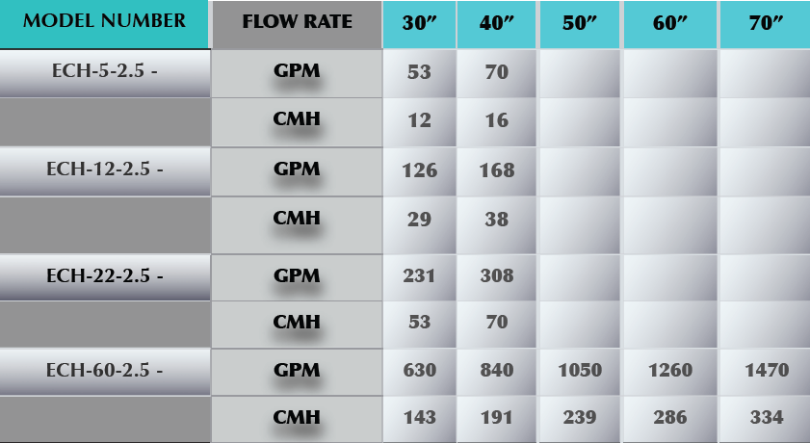
ECH Cartridge Filter Housing Sizing Chart

Slide 15
ECH-5 Head Removal
Pull Tab for Head Removal

Slide 16
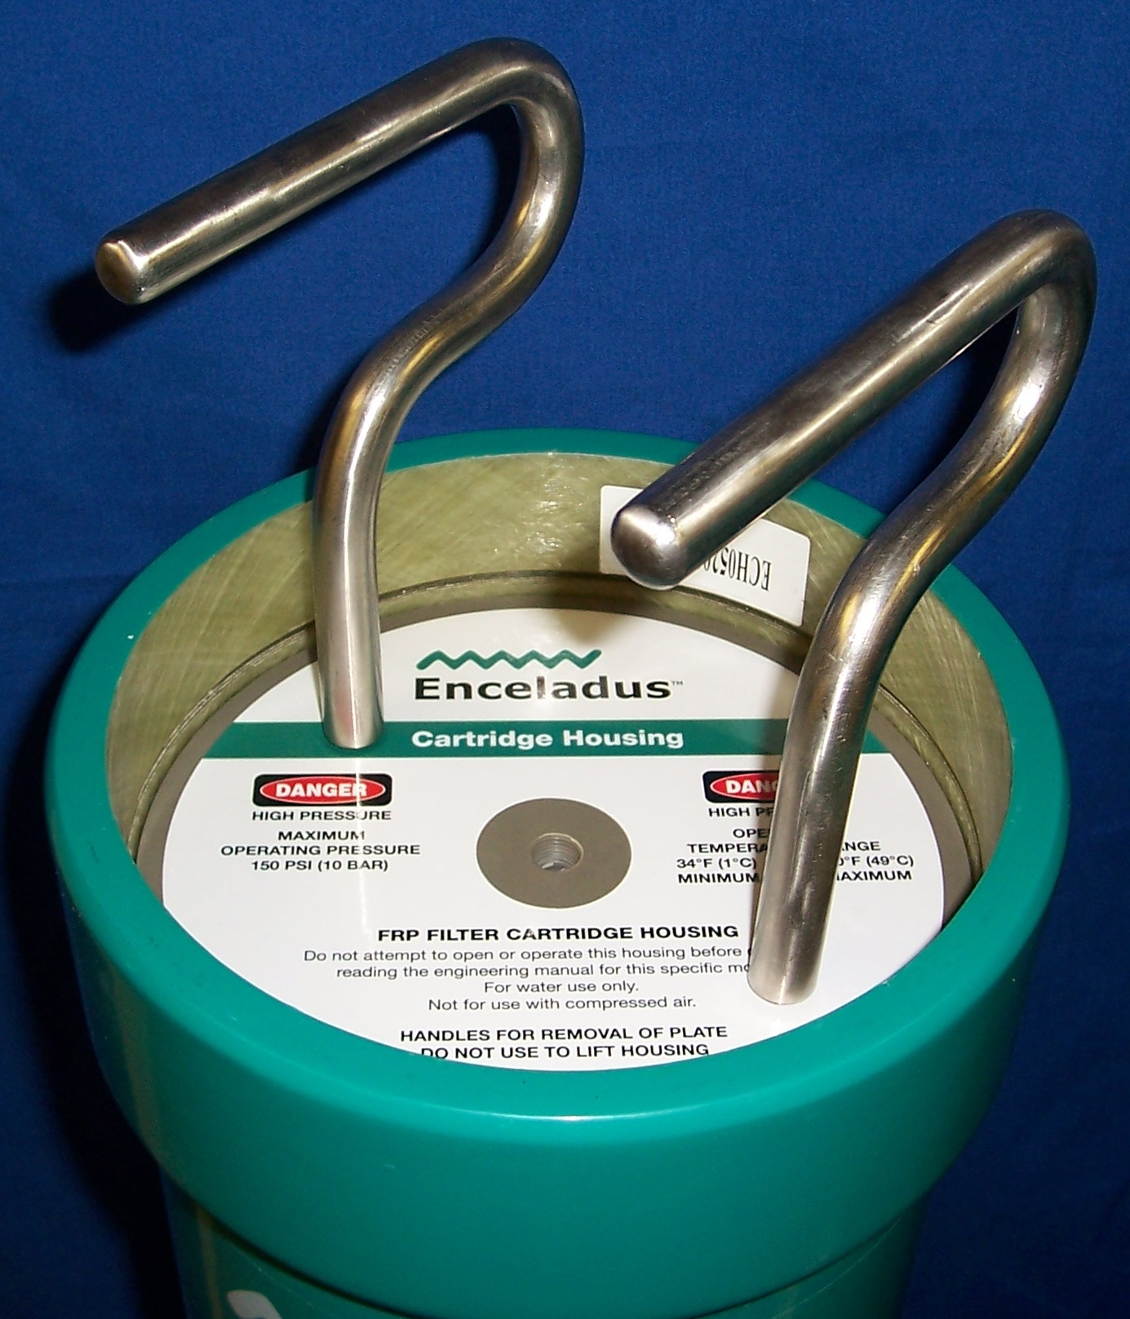
ECH Head Removal Tool
Handles for Head Removal

Slide 17
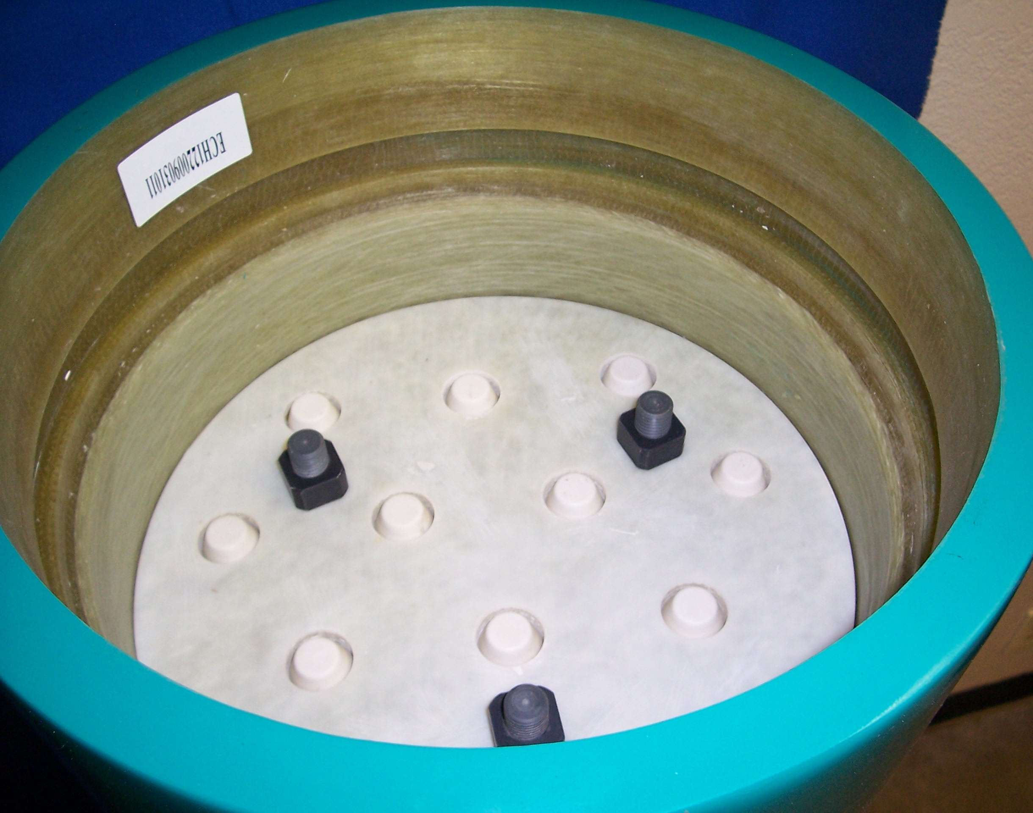
ECH 12 – Open View
Guide Rods
Compression Plate
Cartridge Guides

Slide 18
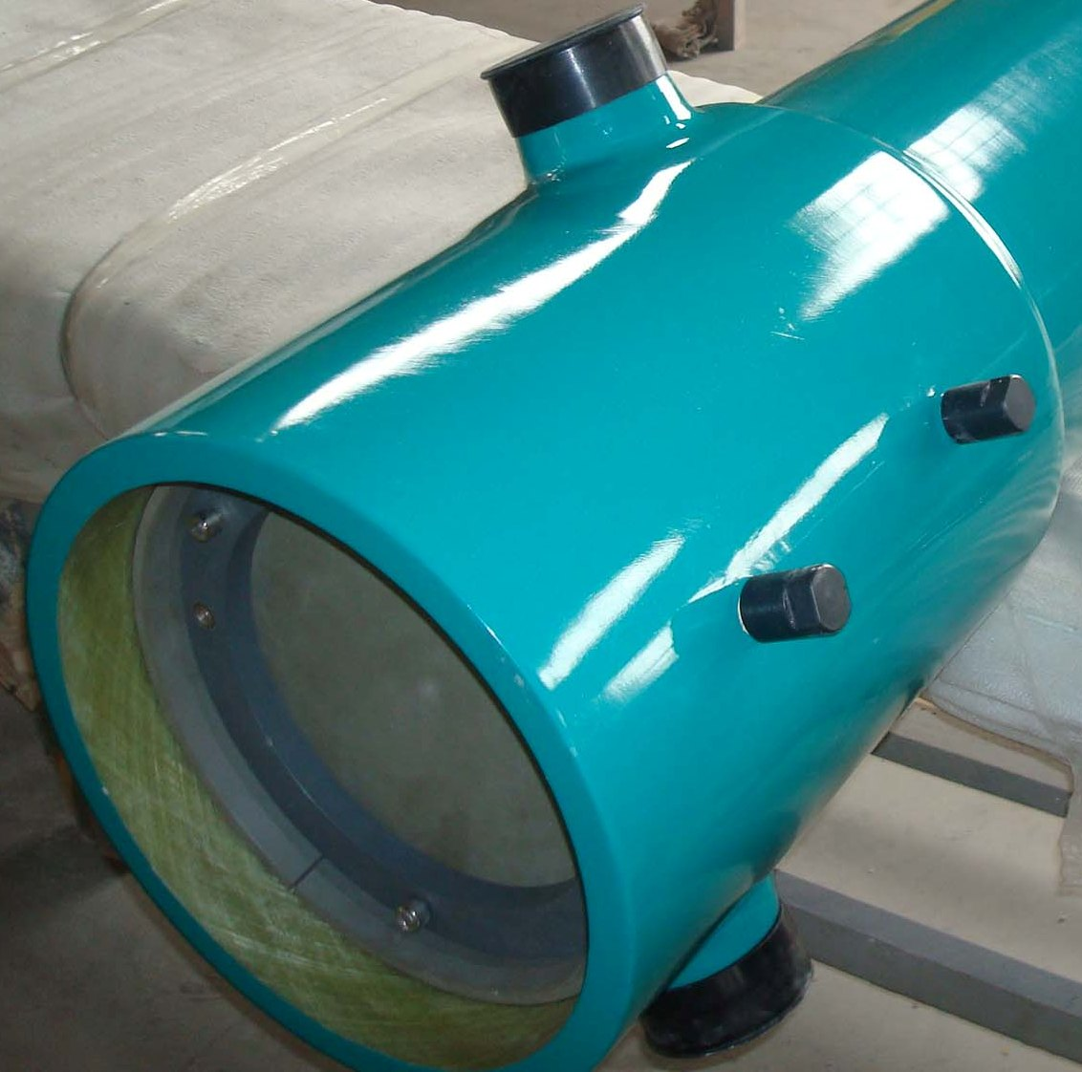
ECH 12, 22 & 60 Models Head Removal
Securing Ring
Locking Rings

Slide 19
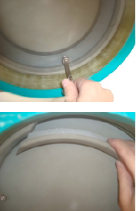
ECH 12, 22 & 60 Models Head Removal
Remove hex bolts
Remove the Locking Rings

Slide 20
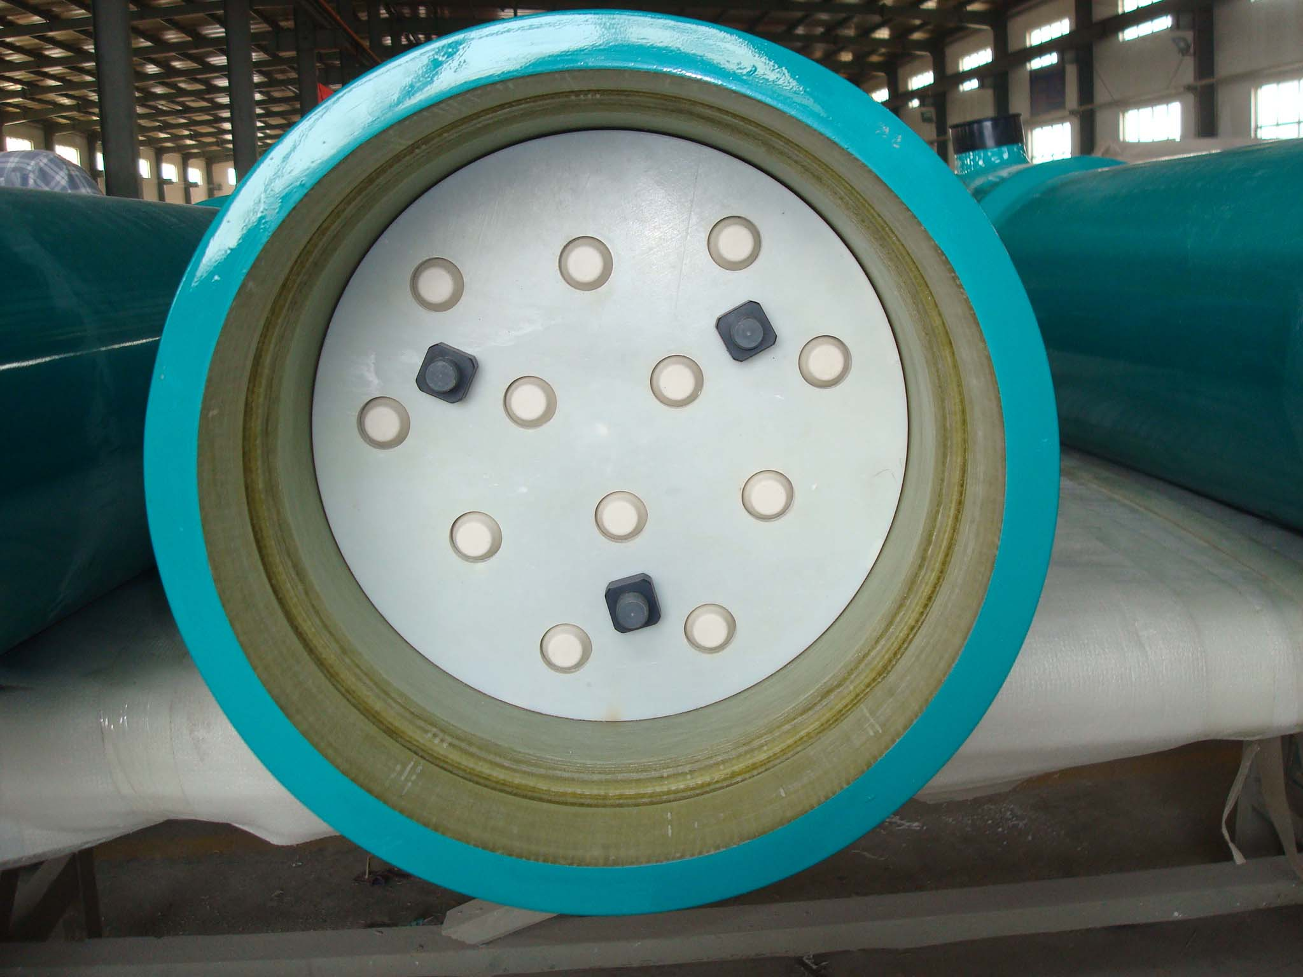
ECH 12, 22 & 60 Models Head Removal
Remove compression plate nuts
Remove the compression plate

Slide 21
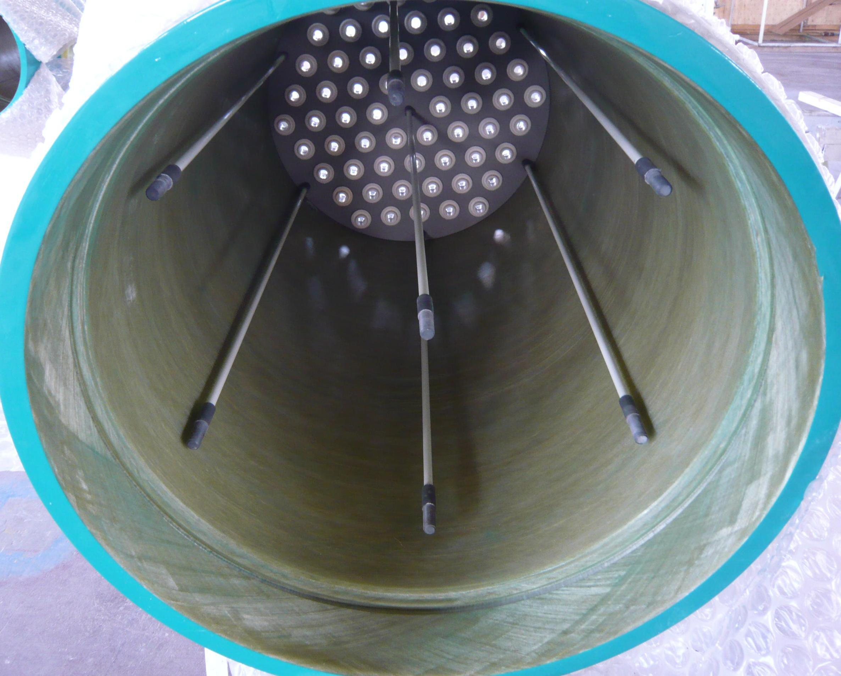
ECH-60 Internals
Guide Rods

Slide 22
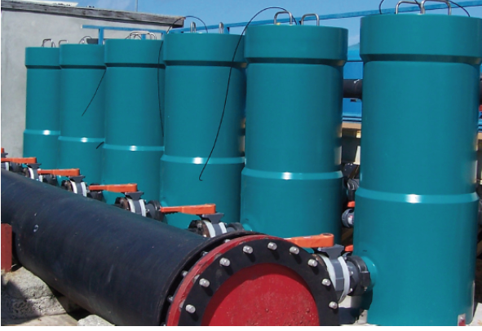
Questions?

