Slide 1
How to Build Successful Academies with a Capstone Experience
By: Dr. Lee Westberry
Berkeley County School District

Slide 2
How to Make CTE the Focus

Slide 3
Notes:
Tana …..Profile of a graduate

Slide 4
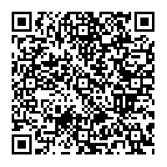
Notes:
Make CTE the focus - The curriculum guide for the district is designed around career pathways for students.
http://bcsdschools.net/cms/lib010/SC01916775/Centricity/domain/72/academies%20of%20berkeley%20county/2015-2016%20IGPResourceGuide%20UPDATE%20MARCH%202016.pdf

Slide 5
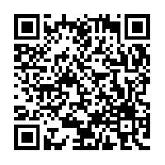
Notes:
Talent Demand Study...Tana

Slide 6
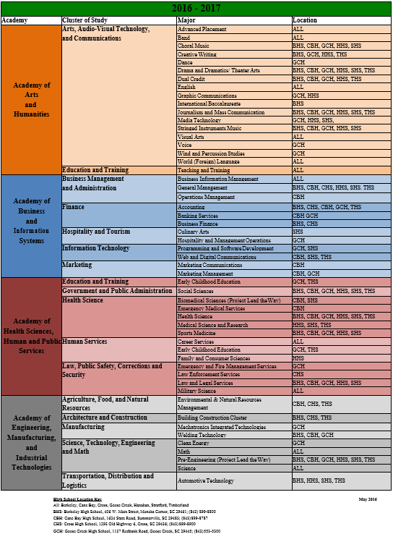
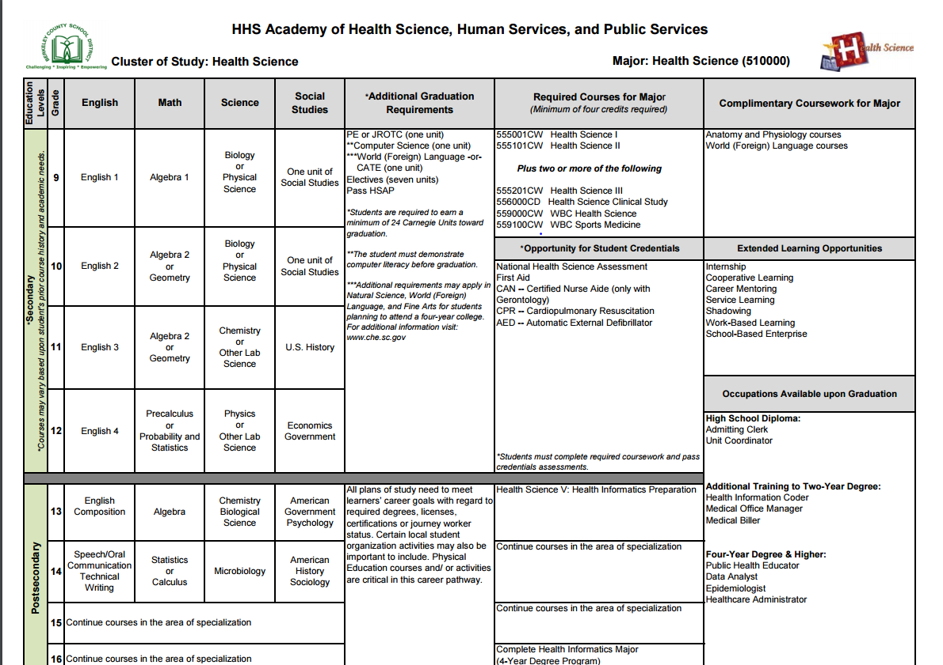
Notes:
2016-2017 Majors/Academies by location..,Tana

Slide 7
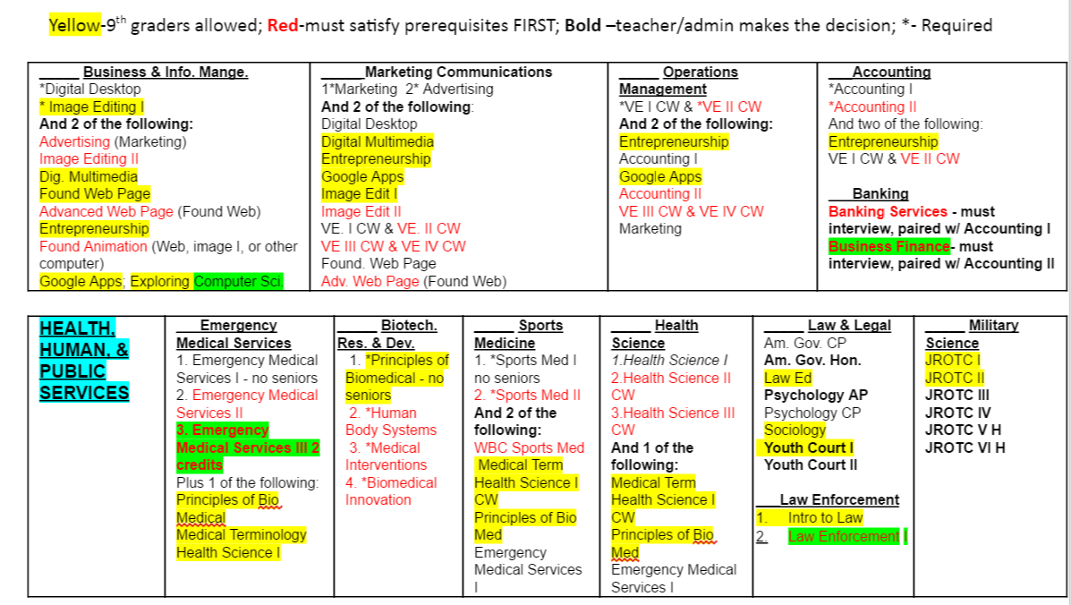
Notes:
Registration sheet from CBHS...Lee

Slide 8
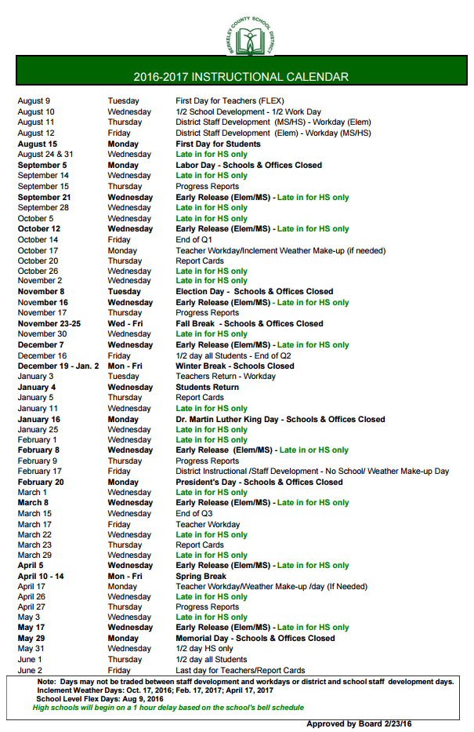
Advisory Board Meeting Dates for All Schools:
October 5
January 11
March 1
April 5
Notes:
Common planning time for advisories..Lee
Copy of late in schedule/district calendar

Slide 9
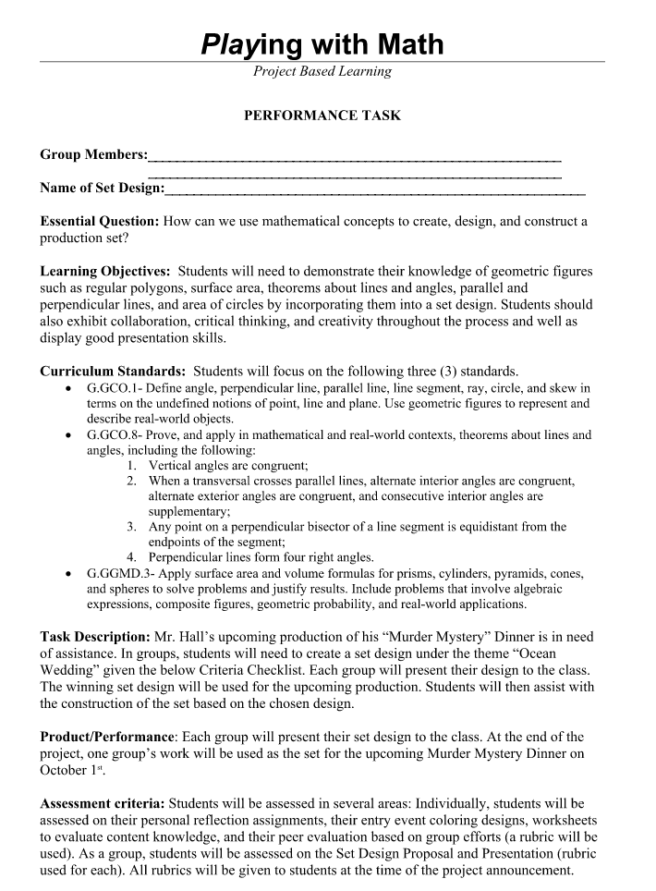
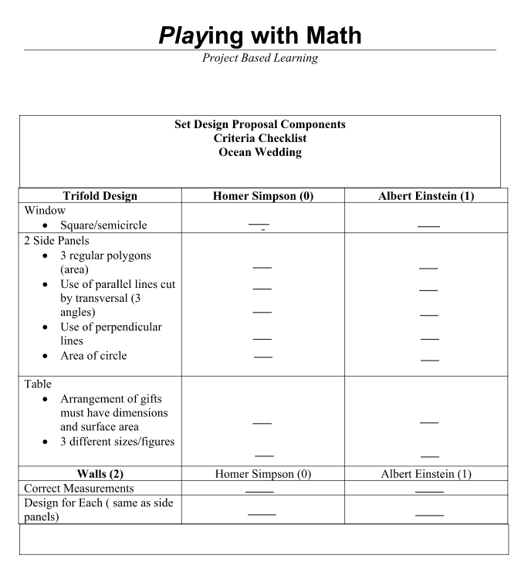
Notes:
PBL Interdisciplinary lesson..Lee

Slide 10
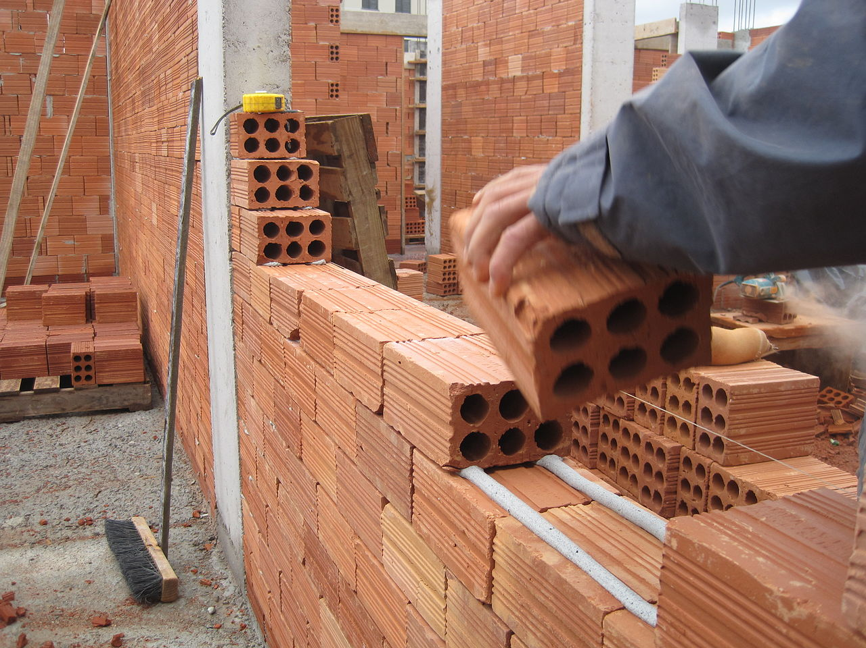
How to Build Better Partnerships
That Last!

Slide 11
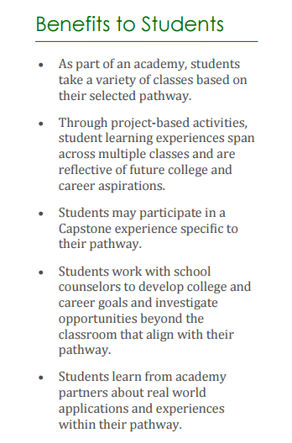
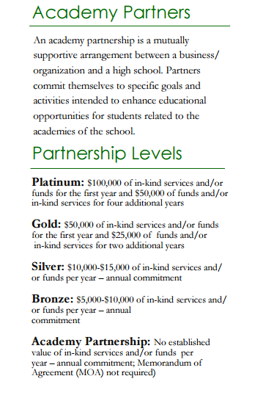
Notes:
Academy Partner model - copy of levels...Tana

Slide 12
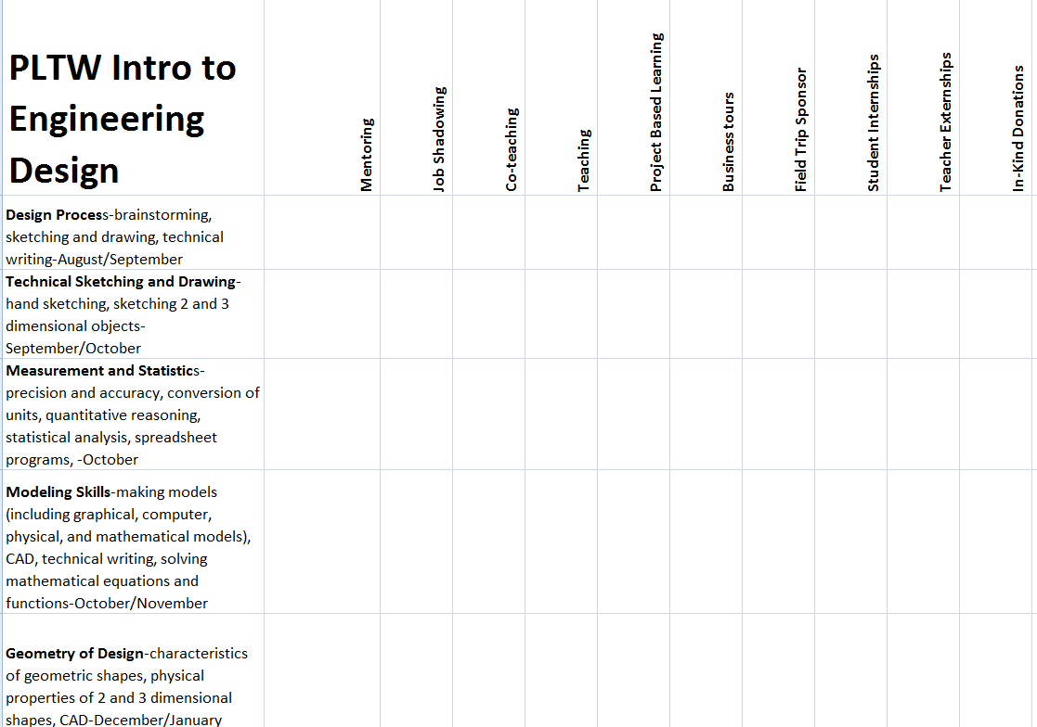
We had to find a way to connect schools and businesses effectively. Designed grids for each course in each pathway to outline experiences for students and partners.
Notes:
Grid Experiences...Lee

Slide 13
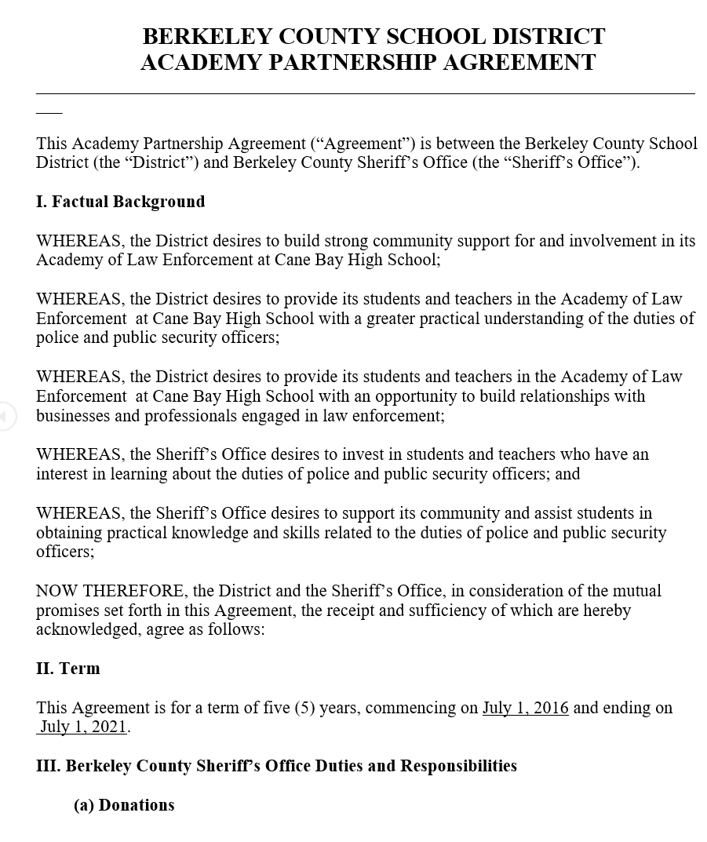
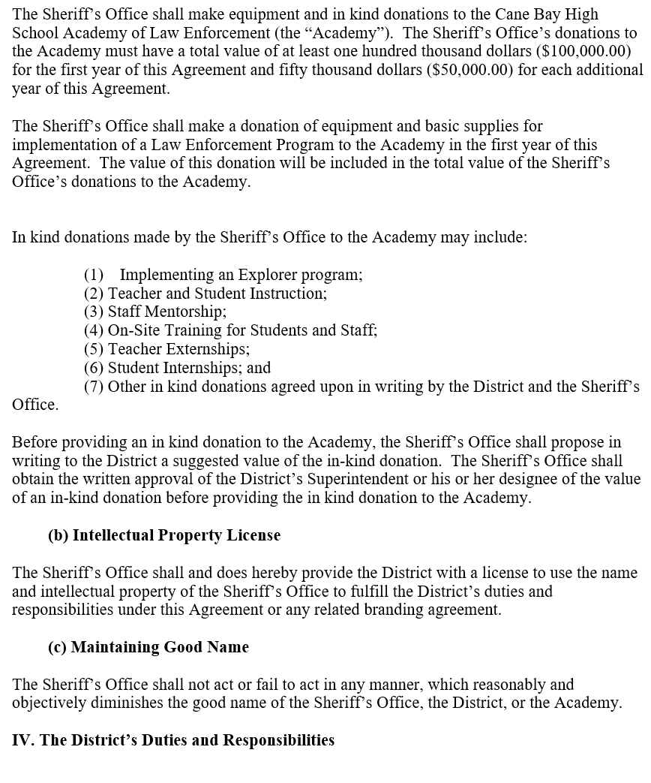
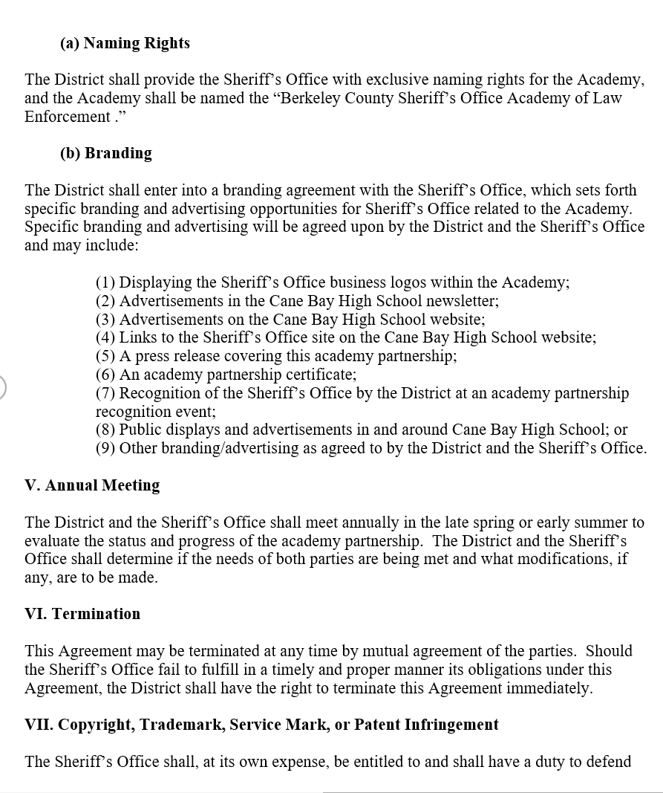
Notes:
Copy of academy contract...Tana

Slide 14
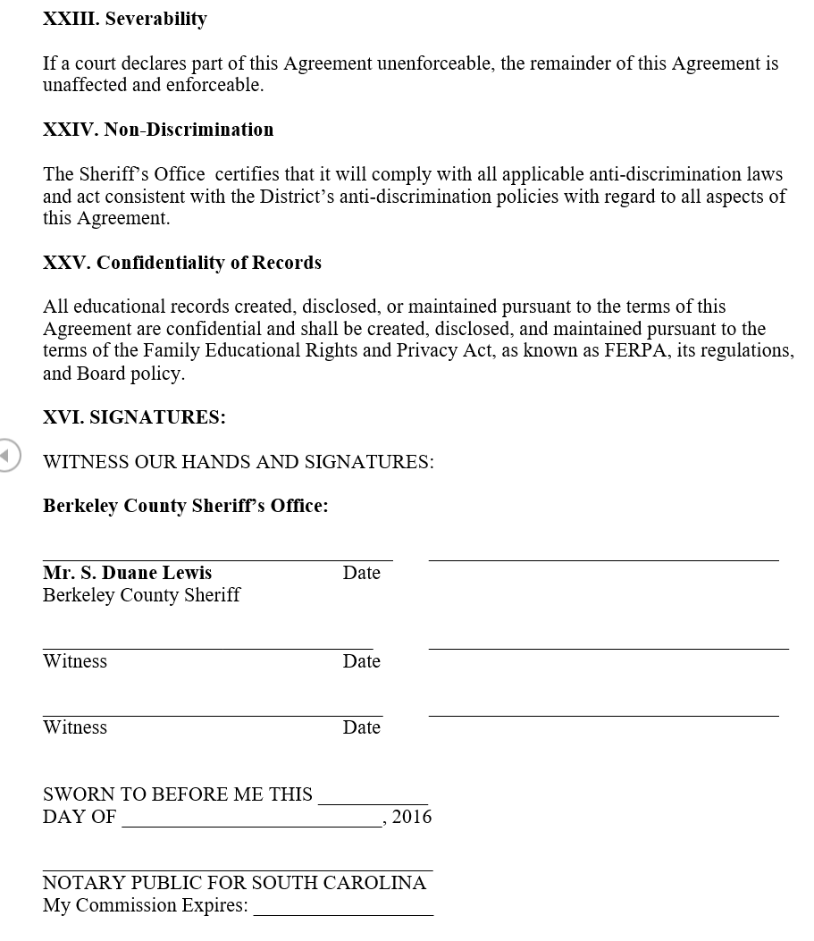
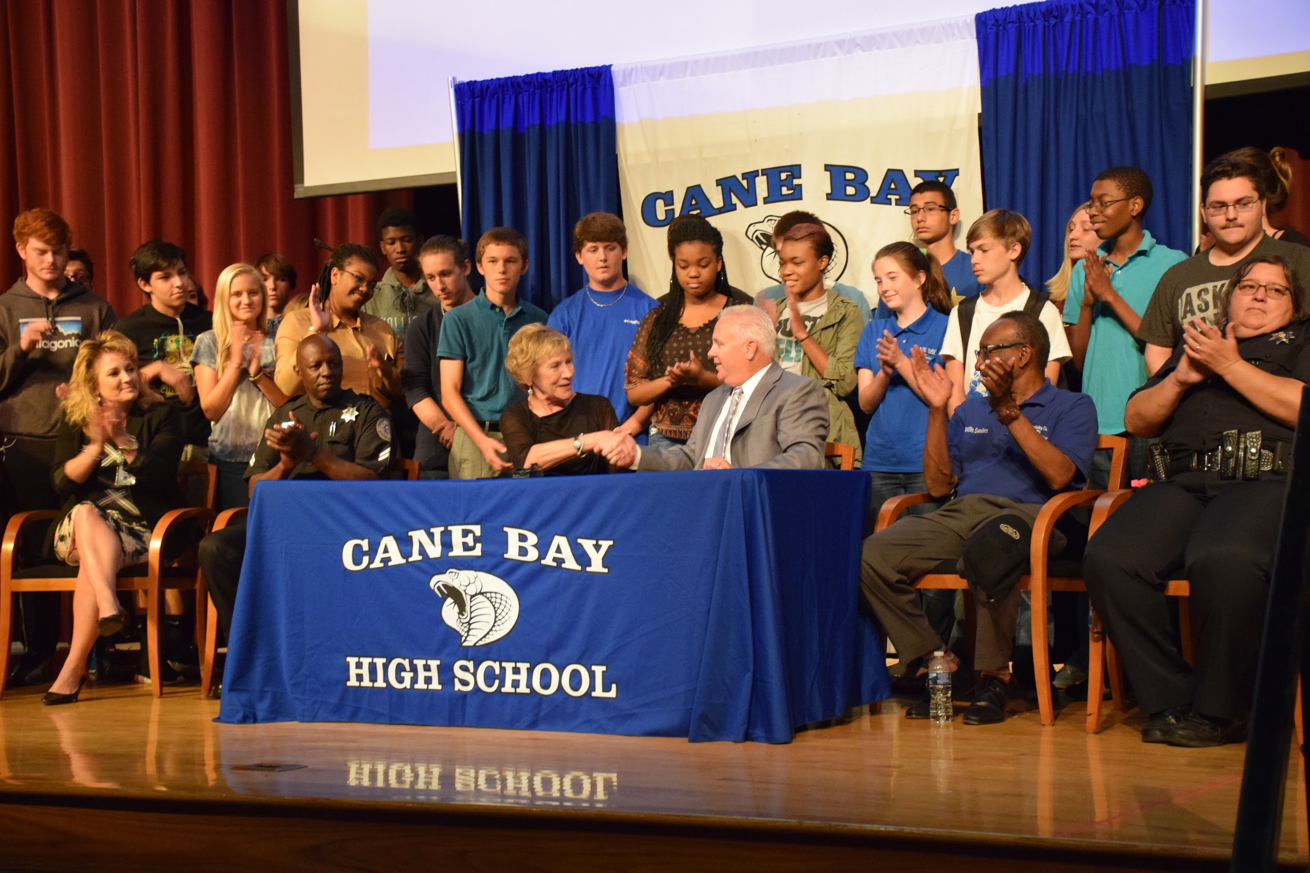
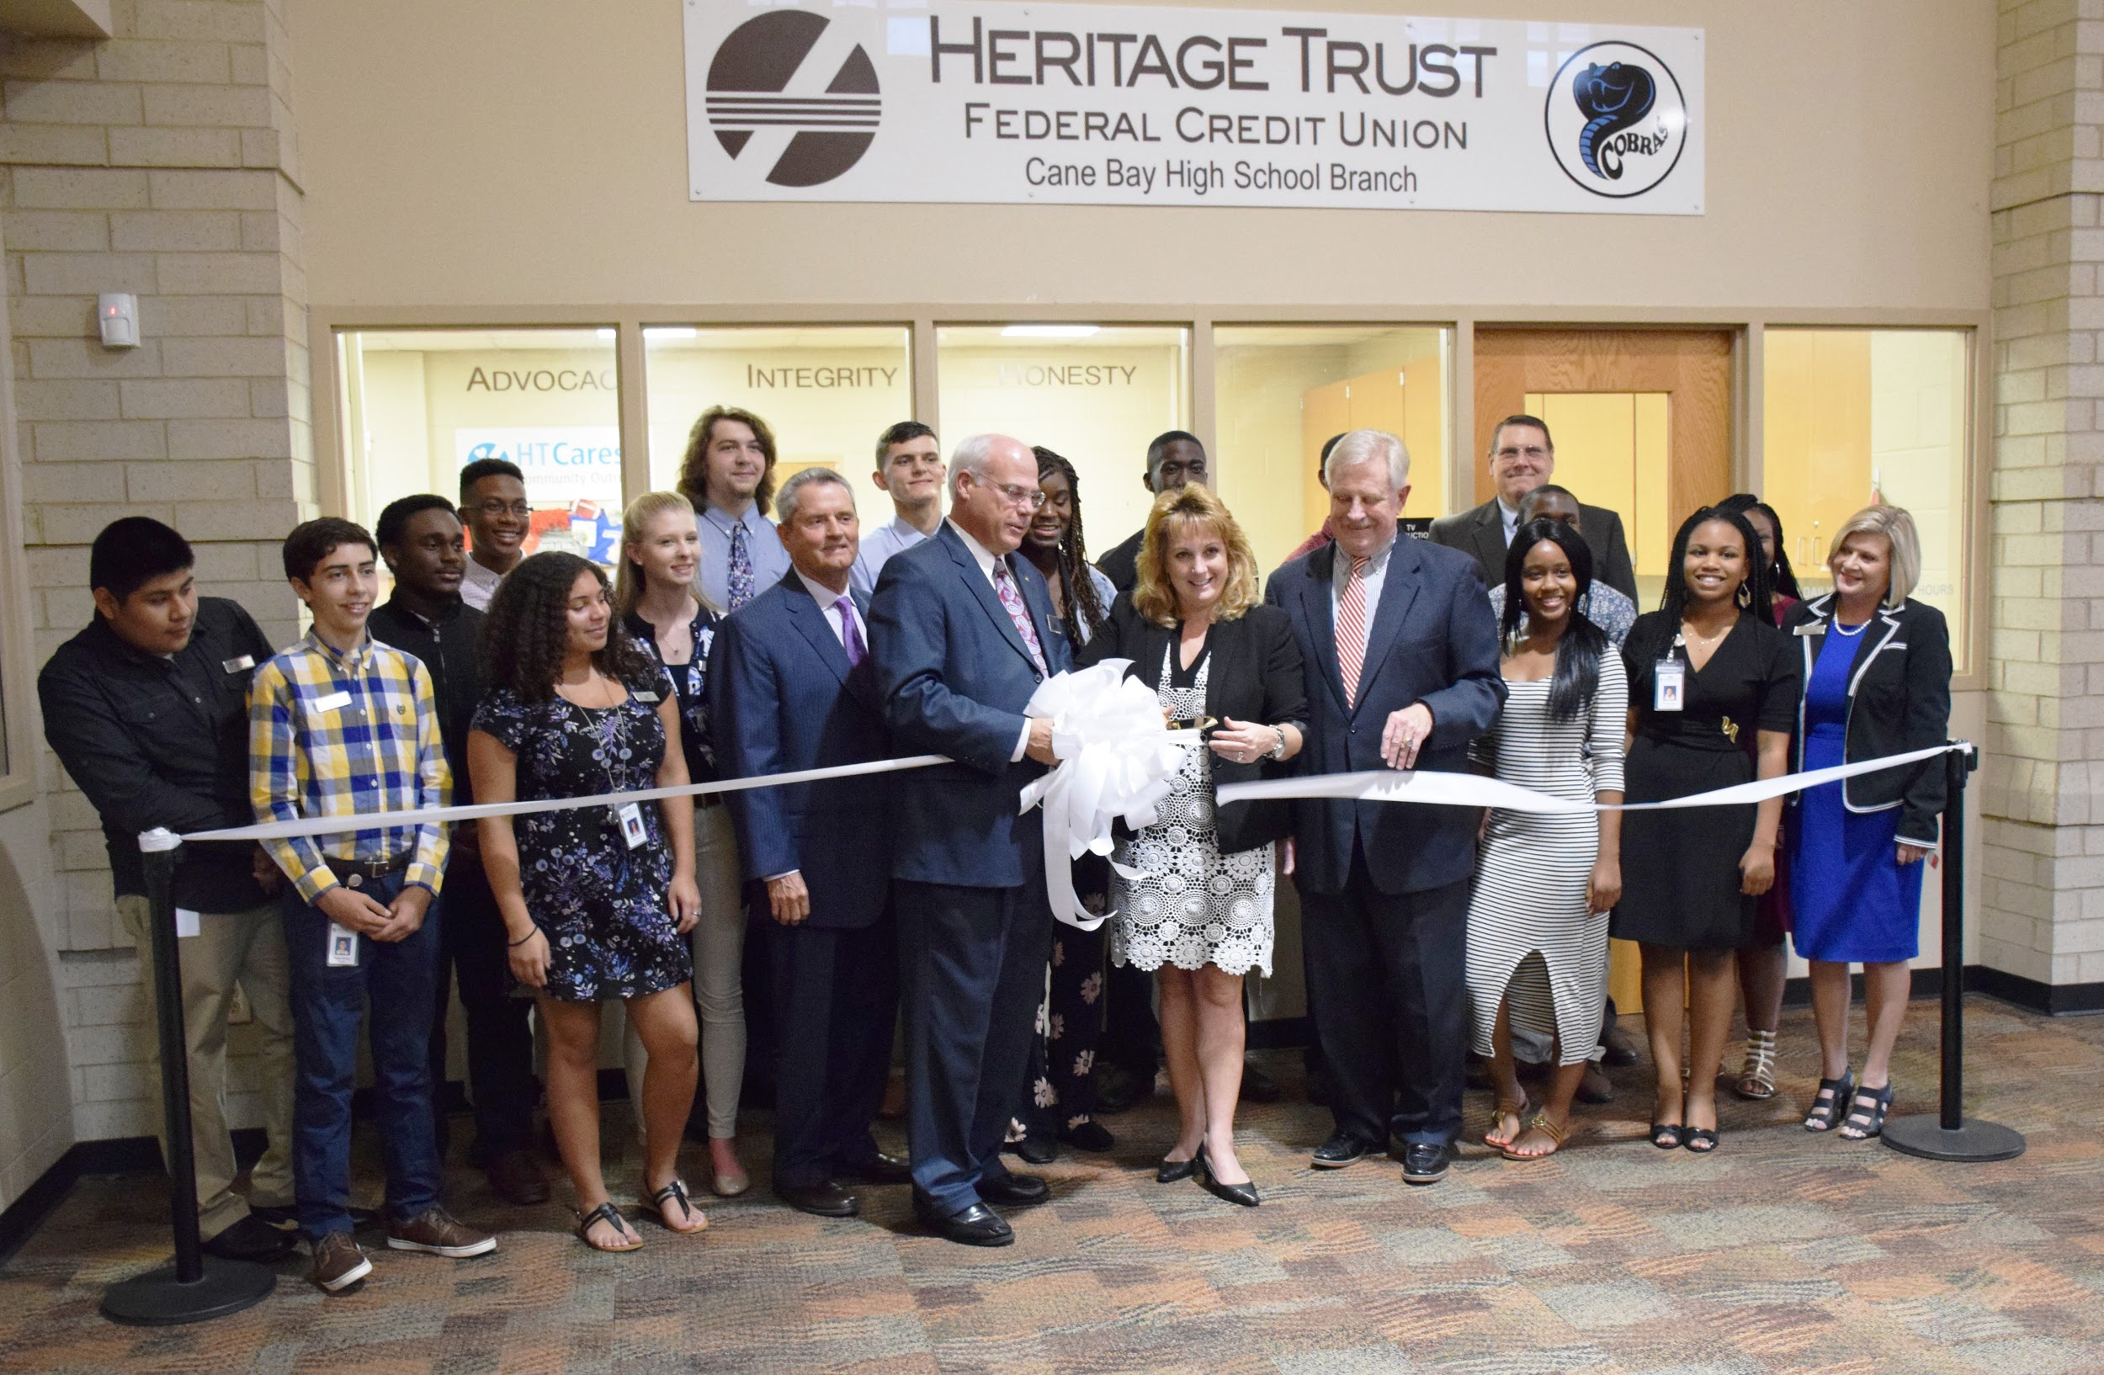
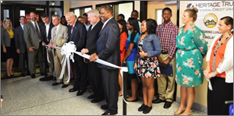
Notes:
Lee

Slide 15
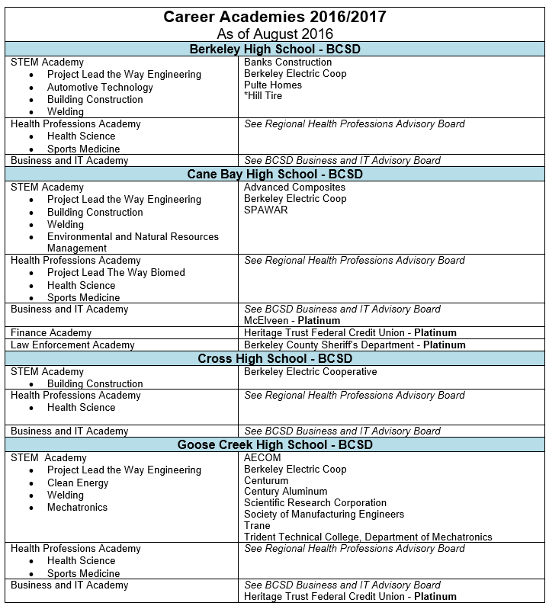
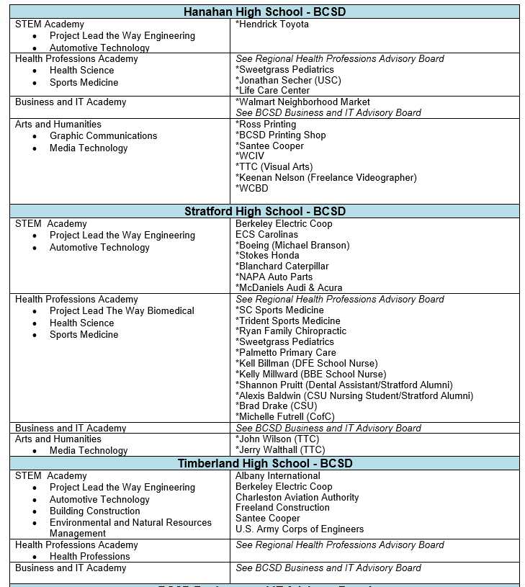
Notes:
Academy Partners by school...Tana

Slide 16
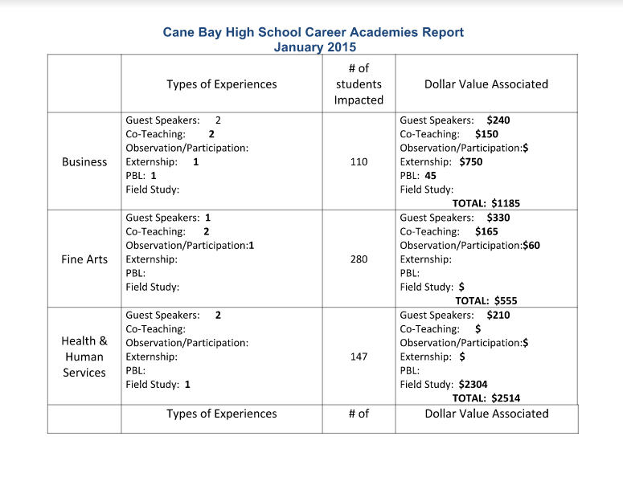
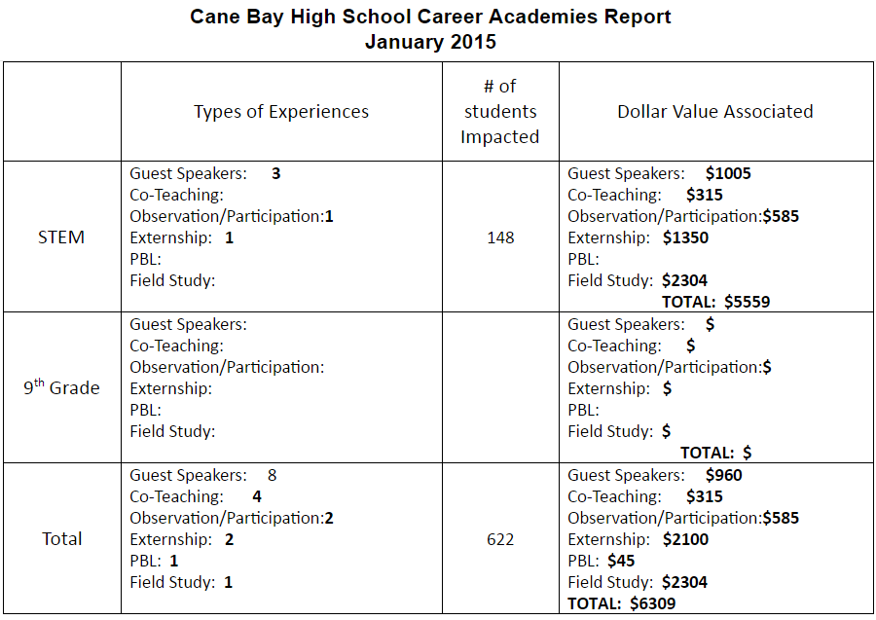
Notes:
Data tracking system- Lee

Slide 17
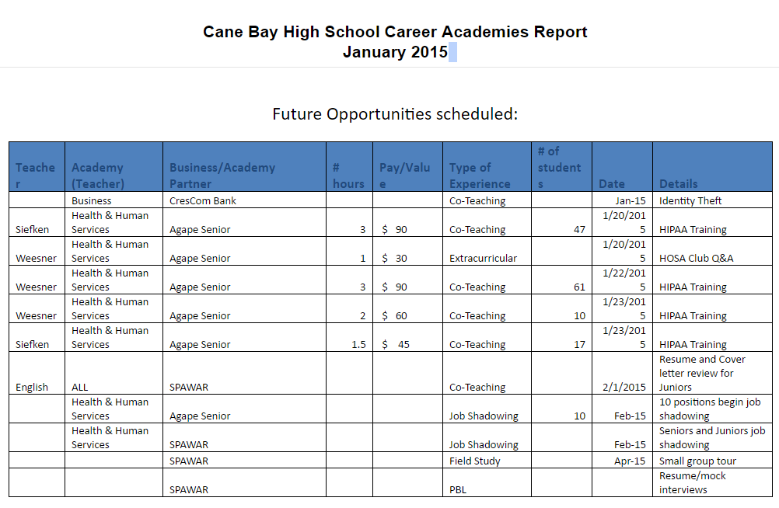
Notes:
Lee

Slide 18
CAPSTONE EXPERIENCE
Notes:
Tana..

Slide 19
How Were We Going to Measure?
Committee from across County
18 months to develop curriculum
Accessibility for all
Board Approval
Honors Credit
Notes:
Demonstration of Profile - copy of requirements
Talk about committee - 18 months - accessibility
Lee

Slide 20
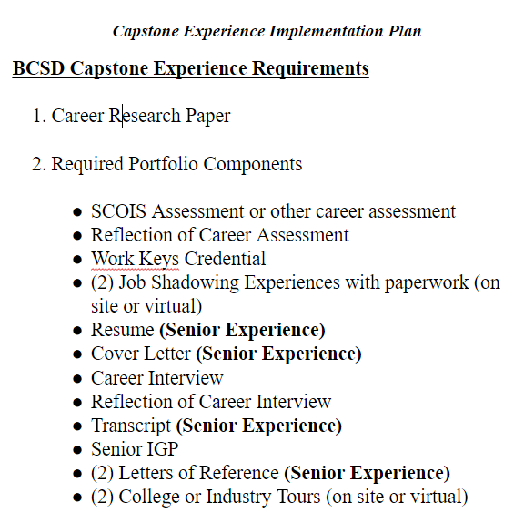
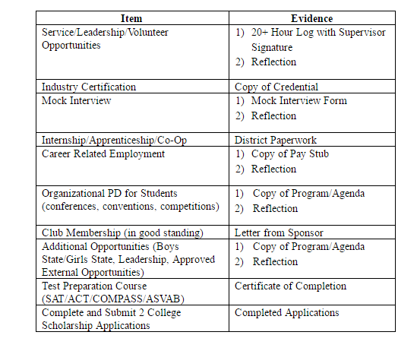
Must Pick 4 from below
Notes:
School plan. Use CBHS school plan..Lee

Slide 21
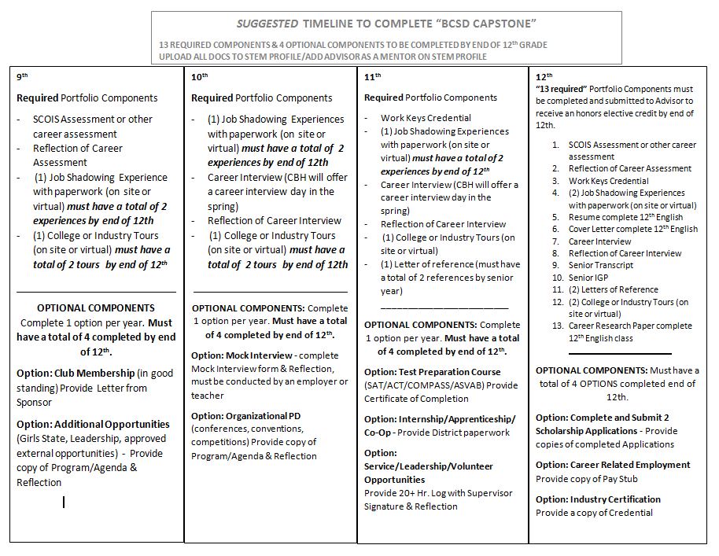
Schools Developed Implementation Plans
With Leadership Teams
Notes:
Copy of school plan - use CBHS plan..Lee

Slide 22
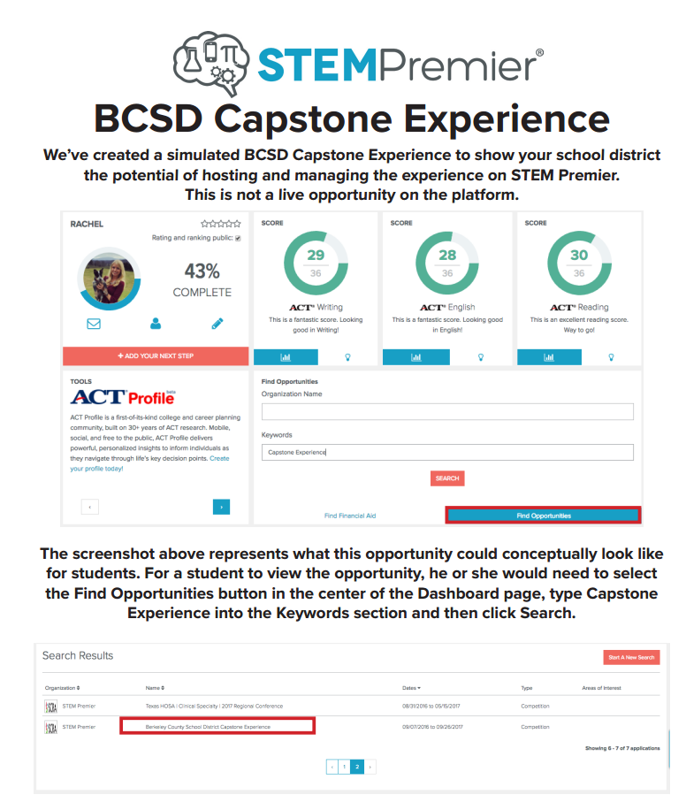
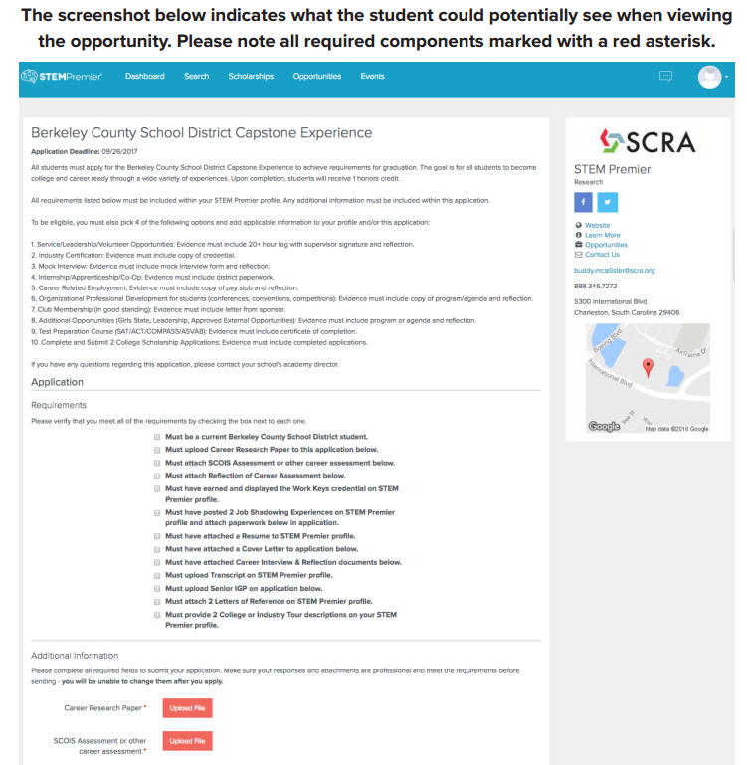
Notes:
STEM Premier Screen shots..Tana

Slide 23
Questions?
Notes:
Copy of rubrics

