Slide 1
Considerations for Mathematics Intervention

Slide 2
srpowell@austin.utexas.edu
@sarahpowellphd
119

Slide 3
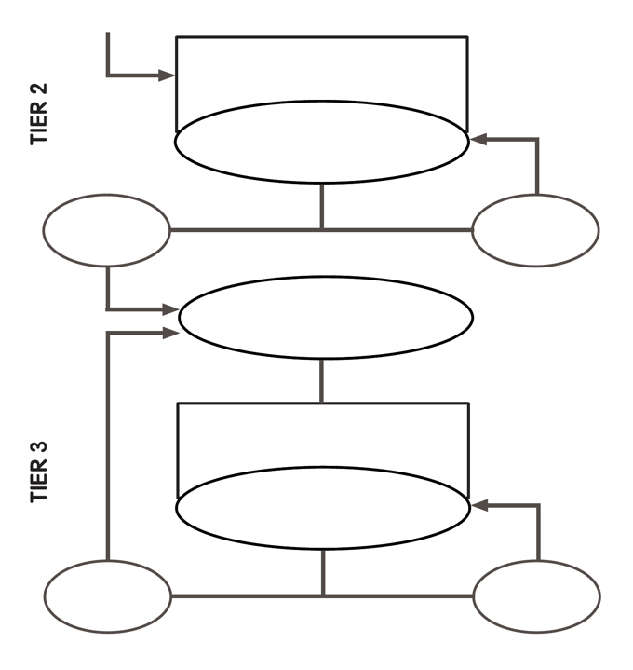

Slide 4
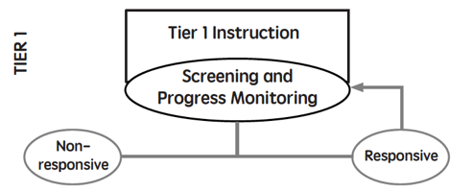
Core instruction utilizes evidence-based practices
All students screened (universal screener)
Students scoring below a cut-score are suspected at risk for math difficulties
Suspected at-risk students monitored for 6 to 10 weeks during primary prevention using progress monitoring

Slide 5
A practice that has shown consistent and positive results
evidence-based practice

Slide 6
evidence-based practice
An intervention (i.e., packaged program) that has shown consistent and positive results
evidence-based intervention

Slide 7
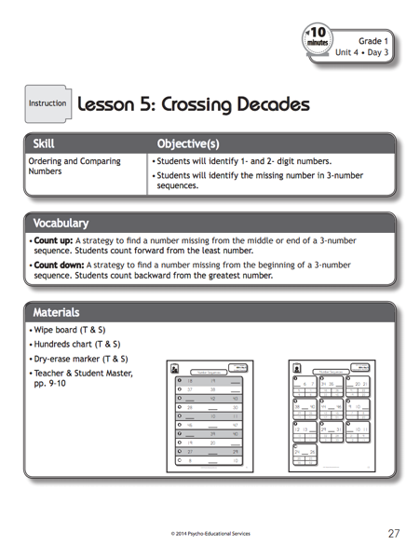
evidence-based practice
evidence-based intervention
Bryant, Bryant, Roberts, Vaughn, Hughes, Porterfield, & Gersten (2011)

Slide 8
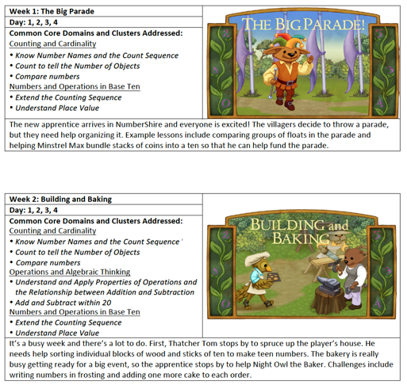
evidence-based practice
evidence-based intervention
https://dibels.uoregon.edu/market/numbershire

Slide 9
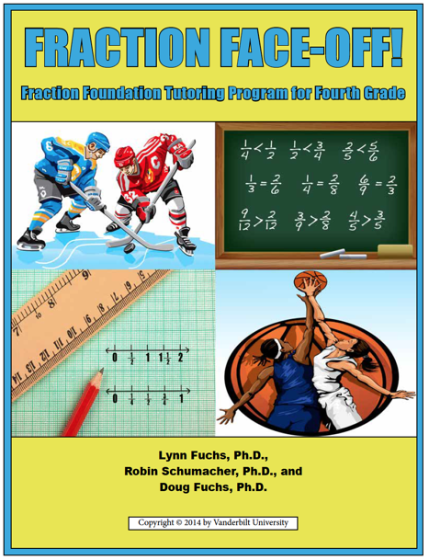
evidence-based practice
evidence-based intervention
Fuchs, Schumacher, & Fuchs (2014)

Slide 10
evidence-based practice
evidence-based intervention
evidence-based strategy
A method or strategy that has shown consistent and positive results

Slide 11
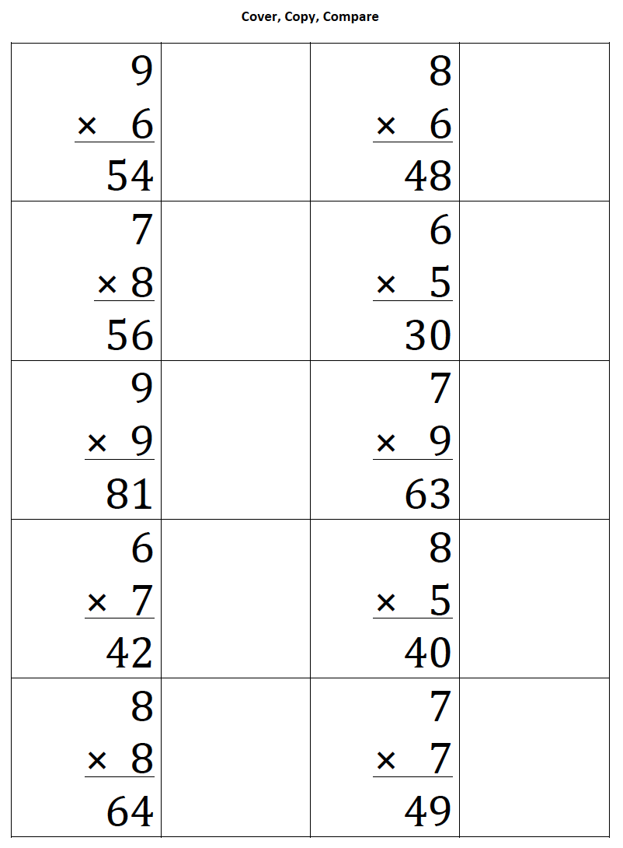
evidence-based practice
evidence-based strategy
ebi.missouri.edu/wp-content/uploads/2013/09/EBI-Brief-Template-Cover-Copy-and-Compare.pdf

Slide 12
evidence-based practice
evidence-based strategy
Strickland & Maccini (2012)

Slide 13
evidence-based practice
5
+ 6
2
+ 2
evidence-based strategy
Burns (2005)
7
+ 4
2
+ 6

Slide 14
evidence-based practice
evidence-based intervention
evidence-based strategy
A method or strategy that has shown a positive result
promising practice

Slide 15
evidence-based practice
evidence-based intervention
evidence-based strategy
promising practice
no or negative evidence

Slide 16
Where to find evidence-based practices…

Slide 17
evidence-based practice
evidence-based intervention
evidence-based strategy
promising practice

Slide 18
Websites ies.ed.gov/ncee/wwc/

Slide 19
Websites www.evidenceforessa.org

Slide 20
Websites www.edreports.org

Slide 21
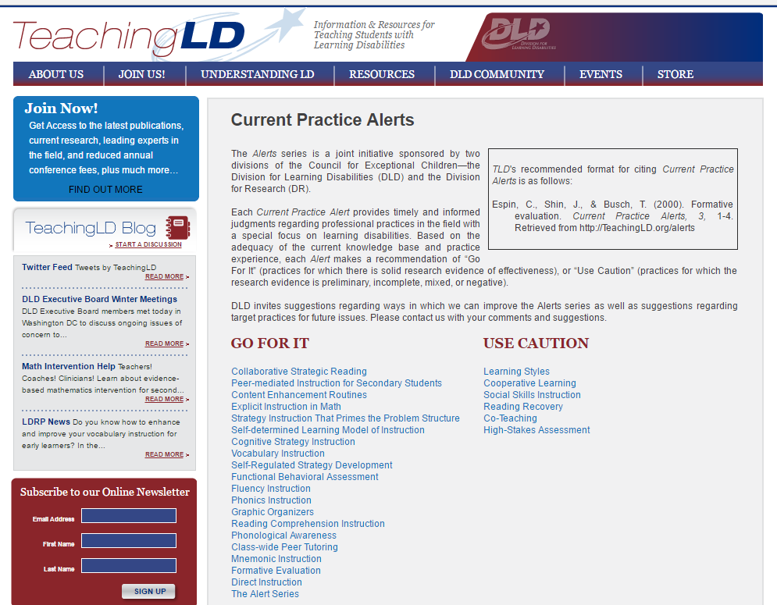
Websites teachingld.org

Slide 22
Websites ebi.missouri.edu

Slide 23
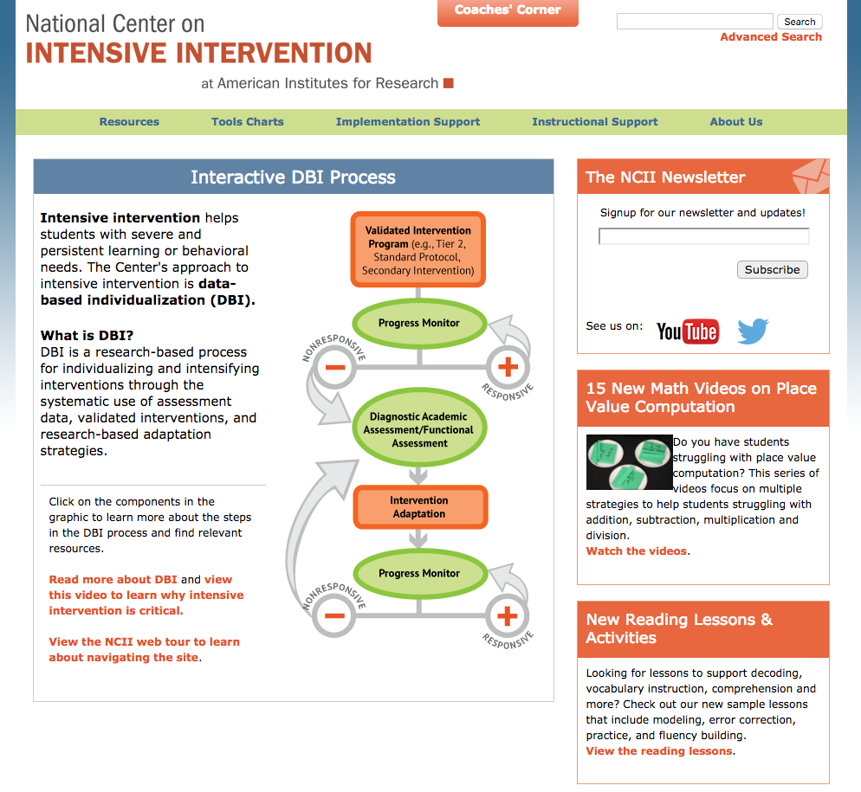
Websites www.intensiveintervention.org

Slide 24
Assessment data to show results
evidence-based practice
Improvement from before intervention
Improvement compared to no treatment students
Replication
evidence-based intervention
Multiple researchers
evidence-based strategy
Multiple students
Multiple times
promising practice
Setting and students similar to your own

Slide 25
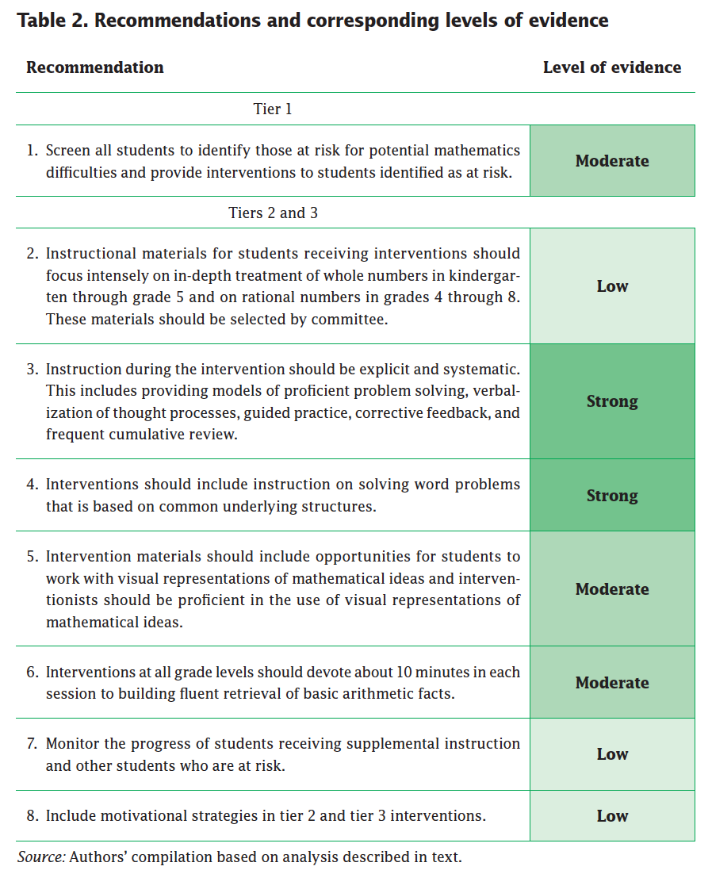
Assessment data to show results
Improvement from before intervention
Improvement compared to no treatment students
Replication
Multiple researchers
Multiple students
Multiple times
Gersten et al. (2009)
Setting and students similar to your own

Slide 26
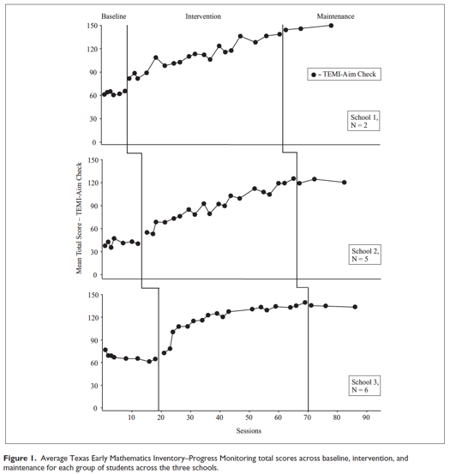
Assessment data to show results
Significant difference from baseline to posttest
Improvement from before intervention
Improvement compared to no treatment students
Replication
Multiple researchers
Multiple students
Multiple times
Bryant et al. (2016)
Setting and students similar to your own

Slide 27
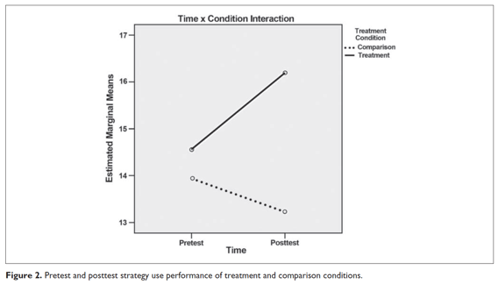
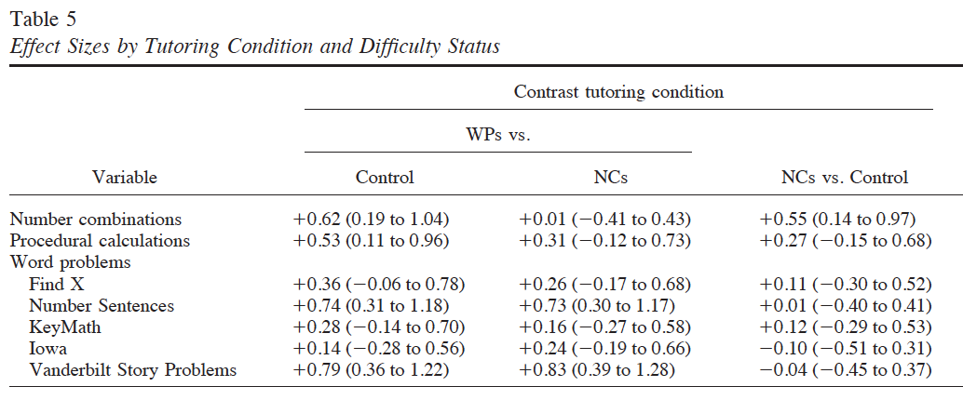
Significant difference between conditions
Assessment data to show results
Improvement from before intervention
Improvement compared to no treatment students
Replication
Fuchs et al. (2009); Krawec, Huang, Montague, Kressler, & de Alba (2012)
Multiple researchers
Multiple students
Multiple times
Setting and students similar to your own

Slide 28
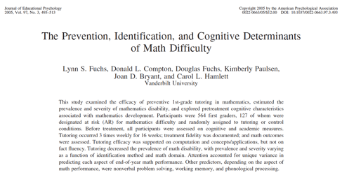
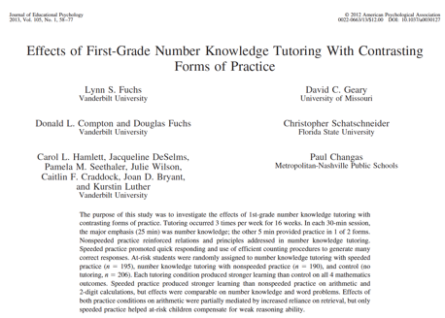
Assessment data to show results
Improvement from before intervention
Improvement compared to no treatment students
Replication
Multiple researchers
Multiple students
Multiple times
Setting and students similar to your own

Slide 29
Assessment data to show results
Improvement from before intervention
Improvement compared to no treatment students
Replication
Multiple researchers
Multiple students
Multiple times
Setting and students similar to your own

Slide 30
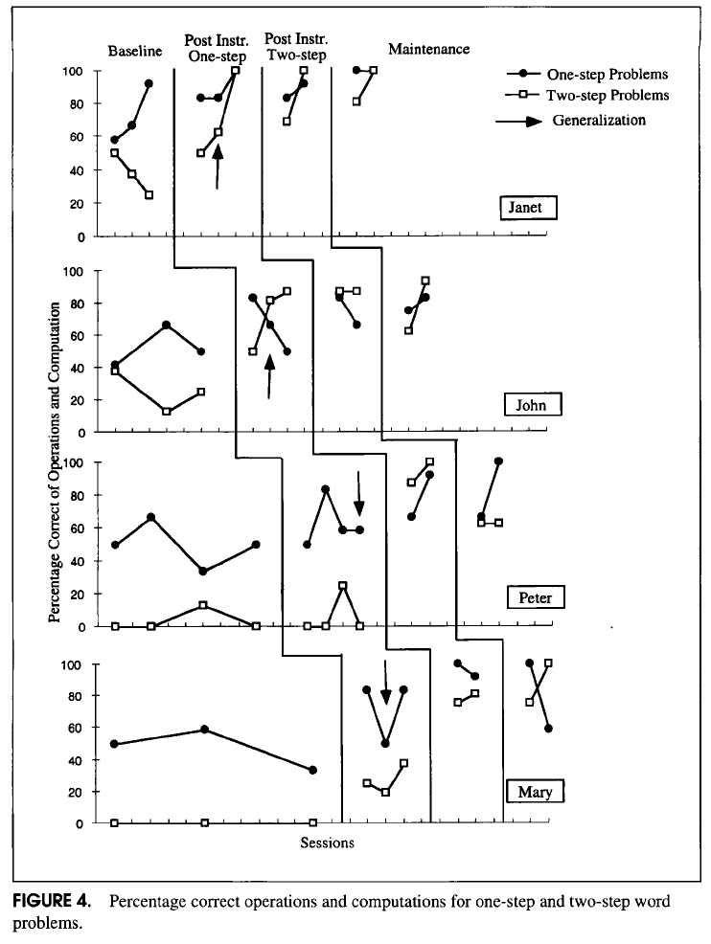
Assessment data to show results
Improvement from before intervention
Improvement compared to no treatment students
Replication
Burns, Kanive, & DeGrande (2012); Jitendra, Hoff, & Beck (1999)
Multiple researchers
Multiple students
Multiple times
Setting and students similar to your own

Slide 31
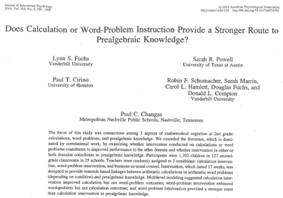
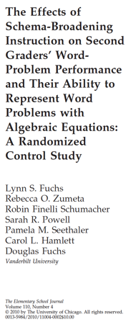
Assessment data to show results
Improvement from before intervention
Improvement compared to no treatment students
Replication
Multiple researchers
Multiple students
Multiple times
Setting and students similar to your own

Slide 32
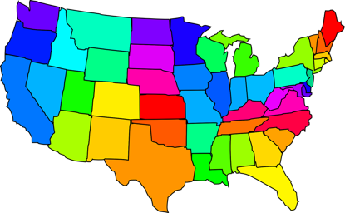
Assessment data to show results
Improvement from before intervention
Improvement compared to no treatment students
Replication
Multiple researchers
Multiple students
Multiple times
Setting and students similar to your own

Slide 33
What are your school’s Tier 1 strengths and weaknesses?

Slide 34
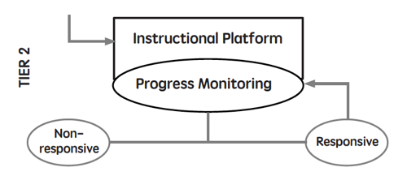
Students are tutored in small groups using evidence-based practices
Tutoring takes place three or four times a week
Each tutoring session lasts 30 to 60 minutes
Tutoring lasts 10 to 20 weeks
Progress monitoring continues weekly

Slide 35
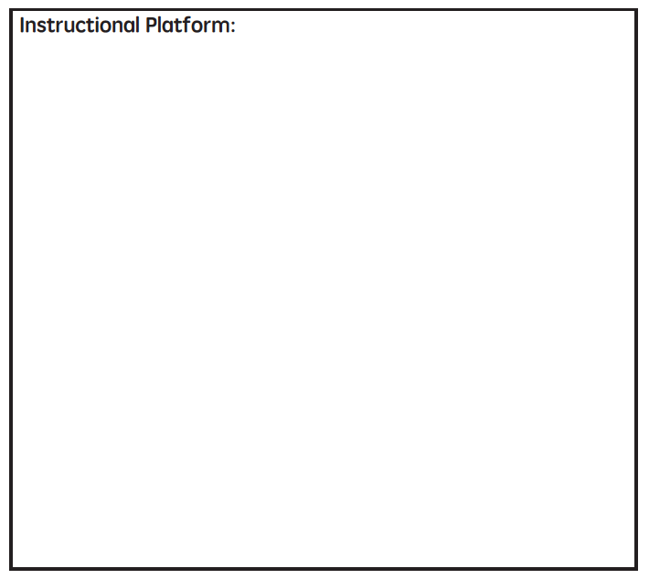
INSTRUCTIONAL DELIVERY
Explicit instruction
Precise language
Multiple representations
INSTRUCTIONAL STRATEGIES
Fluency building
Problem solving instruction

Slide 36
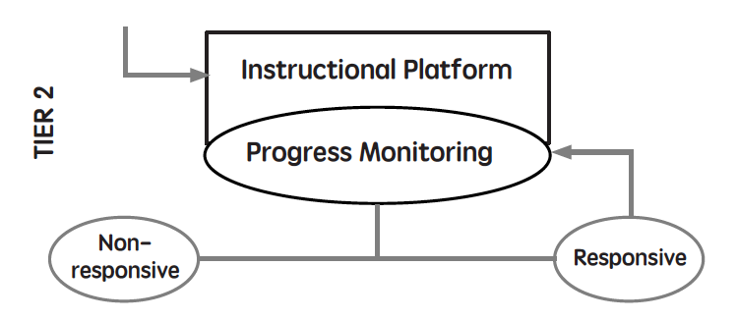
What are your school’s Tier 2 strengths and weaknesses?

Slide 37
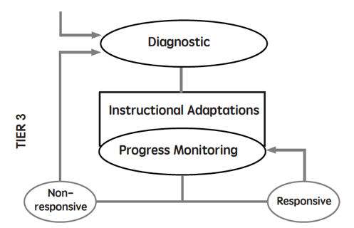
Diagnostics are conducted
Adaptations are made to the student’s intervention
Student progress is monitored weekly
With adequate slopes or end levels, students return to Tier 1 or 2

Slide 38
Implement with greater fidelity
Embed behavioral supports
Increase dosage
Adapt mathematics content
Utilize explicit instruction
Explicitly teach transfer

Slide 39
What are your school’s Tier 3 strengths and weaknesses?

Slide 40
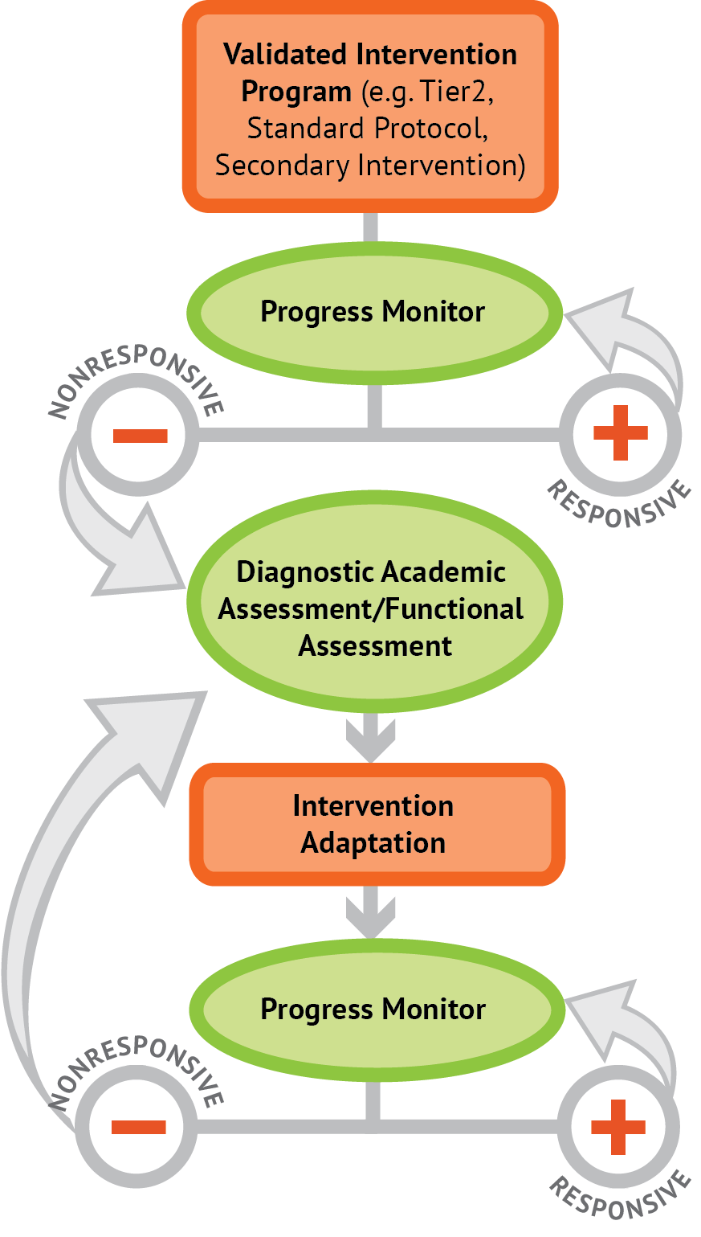

Slide 42
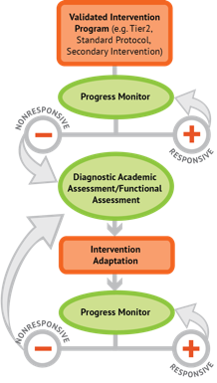
Where student IS
Where student NEEDS TO BE

Slide 43
Fluency

Slide 44
Fluently add and subtract within 5.

Slide 45
Fluently add and subtract within 5.
Add and subtract within 20, demonstrating fluency for addition and subtraction within 10.

Slide 46
Fluently add and subtract within 5.
Add and subtract within 20, demonstrating fluency for addition and subtraction within 10.
Fluently add and subtract within 100 using strategies based on place value, properties of operations, and/or relationships.

Slide 47
Fluently add and subtract within 5.
Add and subtract within 20, demonstrating fluency for addition and subtraction within 10.
Fluently add and subtract within 100 using strategies based on place value, properties of operations, and/or relationships.
Fluently multiply and divide within 100, using strategies such as the relationship between multiplication and division…

Slide 48
Fluently add and subtract within 5.
Add and subtract within 20, demonstrating fluency for addition and subtraction within 10.
Fluently add and subtract within 100 using strategies based on place value, properties of operations, and/or relationships.
Fluently multiply and divide within 100, using strategies such as the relationship between multiplication and division…
Fluently add and subtract multi-digit whole numbers using the standard algorithm.

Slide 49
Fluently add and subtract within 5.
Add and subtract within 20, demonstrating fluency for addition and subtraction within 10.
Fluently add and subtract within 100 using strategies based on place value, properties of operations, and/or relationships.
Fluently multiply and divide within 100, using strategies such as the relationship between multiplication and division…
Fluently add and subtract multi-digit whole numbers using the standard algorithm.
Fluently multiply multi-digit whole numbers using the standard algorithm.

Slide 50
Fluently add and subtract within 5.
Add and subtract within 20, demonstrating fluency for addition and subtraction within 10.
Fluently add and subtract within 100 using strategies based on place value, properties of operations, and/or relationships.
Fluently multiply and divide within 100, using strategies such as the relationship between multiplication and division…
Fluently add and subtract multi-digit whole numbers using the standard algorithm.
Fluently multiply multi-digit whole numbers using the standard algorithm.
Fluently add, subtract, multiply, and divide multi-digit decimals using the standard algorithm.

Slide 51
Where student NEEDS TO BE
Fluently add and subtract within 5.
Add and subtract within 20, demonstrating fluency for addition and subtraction within 10.
Fluently add and subtract within 100 using strategies based on place value, properties of operations, and/or relationships.
Fluently multiply and divide within 100, using strategies such as the relationship between multiplication and division…
Fluently add and subtract multi-digit whole numbers using the standard algorithm.
Fluently multiply multi-digit whole numbers using the standard algorithm.
Fluently add, subtract, multiply, and divide multi-digit decimals using the standard algorithm.

Slide 52
Where student IS
Where student NEEDS TO BE
Fluently add and subtract within 5.
Add and subtract within 20, demonstrating fluency for addition and subtraction within 10.
Fluently add and subtract within 100 using strategies based on place value, properties of operations, and/or relationships.
Fluently multiply and divide within 100, using strategies such as the relationship between multiplication and division…
Fluently add and subtract multi-digit whole numbers using the standard algorithm.
Fluently multiply multi-digit whole numbers using the standard algorithm.
Fluently add, subtract, multiply, and divide multi-digit decimals using the standard algorithm.

Slide 53
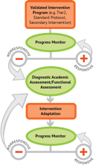
Where student IS
Where student NEEDS TO BE
Fluently add and subtract within 5.
Add and subtract within 20, demonstrating fluency for addition and subtraction within 10.
Fluently add and subtract within 100 using strategies based on place value, properties of operations, and/or relationships.
Fluently multiply and divide within 100, using strategies such as the relationship between multiplication and division…
Fluently add and subtract multi-digit whole numbers using the standard algorithm.
Fluently multiply multi-digit whole numbers using the standard algorithm.
Fluently add, subtract, multiply, and divide multi-digit decimals using the standard algorithm.

Slide 54
Place Value

Slide 55
Compose and decompose numbers from 11 to 19 into ten ones and some further ones…
Recognize that in a multi-digit number, a digit in one place represents 10 times as much as it represents in the place to its right and 1/10 of what it represents in the place to its left.
Use place value understanding to round whole numbers to the nearest 10 or 100.
Recognize that in a multi-digit number, a digit in one place represents ten times what it represents in the place to its right…
Understand that the two digits of a two-digit number represent amounts of tens and ones.
Understand that the three digits of a three-digit number represent amounts of hundreds, tens, and ones.

Slide 56
Compose and decompose numbers from 11 to 19 into ten ones and some further ones…

Slide 57
Compose and decompose numbers from 11 to 19 into ten ones and some further ones…
Understand that the two digits of a two-digit number represent amounts of tens and ones.

Slide 58
Compose and decompose numbers from 11 to 19 into ten ones and some further ones…
Understand that the two digits of a two-digit number represent amounts of tens and ones.
Understand that the three digits of a three-digit number represent amounts of hundreds, tens, and ones.

Slide 59
Compose and decompose numbers from 11 to 19 into ten ones and some further ones…
Understand that the two digits of a two-digit number represent amounts of tens and ones.
Understand that the three digits of a three-digit number represent amounts of hundreds, tens, and ones.
Use place value understanding to round whole numbers to the nearest 10 or 100.

Slide 60
Compose and decompose numbers from 11 to 19 into ten ones and some further ones…
Understand that the two digits of a two-digit number represent amounts of tens and ones.
Understand that the three digits of a three-digit number represent amounts of hundreds, tens, and ones.
Use place value understanding to round whole numbers to the nearest 10 or 100.
Recognize that in a multi-digit number, a digit in one place represents ten times what it represents in the place to its right…

Slide 61
Compose and decompose numbers from 11 to 19 into ten ones and some further ones…
Understand that the two digits of a two-digit number represent amounts of tens and ones.
Understand that the three digits of a three-digit number represent amounts of hundreds, tens, and ones.
Use place value understanding to round whole numbers to the nearest 10 or 100.
Recognize that in a multi-digit number, a digit in one place represents ten times what it represents in the place to its right…
Recognize that in a multi-digit number, a digit in one place represents 10 times as much as it represents in the place to its right and 1/10 of what it represents in the place to its left.

Slide 62
Problem Solving

Slide 63
Interpret and compute quotients of fractions, and solve word problems involving division of fractions by fractions…
Solve word problems that call for addition of three whole numbers whose sum is less than or equal to 20…
Solve real-world and mathematical problems involving the four operations with rational numbers.
Use addition and subtraction within 100 to solve one- and two-step word problems…
Use multiplication and division within 100 to solve word problems…
Solve real-world and mathematical problems leading to two linear equations in two variables.
Solve addition and subtraction word problems, and add and subtract within 10…
Solve multi-step word problems posed with whole numbers and having whole-number answers using the four operations…
Solve word problems involving addition and subtraction of fractions referring to the same whole, including cases of unlike denominators…

Slide 64
Solve addition and subtraction word problems, and add and subtract within 10…
Solve word problems that call for addition of three whole numbers whose sum is less than or equal to 20…
Use addition and subtraction within 100 to solve one- and two-step word problems…
Use multiplication and division within 100 to solve word problems…
Solve multi-step word problems posed with whole numbers and having whole-number answers using the four operations…
Solve word problems involving addition and subtraction of fractions referring to the same whole, including cases of unlike denominators…
Interpret and compute quotients of fractions, and solve word problems involving division of fractions by fractions…
Solve real-world and mathematical problems involving the four operations with rational numbers.
Solve real-world and mathematical problems leading to two linear equations in two variables.

Slide 65
Where student IS
Where student NEEDS TO BE
Solve addition and subtraction word problems, and add and subtract within 10…
Solve word problems that call for addition of three whole numbers whose sum is less than or equal to 20…
Use addition and subtraction within 100 to solve one- and two-step word problems…
Use multiplication and division within 100 to solve word problems…
Solve multi-step word problems posed with whole numbers and having whole-number answers using the four operations…
Solve word problems involving addition and subtraction of fractions referring to the same whole, including cases of unlike denominators…
Interpret and compute quotients of fractions, and solve word problems involving division of fractions by fractions…
Solve real-world and mathematical problems involving the four operations with rational numbers.
Solve real-world and mathematical problems leading to two linear equations in two variables.

Slide 66
Where student IS
Where student NEEDS TO BE
Use addition and subtraction within 100 to solve one- and two-step word problems…
Use multiplication and division within 100 to solve word problems…
Solve multi-step word problems posed with whole numbers and having whole-number answers using the four operations…

Slide 67
Where student IS
Where student NEEDS TO BE
Explain why addition and subtraction strategies work, using place value and the properties of operations.
Understand that the two digits of a two-digit number represent amounts of tens and ones.
Use addition and subtraction within 100 to solve one- and two-step word problems…
Fluently add and subtract within 100 using strategies based on place value, properties of operations, and/or relationships.
Apply properties of operations as strategies to multiply and divide….
Fluently multiply and divide within 100, using strategies such as the relationship between multiplication and division…
Use multiplication and division within 100 to solve word problems…
Fluently add and subtract multi-digit whole numbers using the standard algorithm.
Find whole number quotients and remainders with up to four-digit dividends and one-digit divisors, using strategies based on place value, the properties of operations, and/or the relationship between multiplication and division.
Solve multi-step word problems posed with whole numbers and having whole-number answers using the four operations…
Understand that the three digits of a three-digit number represent amounts of hundreds, tens, and ones.
Fluently multiply multi-digit whole numbers using the standard algorithm.

Slide 68
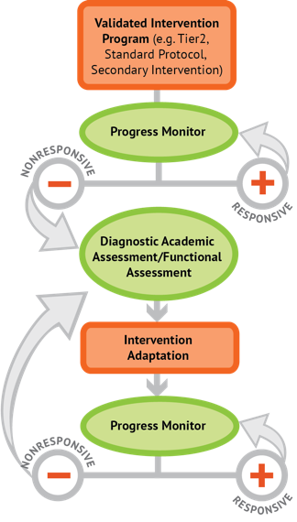
Instructional Platform
INSTRUCTIONAL DELIVERY
Explicit instruction
Precise language
Multiple representations
INSTRUCTIONAL STRATEGIES
Fluency building
Problem solving instruction

Slide 70
Modeling
Practice
Clear Explanation
Guided
Practice
Planned
Examples
Independent Practice
Supports
Asking the right questions
Eliciting frequent responses
Providing immediate specific feedback
Maintaining a brisk pace

Slide 71
Goal and importance
“Today, we are learning about division. This is important because sometimes you have to share objects or things with your friends.”
Modeling
Practice
Clear Explanation
Guided
Practice
We Do
Planned
Examples
Independent Practice
“Let’s continue working with our three-dimensional shapes and volume. Understanding volume and calculating volume helps with measuring capacity.”
You Do
Supporting Practices
Asking the right questions
Eliciting frequent responses
Providing immediate specific feedback
Maintaining a brisk pace
Copyright 2018 Sarah R. Powell, Ph.D.

Slide 72
Goal and importance
Model steps
Modeling
Practice
Clear Explanation
Guided
Practice
“To solve 26 plus 79, I first decide about the operation. Do I add, subtract, multiply or divide?”
We Do
Planned
Examples
Independent Practice
“The plus sign tells me to add. So, I’ll add 26 plus 79. I’ll use the partial sums strategy. First, I add 20 plus 70. What’s 20 plus 70?”
You Do
Supporting Practices
“20 plus 70 is 90. I write 90 right here.”
Asking the right questions
Eliciting frequent responses
Providing immediate specific feedback
Maintaining a brisk pace
“Then I add 6 plus 9. What’s 6 plus 9?”
“6 plus 9 is 15. So, I write 15 here.”
“Finally, we add the partial sums: 90 and 15. 90 plus 15 is 105. So, 26 plus 79 equals 105.”
Copyright 2018 Sarah R. Powell, Ph.D.

Slide 73
Goal and importance
Model steps
Modeling
Practice
Clear Explanation
Concise language
Guided
Practice
We Do
Planned
Examples
Independent Practice
“To solve 26 plus 79, I first decide about the operation. Do I add, subtract, multiply, or divide?”
You Do
“The plus sign tells me to add. So, I’ll add 26 plus 79. I’ll use the partial sums strategy. First, I add 20 plus 70. What’s 20 plus 70?”
Supporting Practices
Asking the right questions
Eliciting frequent responses
Providing immediate specific feedback
Maintaining a brisk pace
“20 plus 70 is 90. I write 90 right here under the equal line.”
“Then I add 6 plus 9. What’s 6 plus 9?”
“6 plus 9 is 15. So, I write 15 here.”
“Finally, we add the partial sums: 90 and 15. 90 plus 15 is 105. So, 26 plus 79 equals 105.”
Copyright 2018 Sarah R. Powell, Ph.D.

Slide 74
Examples
“Today, we are learning about division. This is important because sometimes you have to share objects or things with your friends.”
Modeling
Practice
Clear Explanation
Guided
Practice
24 / 6
We Do
35 $)$ 5
28 $÷$ 7
Planned
Examples
Independent Practice
You Do
Supporting Practices
Asking the right questions
Eliciting frequent responses
Providing immediate specific feedback
Maintaining a brisk pace
Copyright 2018 Sarah R. Powell, Ph.D.

Slide 75
With examples
“Today, we are learning about division. This is important because sometimes you have to share objects or things with your friends.”
Modeling
Practice
Clear Explanation
Guided
Practice
24 / 6
We Do
35 $)$ 5
28 $÷$ 7
Planned
Examples
Independent Practice
You Do
With non-examples
Supporting Practices
Asking the right questions
Eliciting frequent responses
Providing immediate specific feedback
Maintaining a brisk pace
32 $÷$ 8
42 $÷$ 7
25 $−$ 5
Copyright 2018 Sarah R. Powell, Ph.D.

Slide 76
Modeling
Practice
Clear Explanation
Guided
Practice
Planned
Examples
Independent Practice
Supports
Asking the right questions
Eliciting frequent responses
Providing immediate specific feedback
Maintaining a brisk pace
Copyright 2018 Sarah R. Powell, Ph.D.

Slide 77
I Do
Modeling
Practice
Clear Explanation
Guided
Practice
Planned
Examples
Independent Practice
Supporting Practices
Asking the right questions
Eliciting frequent responses
Providing immediate specific feedback
Maintaining a brisk pace
Copyright 2018 Sarah R. Powell, Ph.D.

Slide 78
I Do
Modeling
Practice
Teacher and student practice together
Clear Explanation
Guided
Practice
Planned
Examples
Independent Practice
Supporting Practices
Asking the right questions
Eliciting frequent responses
Providing immediate specific feedback
Maintaining a brisk pace
Copyright 2018 Sarah R. Powell, Ph.D.

Slide 79
I Do
Modeling
Practice
Clear Explanation
Guided
Practice
Planned
Examples
Independent Practice
Student practices with teacher support
Supporting Practices
Asking the right questions
Eliciting frequent responses
Providing immediate specific feedback
Maintaining a brisk pace
Copyright 2018 Sarah R. Powell, Ph.D.

Slide 80
Modeling
Practice
Clear Explanation
Guided
Practice
Planned
Examples
Independent Practice
Supports
Asking the right questions
Eliciting frequent responses
Providing immediate specific feedback
Maintaining a brisk pace
Copyright 2018 Sarah R. Powell, Ph.D.

Slide 81
I Do
Modeling
Practice
Clear Explanation
Guided
Practice
We Do
Planned
Examples
Independent Practice
You Do
Supports
Asking the right questions
Eliciting frequent responses
Providing immediate specific feedback
Maintaining a brisk pace
Copyright 2018 Sarah R. Powell, Ph.D.

Slide 82
I Do
Modeling
Practice
Clear Explanation
Guided
Practice
Low-level and high-level
We Do
Planned
Examples
Independent Practice
You Do
“What is 7 times 9?”
“Which shape has 6 sides?”
“What do you do when you see a word problem?”
“Why do you have to regroup?”
“How would you solve this problem?”
“Why do you have to use zero pairs?”
Supports
Asking the right questions
Eliciting frequent responses
Providing immediate specific feedback
Maintaining a brisk pace
Copyright 2018 Sarah R. Powell, Ph.D.

Slide 83
I Do
Modeling
Practice
Clear Explanation
Guided
Practice
Low-level and high-level
We Do
Planned
Examples
Independent Practice
You Do
Classwide, individual, partner, write on paper, write on whiteboard, thumbs up, etc.
“Turn and discuss the formula for perimeter with your partner.”
“Write the multiplication problem on your whiteboard.”
Supports
Asking the right questions
Eliciting frequent responses
Providing immediate specific feedback
Maintaining a brisk pace
“In your math journal, draw a picture to help you remember to term parallelogram.”
Copyright 2018 Sarah R. Powell, Ph.D.

Slide 84
I Do
Modeling
Practice
Clear Explanation
Guided
Practice
Low-level and high-level
We Do
Planned
Examples
Independent Practice
You Do
Classwide, individual, partner, write on paper, write on whiteboard, thumbs up, etc.
Affirmative and corrective
Supports
“Good work using your word-problem attack strategy.”
Asking the right questions
Eliciting frequent responses
Providing immediate specific feedback
Maintaining a brisk pace
“Let’s look at that again. Tell me how you added in the hundreds column.”
Copyright 2018 Sarah R. Powell, Ph.D.

Slide 85
I Do
Modeling
Practice
Clear Explanation
Guided
Practice
Low-level and high-level
We Do
Planned
Examples
Independent Practice
You Do
Classwide, individual, partner, write on paper, write on whiteboard, thumbs up, etc.
Affirmative and corrective
Planned and organized
Supports
Asking the right questions
Eliciting frequent responses
Providing immediate specific feedback
Maintaining a brisk pace
Copyright 2018 Sarah R. Powell, Ph.D.

Slide 86
Modeling
Practice
Clear Explanation
Guided
Practice
Planned
Examples
Independent Practice
Supports
Asking the right questions
Eliciting frequent responses
Providing immediate specific feedback
Maintaining a brisk pace
Copyright 2018 Sarah R. Powell, Ph.D.

Slide 87
Modeling
Practice
Supports
Introduction of material
Review of material
Modeling
Practice
Modeling
Practice
Supports
Supports

Slide 88
How do you use explicit instruction?
Model steps using concise language
Provide guided practice opportunities
Provide independent practice opportunities
Use supporting practices during modeling and practice
Ask the right questions
Elicit frequent responses
Provide feedback
Be planned and organized

Slide 89
Instructional Platform
INSTRUCTIONAL DELIVERY
Explicit instruction
Precise language
INSTRUCTIONAL STRATEGIES

Slide 90
degree

Slide 91
Vocabulary Across Grades

Slide 92
The Language of Mathematics
Listening
Speaking
Reading
Writing
Vocabulary

Slide 93
1. Some math terms are shared with English but have different meanings
right
base
degree
Rubenstein & Thompson (2002)

Slide 94
1. Some math terms are shared with English but have different meanings
2. Some math words are shared with English with similar meanings
(but a more precise math meaning)
difference
even
Rubenstein & Thompson (2002)

Slide 95
1. Some math terms are shared with English but have different meanings
2. Some math words are shared with English with similar meanings
(but a more precise math meaning)
3. Some math terms are only used in math
numerator
trapezoid
parallelogram
Rubenstein & Thompson (2002)

Slide 96
1. Some math terms are shared with English but have different meanings
2. Some math words are shared with English with similar meanings
(but a more precise math meaning)
3. Some math terms are only used in math
4. Some math terms have more than one meaning
square
round
base
second
Rubenstein & Thompson (2002)

Slide 97
1. Some math terms are shared with English but have different meanings
2. Some math words are shared with English with similar meanings
(but a more precise math meaning)
3. Some math terms are only used in math
4. Some math terms have more than one meaning
5. Some math terms are similar to other content-area terms with different meanings
divide vs. Continental Divide
variable vs. variably cloudy
Rubenstein & Thompson (2002)

Slide 98
1. Some math terms are shared with English but have different meanings
2. Some math words are shared with English with similar meanings
(but a more precise math meaning)
3. Some math terms are only used in math
4. Some math terms have more than one meaning
5. Some math terms are similar to other content-area terms with different meanings
6. Some math terms are homographs
sum vs. some
eight vs. ate
base vs. bass
rows vs. rose
Rubenstein & Thompson (2002)

Slide 99
1. Some math terms are shared with English but have different meanings
2. Some math words are shared with English with similar meanings
(but a more precise math meaning)
3. Some math terms are only used in math
4. Some math terms have more than one meaning
5. Some math terms are similar to other content-area terms with different meanings
6. Some math terms are homographs
7. Some math terms are related but have distinct meanings
hundreds vs. hundredths
factor vs. multiple
numerators vs. denominator
Rubenstein & Thompson (2002)

Slide 100
1. Some math terms are shared with English but have different meanings
2. Some math words are shared with English with similar meanings
(but a more precise math meaning)
3. Some math terms are only used in math
4. Some math terms have more than one meaning
5. Some math terms are similar to other content-area terms with different meanings
6. Some math terms are homographs
7. Some math terms are related but have distinct meanings
8. An English math term may translate into another language with different meanings
mesa vs. tabla
Rubenstein & Thompson (2002)

Slide 101
1. Some math terms are shared with English but have different meanings
2. Some math words are shared with English with similar meanings
(but a more precise math meaning)
3. Some math terms are only used in math
4. Some math terms have more than one meaning
5. Some math terms are similar to other content-area terms with different meanings
6. Some math terms are homographs
7. Some math terms are related but have distinct meanings
8. An English math term may translate into another language with different meanings
four vs. forty
9. English spelling and usage may have irregularities
Rubenstein & Thompson (2002)

Slide 102
1. Some math terms are shared with English but have different meanings
2. Some math words are shared with English with similar meanings
(but a more precise math meaning)
3. Some math terms are only used in math
4. Some math terms have more than one meaning
5. Some math terms are similar to other content-area terms with different meanings
6. Some math terms are homographs
7. Some math terms are related but have distinct meanings
8. An English math term may translate into another language with different meanings
9. English spelling and usage may have irregularities
skip count vs. multiples
10. Some math concepts are verbalized in more than one way
one-fourth vs. one quarter

Slide 103
1. Some math terms are shared with English but have different meanings
2. Some math words are shared with English with similar meanings
(but a more precise math meaning)
3. Some math terms are only used in math
4. Some math terms have more than one meaning
5. Some math terms are similar to other content-area terms with different meanings
6. Some math terms are homographs
7. Some math terms are related but have distinct meanings
8. An English math term may translate into another language with different meanings
9. English spelling and usage may have irregularities
10. Some math concepts are verbalized in more than one way
vertex vs. corner
rhombus vs. diamond
11. Informal terms may be used for formal math terms

Slide 104
Use formal math language
Use terms precisely

Slide 105
http://journals.sagepub.com/doi/full/10.1177/0040059916654901

Slide 118
How do you attend to mathematical language?
Understand why formal mathematical language is important
Plan for mathematical language to be precise
Plan for mathematical language to be concise

Slide 119
Instructional Platform
INSTRUCTIONAL DELIVERY
Explicit instruction
Precise language
Multiple representations
INSTRUCTIONAL STRATEGIES

Slide 120
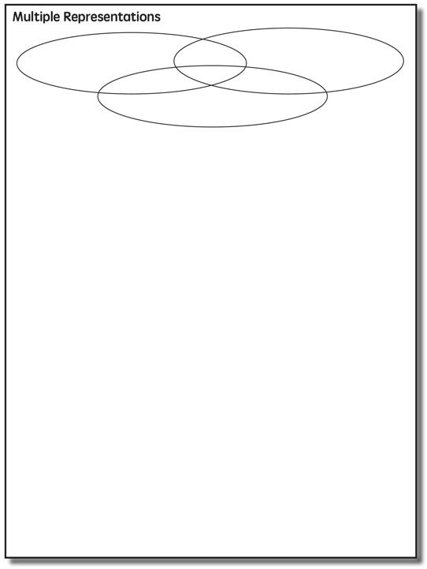

Slide 121
Multiple Representations
Abstract
Pictorial
Concrete

Slide 122
Abstract
Pictorial
Concrete
Three-dimensional objects

Slide 123
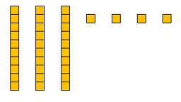
Abstract
Pictorial
Concrete
Two-dimensional images

Slide 124
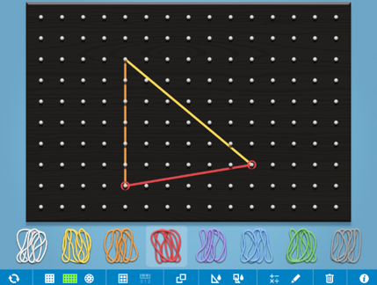
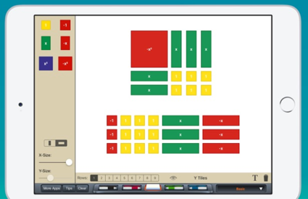
Abstract
Pictorial
Concrete
Two-dimensional images

Slide 125
Abstract
Pictorial
Concrete
Numerals and symbols
2 + 8 = 10
34 = 3 tens and 4 ones
x – 6 = 8
4,179
+ 569

Slide 126
How do you use multiple representations?
Use three-dimensional concrete materials to teach concepts and procedures
Use two-dimensional representations to teach concepts and procedures
Ensure students understand mathematics with numbers and symbols (i.e., the abstract)

Slide 127
Some examples of Multiple Representations

Slide 128
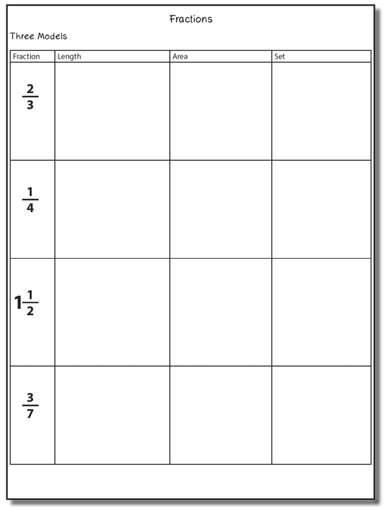

Slide 129
Fraction Models
Length
Area
Set

Slide 130
Length/Measurement
Fractions are appropriated by length
Fraction tiles/bars

Slide 131
Length/Measurement
Fractions are appropriated by length
Cuisenaire rods

Slide 132
Length/Measurement
Fractions are appropriated by length
Number line

Slide 133
Area/Region
Shapes divided into equal sections
Fraction circles

Slide 134
Area/Region
Shapes divided into equal sections
Geoboards

Slide 135
Area/Region
Shapes divided into equal sections
Pattern blocks

Slide 136
Area/Region
Shapes divided into equal sections
Legos

Slide 137
Area/Region
Shapes divided into equal sections
Anglegs

Slide 138
Set/Discrete
Individual shapes match the fraction
Two-color counters

Slide 139
Set/Discrete
Individual shapes match the fraction

Slide 140
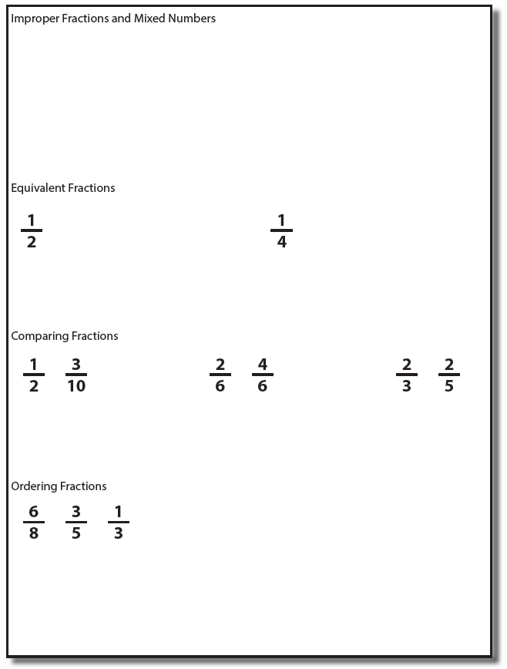

Slide 141
Instructional Platform
INSTRUCTIONAL DELIVERY
Explicit instruction
Precise language
Multiple representations
INSTRUCTIONAL STRATEGIES
Fluency building

Slide 142
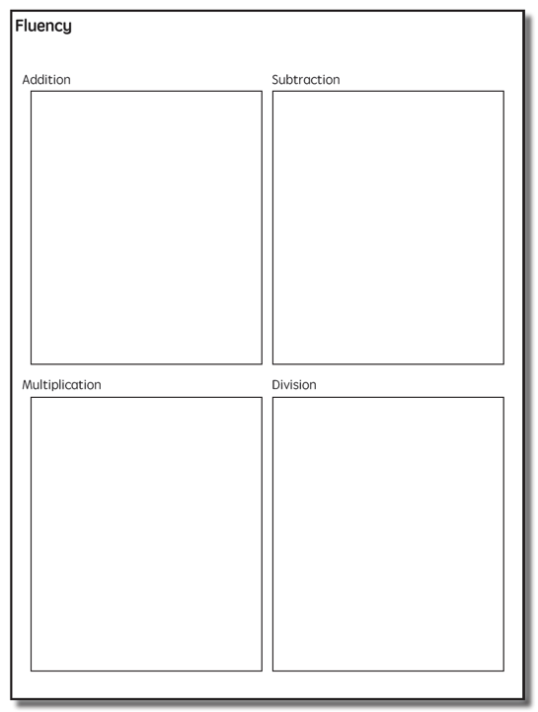

Slide 143
Addition Facts
100 addition basic facts
Single-digit addends sum to a single- or double-digit number
5 (addend)
+ 4 (addend)
9 (sum)

Slide 144
Addition: Part-Part-Whole (Total)
Count one set, count another set, put sets together, count sum
2 + 3 = 5

Slide 145
Addition: Join (Change Increase)
Start with a set, add the other set, count sum
2 + 3 = 5

Slide 146
Why is it important to understand addition in two separate ways?

Slide 147
Total
Parts put together into a total
Freddy saw 4 cardinals and 5 blue jays. How many birds did Freddy see?
4 + 5 = ?
Freddy saw 9 birds. If 4 of the birds were cardinals, how many were blue jays?
4 + ? = 9
Freddy saw 9 birds. 5 of the birds were blue jays, how many were cardinals?
5 + ? = 9

Slide 148
Change
An amount that increases or decreases
Lara had $4. Then she earned $3 for cleaning her room. How much money does Lara have now?
4 + 3 = ?
Lara has $4. Then she earned money for cleaning her room. Now Lara has $7. How much money did she earn?
4 + ? = 7
Lara had some money. Then she made $3 for cleaning her room. Now she has $7. How much money did Lara start with?
? + 3 = 7

Slide 149
Part-Part-Whole Versus Join
3 + 9 = __
7 + 4 = __

Slide 150
Subtraction Facts
100 subtraction basic facts
Subtrahend and difference are single-digit numbers and minuend is single- or double-digit number
16 (minuend)
– 8 (subtrahend)
8 (difference)

Slide 151
Subtraction: Separate (Change Decrease)
Start with a set, take away from that set, count difference
5 – 3 = 2

Slide 152
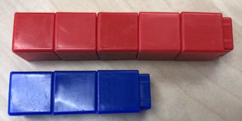
Subtraction: Compare (Difference)
Compare two sets, count difference
5 – 3 = 2

Slide 153
Why is it important to understand subtraction in two separate ways?

Slide 154
Change
An amount that increases or decreases
Melissa had 9 cookies. Then she ate 2 of the cookies. How many cookies does Melissa have now?
9 – 2 = ?
Melissa had 9 cookies. She ate some of the cookies. Now, she has 7 cookies. How many cookies did Melissa eat?
9 – ? = 7
Melissa had some cookies. Then, she ate 2 of the cookies. Now she has 7 cookies left. How many cookies did Melissa have to start with?
? – 2 = 7

Slide 155
Difference
Greater and less amounts compared for a difference
Pedro has 9 apples. Silvia has 4 apples. How many more apples does Pedro have? (How many fewer does Silvia have?)
9 – 4 = ?
Pedro has 5 more apples than Silvia. If Silvia has 4 apples, how many does Pedro have?
? – 4 = 5
Silvia has 5 fewer apples than Pedro. Pedro has 9 apples. How many apples does Silvia have?
9 – ? = 5

Slide 156
Separate Versus Compare
9 – 5 = __
8 – 3 = __

Slide 157
Multiplication Facts
100 multiplication basic facts
Multiplication of single-digit factors results in a single- or double-digit product
2 (factor)
× 3 (factor)
6 (product)

Slide 158
Multiplication: Equal Groups
Show the groups, show the amount for each group, count product
3 × 2 = 6

Slide 159
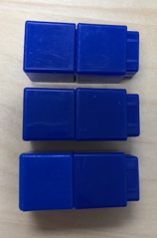
Multiplication: Array/Area
Make the array, count product
3 × 2 = 6

Slide 160
Multiplication: Comparison
Show a set, then multiply the set
3 × 2 = 6

Slide 161
Why is it important to understand multiplication in different ways?

Slide 162
Equal Groups
Groups multiplied by number in each group for a product
Haley has 2 bags of apples. There are 6 apples in each bag. How many apples does Haley have altogether?
2 × 6 = ?
Haley has 12 apples. She wants to share them equally among her 2 friends. How many apples will each friend receive?
2 × ? = 12
Haley has 12 apples. She put them into bags containing 6 apples each. How many bags did Haley use?
? × 6 = 12

Slide 163
Comparison
Set multiplied by a number of times for a product
Beth picked 6 apples. Marcie picked 2 times as many apples as Beth. How many apples did Marcie pick?
6 × 2 = ?

Slide 164
Equal Groups Versus Comparison
6 × 3 = __
4 × 5 = __

Slide 165
Division Facts
90 division basic facts
Divisor and quotient are single-digit numbers and dividend is single- or double-digit number
8 ÷ 4 = 2
(dividend) (divisor) (quotient)

Slide 166
Division: Equal Groups (Partitive Division)
Show the dividend, divide equally among divisor, count quotient
6 ÷ 3 = 2

Slide 167
Division: Equal Groups (Measurement Division)
Show the dividend, make groups of the divisor, count groups
6 ÷ 3 = 2

Slide 168
Why is it important to understand division in different ways?

Slide 169
Equal Groups
Groups multiplied by number in each group for a product
Haley has 2 bags of apples. There are 6 apples in each bag. How many apples does Haley have altogether?
2 × 6 = ?
Haley has 12 apples. She wants to share them equally among her 2 friends. How many apples will each friend receive?
2 × ? = 12
Haley has 12 apples. She put them into bags containing 6 apples each. How many bags did Haley use?
? × 6 = 12

Slide 170
Partitive Versus Measurement
10 ÷ 5 = __
9 ÷ 3 = __

Slide 171
Addition
Subtraction
Multiplication
Division
BRIEF
(1-2 min)
DAILY
(everyday)

Slide 172
Computation

Slide 174
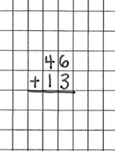
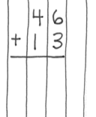
Notation Matters
Work on vertical presentation

Slide 175
Addition and Subtraction
Introduce regrouping/trading/exchanging after mastery of problems without regrouping
10 ones for 1 ten
10 tens for 1 hundred
1 ten for 10 ones
1 hundred for 10 tens
Regroup
Trade
Exchange
Carry
Addition
Regroup
Trade
Exchange
Borrow
Subtraction

Slide 176
Linda
Traditional
Work right to left (start in ones column)

Slide 177
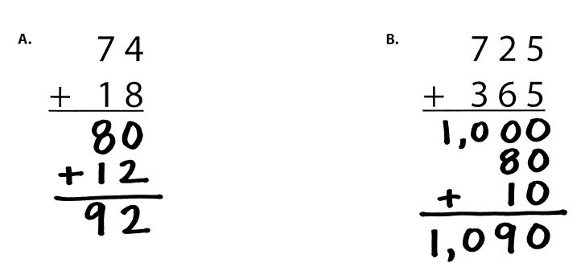
Lluvia
Partial Sums
Work left to right

Slide 178
Jennifer
Opposite Change
Round one number to nearest ten
Amount added is subtracted from other number

Slide 179
Alina
Column Addition
Work left to right

Slide 181
Kimberly
Traditional Method
Work right to left (start in ones column)

Slide 182
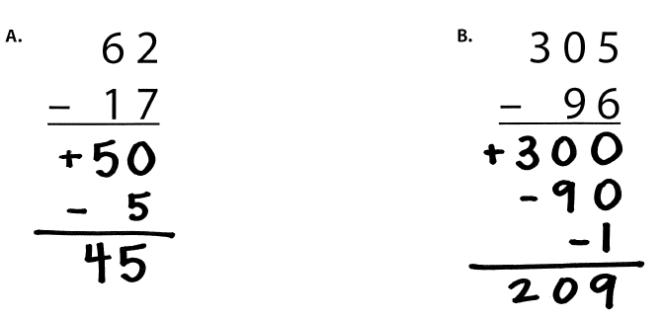
Ricardo
Partial Differences
Work left to right

Slide 183
Tiffiny
Same Change
Change subtrahend to end in 0

Slide 184
Phedra
Add-Up

Slide 187
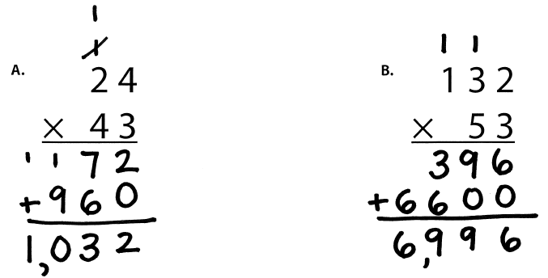
Susan
Traditional
Work right to left (start in ones column)

Slide 188
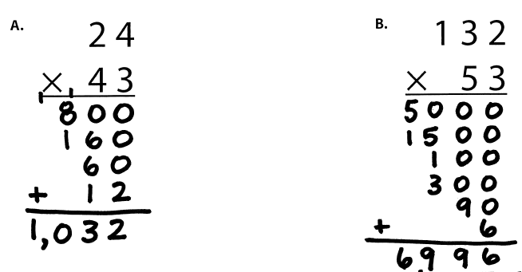
Mary
Partial Products

Slide 189
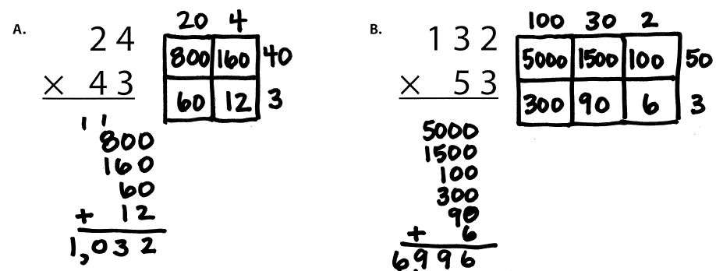
Kathryn
Area

Slide 190
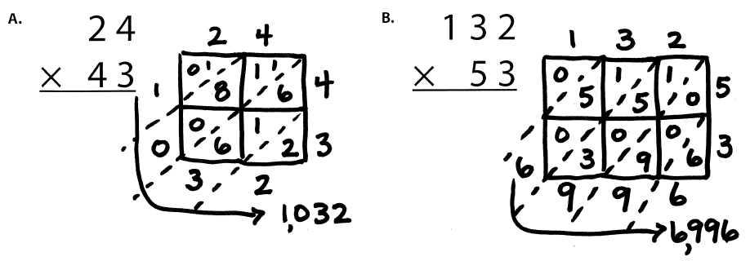
Cynthia
Lattice Method (383 × 27)

Slide 192
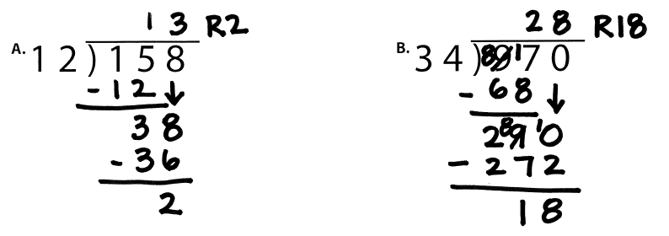
April
Traditional Method
Work Left to Right
Notes:
1. Yellow handouts: Multiplication and division

Slide 193
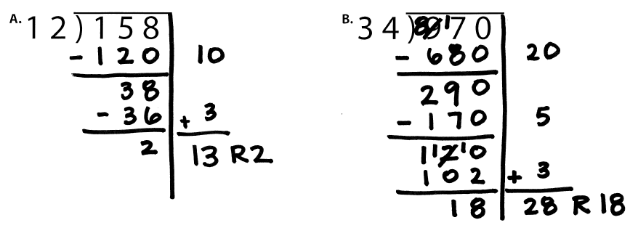
Brian
Partial Quotients

Slide 194
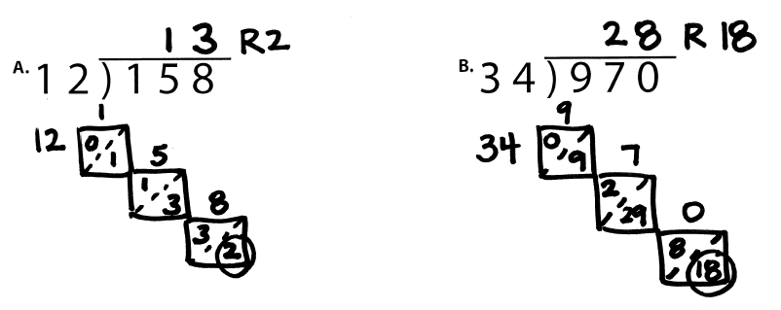
Cheryl
Lattice Division

Slide 195
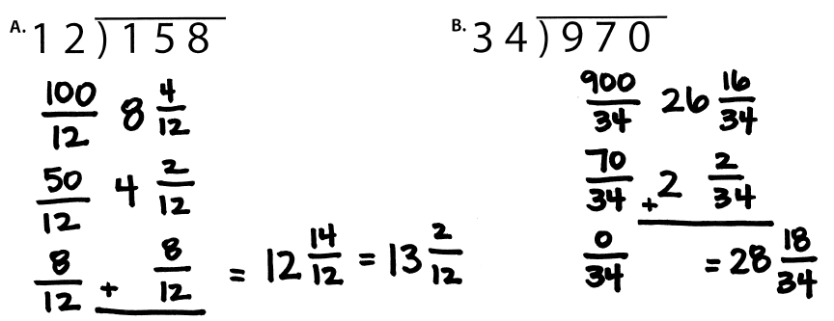
Juanita
Division as Fractions

Slide 197
Instructional Platform
INSTRUCTIONAL DELIVERY
Explicit instruction
Precise language
Multiple representations
INSTRUCTIONAL STRATEGIES
Fluency building
Problem solving instruction

Slide 198
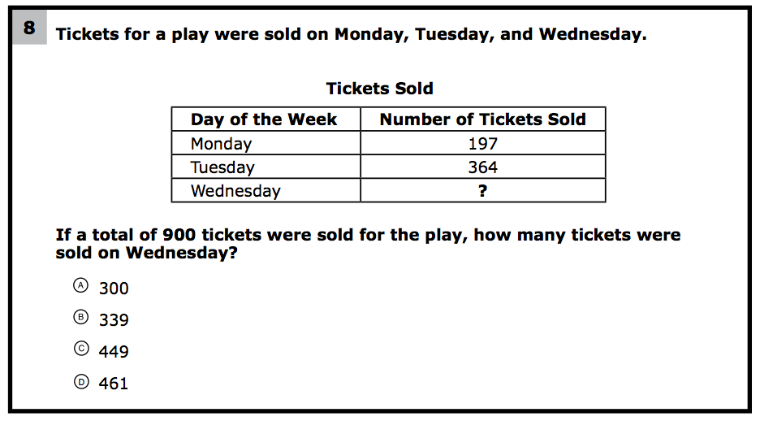
How would you teach this problem?
What do students need to know to solve this problem?
What might cause difficulty for students?

Slide 199
Problem Solving Difficulties
Reading problems
Understanding vocabulary
Identifying relevant information
Ignoring irrelevant information
Interpreting charts and graphs
Identifying appropriate operation(s)
Performing the computation(s)

Slide 201
Don’t tie key words to operations
Do have an attack strategy
Do teach word-problem schemas

Slide 202
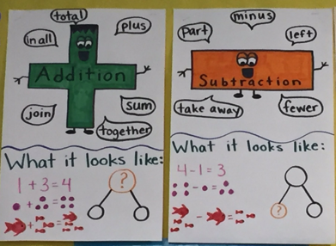
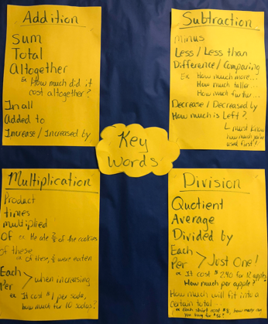

Slide 204
Students need to understand key words. But, key words should not be directly tied to operations.

Slide 207
Don’t tie key words to operations
Do have an attack strategy
Do teach word-problem schemas

Slide 208
For every word problem
Regardless of problem type, students need an attack strategy for working through the problem
This strategy should work for any problem type
Routine Word Problems
Instructional Word Problems

Slide 209
RIDGES
Read the problem.
I know statement.
Draw a picture.
Goal statement.
Equation development.
Solve the equation.
RIDE
Read the problem.
Identify the relevant information.
Determine the operation and unit for the answer.
Enter the correct numbers and calculate, then check the answer.

Slide 211
SIGNS
Survey questions
Identify key words
Graphically draw problem
Note operations
Solve and check
SOLVE
Study the problem.
Organize the facts.
Line up the plan.
Verify the plan with computation.
Examine the answer.

Slide 212
R-CUBES
Read the problem.
Circle key numbers.
Underline the question.
Box action words.
Evaluate steps.
Solve and check.

Slide 214
Don’t tie key words to operations
Do have an attack strategy
Do teach word-problem schemas

Slide 215
Schemas
Total
Difference
Change
Equal Groups
Comparison
Ratios/Proportions

Slide 216
Additive Schemas

Slide 217
Instruction Using Schemas
A schema refers to the structure of the word problem
Total
Difference
Change

Slide 219
Total
Parts put together into a total
Jennifer saw 4 cardinals and 5 blue jays. How many birds did Jennifer see?
4 + 5 = ?
Jennifer saw 9 birds. If 4 of the birds were cardinals, how many were blue jays?
4 + ? = 9
Jennifer saw 9 birds. 5 of the birds were blue jays, how many were cardinals?
5 + ? = 9

Slide 220
Total
“Are parts put together for a total?”

Slide 221
Total
P1 + P2 = T
Fuchs et al. (2008); Griffin & Jitendra (2009)

Slide 222
Total

Slide 223
Total
✔
✔
✔
P1 + P2 = T
U
P
S
✔
✔
28
+
24
=
?
✔
✔
28 + 24 = 52
X = 52 cookies
Grade 3 Smarter Balanced

Slide 224
Total
✔
✔
12
11
+ 1
12
12
- 11
1
✔
U
P
S
✔
✔
11
?
✔
✔
? = 1 millimeter
Grade 2 IXL

Slide 226
Difference
Greater and less amounts compared for a difference
Courtney has 9 apples. Silva has 4 apples. How many more apples does Courtney have? (How many fewer?)
9 – 4 = ?
Courtney has 5 more apples than Silva. If Silva has 4 apples, how many does Courtney have?
? – 4 = 5
Silva has 5 fewer apples than Courtney. Courtney has 9 apples. How many apples does Silva have?
9 – ? = 5

Slide 227
Total
“Are parts put together for a total?”
Difference
“Are amounts compared for a difference?”

Slide 228
Difference
G – L = D
Fuchs et al. (2008); Griffin & Jitendra (2009)

Slide 229
Difference

Slide 230
Difference
✔
✔
G – L = D
✔
U
P
S
✔
✔
107
-
68
=
B
107
68
68
+ ?
107
✔
✔
107 – 68 = 39
B = 39 more beads
Grade 3 Smarter Balanced

Slide 231
Difference

Slide 233
Change
An amount that increases or decreases
Sandra had $4. Then she earned $3 for cleaning her room. How much money does Sandra have now?
4 + 3 = ?
Sandra has $4. Then she earned money for cleaning her room. Now Sandra has $7. How much money did she earn?
4 + ? = 7
Sandra had some money. Then she made $3 for cleaning her room. Now she has $7. How much money did Sandra start with?
? + 3 = 7

Slide 234
Total
“Are parts put together for a total?”
Difference
“Are amounts compared for a difference?”
Change
“Does an amount increase or decrease?”

Slide 235
Change
ST +/– C = E
Fuchs et al. (2008); Griffin & Jitendra (2009)

Slide 236
Change

Slide 237
Change
✔
A bus had 13 passengers. At the next stop, more passengers got on the bus. Now, there are 28 passengers. How many passengers got on the bus?
✔
✔
U
P
S
✔
ST + C = E
✔
13
+
?
=
28
✔
28
- 13
✔
13
+ ?
28
13 + 15 = 28
? = 15 passengers

Slide 238
Change
An amount that increases or decreases
Yolanda baked 9 cookies. Then, she ate 2 of the cookies. How many cookies does Yolanda have now?
9 – 2 = ?
Yolanda baked 9 cookies. Then, she ate some of the cookies. Now, she has 7 cookies. How many cookies did Yolanda eat?
9 – ? = 7
Yolanda baked some cookies. She ate 2 of the cookies and has 7 cookies left. How many cookies did Yolanda bake?
? – 2 = 7

Slide 239
Change
ST +/– C = E
Fuchs et al. (2008); Griffin & Jitendra (2009)

Slide 240
Change

Slide 242
Total

Slide 243
Change

Slide 244
Difference

Slide 245
Total
P1 + P2 + P3 = T

Slide 246
Change
ST – C + C = E

Slide 247
Let’s Review
What’s a Total problem?
What’s a Difference problem?
What’s a Change problem?

Slide 248
Schema Quiz Time!

Slide 249
Difference
Grade 3 STAAR

Slide 250
Total
Grade 5 Smarter Balanced

Slide 251
Change
Grade 4 Smarted Balanced

Slide 252
Don’t tie key words to operations
Do have an attack strategy
Do teach word-problem schemas

Slide 253
Multiplicative Schemas

Slide 255
Equal Groups
Groups multiplied by number in each group for a product
Kristina has 2 bags of apples. There are 6 apples in each bag. How many apples does Kristina have altogether?
2 × 6 = ?
Kristina has 12 apples. She wants to share them equally among her 2 friends. How many apples will each friend receive?
2 × ? = 12
Kristina has 12 apples. She put them into bags containing 6 apples each. How many bags did Kristina use?
? × 6 = 12

Slide 256
Equal Groups
“Are there groups with an equal number in each group?”

Slide 257
Equal Groups
G × N = P

Slide 259
Equal Groups
✔
✔
✔
G x N = P
U
P
S
✔
✔
x
=
6
25
?
✔
✔
6 x 25 = 150
? = 150 cherries

Slide 260
Equal Groups
✔
✔
✔
U
P
S
✔
✔
?
4
24
✔
✔
? x 4 = 24
4
4
Grade 3 STAAR
? = 6 packs

Slide 261
Comparison
Set multiplied by a number of times for a product
Marcie picked 6 apples. Lisa picked 2 times as many apples as Marcie. How many apples did Lisa pick?
6 × 2 = ?
Lisa picked 12 apples. She picked 2 times as many apples as Marcie. How many apples did Marcie pick?
? × 2 = 12
Lisa picked 12 apples, and Marcie picked 6 apples. How many times as many apples did Lisa pick as Marcie did?
6 × ? = 12

Slide 262
Equal Groups
“Are there groups with an equal number in each group?”
Comparison
“Is a set compared a number of times?”

Slide 263
Comparison
S × T = P

Slide 265
Comparison
✔
U
P
S
✔
6
2
?
✔
✔
✔
Grade 4 Smarter Balanced
? = 12 dinosaurs

Slide 266
Comparison

Slide 267
Ratios/Proportions
Description of relations among quantities
A bricklayer laid 92 bricks in 2 hours. At this rate, how many bricks could be laid in 10 hours?
One box of crayons costs $2.49. How much do 7 boxes of crayons cost?

Slide 268
Equal Groups
“Are there groups with an equal number in each group?”
Comparison
“Is a set compared a number of times?”
Ratios/Proportions
“Are there relationships among quantities - if this, then this?”

Slide 269
Ratios/Proportions
Xin et al. (2005)

Slide 271
Ratios/Proportions
✔
✔
✔
✔
U
P
S
✔
✔
176
?
? = 110 slices
✔
✔
8
5

Slide 272
Ratios/Proportions

Slide 274
Equal Groups

Slide 275
Ratios/Proportions

Slide 276
Comparison
Grade 4 Smarter Balanced

Slide 277
Let’s Review
What’s an Equal Groups problem?
What’s a Comparison problem?
What’s a Ratios/Proportions problem?

Slide 278
Schema Quiz Time!

Slide 279
Ratios/Proportions
Grade 6 Smarter Balanced

Slide 280
Equal Groups
Grade 4 PARCC

Slide 281
Comparison
Grade 4 Smarter Balanced

Slide 282
Schemas
Total
Difference
Change
Equal Groups
Comparison
Ratios/Proportions

Slide 283
Don’t tie key words to operations
Do have an attack strategy
Do teach word-problem schemas

Slide 284
How do you incorporate effective problem-solving strategies within intensive intervention?
Don’t use key words tied to operations
Do teach students an attack strategy
Do teach students schemas
Do explicitly teach problem solving
Do provide problem-solving instruction regularly (i.e., several times a week)
Do practice schemas that students will encounter regularly

Slide 285
Instructional Platform
INSTRUCTIONAL DELIVERY
Explicit instruction
Precise language
Multiple representations
INSTRUCTIONAL STRATEGIES
Fluency building
Problem solving instruction

Slide 286
srpowell@austin.utexas.edu
@sarahpowellphd
119

