Slide 1
Chapter 9- A New Republic
Section 1

Slide 2
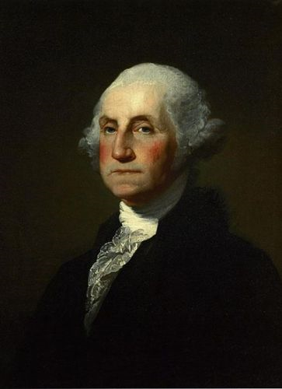
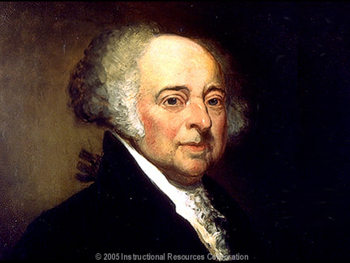
Washington’s Presidency
1789- George Washington inaugurated
Officially sworn in as president
Capital city: New York
Vice President =
John Adams
Precedents=
Examples that become standard practice

Slide 3
Washington’s Precedents
What do you call the President?
“His Excellency”?
“His Majesty the President”?
“His Highness”?
“His High Mightiness, the President of the United States and Protector of their Liberties” ?
“Mr. President”
Cabinet=
group of department heads that serve as a president’s chief advisers

Slide 4
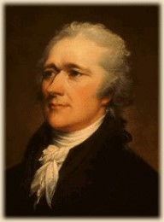
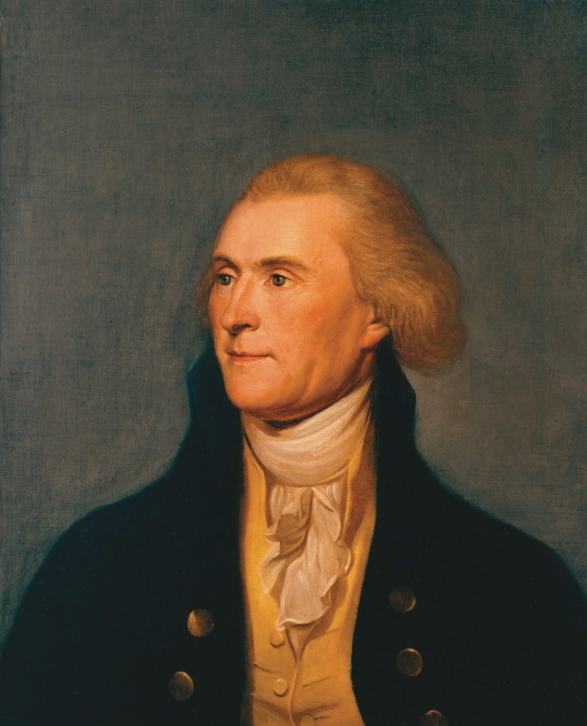
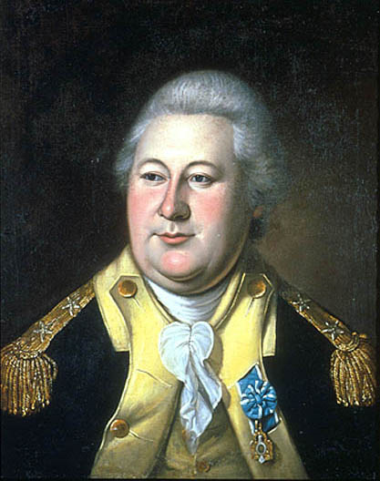
Washington’s Cabinet
Secretary of State
Thomas Jefferson
Dealt with relations with other countries
Secretary of War
Henry Knox
In charge of national defense
Secretary of Treasury
Alexander Hamilton
In charge of nation’s economy
Attorney General
Advise government on legal matters
Edmund Randolph

Slide 5
The Nations finances
War Debts = $52 million
Alexander Hamilton
Believed in a strong central government
Stronger than States
3 Step plan to improve finances

Slide 6
Step 1: Repay War Debts
Including states’ debts
Southern states object
They already paid most of their debts
Compromise: Pay off all states’ debts
And capital would be located in the South
Washington, D.C.

Slide 7
Step 2: Raise Govt. Revenues
Tariffs
Taxes on imported goods (from overseas)
$$$ for government
Made foreign goods more expensive
Buy American goods instead
Step 3: Create a National Bank
Issue money, make loans
Strengthen national Govt.
Not in Constitution
Opposed by Jefferson (and others)
Established 1791

