Slide 1
COMMUNICATION & SOCIAL MEDIA

Slide 2
To Do
Sign in
Agenda, feedback, “Fresh Ideas”

Slide 3
CONNECT!
Check In
“Like” or follow
Post or Tweet
#MCCPTAFallTraining
Tag @MCC_PTA
Pix!

Slide 4
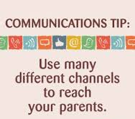
Game Time!

Slide 9
We Did It!

Slide 10
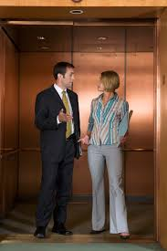
30-Seconds to YES!

Slide 12
#WhatsYourMessage?

Slide 13
Don’t Forget It!

