Slide 1
2024 Gulf Coast Odyssey of the Mind Regional Tournaments
T.E. Weightman Middle School
March 2, 2024
Ready? Set? Compete!
Notes:
Page 17

Slide 2


Slide 3
THE DISTRICT REQUIRED FORM
All Pasco County Public Schools teams must have it in order to compete
one per team member
complete with all signatures
You should have turned it in by January 15; if not, you have until Feb. 20 to do so: text, email, courier, snail mail, etc.

Slide 4
What the well-prepared coach needs to know:
To get team forms go to www.odysseyofthemind.com and log into the members area (under the team tab) using your membership number and school zip code.
To get regional tournament information, go to www.gcodyssey.com.

Slide 5
What the well-prepared coach needs to know:
Paperwork – 4 copies of everything (2 sets)
Outside assistance form will be compared to online registration roster.
Division 1: coach can scribe paperwork.
Division 2 & 3: kids have to complete it on their own.

Slide 6
STYLE FORM
Form MUST match the categories given in the problem.
Form MUST specify the aspect being scored.
Example: “Creative use of a trash item” may be how it’s written in the problem.
On the form the team may write: “Creative use of coffee grounds.”
Be specific in free choice items. “ Backdrop” would include front, back, top, and bottom, and all scene changes.

Slide 7
FORMS
Team lists for ALL problems – copies available online at national site (and here tonight).
Teams need at least 4 copies of the team list to turn in at staging – again, BE SPECIFIC.

Slide 8
What the well-prepared coach needs to know:
Volunteer Assignment – ON THE WEBSITE BY FEB. 20 – CHECK IT!
If you have to change the worker, you can. We don’t need to know. Make sure the new person is of the same category as the original: adults only can be door monitor, strong for trailer packing, etc.
Tell whoever is now serving the shift the name of the original worker, so they can check in as that person.
SOMEONE has to fulfill the assignment, or the team receives the penalty.

Slide 9
What the well-prepared coach needs to know:
The hospitality room is your escape zone. No kids allowed. It will have bottled water and cookies for COACHES ONLY.

Slide 10
THE TOURNAMENT
Sign Colors
P1: DRIVE-IN MOVIE (Red)
P2: AI TECH-NO-ART (Purple)
P3: OPENING NIGHT ANTICS (Yellow)
P4: DEEP SPACE STRUCTURE (Green)
P5: ROCKING WORLD DETOUR (Blue)
P6: Primary: THE NIGHT LIFE (Orange)
Spontaneous
Bathrooms & Info (Tan)

Slide 12
Not Allowed at Tournament
No confetti of any kind
Streamers would be allowed in LT performance sites ONLY and have to be the type that stay connected to a main anchor, or can be easily cleaned up without delay
Silly String or other similar products
Strobe lights or Flashing Lights

Slide 13
Not Allowed at Tournament
Weapons of any kind
OM program guide states that if a team thinks their "weapon" is "fake" enough they can contact the Tournament Director for a ruling.
The guide also states that the rules and regulations of the tournament Site trumps the program guide.
A picture of the fake weapon will need to be provided to your RD so that the RD can in turn provide it to the State Problem Captain and the Tournament Director for PRE APPROVAL in writing.

Slide 14
THE TOURNAMENT
FINAL SCHEDULE IS IN YOUR HANDS.
All scheduling issues that were listed online on the team registration BY JANUARY 15 were honored if they involved coaches seeing their kids on other teams or other issues.
If you’re coaching multiple teams, the long-term time of one team may conflict with the spontaneous time of your other team. You need an adult helper (co-coach or parent).

Slide 15
THE TOURNAMENT
PLEASE Make sure your families know when, where to meet you. (See example form – LAST PAGE in the packet.)
Make sure they have your cell phone number.
Make sure they know that if they are late, they may miss their child’s long-term performance.

Slide 16
NEW STUFF (sort of)
PROGRAMS: Each team is getting 3 programs.
State tournament is at Orange County Convention Center, and it’s on Easter Weekend and our spring break: March 30.
Those going to state are listed in packet.
State will cost $250 for Problems 1-5, $100 for primary.
Alumni (HS seniors +) – NEW Cords and ribbons

Slide 17
Notes:
page14

Slide 18
THE TOURNAMENT
COACH CHECK-IN PROCEDURES (in the packet)
Coach will pick up colored “Coach Contact Card.”
Coach will complete the card by providing phone number(s) which can be used that day to contact the team in case…
Coach will exchange the card for the team’s registration packet.
Notes:
Page 13

Slide 19
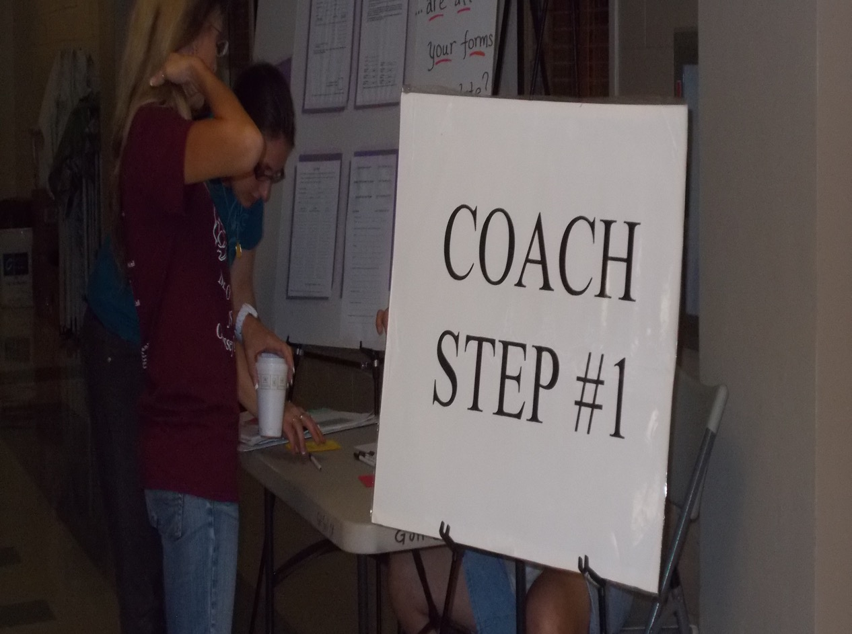

Slide 20
THE TOURNAMENT
Coach check-in opens at 7:00am. It stays open until 2:00pm in the CAFETERIA.
Where you check in is also known as Information, Lost & Found, First Aid, Source of All Answers, etc.
PLEASE SHARE THE INFORMATION IN THE REGISTRATION PACKET WITH YOUR TEAM AND FAMILIES.

Slide 21
TEAM CONTACT BOARD
Check it often
If we have to reach you for score changes, worker no-shows, lost items, etc., we will put it on the board and try the phone number you left at registration, BUT
IT IS THE TEAM’S RESPONSIBILITY TO CHECK THE BOARD OFTEN.

Slide 22
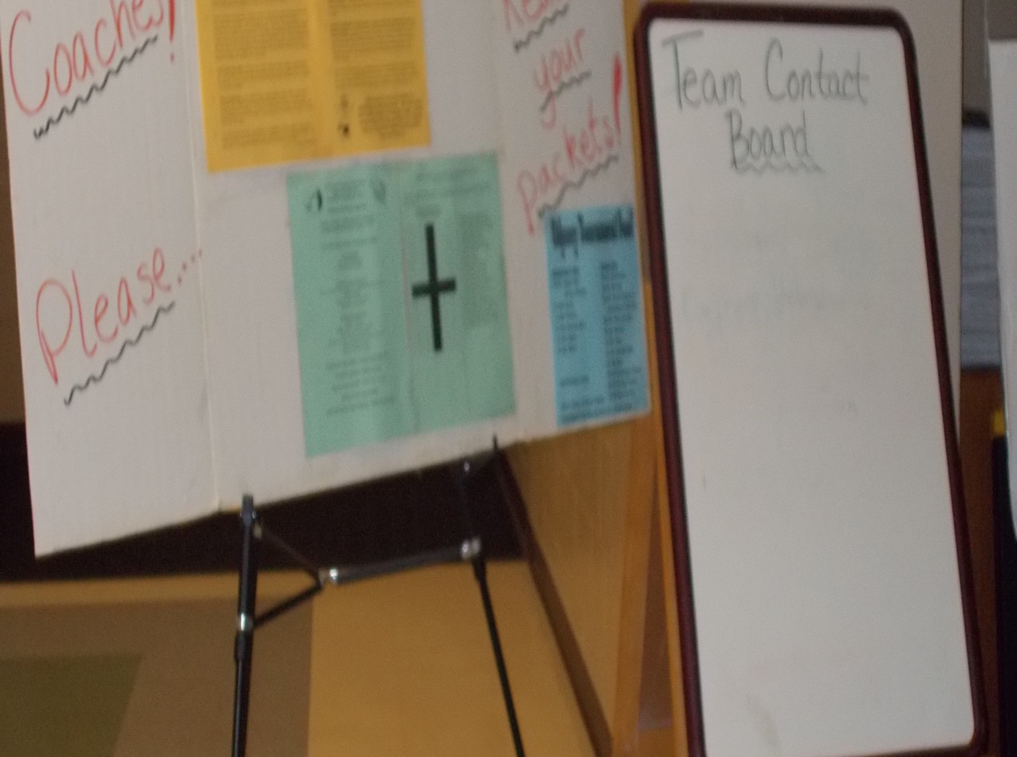

Slide 23
THE TOURNAMENT
Report to spontaneous 15 minutes before your scheduled time. Complete the colored “Spontaneous” Card from your registration packet with the names of the kids on your team. Turn in the card when you check into spontaneous. Coaches can complete the card.
TAKE THEIR CELL PHONES & HOLD THEM TILL THEY’RE OUT OF SPONTANEOUS.

Slide 24
THE TOURNAMENT
Report to long term CHECK IN area 15-20 minutes before your scheduled performance time.
Keep quiet and let the kids answer the questions. SPEAK ONLY IF SPOKEN TO.
Have a team captain who handles the paperwork.
TAKE THEIR CELL PHONES & TURN THEM OFF. TURN YOURS TO SILENT.

Slide 25
THE TOURNAMENT
Adults can help carry props, but they CAN’T adjust them, straighten them, fix them, assemble them, talk about them, etc.
As a coach, you have reserved seats. It’s so the judging team can watch you for outside assistance.

Slide 26
THE TOURNAMENT
Go over the procedures with the kids (in the packet).
Make sure they know what to expect. Practice set up from different directions.
When the performance is over, the judging team will talk to THEM. Stay away until the judges say it’s okay to help them clear away their stuff.
The judges will give each team member a participation pin OR give you a set to give to them. If a team member is absent, ask for a pin for him/her.

Slide 27
SCORES
Check back for your RAW long-term scores in 30 to 60 minutes. Morning performances usually mean waiting an hour or more for scores. Later performances mean the scores are ready sooner.
Share the scores with the kids. You will get RAW style and long-term scores.
If THEY have questions/concerns about the scores, you have 30 minutes to return to the site and discuss those concerns with the HEAD JUDGE ONLY.
Notes:
Page 10

Slide 28
SCORES
Check your raw score for mathematical errors. If the element was worth 0 or 5, you can’t earn 2.5 points. It’s either 0 OR 5.
Subjective scores are NOT debatable.
Raw scores are neither good nor bad. They are relative to all other scores in that problem and division.

Slide 29
SCORES
IF THE TEAM doesn’t understand a score or why they earned a zero for something, you need to keep asking until you can explain it to them.
If the judging team didn’t see it, IT DIDN’T HAPPEN. Even if you have video proof that shows otherwise, we won’t view it. All scored items need to be undeniably noticeable so that the judges see it.
If you need to take something to TRIBUNAL STAGE, make sure you do it FOR THE TEAM.
Notes:
Page 15-16

Slide 30
SCORES
YOU WILL ONLY TALK TO THE HEAD JUDGE ABOUT SCORE CONCERNS
YOU WILL FIND FREDA IF YOU HAVE CONCERNS ABOUT YOUR SCORE AND YOU DON’T THINK THE HEAD JUDGE HAS HEARD YOU. ASK FOR A TRIBUNAL.
YOU WILL NEVER, EVER RAISE YOUR VOICE OR “LOSE IT” WITH OUR JUDGES.

Slide 31
SCORES
IF YOU DON’T GO BACK AND PICK UP YOUR TEAM’S SCORES, YOU FORFEIT THE RIGHT TO APPEAL A MISTAKE.
MISTAKES CAN BE FIXED UNTIL THE JUDGING TEAM IS RELEASED.
THE JUDGING TEAM IS RELEASED ONE HOUR AFTER THE LAST TEAM PERFORMS IN THAT GROUP – SOMETIMES SOONER.

Slide 32
SCORING
Remember raw scores are all you know until AFTER the awards ceremony. Don’t prejudge the team’s chances of going to state. Often the winners of the long-term portion don’t go to state.
PLEASE MAKE SURE YOUR FAMILIES UNDERSTAND THE SCORING SYSTEM.

Slide 33
THE TOURNAMENT
When not competing, teams should attend other performances to root for school mates, check out the competition, check out the site, or just to find examples of creativity.
Good sportsmanship is RULE #1.
No booing, no distractions, no food in the competition rooms, no playing in off-limits areas, no litter

Slide 34
THE TOURNAMENT
Food and souvenirs sales will continue all day until 3:00pm approximately.
Find your own space for prop storage.
Parking is LIMITED, so make sure vehicles are in parking spaces only.
No grills allowed; E-Z ups, chairs, okay, BUT ONLY IN DESIGNATED AREAS. No canopies in center of school or next to buildings.
It’s school property: no alcohol, tobacco

Slide 35
THE TOURNAMENT
SET UP IN THE DESIGNATED GRASSY AREAS OR CAFETERIA.
DO NOT set up on sidewalks or in the center commons grass.
DO NOT set up against any building.
Think about traffic flow and courtesy!

Slide 36
TRASH
If you “camp,” take care of trash by bagging it up.
DO NOT LEAVE BACKDROPS AND LARGE CARDBOARD PROPS AT SCHOOLS. TAKE THEM HOME AND DISPOSE OF THEM.

Slide 37
DANCE PARTY
Socializing and dancing in the gym – prior to awards (45 minutes)
Lots of fun!!!!! – ALL DAY
Bounce Houses
OMER’S FEST - GAMES

Slide 38
PRIMARY AWARDS!!!!
2:00 pm in commons
Ribbons, recognitions, and drawing to see which team goes to state
Then primary teams and their families can depart.
If any stay for full awards ceremony, they sit in the stands.

Slide 39
THE MAIN AWARDS CEREMONY
PLEASE MAKE SURE YOU BRING THE TEAM TO THE AWARDS CEREMONY.
Awards Ceremony is in the gym.
Awards Ceremony starts by 4:30 and lasts two hours.
FULL AWARDS CEREMONY INSTRUCTIONS WILL BE IN TEAM REGISTRATION PACKET.
Coaches going to state meet for 30 minutes after awards in media.
Teams and families going to state meet for 30 minutes after awards in the gym.

Slide 40
THE MAIN AWARDS CEREMONY
MEMBERSHIP BANNER FOR AWARDS CEREMONY – details in the packet
This is NOT the same as your team’s membership sign.
ONE membership banner for the entire membership – talk to your coordinator.
Choose two banner carriers – team members
Notes:
Page 12

Slide 41
THE MAIN AWARDS CEREMONY
Banner carriers line up at 4:00 pm
Parade of champions is just banner carriers.
Scholarships awarded and thank you’s.
Teams and coaches sit on floor of gym in assigned areas (in registration packet)
Parents sit in stands

Slide 42
THE MAIN AWARDS CEREMONY
See chart for who goes to state in each division (Split divisions are totals, so ties can alter the split).
State tournament is MARCH 30 at OCCC in Orlando.
Teams must meet the spirit of the problem to go to next level.
ALL RANATRA FUSCA WINNERS GO TO STATE.
OMER Awards are for really special behavior; not all are read at ceremony, but are passed on to recipient (due by 1:00 pm day of tournament). What you write is what I read to the audience.
Notes:
Page 18

Slide 43
In the next few weeks…
Practice spontaneous.
Read the problem.
Self-score.
Choose Style.
Read the Problem.
Practice spontaneous.
Check for Spirit of the Problem issues!

Slide 44
In the next few weeks…
what if game
what if box
check list
Invite others to the competition.
Encourage the team.
Thank your judge, worker, coordinator.
Schedule the celebration now.

Slide 45
In the next few weeks…
MEET WITH THE FAMILIES:
PARKING ISSUES
WHERE TO MEET
WHAT TO DO AND WHAT NOT TO DO
EXPLAIN SCORING AND GOING ON TO STATE PROCEDURE.
TELL THEM ABOUT WEBSITE: WWW.GCODYSSEY.COM.

Slide 46

Coaching Tips
COACHING TIPS
INSIST THEY READ THE PROBLEM, then RE-READ THE PROBLEM
If You Start Me Up
The Timekeeper will ask the team, “Team, are you ready?”
Many (especially experienced) teams come up with a clever response
What Setup Time?
Don’t make the mistake of neglecting to figure in set-up time.
What happens if something goes wrong during setup?
Who handles what tasks during setup?
Is it better to have a complicated setup, or a simple setup and more performance time?
Is there something someone can do during setup to start the performance?
Time does not stop if the team encounters a problem (except for medical emergencies).

Slide 47
Coaching Tips
COACHING TIPS
INSIST THEY READ THE PROBLEM, then RE-READ THE PROBLEM
Wrapping it Up:
In some (not all) problems, the team needs to signal the Judges that the performance is over. Overtime penalties….
Like the beginning, the end is important. Experienced teams find a “creative” way.
Tell it to the Judge!
After the performance ends, the judges will talk to the team and ask them questions about their solution.
This is a part of the the solution. Let the team know to expect it and practice it with them.
Don’t forget the Membership Sign… Contingency Plan!

Slide 48
OOTM Recognition
Odyssey of the Mind Recognition
OMER’s Award
In recognition of teams or individuals who demonstrate
outstanding sportsmanship, exemplary behavior, and exceptional talent
Ranatra Fusca
presented to teams or individuals who exhibit
exceptional creativity, either through some aspect of their
problem solution, or an extraordinary idea
beyond the problem solution
Tournament Placement
determined by total score
Ties are awarded if there is
less than 1 point difference

Slide 49
In the next few weeks…
DISCUSS WITH THE TEAM AND FAMILIES THE POSSIBILITY OF GOING TO WORLD FINALS:
Costs – at least $1000 per person
Time – conflicts with graduation or end of year events (May 21-24 in IOWA)
Decide if you will accept or turn down the invitation to Worlds if you earn it, so state can offer it to the next in line that night if applicable.

Slide 50
GOOD LUCK! BE CREATIVE! SEE YOU SOON!
Freda’s Contact info:
813-924-0850, cell fabercro@pasco.k12.fl.us

