Slide 1
Delegates Assembly April 27, 2021

Slide 2
Start Ups
7:00 pm WELCOME, PTA MISSION
7:05 pm INFORMATIONAL UPDATES
National/MDPTA Update
See Folder!!

Slide 3
National PTA Updates
National PTA
March 26 – National pulled the charter of the MDPTA.
MDPTA is still a corporation under the Maryland Secretary of State so may still “conduct business.”
MDPTA is no longer allowed to “conduct business” using the PTA trademark, name, brand, resources, etc.
National did send a “cease and desist” letter.
National is in process of determining assets, resources, etc.
March 31 – National held 2 zoom meetings with Maryland PTA leaders across the state.
Local units should still follow their approved bylaws.
Local units should remit any dues directly to National PTA (not using Memberhub feature).
National is in process of establishing new State Organization.
National and Councils will support local units in interim.

Slide 4
WHAT DOES THIS MEAN FOR PTAs
PER NATIONAL, FOLLOW YOUR BYLAWS
FAQs – (details in folder)
Bylaws Need Amending? Go ahead, pass the changes, and send amended bylaws to National mdpta@pta.org
Compliance Documents (990, etc.) – FILE THOSE DOCS and send copies to National Support Team mdpta@pta.org
Dues -- Use National Transmission form and mail $4.25 per member (any you haven’t yet paid) to National PTA and $1 per member to MCCPTA.
MemberHub – It’s available (MemberHub is aware of issues) just don’t pay your National/State Dues through it
Reflections – We are still working through mechanics – aiming to celebrate students this summer!
Financials -- Pass a summer budget and conduct your financial reviews (after June 30), as required
Elections – Yes, hold them! (FAQ on elections in later slide)

Slide 5
Election of 2021-2022 MCCPTA Officers
MCCPTA Bylaws – Article VI: Officers and Their Election
Section 1 – Officers to be elected.
Section 2 – Elected at General Membership Meeting in April.
Section 3 – “Officers shall be elected by ballot; however, if there is only one nominee for any office, election for that office may be by voice vote.”
Section 4 – Requirements to be eligible outlined, term of office (and limit of 3 terms in the same office).
Section 5 – Removal from office.
Section 6 – Vacancies.
Section 7 -- Nominating Committee shall be 7 members from designated areas, serve for a year until the next nominating committee is selected, nominates the slate (one candidate) for each office, send the list and qualifications to the members and delegates, presents to the MCCPTA BOD, Presidents and Delegates the list of individual who plan to run from the floor.

Slide 6
Members of 2021-2022 NomCom
Kristen Carter (CLARKSBURG/NORTHWEST/QUINCE ORCHARD/SENECA VALLEY)
Maggie Conley (BLAKE/PAINT BRANCH/SPRINGBROOK/SHERWOOD)
Kristin Erdheim (DAMASCUS/GAITHERSBURG/MAGRUDER/ WATKINS MILL)
Miguel Mitchell (DCC)
Debby Orsak (BETHESDA CHEVY CHASE/WALTER JOHNSON/ WHITMAN)
Kellie Schoolar-Reynolds (AT-LARGE)
Jennifer Young (CHURCHILL/RM/POOLESVILLE/ROCKVILLE/ WOOTTON)

Slide 7
Slate of Candidates 2021-2022
Presented 30 days before election:
President – Cynthia Simonson
Vice President of Educational Issues – Rodney Peele
Vice President of Administration – Rochelle Fink
Vice President of Programs – Charisse Scott
Vice President of Advocacy – Laura Mitchell
Recording Secretary for Delegates Assembly – Tammy Fox
Treasurer – Francesco Paganini
Running from the Floor:
Recording Secretary for Board of Directors – Tangela Wilson

Slide 8
Local Unit Elections FAQs
FOLLOW YOUR BYLAWS!!!
FAQs
Volunteers – Can’t find enough people to fill the roles?
Nominating Committee Role – who selects?
Just officers? Whole Board? Delegates?
Can we require people to announce beforehand they are going to run from floor?
No Membership – Never held a membership drive so no members to qualify as officers…
Voting Procedures – How to do this?
Voting Virtually (allowed)
Voting in Person (allowed)
Most votes vs. Majority of votes
Reporting the vote!!
Designate an individual (Secretary is great) to populate “Blue Book” to access elists, trainings, etc. -- http://tiny.cc/2021bluebook

Slide 9
AVP and Cluster Coordinator Elections
MCCPTA Area Vice Presidents
Elections –
Nominating Committee member overseeing this Area will convene and chair convening at least 6 PTA Presidents (or designee) and/or Cluster Coordinators to select a AVP.
AVP Responsibilities –
Extend PTA Work of the PTAs in the Area, assist with Training PTA Leaders, organize new PTAs in area, coordinate work of Cluster Coordinators.
Work on special initiatives with countywide implications (e.g., Honors for All, PSAT Communications, Principal Selection procedures, etc.)
MCCPTA Cluster Coordinator
Elections –
A majority of the PTA Presidents (or their designee) for the Cluster must meet and by majority vote, approve the Cluster Coordinators.
Each Cluster may have up to 3 Cluster Coordinators representing the Cluster on the MCCPTA Board
Cluster Coordinator Responsibilities --
Provide support to PTAs struggling to meet 501c3 requirements (compliance)
Act as a resource for questions that come up
Solicit information from PTA Presidents and Principals for Capital Improvement Program (CIP) budget and Operating Budget
Serve as a liaison to the local PTAs on MCCPTA advocacy priorities and initiatives
Help shape MCCPTA priorities and initiatives – serve on committees, approve committee Work Plans, etc.

Slide 10
Training Needs Discussion
Where you think MCCPTA should focus training this summer/fall?

Slide 11
MCCPTA Year End Reports
MCCPTA Officers/Committees – Year End Reporting… ideas for how to make it “consumable”

Slide 12
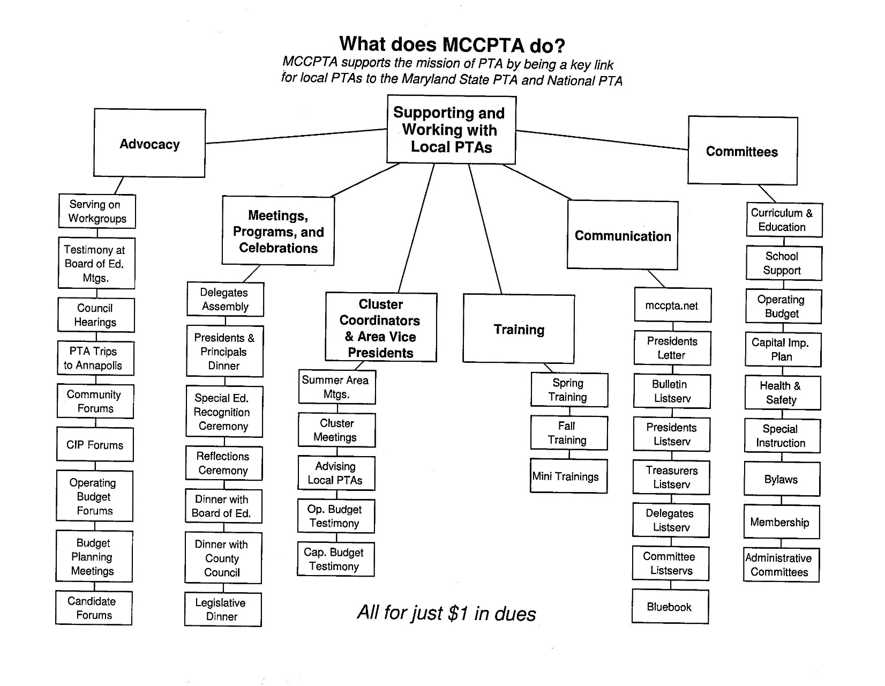
MCCPTA Year End Reports

Slide 13
Reports
Treasurer
VP Programs

