Slide 1
Global brand value chain
Organizational structure
Global Brand
Enabling Structures and Processes
Global brand management
Shareholder value
Corporate social responsibility
Dimensions of value creation
Customer proposition
Marketing mix program
Digital strategy
Global Brand Building
Global brand equity
Performance

Slide 2
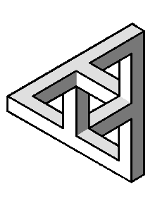
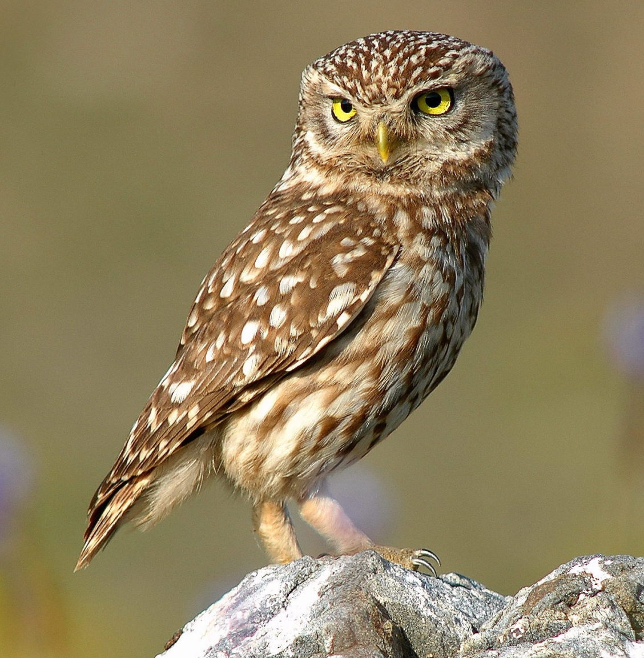
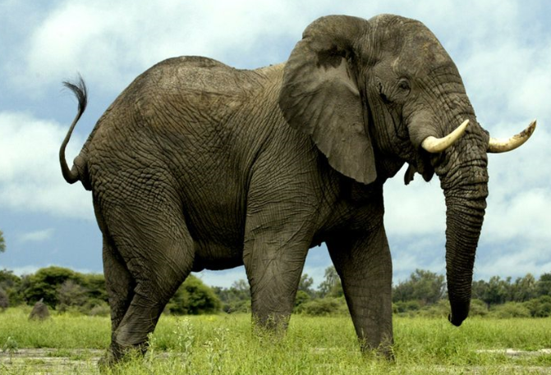
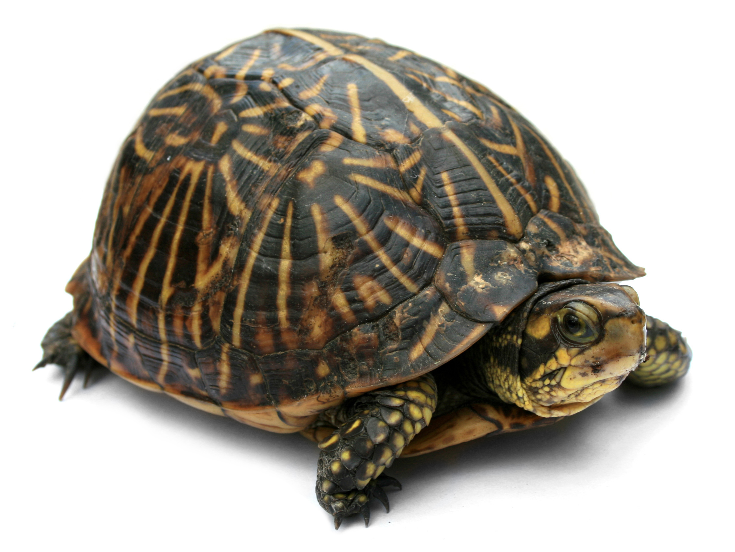
The global brand paradox
The MNC must achieve four goals:
maintain brand consistency and capture economies of scale and scope across borders;
differentiate the brand proposition, its products and services where necessary to suit the needs of local customers;
leverage learnings and share knowledge between all parts of the company;
- all without letting complexity get in the way of speed and agility.
+
+
+
=

Slide 3
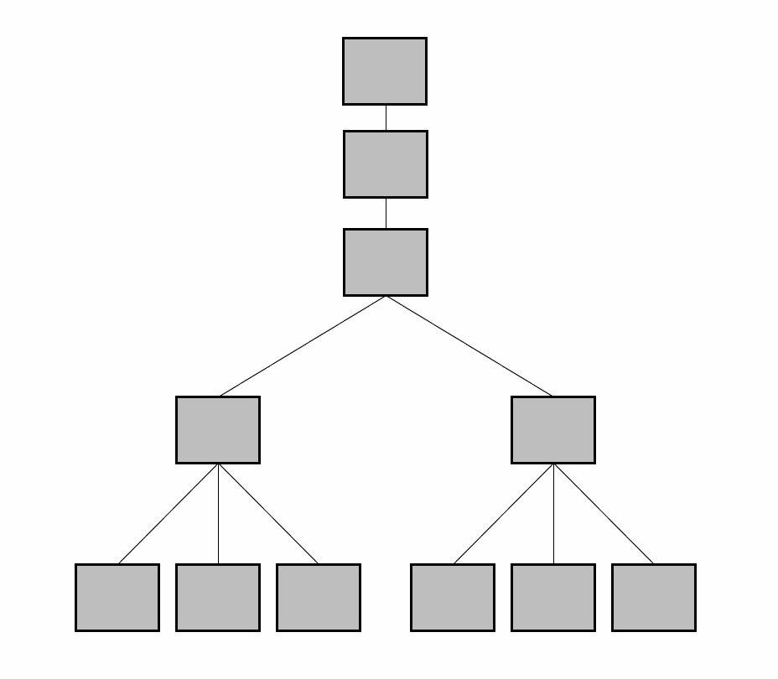
Coordinating mechanisms
Centralization:
“Who decides?”
Formalization:
“How is the decision made”
Normative-cultural control:
“What binds us together?”
Least “expensive” to institutionalize
Most “expensive” to institutionalize

Slide 4
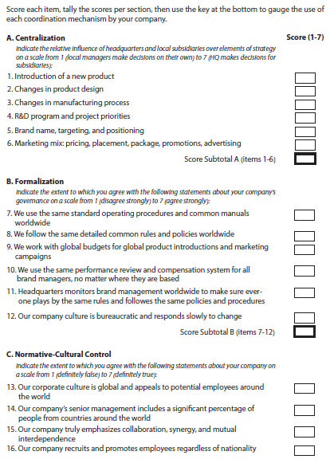
Diagnosing the use of coordinating mechanisms by your company
Purposes
Examine whether managers at HQ and executives in the field have similar or different perceptions
Compare the scores for your company with those of your competitors.
Benchmark use of coordinating mechanisms versus the four generic organizational models (Table 6.1)

Slide 5
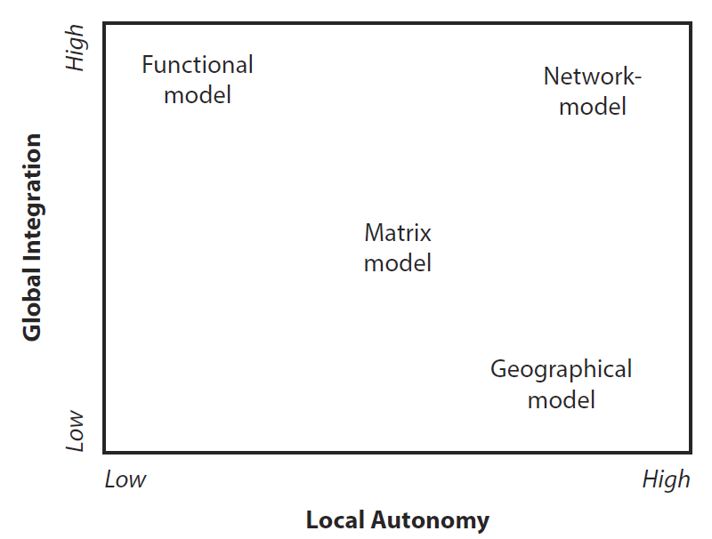
Organizational models

Slide 6
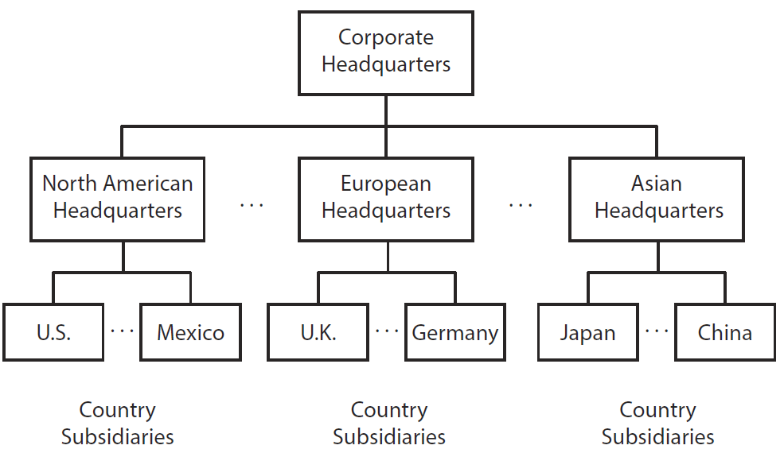
Geographical model (Kimberly-Clark, Haier, Unilever Food division in case)
Advantages
Allows individual subsidiaries great independence, untrammeled by dictates from above (centralization) or constraining common rules and procedures (formalization).
Allows for local experimentation and facilitates rapid response to changes in local market conditions.
Attractive for local talent
Normative-cultural control (weak)
Disadvantages
Unless local brand managers have fully absorbed corporate goals and the global brand identity, local experimentation will lead to brand anarchy, and diseconomies of scale and scope
COMET sources of global brand value not leveraged
No transnational learning – “reinventing the wheel”

Slide 7
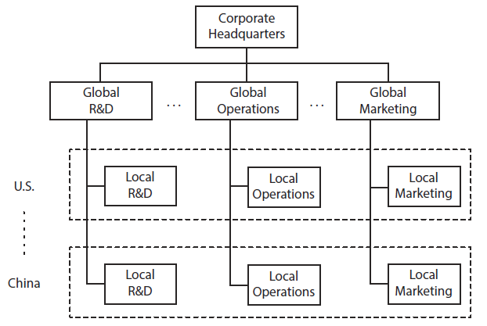
Functional model (Samsung, Ikea, Roman Catholic Church)
Advantages
Ensures brand consistency
Allows for economies of scale and scope
Efficient and rapid new product introduction
Allows for rapid dissemination of best practices from the home country
Many COMET facets maximized, especially O1, O2, M2, E1, E2, T1.
Disadvantages
Associated with many marketing “blunders”
Loss of local market opportunities
Difficult to attract local talent
Risks political backlash in ‘sensitive’ industries
No organizational learning from other countries – low score on COMET facets M3, T2, T3
Centralization

Slide 8
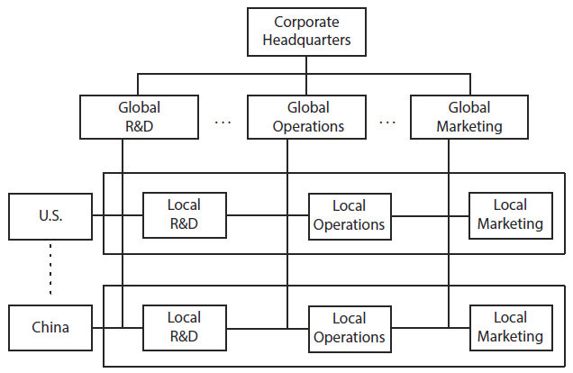
Matrix model (Philips, Schlumberger, P&G)
Advantages
Combines strengths of geographical and functional model by giving equal power and responsibilities to functions and geography
Greater receptivity to learnings from local markets
Ability to attract global talent
Simultaneously addresses global consistency and efficiency, and local responsiveness
Disadvantages
Organizational structure may become unmanageably complex
Conflicting objectives of the two bosses
Slow; numerous conflict resolution mechanisms have to be put in place, particularly committees, meetings, and task forces
Formalization
Committee decisions often mean nobody is responsible
Coordination costs - such as travel, communication, time spent in meetings and delays in making decisions – can rise very rapidly
To satisfy their ‘two bosses,’ managers may adopt middle-of-the-road solutions, ultimately leading to mediocre decisions, which satisfy neither the demand for global efficiency nor the need for and local responsiveness
Asymmetric: typically, one of the two matrix dimensions dominates in practice
Some worldwide learning takes place but no good mechanisms for sharing learnings laterally

Slide 9
Attacking the matrix
Pages 33, 45

Slide 10
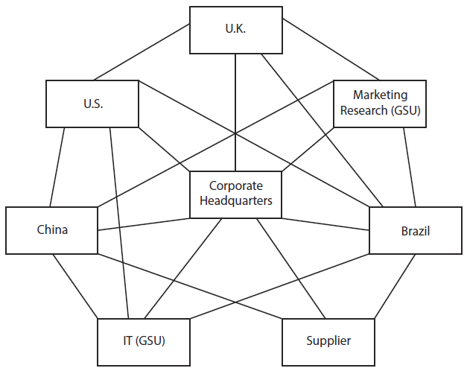
Network model (IBM, Airbnb)
Advantages
True worldwide learning leverages unique strengths of company being global
Fluid, flexible design
Model of the future? De-emphasis of hierarchical lines fits 21st century and millennials?
Openness to the environment (permeable boundaries) facilitates crowdsourcing
Ability to attract best talent around the world
Symmetric
Easier entry into new markets
Normative-cultural control (strong)

Slide 11
Local IBM subsidiaries draw upon the entire web of activities - Germany

Slide 12
Network model (IBM, Airbnb, Bharti Airtel)
Advantages
True worldwide learning leverages unique strengths of company being global
Fluid, flexible design
Model of the future? De-emphasis of hierarchical lines fits 21st century and millennials?
Openness to the environment facilitates crowdsourcing
Ability to attract best talent around the world
Symmetric
Easier entry into new markets
Disadvantages
Lack of experience with this model
Like complex organisms do organizations require hierarchy?
Requires true (not token) diversity in senior management
Normative-cultural control (strong)

Slide 13
(Lack of) diversity in top management around the world

Slide 14
Network model (IBM, Airbnb, Bharti Airtel)
Advantages
True worldwide learning leverages unique strengths of company being global
Fluid, flexible design
Model of the future? De-emphasis of hierarchical lines fits 21st century and millennials?
Openness to the environment facilitates crowdsourcing
Ability to attract best talent around the world
Symmetric
Easier entry into new markets
Disadvantages
Lack of experience with this model
Complex organisms and organizations require hierarchy?
Requires true (not token) diversity in senior management
Critically depends on organizational culture, lateral communication, trust, and shared values:
how many differentiating company values can there be?
horizontal and egalitarian culture not equally accepted around the world
intensive lateral communication requires proficiency in common language (typically English)
communication heavily affected by a manager’s national culture
managers may not be interested to be so closely identified with the company
Not readily applicable to some classes of MNCs (SOEs!)
Coordination costs are very high
Normative-cultural control (strong)

Slide 15
Evaluating the four organizational solutions to the global brand paradox (see also Table 6.1 in the book)
Global brand paradox | Geographical model | Functional model | Matrix model | Network model
Achieve global brand consistency and efficiency |  |  |  | ?
Achieve local responsiveness |  |  |  | ?
Achieve worldwide learning
Achieve speed and agility
Doability (experience, proven success rate…)
From home country
From other countries
Global
Global
Local
Local

Slide 16
A look ahead
To be successful in the future, your organization will need:
Speed
Economies of scale and scope
Consistency
Collaboration

Slide 17
Organizational structure vs. management processes
Management
processes
Organizational structure

Slide 18
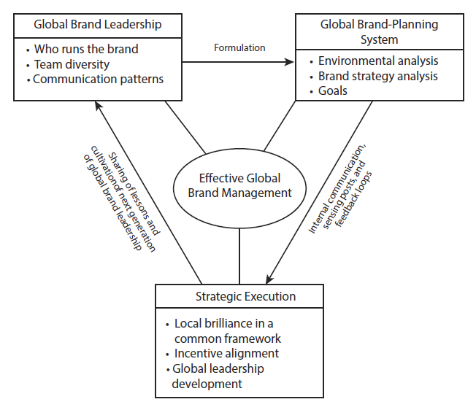
Effective global brand management

Slide 19
Assign global brand responsibility and leadership
Brand management team
Brand champion
Top management team

Slide 20
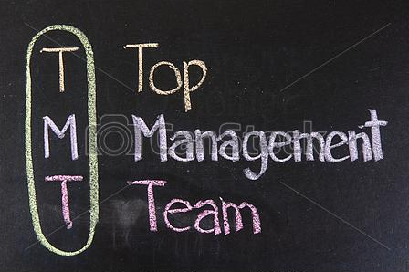
When is TMT most effective?
Deliberation combined with a chairman who is clearly in charge
Functional and gender diversity
Cultural diversity

