Slide 1
Emission Warranty
Mandated by the Government
US reference 40 CFR – 1037.120
Requirements adopted by Canada
Notes:
From my role I am seeing that not all shops are current with training and warranty when it comes to Emission coverage. I want to share what the rules are and give some guidance on what you can do to improve your bottom line. All information shared is public – available via a quick Google search.
The short story is that the majority of your emission system carries a 5 yr 160 km warranty.

Slide 2
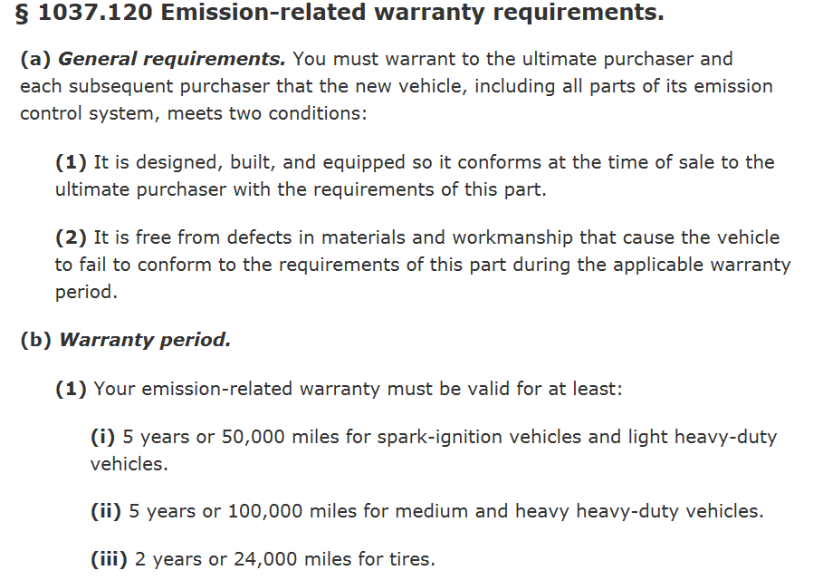
Notes:
A quick clip from the US bible – the CFR – if you look this up you will also see tire and AC coverage.

Slide 3
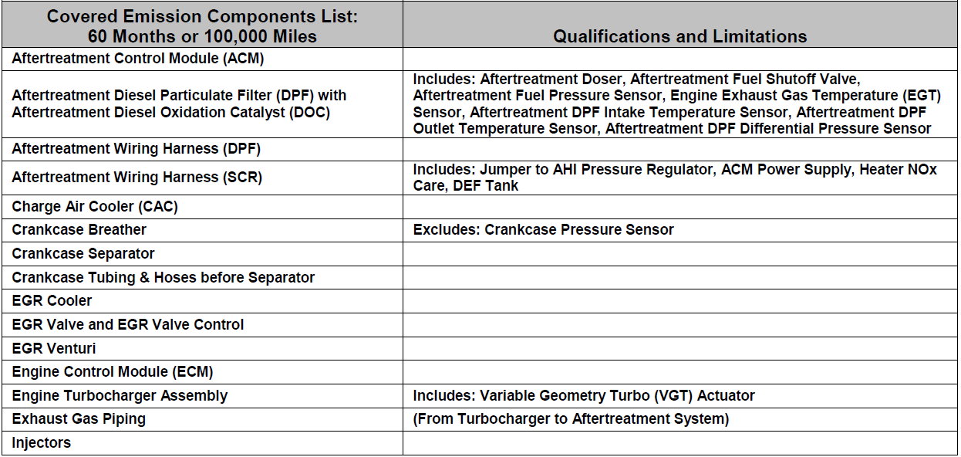
Volvo

Slide 4
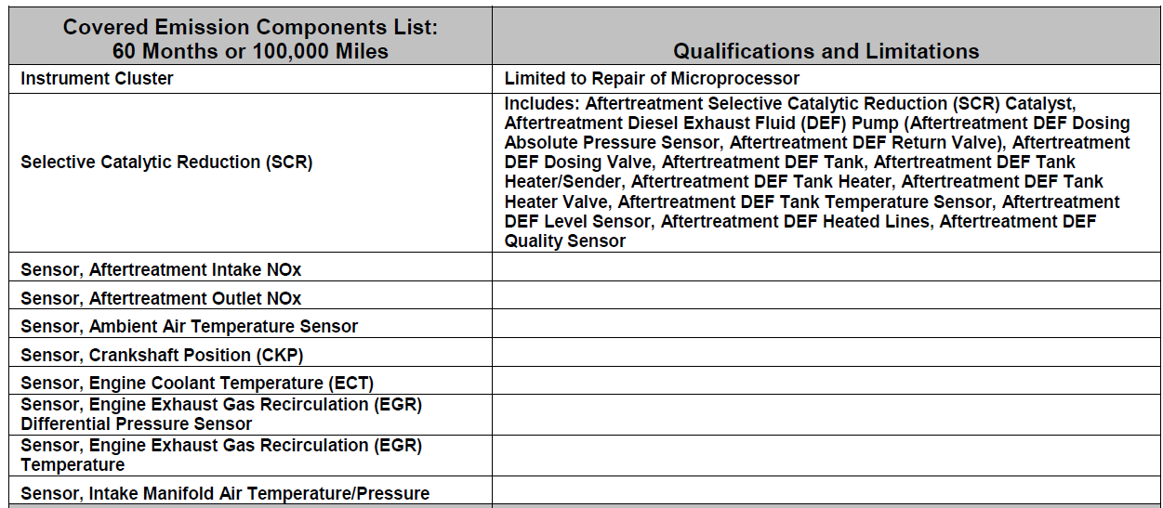
Volvo

Slide 5
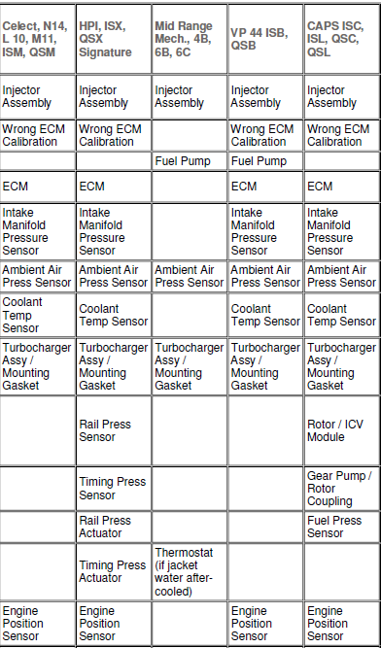
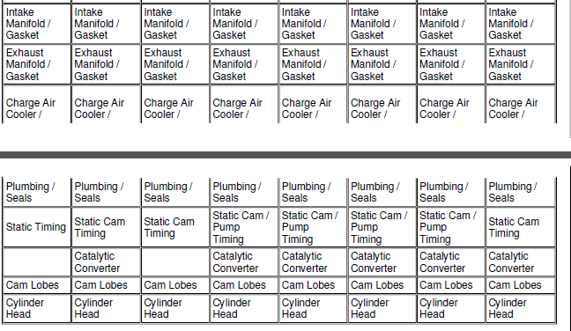
Cummins

Slide 6
What am I supposed to do
Go on the internet and understand what is available to you
Let your Dealer know what you are expecting
Keep good records – oil type, frequency etc.
Get to know your engine rep
Don’t be afraid of asking for assistance ie: policy it is out there
Ask your engine rep about potential campaigns (non published coverages)
Be Aware – not all dealers may be as “up to speed” as you are
Notes:
This coverage is public and supported by all engine manufacturers. You have paid for it – 10k bumps in engine cost for each EPA improvement
Its you job to know what is available – do not relay on the dealer, they may not have read up on this but note (Customer pay is always better than warranty from the engine mfg.)
Training for emission system diagnosis is getting better but is still lacking in many areas of the country
Let your dealer know what you are expecting – It is much easier to address before you have to reach into your wallet
Keep good records – know what oils you must use – cheap oil may result in and expensive repair that may have been covered
There may be repeat offenders in your emission system, let the dealer know if you have already had a component replaced.
We are all continuing to learn about how these systems work and how duty cycles impact performance – occasionally there may be programming available to “cure your ill” this is an area where your engine rep can assist.
Life has changed – have your specs ? On your next build ask your engine rep to have a once over on your spec in addition to your truck sales rep. you may get a surprise !

