Slide 1
Chapter 15
Section 3

Slide 2
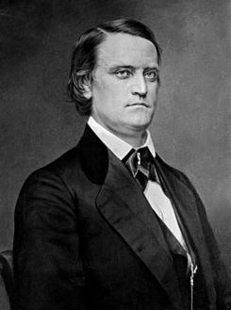
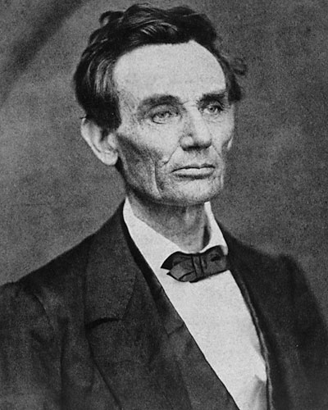
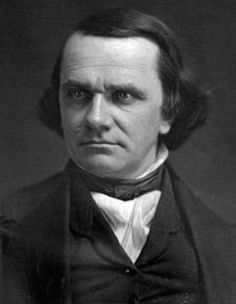
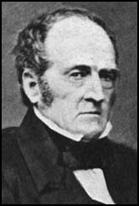
Election of 1860
Democratic Party split over slavery
Northern Democrats
Southern Democrats
Candidates
Stephen Douglas
Northern Democrat
Senator from Illinois
John Breckenridge
Southern Democrat
Vice President
From Kentucky
Abraham Lincoln
Republican
House of Representatives
From Illinois
John Bell
Constitutional Union Party
Wanted to preserve the Union
Senator From Tennessee

Slide 3
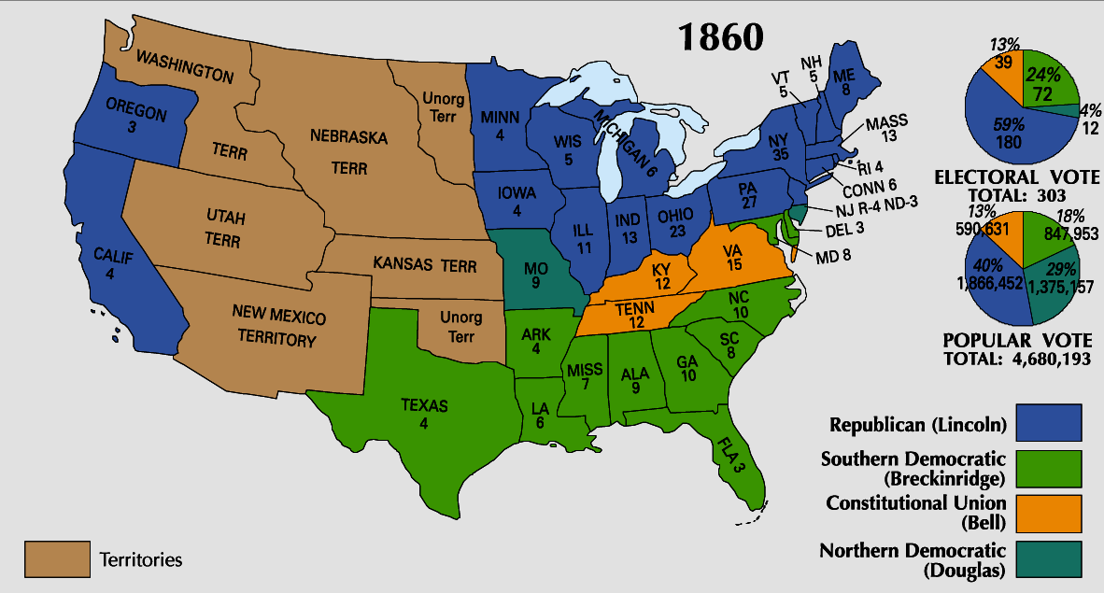

Slide 4
The Election of 1860 (cont.)
Two Races
North: Lincoln vs. Douglas
South: Breckinridge vs. Bell
Lincoln won in the North
Breckinridge won most of the South
Douglas and Bell won in “Border States”
Since the North had the largest population, Lincoln won
Southerners felt threatened

Slide 5
Southern States Secede
Believed Lincoln would try to ban slavery
Believed in “States Rights”
States have certain right the federal government cannot overrule
States could leave the Union if they wanted to
Dec. 1860- South Carolina becomes the first state to secede (leave the Union)
Other Southern States followed
Formed the Confederate States of America

Slide 6
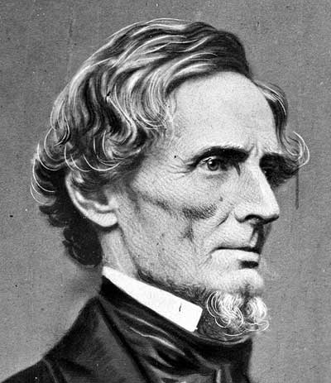
Confederate States of America
Elected Jefferson Davis their President
Capital: Montgomery, Alabama
Wrote its own Constitution

Slide 7
