Slide 1
When
How long was WWII?
When did it Start?
When did it end?
When did the U.S. get involved?

Slide 2
WWII Era TimeLine
1920-1945
Jan 3 1925
Mussolini Takes over Italy

Slide 3
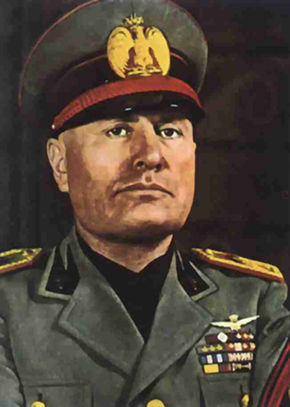
July 29, 1921
Fascist leader Benito Mussolini is appointed the Premier of Italy.

Slide 4
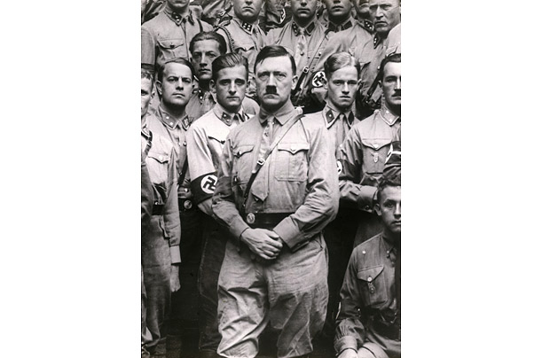
October 29, 1922
Adolph Hitler becomes the leader of the National Socialist German Workers (Nazi) Party.

Slide 5
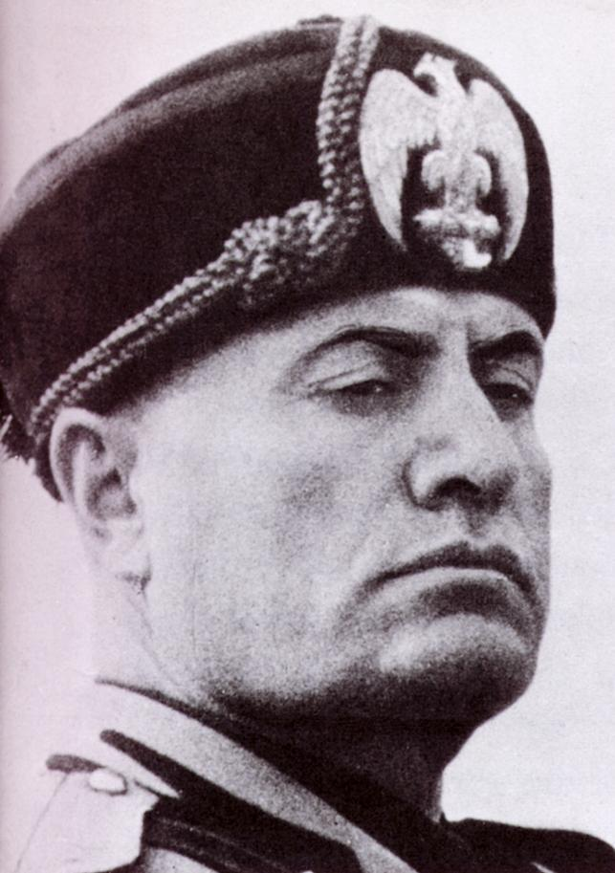
January 3, 1925
Mussolini ends democracy in Italy by dismissing the Italian Parliament.

Slide 6
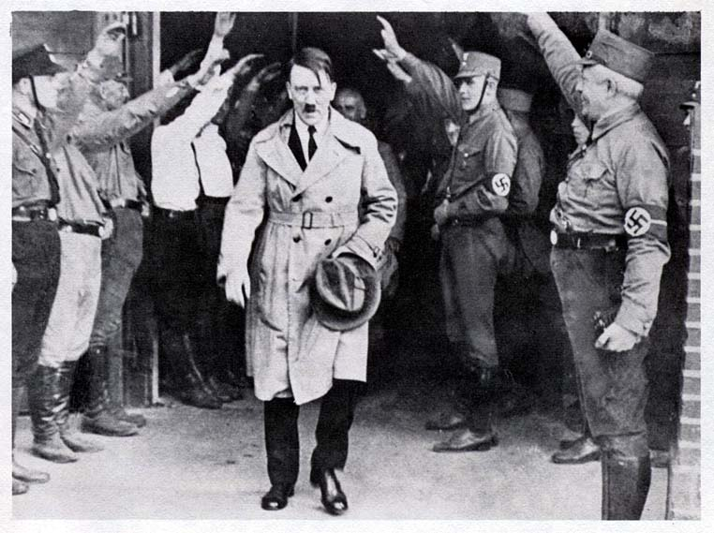
January 30, 1933
Adolph Hitler is appointed the Chancellor of Germany.

Slide 7
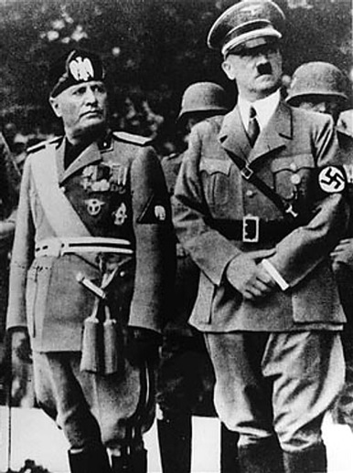
October 25, 1936
Hitler and Mussolini announced a Rome-Berlin alliance -- the Axis.

Slide 8
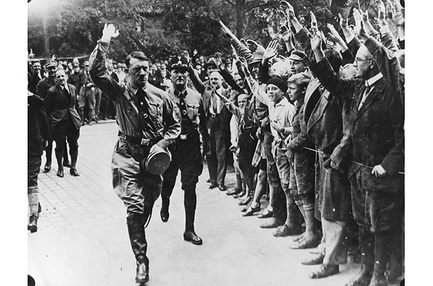
March 12, 1938
Germany invades Austria and annexes it the next day.

Slide 9
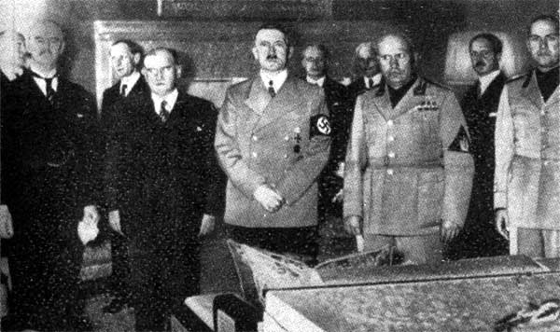
September 29, 1938
Germany, Britain, France, and Italy sign the Munich Pact allowing Germany to invade the Sudeten territories of Czechoslovakia

Slide 10
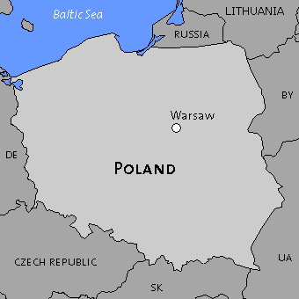
March 31, 1939
Britain declares that it will support Poland.

Slide 11
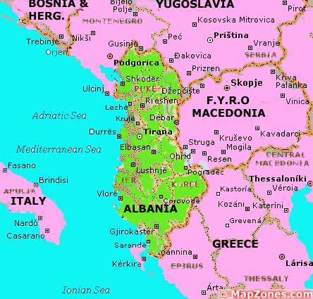
April 1939
Italy invades Albania.

Slide 12
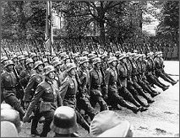
September 1, 1939
Germany invades Poland.

Slide 13
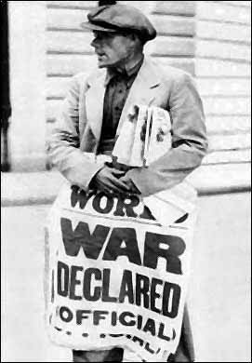
September 3, 1939
Britain, France, Australia and New Zealand declare war on Germany after German forces penetrate deeper into Poland. This marks the beginning of World War II.

Slide 14
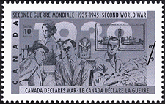
September 10, 1939
Canada declares war on Germany.

Slide 15
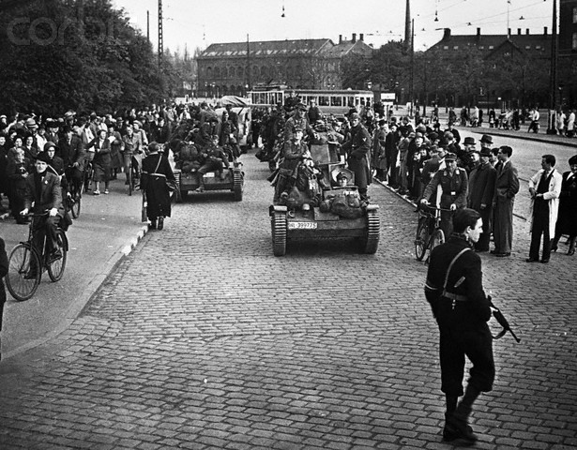
April 9, 1940
Denmark surrenders to Germany. Germany invades Norway.

Slide 16
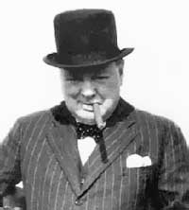
May 10, 1940
Winston Churchill becomes the new Prime Minister of Britain, replacing Chamberlain.
Germany invades the Netherlands (Holland); it surrenders four days later.
Germany invades Belgium.

Slide 17
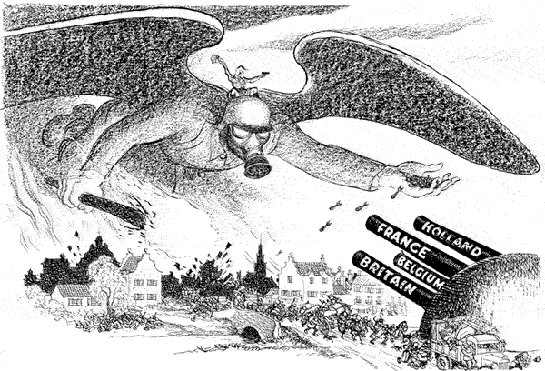

Slide 18
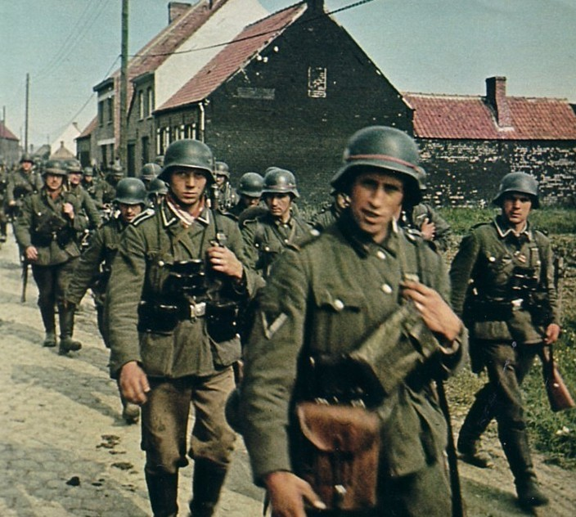
May 28, 1940
Belgium surrenders to Germany.

Slide 19
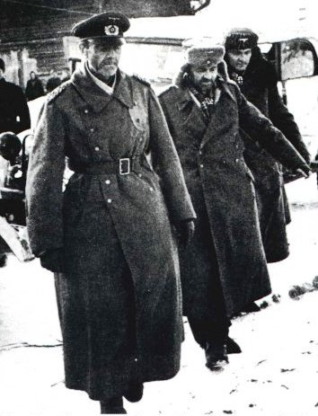
June 10, 1940
Norway surrenders to Germany.
Italy declares war on Britain and France.

Slide 20
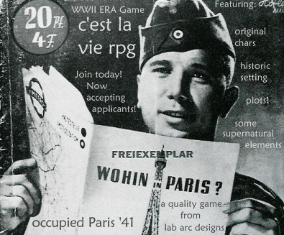
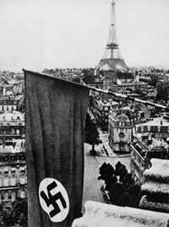
June 14, 1940
German troops enter Paris.

Slide 21
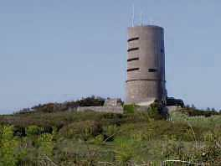
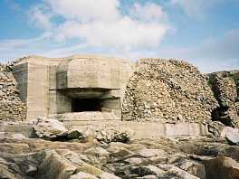
June 30, 1940
Germany invades the Channel Islands. This will be the only part of Britain to be occupied by the Germans.

Slide 22
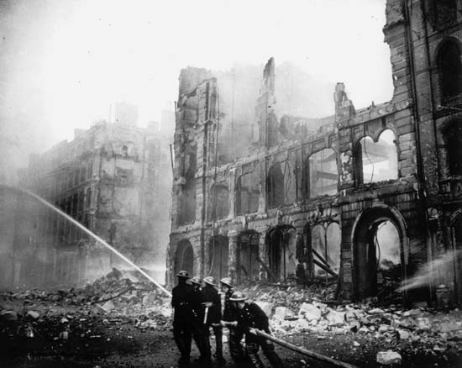
July 10, 1940
The Battle of Britain begins. Germany bombs Britain, and the British defend themselves from the air in what Winston Churchill would call their "finest hour."

Slide 23
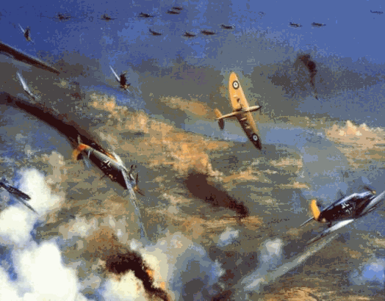
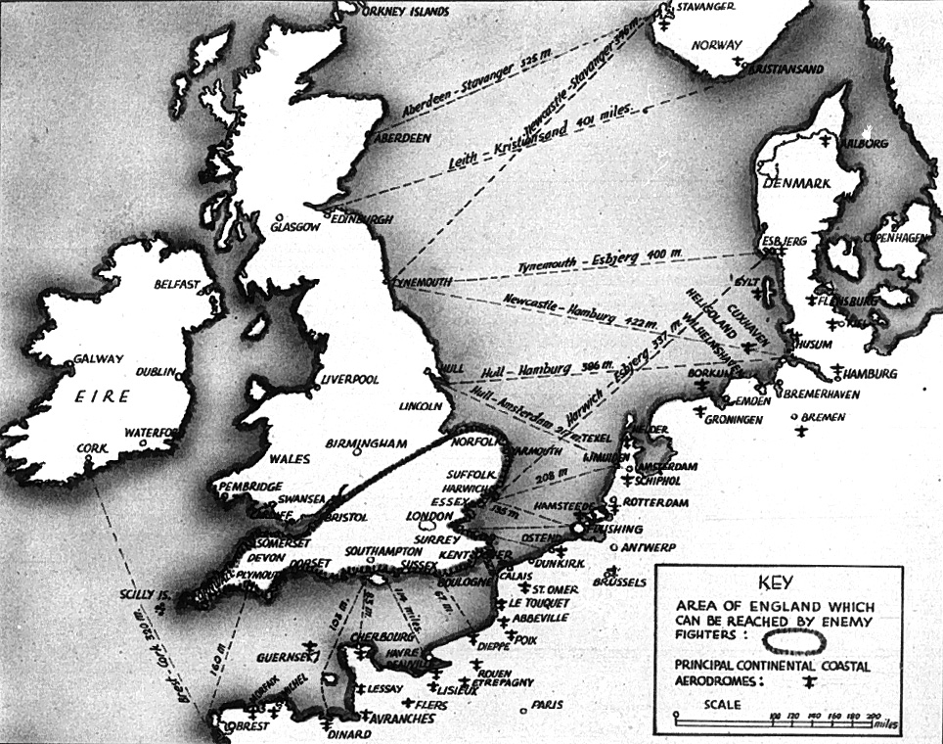

Slide 24
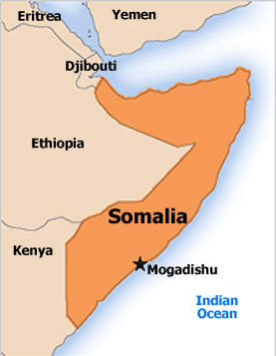
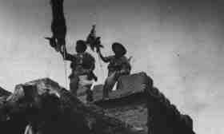
August 3, 1940
Italy invades British Somaliland, marking the beginning of World War II in Africa.

Slide 25
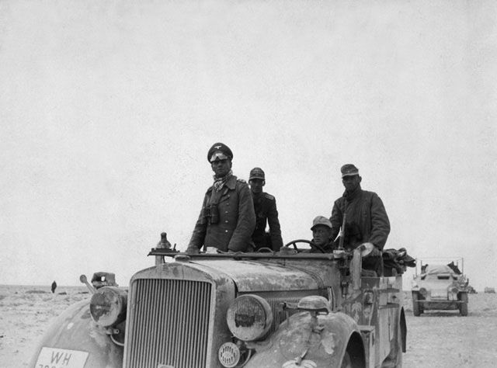
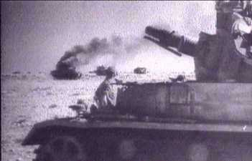
September 13, 1940
Italy invades Egypt.

Slide 26
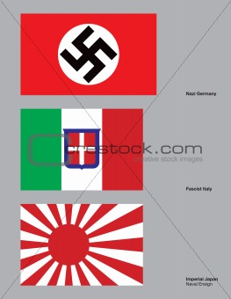
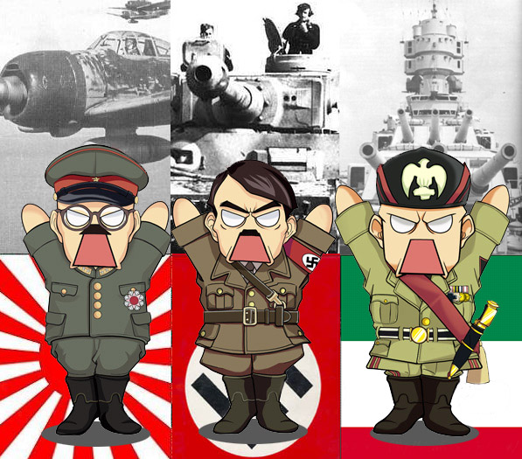
September 27, 1940
Germany, Italy, and Japan sign the Tripartite Pact, making Japan part of the Axis.

Slide 27
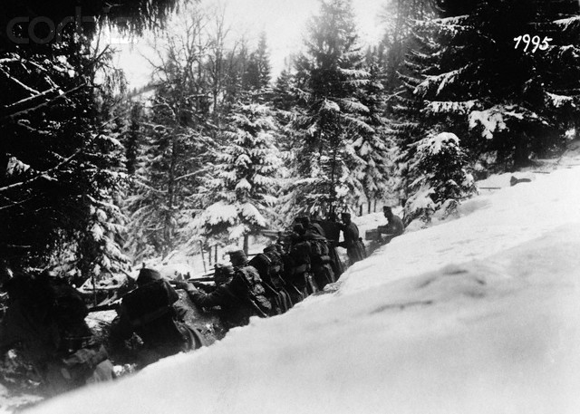
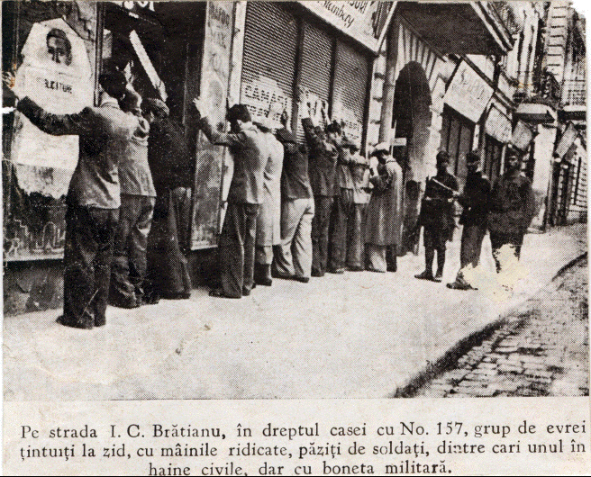
October 7, 1940
Germany invades Romania.

Slide 28
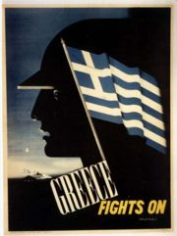
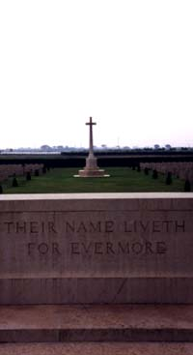
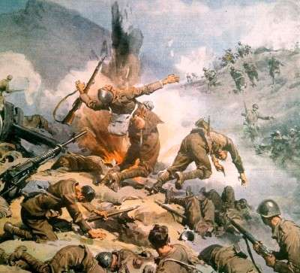
October 31, 1940
Italy invades Greece, but fails to conquer it.

Slide 29
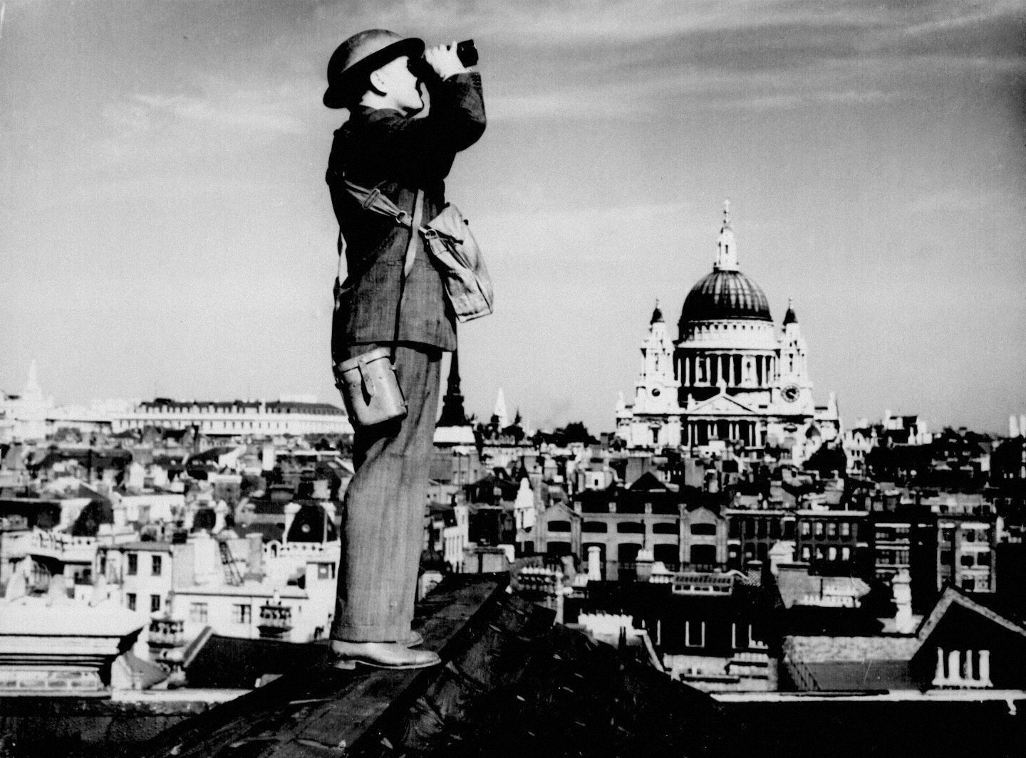
October 31, 1940
The Battle of Britain ends. The powerful German Luftwaffe fails to crush British morale.

Slide 30
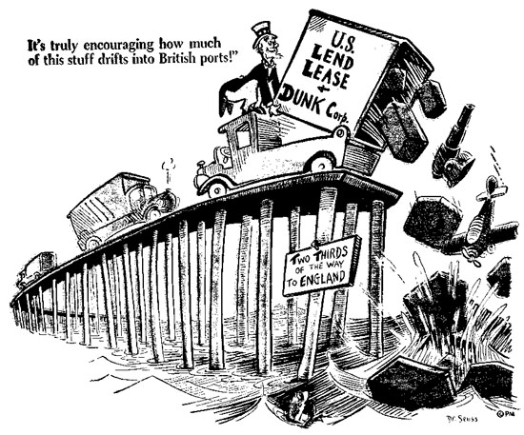
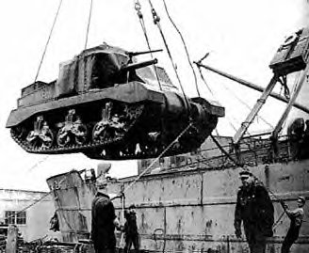
March 11, 1941
The U.S. Congress passes the Lend-Lease Act giving Roosevelt the authority to sell, transfer, or lease war goods to the government of any Allied country, thereby effectively ending American neutrality.

Slide 31
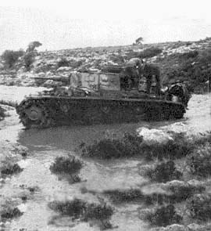
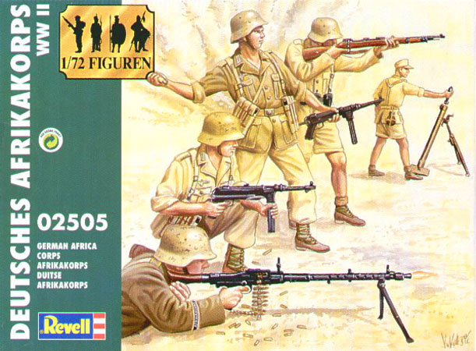
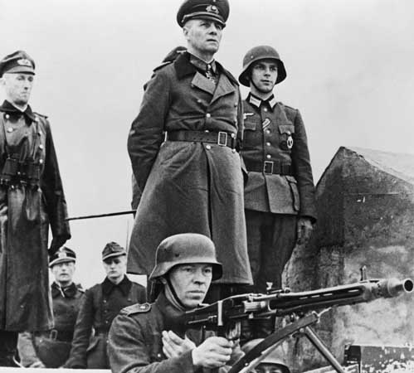
March 30, 1941
The German Afrika Korps begins its offensive in North Africa.

Slide 32
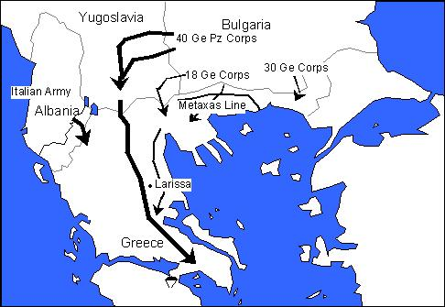
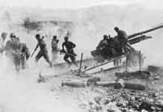
April 6, 1941
Germany invades Yugoslavia and Greece.

Slide 33
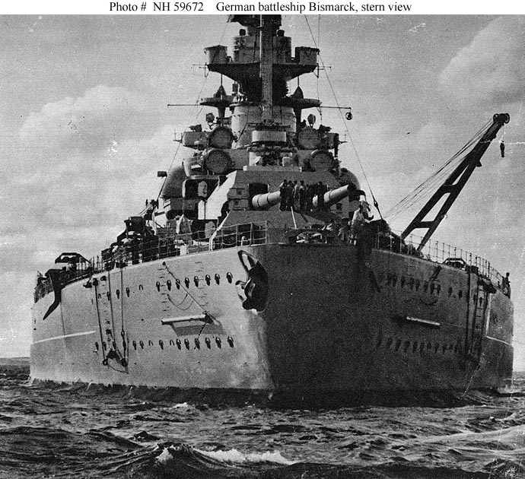
May 27, 1941
Bismarck, German battleship, sunk by British warships while she was on maiden voyage.

Slide 34
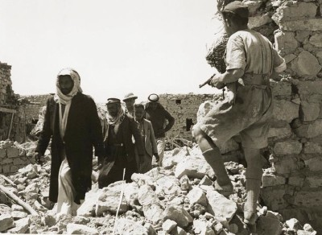
June 4, 1941
Britain invades Iraq and overthrows its pro-German government.

Slide 35
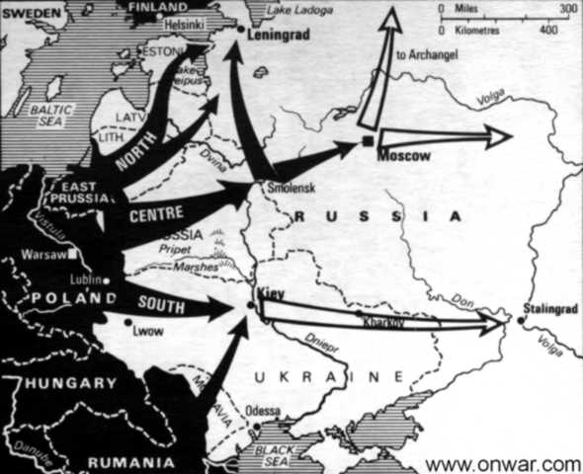
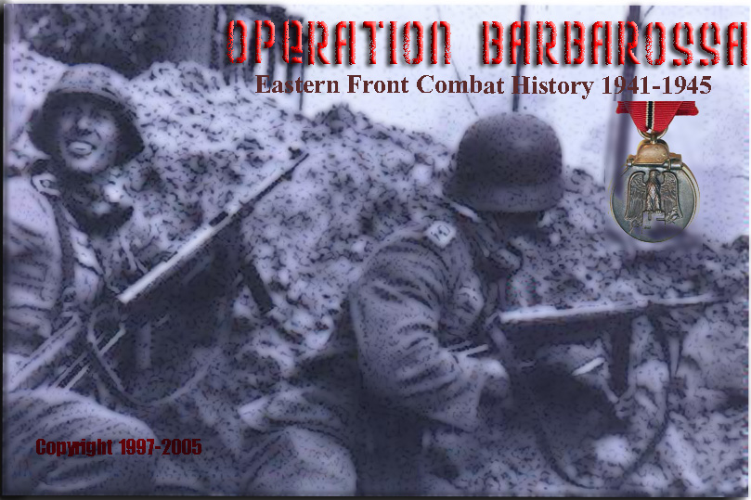
June 22, 1941
Germany invades Russia, thereby beginning Operation Barbarossa. Italy and Romania declare war on the USSR.

Slide 36
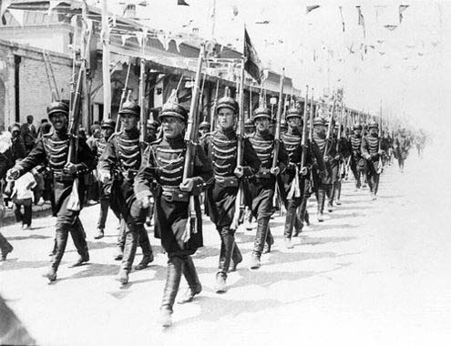
July 25, 1941
Britain and Russia occupy Iran.

Slide 37
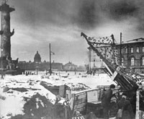
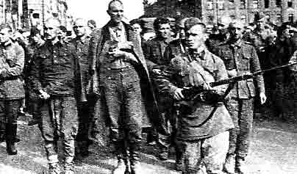
September 15, 1941
Germany begins the Siege of Leningrad. It would not end until January 1944.

Slide 38
October 1, 1941
The U.S. begins supplying the USSR under the Lend-Lease Act.

Slide 39
December 5, 1941
Germany abandons its attack on Moscow; the USSR counterattacks.

Slide 40
December 7, 1941
Japan attacks the American naval base at Pearl Harbor, Hawaii.

Slide 43
December 8, 1941
The Allies -- except the USSR -- declare war on Japan.

Slide 44
December 11, 1941
Germany and Italy declare war on the U.S.

Slide 45
December 25, 1941
Japan invades Hong Kong.

Slide 46
January 20, 1942
Germany holds the Wannsee Conference in Berlin to find a "Final Solution" for the Jews.

Slide 47
April 18, 1942
Doolittle's raiders bomb Toyko.

Slide 48
May 4, 1942
The U.S. Navy repels the Japanese at the Battle of the Coral Sea. This helps save Australia and blocks the Japanese juggernaut in the Pacific.

Slide 49
June 4, 1942
The U.S. defeat the Japanese at the Battle of Midway. Together with the Battle of the Coral Sea, this marks the turning point in the war in the Pacific.

Slide 50
June 18, 1942
The U.S. Army Corps of Engineers initiates the Manhattan Project to develop an atomic bomb.

Slide 51
July 22, 1942
Germany begins deporting hundreds of thousands of Jews from the Warsaw ghetto to the Treblinka concentration camp.

Slide 53
January 14, 1943
The Casablanca Conference between the U.S. and Britain begins. Roosevelt and Churchill agree that Germany must surrender unconditionally, and plan the Allied invasion of Sicily.

Slide 54
January 31, 1943
Over 90,000 German troops at Stalingrad surrender to the Soviets. It is a significant turning point in the war against Germany.

Slide 55
April 19, 1943
The Warsaw Ghetto Uprising begins after German troops attempt to deport the ghetto's last surviving Jews. About 750 Jews fought back the Germans for almost a month.

Slide 57
May 12, 1943
Axis forces in North Africa surrender.

Slide 58
May 16, 1943
German troops crush the last resistance of the Warsaw Ghetto Uprising and kill thousands of Jews. The rest are sent to the Treblinka concentration camp to die.

Slide 59
July 25, 1943
Benito Mussolini's fascist government is overthrown in Italy. The new Italian government begins peace talks.

Slide 60
September 3, 1943
British troops land on mainland Italy, beginning the Allied campaign in Italy. American troops land six days later. The new Italian government formally surrenders.

Slide 61
January 27, 1944
The German siege of Leningrad that began in September 1941 finally ends.

Slide 62
February 20, 1944
The Allies begin massive bombing campaign of Germany.

Slide 63
June 6, 1944
D-Day Allied invasion of Nazi occupied France.

Slide 64
June 13, 1944
Germany launches the first V-1 flying-bomb on Britain.

Slide 66
June 19, 1944
The U.S. defeat the Japanese in a massive air battle known as the Battle of the Philippine Sea. The Japanese lost more than 400 planes and three carriers. This victory paved the way for eventual success in the Marianas invasion.

Slide 67
July 20, 1944
German military leaders attempt but fail to kill Adolf Hitler in the Rastenburg Assassination Plot. Hitler then kills about 200 suspected plotters. U.S. troops make an amphibious assault on the Japanese -held island of Guam in the Marianas.

Slide 68
August 25, 1944
The Allies liberate Paris.

Slide 69
September 11, 1944
The Allies enter Germany.

Slide 70
November 4, 1944
Axis forces in Greece surrender.

Slide 71
January 27, 1945
Soviet troops liberate the Auschwitz and Birkenau concentration camps, discovering hundreds of corpses from people who were recently murdered, thousands of people barely alive, and the earthly remains of approximately 1,000,000 men and women.

Slide 72
January 28, 1945
In Western Europe, the Battle of the Bulge ends. Americans suffered some 75,000 casualties and the Germans lost 80,000 to l00,000. The Americans can recover from their military losses; the Germans cannot. Few people besides Hitler believe Germany can still win the war.

Slide 73
March 7, 1945
The Allies capture two significant targets in Germany -- the Remagen bridge over the Rhine, and the city of Cologne.

Slide 74
March 9, 1945
U.S. firebombing of Tokyo kills about 85,000 Japanese.

Slide 75
March 16, 1945
U.S. troops complete the capture of Iwo Jima from the Japanese, at the cost of 20,000 American casualties.

Slide 76
April 1, 1945
U.S. troops invade Okinawa, the first Japanese home island to be reached. The fierce Japanese defenders would inflict about 35,000 American casualties. In Europe, the Allies surround over 300,000 German troops in the Ruhr, and the final Allied offensive in northern Italy begins.

Slide 77
April 23, 1945
Soviet troops reach Berlin.

Slide 78
April 28, 1945
Benito Mussolini is captured by Italian anti-fascists and executed.

Slide 79
April 29, 1945
U.S. troops liberate the Dachau concentration camp where they discover evidence of gruesome medical experiments.

Slide 80
April 30, 1945
Adolf Hitler and Eva Braun commit suicide in a Berlin bunker as Soviet troops advance through the city.

Slide 81
May 8, 1945
V-E Day is declared -- Victory in Europe.

Slide 82
August 6, 1945
A U.S. B-29 named Enola Gay drops the "Little Boy" atomic bomb over Hiroshima, Japan. Approximately 140,000 people in the area will die by the end of the year.

Slide 83
August 9, 1945
A U.S. B-29 named Bock's Car drops the "Fat Man" atomic bomb on Nagasaki, Japan. Approximately 70,000 people in the area will die by the end of the year.

Slide 85
August 15, 1945
Japan agrees to unconditionally surrender.
V-J Day is declared -- Victory over Japan.

Slide 86
Begins September 3, 1939
To
Ends August 15, 1945
6 years long

