Slide 1
Personal growth. Professional opportunity. Powerful journey.
LegalShield makes no guarantee or promise of income or business as results are determined by the efforts of those individuals who market LegalShield plans as Independent Associates. These experiences are specific to each Independent Associate’s efforts, abilities and motivation available at opportunity.legalshield.com.
Notes:
Doc Revision Number: LegalShield Presentation USA
Effective Date: October 2017
Length of presentation: 45 minutes

Slide 2
Personal growth. Professional opportunity. Powerful journey.
LegalShield makes no guarantee or promise of income or business as results are determined by the efforts of those individuals who market LegalShield plans as Independent Associates. These experiences are specific to each Independent Associate’s efforts, abilities and motivation available at opportunity.legalshield.com.
Notes:
Doc Revision Number: LegalShield Presentation USA
Effective Date: October 2017
Length of presentation: 45 minutes

Slide 3
Personal growth. Professional opportunity. Powerful journey.
LegalShield makes no guarantee or promise of income or business as results are determined by the efforts of those individuals who market LegalShield plans as Independent Associates. These experiences are specific to each Independent Associate’s efforts, abilities and motivation available at opportunity.legalshield.com.
Notes:
Doc Revision Number: LegalShield Presentation USA
Effective Date: October 2017
Length of presentation: 45 minutes

Slide 4
Personal growth. Professional opportunity. Powerful journey.
LegalShield makes no guarantee or promise of income or business as results are determined by the efforts of those individuals who market LegalShield plans as Independent Associates. These experiences are specific to each Independent Associate’s efforts, abilities and motivation available at opportunity.legalshield.com.
Notes:
Doc Revision Number: LegalShield Presentation USA
Effective Date: October 2017
Length of presentation: 45 minutes

Slide 5
Personal growth. Professional opportunity. Powerful journey.
LegalShield makes no guarantee or promise of income or business as results are determined by the efforts of those individuals who market LegalShield plans as Independent Associates. These experiences are specific to each Independent Associate’s efforts, abilities and motivation available at opportunity.legalshield.com.
Notes:
Doc Revision Number: LegalShield Presentation USA
Effective Date: October 2017
Length of presentation: 45 minutes

Slide 6
The best business models of today are
SIMPLE
DISRUPTIVE
NOBLE
They are NOT EASILY DUPLICATED.
And they HAVE AN APP.
Let’s look at some examples…

Slide 7
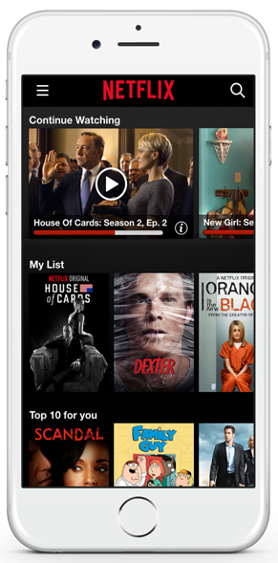
Disruptive Innovation. Simpler. Easier. More affordable.

Slide 8
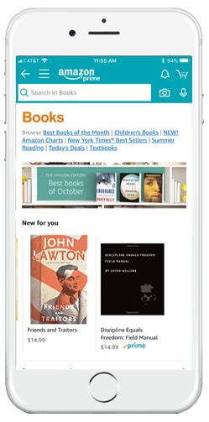
Disruptive Innovation. Simpler. Easier. More affordable.

Slide 9
THE LEGAL PROFESSION
Expensive
Unresponsive
Unaccountable
Notes:
“The Legal Profession is notorious for being expensive, unresponsive and unaccountable.”

Slide 10
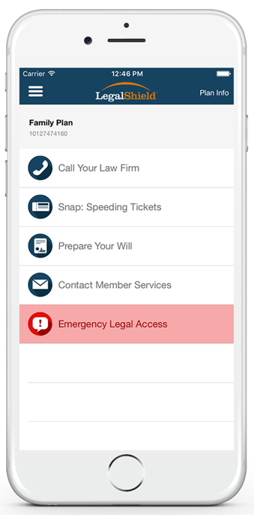
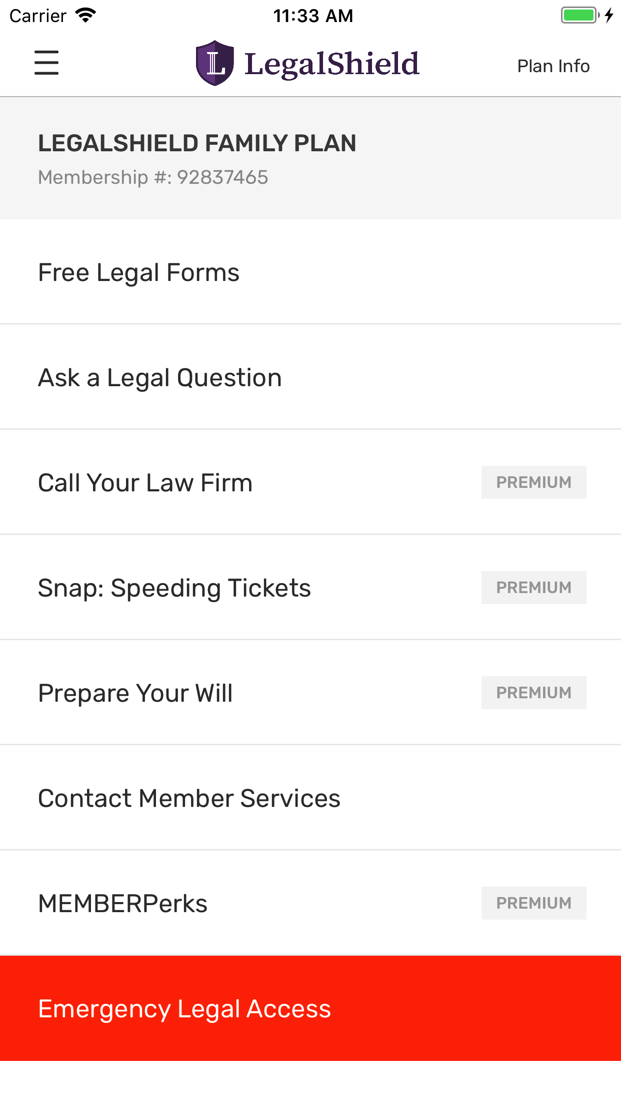
Disruptive Innovation
Affordable
Accountable
Responsive
Simpler. Easier. More affordable.
Notes:
“The LegalShield app makes legal services affordable, accountable and responsive.”

Slide 11
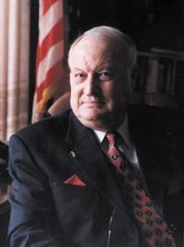
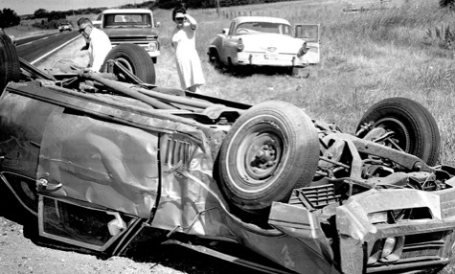
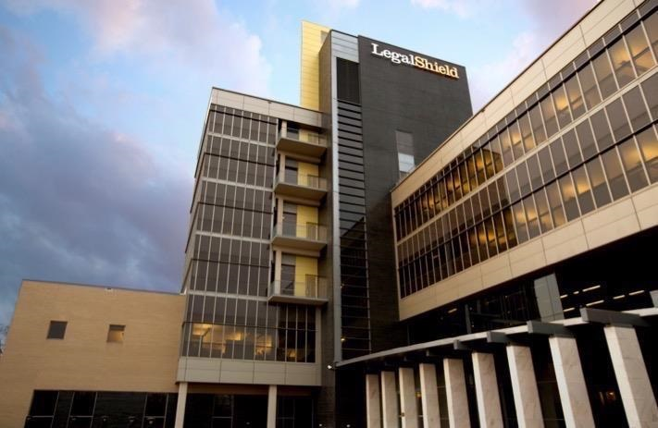
Our Company
Established in 1972.
Protecting approximately 4.6 million lives in the U.S. and Canada.
With a dedicated network of quality law firms in all 50 states and 4 Canadian provinces.
4.7
4.7
Notes:
Our company is a 45-year old startup.

Slide 12
Our Purpose We PROTECT & EMPOWER People.
Notes:
Our Purpose:
We protect and empower people.

Slide 13
Our Vision To provide EQUAL ACCESS to the LIBERTY, EQUALITY, OPPORTUNITY & JUSTICE that every human deserves and expects.
Notes:
Our Vision:
To provide equal access to the Liberty,
Equality, Opportunity & Justice that
every human deserves and expects.

Slide 14
Our Mission To help people improve their lives by TEACHING LIFE-TRANSFORMING SKILLS and to DELIVER EXCEPTIONAL PRODUCTS & SERVICES that promote peace of mind and confidence in a world that is oftentimes uncaring and selfish.
Notes:
Our Mission:
To help people improve their lives by
TEACHING LIFE-TRANSFORMING SKILLS and to
DELIVER EXCEPTIONAL PRODUCTS & SERVICES
that promote peace of mind and confidence in a world that is oftentimes uncaring and selfish.

Slide 15
Common Legal Situations:
Consumer/Finance
Estate Planning
Traffic
Family Law
Landlord/Tenant
Real Estate
Employment
Civil Litigation
Collection
General Law
Business
Criminal
Contract
Personal Injury
Immigration

Slide 16
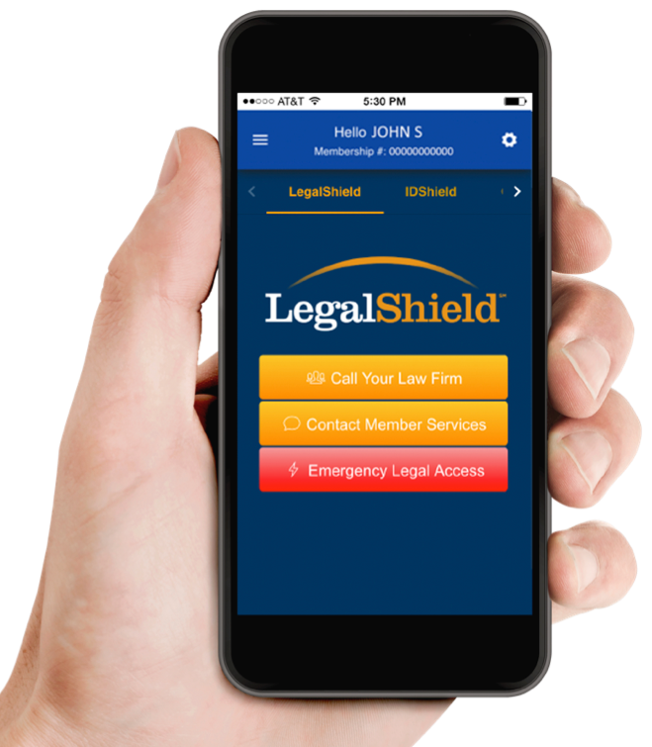
Tap. Call. Equal Access.
Advice, Consultation & Representation
Document Preparation
Auto Coverage
Family Law
IRS Support
Exclusions and limitations apply. Services and benefits vary by state/province.
See www.legalshield.com/fullplandetails [and select your state/province] for specifics.
Please review a contract for complete terms, conditions and exclusions before purchase.
Notes:
How did Patrick tie each of these things to the app in his presentation. Fisher Price it here and do the same for the audience.

Slide 17
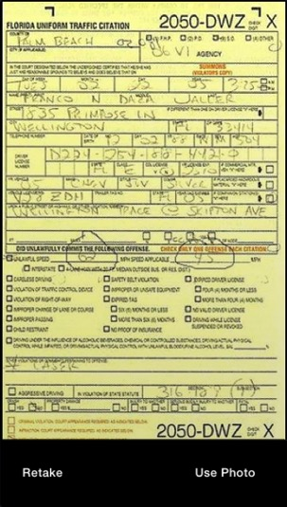
Tap. Snap. Send.
Ticket and Member info submitted to YOUR law firm
Consultation within 8 business hours
Exclusions and limitations apply. Services and benefits vary by state/province.
See www.legalshield.com/fullplandetails [and select your state/province] for specifics.
Please review a contract for complete terms, conditions and exclusions before purchase.

Slide 18
Tap. Download. Complete.
Lawyers Prepare Your:
Will
Living Will
Healthcare Power of Attorney
Durable Power of Attorney
Exclusions and limitations apply. Services and benefits vary by state/province.
See www.legalshield.com/fullplandetails [and select your state/province] for specifics.
Please review a contract for complete terms, conditions and exclusions before purchase.

Slide 19
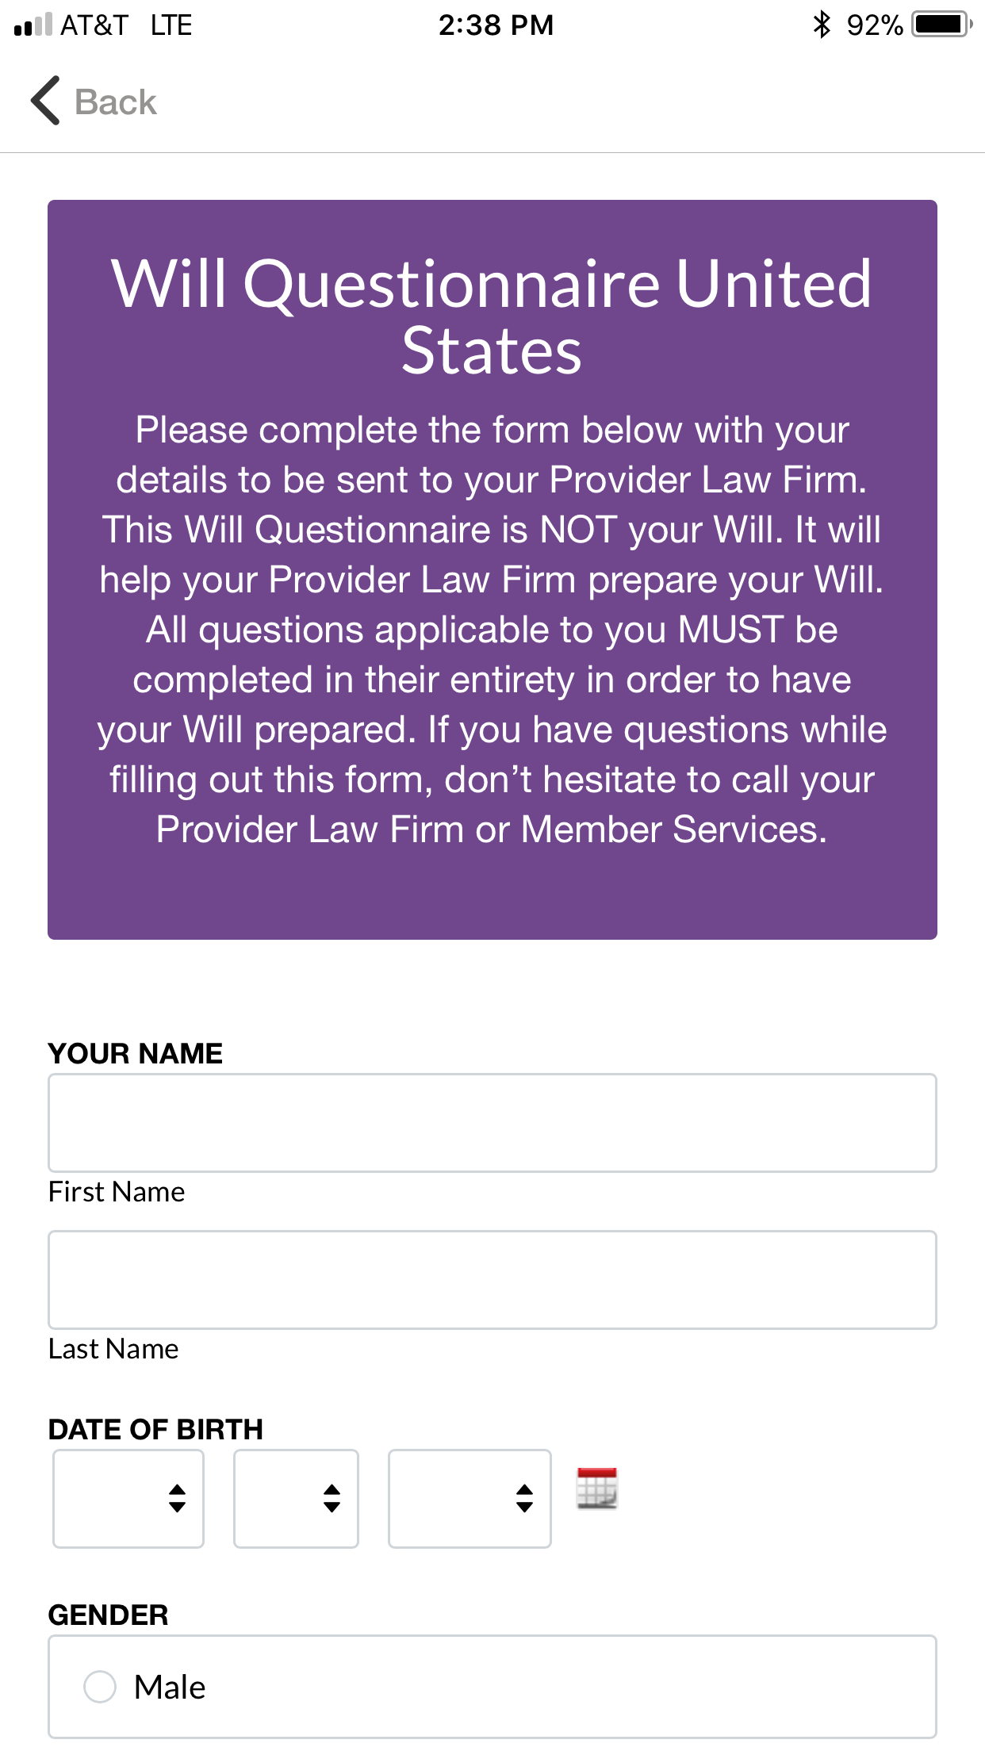
Tap. Download. Complete.
Just push a button and start on your Will!
Exclusions and limitations apply. Services and benefits vary by state/province.
See www.legalshield.com/fullplandetails [and select your state/province] for specifics.
Please review a contract for complete terms, conditions and exclusions before purchase.

Slide 20
Tap. Call. Access.
24/7 Emergency Access For covered situations
Exclusions and limitations apply. Services and benefits vary by state/province.
See www.legalshield.com/fullplandetails [and select your state/province] for specifics.
Please review a contract for complete terms, conditions and exclusions before purchase.

Slide 21
If you are injured at work or in an accident, talk to your Provider Law Firm about representing you on a contingency basis, which means you don’t pay hourly rates.
Exclusions and limitations may apply. There is no guarantee related to the outcome or that an attorney will be able to take the matter on a contingency fee basis. This is subject to the Provider Attorney’s professional judgment and a separate attorney-client contract.

Slide 22
Contingency Cases
What if you…
Are the victim of an auto accident?
Get hurt while on the job?
Are the victim of medical malpractice?

Slide 23
25% Preferred Member Discount
DUI
Bankruptcy
Contested Adoption
Contested Divorce
Exclusions and limitations apply. Services and benefits vary by state/province. See www.legalshield.com/fullplandetails [and select your state/province] for specifics. Please review a contract for complete terms, conditions and exclusions before purchase.

Slide 24
Tap. Access. Save.
Take advantage of the savings with MemberPERKS!
These benefits are for LegalShield and IDShield members. All offers or promotions are subject to change without notice.

Slide 25
Who’s Covered
The member
The member’s spouse
Never-married dependent children under age 26 living at home or full-time student
Dependent children under age 18 for whom the member is legal guardian
Physically or mentally disabled children living at home

Slide 26
Which Would You Choose?
A Lawyer Charging
$250/HOUR
Join LegalShield for
ABOUT $1/DAY

Slide 27
With all the recent Data Breaches, there is a HUGE problem that everyone faces:
IDENTITY THEFT
Criminals don’t want your money. THEY WANT YOUR IDENTITY.

Slide 28
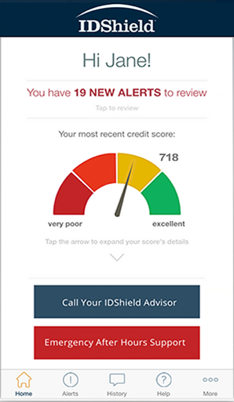
Common types of Identity Theft:
Tax returns
Medical claims
Social Security claims
Credit
Driver’s License
Criminal/Character
You are guilty until proven innocent!
Exclusions and limitations apply. Services and benefits vary by state/province. See www.legalshield.com/fullplandetails [and select your state/province] for specifics. Please review a contract for complete terms, conditions and exclusions before purchase. IDShield is a product of LegalShield, and provides access to identity theft protection and restoration services through an exclusive relationship with Kroll. Neither LegalShield nor its officers, employees, or sales associates directly or indirectly provide identity theft protection, restoration services, or advice.

Slide 29
Monitoring & Alerts
Credit Score
SSN
Passport
Drivers License
Medical ID
Email
Loans
Credit Cards
Bank Accounts
Black Market Website Surveillance
Social Media
Exclusions and limitations apply. Services and benefits vary by state/province. See www.legalshield.com/fullplandetails [and select your state/province] for specifics. Please review a contract for complete terms, conditions and exclusions before purchase. IDShield is a product of LegalShield, and provides access to identity theft protection and restoration services through an exclusive relationship with Kroll. Neither LegalShield nor its officers, employees, or sales associates directly or indirectly provide identity theft protection, restoration services, or advice.

Slide 30
Comprehensive Restoration
Licensed private investigators will:
Do whatever it takes
As long as it takes
Restore identity to its pre-theft status
Exclusions and limitations apply. Services and benefits vary by state/province. See www.legalshield.com/fullplandetails [and select your state/province] for specifics. Please review a contract for complete terms, conditions and exclusions before purchase. IDShield is a product of LegalShield, and provides access to identity theft protection and restoration services through an exclusive relationship with Kroll. Neither LegalShield nor its officers, employees, or sales associates directly or indirectly provide identity theft protection, restoration services, or advice.

Slide 31
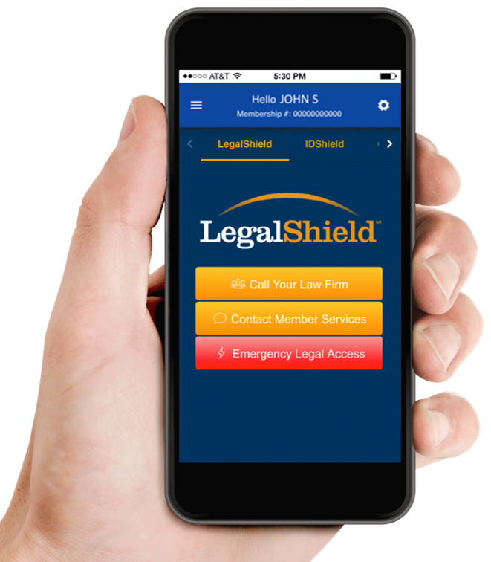
= $49.90/month
($24.95 LegalShield + $24.95 IDShield)
FAMILY
= $9.95/month
($9.95 IDShield)
INDIVIDUAL
LegalShield provides access to legal services offered by a network of provider law firms to LegalShield members through membership based participation. Neither LegalShield nor its officers, employees or sales associates directly or indirectly provide legal services, representation or advice. IDShield is a product of LegalShield, and provides access to identity theft protection and restoration services through an exclusive relationship with Kroll. Neither IDShield nor its officers, employees, or sales associates directly or indirectly provide identity theft protection, restoration services, or advice.
31

Slide 32
Thank You
LegalShield
Marketed by Pre-Paid Legal Services, Inc. dba LegalShield or applicable subsidiary: Pre-Paid Legal CasualtySM, Inc. In Florida: LS, Inc. In Virginia: Legal Service Plans of Virginia, Inc. Pre-Paid Legal Access, Inc. PPL Legal Care of Canada, Inc.
©2017 LegalShield, Inc.
Cook Associate
tmcook.legalshieldassociate.com
eMail: tmcook@legalshieldassociate.com

Slide 33
Our Purpose We PROTECT & EMPOWER People.
tmcook.legalshieldassociate.com
Cook Associate
Notes:
Our Purpose:
We protect and empower people.

