Slide 1
Preliminary Design Review
Vertical Projectile - AIAA OC Section 2018-2019
November 9th, 2018
Notes:
Introductions Jason: Hi my name is jason and I am incharge of the Full Scale rocket.

Slide 2
Contents
Mission Statement
Vehicle Design
Dimensions
Motor
Recovery System
GPS
Air Brake System
Engineering Payload
Risks and Safety
Notes:
Brenda
Read from slide

Slide 3
Mission Statement

Slide 4
Mission Statement
The rocket must reach a target altitude of 4600 ft, deploy its drogue chute at apogee, descend to 600 ft, deploy its main chute, and then deploy the payload, a rover, once the rocket has landed. The rover will then angle its camera towards the rocket and take pictures of the length of the rocket. The pictures will be returned so damage after the flight can be documented via the rover.
Notes:
Adelle
**Rover will not be going down the length of the rocket. It will find the colored area, take a picture, and then the program will end.
Our rocket must reach an altitude of 4600 ft, deploy its drogue chute at apogee, and then descend to 600 ft where it will deploy the main parachute. The payload, a rover, will be deployed once the rocket lands. The rover will be finding a colored band on the body of the rocket, move towards that colored area, then take a picture there. We made a change to the mission statement: the rover will not be moving along the length of the rocket.

Slide 5
Vehicle

Slide 6
Material Justification
Fiberglass body tubes
Affordable
Strong
Fiberglass tape
Keep fins in fin slot
Epoxy
Durable, compatible with fiberglass
Notes:
Catherine
-We chose fiberglass body tubes because they are affordable and strong; we chose fiberglass tape to firmly keep the fins in the slot. Because epoxy is compatible with fiberglass and durable, we chose epoxy to connect the different parts.

Slide 7
Vehicle: System Diagram
Second Event
First Event
Ind. Section 1
Ind. Section 2
Ind. Section 3
GPS
Main Chute
Drogue Chute
Motor
Payload Bay + Sabot
Avionics Bay
Air Brake Module
Notes:
Catherine (explain system diagram)
The rocket separates right above the main chute and right above the drogue chute.
The first individual section, from the top to the bottom, includes our GPS and then our Payload Bay and Sabot. The second individual section, from the top to the bottom, ,includes our Main Chute and Avionics Bay. Finally, the third individual section, from top to bottom includes our Air Brake Module and the Motor.
The second set of fins has been taken out to make sure the rocket is not overstabilized.
Sabot will no longer be ejected with the main parachute ejection. Will be elaborated on in the payload section.

Slide 8
Vehicle: Dimensions
Length: 122.5 inches
Diameter: 4 inches
Semi-Span of Fins 3.25 in
Total Mass: 10987 g
Motor Choice: Cesaroni K1085WT
GPS
Payload
Main Chute
Drogue Chute
Air Brakes
Notes:
Jason, The Length of this rocket vehicle is 122.5 inches or 311.15 cm. It’s diameter is 4 inches. The total mass of the rocket is 10987 g or about 24 pounds with the semi_span of fins at 3.25 inches. The motor Choice is a Cesaroni K1085WT

Slide 9
Vehicle: Dimensions
CG: 82.3643 in
CP: 88.6516 in
Stability Margin at Rail Exit: 3.2 Calibers
CG
CP
Notes:
Jason, The center of gravity is about 82 inches, and the center of pressure is about 88 inches, the stability margin at rail exit is 3.2 calibers.

Slide 10
Vehicle: Dimensions
Thrust-to-weight ratio: 10:1
Rail Exit Velocity:
69.597 fps
Notes:
Adelle
Our thrust-to-weight ratio is 10:1, which exceeds the NASA minimum of 5:1,
And our rail exit velocity is approximately 70 ft/second, which satisfies the NASA requirement of at least 52 ft/second.

Slide 11
Motor Selection Alternatives
Motor | Total Impulse (Ns) | Total Mass (g) | Max Altitude (ft) | Max Velocity (ft/s) | Max Acceleration (ft/s^2)
CTI K661 | 2430.4 | 2528 | 5164.4 | 614.5 | 693.99
CTI K555 | 2406.2 | 2759 | 4886.42 | 547.75 | 693.93
CTI K2000 | 2329.9 | 2465 | 5072.87 | 691.57 | 749.44
CTI K735 | 1955.2 | 2509 | 5149.74 | 661.51 | 693.92
CTI K1085 | 2412.0 | 2430.0 | 5080.44 | 653.06 | 974.61
Notes:
Brenda
The table shows the motor choices considered for the full-scale rocket.
The CTI K1085 falls within NAR requirements for a K class motor where the max total impulse is 2560Ns and the K1085 has a total impulse of 2412Ns.
The weight of the designed rocket for the past two years has been heavier than anticipated. Assuming that the rocket design is heavier than what will actually result, the increased altitude and velocity help to ensure the rocket will reach the target altitude.
Assuming the rocket is heavier, the motor will account for the loss of a couple hundred feet altitude when the actual rocket is built versus on the simulation.
The weight of the CTI K1085 motor is lighter than most of the other motors compared. At 2430 grams, this helps to ensure that the rocket will not end up too much heavier than anticipated.
The burnout time of the K1085 motor is estimated to be about 2.1 (thrustcurve.org) and 2.28 (rocksim) seconds. Due to the burnout being so short, the vehicle will be able to put into use the air brake module the team will design

Slide 12
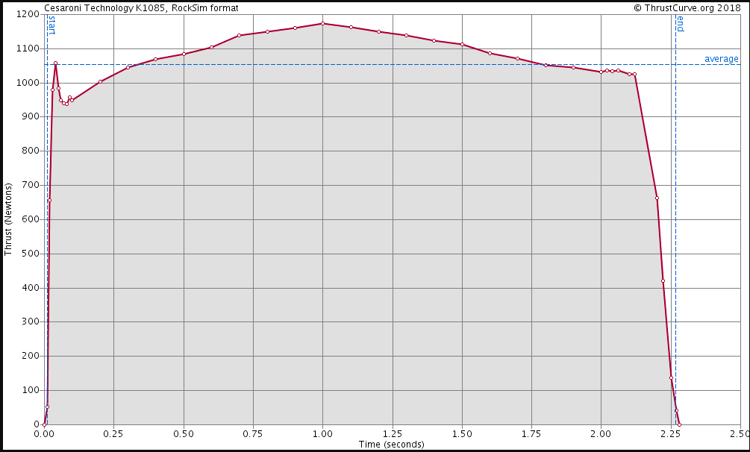
Thrust Curve
Notes:
Brenda
The thrust curve graph shown by thrustcurve.org for the K1085 motor has a larger spike at the beginning of the flight, indicating a higher velocity at first and therefore a straighter flight. This also indicates greater force upon the vehicle and payload. However, we believe that our design will be able to withstand the force.

Slide 13
Subsystems

Slide 14
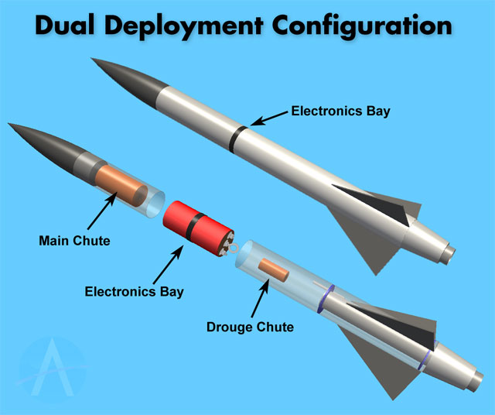
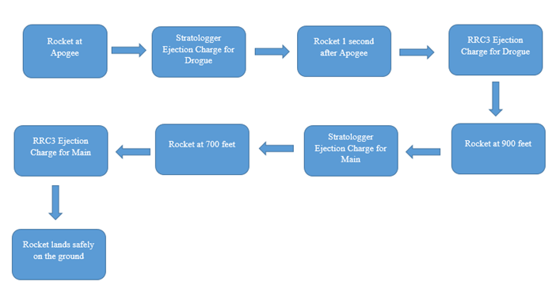
Recovery Subsystem
500
600
Notes:
Shelly
The recovery electronics will be in the avionics bay, a 10.2” tube coupler with a 1” band made of fiberglass body (4” diameter) tube to separate the upper and middle body tubes. The vehicle will use redundant dual deployment for recovery. The top section will be connected to the parachutes via a nylon shock cord, and the avionics bay will also be connected via a nylon shock cord. Recovery will occur in three phases – near apogee a small drogue parachute will be deployed that is designed to slow the rocket for initial descent. Much later, at an altitude of 600 feet, the ejection charge will deploy the main, which is designated to drastically slow down ascent for the purpose of safety.

Slide 15
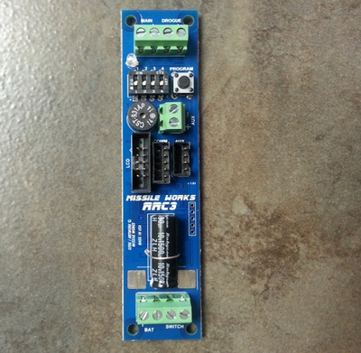
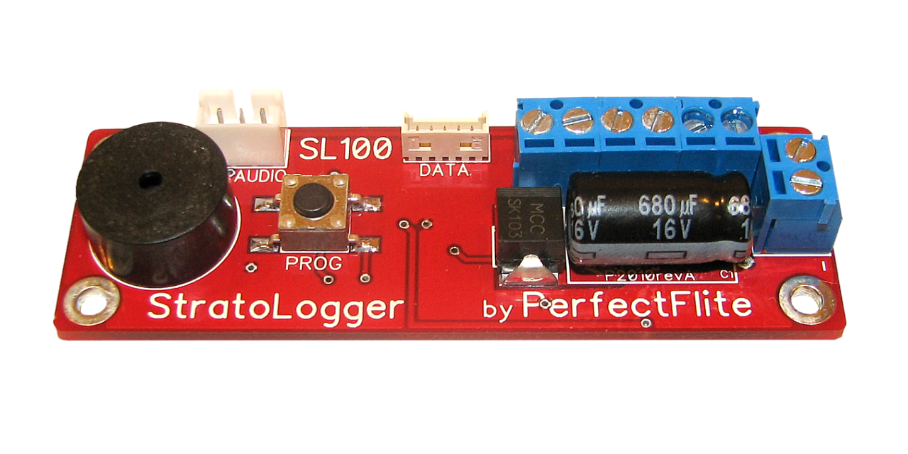
Recovery Subsystem
Primary set of recovery electronics - Stratologger CF Flight Computer
Backup set - RRC3 Flight Computer
Notes:
Shelly
The primary set of recovery electronics will use a Stratologger CF Flight Computer, and the backup set will use an RRC3 Flight computer. In this way, if there is a bug in the design of either flight computer that would affect the recovery during our flight it will not be replicated in the other set of electronics. Each of the two recovery electronics has its own separate commercially available battery capable of powering the electronics for a minimum of 1 hour dwell time plus flight time. That battery is disconnected through an interlock key switch accessible on the outside of the rocket near the nose cone, and this is to ensure that the electronics are not powered on until it is safe to do so on the launch pad. They key can be removed only when the switch is locked ON. The recovery electronics will ignite a measured portion of gunpowder using an electric match. Recovery electronics are totally independent of the payload electronics and power. To assure that the radio frequency signals of other electronics do not interfere with recovery, use a MG Chemicals SuperShield.

Slide 16
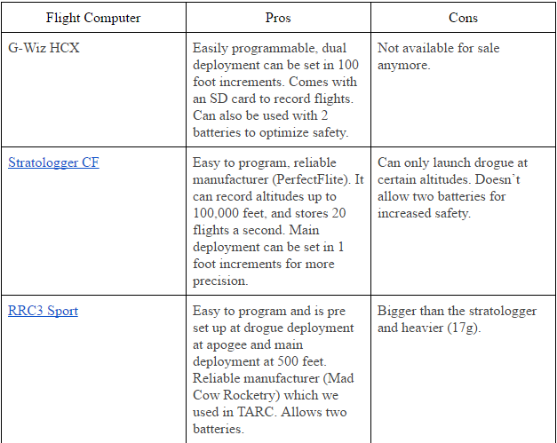
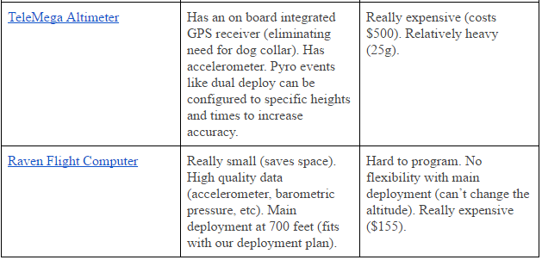
Recovery Electronic Alternatives Considered
Notes:
Shelly
This is a table showing the recovery electronic alternatives that we have considered. After analyzing the pros and cons of each flight computer, we decided to use the Stratologger CF flight computer as our primary flight computer and the RRC3 as our secondary one, keeping in mind cost and ease of accessibility. These two were our cheapest options, since both sold for less than $100. Even though they only provided altitude data, they were also the easiest to program compared to the other options.

Slide 17
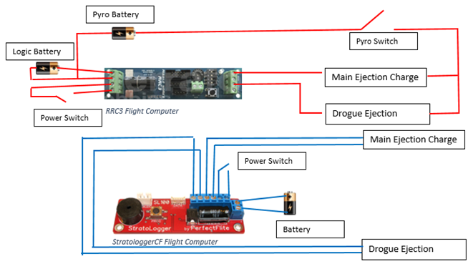
Recovery Subsystem
Notes:
Elsa
Redundancy Dual Replace System
Our main charge and backup charge are totally separated from each other, including the battery.
Main Charge and Backup charge will not eject at the same time; there are 3 seconds difference between their ejection. If the main charge does not work in the launching, 3 seconds later the backup charge will eject.
The picture we put there simply illustrates that the two systems have the same function.

Slide 18
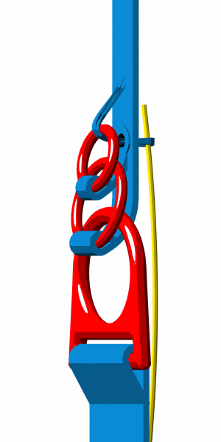
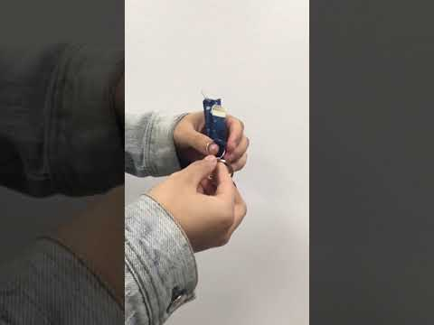
Recovery Subsystem
Deployment:
3-Ring System
https://www.youtube.com/watch?v=T6pXytpAnZ0&feature=youtu.be
Notes:
Elsa
All of the lines connected to the parachute will be detached except one, so that the rover, our payload, will not run over the parachute after the rocket is landed.
3-ring system is really reliable that sport skydivers and military free-fall parachutists use it.
There is an animation on the slide to describe how this system would work. On the right side is a video of our prototype.

Slide 19
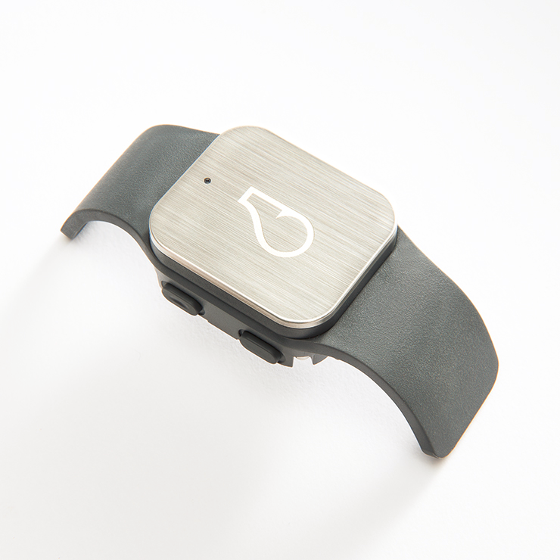
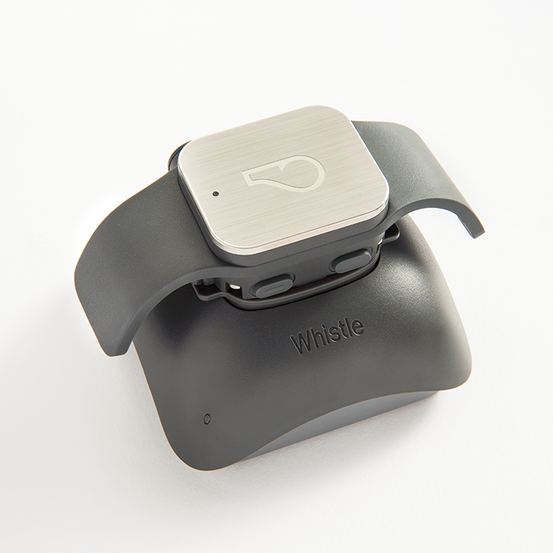
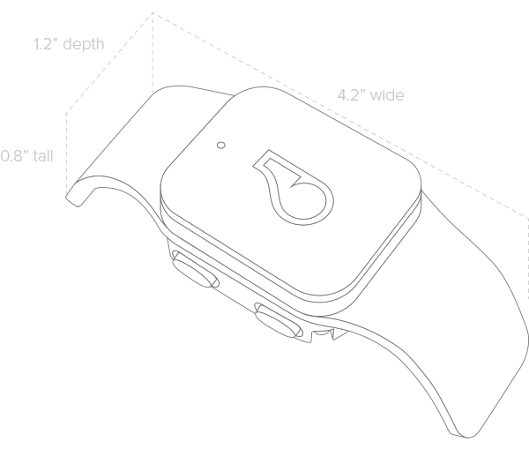
GPS Subsystem
Notes:
Jason: we chose the dog whistle gps system. It is very easy to use and requires little to no knowledge of apps and programming. But it only works with in cellular range.
There are three main subsystems to the Whistle GPS dog tracker: the dog collar, the base station, and the phone app. The dog collar, or the actual GPS device will go inside the rocket, has the following dimension diagram:
It has the dimensions of 4.2” x 0.8” x 1.2” with a mass of 35.44 g, with a battery life of up to 10 days of continuous use. The dog collar will simply be placed into the rocket after being charged from the base station, and no other technical interference is necessary to activate it. The base station, or the charging station of the Whistle GPS, is seen in the diagram:
The base station, pictured above with the Whistle GPS dog tracker piece, has an estimated mass of 300 grams but will not be inside the rocket. In addition to being the charging station of the dog collar, the base station also serves as the telemetry for the GPS. The user (our team) has to set up a whistle zone (the “safe” range) such that when the dog collar leaves the whistle zone the device will start tracking it. The final component of the Whistle GPS dog tracker is the smartphone app. The app will collect the data from the base station wirelessly using cellular networks and will display the position of the rocket in real time)

Slide 20
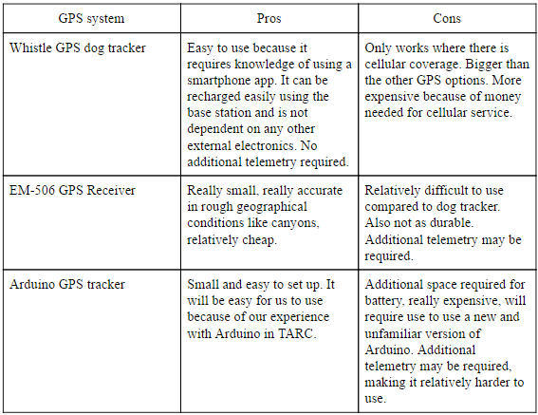
GPS Alternatives Considered
Notes:
Adelle
There were several alternatives for the GPS. We already explained the Whistle GPS dog tracker in the previous slide.
The EM-506 GPS Receiver, one of the alternatives, is small and very accurate in rough geographical conditions, and it is also relatively cheap; however, it is more difficult to use than the Whistle GPS, and is also not as durable.
The Arduino GPS tracker would have been small and easy to set up, especially due to our experience with Arduino in TARC; however, this GPS is very expensive, requires extra space for the battery, and would require us to use an unfamiliar version of Arduino, making it more difficult to use.

Slide 21
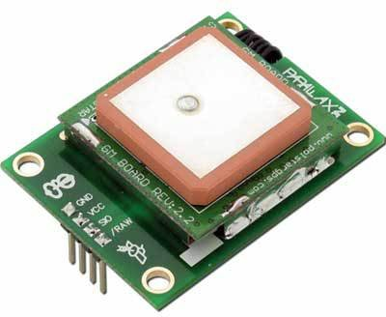
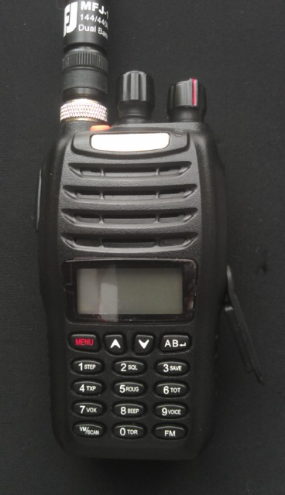
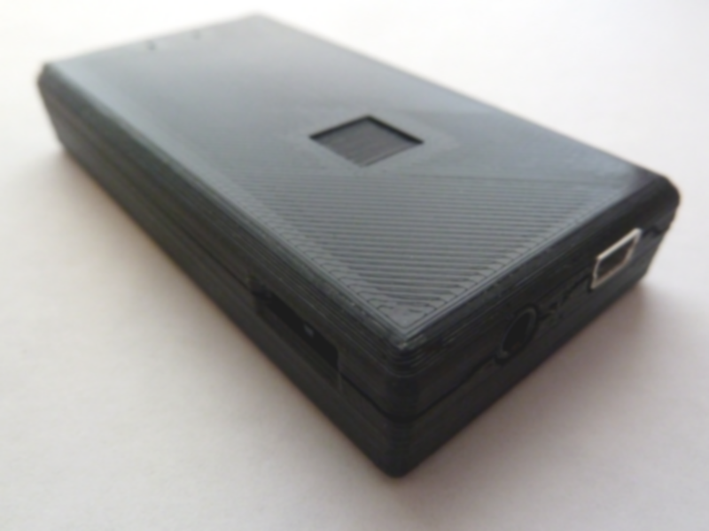
GPS Payload
Consideration: APRSdroid system
Parallax GPS in the payload
Mobilinkd and BaoFeng and APRSdroid system on the ground
Notes:
Brenda
Since we have a payload that leaves the rocket and is not tethered to the rocket, we will be using a Parallax GPS and a Mobilinkd and APRSdroid system for the payload’s GPS. On the right is the Parallax, the part that attaches to the Arduino in the payload, and on the left is the Mobilinkd radio and receiver.
The system requires the use of a HAM radio license, which I have. My call sign will be the one linked to the system.

Slide 22
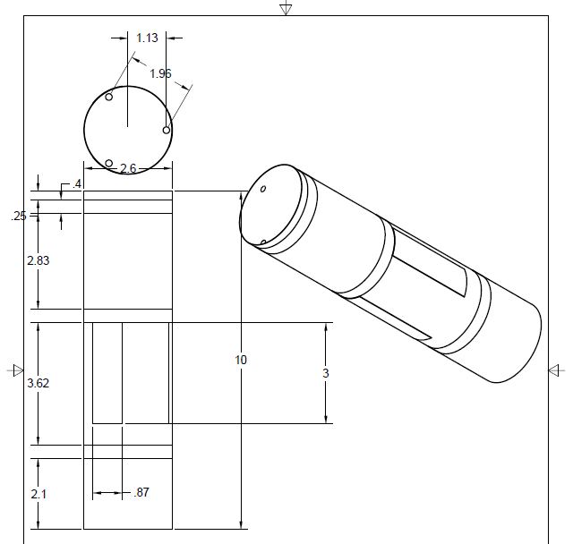
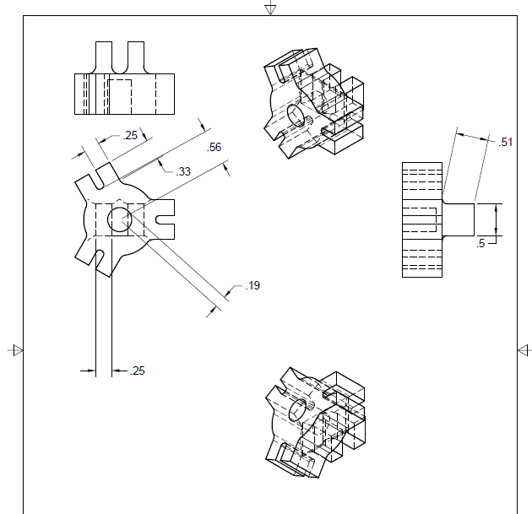
Air Brakes Subsystem
Spider Gear
Air Brake Assembly
Notes:
Aaron
Air Brake Assembly
This is a diagram of the 2.6 inch prototype air brake assembly. The lengths are the same as the 3 inch subscale rocket.
For the 4 inch rocket, there will be 1 more inch of length.
The air brakes themselves are 1 inch wide and 3 inches long.
The bulkheads are 0.40 inches thick
The whole assembly is assembled via three threaded rods with aluminium spacers.
Keeps the bulkheads at specified distances.
Spider Gear
The spider gear is to be put inside the air brake assembly
In the same section as the air brakes
It will be pulled by the air cylinder, and will actuate all three air brakes in an umbrella like fashion
Using control arms cut out of aluminium.
This part will be machined out of aluminium.
Holes will be drilled to allow the air cylinder to mount to the gear and to allow the gear to actuate the air brakes.

Slide 23
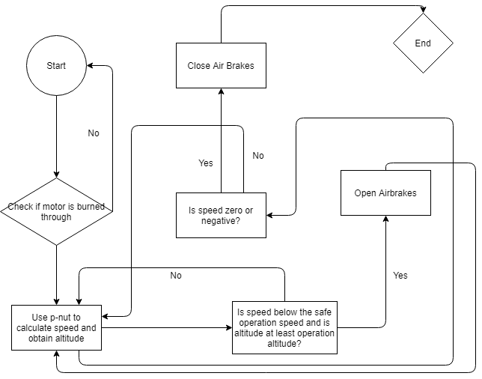
Air Brakes Subsystem
Air Brake Algorithm
Notes:
Eric
This is the method we use for determining when to use the airbrake ,to avoid frequent opening and closing of the airbrake.

Slide 24
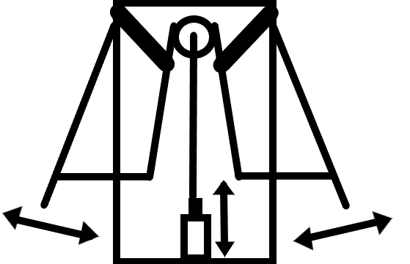
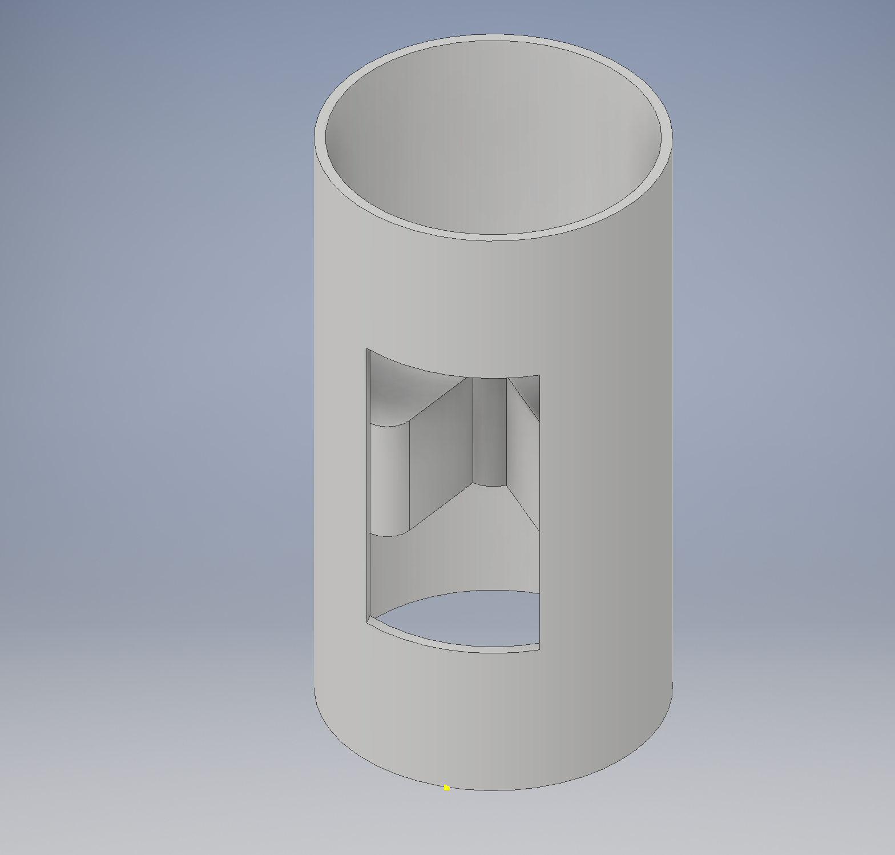
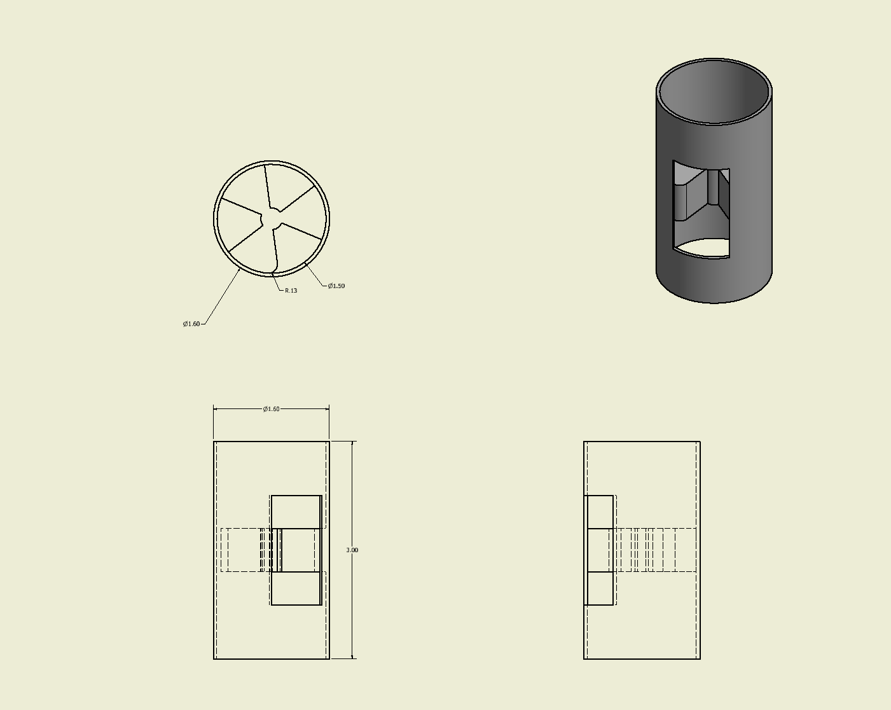
Air Brake Alternatives Considered
Solenoid
Electric Motor
Notes:
Aaron/Eric (each explain one)
Solenoid(Aaron)
The solenoid design is very simple, exactly like the leading design
It will utilize a solenoid in place of the air cylinder
Due to overheating concerns, the algorithm is different from the lead algorithm, with the solenoid being actuated in 2 second intervals in order to prevent the solenoid from overheating.
Electric Motor(Eric)
A motor will cause the three fans to spin and push the airbrake out.

Slide 25
Engineering Payload

Slide 26
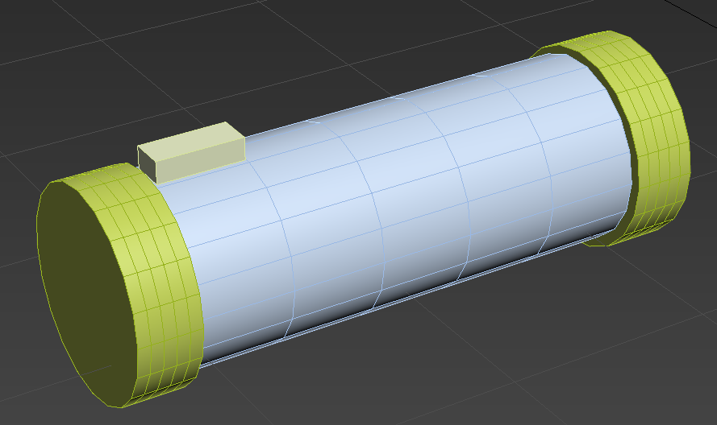
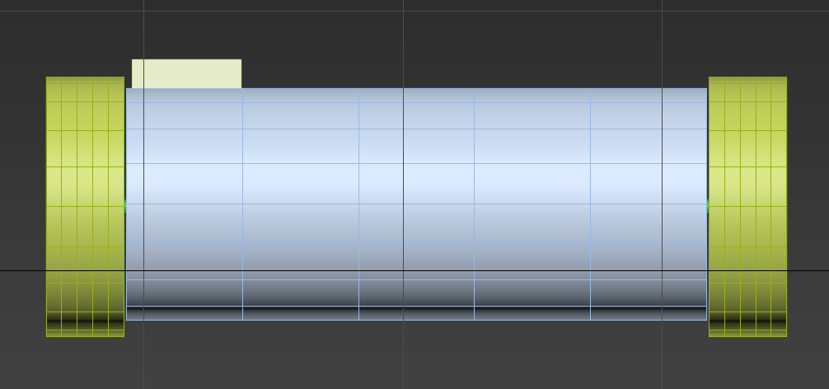
Rover
Camera
This is the basic outlook of our rover.
Notes:
Joseph
As you can see. The box that on the top is the camera. Only the wheel will spin while it is moving.
The reason why we did not put the camera in the front is the camera size doesn’t fit in if we place it in the front.
Since we decide to use the difference between two wheels to make the rover able to change the direction, so I didn’t leave space for the wheels to turn left or right.

Slide 27
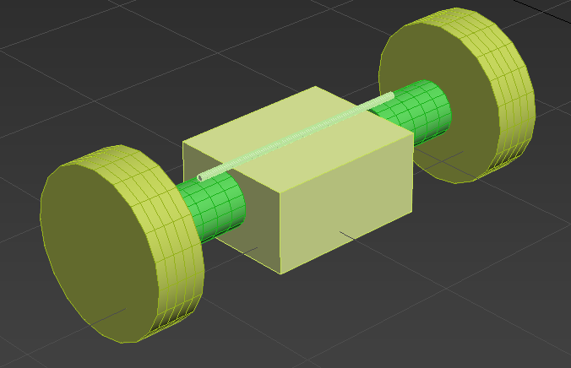
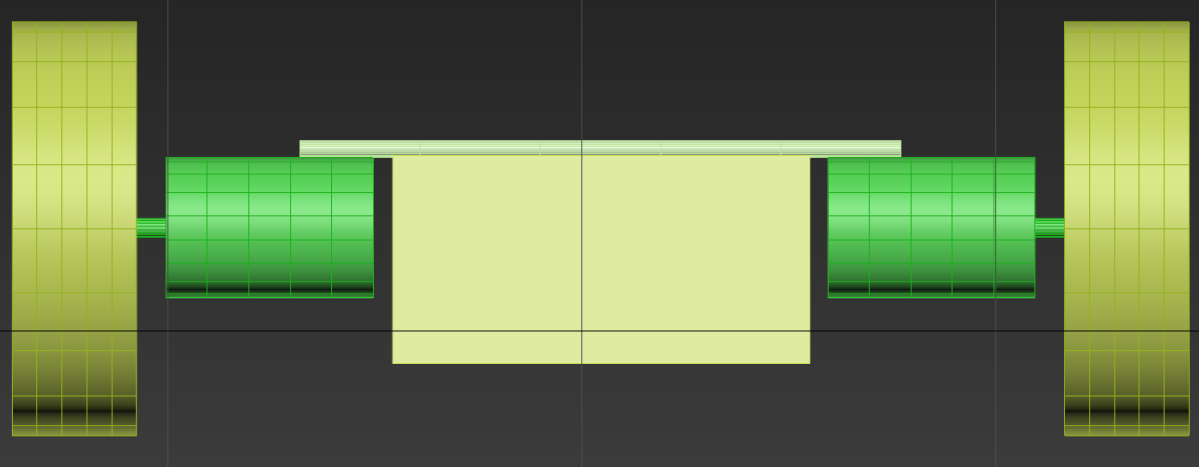
Rover
Inside of Rover
Basic component distribution of the rover.
Notes:
Joseph
This is the rough draft of inner component distribution of our rover.
The box is used to contain the main electronic component like arduino board.
The green cylinders are motors, which are connected by a metal stick on the top.
This metal stick is also used to stable the box.
The yellow cylinders are wheels, which are separated in order to enable them to spin in different speed.

Slide 28
Payload Alternatives
Notes:
Hugo/Joseph/Catherine(The Tank)/Eric(IDC), (Each explain one alternative)
The IDC is what our current rover design is based on.
Joseph: The BB-8 model designed by two of our youngest member. This idea is interesting because of magnet, but this is also a huge challenge for the team. And the shape of it will not fit in our container.

Slide 29
Rover - Task
Notes:
Ekas
There are three main steps in the completion of the task of the Rover which is our leading design. The First step the rover must complete is to snap a picture of the rocket and then proceed to send this back to the ground station. The next step is for the rover to make a circle around the area that it will travel in order to give us at the station a better understanding of the terrain where it will proceed to scan the area for a green band. If unable to find this band, it will rescan the rocket to find it. Lastly, after calculating the distance and the angle to the green band, it will travel to it and take a picture thus ending the task of the Rover

Slide 30
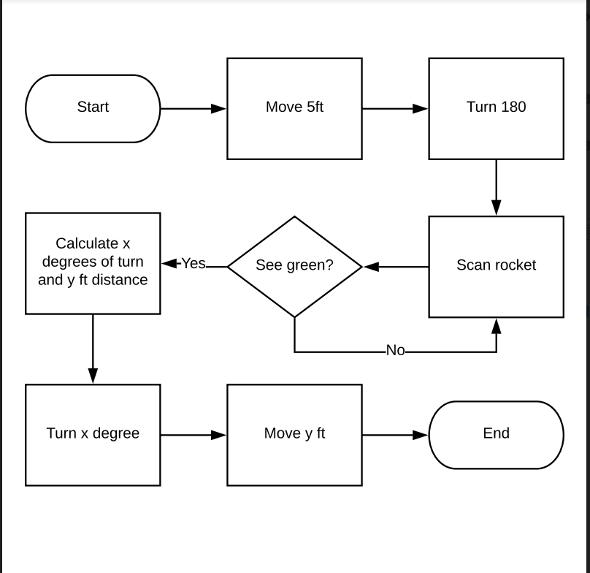
Rover - System Diagram
Notes:
Hugo /

Slide 31
Payload Release Mechanism
Yoke
Red Line -> Fishing Wire
Bearing
Servo
Notes:
Brenda
Due to safety concerns of the sabot, we will not be using the sabot design for the release of the rover. Instead, we’re going to use pistons to push the rover out.
Rover will be placed inside the sabot, which will be pushed out with the rover. The sabot is to protect the rover from the black powder charges. The shock cord will go above the sabot and connect to a machine closed eyebolt.

Slide 32
Calculations

Slide 33
Kinetic Energy
Kinetic Energy of Each Section (Ft-lbs) Main Chute | Section 1 | Section 2 | Section 3 | Section 4
 | 26.5272 | 14.4321 | 49.663
Kinetic Energy of Each Section (Ft-lbs) Drogue Chute | Section 1 | Section 2 | Section 3 | Section 4
 | 628.1598 | 341.536 | 1176.0125
Notes:
Eric
This is the calculated KE.
Found out mass of rocket parts using Rocksim
Found out velocity of main chute and drogue chute from fruity chutes
Plugged into the equation (½)mv²

Slide 34
Drift
Wind Speed (mph) | 0 | 5 | 10 | 15 | 20
Drift (ft) | 0 | 617.4058 | 1234.8116 | 1852.2174 | 2469.6232
Notes:
Eric
Mass is underestimation so that when wind is 20 mph, the drift is under 1 mile

Slide 35
Safety
Notes:
Brenda
The following slides are about the safety of the project. The team has heavily considered safety into all aspects of the project. The following slides showcase the charts and tables used. We will only briefly mention these. They are featured in detail in our PDR report.

Slide 36
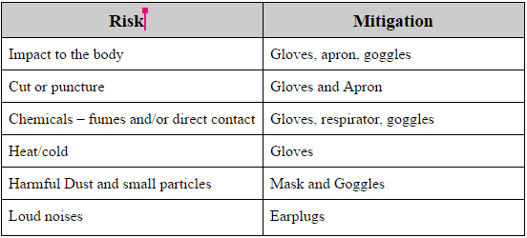
Safety
The following items will be present and available for team member use whenever they are working, constructing the vehicle or payload, or launching.
Safety goggles
Rubber gloves
Protective aprons
Ear Plugs
Leather gloves
Respirators / Dust Masks
Notes:
Hugo / The following chart shows the possible hazards during construction. Mitigations include gloves, goggles, and masks.

Slide 37
Safety
Eye protection must be worn whenever there is a danger of:
Dust, dirt, metal, or wood chips entering the eye. This can happen when sawing, grinding, hammering, or using power tools.
Strong winds during a launch (common at Lucerne Dry Lake)
Chemical splashes when using paints, solvents, or adhesives
Objects thrown (intentionally or inadvertently) or swinging into a team member
These types of gloves must be worn to protect the team member’s hands whenever there is danger of contact with a hazardous material:
Latex or rubber gloves for possible contact with hazardous chemicals such as adhesive, paint, or thinners, or dangerous solid materials.
Leather gloves to protect against impact, cuts, or abrasions (e.g. in the use of some power tools such as grinders)
Notes:
Hugo /
The following slide determines conditions where eye protection and gloves are necessary.

Slide 38
Safety
Team members will always work in a clean, well-ventilated area. Protection for a team member’s lungs (dust mask or respirator) must be used when:
Working with chemicals emitting fumes (e.g. paints and solvents). In this case, the team member must wear a respirator.
Working in an environment where there is dust (e.g. sanding and working with power tools). The team member must wear a dust mask.
Body protection, such as an apron must be worn whenever there is danger of:
Splashes or spills from chemicals
Possible impact from tools
Ear protection (plugs or ear muffs) must be worn whenever there are loud noises present, which include:
Using loud power tools or hammers
Launching larger rocket motors at launches
Notes:
Hugo /
The following slide determines when masks, ear protection, and body protection must be used.

Slide 39
Vehicle Risk Mitigation
The engine fails to ignite when launching the rocket. | Team members will make sure that the igniter is inserted into the engine completely, securing the connection between the engine and the igniter.
The engine is too loose or tight for the motor casing. | Team members will make sure the motor casing matches the corresponding engine size and that the motor casing fits into the motor mount without being too loose or too tight.
The air brakes don't function in flight. | Electronics will be activated at ground level for a test of the air brakes functions. Before the assembly of the whole rocket, the motor for the air brakes will be checked for its functions.
The rocket body bends inward on itself. | The materials used for the body tubes is fiberglass, which can stand against considerable amounts of outside forces. The flight boards, bulkheads, and centering rings on the inside of the body tubes will also support the circular structure of the body tube.
The quick links are not attached securely. | Team members will ensure that all connections between the body tubes and other parts of the rocket are assembled correctly before launching. A checklist will be written for the above tasks, members will be checking and signing off each of the tasks when completed.
The ejection charge does not have enough force to shear the shear pins. | The force required to shear the pins will be accurately noted when they are purchased. Black powder ground tests will be performed to make sure that the force provided from the ejections charges exceeds the force that the pin can withstand. To further make sure that the pin will shear, the backup charge will provide a greater force.
The electronic matches move outside of their specified area. | Team members will make sure that the matches are tightened in their specified area before attaching the shear pins. This task will be placed on the pre-launch checklist.
The motor explodes. | As a high school team, we are not allowed to build the motor and the construction of said motor will be done by a certified individual. The team will ensure that while the motor is in our hands, assuming that it has been assembled correctly, the motor will not be damaged nor will we alter the motor in a way that could cause a malfunction.
Parachute does not deploy because of packing issues. | Team members will check that the parachute is packed correctly into the body tube before launch and make sure the ejection charges will separate the body tubes when parachute is ready to deploy via black powder tests.
Notes:
Catherine
The following shows risks to the vehicle and mitigations. The least severe risks are in yellow, and the most severe are in red.

Slide 40
Payload Risk Mitigation
The camera malfunctions. | Team members will make sure the camera is turned on and functions correctly before the launch.
Batteries are not fully charged. | Team members will make sure to charge battery to max capacity before launch
Batteries fail. | Before launch, team members will use a voltmeter to check if the battery is functional and fully charged.
Payload doesn’t deploy | Before launch, the release mechanism of the sabot will be checked by team members to see if the payload can be released.
The wheels don’t move. | The payload will be tested by team members before the launch to see if the wheels can spin freely and move the rover on ground.
Payload unable to move on ground due to dirt. | The payload is equipped with a mechanism that scoops the dirt of the wheels after ever rotation, however, it will still be tested before the launch to see if the mechanism is capable of clearing the dirt of the wheels.
Payload deploys early due to loose sabot. | Team members will make sure that the sabot is not damaged or loose before the launch to ensure the rover doesn't drop from the rocket.
Notes:
Ekas
The following shows risks to the payload and mitigations. The least severe risks are in yellow, and the most severe are in red.

Slide 41
Recovery Risk Mitigation
The backup charges do not go off. | Team members will check if the RRC3 is beeping in the sequence that is shown on the manual.
The backup electronics batteries disconnect. | Battery holders and zip ties will be used to secure the battery in its position. The sturdiness of the battery holder and zip ties will be check before every launch by team members.
The backup RRC3 flight computers are shut down. | Team members will check if the flight computers are beeping and and signing their names on the checklist.
The drogue chute deployed at the incorrect altitude. | Team members will check that RRC3 and the Stratologger are both beeping in their respective sequences as shown on their manuals.
The air brakes not closing during descent and influencing the recovery. | Team members will upload the most recent code from the computer to the arduino and check if the arduino’s respective LED light is blinking.
The drogue chute doesn't deploy. | Team members will make sure the electronics are turned on and check if they are beeping, and members who checked will sign on the checklist. The backup ejection charge can also resolve this issue.
The main chute doesn't deploy. | Solutions include both the backup Flight Computer and the backup ejection charges.
The Stratologger CF Flight Computer is shut down. | Team members will check the Stratologger is beeping in its respective sequence as shown on the manuals, they will sign their names on the checklist after.
The main battery disconnect. | Brand new batteries will be used, and a test will be contacted right before the launch to see if all of the electronics can be powered up correctly.
Notes:
Elsa
The following shows risks to the recovery and mitigations. The least severe risks are in yellow, and the most severe are in red.

Slide 42
FMEA for Environmental Concerns
Potential Issues/ Failure Mode | Potential Failure Effects | Severity (1-10) | Potential Causes | Occurrence (1-10) | Mitigation
Wind speeds are unsuitable for launching the rocket. | If rocket is launched, rocket will fly in an unstable manner, making it difficult for performing proper tasks. | 6 | Environmental conditions are not suitable and worsen as the day proceeds at Lucerne Dry Lake. | 6 | Launch rail can be tilted at an angle that is with the wind in correlation with the speed of the wind. If wind speeds are too strong, the team will wait for conditions to improve.
Rain falls when the rocket is on the launch pad or in preparation. | Drag increases, resulting a possible lower altitude for the rocket. Stability also decreases. | 5 | Weather conditions are not suitable. | 4 | Rocket will be launched if rain is light; if rain is too strong, the team will wait for conditions to improve.
A fire can spread to the surrounding environment. | The launch site can catch on fire, resulting in damage to the nature. | 9 | Rocket can malfunction and once it lands, a fire can begin. Malfunction of the motor, sparks or ignition can set the rocket on fire. | 0 | If the rocket does catch on fire in any way, no parts of the environment will catch on fire. There is only dirt at Lucerne Dry Lake for miles. No grass is near the launch site.
Notes:
Adelle
This shows a part of the FMEA chart for the environment. The full chart is in the PDR Report

Slide 43
FMEA for Design Concerns
Potential Issues/ Failure Mode | Potential Failure Effects | Severity (1-10) | Potential Causes | Occurrence (1-10) | Mitigation
Battery for the rover (payload) explodes or fail. | The rocket can be damaged, forcing a complete redesign and new construction process. | 9 | Incorrect wiring or the battery cannot withstand certain malfunctions in the coding. | 1 | The team decided to switch to a 9 volt battery to better suit the payload. A checklist will be followed when constructing the rocket so no incorrect actions will occur.
The Rover fails to deploy after landing | Experiment cannot be conducted. Sparking could occur within the rocket. | 5 | Wiring is incorrect. Battery was not activated, or no connection in the circuit. | 1 | A checklist will be followed during construction and when preparing the rocket to launch.
The rocket does not fly in a stable manner. | Altitude might not be met. Damage to the rocket can occur. The rocket will fly uncontrollably, possible hurting someone. | 6 | While constructing the rocket, mass change might have occurred. During the design process, stability margin might not have been considered. Weather conditions also influence instability. | 3 | Stability margin is always looked at when designing the rocket and when making any changes to that design. Weather conditions will be monitored, and the rocket will not be launched in unsafe conditions.
Notes:
Joseph
This shows a part of the FMEA chart for the design of the vehicle. The full chart is in the PDR Report

Slide 44
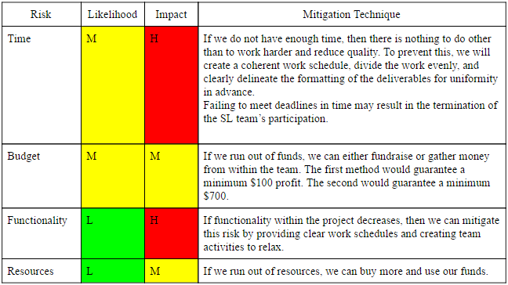
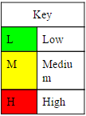
Project Risk Identification
Notes:
Brenda
We listed risks to the project that would prevent it from continuing. These risks are not associated with flight.

Slide 45
Thank You!
Notes:
Redo fly sheet
Elaborate on piston mechanics
Keep some of the safety related payload requirements
Active retention system
Hook release system
Locked if run out of power.
Actively hold rover inside bay
Altimeter -> check to make sure that the rocket is on the ground
Then push out sabot
Natural state of piston
Sabot should not be able to move.
Change piston mechanics so that the release of the rover is manually controlled
Range Deployment Area to release the rover * start deployment of rover
3-ring system
1” nylon shock cord to create the system
Probably not allowed. 95%
Delta Review
Email appointment
Possibly Monday 26th or 27th at 6am PST
Issue with the 3-ring system
And issue with making the system.
Possibly buy one instead.
Prepare defense for 3-ring system
See if you can purchase system.

