Slide 1
Renal Cell Carcinoma
Laura S. Wood RN, MSN, OCN
Renal Cancer Research Coordinator
Cleveland Clinic Taussig Cancer Center

Slide 2
Objectives
Delineate key guideline recommendations for diagnosis, staging, and treatment algorithms for patients with advanced renal cell carcinoma
Distinguish between targeted therapy and immunotherapy with respect to treatment options in advanced renal cell carcinoma
Discuss toxicity profile of systemic therapies approved for
renal cell carcinoma
Describe the role of nurses and advanced practitioners in managing treatment-related toxicities and maximizing clinical outcomes

Slide 3
Renal Cell Carcinoma
63,900 new cases
14,400 deaths
2.5 % of all cancers
Male : Female 3:2
Median age ~ 64 yrs
Siegel RL et al. CA Cancer J Clin. 2017.

Slide 4
Renal Cell Carcinoma: Diagnosis
Local symptoms
  Hematuria
  Flank pain
  Palpable mass
Systemic symptoms
  Due to metastasis or paraneoplastic syndrome secondary to protein secretion
    Hypercalcemia: parathyroid hormone-related protein
    Hypertension: renin secretion
    Erythrocytosis: erythropoietin secretion

Slide 5
Case Study # 1
54 year old male, non-smoker
Hypertensive 145/78 on amlodipine 10mg daily x
4 years
Presents to PCP with right flank pain for 6 months and mild cough

Slide 6
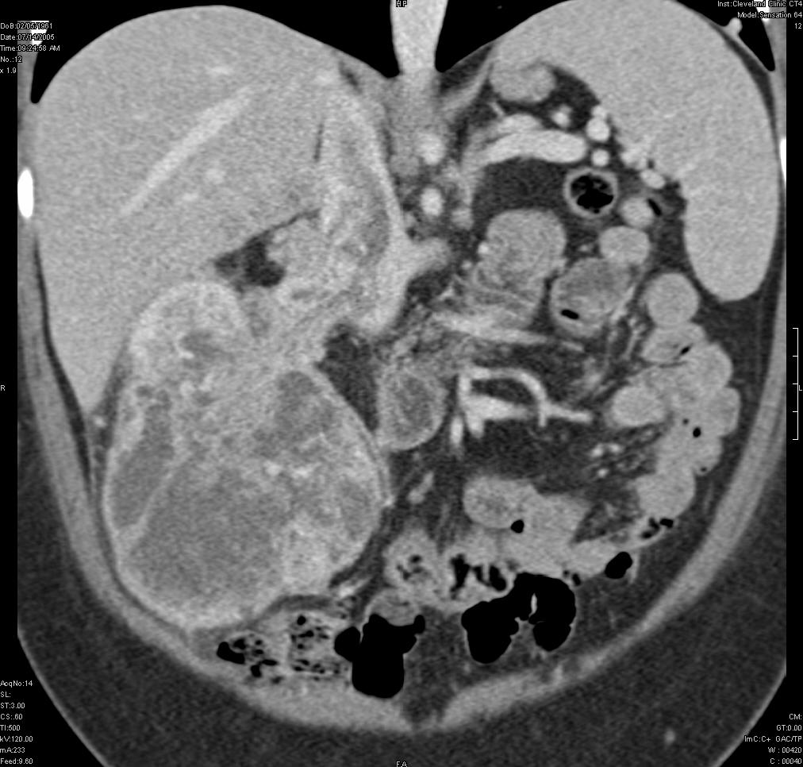
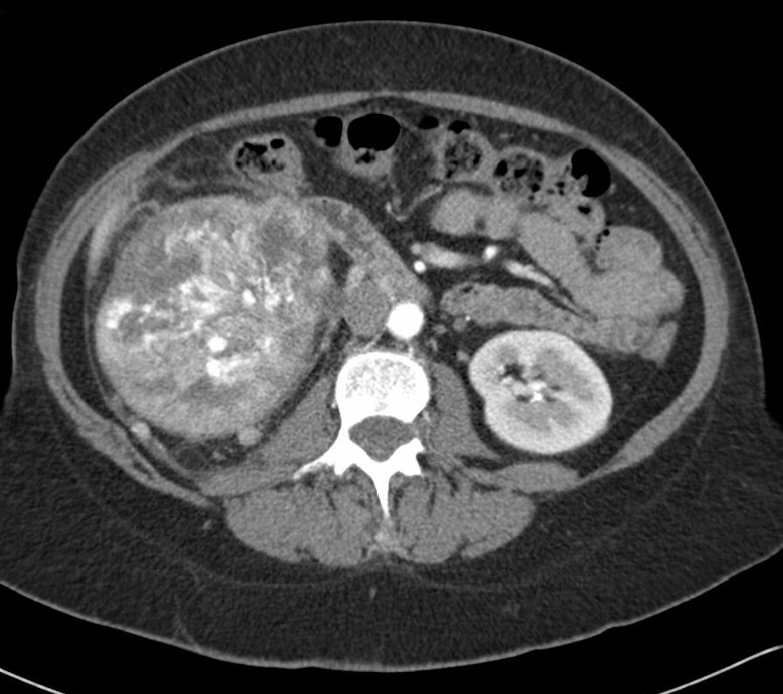
Case Study # 1

Slide 7
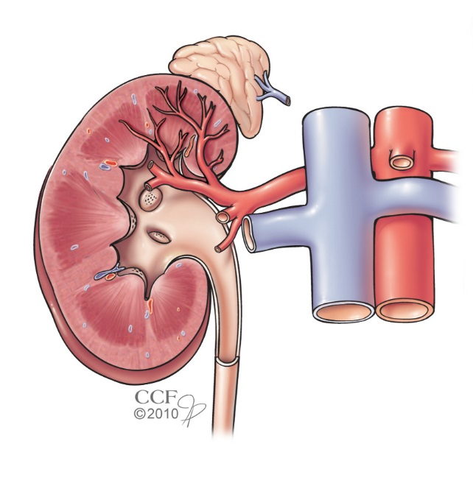
Surgical Intervention
Radical nephrectomy
Nephron-sparing surgery
  Partial nephrectomy
Open or laparoscopic procedure
Probe ablation
  Cryotherapy
  Radio-frequency ablation (RFA)

Slide 8
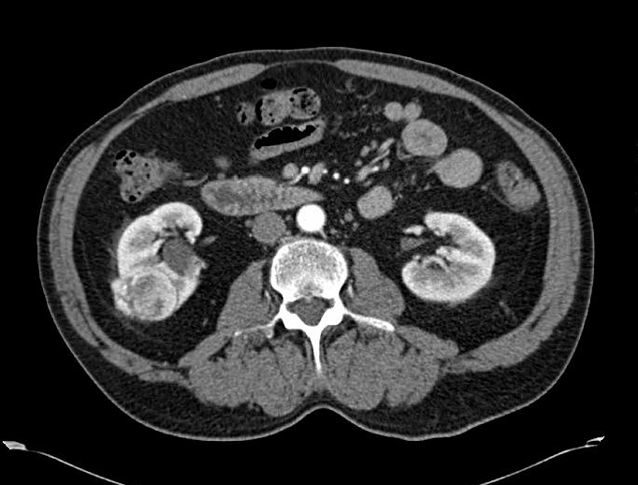
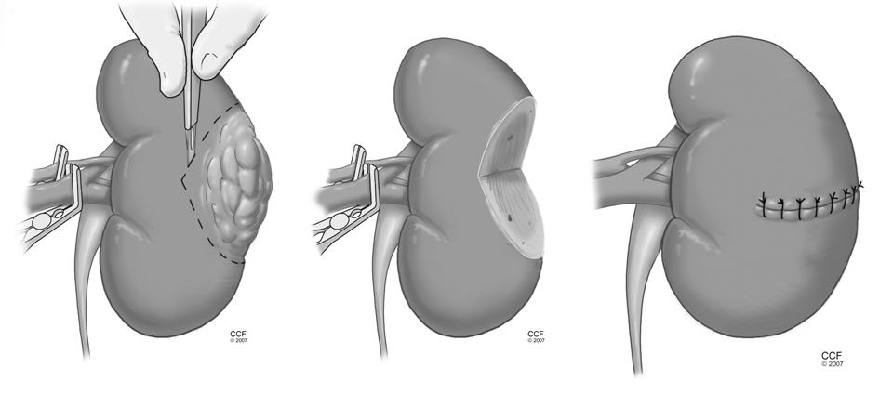
Partial Nephrectomy

Slide 9
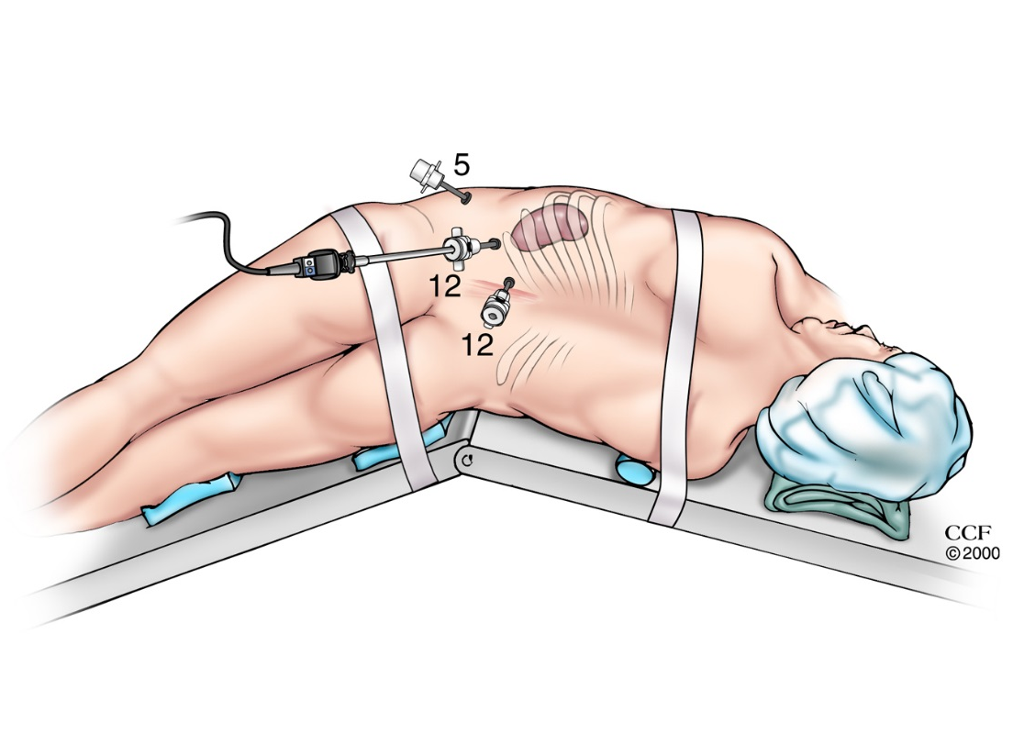
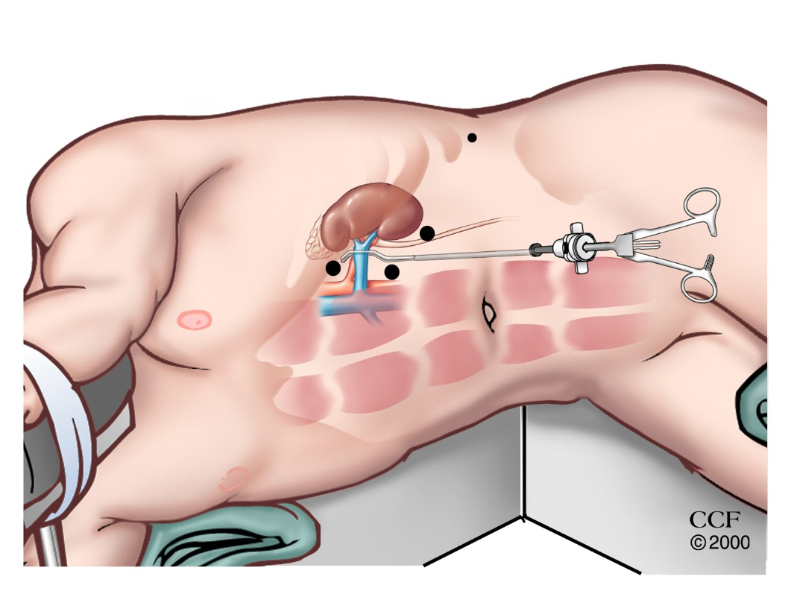
Laparoscopic Surgery
Retroperitoneal Approach
Transperitoneal Approach

Slide 10
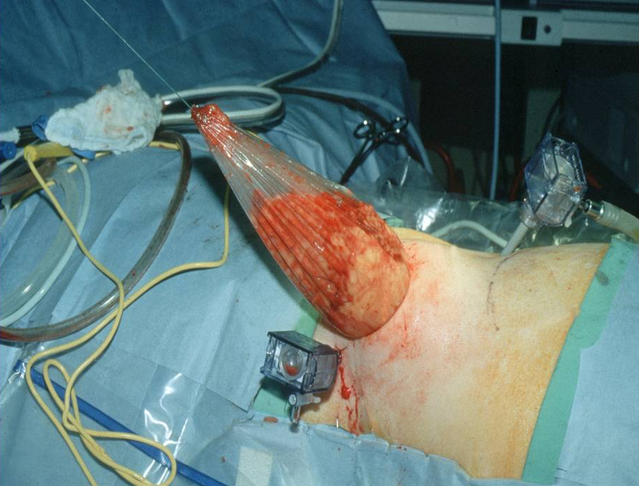

Slide 11
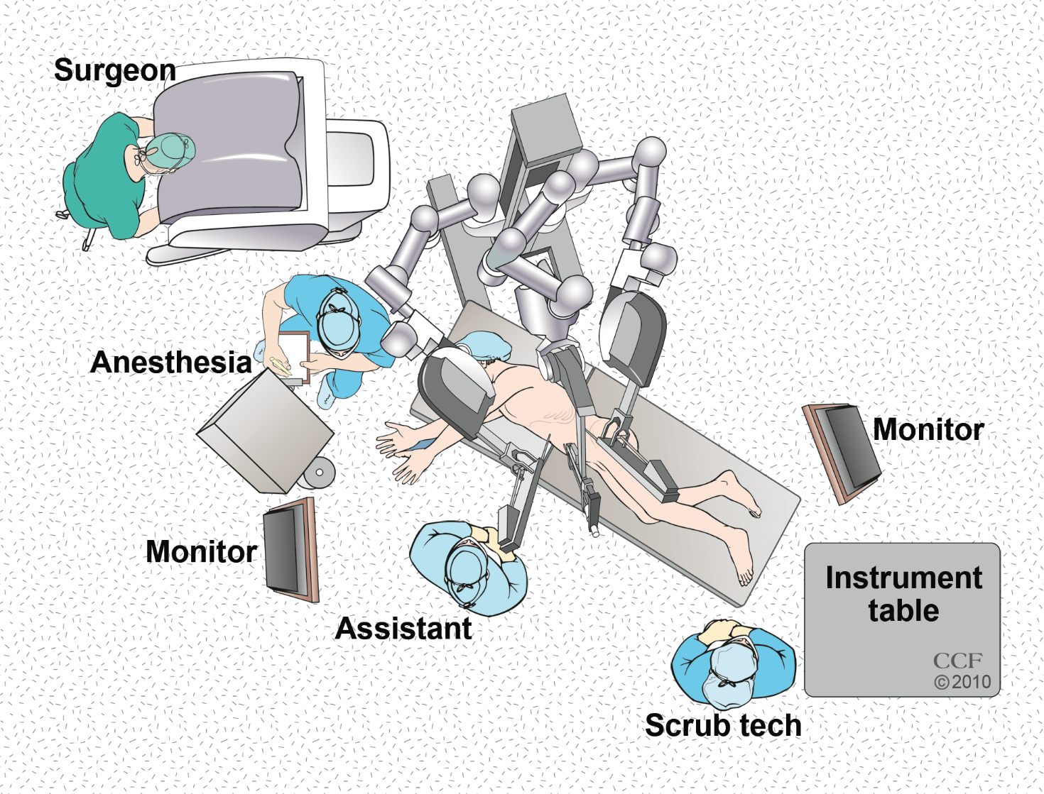
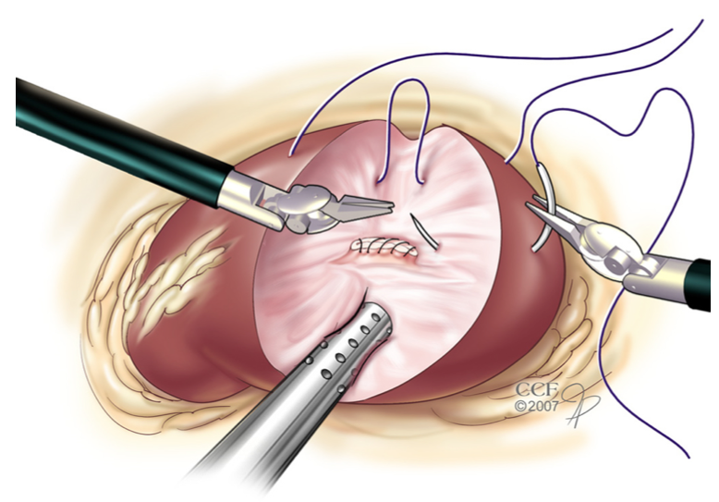
Robotic Surgery

Slide 12
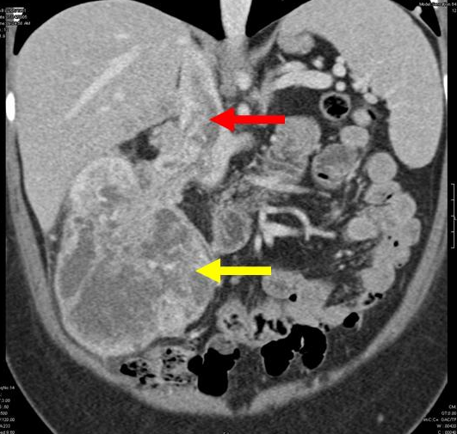
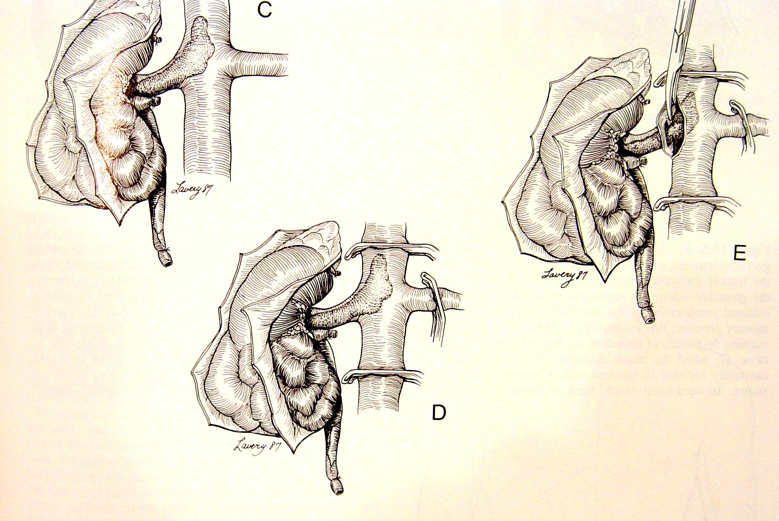
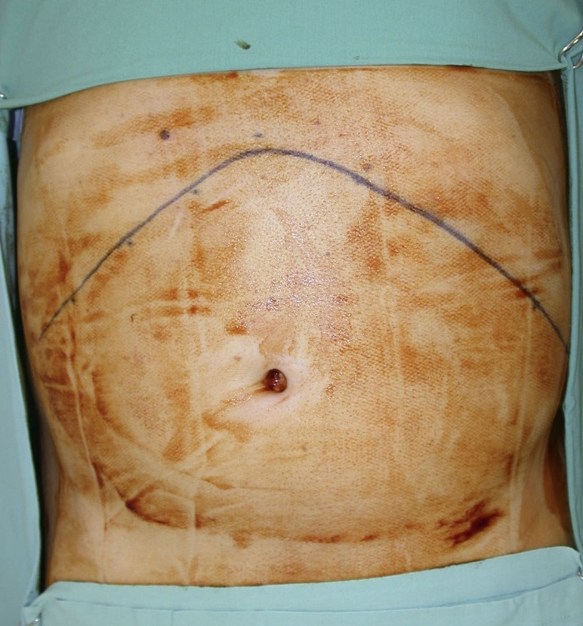
Case Study # 1
IVC Thrombectomy

Slide 13
Indications for Ablative Procedure
Small tumors
Poor anesthesia risk
Older patients with significant co-morbidity
Compromised renal function
Partial nephrectomy technically challenging
Multiple tumors

Slide 14
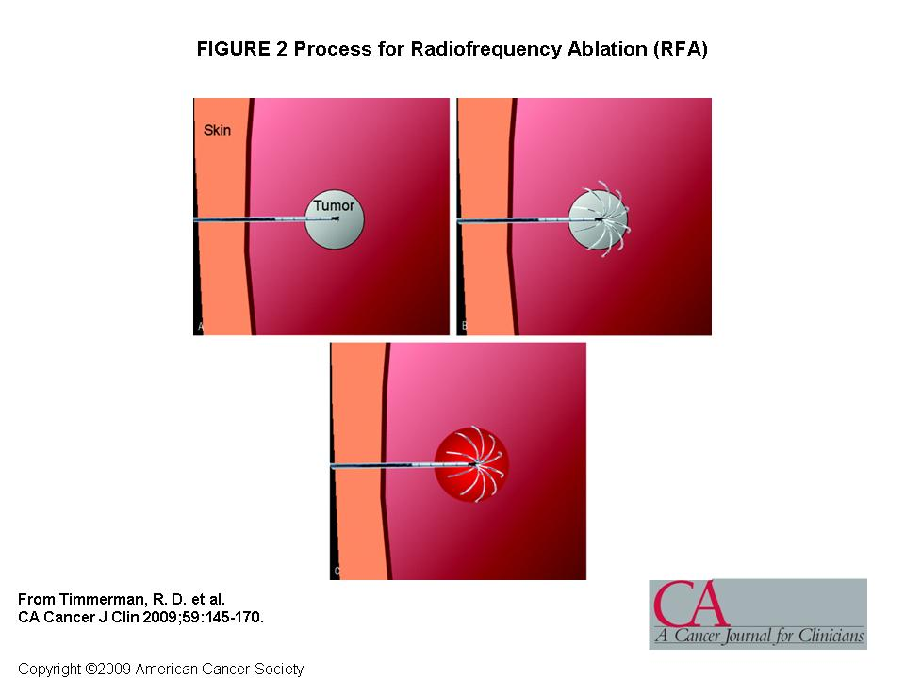
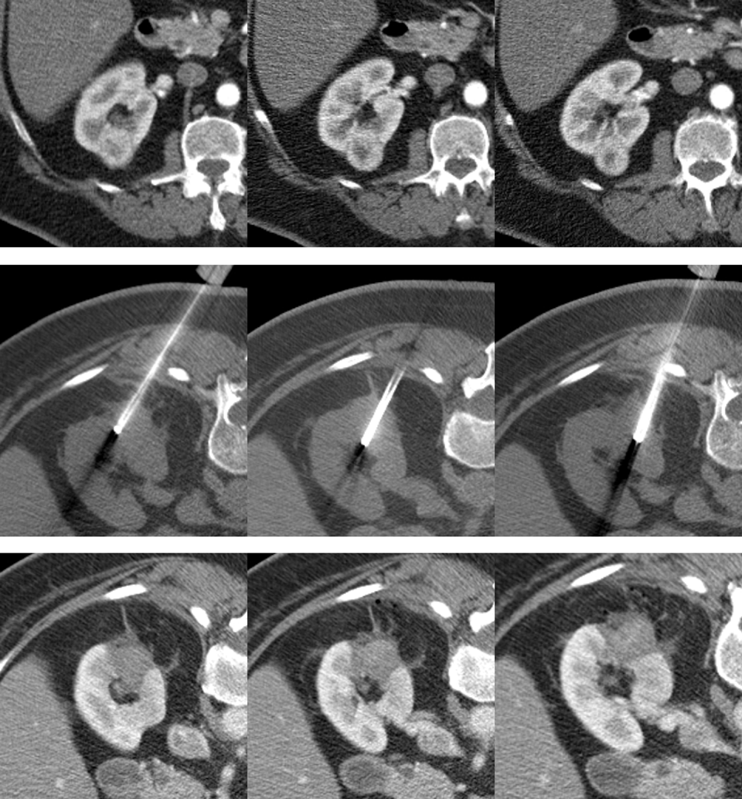
Radiofrequency Ablation: RFA

Slide 15
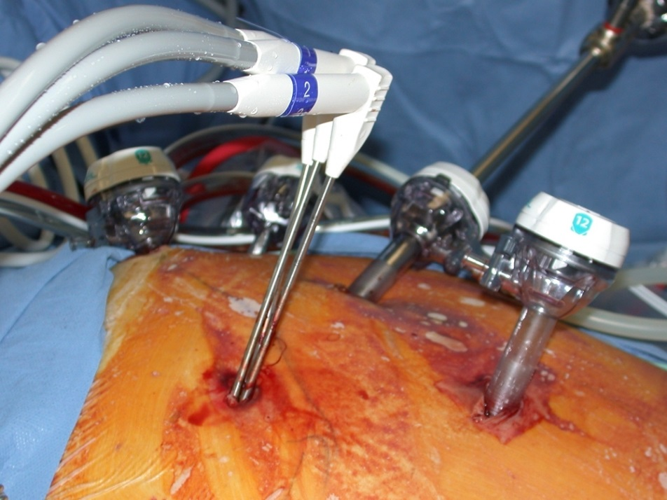
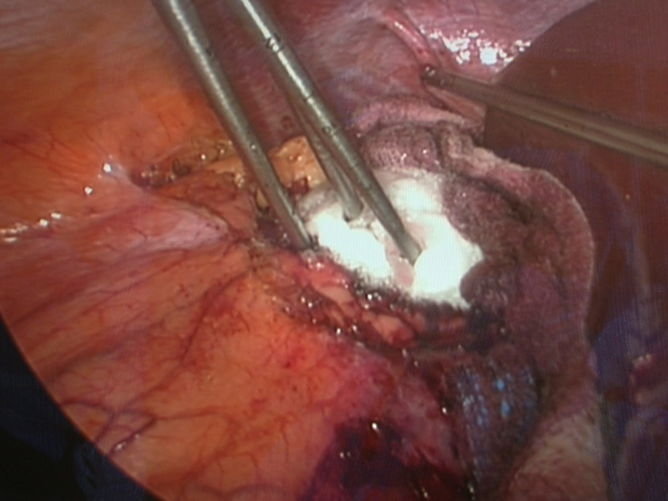
Cryotherapy
Probe Placement
Freeze Ball

Slide 16
Cytoreductive Nephrectomy
Improved survival in patients treated with cytokine therapy^{1, 2}
Phase II studies have demonstrated feasibility of surgery following targeted therapy^{3,4,5,6,7}
Phase III trials are ongoing
  Who are the appropriate patients?
  Which therapies provide the greatest benefit and least risk ?
  What is the appropriate duration of neo-adjuvant therapy?
1. Flanigan et al. NEJM. 2001. 2. Mickisch et al. Lancet. 2001. 3. Margulis et al. J Urol. 2008. 4. Thomas et al. J Urol. 2009. 5. Jonasch et al. JCO. 2009. 6. Klink et al. JCO. 2012. 7. Rini et al, in press 2012.

Slide 17
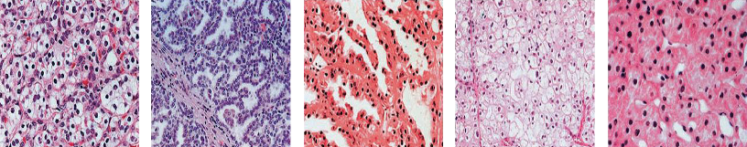
Histological Classification of Human Renal Epithelial Neoplasms
RCC
Type
Clear cell
Papillary type 1
Papillary type 2
Chromophobe
Oncocytoma
Incidence
75%
5%
10%
5%
5%
associated mutations
VHL
c-Met
FH
BHD
BHD
BHD=Birt-Hogg-Dubé, FH=fumarate hydratase, VHL=von Hippel-Lindau.
Linehan WM et al. J Urol. 2003.
Notes:
References
1. Linehan WM et al. The genetic basis of cancer of the kidney. J Urol. 2003;170:2163-2172.
2. Kim WY. J Clin Oncol. Role of VHL gene mutation in human cancer. 2004;22:4991-5004.
3. Kidney Cancer Association. Kidney cancer subtypes. Available at:
http://www.curekidneycancer.org/index.cfm?pageID=85. Accessed January 23, 2007.

Slide 18
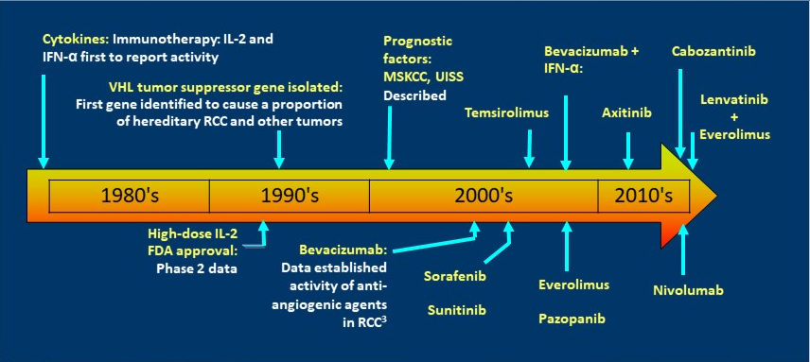
The Last Decade in RCC Drug Development

Slide 19
RCC Therapy in 2017
Immunotherapy
  IL-2
  IFN-α
  Nivolumab
VEGF Inhibitors
  Sunitinib
  Sorafenib
  Pazopanib
  Bevacizumab + IFN-α
  Axitinib
mTOR Inhibitors
  Temsirolimus
  Everolimus
VEGF / cMET / AXL
  Cabozantinib
Combination
  Lenvatinib +
  Everolimus
NCCN Guidelines. Kidney Cancer. Version 2.2017.Available at https://www.nccn.org/professionals/physician_gls/pdf/kidney.pdf.

Slide 20
Role of the Nurse and
Advance Practice Provider
Understand the available treatment options for RCC
Provide appropriate patient education to maximize side effect management and Quality of Life
Recognize that side effects are based on the drug’s mechanism of action
Focus on early assessment, intervention, and monitoring of adverse events

Slide 21
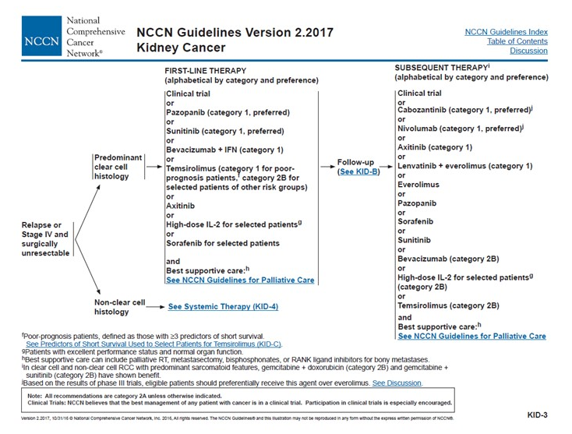

Slide 22
High-Dose Interleukin-2
25% objective response rate; 11% durable remission rate (PFS ≥ 3 years)
McDermott et al. Clin Can Res. 2015
Notes:
22

Slide 23
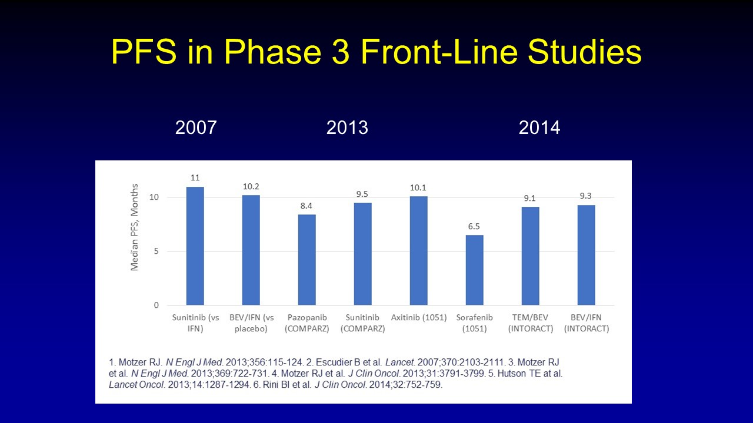

Slide 24
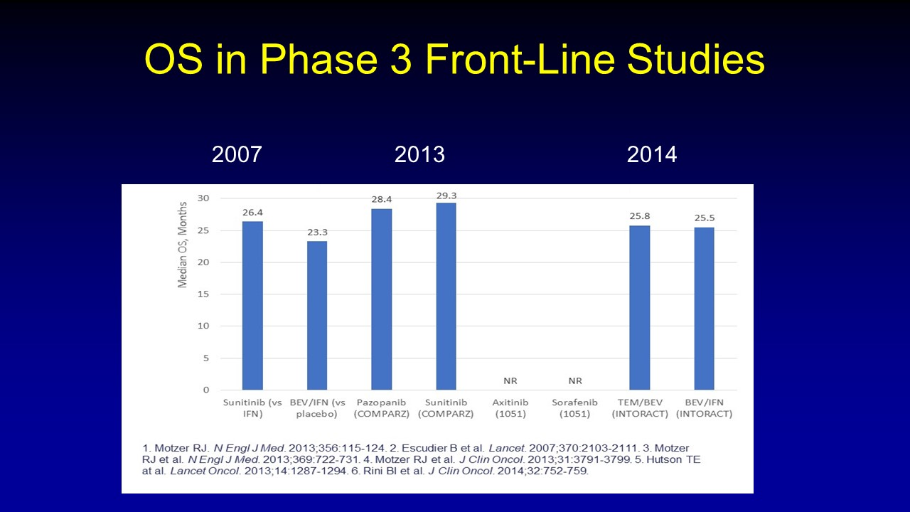

Slide 25
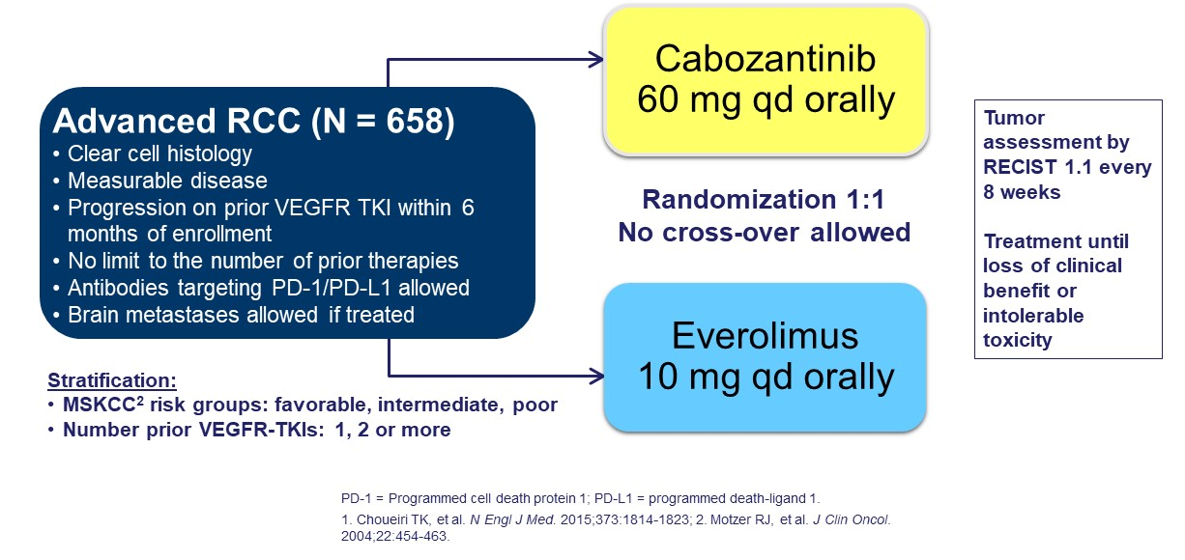
METEOR: Phase 3 Cabozantinib vs. Everolimus Following VEG-F Therapy
70% had only 1 prior VEGF
 | Cabozantinib | Everolimus
RR | 17 % | 3 % | p <0.0001
PFS | 7.4 mo | 3.9 mo | p=0.00026
OS | 21.4 mo | 16.5 mo | p <0.0001
Choueiri TK et al. Lancet Oncol. 2016

Slide 26
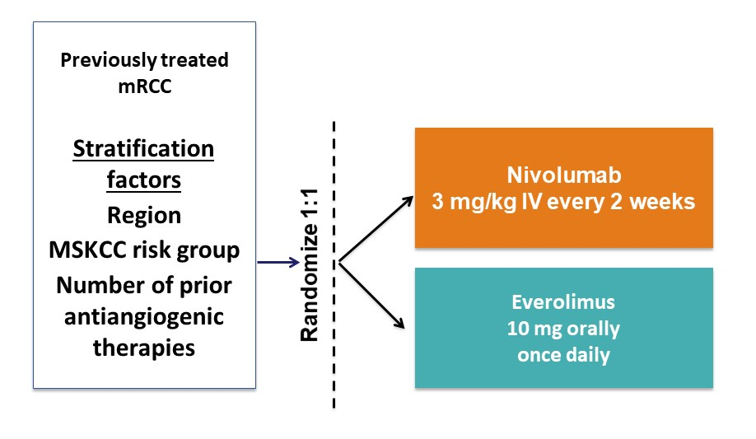
Phase 3 Nivolumab vs. Everolimus
Phase 3 study 2nd-line +
post-VEGF therapy in mRCC
 | Nivolumab | Everolimus
RR | 25 % | 5 % | p <0.001
PFS | 4.6 mo | 4.4 mo | p=0.011
OS | 25.0 mo | 19.6 mo | p=0.0018
Motzer RJ et al. NEJM. 2015

Slide 27
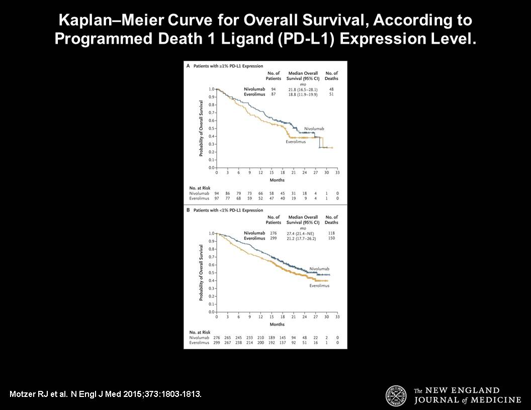
Nivolumab vs. Everolimus: Survival based on PD-L1 status

Slide 28
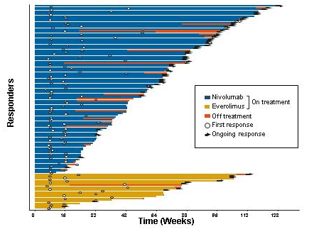
Continued Response Following Discontinuation
Motzer RJ et al. NEJM. 2015

Slide 29
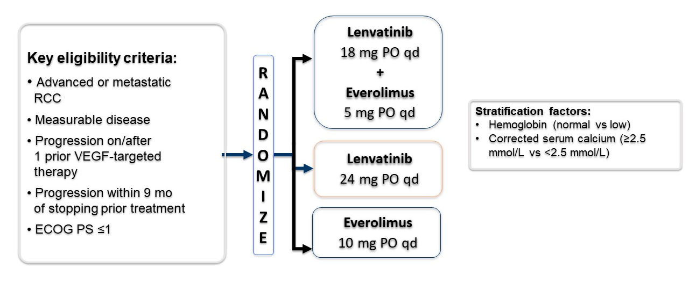
Phase 2 Lenvatinib vs. Everolimus
 | Lenvatinib + Everolimus | Lenvatinib | Everolimus
RR | 43 % | 27 % | 6 %
PFS | 12.8 mo | 9.0 mo | 5.6 mo
OS | 25.5 mo | 18.4 mo | 17.5 mo
Motzer RJ et al. Lancet. 2015

Slide 30
Treatment of non-clear cell RCC
ASPEN¹ |  | Everolimus | Sunitinib
 | PFS | 5.6 mo | 8.3 mo
 | OS | 13.2 mo | 13.5 mo
ESPN² |  | Everolimus | Sunitinib
 | PFS | 4.1 mo | 6.1 mo
 | OS | 10.5 mo | NR
1. Armstrong AJ et al. Lancet Oncol. 2016. 2. Tannir NM et al. Eur Urol. 2016.

Slide 31
Targeted Agents: Common Adverse Events
Adverse Event | Sorafenib & Axitinib | Sunitinib & Pazopanib | Cabozantinib | Lenvatinib | Bevacizumab | Everolimus | Temsirolimus
Fatigue | + | + | + | + | + | + | +
Hand-foot Syndrome | + | + | + | +
Hypertension | + | + | + | + | +
Diarrhea | + | + | + | + |  | + | +
Stomatitis | + | + | + | + |  | + | +
Myelosuppression |  | + | + |  |  | + | +
Pneumonitis |  |  |  |  |  | + | +
Infections |  |  |  |  |  | + | +
Hypersensitivity reaction |  |  |  |  | + |  | +
Proteinuria |  |  |  |  | +
Metabolic syndrome |  |  |  |  |  | + | +

Slide 32
Targeted Agents: Common Adverse Events
Adverse Event | Sorafenib & Axitinib | Sunitinib & Pazopanib | Cabozantinib | Lenvatinib | Bevacizumab | Everolimus | Temsirolimus
Fatigue | + | + | + | + | + | + | +
Hand-foot Syndrome | + | + | + | +
Hypertension | + | + | + | + | +
Diarrhea | + | + | + | + |  | + | +
Stomatitis | + | + | + | + |  | + | +
Myelosuppression |  | + | + |  |  | + | +
Pneumonitis |  |  |  |  |  | + | +
Infections |  |  |  |  |  | + | +
Hypersensitivity reaction |  |  |  |  | + |  | +
Proteinuria |  |  |  |  | +
Metabolic syndrome |  |  |  |  |  | + | +

Slide 33
Targeted Agents: Common Adverse Events
Adverse Event | Sorafenib & Axitinib | Sunitinib & Pazopanib | Cabozantinib | Lenvatinib | Bevacizumab | Everolimus | Temsirolimus
Fatigue | + | + | + | + | + | + | +
Hand-foot Syndrome | + | + | + | +
Hypertension | + | + | + | + | +
Diarrhea | + | + | + | + |  | + | +
Stomatitis | + | + | + | + |  | + | +
Myelosuppression |  | + | + |  |  | + | +
Pneumonitis |  |  |  |  |  | + | +
Infections |  |  |  |  |  | + | +
Hypersensitivity reaction |  |  |  |  | + |  | +
Proteinuria |  |  |  |  | +
Metabolic syndrome |  |  |  |  |  | + | +

Slide 34
Nursing Management
Patient education prior to initiation of therapy
Written information and resources
Awareness of “class effect” toxicities
Pro-active approach to assessment and intervention
Early and ongoing communication
Intervene early and follow-up frequently

Slide 35
Dermatologic Side Effects
Dry skin
Rash
Pruritis
Hand-foot syndrome
  Palmar-plantar erythrodysesthesia syndrome
  Hand-foot skin reaction

Slide 36
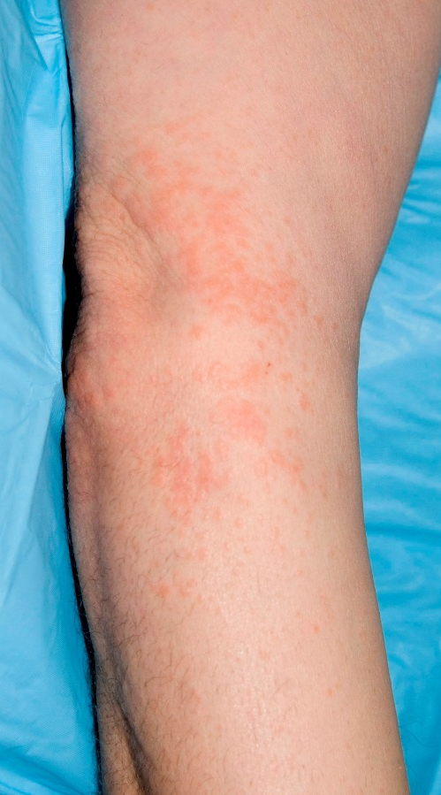
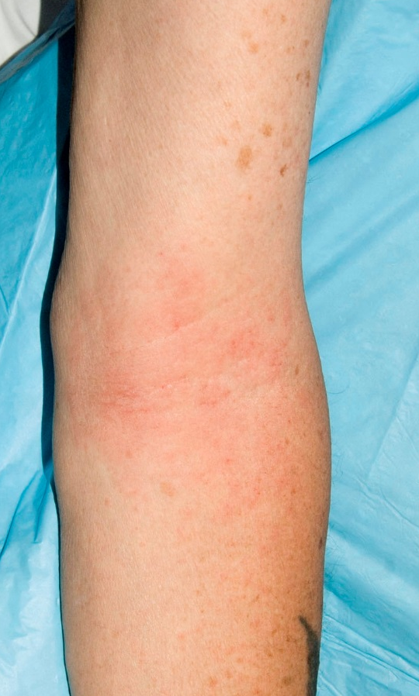
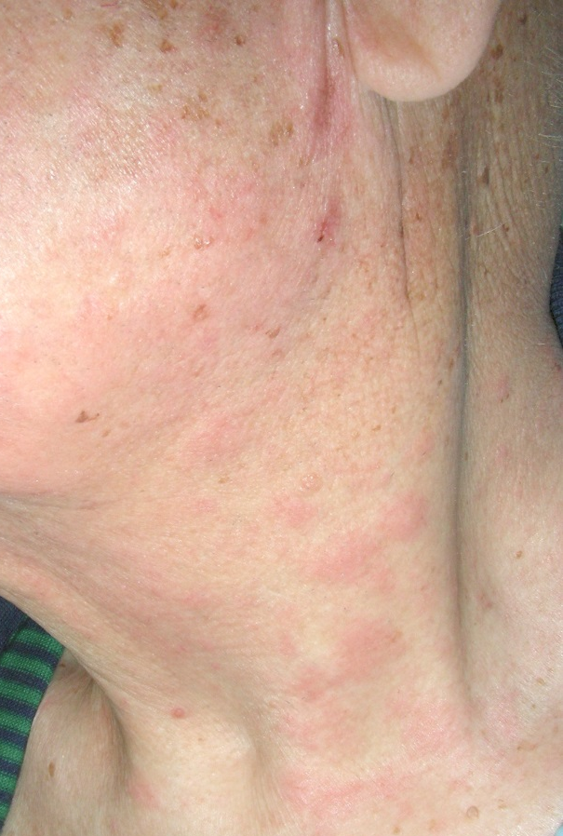
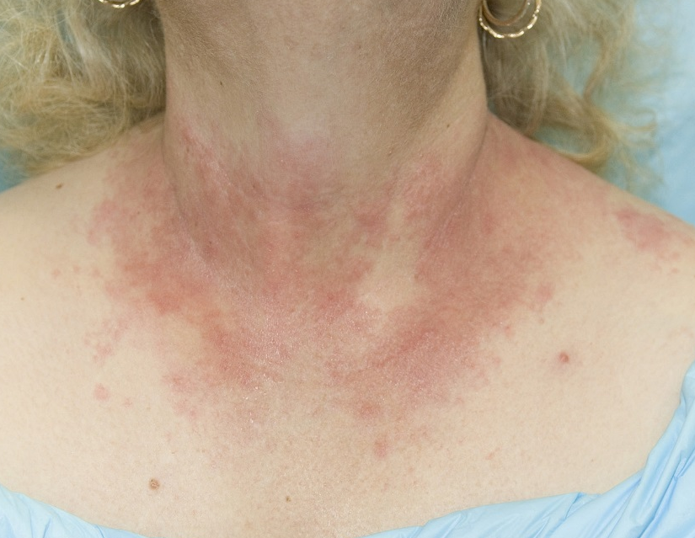
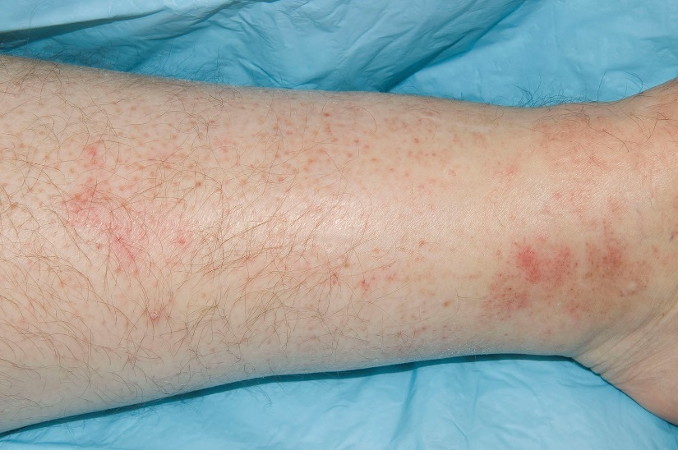

Slide 37
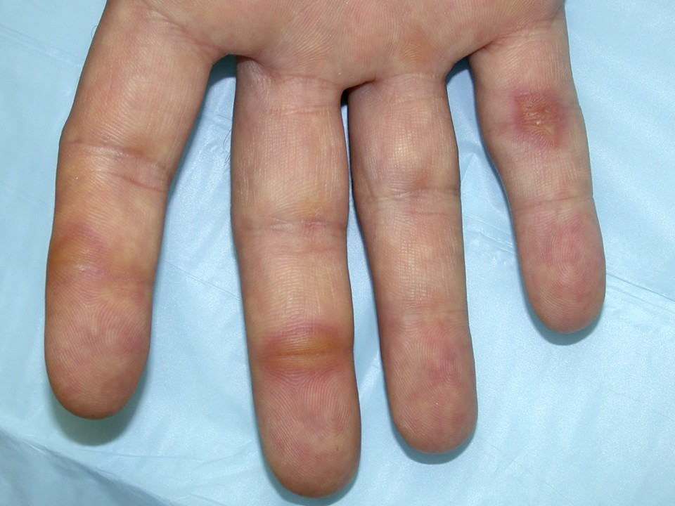
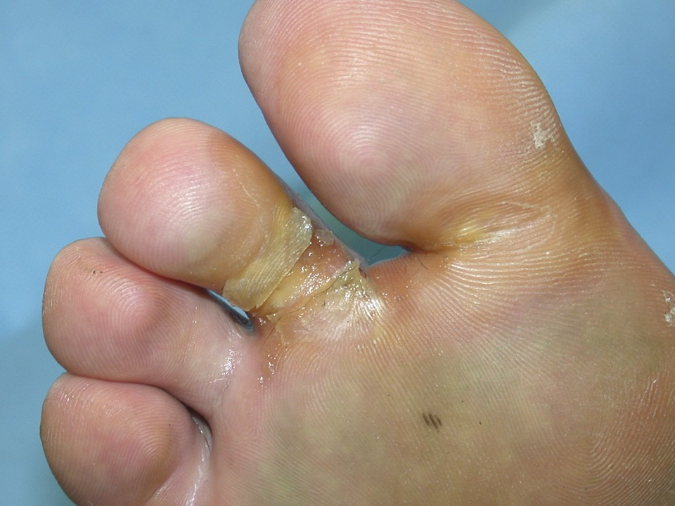
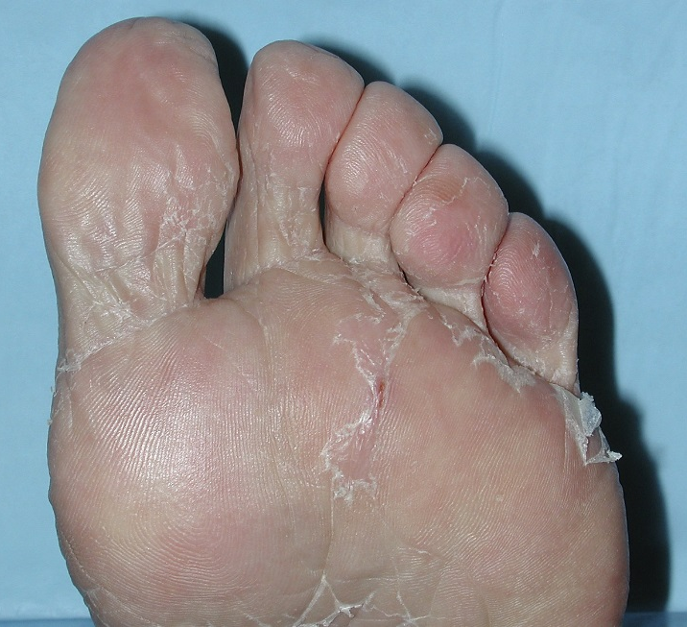
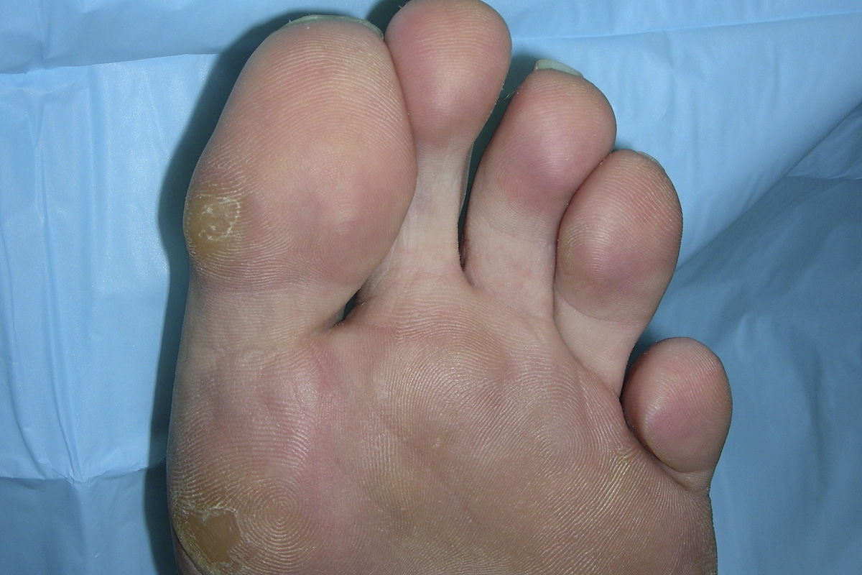
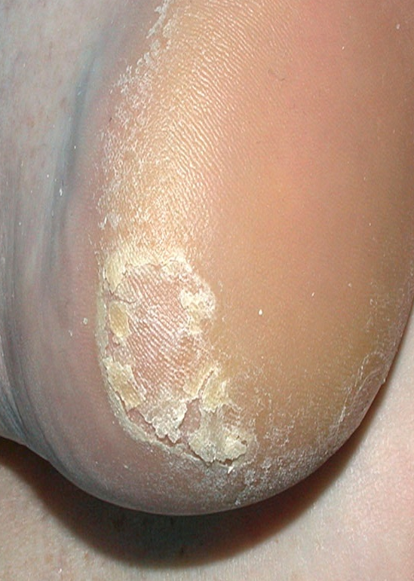

Slide 38
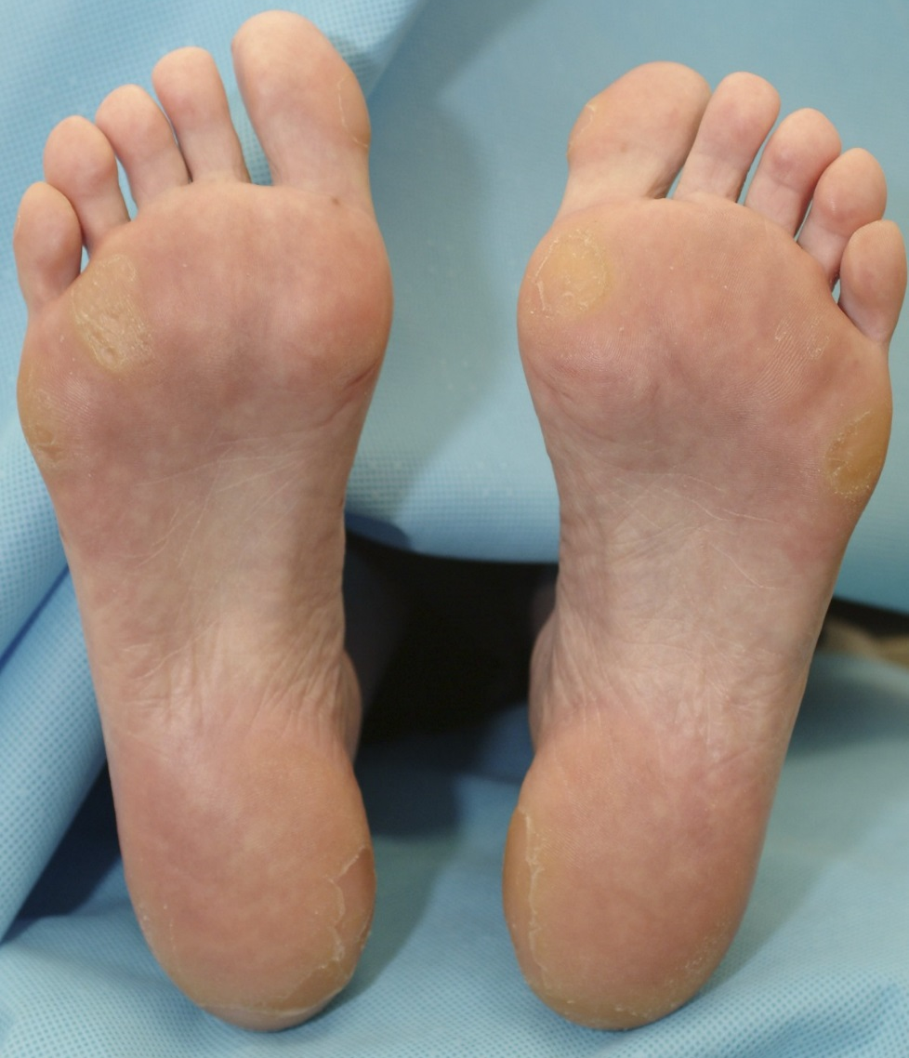
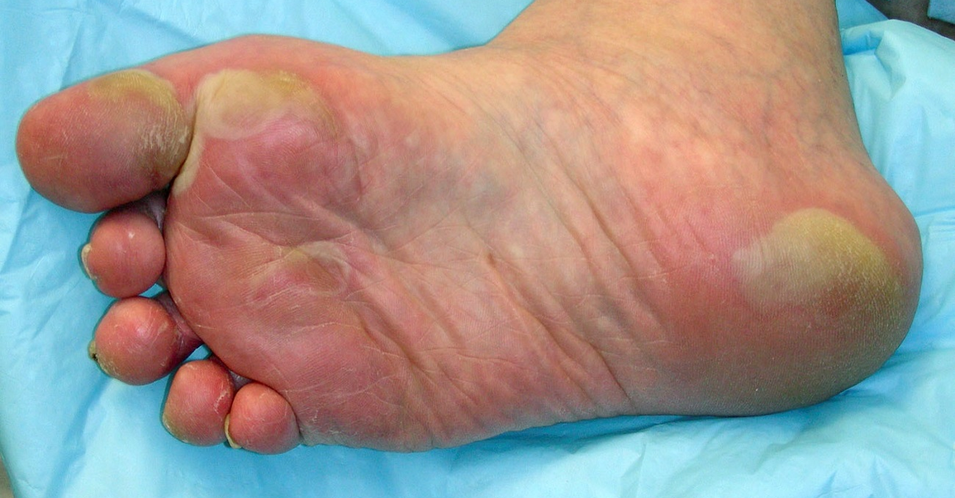

Slide 39
The “3C” Approach to Manage MKI-HFSR
Control calluses
  Prophylactic removal of hyperkeratotic areas before & during treatment
  Pumice stone, Ped Egg pedicure, podiatrist
Comfort with cushions
  Protect pressure-sensitive areas of hands & feet
    Well-padded, well-fitting, soft shoes
    Insole cushions or inserts
Cover with creams
  Frequent use of emolient creams
  Keratolytic agents on callused areas of palms & soles
Wood L et al. Community Oncology. 2010.

Slide 40

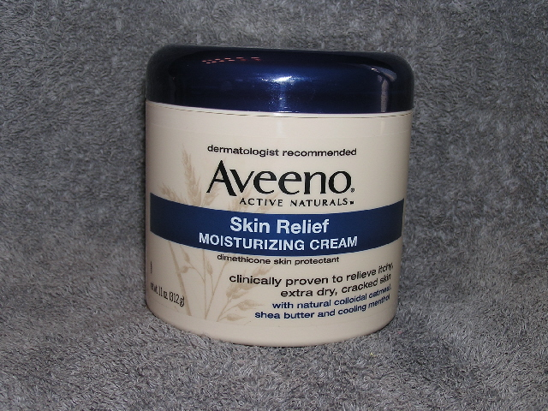

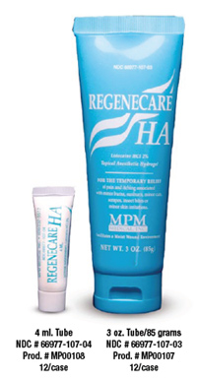
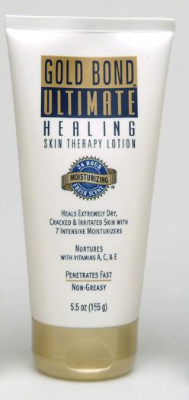
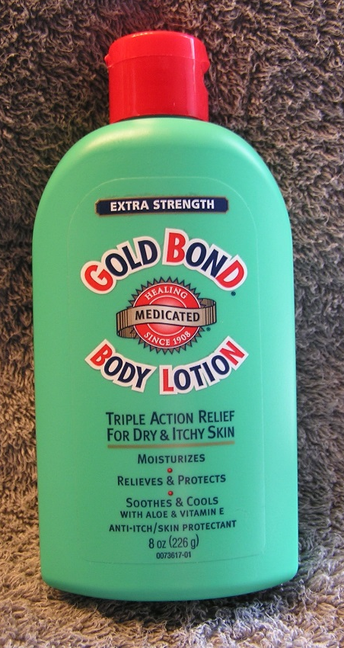

Slide 41
Additional Side Effects
Fatigue
Diarrhea
Nausea / Vomiting
Mucositis
  Clinical or Functional
Anorexia
  Other causes must be ruled out
Hypertension

Slide 42
General Guidelines: Immunotherapy
Early recognition of symptoms & frequent monitoring
Establish correct diagnosis
  Presentation can be subtle
  Other causes must be ruled out
irAEs can become severe & life threatening if diagnosis and appropriate treatment are delayed
Fecher LA et al. The Oncologist. 2013.

Slide 43
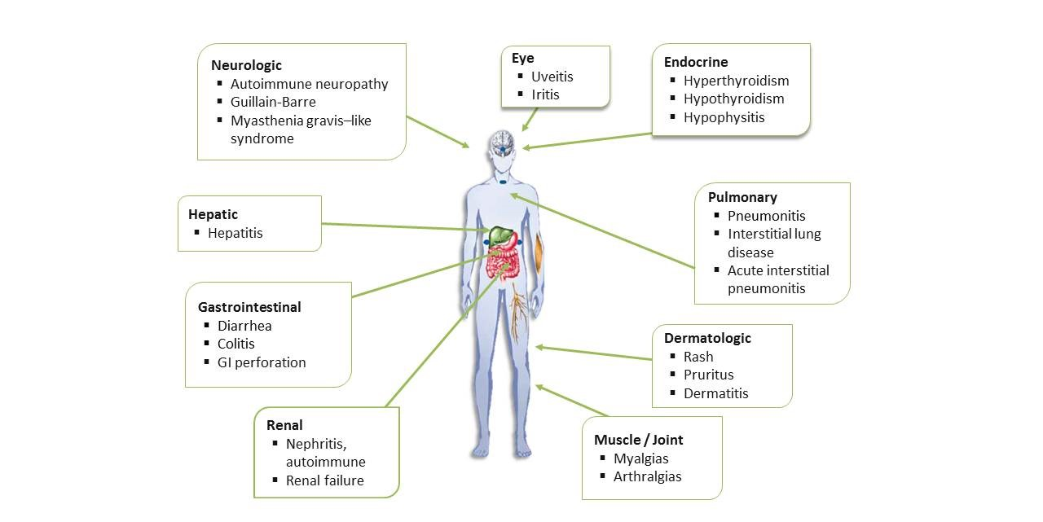
Immune-Related Adverse Events: irAEs

Slide 44
Case Study # 2
54 year male with metastatic renal cancer
Treatment:
  Sunitinib for 16 months
  Nivolumab for 11 months
Calls with increasing fatigue and DOE
  Denies fever or chills
  Nobody in family with URI symptoms
Patient is worried his cancer is worse

Slide 45
Options:
Provide reassurance
  He’s getting CT scans in 2 weeks
  Will assess disease before his next Nivolumab infusion
See patient in the office in a few days if no improvement in symptoms
Send to the ER

Slide 46
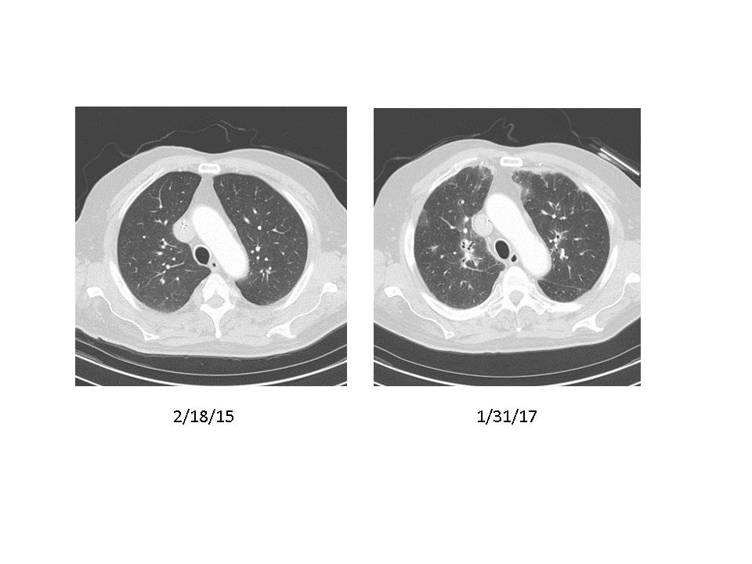
Nursing Management
See in office today for evaluation
  Resting & ambulatory pulse ox
  CXR or CT scan

Slide 47
Nursing Management of immune-related irAEs
Patient education
  Review what irAEs are
irAEs
    Assessment
    Management
    Follow up
Prednisone 1-2mg / kg and taper slowly
Hold Nivolumab
  Until symptoms resolved & Prednisone 10mg daily or below

Slide 48
mRCC: Brain and Bone metastasis
Bone metastasis
  Symptomatic
    Limited ability to use NSAIDs due to CKD
    Tylenol ineffective in treating bone pain
Brain metastasis
  Brain is a sanctuary site
  Develop brain mets in spite of good systemic disease control
  Interrupt systemic therapy, GK, then resume systemic therapy if patient had been responding to therapy

Slide 49
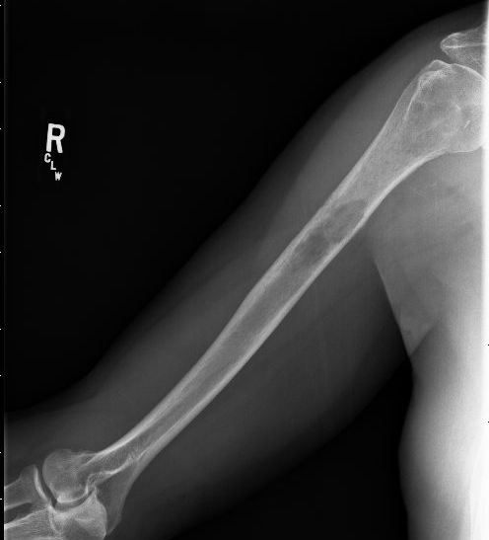
Case Study # 3
65 year old male
  Axitinib 2nd-line therapy
Pain right upper arm with movement

Slide 50
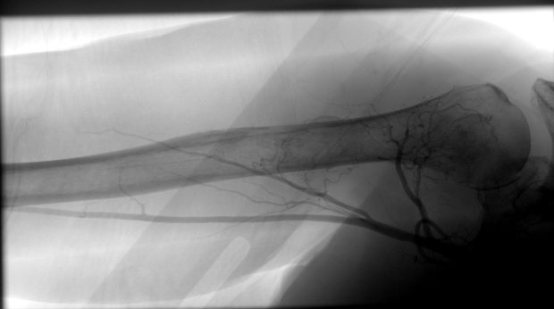
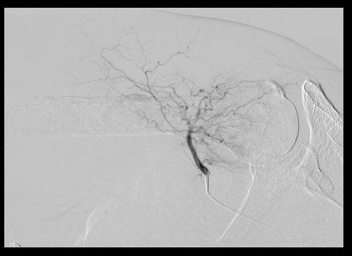
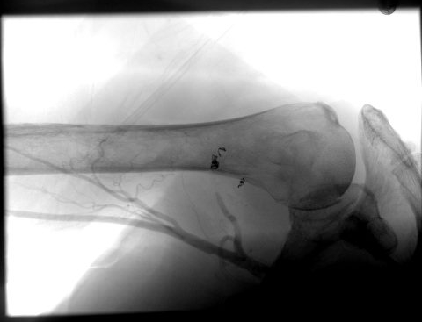
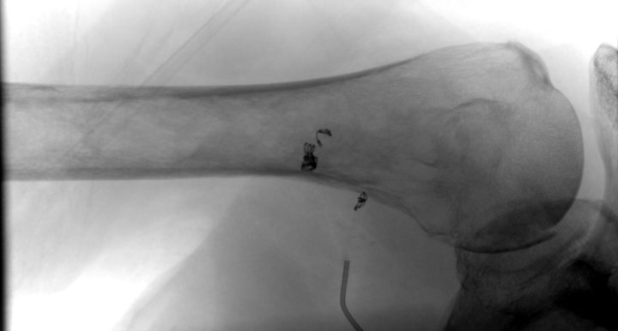
Tumor Embolization

Slide 51

CABOSUN: Subgroup Analysis
Choueiri et al. 2017

Slide 52
Treatment of mRCC in 2017
1st-Line | 2nd-Line
Clinical Trial | Clinical Trial
Sunitinib | Axitinib
Pazopanib | Cabozantinib
Bevacizumab/IFN | Nivolumab
Temsirolimus* | Lenvatinib/ Everolimus
* Poor risk

Slide 53
RCC: Role for Adjuvant Therapy ?
  ASSURE¹: Sunitinib vs. Sorafenib vs. Placebo
    Protocol amended to decrease starting doses of Sunitinib and Sorafenib due to toxicity
  PROTECT²: Pazopanib vs. Placebo
    Protocol amended to decrease starting dose of Pazopanib due to toxicity
  S-TRAC³: Sunitinib vs. Placebo
    Disease-Free-Survival 6.8 yrs vs. 5.6 yrs
1. Haas NB et al. Lancet. 2016. 3. Ravaud A et al. NEJM. 2016. Motzer RJ et al. JCO. 2017

Slide 54

Adjuvant Trials in RCC
Right dose of VEGFR TKI likely improves DFS in high risk resected RCC
OS benefit still unclear
Risk/benefit of 1 year DFS vs 1 year of toxicity needs to be considered
1. Haas NB et al. Lancet. 2016. 3. Ravaud A et al. NEJM. 2016. Motzer RJ et al. JCO. 2017

Slide 55
Summary
Significant improvement in treatment options for renal cancer
Continued clinical trials to determine biomarkers that may facilitate most appropriate treatment selection
Ongoing efforts to determine potential for adjuvant therapy in renal and urothelial cancers
Clinical trial referral and enrollment is critical to improving treatment options and survival

