Slide 1
TESTING FOR DIFFERENCES BETWEEN SAMPLES
THE MANN-WHITNEY U TEST

Slide 2
Let’s say you have collected two samples. For instance from different places along a beach or at different point along the course of a river.
The two samples may look a different, but are they?
You could compare the means ,modes and medians of the two samples and even look at the two samples side by side on dispersion diagrams; but that may show that they are different, but will not prove they are different unless the two diagrams show no overlap at all.
One way to test for a statistically significant difference between two samples is to use the Mann-Whitney U test. This tests for differences between the medians of the two samples.

Slide 3
Look at these two samples which show long axis data in millimetres (mm) for two sites at different points along the same beach.
SAMPLE A
SAMPLE B
18
15
13
10
9
7
5
4 3
24
22
19
14
12
11
9
8
They look different, but there is some overlap of data

Slide 4
Before we do the test we need to formulate a hypothesis
In the Mann-Whitney U test we presume that the two samples have been taken from the same parent population and that any differences we see between the two sample are due to chance
Our NULL HYPOTHESIS would be that there is no significant difference between the two samples
Our aim is to disprove the Null Hypothesis so that we can accept the ALTERNATIVE HYPOTHESIS:-
There is a statistically significant difference between the two samples and we can assume they came from different parent populations.
In this case we would have proved that beach pebble size changes along the beach

Slide 5
For the Mann-Whitney U test the two samples are ranked together
Sample A | rank | Sample B | rank
18 | 4 | 24 | 1
15 | 5 | 22 | 2
13 | 7 | 19 | 3
10 | 10 | 14 | 6
9 | 11.5 | 12 | 8
7 | 14 | 11 | 9
5 | 15 | 9 | 11.5
4 | 16 | 8 | 13
3 | 17
∑rA | 99.5 | ∑rB | 53.5
∑rA
is the sum of all the A sample ranks
∑rB
Is the sum of all the B sample ranks

Slide 6
We then use the Mann-Whitney U formula for the sample with the largest total ranks, in this case Sample A
∑rA
is 99.5
U for sample A = na.nb + na (na + 1) - ∑rA
2
= 9 x 8 + 9 ( 9 + 1) - 99.5
2
= 72 + 90 - 99.5
2
= 72 + 45 - 99.5
U a = 17.5
But what does U = 17.5 mean?

Slide 7
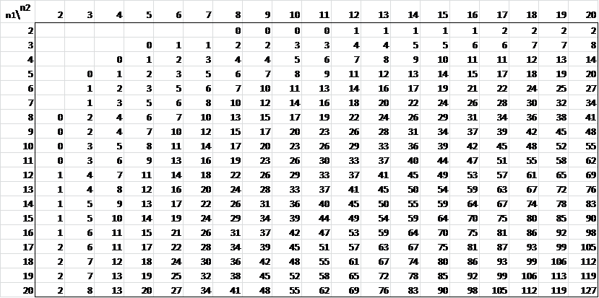
This value for U needs to be looked up on the 95% confidence level significance table
Our sample sizes are 9
and 8
So the critical value is 15. If the U value is smaller than this we can reject the null hypothesis and accept the alternative hypothesis that the two samples are statistically significantly different
What is the result in our case?

