Slide 1
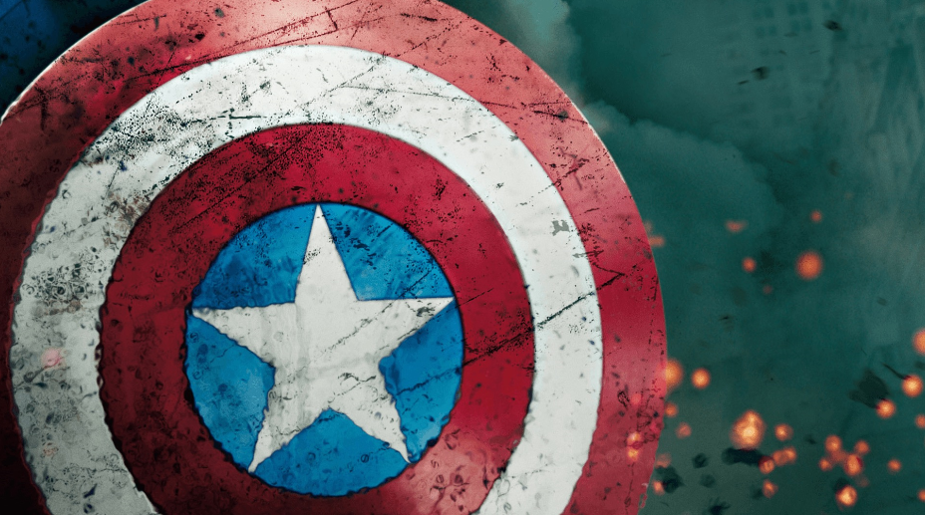
Contextualization
Rebecca Richardson,
Allen High School

Slide 2


Welcome!
Please type your name into the comment box. I will use this to create a list for attendance purposes.
The goal of this session is to both review the contextualization skill and introduce a way to incorporate skill practice into daily lesson plans. The contextualization skill, in my opinion, is one that can be learned and mastered more quickly than other essay skills such as sourcing, complexity, and using multiple documents to defend an argument. However, it is not an “easy” or “low-bar” skill and requires practice. My goal with my students is to prepare them to at least master four of the main essay skills by the end of the course. [More than four is bonus.]

Slide 3

Contextualization Tips
Contextualization is essential for providing evidence the student understands what is going on in the era or why a topic is historically significant to U.S. history …and to show the student can relate that knowledge to the overall topic in their essay!
It can appear anywhere in the essay.
It can include evidence and connections from other eras, but they must explicitly link it to the topic/era of the essay.
Needs to include at least ONE piece of specific evidence. If they cannot identify something specific it is okay to focus on developments… [Do NOT include that evidence anywhere else in the essay… not in the thesis… not in the body paragraphs.]
Practicing this skill with both local and broad context is recommended, however if they stay broad… that’s okay.
As with most analysis… EXPLAINING HOW OR WHY IS IMPORTANT!
Rarely is there a length requirement; however, encourage at least three sentences.
Add a sentence clearly explaining how your context relates to the topic of the essay. Readers won’t infer!
FFAPUSH.COM

Slide 4

Contextualization Strategy
If students struggle to “set the scene” by explaining the historical context of the essay topic, here is a question to have them consider:
What do you need to know in order to understand the historical significance of this topic? “Brain-dump” who, what, when, where, why, how.
They might also begin their contextualization with…
In order to understand the historical significance of (topic), one must consider…
Remember that chronological framing is not enough but is a good start. They need to show understanding of the topic in the big picture.
Also encourage student to consider, “Why is College Board is asking this question? What understanding do they want me to demonstrate about history?”
FFAPUSH.COM

Slide 5

What happens in contextualization…
Stays in contextualization!
One frequent weakness I’ve seen is double-dipping and contextualization crossovers that are inappropriate. One contextualization tip is including at least one piece of specific historical evidence BUT… and this is important… do not repeat that evidence in the thesis or in the body paragraphs.
Set the scene… contextualization… and then let it be. Don’t connect back to it, don’t use it to defend a thesis, and don’t use the evidence or development again in body paragraphs or in document analysis.

Slide 6
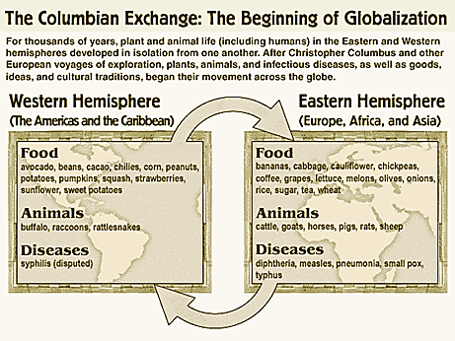
Contextualization Activity – The Columbian Exchange
After students read about the topic and/or you discuss it in class, have them summarize or discuss the event. Providing an excerpt from the content outline or an image can also be beneficial, especially when they are just learning the skill.
From the 2015 Revised Content Outline:
Key Concept 1.2: Contact among Europeans, Native Americans, and Africans resulted in the Columbian Exchange and significant social, cultural, and political changes on both sides of the Atlantic Ocean.
I. European expansion into the Western Hemisphere generated intense social, religious, political, and economic competition and changes within European societies.
  European nations’ efforts to explore and conquer the New World stemmed from a search for new sources of wealth, economic and military competition, and a desire to spread Christianity.
  The Columbian Exchange brought new crops to Europe from the Americas, stimulating European population growth, and new sources of mineral wealth, which facilitated the European shift from feudalism to capitalism.
  Improvements in maritime technology and more organized methods for conducting international trade, such as joint-stock companies, helped drive changes to economies in Europe and the Americas.
II. The Columbian Exchange and development of the Spanish Empire in the Western Hemisphere resulted in extensive demographic, economic, and social changes.
  Spanish exploration and conquest of the Americas were accompanied and furthered by widespread deadly epidemics that devastated native populations and by the introduction of crops and animals not found in the Americas.
  In the encomienda system, Spanish colonial economies marshaled Native American labor to support plantation-based agriculture and extract precious metals and other resources.
  European traders partnered with some West African groups who practiced slavery to forcibly extract slave labor for the Americas. The Spanish imported enslaved Africans to labor in plantation agriculture and mining.
  The Spanish developed a caste system that incorporated, and carefully defined the status of, the diverse population of Europeans, Africans, and Native Americans in their empire.
  Provide a prompt, and then have them contextualize using the three-step process outlined on the next page.
http://nebula.wsimg.com/96b7fbe175f7221dd7bd5b34baba13c7?AccessKeyId=E9AACE2A0AB5B10EA5F6&disposition=0&alloworigin=1

Slide 7
Contextualization
The skill: Identify and describe a historical context for a specific historical development or process. Explain how a specific historical development or process is situated within a broader historical context.
Prompt: Evaluate the impact of the Columbian Exchange on the societies of Europe and North America.
Local Context
(Who, What, When, Where)
Broad
Context
Why, How
What is the
“Big Picture?”
What is the theme?
Relating to the topic of the essay:
If the contextualization is not obviously related to the topic of the essay, add a sentence explaining the connection: This relates to the topic of European and North American societies because…
Broad Context is most important part of this process!
This strategy is adapted from writing strategy developed by John P. Irish.

Slide 8
Contextualization - Sample #1
The skill: Identify and describe a historical context for a specific historical development or process. Explain how a specific historical development or process is situated within a broader historical context.
Prompt: Evaluate the impact of the Columbian Exchange on the societies of Europe and North America.
Local Context
(Who, What, When, Where)
The Columbian Exchange was a massive exchange of food, animals, and diseases from the Old World, Europe, to the New World, the Americas. It occurred following Christopher Columbus’s Voyage to the America’s, which is where the term Columbian comes from.
This example focuses on the defining strategy. The student is communicating his or her understanding of the topic.
Broad
Context
Why, How
What is the
“Big Picture?”
What is the theme?
Relating to the topic of the essay:
If the contextualization is not obviously related to the topic of the essay, add a sentence explaining the connection.
Broad Context is most important part of this process!
This exchange was caused by
European desire to increase trade
with Asia followed by a desire to
exploit the Americas for their
vast resources.
This relates to the topic of European and North American societies because… the contact that resulted led to new items being introduced into both continents.

Slide 9
Contextualization - Sample #2
The skill: Identify and describe a historical context for a specific historical development or process. Explain how a specific historical development or process is situated within a broader historical context.
Prompt: Evaluate the impact of the Columbian Exchange on the societies of Europe and North America.
Local Context
(Who, What, When, Where)
The American Indian population in the North America is a fraction of what it was before contact with Europeans.
This example is focusing on one part of the prompt, North America, in order to demonstrate deeper understanding. The risk here is that they will need to focus on other impacts. (other than disease)
Broad
Context
Why, How
What is the
“Big Picture?”
What is the theme?
Relating to the topic of the essay:
If the contextualization is not obviously related to the topic of the essay, add a sentence explaining the connection.
Broad Context is most important part of this process!
European conquest and the development of the United States
resulted in many deaths and loss
of land for the Natives.
This relates to the topic of the Columbian Exchange because part of the exchange included diseases such as smallpox, and many Natives had no immunities to European disease.

Slide 10
Contextualization - Sample #3
The skill: Identify and describe a historical context for a specific historical development or process. Explain how a specific historical development or process is situated within a broader historical context.
Prompt: Evaluate the impact of the Columbian Exchange on the societies of Europe and North America.
Local Context
(Who, What, When, Where)
Prior to 1492, many Europeans such as Christopher Columbus were searching for a faster and safer route to Asia.
NOTE: The most successful contextualizations are those who explain the prelude; what happened just before the event or what led to the event/topic.
Broad
Context
Why, How
What is the
“Big Picture?”
What is the theme?
Relating to the topic of the essay:
If the contextualization is not obviously related to the topic of the essay, add a sentence explaining the connection.
Broad Context is most important part of this process!
The desire for things like Asian spices led to increased trade between Asia and Europe. The trading routes were not always safe, and they were very long and
slow. A faster route by sea could help
improve trade.
This relates to the topic of the Columbian Exchange because as the exchange grew, so did colonization and trade, eventually developing into triangular trade.

Slide 11
Contextualization Practice – Warmups
One strategy teachers may use to continually practice this skill throughout the year is to begin class with a warmup activity once or twice a week. This could include presenting a prompt related to the reading assignment, and then having a discussion as a class (or group collaboration) to contextualize the topic.
Example: Students arrive, and a prompt is on the board. While you take attendance, they discuss and/or record a contextualization. Graphic organizers could be provided, or a simple framework displayed on the board/screen.
Sample prompts:
Compare and contrast the English and Spanish colonization of the Americas.
Explain the causes of the American Revolution.
To what extent was the Second Great Awakening responsible for the abolition movement?
Evaluate the impact of the Spanish American War on the United States.
How did United States foreign policy during the Second World War foster change in America’s role in the world?
You will have access to a document with several potential prompts - FYI

Slide 12
For students struggling to make connections…
By providing topics, you can speed up the process as well as helping to reinforce the importance of linking the contextualization to the topic of the prompt. Students can discuss and/or write, and then share out to the class. This type of activity can also enable the teacher to review events pre and post topic.
Example
Prompt: Explain Woodrow Wilson’s goals for United States intervention in the First World War.
Table/Group 1: Contextualize using the causes of the First World War.
Table/Group 2: Contextualize using United Nations.
Table/Group 3: Contextualize using the Treaty of Versailles.
Table/Group 4: Contextualize using the War of 1812.
Table/Group 5: Contextualize using Washington’s Proclamation of Neutrality.
Table/Group 6: Contextualize using the Spanish – American War.

Slide 13
For students struggling to make connections…
Sample contextualizations.
United States entry into the W.W.I. was partially due to unrestricted submarine warfare by the German army. The U.S. had declared neutrality, but this warfare prevented safe travels on the sea. This relates to the topic of Woodrow Wilson’s goals for U.S. intervention in the First World War, because one of his goals was to establish freedom of the seas.
The United Nations is an organization of many nations who seek to work out problems diplomatically to prevent war. It was created after W.W.II ended in 1945. This relates to the topic of Woodrow Wilson’s goals during W.W.I, because the idea of the U.N. was originally developed by Wilson in his Fourteen Points which called for a League of Nations. Both organizations had a goal of reducing conflicts.
The Treaty of Versailles was the official end to W.W.I. The United States did not ratify this treaty, because many people did not support the League of Nations as well as other factors in the treaty. The overall feeling following the war was one of isolationism more than support for intervention or participation in world organizations. This relates to the topic of Wilson’s goals, because the U.S. choosing not to join the League of Nations marked a failure for his vision.
The War of 1812 was a war between the U.S. and Great Britain. It was caused partially due to the lack of freedom of the seas. England and France were at war, and the U.S. declared neutrality but still sought to trade and travel on the seas. England and France seized many ships and impressed many men. This relates to Wilson’s goals for intervention in W.W.I, because establishing freedom of the seas was part of his plan for peace as it was a common cause of war.
Washington’s Proclamation of Neutrality was America’s first official foreign policy during the administration of the first President. It declared that the U.S. would not get involved in foreign conflicts including the French Revolution. This relates to Wilson’s goals during the First World War, because Wilson was breaking from tradition set by Washington by supporting the war effort as part of the Allies.
The Spanish – American War was fought in 1898. The U.S. won this war and gained new territories which began American imperialism and placed the U.S. as a world power with increasing influence. This relates to the topic of Wilson’s goals during the First World War, because that change in status gave Wilson influence in fighting the war, influencing the end of the war, and attempting to change America’s role in foreign affairs.
Notes:
These may seem a little brief… but for most years these would be enough to earn the point.

Slide 14
How is Contextualization Graded?
CONTEXTUALIZATION: 1 point - Situates the argument by explaining the broader historical events, developments, or processes immediately relevant to the question.
Scoring Note: Contextualization requires using knowledge not found in the documents to situate the argument within broader historical events, developments, or processes immediately relevant to the question. The contextualization point is not awarded for merely a phrase or reference, but instead requires an explanation, typically consisting of multiple sentences or a full paragraph.
In recent years, many students begin their essay by contextualizing the topic. If it is just one sentence, it is rarely enough to earn the point. If it is not clearly related to the topic of the essay, it will not earn the point. If it is overly simple and/or lacks any specific piece of evidence, it will not earn the point. The most successful contextualizations I have seen in recent years include setting the scene with a development immediately preceding the parameters of the prompt. This can be a useful tool in teaching and practicing the skill.
For example, for the DBQ on Progressive reform the best contextualizations focused on the Populists.

Slide 15
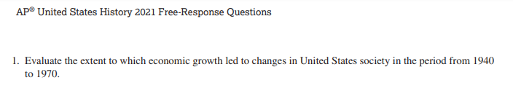
Step by Step Discussion
What is the topic of the essay?
What is the skill being tested? (causation, comparison, or CCOT)
What are the parameters of the prompt?
What is significant about the parameters?
What eras are included in the parameters?
What era came before the parameters/eras of the prompt?
What came after the parameters/eras of the prompt?
Economic Growth, U.S. society
CCOT
1940-1970
Year before entry into WWII, beginning stagnant decade
WWII, Cold War, Civil Rights Movement
Great Depression
Stagnation, Arab-Oil Embargo,
Affirmative Action, Reaganomics

