Slide 1
Penalty Enforcement
August 28, 2024

Slide 2
Classification of fouls
all fouls are either dead-ball or live ball fouls.
a live ball foul is simply a foul that occurs while the ball is live.
game time line
DEAD BALL
LIVE BALL
DEAD BALL
40/25 SEC
DURATION OF DOWN

Slide 3
Enforcement Procedures
All fouls are either dead ball fouls or live ball fouls.
Nonplayer & Unsportsmanlike (UNS) fouls may occur while the ball is either live or dead but are always enforced as dead ball fouls.
Any live-ball foul is penalized from the basic spot per Rule 10-4 unless otherwise specified by rule (Fundamental X.3).
A team may accept the penalty, but decline the yardage, for any foul.

Slide 4
Every Penalty Is Enforced From One of the Following Spots…
The Basic Spot (BS)
Point of reference for penalty enforcement (10-4)
Previous Spot (PS)
Spot where the ball was last snapped or free kicked.
Succeeding Spot (SS)
Spot where the ball will next be snapped or free kicked if there was no foul.
Spot of the Foul
Spot where the foul occurred.
End of the Run
Where the ball becomes dead in the runner’s possession.
Where the runner loses possession if the run is followed by a loose ball.
Spot of the catch or recovery when momentum rule is in effect.
Post Scrimmage Kick spot (PSK)
Spot where a scrimmage kick ends or the 20-yard line if the kick results in a touchback.

Slide 5
Dead Ball Fouls PRIOR to the snap
FIELDS
False Start
Illegal Substitution
Encroachment
Leave the Field on the Wrong Sideline or Either End Line
Delay of Game
Snap Infraction (clutching/jerking the ball)

Slide 6
Sound Whistle & Throw Flag
These fouls prevent the ball from becoming live.
Sound your whistle, throw your flag high into the air, & stop the game clock 2X.
Report 4 W’s to the R.
These penalties are enforced from the Succeeding Spot (LOS or KO).

Slide 7
The “4 W’s”
Who committed the foul?
Offense, defense, kickers, receivers
What was the foul?
Type of foul (Holding, DPI, Horse Collar, etc).
When did the foul occur?
Dead ball, Simultaneous with the Snap, Loose ball Play, Running Play, Before/After COP
Where did the foul occur?
Spot of the Foul unless simultaneous with snap

Slide 8
Live Ball Fouls SIMULTANEOUS with the Snap
MISHAPS
Illegal Motion
Illegal Formation (player is neither back or lineman)
Illegal Shift
Having more than the maximum number of backfield players (aka: illegal formation)
A player that does not touch the 9-yard marks or numbers at some point between RFP and the snap
Illegal Participation
Substitution (not getting off of the field in time)

Slide 9
Throw Flag & Go
Throw your flag high into the air & keep officiating.
DO NOT SOUND YOUR WHISTLE.
These penalties are enforced from the previous spot (where the ball was last snapped or free kicked).

Slide 10
Live Ball Foul is….
… A foul which occurs during a down
Every live ball foul occurs either during a
Loose Ball Play
Running Play

Slide 11
Loose Ball Play
A Loose Ball Play is action during:
A free kick or scrimmage kick other than PSK fouls;
A legal forward pass;
A backward pass (including the snap), an illegal kick, or fumble by A in or behind their neutral zone prior to a change of team possession;
The run or runs which precede any of the above.

Slide 12
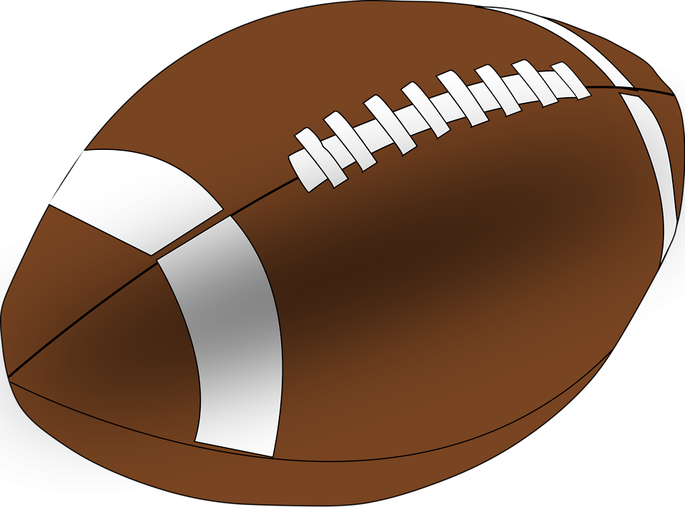
Types of plays
loose ball play-pass
Catch
Line of scrimmage
Snap
Basic spot
Run
A run followed by a legal forward pass, both are part of one loose ball play.

Slide 13
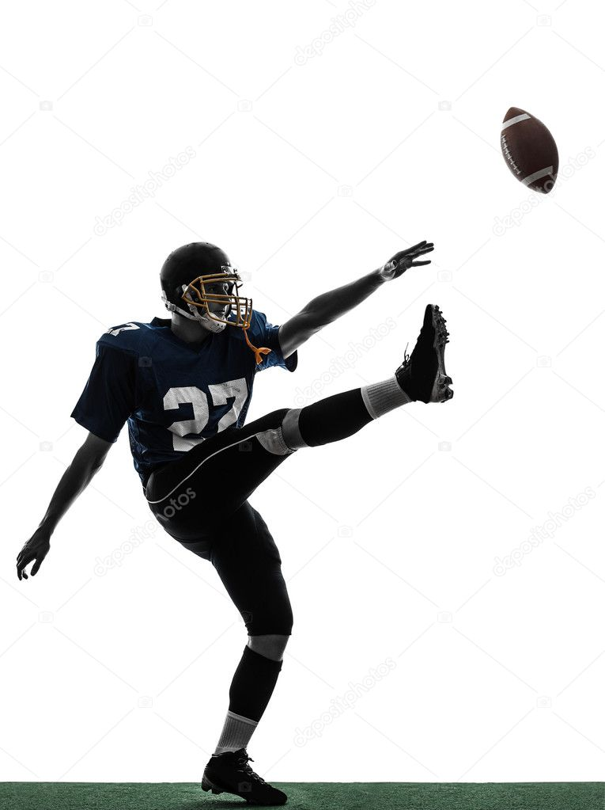
Types of plays
loose ball play-punt
Catch
Line of scrimmage
Snap
Basic spot
Backward Pass
A backward pass followed by a scrimmage kick both are part of one loose ball play.

Slide 14
Types of plays
loose ball play-fumble
Line of scrimmage
Snap
Basic spot
Recovery
Scramble
Fumble
Run
A run followed by a fumble behind the natural zone both are part of one loose ball play..

Slide 15
Types of plays
loose ball play-pass
Tackle
Basic spot
Running Ball Play
Run
Catch
Line of scrimmage
Snap
Basic spot
Loose Ball Play
Run
The forward pass and the run preceding it are a loose ball play. Once the ball is caught, a separate running play begins..

Slide 16
Running Play
A Running Play comprises all live ball action which is not included in a Loose Ball Play.
The End of the Run is:
Where the ball becomes dead in the runner’s possession.
Where the runner loses possession if his run is followed by a loose ball. (Bean bag if beyond the LOS)
The spot of the catch or recovery when the momentum rule is in effect.

Slide 17
Types of plays
running play
Tackle
RUN
End of the run = Basic Spot

Slide 18
Types of plays
running play
Fumble
Out of Bounds
RUN
SCRAMBLE
Basic Spot
There is only one run on this play. The scramble is part of the running play. Thus, the basic spot for any penalty that occurs during the scramble is the spot of the fumble.

Slide 19
Types of plays
running play
Fumble
Fumble
Recovery
Recovery
Tackle
FIRST RUN
SCRAMBLE
SECOND RUN
FIRST RUN
SCRAMBLE
Basic Spot
Basic Spot
1st Running Play
2nd Running Play
Two runs, two running plays, two basic spots. For fouls during the first run and ensuing scramble, the spot of the fumble is the basic spot. For fouls during the second running play, the basic spot is where the ball becomes dead.

Slide 20
Basic Spot
Succeeding Spot (SS)
Dead ball fouls
Previous Spot (PS)
Fouls that occur during a Loose Ball Play
Fouls that occur in some running play scenarios when the run ends behind the LOS.
Fouls that are Simultaneous with the Snap.
End of the Run
Fouls that occur during certain running play situations when the run ends beyond the LOS.
Post Scrimmage Kick (PSK) spot
Fouls which have PSK Enforcement.

Slide 21
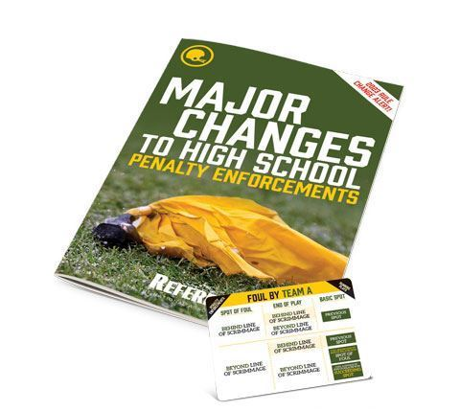
The All-But-One Principle That We’ve Known for Years Will Only Apply When the End of the Run is Beyond the LOS and there is a B foul or an A foul Beyond the LOS

Slide 22
All-but-one principle – run & FOUL BEYOND neutral zone
Basic Spot
Defensive Foul
Behind Basic Spot
Defensive Foul
Beyond Basic Spot
Offensive Foul Behind
Basic Spot Enforced from
The Spot of the Foul
Offensive Foul
Beyond Basic Spot
Team Direction

Slide 23
Unless A Limited Number Of Exceptions Apply, Officials Will No Longer Enforce A Penalty From Behind The Previous Spot

Slide 24
All-but-one principle – Fouls behind Neutral Zone
Basic Spot
Defensive Foul
Behind Basic Spot
Defensive Foul
Beyond Basic Spot
Offensive Foul Behind Basic Spot Enforced from The Spot of the Foul
(exceptions – illegal batting / kicking, illegal forward pass, foul in EZ)
Offensive Foul
Beyond Basic Spot
Team Direction

Slide 25
Penalty Enforcement Rule Change There are several exceptions to 10-4
All illegal forward passes (including intentional grounding) are considered running plays and marked from the spot of the foul.
The basic spot is the spot of the foul for illegal batting or illegal kicking when the foul occurs behind the end of the run or related run (10-4-4a).
For illegal participation as in 9-6-4a and 9-6-4g the basic spot is the spot of the foul as defined in Rule 10-4 unless PSK applies. For illegal participation as in 9-1, 9-2, 9-3, & 9-6-4b-f during a loose ball follow 10-4-2b.
A foul by the team in possession that occurs behind the end of the run or related run following a change of possession is enforced from the spot of the foul. A foul that occurs beyond the end of the run or related run following a change in possession is enforced from the end of the run (succeeding spot).
When a player on offense commits any foul in his/her end zone for which the penalty is accepted or throws an illegal forward pass from his/her end zone and the penalty is declined in a situation which leaves him/her in possession at the spot of the illegal pass and with the ball having been forced into the end zone by the passing team it results in a safety.

Slide 26
Establishing the Line-to-Gain (LTG)
On a live ball foul, mark off the penalty yardage first then establish the line-to-gain.
Penalties for fouls with succeeding spot enforcement which occur prior to the R’s Ready signal shall be administered before setting the chains for a new series.
Penalties for fouls with succeeding spot enforcement which occur after the R’s ready signal shall be administered after setting the chains for a new series

Slide 27
Special Enforcements
Half the Distance
No penalty can take the ball more than half the distance to the offending team’s goal line. This applies:
Inside the 30-yard line for a 15-yard penalty
Inside the 20-yard line for a 10-yard penalty
Inside the 10-yard line for a 5-yard penalty
DQ Player
A DQ player must be removed.

Slide 28
Special Enforcements
Roughing the Passer (RPS) Fouls
The Basic Spot of Enforcement for RPS fouls is the previous spot.
However, the enforcement spot is the dead ball spot for RPS when the dead ball spot is beyond the neutral zone & there has been no change of team possession.

Slide 29
Special Enforcements
Free Kick Out of Bounds Fouls
The Basic Spot of Enforcement for this foul is the previous spot.
However, the offended team has other options:
5 Yards from the Succeeding Spot;
Put the ball in play at the inbounds spot 25 yards beyond the previous spot; or
Decline the penalty and put the ball in play at the inbounds spot (not likely to take this option).

Slide 30
Special Enforcements
Fouls by K During a Free or Scrimmage Kick Down Prior to the End of the Legal Kick
The Basic Spot of Enforcement for fouls during a kick is the Previous Spot.
However, the Basic Spot may, at the option of the offended team, be the Succeeding Spot for fouls by K during a legal free or scrimmage kick down (other than kick catching interference) prior to the end of the kick when K will not be next to put the ball in play.

Slide 31
Special Enforcements
Safety/Goal Line
If the offense commits a foul in its own end zone, accepting the penalty results in a safety.
The basic spot is the previous spot for fouls, which are committed during running plays by the opponent of the team in possession at the time of the foul when the team in possession is responsible for forcing the ball across its own goal line and the related run ends in the end zone.
Forfeiture of the Game
The R’s decision to forfeit a game is final.
Foul Prior to a Try
For fouls which occur during the interval between the touchdown and the initial ready-for-play on the Try, it may be enforced on either the succeeding spot (Try) or on the subsequent kickoff. If the foul occurs AFTER the initial ready-for-play it must be enforced on the Try.

Slide 32
Special Enforcements
Foul During a TD
If there is a foul by the offensive team, other than UNS or non-player, during a down which results in a successful TD, the acceptance of the penalty nullifies the score.
If there is a foul by the defensive team during a down which results in a successful TD, the scoring team may choose to have the foul enforced EITHER at the Succeeding Spot (Try) OR the subsequent Kickoff.

Slide 33
Special Enforcements
Foul During a Try
If there is a foul by the offensive team, other than UNS or non-player, during a down which results in a successful Try, the acceptance of the penalty nullifies the score.
If there is a foul by the defensive team during a down which results in a successful Try, A is given the choice of accepting the penalty and replaying the down following enforcement or assessing the penalty from the succeeding spot, the kickoff.

Slide 34
Special Enforcements
Double Foul
If both teams, commit live ball fouls &,
there is no change of possession,
there is a change of possession & the team in final possession fouls prior the final change of possession, or
there is a change of possession & the team last in possession accepts their opponent’s foul,
the fouls offset & the down is replayed.

Slide 35
Clean Hands principle
If each team fouls during a down in which there is a change of possession, the team last in possession may retain the ball, provided its foul is not prior to the final change of possession, and it declines all live ball penalties.
PSK fouls are also covered under the “clean hands” Rule.

Slide 36
Special Enforcements
Multiple Live Ball Fouls
When a team commits two or more live ball fouls, their opponents may only accept one penalty.
Multiple Dead Ball Fouls
Penalties for dead ball fouls are enforced in the order of occurrence.

Slide 37
Special Enforcements
Kick Catching Interference (KCI)
If the kicking team commits KCI, the receiving team has 3 options:
results of the play,
a 15-yard penalty from the previous spot and a replay of the down, or
an awarded catch after enforcement of a 15-yard penalty from the spot of the foul

Slide 38
Post Scrimmage Kick (PSK) Fouls
PSK enforcement applies only if all of the following conditions are met:
The foul is by the receiving team beyond the offensive team’s scrimmage line
The foul takes place during the interval between the snap & the end of the kick
The scrimmage kick crosses the kicking team’s scrimmage line
The ball belongs to the receiving team when the down ends
PSK only applies to scrimmage plays other than a try or successful field goal.
If any one of these elements is missing, the previous spot is the basic spot.
The All-But-One principle applies, but the basic spot is where the kick ends. If the kick ends in the receiving team’s end zone, the 20-yard line is the basic spot.

Slide 39
Post Scrimmage Kick (PSK) Fouls
POST-SCRIMMAGE KICK ENFORCEMENT
PSK WINDOW
Kick beyond NZ
Subsequent Run
KICK
Ball crosses the neutral zone
R Possesses the ball & ends the kick
End of Play
SNAP

Slide 40
Loss of Down Fouls
The following fouls by A result in a Loss of Down:
Illegal Forward Pass
includes Intentional grounding
Illegal Handing the Ball Forward
Illegal Touching of a Forward Pass by an Ineligible

Slide 41
Automatic First Down Fouls
The following fouls by B result in an Automatic First Down for A:
Roughing the Passer
Roughing the Kicker or Holder
Roughing the Snapper

Slide 42
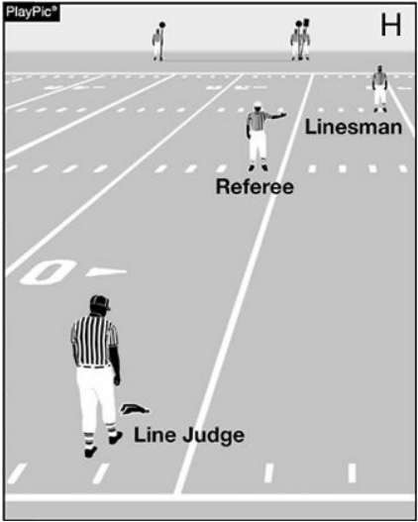
CREW RESPONSIBILITIES
Head linesman
As a backup to ensure the umpire has properly enforced the penalty, as the referee is signaling the foul the linesman should proceed to the succeeding spot. Once the penalty is enforced, the linesman should have the down box, the line-to-gain equipment or both moved.
be certain of the down number. Don’t forget that acceptance of a penalty that includes loss of down or declination of a penalty will not result in a replay of the previous down.
includes loss of down or declination of a penalty will not result in a replay of the previous down
Line Judge
the line judge holds the previous line of scrimmage. This is a good back up in case the chains move incorrectly or prematurely.
Back Judge
the back judge may have to move up toward the line to let players know they should return to their respective sides of the ball.

Slide 43
Ball Placement
The lateral position of the ball with a penalty is important.
If the enforcement spot is the previous spot = spot the ball on the previous spot.
If the enforcement spot is the succeeding spot = spot the ball on the succeeding spot.
If the enforcement spot is the spot of the foul = spot the ball on the spot of the foul, if foul occurred in a side zone, spot on nearest hash.

Slide 44
“Me-Too” Flags
Avoid throwing “me-too” flags. This involves having the official closest to the official who threw his flag also throwing his flag as a means of supporting his partner.
The concept is the coach will think it is an acceptable call because two officials had it. The technique is both unnecessary and deceptive.
While there are some situations in which the coverage will overlap two officials, many plays dictate each official maintain unique coverage.
Further, if the two officials were to offer contradicting explanations of the foul, the crew’s integrity would be severely diminished.
Finally, excessive flags will contribute to an image of a “flag happy” crew.

