Slide 1
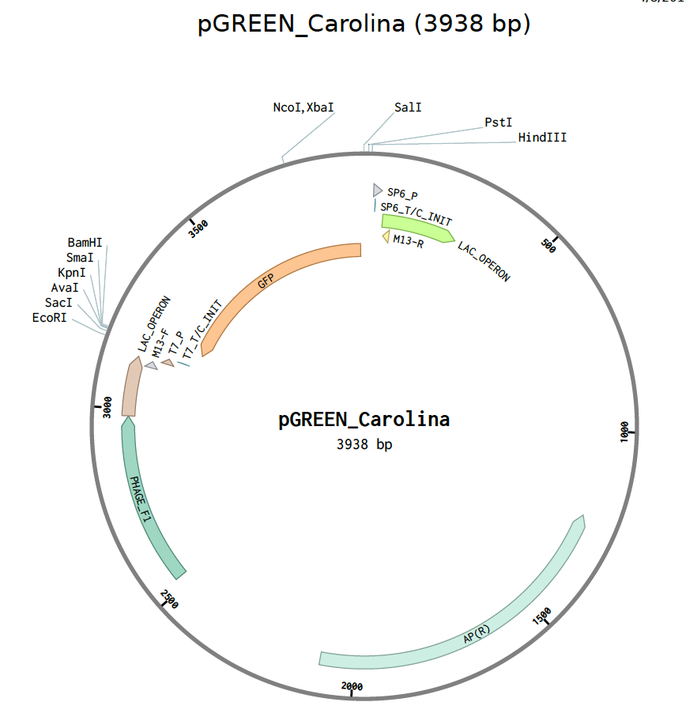
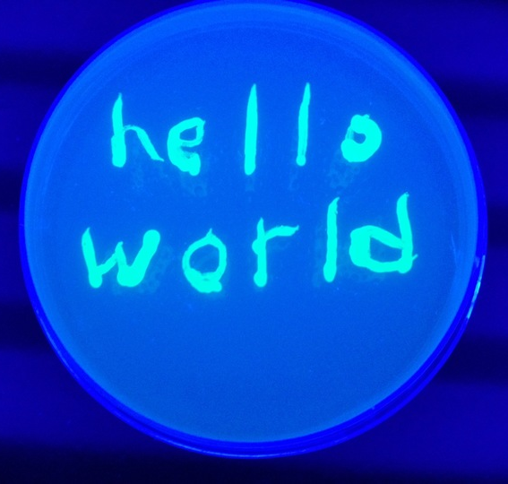
GFP Painting
GFP = Green Flourescent Protein
A gene isolated from a jellyfish
Glows green when UV light shines on it
Used as a reporter by biologists
Plasmid: circular DNA containing genes, used by biologists to move genes between organisms and manipulate DNA
Maintained within bacterial cell in many copies (E. coli K12)
Experiment:
1 LB plate, 1 inoculating loop
1 culture – E coli with pGREEN
Write message on plate
Paint culture on plate
Incubate at 37º Celsius overnight
Shine UV (ultraviolet light) on plate
Send picture
www.tridiybio.org

