Slide 1
EdVestors Math Fellows
May 1, 2019

Slide 2
srpowell@austin.utexas.edu
@sarahpowellphd
119

Slide 3
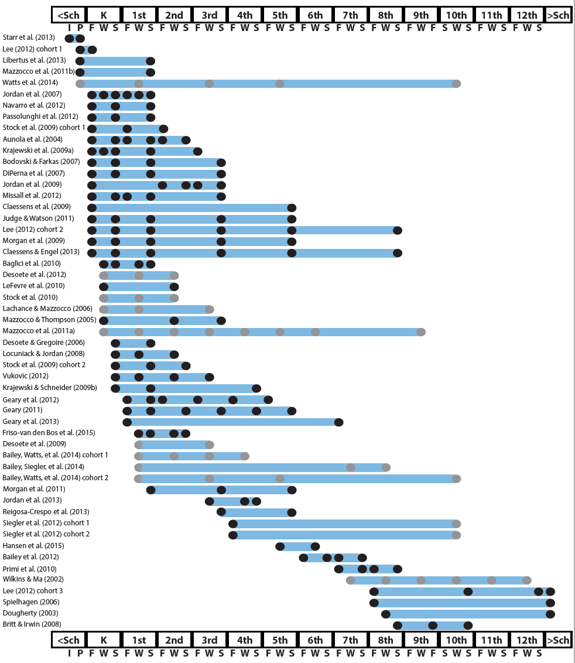
http://www.greatertexasfoundation.org/trajectories-of-mathematics-performance/

Slide 4
Broad math in preK predicted K broad math
Mathematics in preschool predicts later mathematics
http://www.greatertexasfoundation.org/trajectories-of-mathematics-performance/
Broad math in preK predicted grade 10 broad math

Slide 5
Counting in K predicted grade 1 broad math
Mathematics in kindergarten predicts later mathematics
http://www.greatertexasfoundation.org/trajectories-of-mathematics-performance/
Broad math in K predicted grade 8 broad math
K math accurately predicted math performance below 10th percentile in grades 2 and 3 with 84% correct classification

Slide 6
Mathematics in elementary school
predicts later mathematics
Addition influenced arithmetic with increasing importance from grades 1 to 5
http://www.greatertexasfoundation.org/trajectories-of-mathematics-performance/
Grade 1 arithmetic predicted arithmetic at grades 2, 3, and 4
Grade 1 broad math predicted broad math at grades 3, 5, and 10

Slide 7
Mathematics in middle school
predicts later mathematics
Counting and comparison in grades 2 or 4 predicted broad math 1 year later
http://www.greatertexasfoundation.org/trajectories-of-mathematics-performance/
Fractions at 10-12 years old predicted broad math 5 years later
Broad math in grade 7 predicted broad math in grade 8

Slide 8
Broad math in grade 8 predicted completion of 4-year college degree
Mathematics in
high school
predicts later outcomes
http://www.greatertexasfoundation.org/trajectories-of-mathematics-performance/
Students who took algebra in grades 8 took more advanced math courses and enrolled in 4-year colleges more often than students who took algebra in grade 9
Numeracy measured in adolescence impacted hourly earnings 7 to 15 years later

Slide 9
Mathematics in preschool predicts later mathematics
Mathematics in kindergarten predicts later mathematics
http://www.greatertexasfoundation.org/trajectories-of-mathematics-performance/
Mathematics in elementary school
predicts later mathematics
Mathematics in middle school
predicts later mathematics
Mathematics in
high school
predicts later outcomes

Slide 10
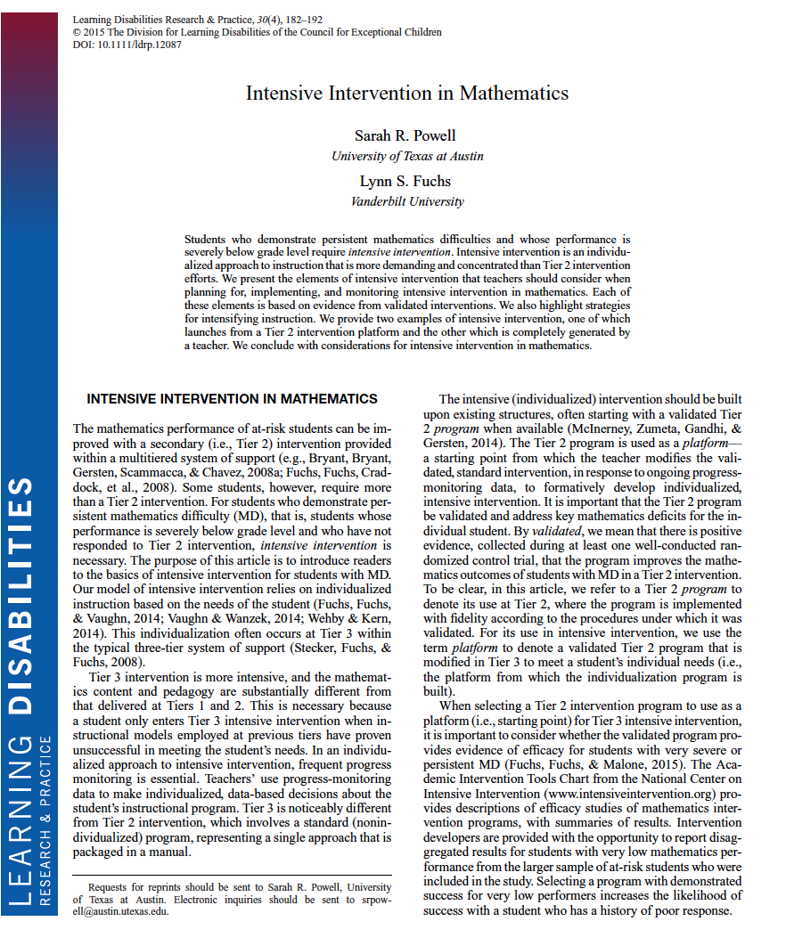

Slide 11
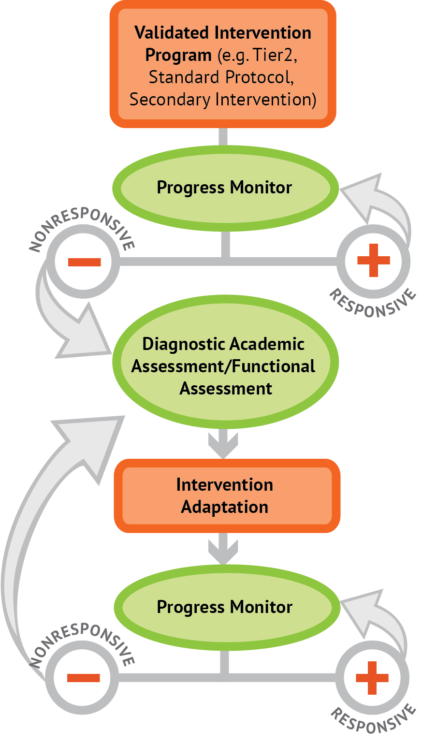
Intervention: Occurs frequently and with intensity
Assessment: Formative
Assessment: Diagnostic
Intervention adaptation: Content, dosage, explicit instruction, attention to transfer
Assessment: Formative

Slide 12
Where student IS
Where student NEEDS TO BE

Slide 13
evidence-based practice
evidence-based intervention
evidence-based strategy
promising practice
no or negative evidence

Slide 14
Assessment data to show results
evidence-based practice
Improvement from before intervention
Improvement compared to no treatment students
Replication
evidence-based intervention
Multiple researchers
evidence-based strategy
Multiple students
Multiple times
promising practice
Setting and students similar to your own

Slide 15
Intervention Platform
INSTRUCTIONAL DELIVERY
Explicit instruction
Concise language
Multiple representations
INSTRUCTIONAL STRATEGIES
Fluency building
Problem solving instruction
Motivation component

Slide 16
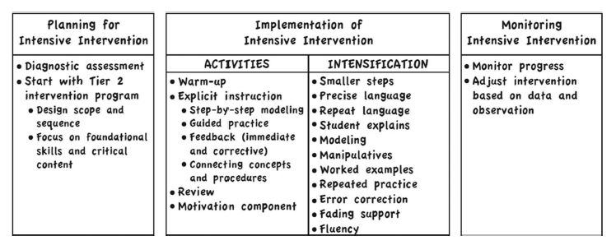

Slide 17
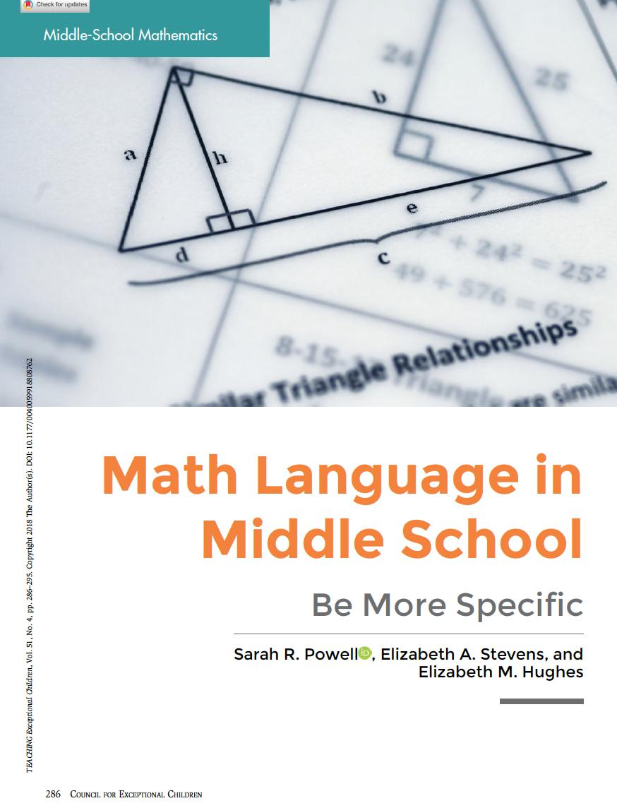

Slide 18
Vocabulary Across Grades

Slide 19
Use formal math language
Use terms precisely

Slide 20
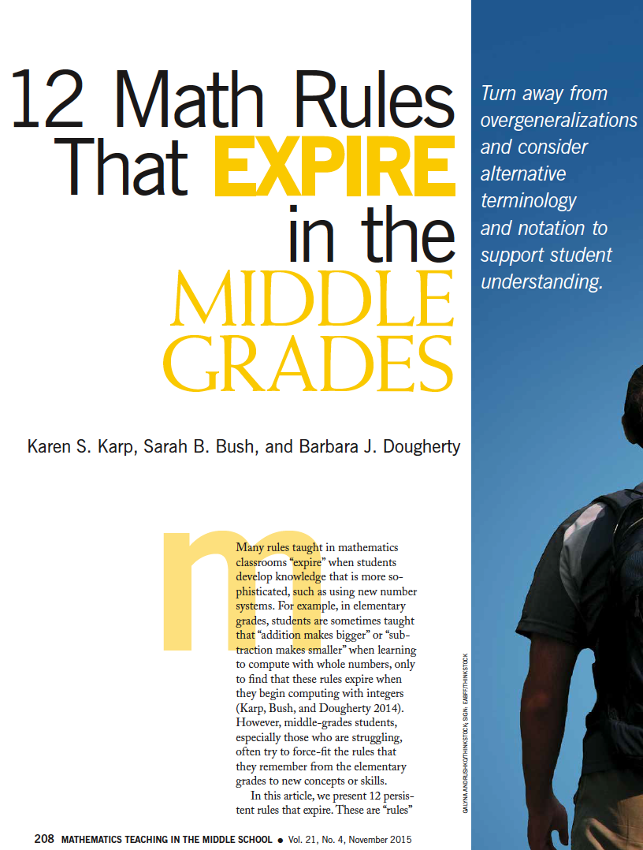

Slide 21
Conceptual
Procedural

Slide 22
srpowell@austin.utexas.edu
@sarahpowellphd
119

