Slide 1
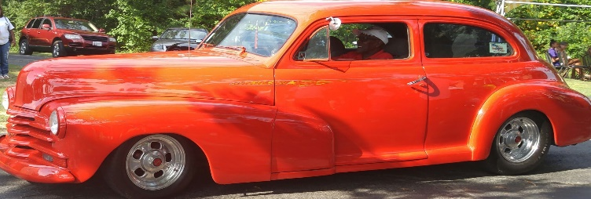
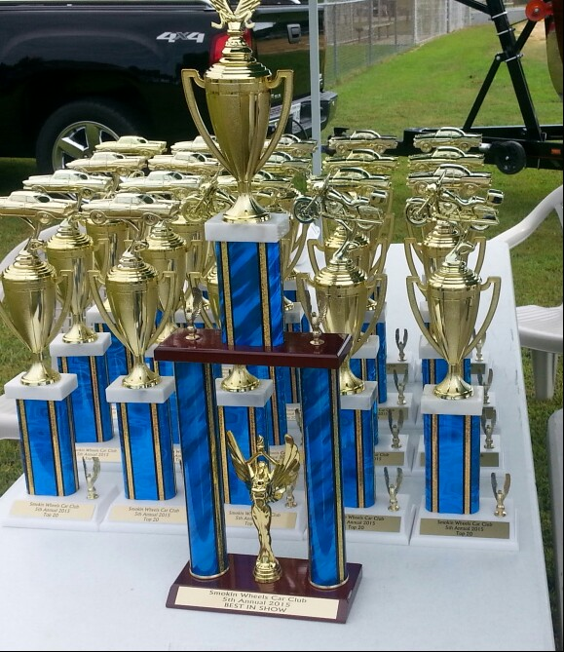
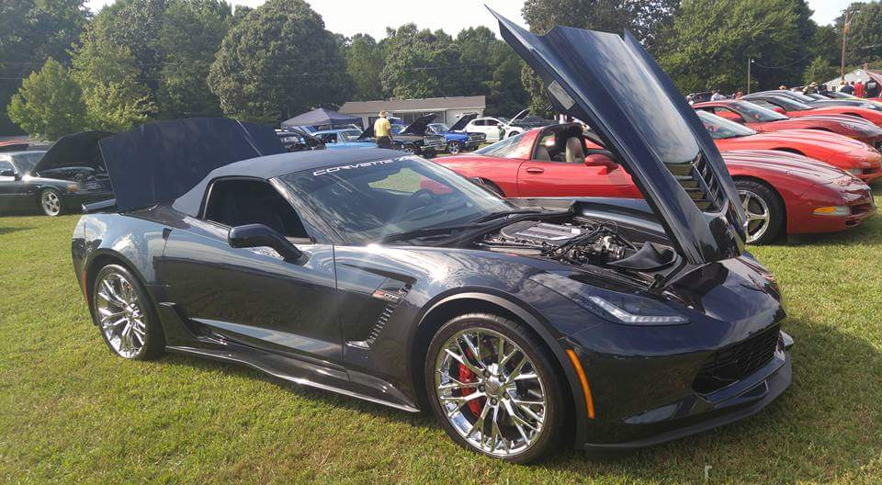
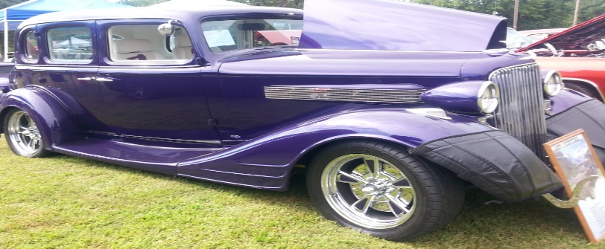
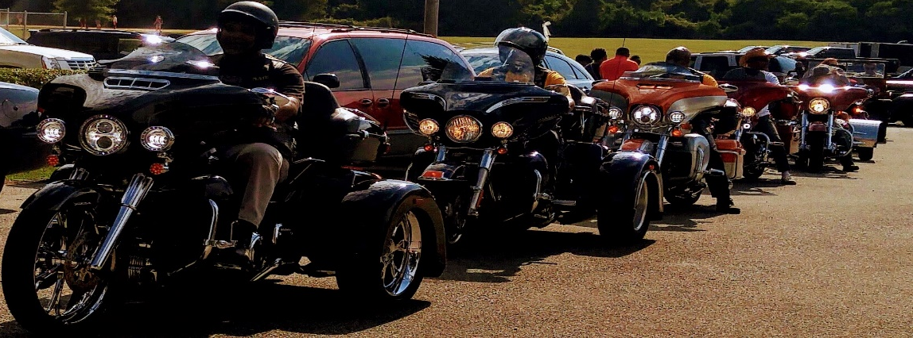
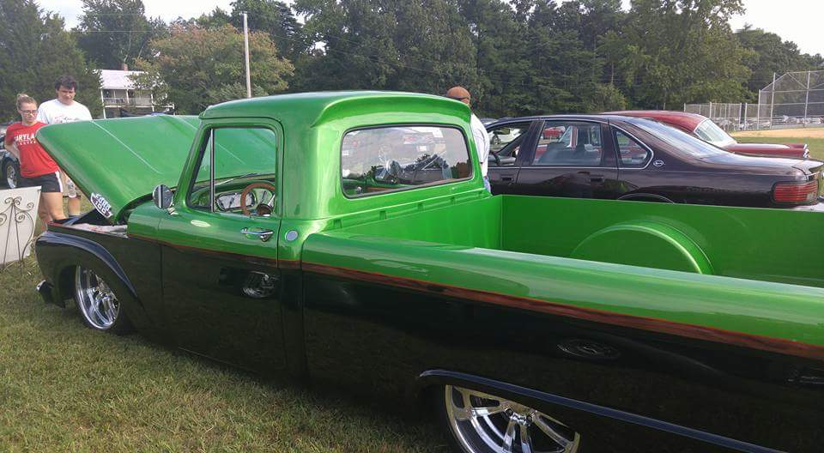
ST. PETER CLAVER CATHOLIC CHURCH
ANNUAL PRE-LABOR DAY DINNER & FESTIVAL
CLASSIC ANTIQUE CAR & BIKE SHOW
ON: SUNDAY, SEPTEMBER 02, 2018
16922 St. Peter Claver Road, St. Inigoes, MD 20684
Gates open- 9:00 a.m.
Judging @ 2:30 p.m.
Car & Bike Show @ 4:30 p.m.
THEME:
“IT’S A FAMILY AFFAIR”
$20.00 per Car or Bike Entry
All proceeds go to St. Peter Claver Church
For more Info. Pls. Contact:
Wayne Barnes- 301-580-5091
BEST SHOW EVER-
PLS. NO OUTSIDE COOLERS

