Slide 1
Fall 2015 Attendance Conference
Present and Accounted For
Office of Assessment Logistics

Slide 2
Data Review

Slide 3
Data Review Phases
YOU are Here
Phase 1
Phase 2
Phase 3
Phase 4
EIS Download
Demo Stats/ Review
EIS Download
Demo Stats/
Roster Review
EIS Download
Demo Stats/
Roster Review
EIS Download
Pre-Id Upload
Testing
EIS Download
Discrepancy
Review
Instructional
Roster
Linkage Roster
Quick Scores

Slide 4
EIS Pulls

Slide 5
2015-2016 EIS Pulls
8/14
First EIS pull – grades 3-11
Upload into MICA for Phase II
Bi-weekly
EIS pulls on Fridays
Upload into MICA and EdTools
10/8
All students grades 3-11
Upload into MIST for EOC Fall Part I
11/13
All students grades 3-11
Upload into MIST for EOC Fall Part II
12/4
All students grades 3-11
Upload into EdTools for Fall EOC SDDV/TSC
Demographic data should be updated in EdTools by COB Wednesday after each pull.
*all dates subject to change

Slide 6
File Uses
Updates will be uploaded into MICA every two weeks – new students may either be manually entered or wait for the next update.
Students will be uploaded into MIST for operational testing.
Students will receive pre-id paper response documents for science testing in the spring.
Establishes initial class rosters in EdTools for Teacher Student Connection (TSC)

Slide 7
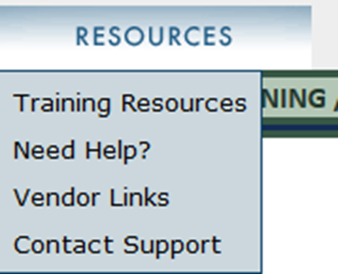
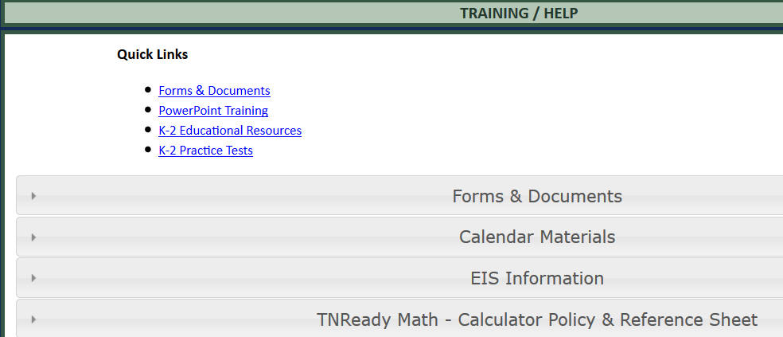
EIS File Layout - Location

Slide 8
EIS File Layout
The EIS File Layout is an excel workbook that contains separate worksheets for each of the following:
Record layout: details for each field in a student record, the valid values for that field, the rules used by our EIS programmer to pull that information, and the EIS extract record source.
Rules: additional business rules that would not fit in the file layout
3-8 Course and 3-8 Priority: the 3-8 course codes and the order in which they appear in the course table for the EIS pull
Secondary and Secondary Priority: the secondary course codes and the order in which they appear in the course table for the EIS pull
Schedule: the specific fields used to determine the student’s class, a student may have up to 9 courses in the record – this worksheet also contains more detail about the rules for Membership
Demo Stats rules: Special rules used to populate the demo stats page in EdTools

Slide 9
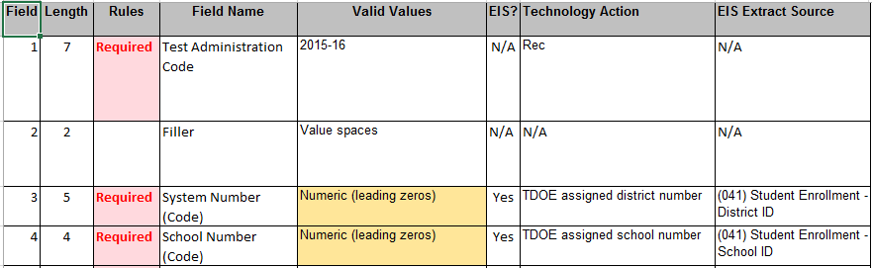
Fields 1-4
Fields 1-4 contain general information to identify the test, district, school.
These fields are automatically populated in the file and do not require anything from the school or district.

Slide 10
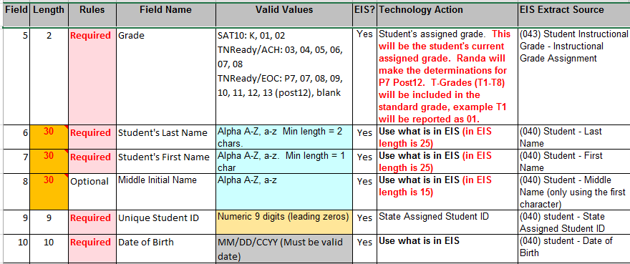
Fields 5 -10
Fields 5-10 contain student identification information that should be included in the student enrollment. A middle name or initial is not required.

Slide 11
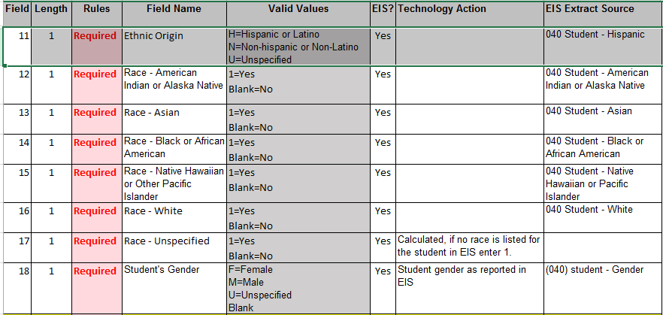
Fields 11-18
Fields 11-18 contain ethinic origin, race and gender, these fields should be included in the student enrollment.
Only student gender (field 18) will all be uploaded into both MICA and MIST.
Ethnic origin and race will be available for review in Demo Stats in EdTools.

Slide 12
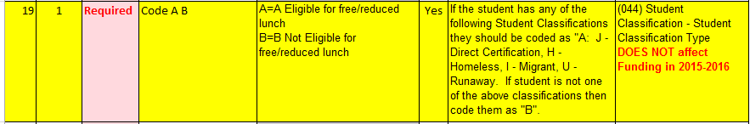
Fields 19 – Code A/B
Fields 19 is a required field and populates information for school nutrition.
In 2015-2016 a new student classification “J” has been added to identify all students who are eligible for free or reduced lunch through direct certification. A “directly certified” student is any student eligible to receive free lunch without an application, regardless of the district or school CEP status. Code "J" will identify students that are direct certified via SNAP, TANF, foster or by state or local officials. This will impact all schools. Resources for regarding code “J” are provided on the next slide. In addition to Code J, Codes H, I, and U will be included in the Code A eligible classification.

Slide 13
Fields 19 – Code “J” Resources
Information regarding Free and Reduced-Price Meals is available on the website: http://tn.gov/education/article/free-and-reduced-price-meals
The memo defining the economically disadvantaged subgroup for accountability: https://gallery.mailchimp.com/b28b453ee164f9a2e2b5057e1/files/ED_Definition_for_Accountability_Memo.pdf
Memo regarding classification code “J”: https://gallery.mailchimp.com/b28b453ee164f9a2e2b5057e1/files/New_Student_Classification_Code_J.pdf
The FAQ regarding ED Definition for Accountability: https://gallery.mailchimp.com/b28b453ee164f9a2e2b5057e1/files/ED_Definition_for_Accountability_FAQ_.pdf

Slide 14
Fields 20-26
Fields 20-26 contain specific special program demographic information. The rules related to Fields 21, 22, and 26 are located on the rules tab of the workbook.

Slide 15
Fields 27-33 continued 34 - 89
Fields 27-89 contain the class schedule for the student. These fields will determine the class rosters in MICA, MIST, and for Class Rosters in EdTools. Content areas require the course codes provided on the 3-8 and secondary tabs of the workbook. Testing Cycle will help to establish the test administration for the student.

Slide 16
3-8 Course Codes
The course codes must be used in order for a student to be scheduled for a test in MICA or MIST. Science course codes are required for pre-id.
  Applies to Fields 29, 36, 43, 50, 57, 64, 71, 78, 85

Slide 17
Secondary Course Codes

Slide 18
Rules for Testing Cycle – Test Schedule
Determination of testing cycle will impact when a student is scheduled to test in MIST. This will be used regardless of class schedule in Field 93 (traditional/modified)
Fall Block (F):
  Class end date < February 1
Spring Block (S):
  Class Start Date > December 1
  Class End Date <= Attendance End Date or Null (EIS prefers null)
Year Long Classes (Y):
  Class Start Date = Attendance Start Date
  Class End Date = Attendance End Date > May 1 or Null
  Applies to Fields 33, 40, 47, 54, 61, 68, 75, 82, 89

Slide 19
Fields 90-93
Fields 90-91 are filler fields and are automatically populated.
Field 92 indicates if a student is a CTE concentrator and is pulled from etiger
Field 93 indicates the school schedule and will be used to help establish block schedule test administrations

Slide 20
Fields 94 - 95
Fields 94-95 will generate Instructional Availability and Membership data. Previously these had to be hand entered. For Instructional Availability, which is used for teacher-effect, we will calculate the days based on date of enrollment and number of absences. Membership will be calculated based on date of current enrollment and any previous enrollments for this academic year. Membership is used as part of federal reporting only.

Slide 21
Fields 96 - 98
Fields 96-97 are new fields for 2015-2016.
District 60% enrollment will be used to determine a student’s eligibility for inclusion in district accountability. It will be based on the date of enrollment.
EL Excluded is determined on the first date of enrollment in a US School. Students who meet this criterion do not take the ELA assessments. They are required to take math, science and social studies assessments, however the scores for their math assessments do not count in accountability.
Field 98 is the final field of the student record and is automatically populated.

Slide 22
Business Rules for the EIS pull
For a Student record to be pulled – the student must have: An Enrollment in a school
An Instructional Grade record for that enrollment
A Student Class Assignment (course code) record for that enrollment
A Class Section (local class number) for the Student Class Assignment
A Teacher identified as the teacher of record for the class section (Master Teacher record)
A Valid Teacher License number for the teacher of record (above)

Slide 23
Additional Rules
The business rules for populating the following fields are provided on the rules tab:
Instructional grade
Title I status
Service enrollments
Teacher of record
Alternative Schools
Special Education hours
Gifted
Functionally Delayed
Course codes
Testing Cycle – this is very important for block schedule rosters
Schedule – also very important for block schedule rosters
Instructional availability – used for teacher effect
Membership – used for federal reporting
>60% enrollment – used for accountability

Slide 24
EdTools

Slide 25

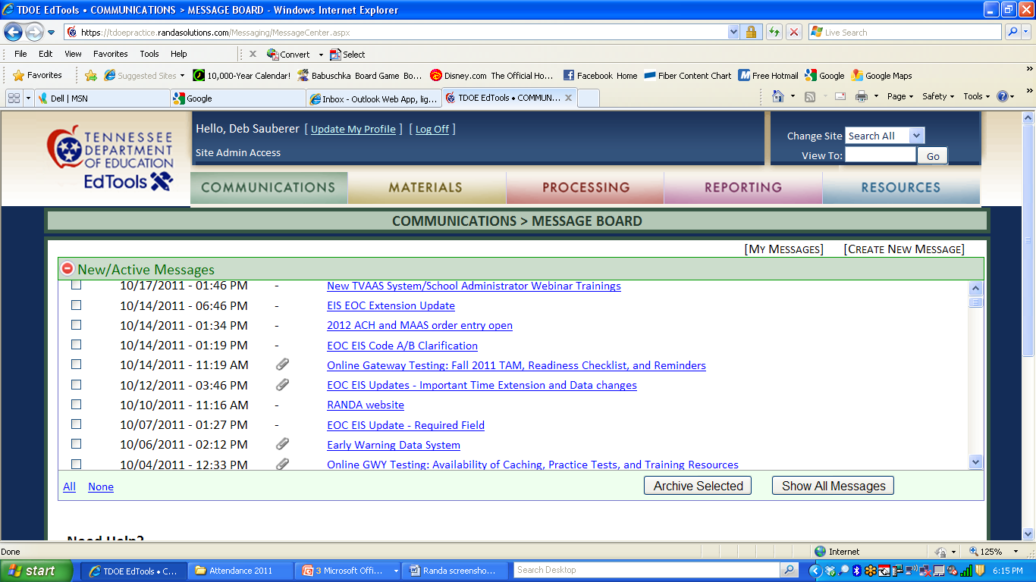
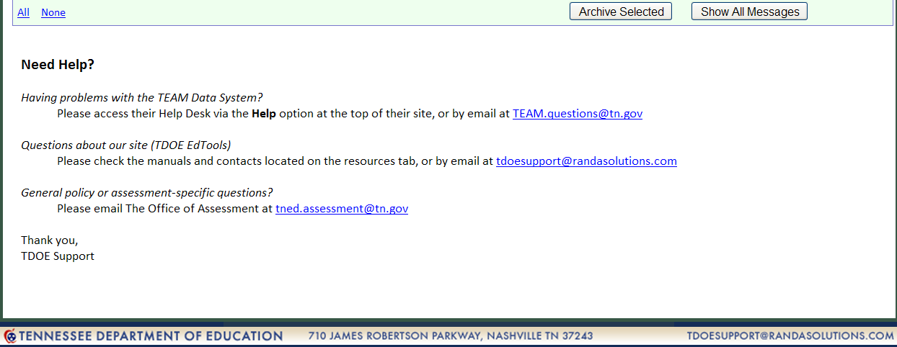
https://tdoe.randasolutions.com/
User accounts for EdTools can be created by the building or district testing coordinator

Slide 26
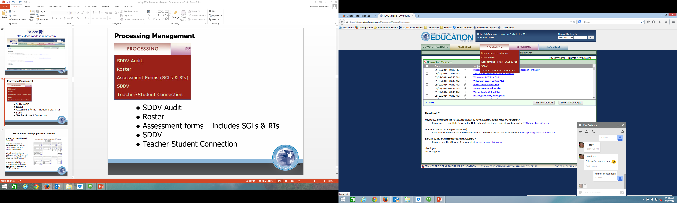
Processing Management
Demographic Statistics
Class Roster
Assessment forms – includes SGLs & RIs
SDDV
Teacher-Student Connection

Slide 27
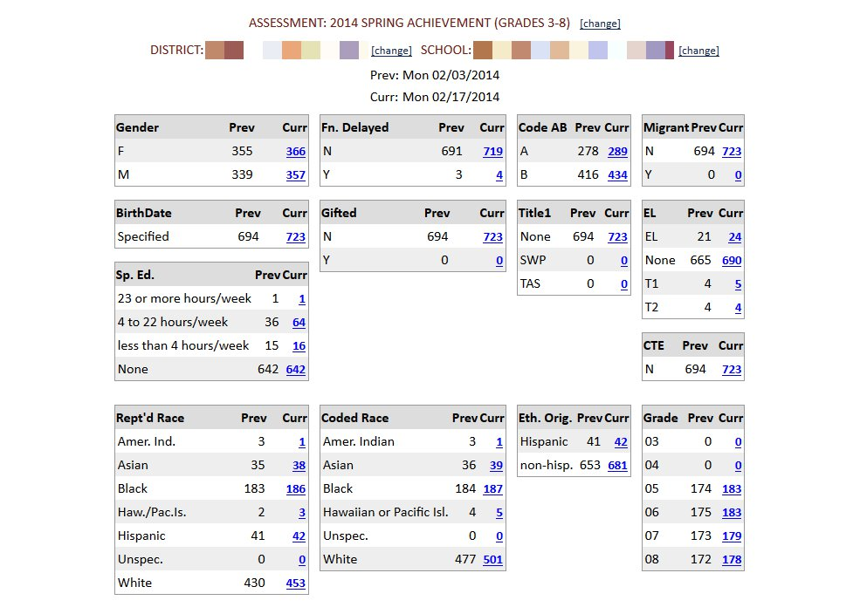
Demographic Statistics: Demographic Data Review
Demo stats will be refreshed with each bi-weekly pull through-out the year.
Districts are able to download data at a school summary level and at a student specific level.
This data is pulled by a TDOE EIS programmer and cannot be changed or researched by RANDA or Measurement Inc..

Slide 28
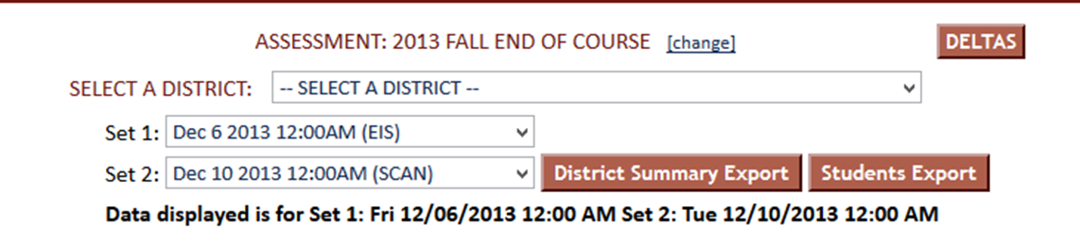
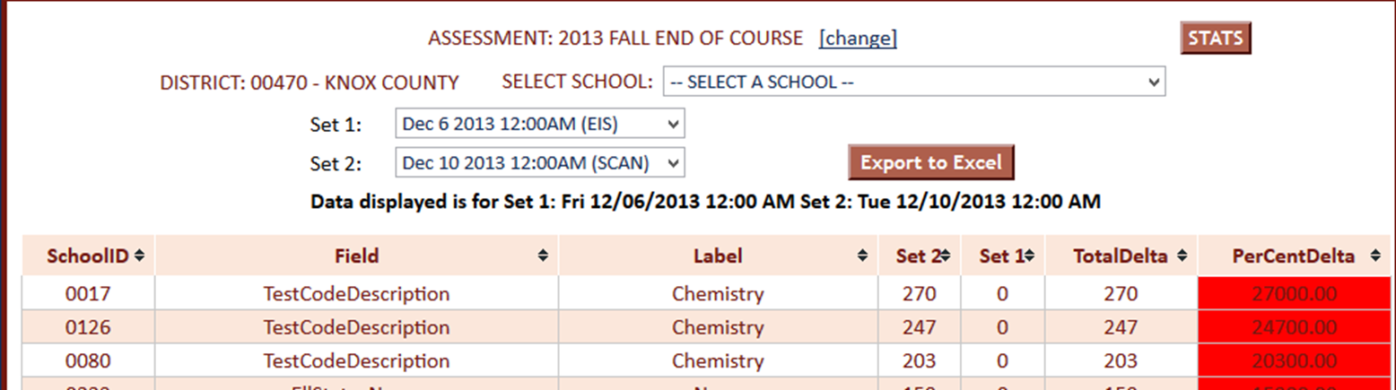
Delta Reports
Delta reports indicate the percent of change between two different data pulls.

Slide 29
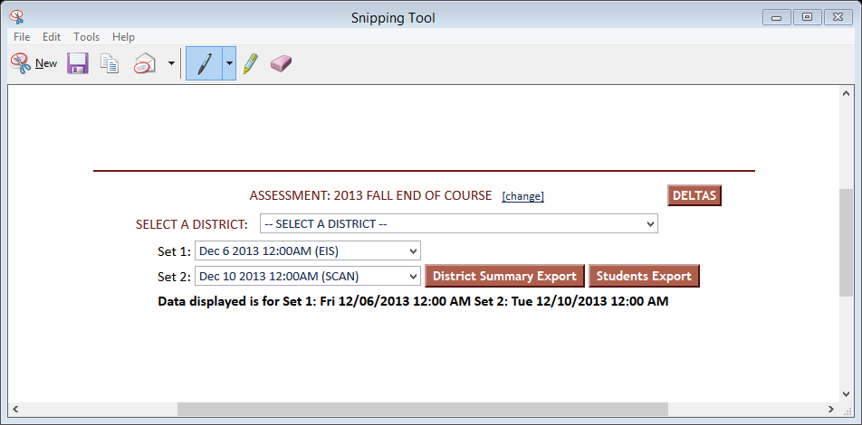
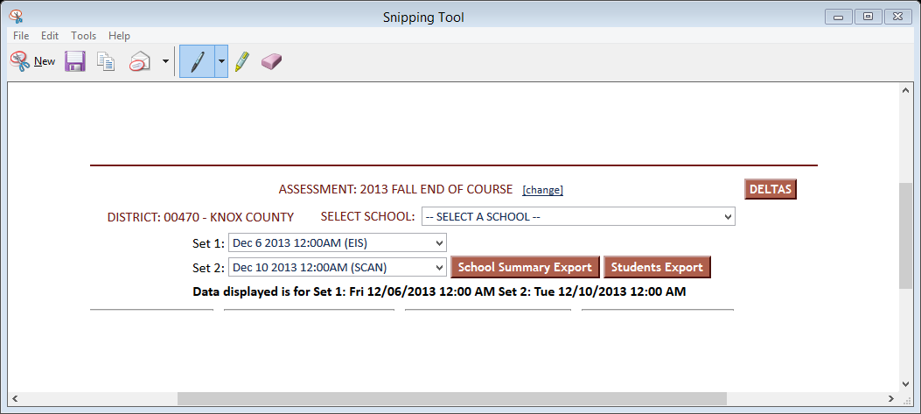
Delta reports provide comparisons between pulls by data field.
Select the test from the drop down, then select Deltas
Select data sets from available pulls -
Export files into Excel
School Summary provides n-counts for each school by data field
Student Export provides student basic information

Slide 30
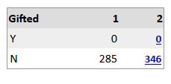
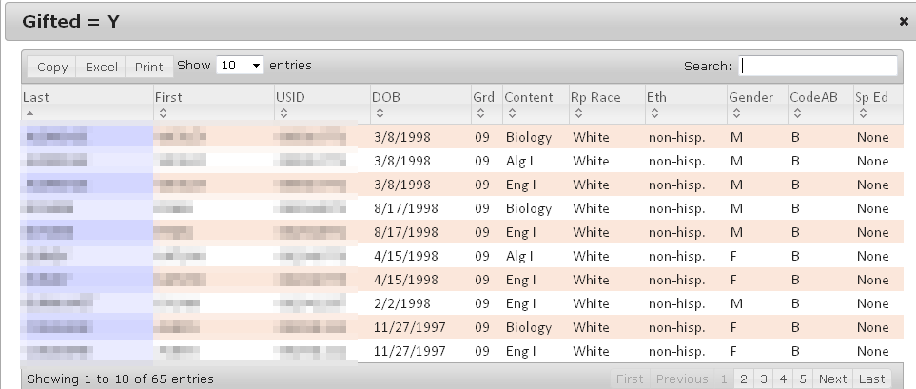
Individual demographic field
At the School level click on the number in a specific demographic field to see the list of students currently reported.

Slide 31
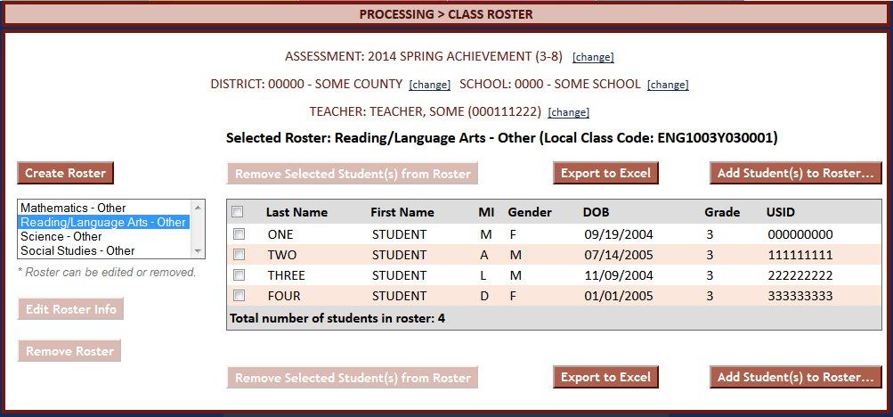
Class Roster: Teacher review
Rosters will be read only until the final EIS pull for processing, once that pull is loaded teachers and administrators may begin reviewing rosters before TSC opens. Any changes made to rosters will be included in TSC when it is opened during processing.

Slide 32
DATA …..
It’s all about the Demographics…
SSN
ethnicity
Name
gender
Membership
econ
sped
attendance
ell
accommodations

Slide 33

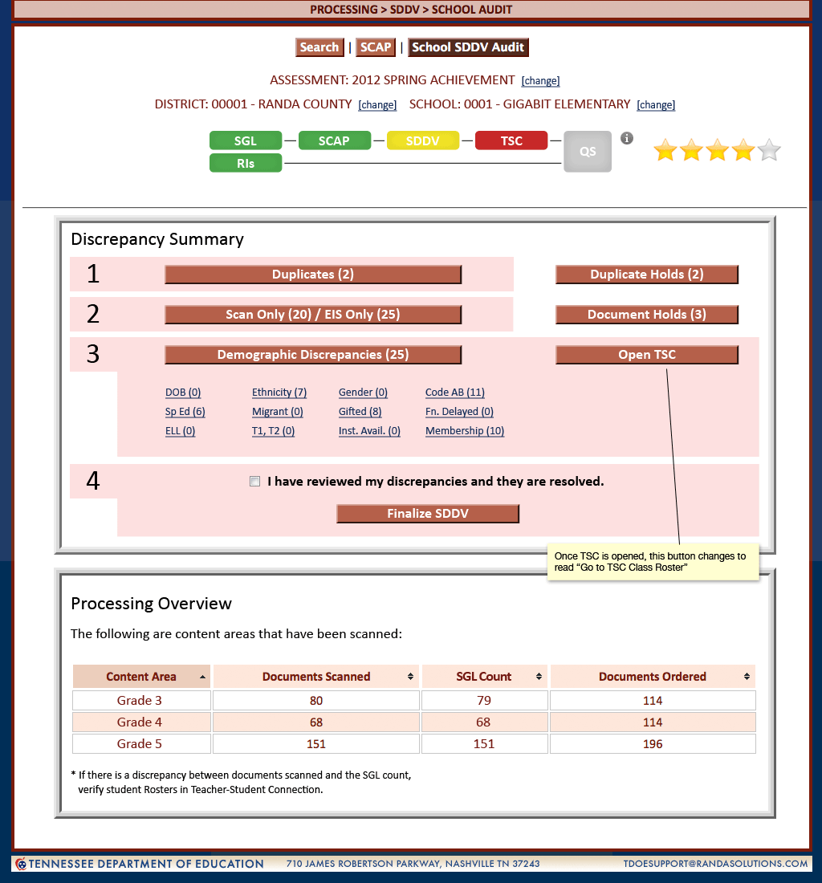
Student Demographic Data Verification (SDDV)
Step 3 on the Progress Bar
Education Information System (EIS)
Discrepancy reports

Slide 34
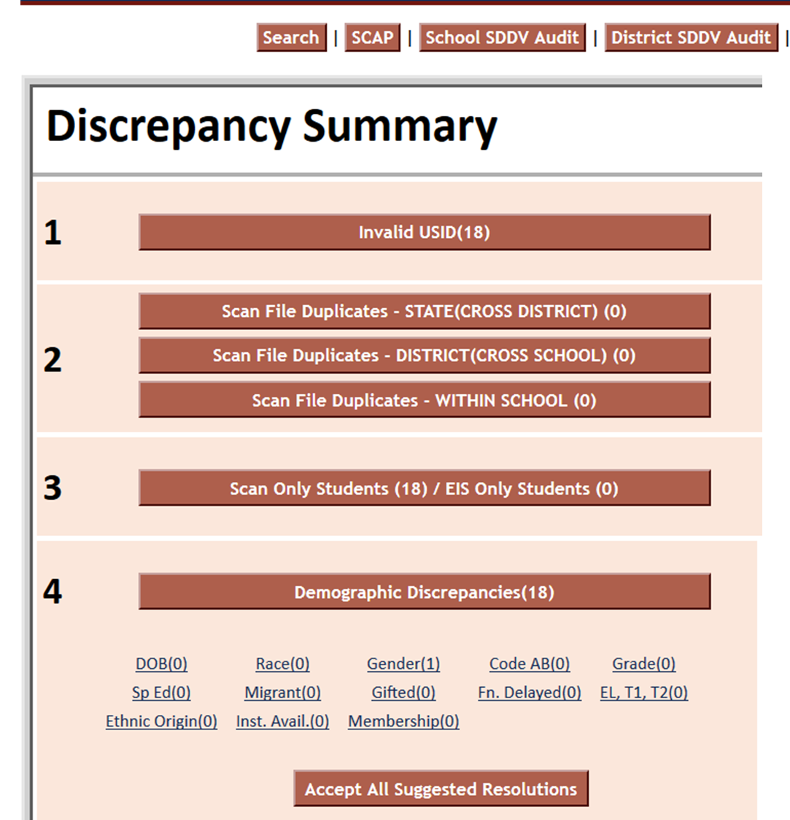
Discrepancy Summary
5 Step Process
1. Invalid USID
2. Review Duplicates
3. Scan vs. EIS
4. Demographic Discrepancies
5. Finalize

Slide 35
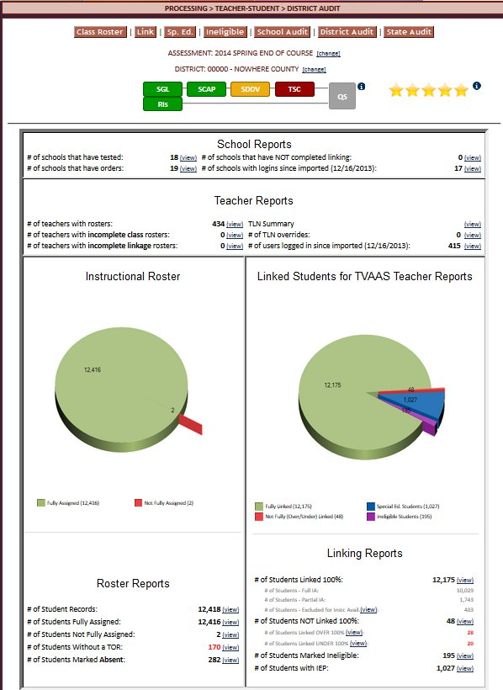
Teacher-Student Connection
Step 4 on the Progress Bar
School & District
Audit
Class Rosters
Assignment Rosters
Linkage Rosters

Slide 36
Where does the Roster come from?
Teacher License is in EIS
Teacher License on EdTools Account
Teacher License from MIST

Slide 37
Data Q/A All Along the Way
Value-Added
Accountability Determinations
Data and Research
Test Processing Center
System Testing Coordinator
Building Testing Coordinator
Teacher

Slide 38
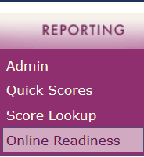
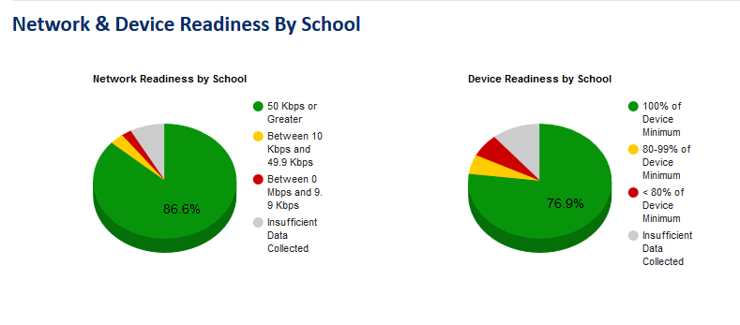
Reporting
The Online Readiness Tools is located on the Reporting tab.
Districts have been working to update their readiness data with summer purchases and upgrades. At this time there are no TN Public Schools that have requested a waiver to test on paper in 2015-2016.

Slide 39
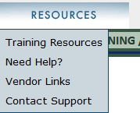
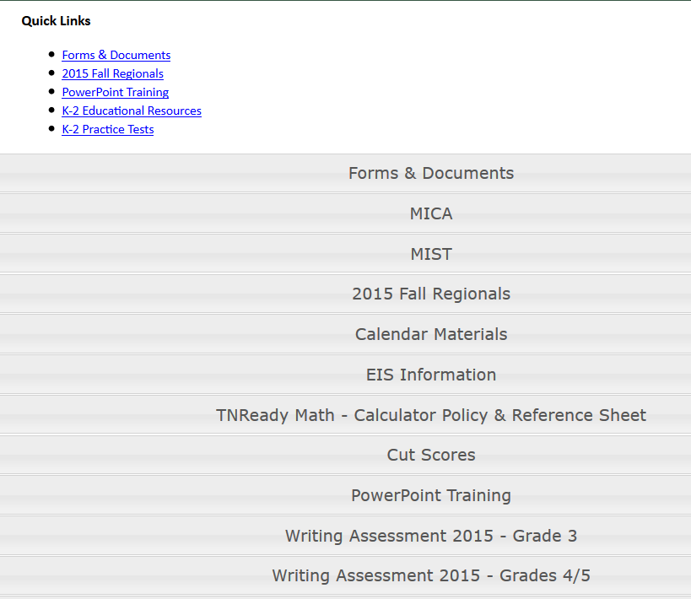
Resources – Training Resources
We have narrowed the Resources Tab to make it more efficient. All training documents or other resources are in one place on the dropdown.

Slide 40
Resources – Contact Support
In an effort to streamline communication efforts and keep all information on the same page, we added a Support service to EdTools.
From the Resources Tab select Contact Support.

Slide 41
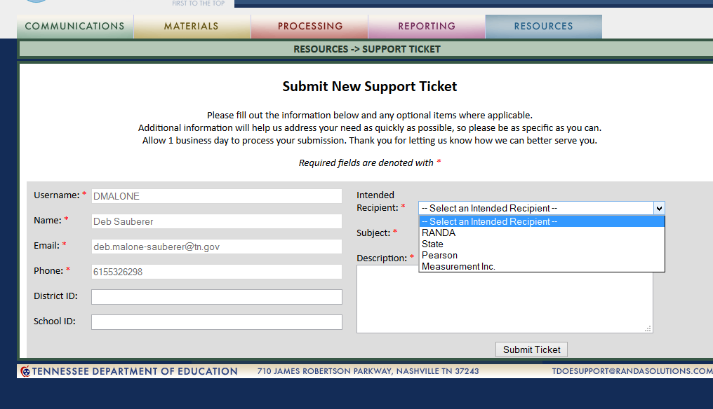
Contact Support
A support Ticket will be generated, select your intended Recipient

Slide 42
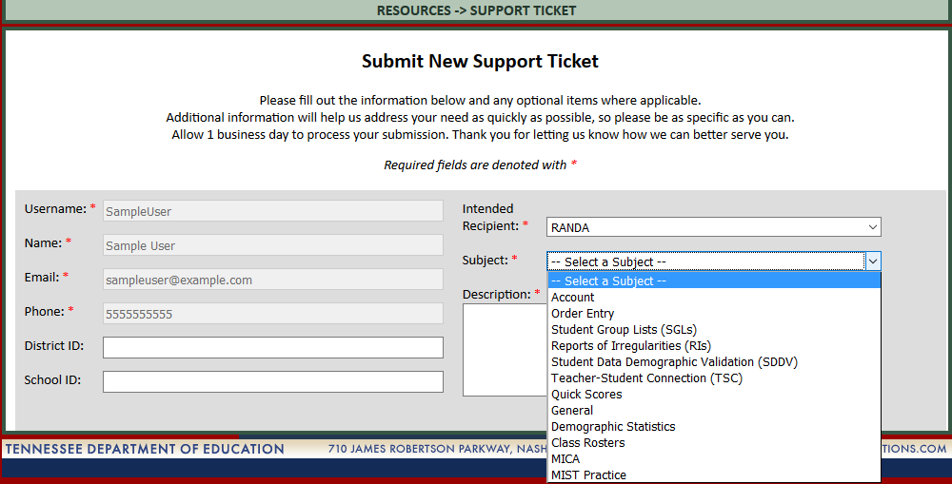
Contact Support
Select a Subject area, we will expand the selections as the system builds. Use the Subject “General” if you aren’t sure.

Slide 43
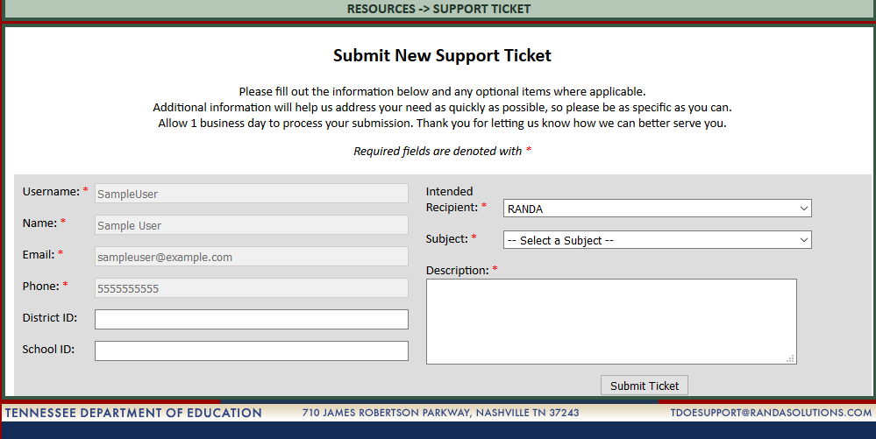
Contact Support
Complete the Description, provide as much detail as possible. The support ticket will be triaged by our trained support staff. Whenever possible they will provide an answer to your questions. Otherwise, they will forward the inquiry to the appropriate person for review and response – this includes the department and our vendors.
Please do not send separate emails to TNED, TDOE or Vendor Support desks – it multiplies the number of emails to be reviewed and slows down our response time.
The ticket will be used to track the issue and ensure you receive a timely response.

Slide 44
Contact Information
Assessment Logistics
  Phone:
  (615) 741-0720
  E-mail:
  Tned.assessment@tn.gov
  Web:
  http://tn.gov/education/section/assessment
  EDTools:
  https://tdoe.randasolutions.com

Slide 45

Thank You

