Slide 1
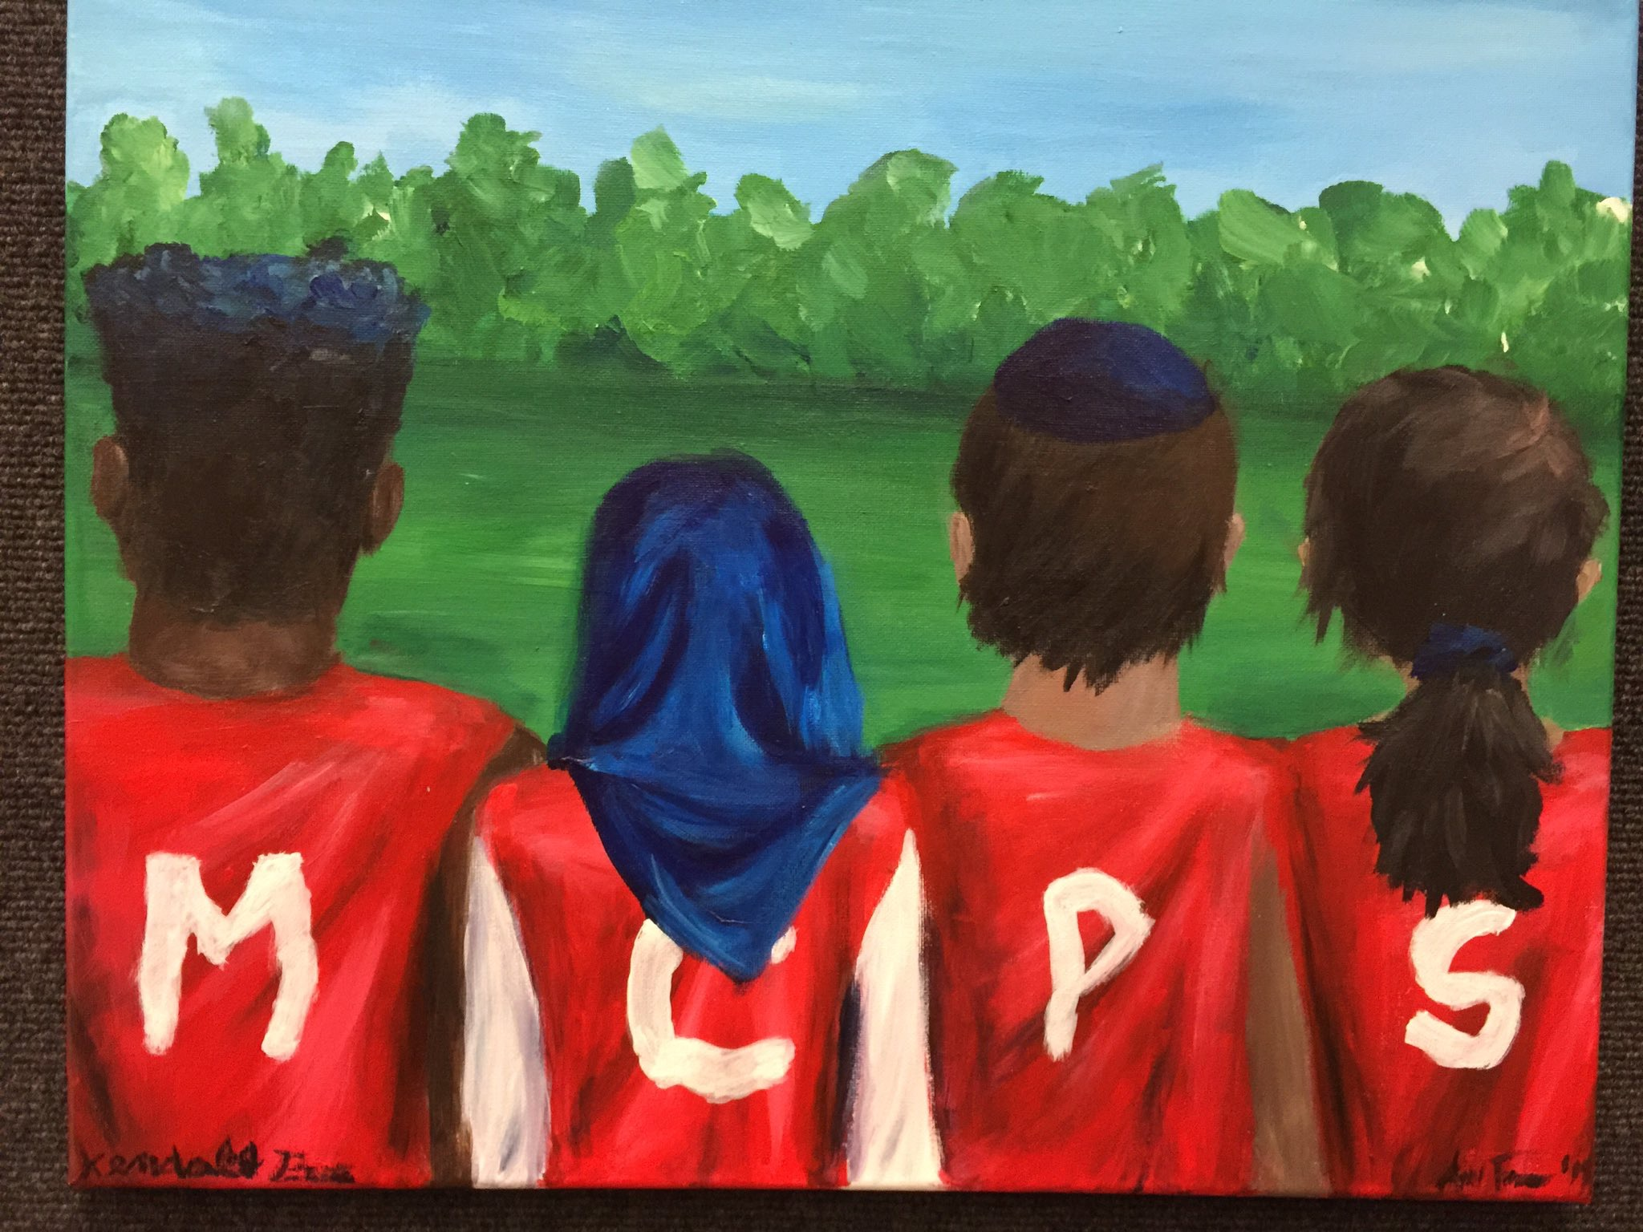
The Path Forward:
Combating Intolerance & Creating Opportunity
Artwork by Ariel Fromm & Kendall Price, Montgomery Blair High School

Slide 2
Who are we?
Largest school district in Maryland
17th largest school district out of about 15,000 in U.S.
In 2016-17, MCPS made up 40% of school population growth in Maryland
Students from more than 157 countries speak 138 languages in their homes
Among top 20 U.S. school districts with highest concentration of English language learners
MoCo has three of top 10 most diverse U.S. cities: Gaithersburg, Germantown, Silver Spring
Notes:
MCPS is the second largest employer (23,000 employees, 13,000 teachers) in Maryland after Giant (27K employees) MCPS was ranked 31st best employer to work with in 2017 by Forbes magazine.

Slide 3
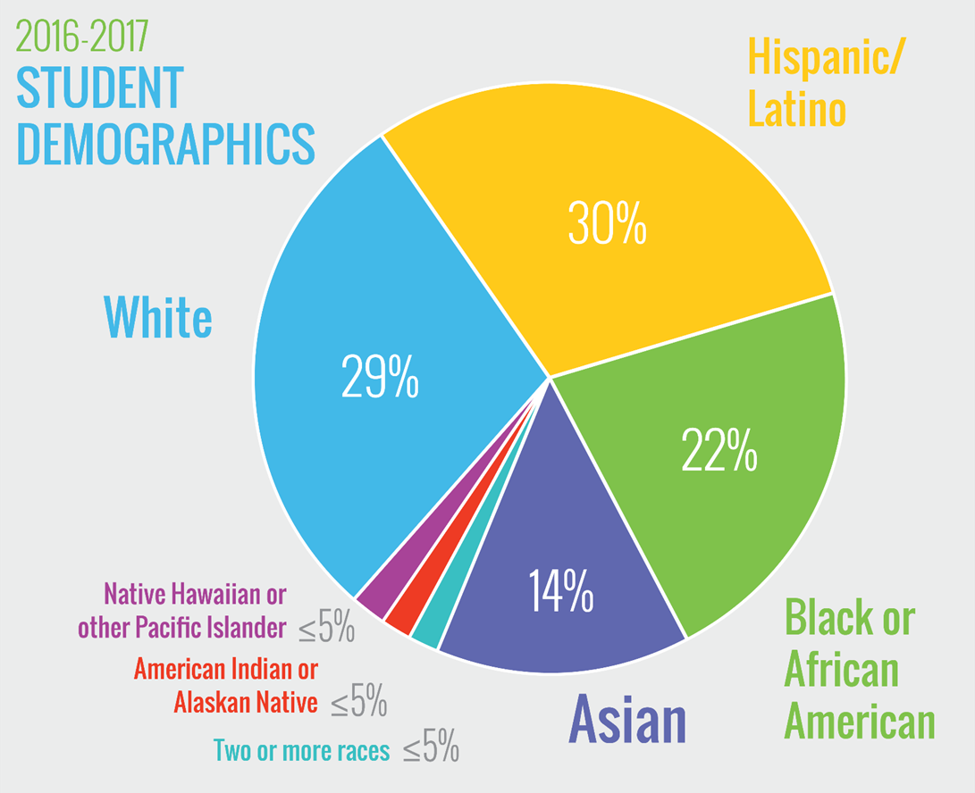
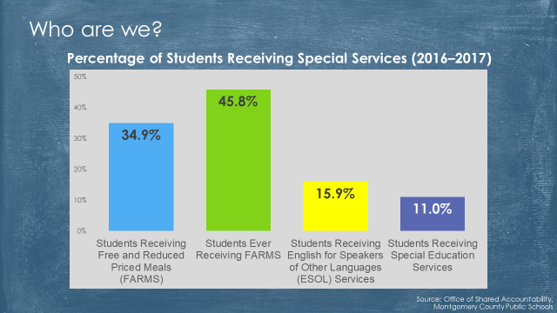
Who are we?

Slide 4
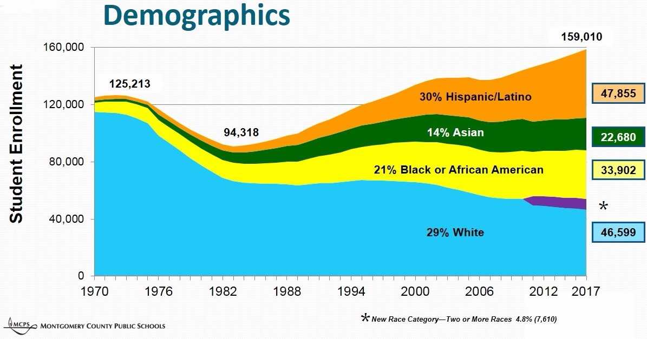
Notes:
Interesting capital (facility) facts: MCPS closed 63 schools during late 1970s. Now would cost over $800 million to put over 9K students currently in over 400 portables in classrooms. Backlog of maintenance: HVAC, windows, compliance, electrical, plumbing, etc. is over $800 million as well. Elementary School preferred capacity is 450-750. ES cost about$ 27 million depending on site development & building. Middle school is 750 – 1,200. MS cost $45-50K to build. High School preferred capacity is 1,600 – 2,400. Costs $85 -110 million to build. Our per foot building cost is about 17% less than State average. The school system’s operating budget was funded at or below Maintenance of Effort (MOE) from 2010-2016.
2016 was the first increase in property tax in 8 years (2008 for fiscal year ‘09) 2008 was the beginning of the Great Recession. Montgomery County has the highest percentage of people who live and work in-county in metro area.

Slide 5
Notes:
We have more FARMS-eligible students than all the students in DC Public Schools.

Slide 6
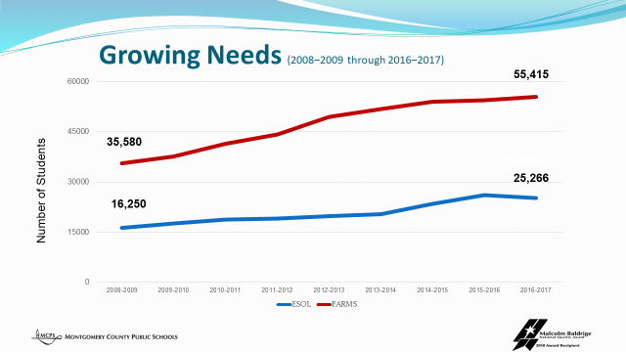
Notes:
¾ of all our English Language Learners are enrolled in a high FARMS school.

Slide 7
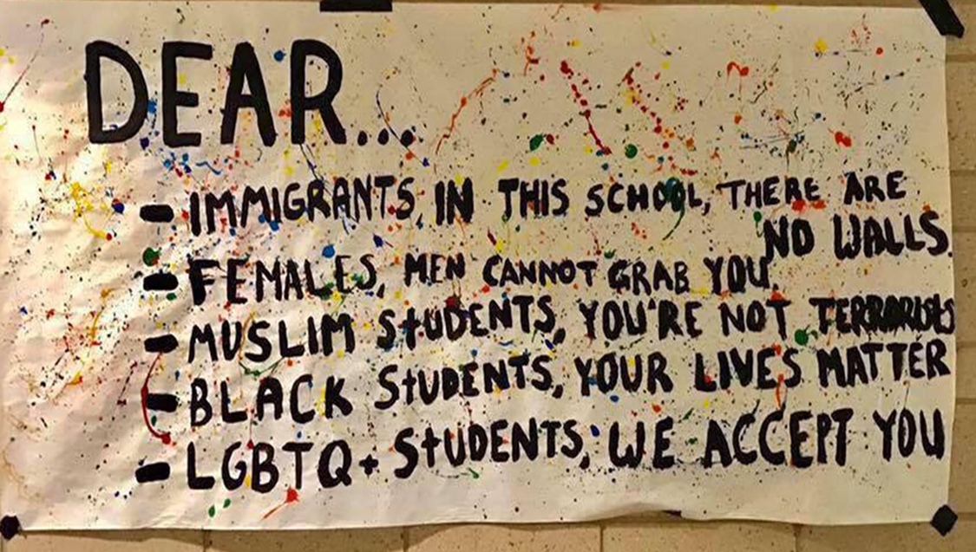
MCPS MISSION
Every student will have the academic, creative problem solving, and social emotional skills to be successful in college and career.
CORE VALUES
Equity
Respect
Learning
Relationships
Excellence

Slide 8
Our Values: Equity
WE BELIEVE
that each and every student matters;
outcomes should not be predictable by race, ethnicity, or socioeconomic status;
equity demands the elimination of all gaps; and creating and maximizing future opportunities for students and staff is necessary.
THEREFORE, we will hold high expectations for all students and staff; distribute resources as necessary to provide extra supports and interventions so all students can achieve; identify and eliminate any institutional barriers to students’ success; and ensure that equitable practices are used in all classrooms and workplaces.

Slide 9
Our Values: Respect
WE BELIEVE
that each individual’s contributions add value to our learning community;
fair treatment, honesty, openness, and integrity are essential; and
the diversity of our culture, interests, skills, and backgrounds is an asset that makes us stronger.
THEREFORE, we will model civility in all interactions and encourage candid conversations; deal fairly and honestly with each other; and listen to others’ perspectives with openness and accept that there are various points of view.

Slide 10
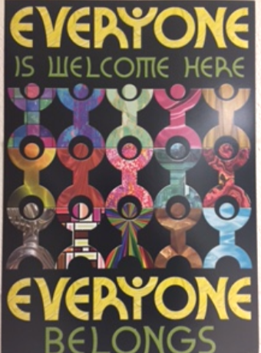
MCPS Policies
Guidelines for Respecting Religious Diversity
Policy JHF: Bullying, Harassment and Intimidation
Policy ACA: Non-Discrimination, Equity, Cultural Proficiency

Slide 11

Respect and Equity
Equity Initiatives Unit: Study Circles, Equity & Excellence certification, Equity Office culturally proficient trainings for staff, resources (i.e. Speak Up/Teaching Tolerance), religious literacy program for teachers, school support
Partnerships: MoCo Human Rights Commission, Committee on Hate/Violence, MoCo Interfaith Community Liaison
Digital citizenship program: Common Sense Education on cybercivility
United We Learn: Combating Hate through the Arts
Restorative Justice Practices
Mindfulness and Trauma Informed Teaching Practices
Project-based learning

Slide 12
MCPS Statements
A Message from Superintendent Dr. Jack Smith on the critical need to engage in meaningful conversations about race, civility and the unique lived experiences of MCPS students. 9/23/2016
A Message from Superintendent Jack R. Smith 11/11/2016
“This election season has been particularly difficult. It caused a great deal of emotion among many members of our community. We want to take this opportunity to reiterate the values that are foundational to this school system.”
Statement on Hate-Related Vandalism at Montgomery County Public Schools 11/15/2016
Safe and Welcoming Schools for All Students 1/10/2017
Statement on Trump Administration's Decision to Rescind Federal Protections for Transgender Students 2/23/2017

Slide 13
Diversity
Why does Montgomery County value diversity?
Do students benefit by being in a diverse environment?
How diverse are our schools?

Slide 14
Benefits of Diversity
Decades of social science research finds that students who attend desegregated schools have higher levels of academic achievement and are more likely to graduate from high school and college.
Diverse K-12 schooling is also related to a reduction in prejudice, stereotypes, and negative attitudes while at the same time increasing friendships and trust across racial groups.
Experiencing desegregated learning environments enhances students’ capacity for navigating multicultural situations. Students who have attended desegrated schools are more likely to live and work in desegrated environments in life.*

Slide 15
Diversity
All students benefit from diversity:
“Researchers have documented that students’ exposure to other students who are different from themselves and the novel ideas and challenges that such exposure brings leads to improved cognitive skills, including critical thinking and problem solving.”*

Slide 16
Implicit Bias
“Unlike explicit bias (which reflects the attitudes or beliefs that one endorses at a conscious level), implicit bias is the bias in judgment and/or behavior that results from subtle cognitive processes (e.g., implicit attitudes and implicit stereotypes) that often operate at a level below conscious awareness and without intentional control.”
- National Center for State Courts

Slide 17
Structural Racism
A system in which public policies, institutional practices, cultural representations, and other norms work in various, often reinforcing ways to perpetuate racial group inequity. It identifies dimensions of our history and culture that have allowed privileges associated with “whiteness” and disadvantages associated with “color” to endure and adapt over time.
Indicators/Manifestations Inequalities in:
power
access
opportunities
treatment
policy impacts and outcomes
-The Aspen Institute
Notes:
whether they are intentional or not. Structural racism is more difficult to locate in a particular institution because it involves the reinforcing effects of multiple institutions and cultural norms, past and present, continually producing new, and re-producing old forms of racism.

Slide 18
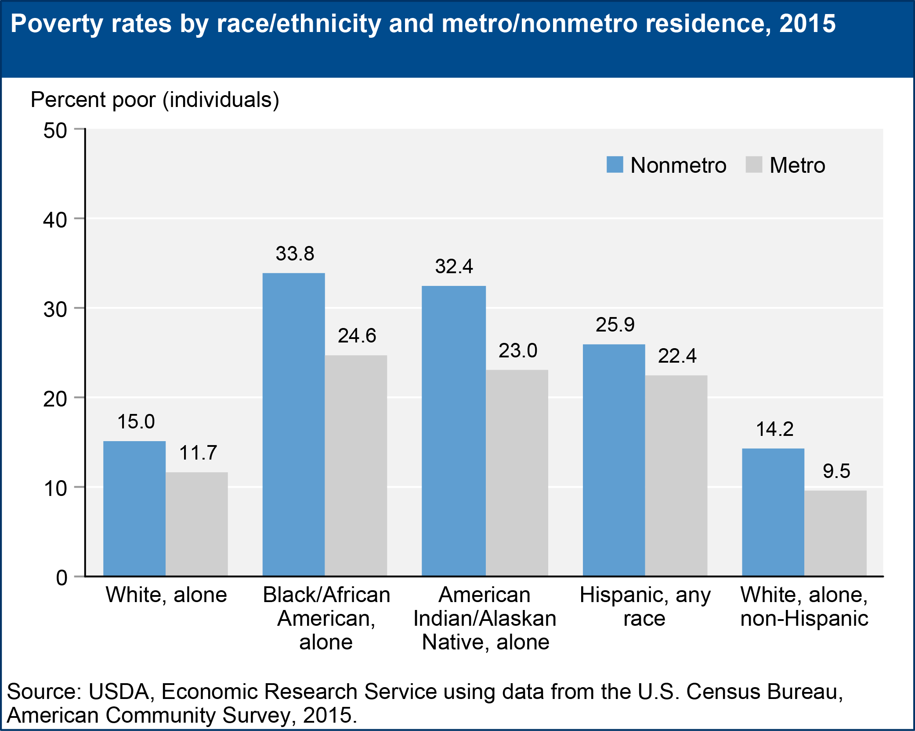
Structural Racism
Poverty
African-Americans are twice as likely to be poor
as whites.
African-American and Hispanic workers are far
more likely to be in low-wage jobs.
Criminal justice system
Ex: Marijuana use is roughly equal among blacks and and whites, yet African-Americans are 3.73 times
as likely to be arrested for marijuana possession.
Health disparities and social determinants
People of color have greater exposure to environmental hazards, less health care access, and higher rates of suicide, asthma attacks, chronic disease, work-related injuries, tuberculosis, etc.

Slide 19
Structural Racism
Housing
“A century of government policy actively enforced segregation in housing, and the effects of these policies still reverberate throughout the economy effecting new generations.” *
Redlining: a discriminatory practice by which banks, insurance companies, etc., refuse or limit loans, mortgages, insurance, etc., within specific geographic areas, especially inner-city neighborhoods
New Deal FHA Underwriting Manual: “Incompatible racial groups should not be permitted to live in the same communities.”
Access to credit: African-American service members, for example, were unable to take advantage of low-cost mortgages through the GI Bill.
Racially restrictive neighborhood deed covenants
Access to affordable housing
* Richard Rothstein, Author, “The Color of Law: The Forgotten History of How Government Segregated America”

Slide 20

Structural Racism

Slide 21
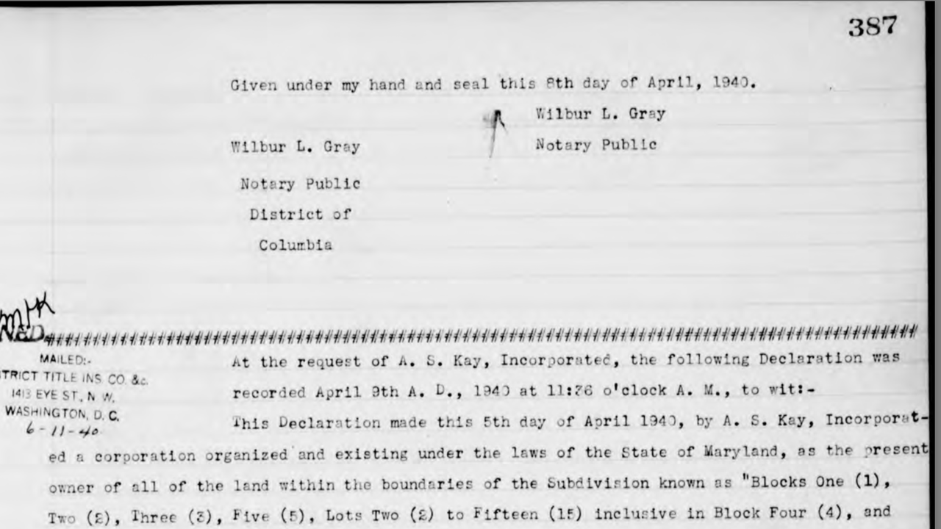
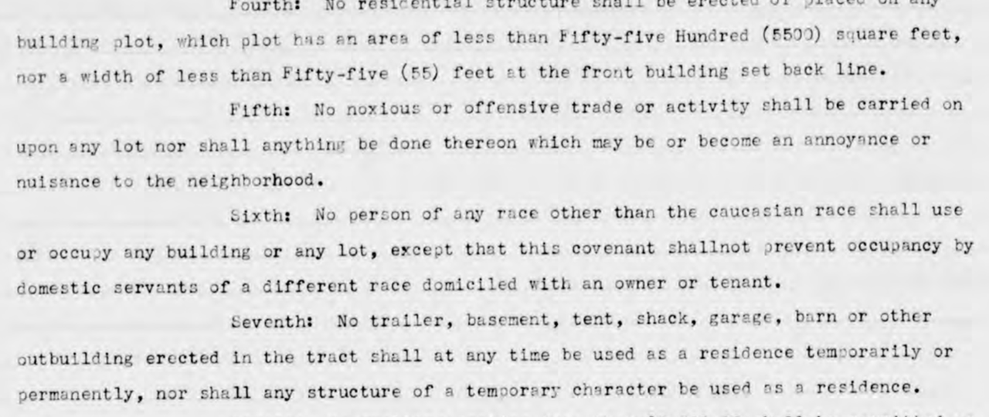
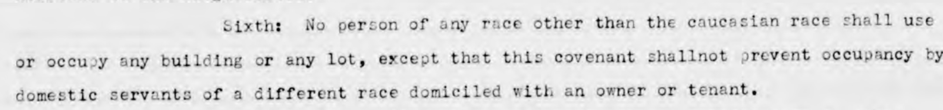
Housing Covenant, 1940, Montgomery County
Notes:
Housing covenant for my neighborhood. Indian spring estates.

Slide 22
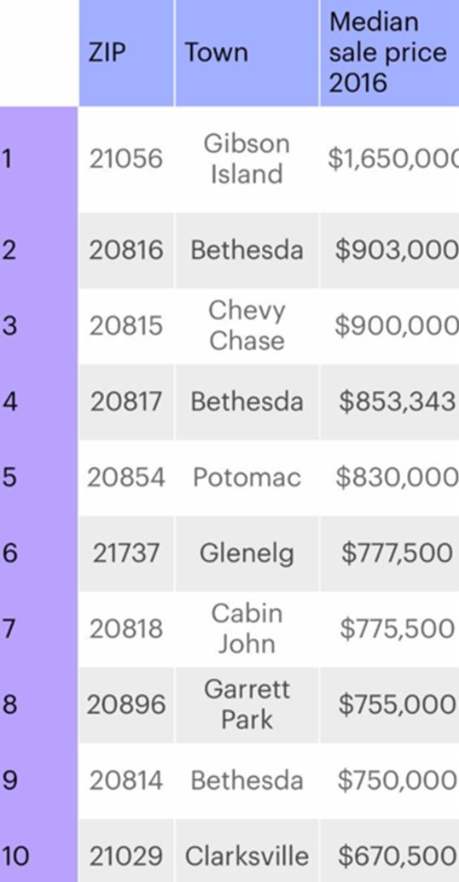
Wealth Most Expensive Zip Codes
Maryland has highest population of millionaires per capita
MoCo is wealthiest county in Maryland
Two wealthiest legislative districts in Maryland
Three of the five wealthiest neighborhoods in the U.S.
Home to seven billionaires
11th wealthiest county in U.S.
Median household income: $94,965
7 of 10 most expensive ZIP codes in Maryland are in
MoCo by median home sale price

Slide 23
Home Ownership and Wealth
Difference between income and wealth: Wealth refers to the stock of assets held by a person or household at a single point in time. Income refers to money received by a person or household over some period of time.
Homes are a financial asset reserve that can be used as a safety net. Equity loans can be used for college and starting businesses. Homes are a transferable asset. As homes rise in value, wealth increases.
Home ownership in U.S.: In 2012, 73% of white households owned their own homes compared with 46% of Latino and 44% of African American households.*
Today African-American incomes on average are 60% of average white incomes, but African-American wealth is about 5% of white wealth in U.S.**
* Source: Pew Research Center, Demographic & Economic Data by Race www.PewSocialTrends.org
** Source: NPR, Fresh Air, http://www.npr.org/2017/05/03/526655831/a-forgotten-history-of-how-the-u-s-government-segregated-america

Slide 24
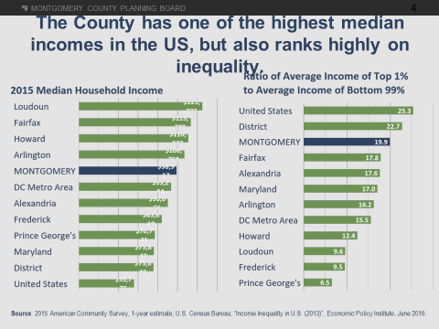

Slide 25
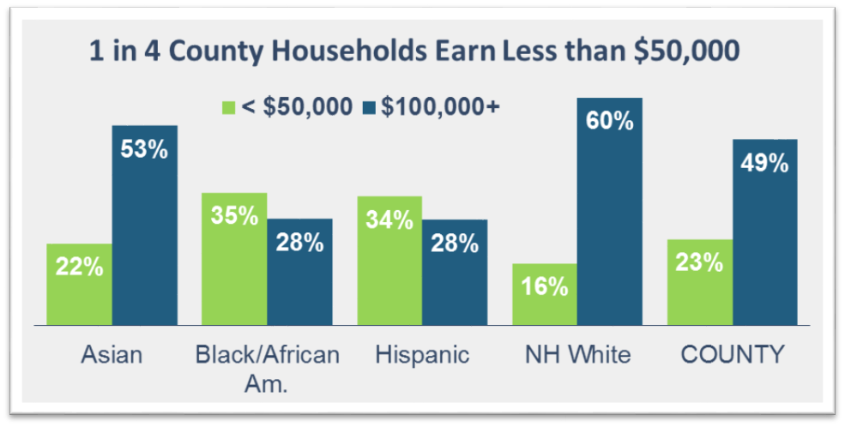
Montgomery County
Income is unequally distributed by race:
2015 American Community Survey, US Census Bureau
Total Households: 51,900 64,800 50,125 195,655 371,460

Slide 26
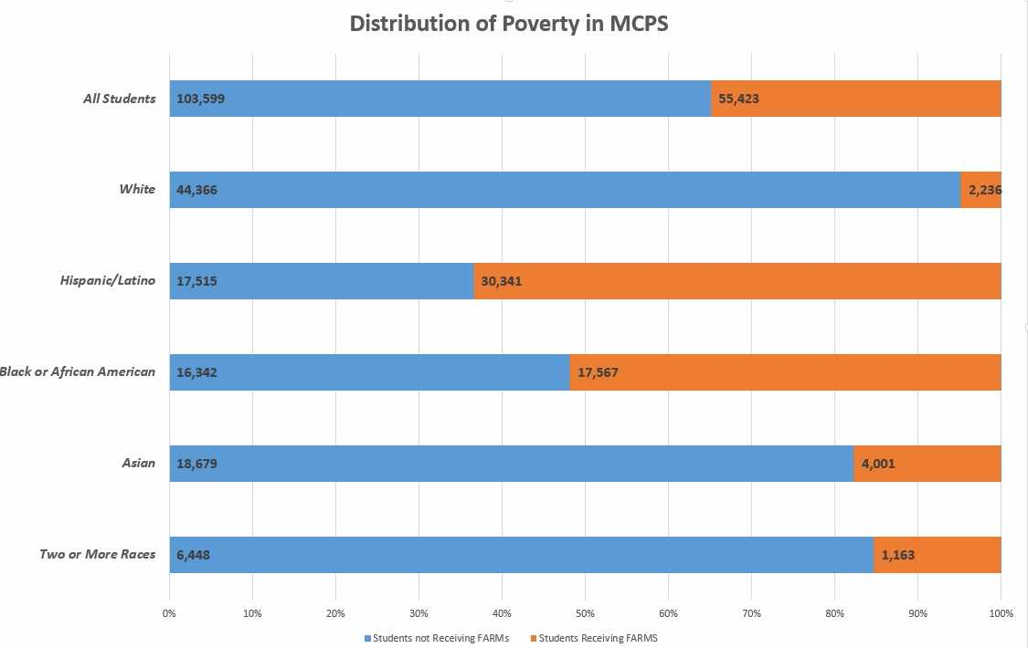

Slide 27
FARMS and Poverty
83% of MCPS FARMS-eligible students are free eligible, or about 45,000 students.
Federal guidelines for eligibility for free meals for a family of three is $26,208.
Adequate family income for a family of three in MoCo is $71,000, which covers housing, food and basic needs. *
Annual salary for a full-time minimum wage job is $19,760.
MoCo has more children who are food insecure than any other county in Maryland.
Majority of K-12 students in U.S. are now FARMS eligible for the first time in 50 years.
* Economic Policy Institute Family Budget Calculator

Slide 28
Education
MoCo is one of top five most highly educated counties in U.S.
Most highly educated town in US: Chevy Chase, 93% have bachelor’s degree or higher
18 federal agencies & installations: USDA, NIH, US Nuc Reg Com, NIST, etc.
Massive gap in college graduation rates between rich and poor is growing even wider in U.S. : 77% vs. 9% - The Pell Institute, 2015, Indicators of Higher Education Equity
“Wealthy parents invest more time and money than ever before in their children (in weekend sports, ballet, music lessons, math tutors, and in overall involvement in their children’s schools), while lower-income families, which are now more likely than ever to be headed by a single parent, are increasingly stretched for time and resources. This has been particularly true as more parents try to position their children for college, which has become ever more essential for success in today’s economy.”

Slide 29
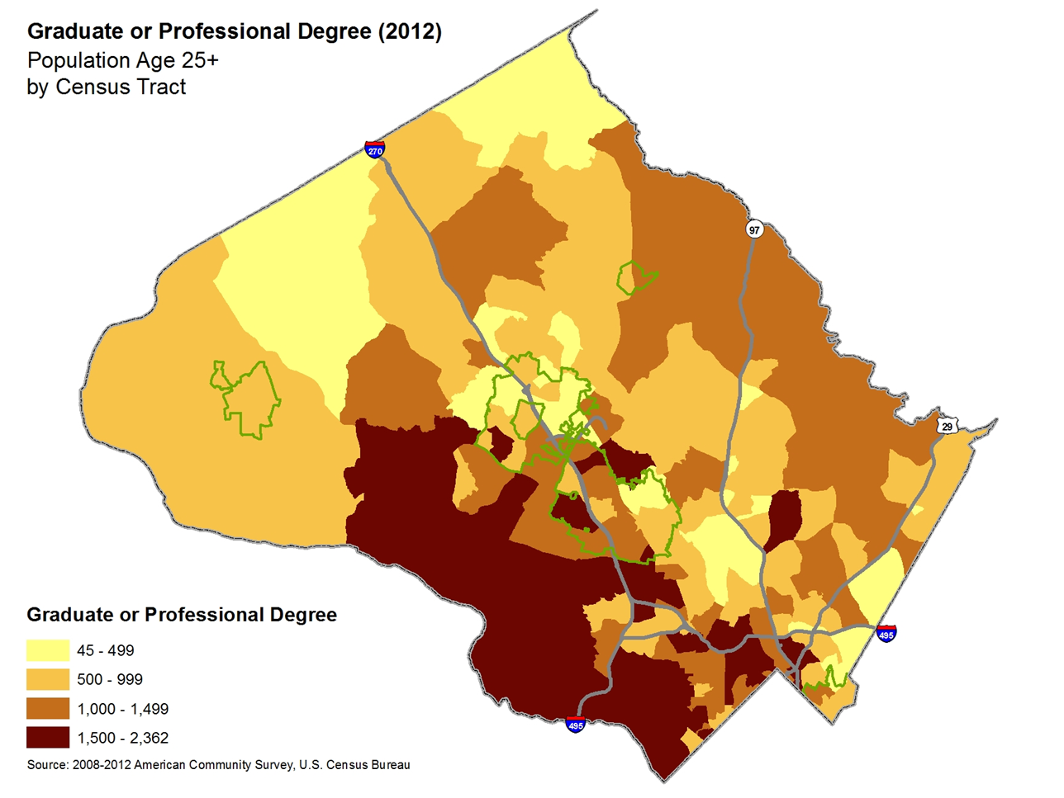

Slide 30
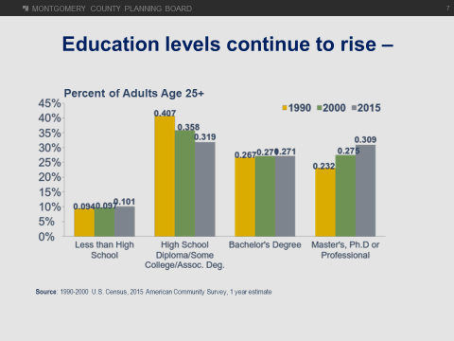

Slide 31
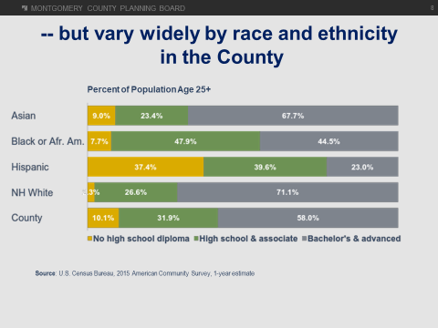

Slide 32
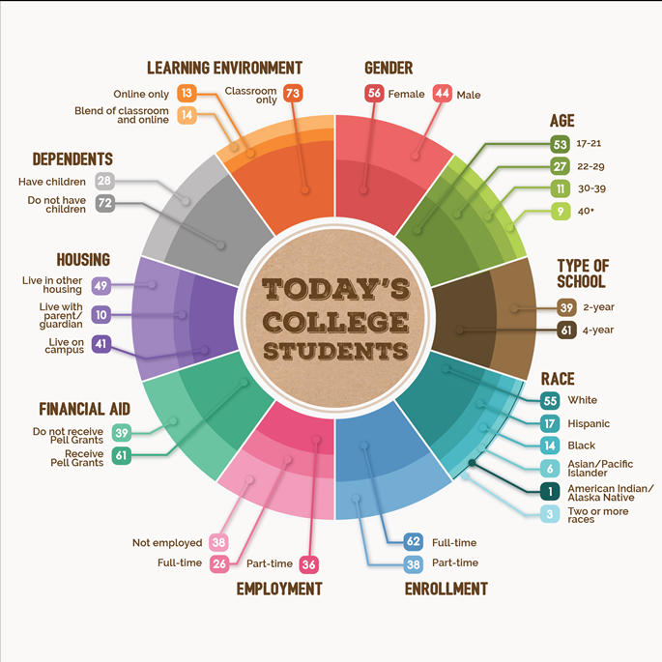
62 percent of college kids are part or fully employed while going to school
2/5 are in two-year colleges
3/10 have kids
55% white, 17% Hispanic, 14% Black
Average college student loan debt for Maryland is $27,672 – The Institute for College Access and Success
Only 40 percent of students complete a bachelor’s degree within four years and only 60 percent graduate from the college at which they started within six years of entry. – Gates Foundation
Source: Bill & Melinda Gates Foundation

Slide 33
High Schools with Lowest FARMS Population

Slide 34
History of Segregation in MCPS
Montgomery County Public Schools was established in 1860 for white children.
1866: First school for African American children, the Sharp Street School in Sandy Spring, opens with financial and scholastic support of many Quakers, six years prior to establishment of a public school system for African Americans in Maryland.
1896: U.S. Supreme Court case of Plessy v. Ferguson confirms the doctrine of “separate but equal.”
1922: County sets a school term of 161 days for African American schools and 190 days for white schools.
1926: First of 15 “Rosenwald” schools built for African American students with money from a fund established by philanthropist Julius Rosenwald.
More than 60 years after the end of slavery, Rockville Colored High opened in 1927 as the only high school in Montgomery County for African-American students.
1935: Lincoln High School replaces Rockville Colored High School to serve grades 8-11.
* Sources: Montgomery County Historical Society, Montgomery County Government, NAACP Parents Council
Notes:
Before 1927, Black students who wanted to go to school past 8th grade would need to go to another jurisdiction. In Montgomery County, where white enrollment decreased from nearly two-thirds of school rolls in 1989 to 35 percent by 2010, about one in four Latino or African American students is enrolled in an intensely segregated school. A national report by the same organization found that Maryland was the sixth-most-segregated state in the country for black students.Washington Post
George Washington Carver high school opened in 1951, The first major improvement for black schools came in 1926.
#In that year, the county began to build or renovate 15 black elementary schools using money donated by the businessman and philanthropist Julius Rosenwald.
#Rosenwald “had a lot of money but he didn’t believe in keeping it,” Clarke said, and his money paid for more than 5,000 black schools nationally.
#The 15 local Rosenwald schools were built between 1926 and 1928 included a one-room schoolhouse in Scotland and a two-room building on River Road. Most of the remaining black elementary schools were closed…In 1866, the Quaker community in Sandy Spring opened the first school for African-American children, the Sharpe Street Industrial School. Other schools followed, but from emancipation well into the 1900s, the burden of educating black children fell mostly on individual black communities.

Slide 35
History of Segregation in MCPS
In 1937, William B. Gibbs Jr., principal of Rockville Colored Elementary School, brought a lawsuit against the Board which abolished the practice of paying African-American teachers less than white peers.
1951: County opens its first senior high school and first college for African American students, George Washington Carver High School and Junior College, in Rockville. Upon the opening of Carver, Lincoln becomes a junior high school for grades 7-9.
Schools in Montgomery County were separated by race for almost a century. The school board resisted investing in African-American schools. They often used supplies discarded from white schools, and had larger class sizes and substandard facilities with no plumbing.
In 1954, the Supreme Court issued its historic Brown v. Board of Education decision. Montgomery County schools begin desegregation.
1955: Board of Education adopts a policy on integration, and, assured by state superintendent that Supreme Court decision supersedes state laws that prohibit integration, MCPS superintendent Forbes H. Norris gives the order to begin implementing the policy.
1956: Poolesville citizens argue against integration of their school before board. Parents who refuse to send their children to the newly integrated school relent after Norris threatens to take them to court for failure to comply with state attendance laws.

Slide 36
History of Segregation in MCPS
1957: The Board adopts integration plan for 1957-58, which affects students in kindergarten through grade 9 at Bethesda-Chevy Chase, Montgomery Blair, Northwood, Wheaton, and Walter Johnson.
1959: Margaret T. Jones is appointed the first African American principal of an all-white school, Bannockburn ES. Gerald G. Reymore is the first white principal of Rock Terrace ES, a school for African Americans.
1960: Carver graduates its last class before closing as the last African American school in the county. All undergraduate students are assigned to integrated schools for the next year.
1961: The Montgomery County Public School System was declared fully integrated, seven years after Brown v. Board. Carver reopens to house the central administrative offices for the school system.

Slide 37
Segregation
According to U.S. Government Accountability Office report:
More than 60 years since Brown v. Board of Education, schools are increasingly segregated by race and class.
The percentage of all schools with so-called racial or socio-economic isolation almost doubled in last 15 years.*
Hispanic students tended to be “triple segregated” by race, economics and language
In Montgomery County, “about one in four Latino or African American students is enrolled in an intensely segregated school.” **
* Isolated schools: 75% or more of students are same race or class

Slide 38
Performance of Montgomery County Public
Schools’ High Schools – A FY 2014 Update
The Office of Legislative Oversite (OLO) “finds an increase in the stratification of MCPS high schools by income, race, and ethnicity. OLO also finds that the achievement gap between high- and low-poverty high schools has widened among a majority of measures considered.”
The share of black and Latino students in MCPS’ consortia and consortia-like high schools grew while the share of white, Asian, and non-FARMS students in MCPS’ low-poverty non-consortia high schools grew.

Slide 39
Opportunity Hoarding
“Eula: … I think quite a few of the parents in my community and in my circle actually see some version of opportunity hoarding as their duty—as what they are supposed to do for their child…
Hillary: Because, like, why wouldn’t you get them the best opportunities?”
From The podcast The Longest Time
“It’s a brief 30 seconds, but the idea really struck me: opportunity hoarding [as a parent] is the phenomenon when you advocate for the best resources and opportunities for your child. There’s an almost evolutionary compulsion to want your child to have the best of everything. It’s engrained in us that we should loudly promote what is best for our child.
The problem is that my voice, as a parent with racial and class privilege, is already prioritized in society. When I compound it with a parent’s natural tendency to opportunity hoard for my child, parenting becomes a clear mechanism for the exacerbation of power along the lines of race and class.”
From the podcast Wake the Children

Slide 40
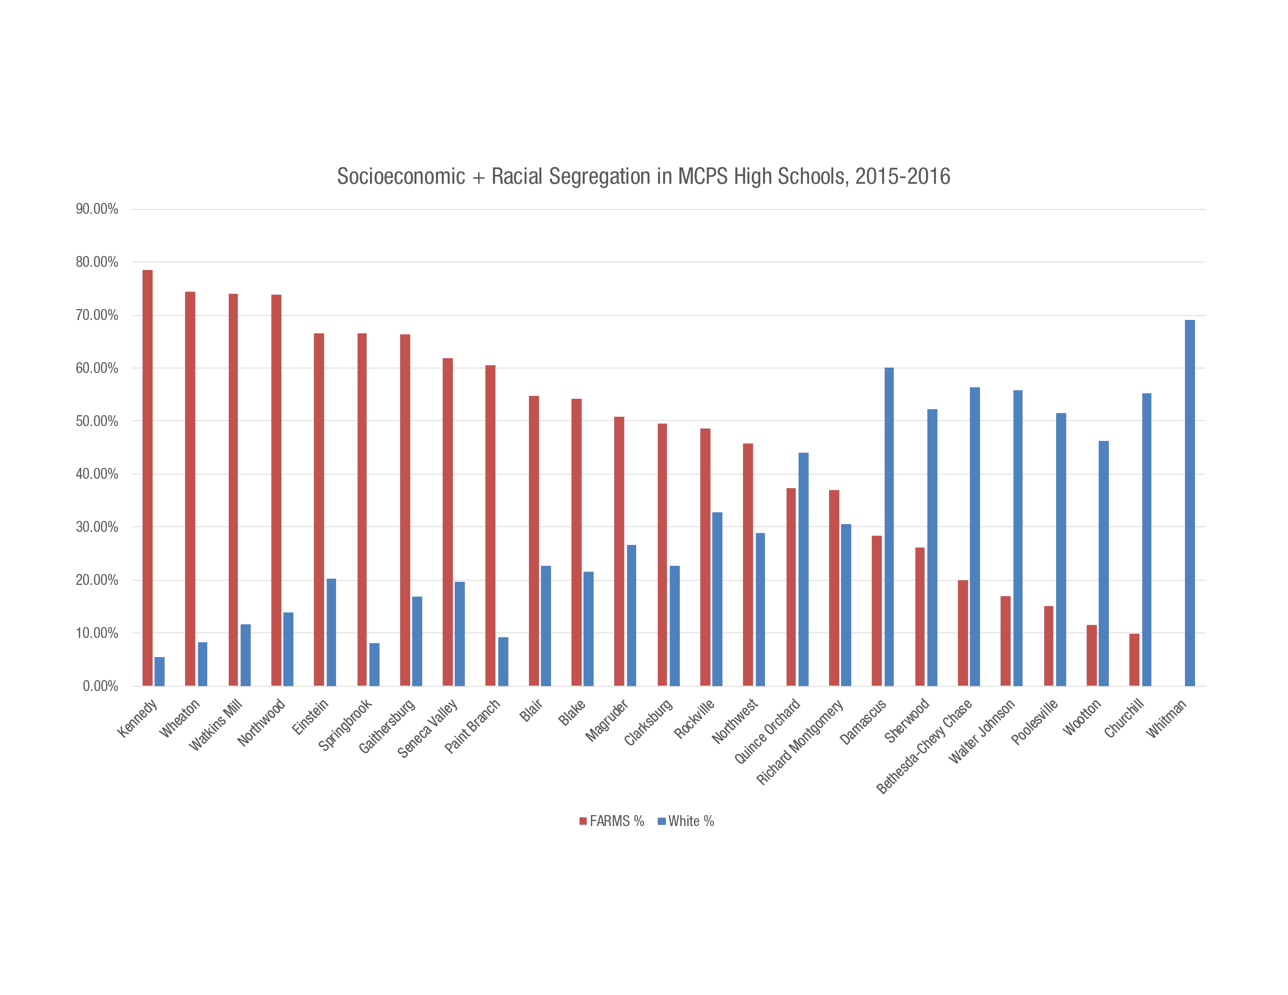
Notes:
69% of students in our Alternative Program are FARMS eligible.

Slide 41
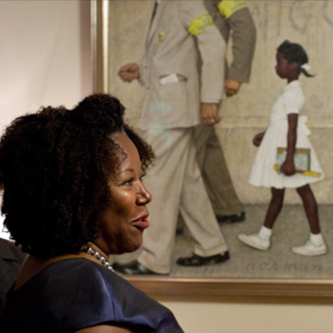
Ruby Bridges was six years old when she was the first African-American student to attend an all-white Southern school. White students refused to attend school with her. Teachers refused to teach her. She is 63.

Slide 42
Policy ACD: Quality Integrated Education
Purpose (excerpt), 1975:
• The Board of Education’s primary responsibility is to provide the opportunity for each student to obtain a high quality education and to encourage each student to work toward that objective to the maximum of his or her abilities.
• The Board of Education is committed to the proposition that education is most effective in a diverse, integrated setting, and that therefore a major purpose of the policy is to provide a framework for actions designed to promote diversity so that the isolation of racial, ethnic, and socioeconomic groups is avoided and the full benefits of integration are achieved. Another important goal of the Board is to ensure that all students and staff have experiences and develop greater skills and increased sensitivity in working with others of diverse backgrounds so that they may function well as members of this pluralistic society.

Slide 43
Policy ACD: Quality Integrated Education
Purpose (excerpt), 1975:
•Quality education for children cannot be dependent on either racial or ethnic backgrounds or on family, or on socioeconomic status.
•If a school contains a substantial number of students with educational needs as reflected in the recognized measures of student achievement, intensive support including the allocation of additional resources when needed, must be given to ensure that all students have the opportunity to reach their potential.

Slide 44
MCPS Hidden Gems
Kennedy High School: International Baccalaureate (IB)World School, U.S. News 2014 Best High Schools Silver Medal winner, Signature Program: Leadership Training Institute application program, Academies: Broadcast Journalism & Comm, Business Admin & Management, Health Professions, Navy Jr. Reserve Training Corps
Watkins Mill High School: Only high school in the world that offers all three levels of IB World programs: Middle Years Programme (MYP grades 9-10), IB Career Related Certificates (which can be earned alongside academy programs), and IB Diploma. Academies: Engineering (Project Lead the Way (PTLW) project based learning, Finance, Hospitality, Medical Careers, Early Childhood. Awarded national Best of School Newspapers Online, Excellence in Writing Award last two years
Wheaton High School: Bioscience & Engineering PLTW application programs. Ranked 3rd in U.S. for PTLW. Institute for Global and Cultural Studies, IT. Class of ‘17 earned $1.5 million in scholarships and 84% of grads planned to attend two and four-year colleges. Silver Medal winner, US News & World Report, 2017
Northwood High School: Middle College – Opportunity to earn associate’s degree during high school; Academies: Music, Theatre & Dance; Politics, Advocacy & Law, Tech & Environmental Systems Sciences; Humanities, Art & Media, NEW Finance, Accounting, Marketing and Education. Literary arts magazine, the Pen & Shield, won a First-Class award from the National Scholastic Press Assoc. 90% of grads attending 2 or 4 yr colleges

Slide 45
Risks of Inequity
Higher level of economic inequality means higher level of poverty
Exploitation of disadvantaged populations
Higher disease and mortality rates
Higher health care costs
Less effective, lower-income workforce
Positive relationship between income inequality and crime
Economic and racial isolation
Political polarization

Slide 46
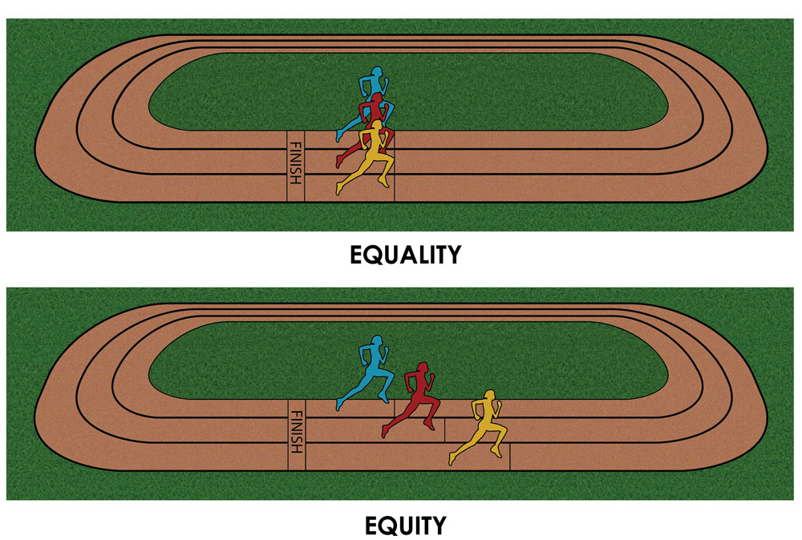
Academic Gaps: Race or Poverty?
Research shows both racial bias, and income bias and hurdles, create barriers to opportunities for challenge and achievement.
Source: culturalorganizing.org

Slide 47
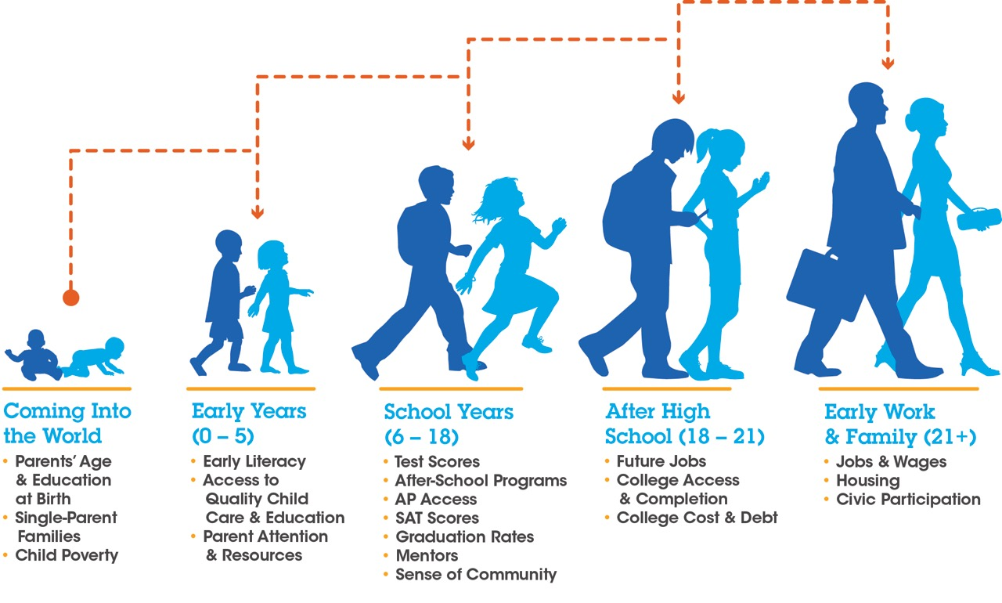
Source: Ourkidsnh.org

Slide 48
Academic Gaps: Poverty
“Are smart students from poor families more likely to be overlooked for gifted or high-level math classes? The answer is a resounding yes, a team of North Carolina investigative journalists has found.”
“Using anonymized state records involving tens of thousands of students and zeroing in on end-of-grade achievement tests, Joseph Neff found that just one out of three low-income students with superior math scores was labeled gifted by educators, compared to one out of two students—with equal achievement—from wealthier homes. These high-potential, low-income students also were found much less likely to take high school math in middle school, ‘an important step toward the type of transcript that will open college doors,’ notes Neff, with his colleagues Ann Doss Helms and David Raynor.”
                Source: “Counted Out” News & Observer, Mary Ellen Flannery

Slide 49
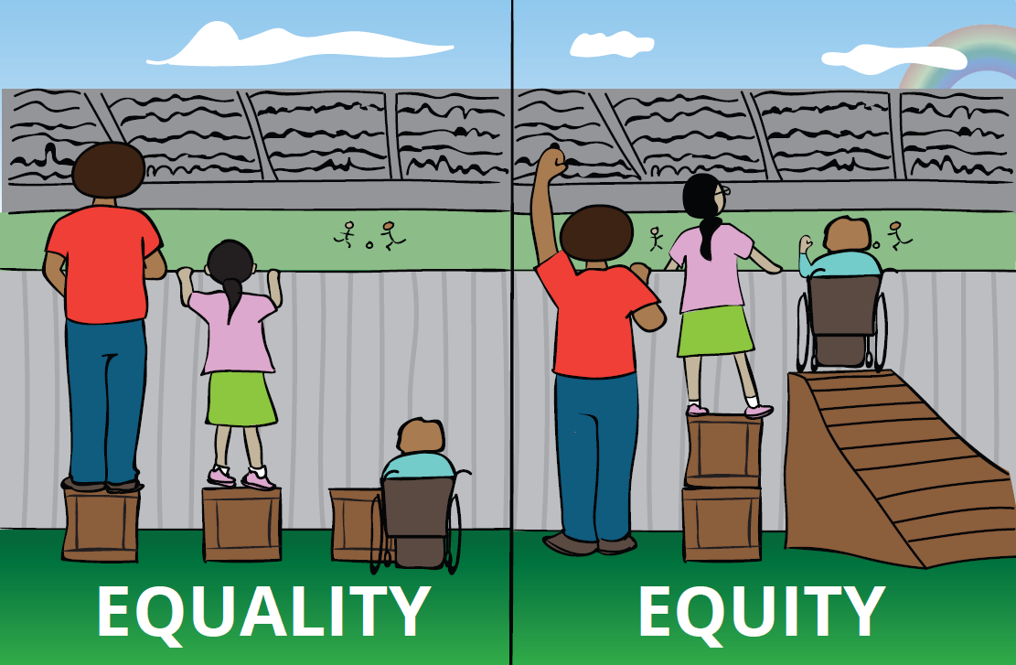
Equality versus Equity: Opportunity to Learn

Slide 50
Academic Gaps: Race
“When evaluating the same black student, white teachers expect significantly less academic success than do black teachers, a new study concludes. This is especially true for black boys.
When a black teacher and a white teacher evaluate the same black student, the white teacher is about 30 percent less likely to predict the student will complete a four-year college degree, the study found. White teachers are also almost 40 percent less likely to expect their black students will graduate high school.”
“The study suggests that the more modest expectations of some teachers could become self-fulfilling prophecies.”
Johns Hopkins University HUB, “Teacher expectations reflect racial biases, Johns Hopkins study suggests”, Jim Rosen, Mar 30, 2016
Notes:
Lots of studies on disproportionate discipline depending on race. Pre-K study.

Slide 51
How do we combat the “soft bigotry of low expectations?” (John Gerson)
By increasing Opportunities to Learn:

Slide 52
Ensuring Equitable Access
Expanded Centers for Enrichment to additional schools
Seek to meet needs of a broad continuum of students at EVERY school through talent development, extended opportunities for learning (summer program), etc.
Reverse concept of scarcity.
Field tested effort to increase underrepresented populations in gifted programs: Used central review process of composite measures of student data instead of parent-driven application process. Name and race-blind.
Results…

Slide 55
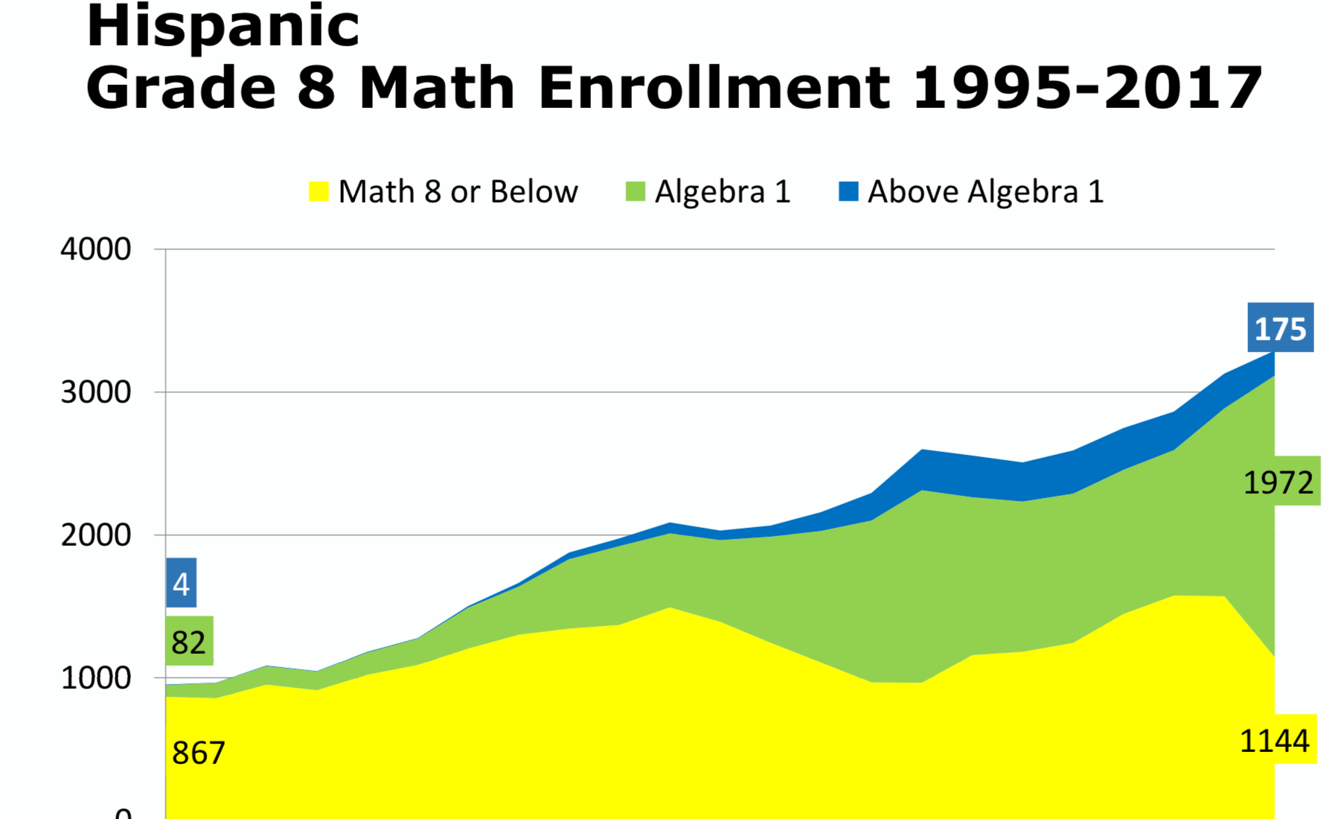
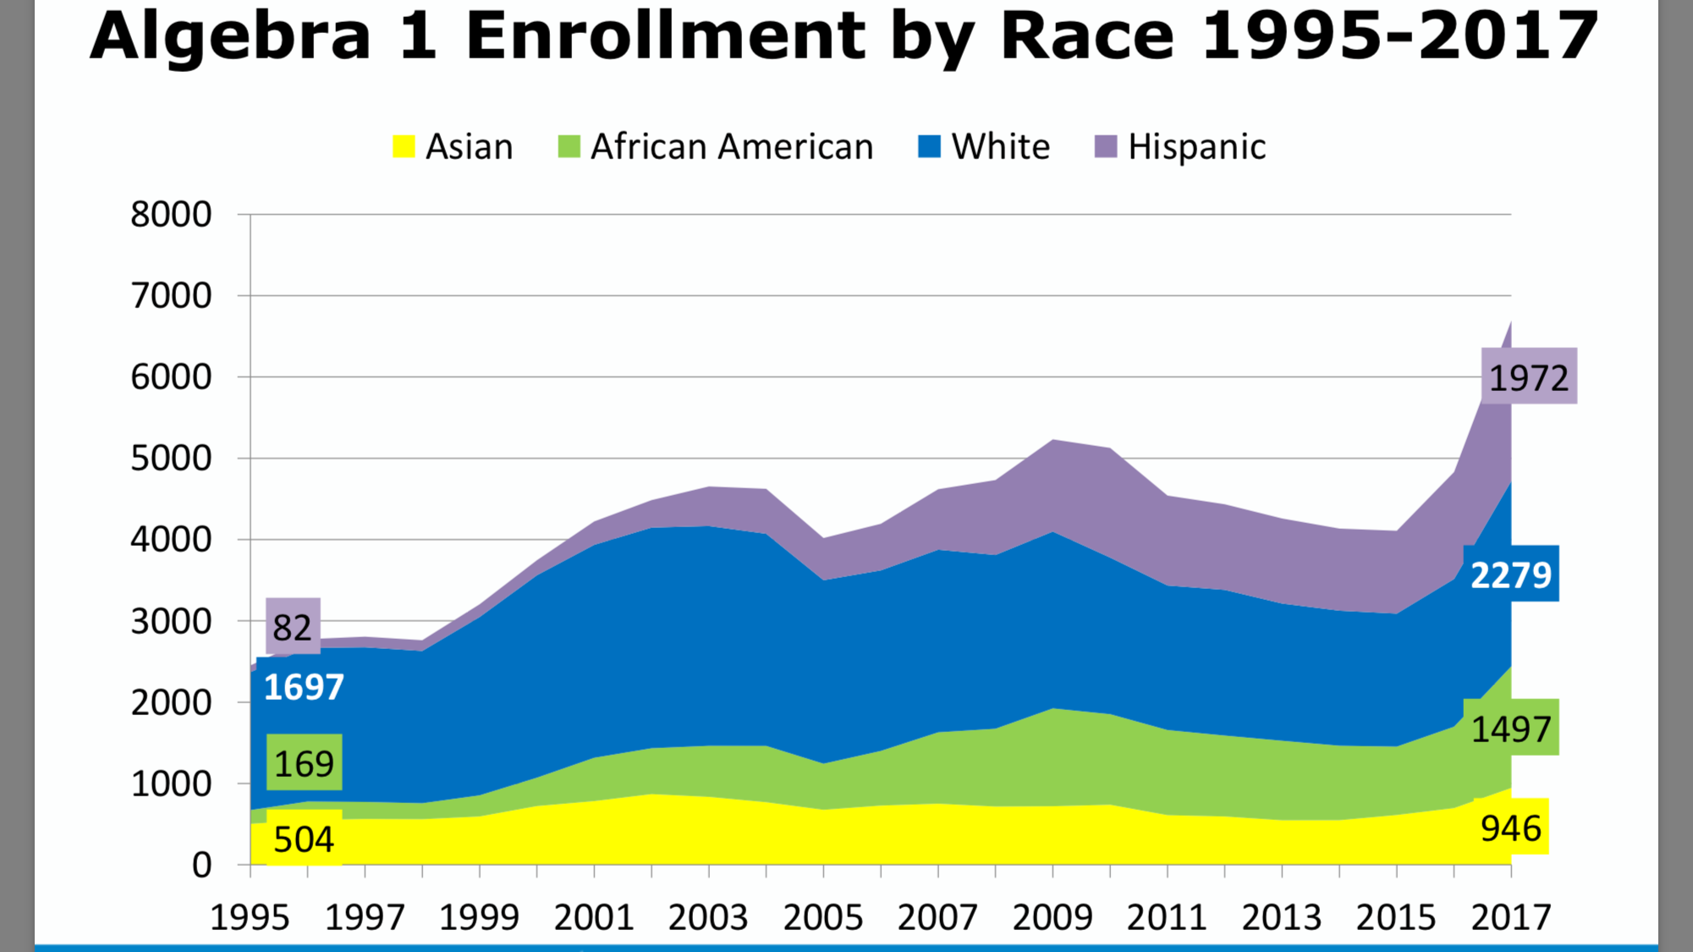
Opportunity to take Algebra 1 by 8th grade creates greater opportunities to take challenging classes, including higher level science and AP classes in high school.
Increased percentage of students of color enrolled in Algebra 1& higher rather than Math 8 or below

Slide 56
Increasing percentage of students of color in higher level math did not significantly impact performance.

Slide 57
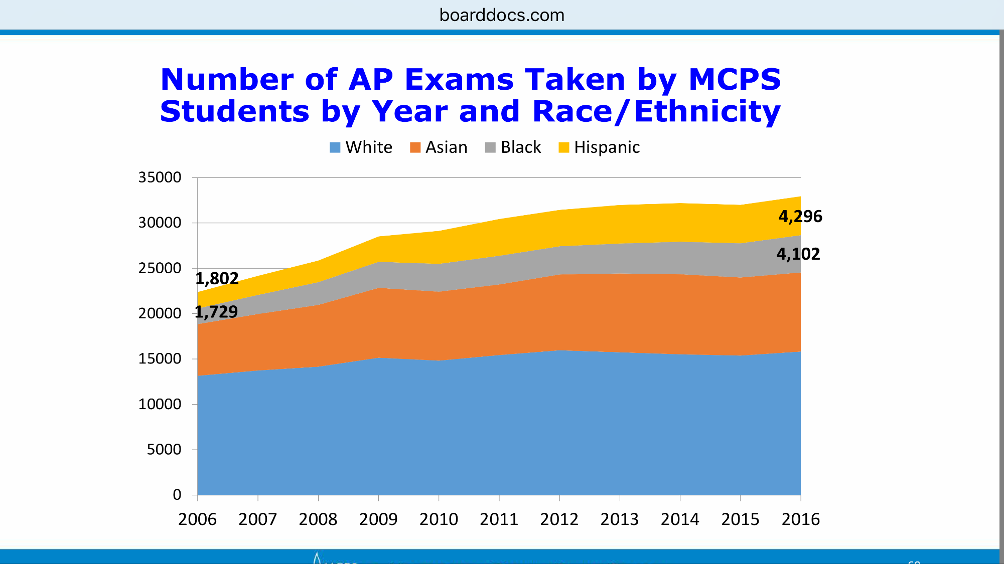

Slide 58
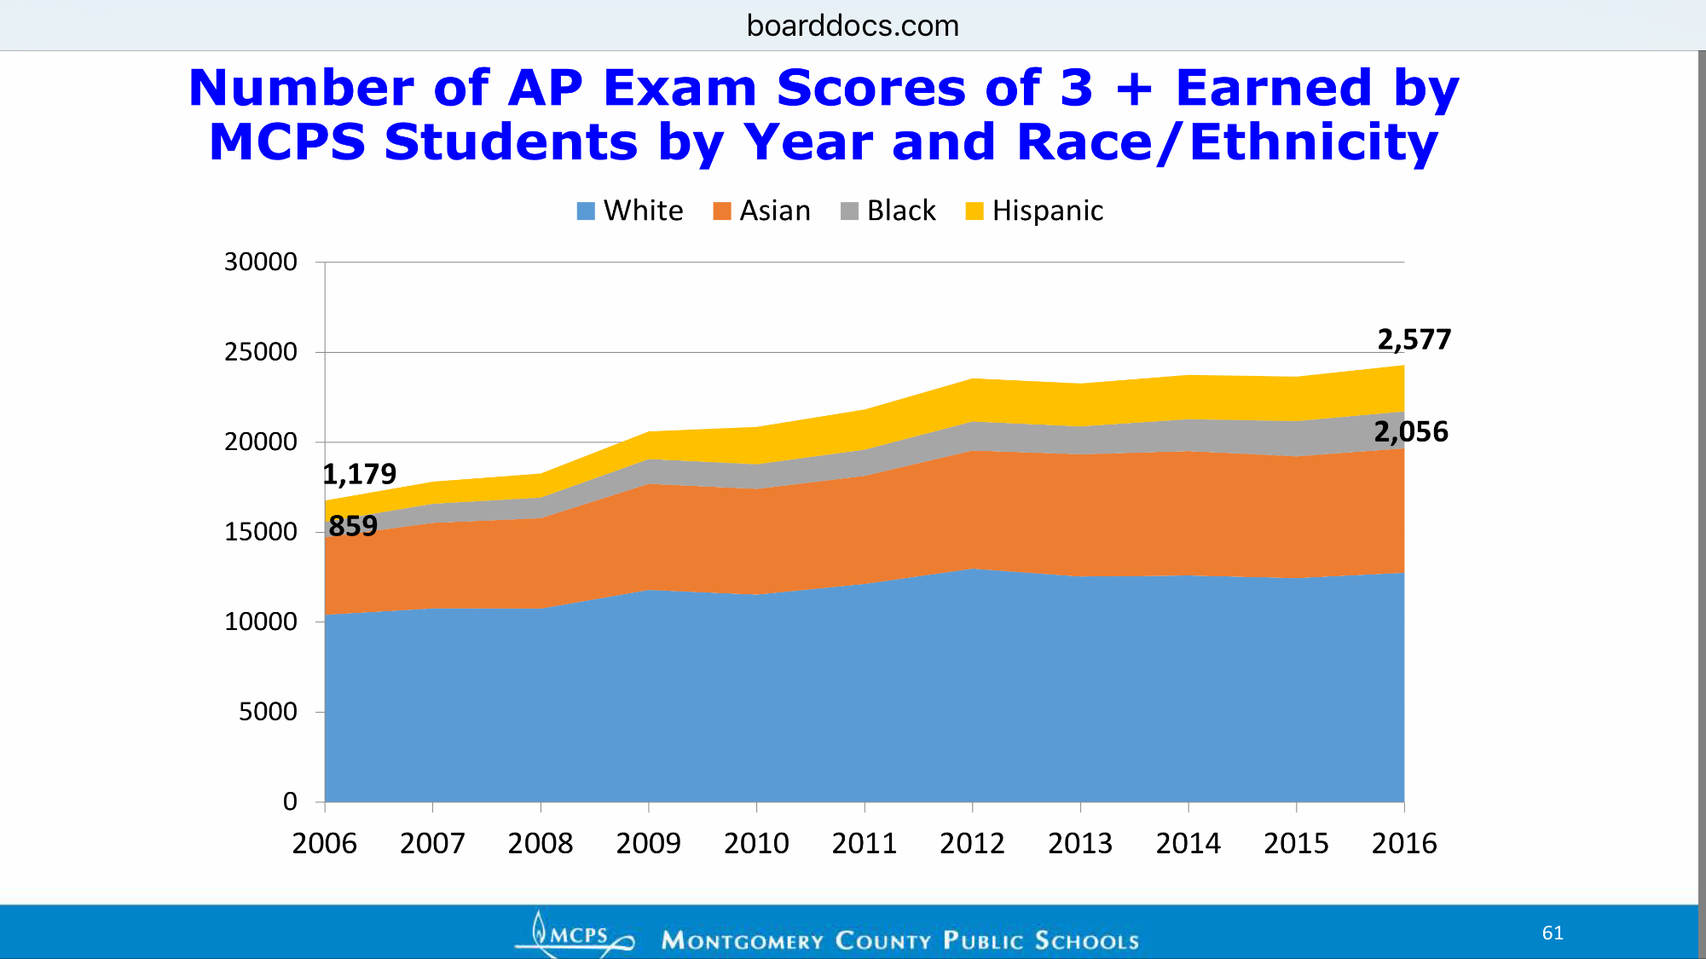

Slide 59
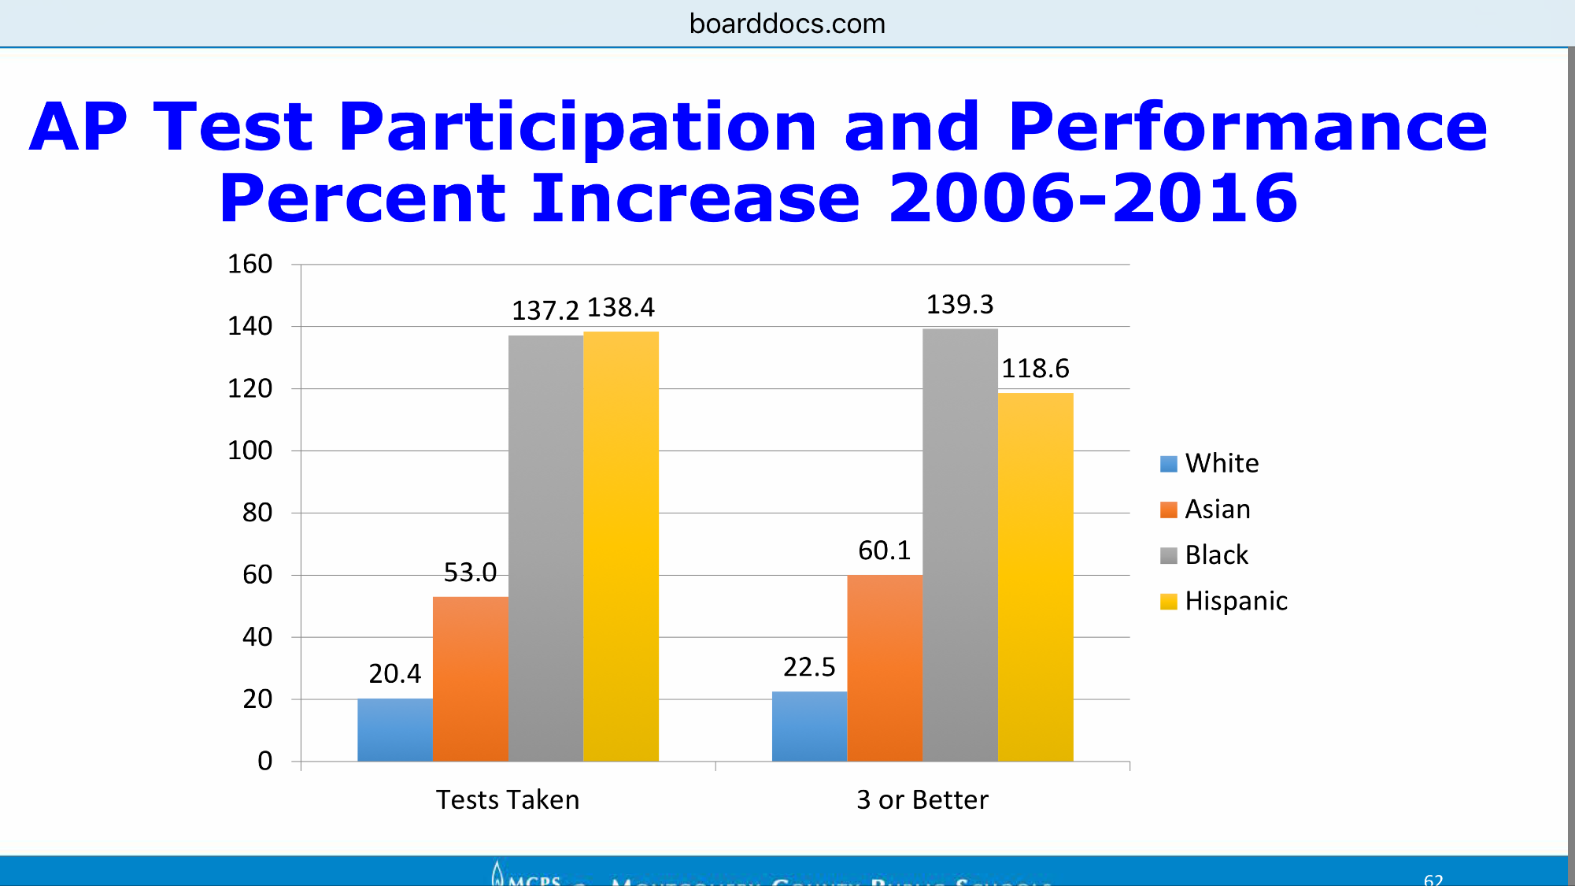

Slide 60
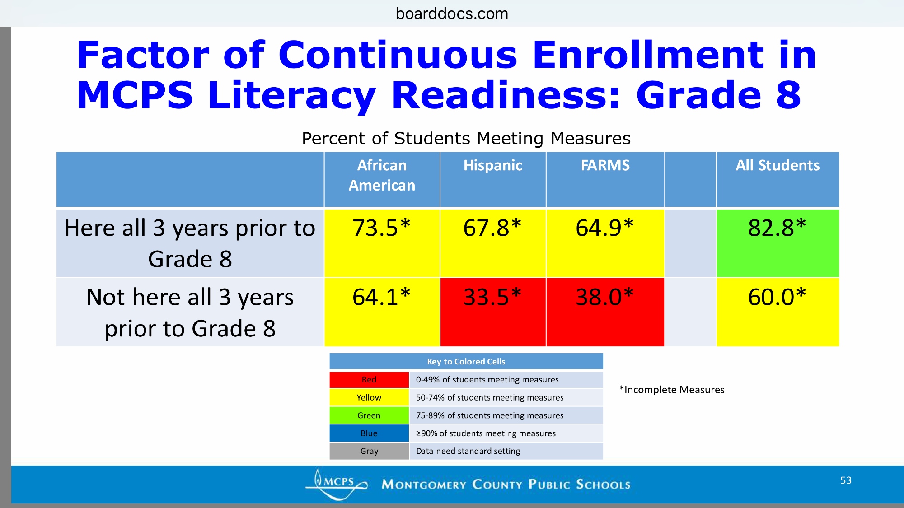
Value Added of MCPS

Slide 61
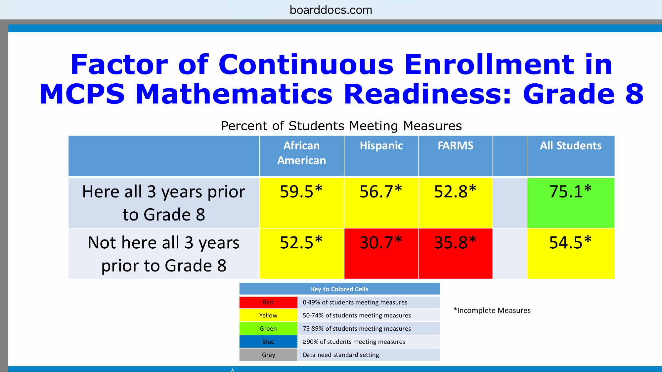

Slide 62
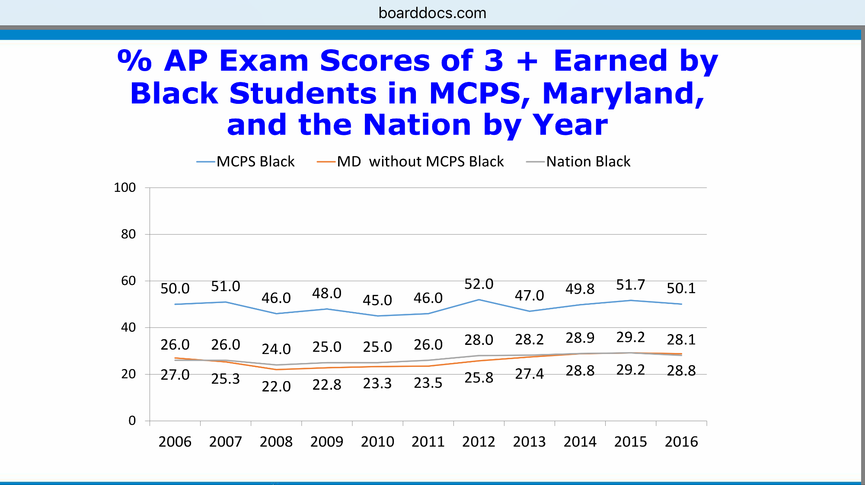

Slide 63
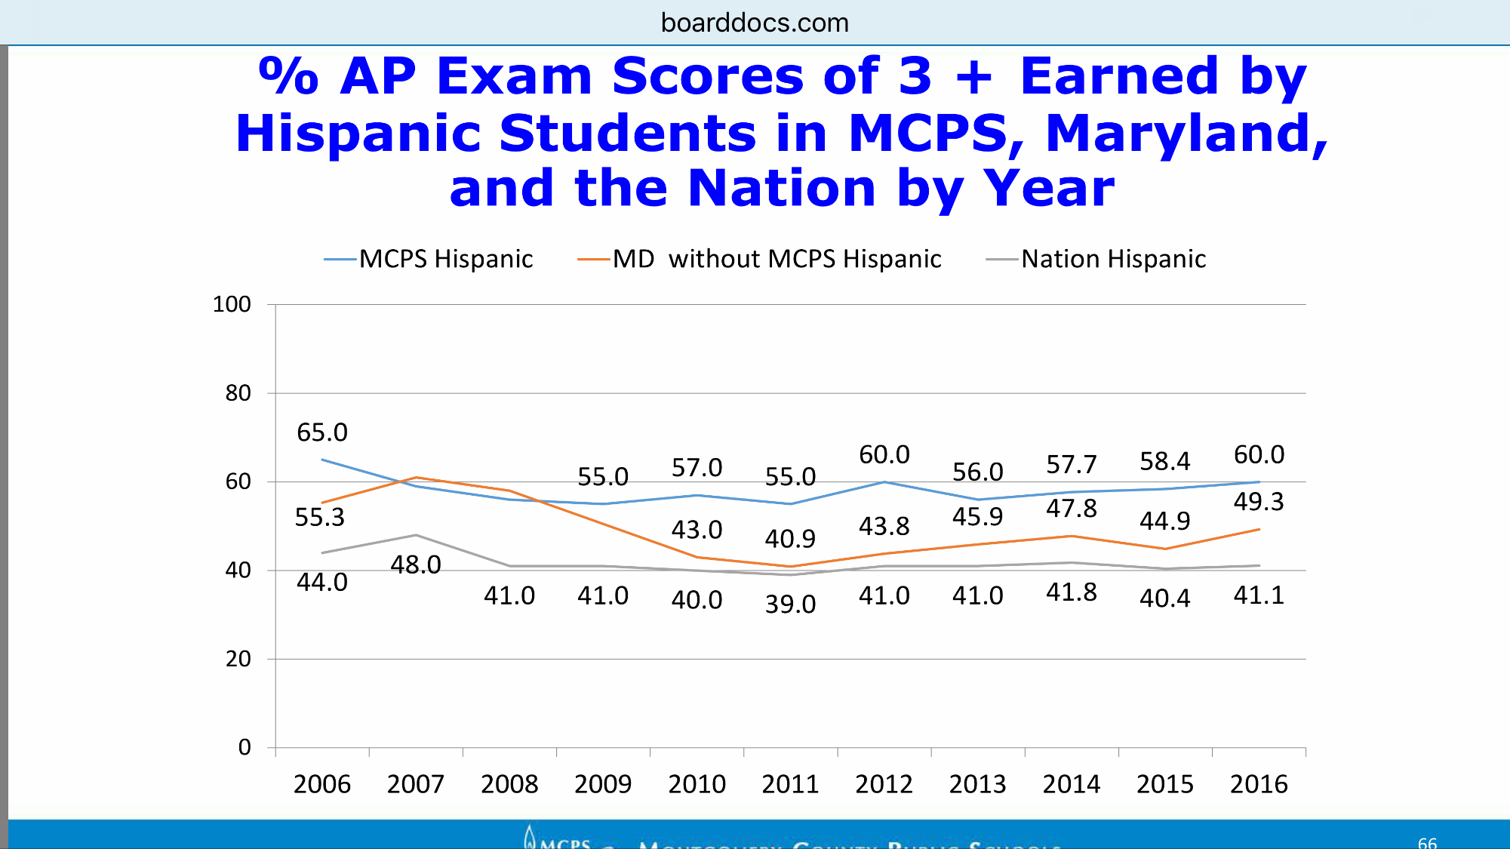

Slide 64
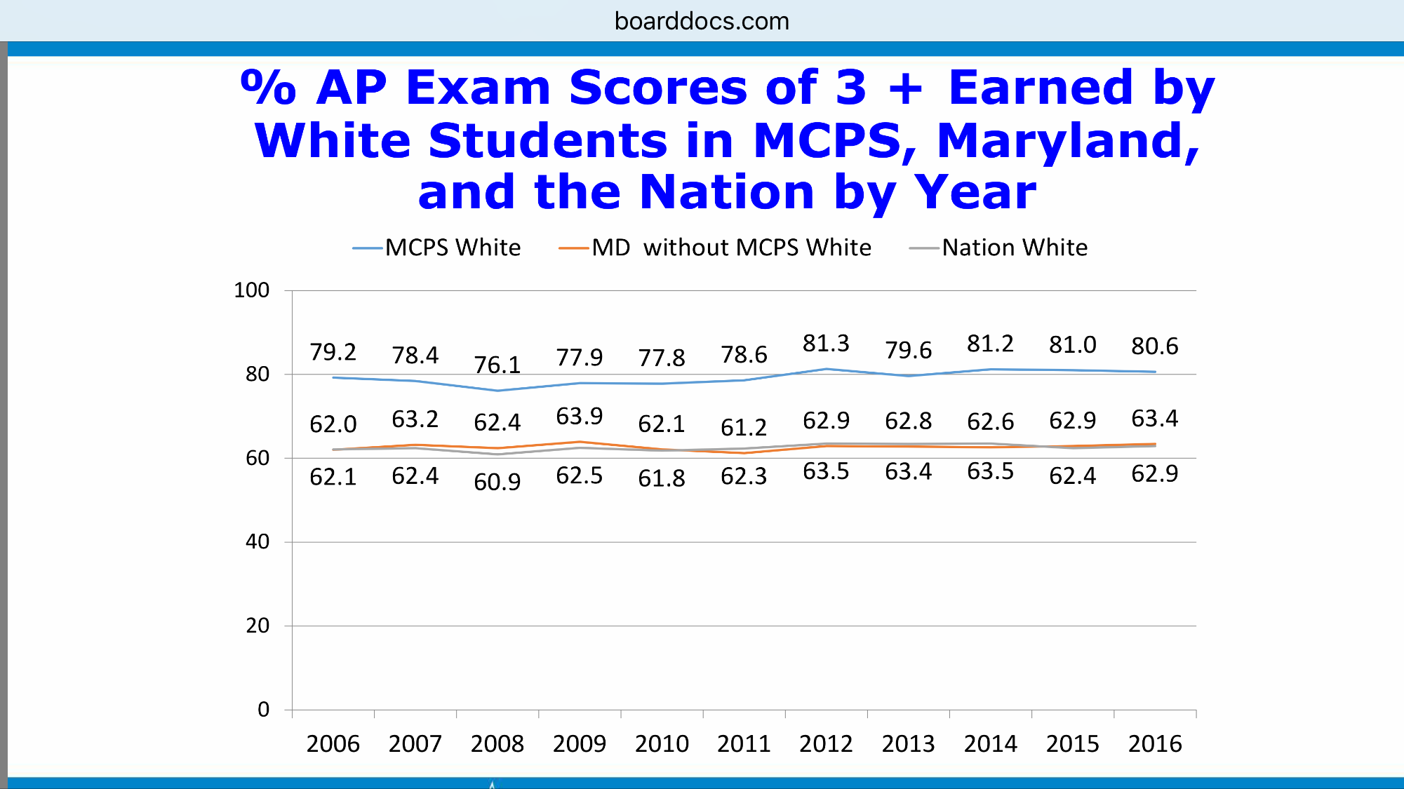

Slide 65
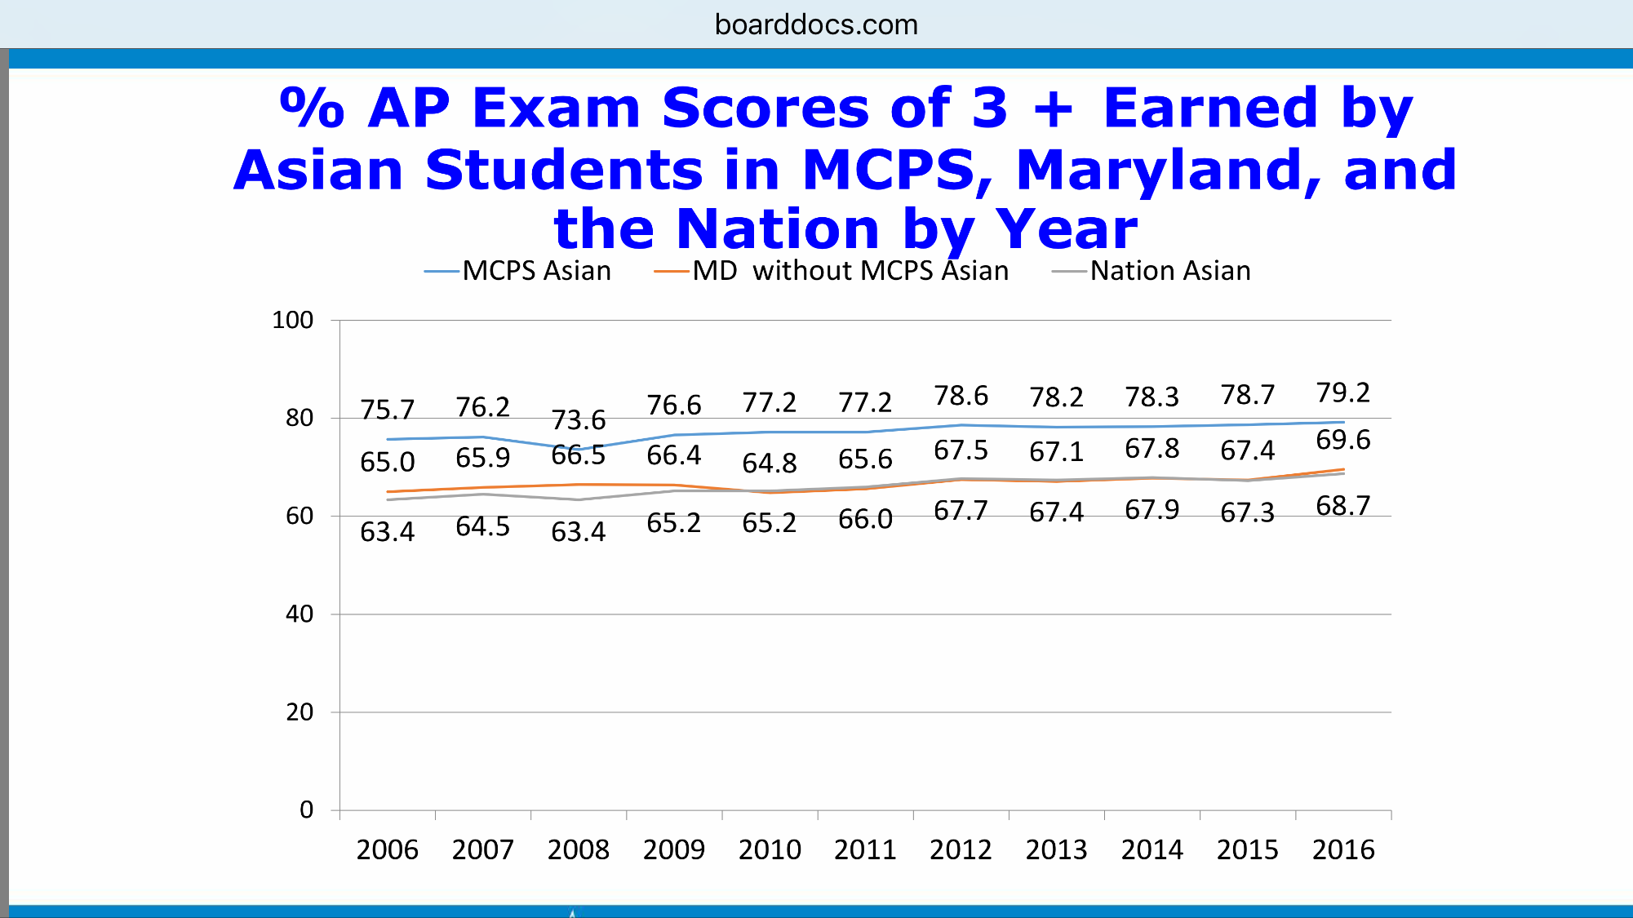

Slide 66
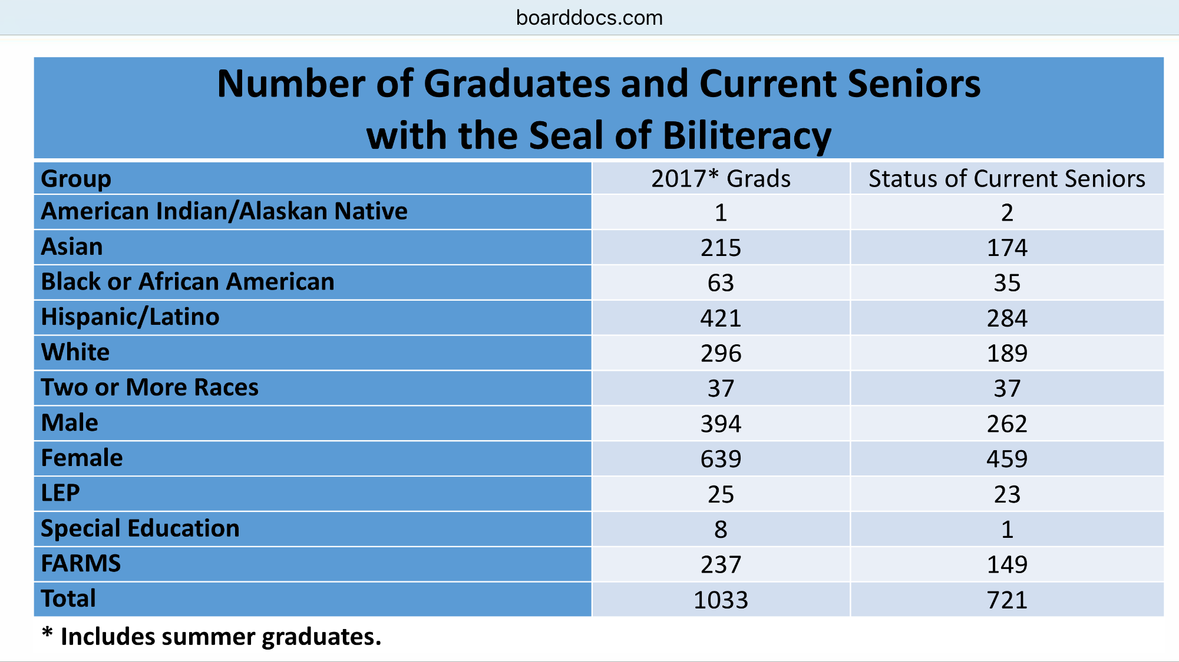
Multilingualism as an asset
Goal: To graduate 50% of seniors
with Seal of Biliteracy

Slide 67
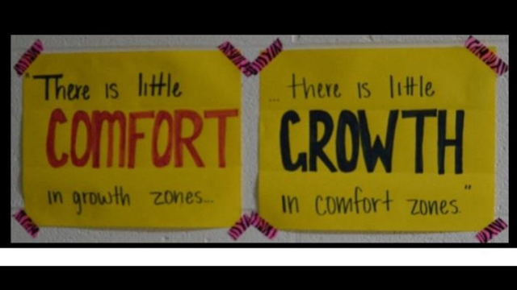

Slide 68
Superintendent’s Statement on Rockville HS
“While I know this tragic incident has become part of a national political debate, I want to remind community members that the lives of real students have been forever affected. While many have chosen to engage civilly in the conversation, far too many have crossed the line with racist, xenophobic calls and emails. MCPS is working with law enforcement to identify those who are making threats toward our students and schools. This behavior will not be tolerated in our community.”

Slide 69
Fake News
Sean Spicer:
“I think the city should look at its policies, and I think that this is something authorities are going to have to look at…Part of the reason the president has made illegal immigration and a crackdown such a big deal is because of tragedies like this.”
Governor Larry Hogan:
"Why is an 18-year-old man in a class with 13- or 14-year-old girls? Why was his status not known to those folks?...My biggest concern is the Montgomery County School System and their lack of cooperation.“

Slide 70
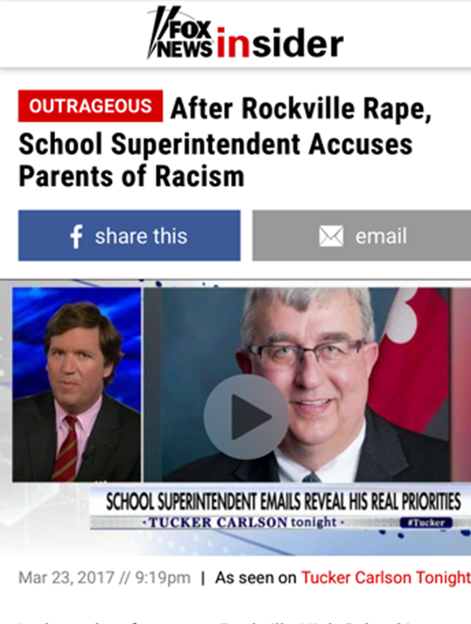



“Dr. Smith told parents if they didn’t want illegal immigrants coming into their schools and possibly raping 9th graders then they were racists and he would call the police on them.” – Tucker Carlson

Slide 71
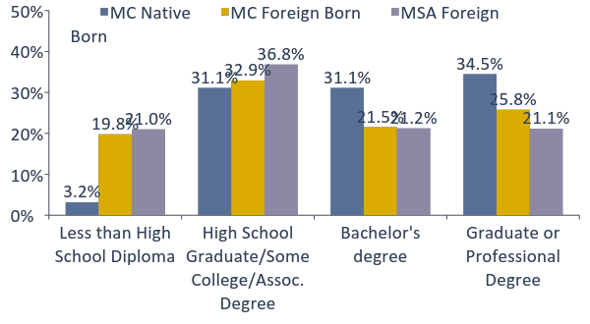
71
Almost half of foreign-born residents
have a bachelor’s degree or higher
EDUCATIONAL ATTAINMENT OF NATIVE AND FOREIGN BORN (2015)
Percent of Adults Age 25 and Older
Source: U.S. Census, 2015 American Community Survey 1-year estimate.
Notes:
MC foreign born (age 25+): 296,429
Almost half (47%) of MC foreign born age 25+ held a Bachelor’s, Graduate, or Professional degree.
A higher percentage than 42% for MSA, but less than MC native born, 66%.
About 1/5th of foreign-born adults in MoCo and metro area have less than a high school diploma.
MC native born (age 25+): 417,410
2/3 (66%) of MC native born had a Bachelor’s or advanced degree.
Only 3% of MoCo native born population has less than a high school diploma.
[updated 9/2016 zorich]

Slide 72
MCPS
All 25 high schools earned spot in WaPo Challenge Index of “America’s Most Challenging Schools”
US News’ Best High Schools, 5 Gold and 4 Silver Medal winners, top 5 high schools in MD. Paint Branch, 22nd; Wheaton High School, 27th in MD, top 5% of schools in the country
Maryland is in top five states for education
The Class of 2016 earned a 1631 avg combined SAT score, surpassing both national and state averages. Nearly 65 % of grads took the SAT, and MCPS’ Hispanic and African American students outperformed their peers across the nation.
2016 Niche Best Schools: MCPS 308th, Fairfax 356th
MCPS has one of the highest graduation rates among nation’s largest school districts, according to Ed Week report
The Schott Foundation reports that MCPS has the highest graduation rate in the nation for African American males among the nation’s largest districts
MCPS students took 33,000 AP exams in 2015. Students earned a college-ready score (3 or higher) on 74.2% of those exams
In 2015, the percentage of MCPS African American and Hispanic graduates earning a 3 or higher on at least one AP exam surpassed the state and national ^{average}

Slide 73
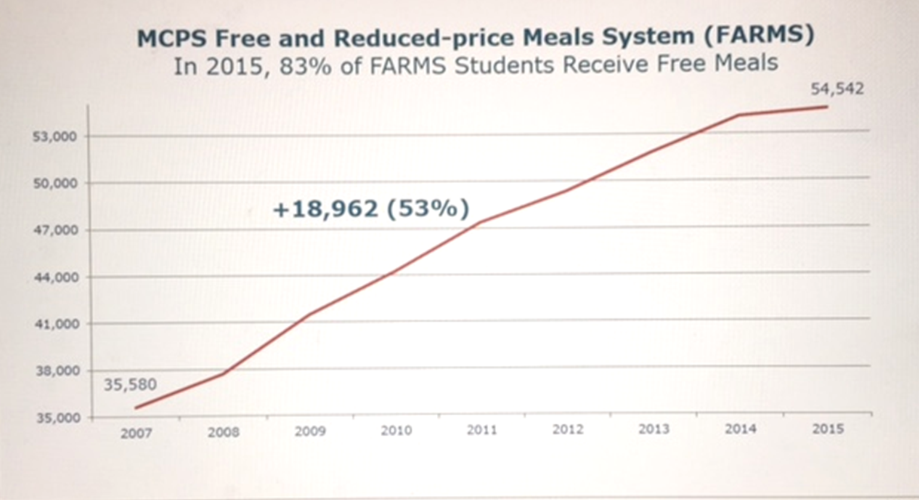
Maintenance of Effort (MOE):
MOE is a state law that sets a funding "floor" for county governments. It requires them to spend at least the same amount per student as the previous fiscal year. In MoCo it was used as a “ceiling.”
From 2010-2016, MoCo funded at or below MOE – same dollars, less services. From 2009 to 2011, MoCo cut its local funding for MCPS by $144 million. MOE does not allow for inflation or increases in compensation or costs of business. MCPS increased class size twice, cut professional development, reduced resource staff, etc.

Slide 74
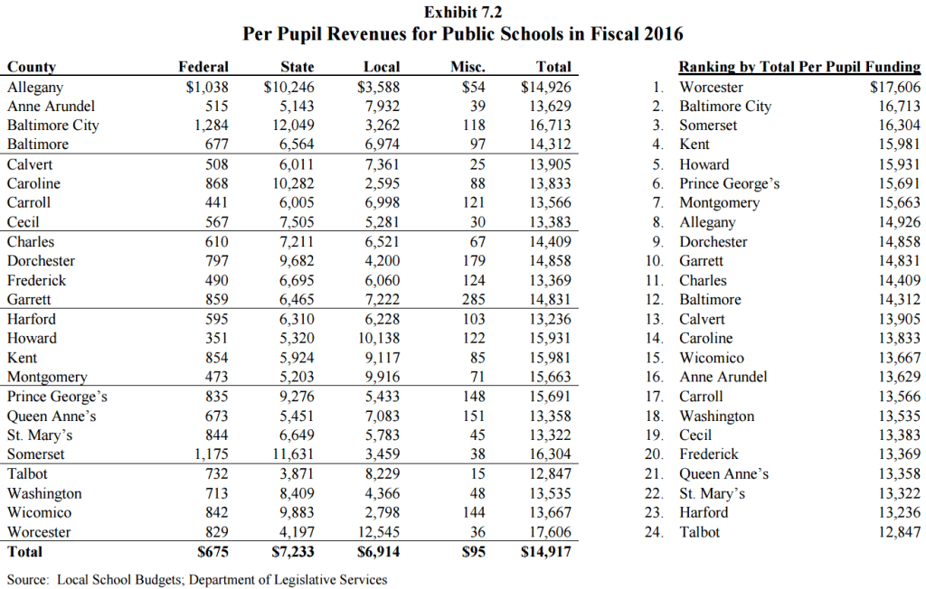

Slide 75
2018 Budget Initiatives to Close Opportunity Gap
Build pipelines from elementary schools to improve engagement, challenge and opportunities in arts, sciences, and mathematics programs:
Implement systems that result in comprehensive and systemic college/career planning efforts starting in middle school
Diploma program for students who need alternative path to graduation
Enhance achievement focused co-curricular programs to all middle schools
Expand home-school special education model to remaining elementary schools
Professional development for math instruction, materials and focused support
Eliminate extra-curricular fees. Free first-time ACT, SAT and career certification

Slide 76
2018 Budget Initiatives to Close Opportunity Gap
Add six Equal Opportunity Schools to increase access to advanced placement courses
Focused training for teachers on effective practices, content knowledge, cultural competency and implicit bias
Build pathways for support service employees to become teachers, committed and diverse educators. Diversify teacher workforce
East County Arts Initiative
Expand partnership with Montgomery College and the Universities at Shady Grove to increase number of schools in the Achieving Collegiate Excellence and Success (ACES) program
Expand STEM courses and access to STEM extracurricular activities (robotics, coding, etc.)
Create efficiencies and ensure effective operations through updating and enhancing business systems

Slide 77
Vision for the Future of Montgomery County
What is your vision?
What are the biggest challenges?
What are the opportunities?
How do we get there from here? What will it take?
What would be needed regarding policy changes or budget priorities?
What is the level of community willingness?

Slide 78
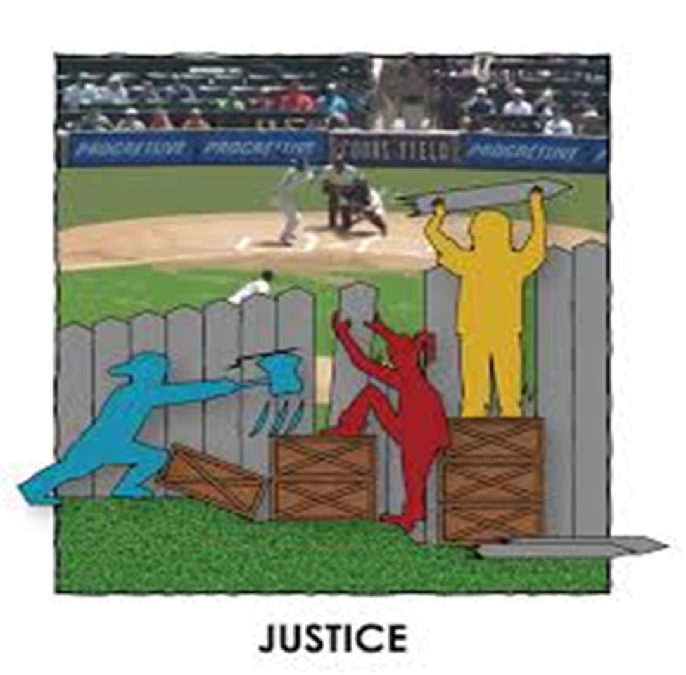

Slide 79
“People make choices. Choices make history.”
- Facing History and Ourselves www.facinghistory.org

Slide 80
“May your choices reflect your hopes, not your fears.”
- Nelson Mandela

Slide 81
https://vimeo.com/182020903

Slide 82
Questions & Discussion

