Slide 1
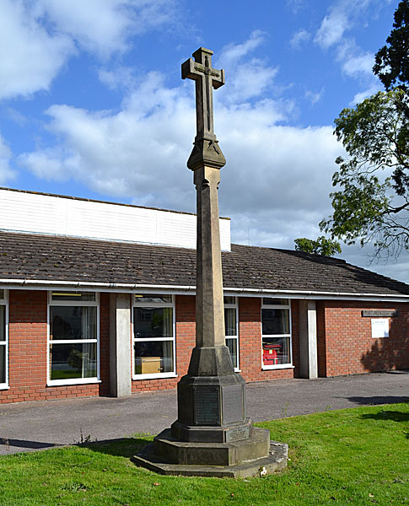
Welcome to the
Annual Parish Meeting

Slide 2
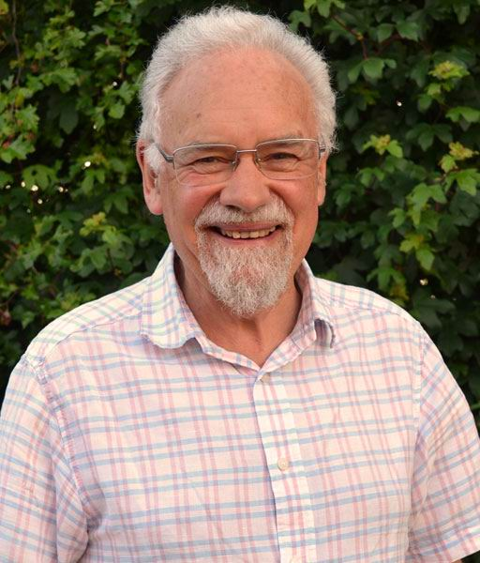
The Agenda
Apologies. 2016 minutes.
Council Reports.
B’ham Resilience Project.
Velo Birmingham.
Footpaths. County & District Reps.
Neighbourhood Plan
Open Forum
Chairman Cllr. James Bradley

Slide 3
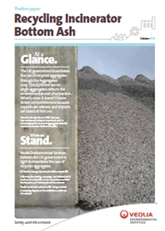
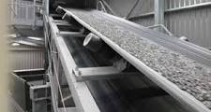
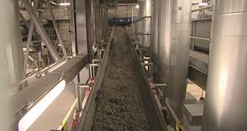
2016- 17
Veolia ES Ltd Planning
Application
Refused !

Slide 4

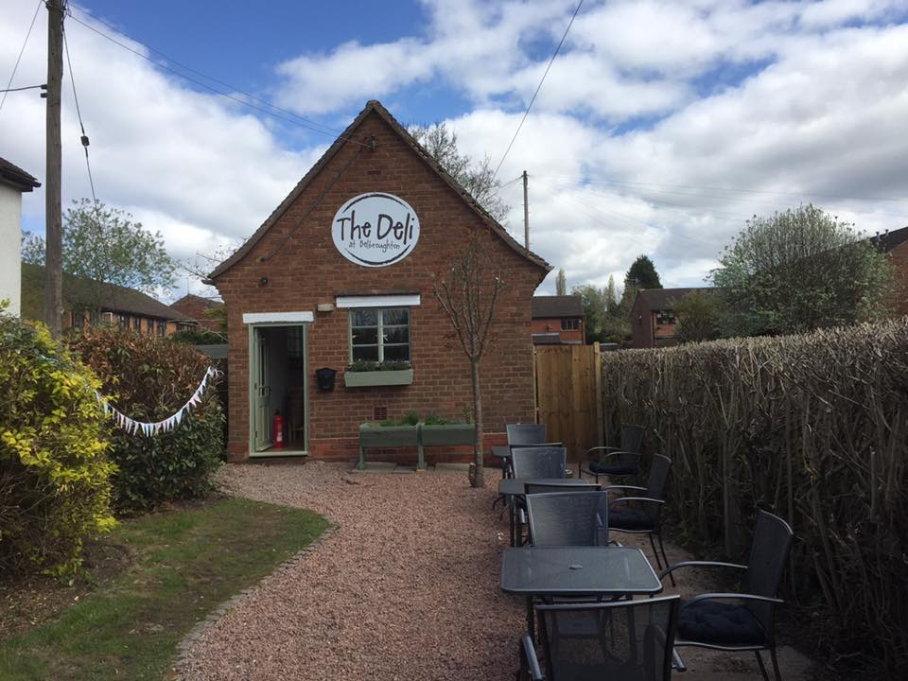
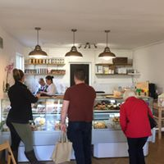
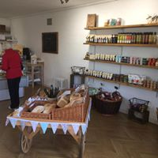
The Parish Room Belbroughton

Slide 5
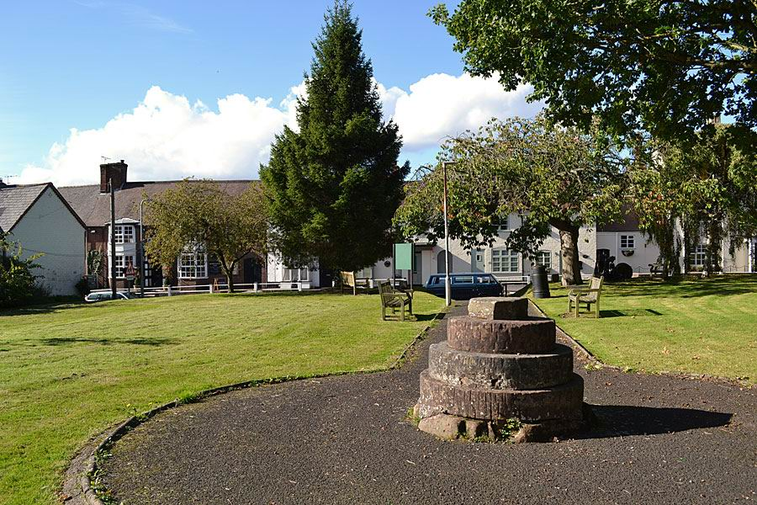
The Green Belbroughton

Slide 6
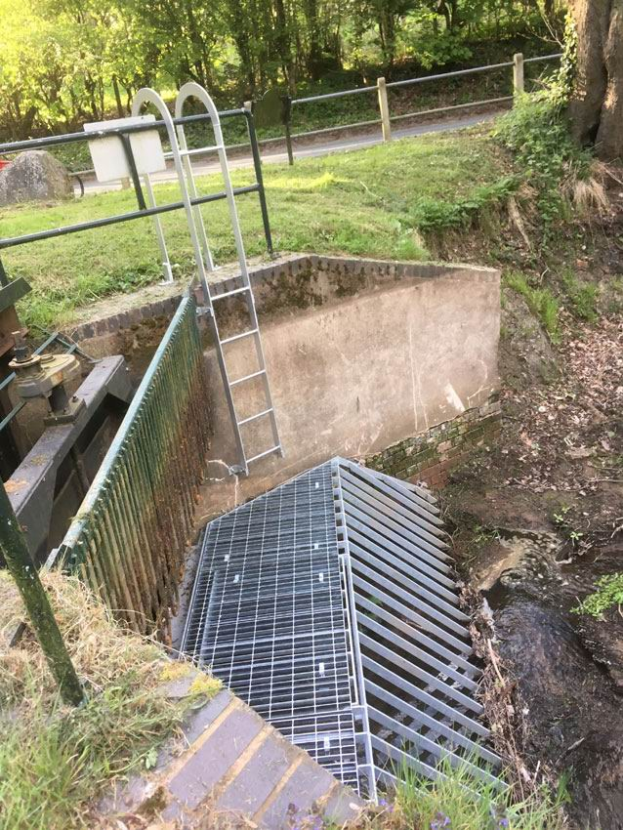
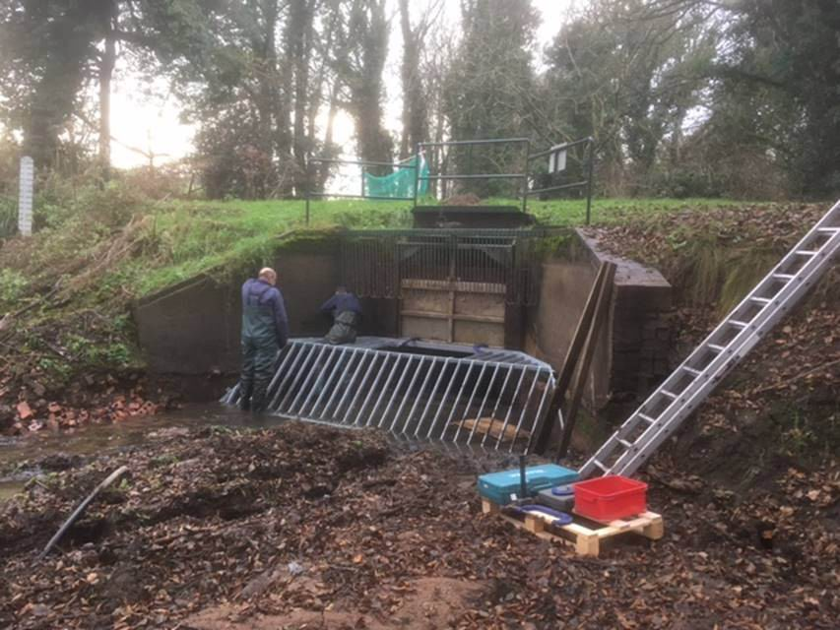
Little Bell Hall Pool

Slide 7
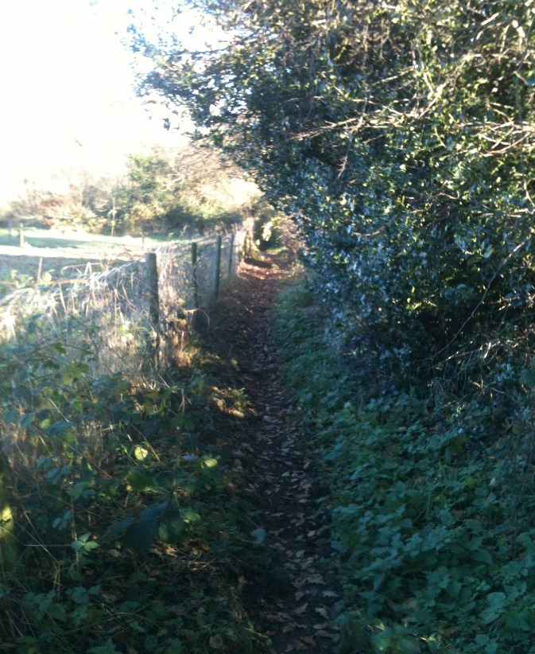
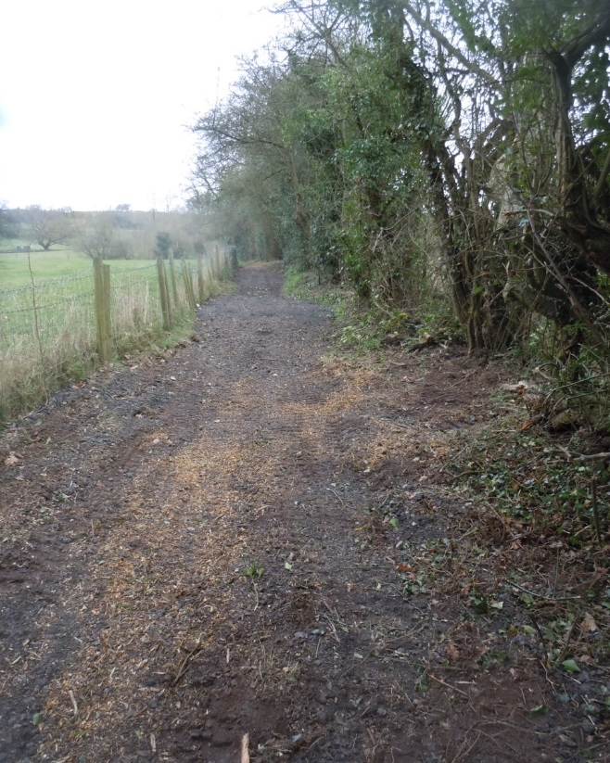
Finance – a small Deficit but...
Footpaths works – & more to come…

Slide 8
2017-18
Precept - up a bit, for good reasons
Neighbourhood Plan – more to come
Fairfield Recreation Ground Carpark
Little Bell Hall Pool
Traffic and Lighting
Footpaths and Greenery
The Green Belbroughton
Effects of cuts elsewhere

Slide 9
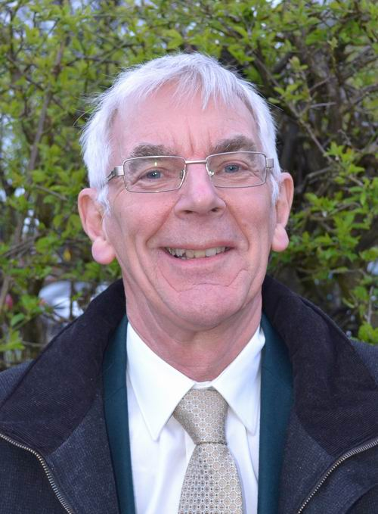
Finance Committee Chairman
Cllr. Alan Mabbett
2016/17 ‘Ordinary’ Income and Expenditure
Income
Precept - £60,000
Lengthsman Scheme - £3,148
Tax Support Grant £1,311
Meeting Room Rent £1,331
Total - £65,790
Expenditure £66,920
Deficit £1,130

Slide 10
Major Expenditure items
Clerk (inc. N.I. & Pension £4.3k) £17,931
Footway Lighting £5,493
Open Spaces £4,907
Maintenance Grants £4,815
Grass Cutting £4,550
Little Bell Hall Pool £4,509
Gen Admin £4,216
Lengthsman £3,814
Queens Hill Wall – Tfr. to reserves £5,000 (final year)

Slide 11
Maintenance Grants Paid
Belbroughton Parochial Church Council £2,200
Belbroughton Recreation Centre £1,155
Fairfield Village Hall £730
Belbroughton Church Hall £730

Slide 12
Your ‘Precept’ - Annual Average Charge
2016 2017
Per Property (1,157) £51.86 £56.18
( Per Elector (2,174) £27.60 £28.90 )

Slide 13
‘Other’ Income from the P.C. Assets
Agricultural Holdings rents £7,295
Parish Room Belbroughton rent £1,188
Fairfield Villa F. C. rent £2,554
Investment inc. from Cash deposits £3,766
Wayleaves £514
Total £15,317

Slide 14
Funded from the Assets Income
Capital Grants:
Belbroughton First Steps Nursery £1,000
Fairfield Village Hall £1,000
Belbroughton Cricket Club £1,000
Parish Projects:
Fairfield Bus shelters upgrade £600
Fairfield Gardening works £265
Minor Grants:
Fairfield Social Club £200
Fairfield Community Association £250
Fairfield Welcome Club £250
Belbroughton History Society £150
Donations C.A.B Bromsgrove £275
Fairfield Defibrillator £300

Slide 15
Parish Council Cash Investments
Bank of Cyprus £70,000 2.05%
Cambridge & Counties Bank £25,600 1.80%
Cambridge & Counties Bank £46,437 1.50%
Shawbrook Bank £40,000 1.50%
Shawbrook Bank £25,000 1.40%
Secure Trust Bank £20,000 2.33%
Hampshire Trust Bank £75,000 1.65%
Total £302,037

Slide 16
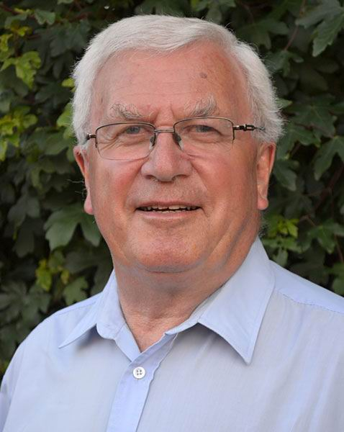
Planning Committee Chairman
Cllr. Chris Scurrell
35 planning applications considered during the year.
Recommendations made to the District Council :-
17 No Objection
11 No Objection but with conditions
7 Objected
Veolia Plc - Sandy Lane site – In Oct 2016 The Council objected strongly to the Incinerator Bottom Ash planning application and was pleased that Worcs. County Council refused the permission.

Slide 17
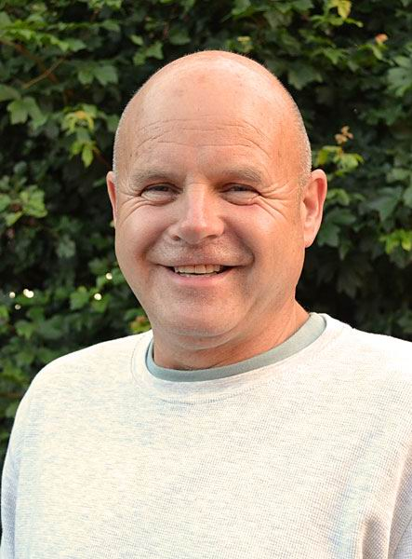
Agricultural Holdings Committee
Cllr Allan Hood
The Council owns 85 acres of arable
farmland in Wildmoor & Stoneybridge.
Let under 13 tenancies at £85/acre & is
used for various arable cropping types.
This rent is set to increase by £5/acre this
Sept. giving an annual income of £7,650
which is used to fund the Capital & Minor Grants and Projects.
Council inspects the holdings during the year to ensure they are well maintained which has proved to be the case.
As well as providing a regular income the land is a significant area of ‘Green Belt’ in the Council’s ownership and control.

Slide 18
Volunteer
Parish Footpath Wardens
Paul and Lynne Hardcastle

Slide 19

Presentations
Severn Trent Birmingham Resilience Project
Velo Birmingham

Slide 20
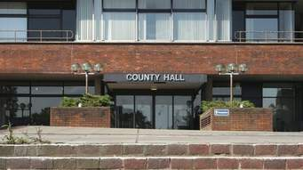
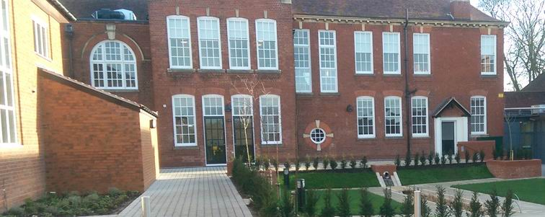
County and District Councillors
County Councillors Karen May & Shirley Webb
District Councillors Chris Allen-Jones &
Margaret Sherrey

Slide 21
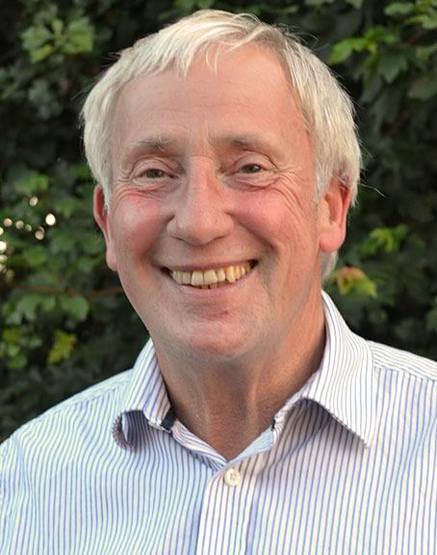
Neighbourhood Planning
Cllr. Dr Robert
Morgan
Annual Parish Meeting
Fairfield May 2017
Notes:
What is it all about
Where has it come from
what are the other terms associated with the idea.

Slide 22

Putting Communities in charge of Planning

Slide 23
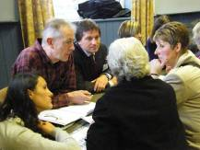
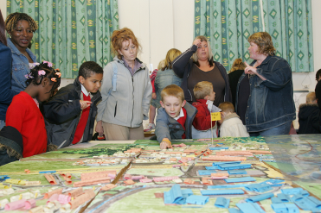

Basic Principles:
Planning at neighbourhood level
  Empowers communities to take control
  Is Community... Not Parish Council led.
  Can Inspire. innovation and creativity
  Explores ways of enabling community development.
Notes:
While the exact details of the Government’s neighbourhood planning policy are still in development we certainly have a strong feel for the direction of travel and we have clauses for the Localism Bill that support that Direction of Travel. So what are the key principles – at their heart is genuine and active community engagement and empowerment and planning’s role as an enabler of change. There are some basic principles which have stayed consistent:
reducing local authority decision-making on development and planning in neighbourhoods
the ability for neighbourhoods to be self-defined (but within constraints)
a neighbourhood-owned and community-initiated process – not an LPA led process (they are far more in a supportive role)
creating a light-touch testing process, ensuring that examinations with public hearings will be the exception rather than the rule
using the planning process and decentralisation to maximise creativity and innovation at a local level
through the granting of pp it reduces the amount of small scale development in the planning system
it is an entirely permissive regime – there is no requirement to have a neighbourhood plan– you can still apply for planning permission through the normal LPA application route

Slide 24
Structure of the Future
Planning System
National planning
policies
Right to build
BDC
LOCAL PLAN
(core strategy)
Right to buy
Right to challenge
Neighbourhood
Plan
Notes:
I will now try to run through the key highlights of the new neighbourhood planning system. This will be quite a high-level discussion, but I am happy to discuss the details with anyone after this event and over the next few weeks.
Crucially, there neighbourhood plans can only be brought forward by 2 applicants – a neighbourhood forum or a parish council. A neighbourhood development order can be bought forward by 3 applicants – a neighbourhood forum, a parish council or a CrTB organisation. If a developer wants to bring forward a neighbourhood plan it will need to be sponsored, supported and formally submitted by one of these organisation.
A neighbourhood forum will be a community group – they will be designated “the neighbourhood forum” :
- at least 3 members of the neighbourhood to which the neighbourhood plan or order relates
- written constitution, - bank account
- establish to further social, economic or environmental interests of the residents
A CrTB organisation has similar definition plus it has specific requirements around the distribution of any profits made from the development granted by the CrTB order, the membership, and how its assets are distributed.
A parish council can make an application in relation to any area that consists of or includes the whole or any part of the council’s area.
There are 3 tools:
A Neighbourhood Development Order which can grant outline or full permission for certain categories or types of development
A Neighbourhood Development plan which sets out policies for the development and use of land in the neighbourhood
A CrTB Order which can grant outline or full permission but only where the order is brought forward by a CrTB organisation and that the benefits of the development are explicitly retained within the community

Slide 25
WHAT CAN A NEIGHBOURHOOD PLAN DO ?
Be expensive
Divert precious resources
Absorb energy of a community
Divide a community
Be ineffective if legally challenged
Fail to engage with the community wishes
Ineffectually absorb the time and enthusiasm of volunteers
An initiative that fails because of change of national government policy.

Slide 26
Putting Communities in charge of Planning

Slide 27
WHAT CAN A NEIGHBOURHOOD PLAN DO ?
It can give power to plan
FUTURE vision of what the area should look like
deciding where new shops, offices, homes, etc. should go
what green spaces should be protected FOR THE COMMUNITY
neighbourhood development orders TO SET LAND USE

Slide 28
SO......WHAT NEXT ?
A Questionnaire
Parish Council and community evaluate the result
Sets up a steering meeting
Search for volunteers
Format steering committee (constitution; website, officers ....etc.
Inform district council & planning office
Invite community members to participate

Slide 29
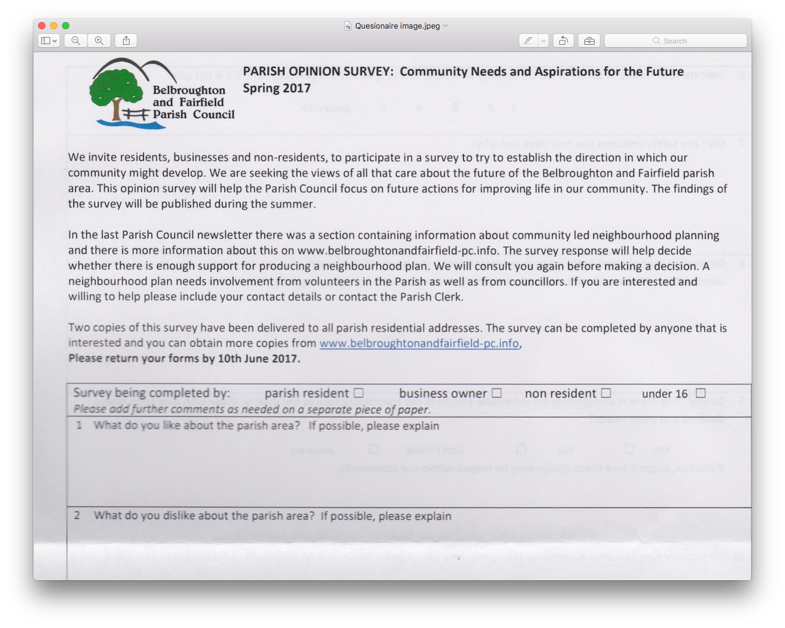
The Questionnaire

Slide 30
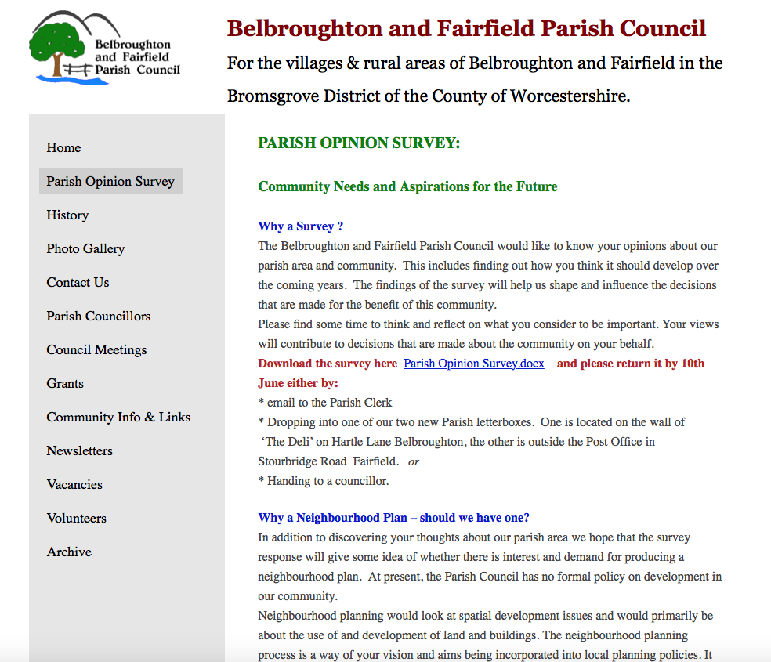
The Questionnaire

Slide 31
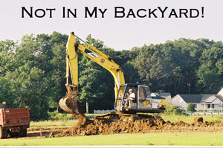
An Ambition
Restore the idea that development can be a force for good, rather than something to be resisted at all costs
Turning Opponents into Proponents of Growth
Capturing Benefits and Incentives
Notes:
Finally, and apologies for the very quick trawl, but to conclude we must go back to the beginning.
Neighbourhood planning is a key part of the must wider agenda of turning the tables on the development discussion. From communities resisting development because they only see the costs to communities welcoming development because they have had a role in controlling its form and nature, they feel ownership towards it and they feel collective responsibility for the future of their communities. They also have the incentives to see the tangible difference development has on their own lives and to gain real pride in their surroundings which they have helped to change.

Slide 32
The Questionnaire

Slide 33
Thanks
Any Questions?
Cllr. Dr Robert
Morgan
Annual Parish Meeting
Fairfield May 2017
Notes:
What is it all about
Where has it come from
what are the other terms associated with the idea.

Slide 34
Open Forum
Question time on any other matters of interest to residents and an opportunity for any other organisations present to bring something to the attention of the parish.
Please tell us your name and where you are resident.

Slide 35
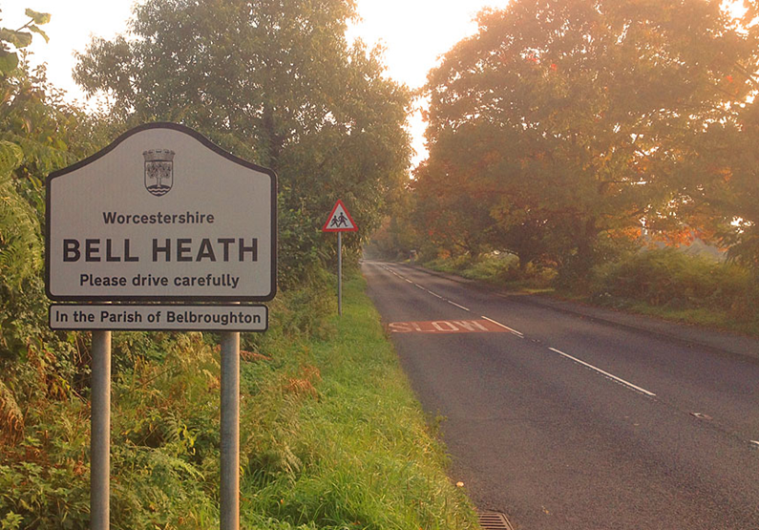
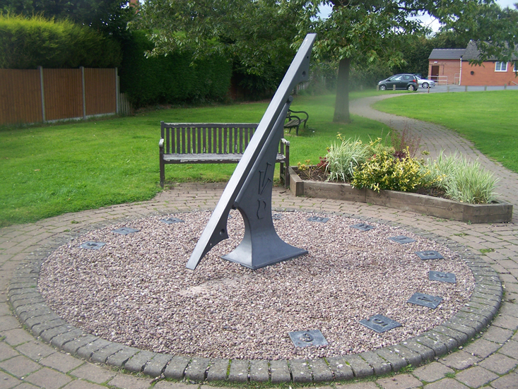
Thanks for coming

